Slide 1
B.TECH CSE · PROJECT REVIEW
SignSpeak
Real-time American Sign Language (ASL) to text and speech, running entirely in the web browser
MY
NAME
A-N-I
→ “My name is Ani.”
Team
A. Anirudh — 247R1A6603
D. Srikar Reddy — 247R1A6621
G. Prashanth — 247R1A6622
Under the guidance of
____________________
Department of Computer Science & Engineering
CMR Technical Campus, Hyderabad
Notes:
Introduce the team and the project. SignSpeak converts American Sign Language — fingerspelled letters and word signs — into an editable English transcript, live, inside a normal web browser. The hand figure on the right is the 21-point MediaPipe hand landmark model the whole system is built on. Fill in the guide name before presenting.

Slide 2
AGENDA
02
Contents
01
Abstract
07
UML diagrams — use case, class, sequence, activity, state
02
Problem statement
08
Data flow, component & deployment diagrams
03
Existing systems & limitations
09
ML pipeline & model design
04
Proposed solution & objectives
10
Modules implemented
05
Requirements & tech stack
11
Results & testing
06
System architecture
12
Limitations, future scope & conclusion
SignSpeak
Notes:
Walk through the order of the presentation.

Slide 3
ABSTRACT
03
Abstract
Deaf and hard-of-hearing people who use sign language often cannot communicate directly with people who do not sign, and human interpreters are scarce. SignSpeak is a browser-based system that recognises American Sign Language in real time and turns it into editable English text and speech.
A webcam feed is processed on the device by Google MediaPipe, which extracts 21 three-dimensional landmarks per hand. The landmarks are normalised (wrist-anchored, scale- and aspect-corrected) into a compact feature vector and classified by a small multilayer perceptron whose forward pass is written in TypeScript. A temporal smoother turns noisy per-frame predictions into stable letter and word commits. An optional large language model converts the resulting gloss sequence into a fluent English sentence, which is spoken aloud.
Video never leaves the device. Fingerspelling reaches 98.3% accuracy on a held-out test set; the 33-word vocabulary reaches 56.5% on an honest, de-duplicated split, which identifies data volume as the next bottleneck.
Keywords
Sign language recognition
ASL fingerspelling
MediaPipe hand landmarks
Multilayer perceptron
Temporal smoothing
Gloss-to-text LLM
On-device ML
Accessibility
SignSpeak
Notes:
Read the abstract in your own words. Key message: landmark-based, on-device, honest numbers, and an LLM only for the final gloss-to-English step.

Slide 4
PROBLEM
04
Problem statement
430M
70M+
300+
people worldwide live with disabling hearing loss
deaf people use a sign language as their first language
distinct sign languages — ASL is not “English on the hands”
WHO
World Federation of the Deaf
World Federation of the Deaf
The problem we address
Communication gap: signers and non-signers cannot talk directly; certified interpreters are few, costly and must be booked in advance.
Tools stop at recognition: most automated systems recognise one isolated sign and output a keyword, not a readable sentence.
Fragile and invasive: pixel-based models break under poor lighting or busy backgrounds, and many upload the user’s video to a server.
SignSpeak
Notes:
Sources: WHO deafness and hearing loss fact sheet (430 million people need rehabilitation for disabling hearing loss); World Federation of the Deaf (about 70 million deaf people worldwide, over 300 sign languages). The core problem: a communication gap that today depends on scarce human interpreters, and automated tools that are not usable in real conversations.

Slide 5
LITERATURE SURVEY
05
Existing systems and their limitations
Approach | How it works | Key limitation
Sensor / data gloves | Flex sensors and IMUs on the hand | Expensive, intrusive hardware; misses facial grammar
CNN on raw pixels | Image classifier on webcam frames (e.g. ASL-alphabet CNNs) | Sensitive to lighting, skin tone and background; heavy models
Isolated-sign recognisers (WLASL-style) | Video model predicts one gloss per clip | Outputs keywords, not sentences; offline research code
Server-side translators (e.g. sign.mt) | Holistic landmarks in browser, recognition on remote API | Video / pose leaves device; needs network; no practice feedback
SignSpeak (proposed) | Hand landmarks → MLP in browser → smoother → LLM | Small vocabulary today; word accuracy limited by data
SignSpeak
Notes:
Summarise each family of existing approaches and the one limitation that matters. The last row is our position. sign.mt was studied in detail (docs/SIGN_TRANSLATE_STUDY.md): it uses MediaPipe Holistic but sends recognition to remote servers and has no learner feedback.

Slide 6
PROPOSED SOLUTION
06
SignSpeak: landmarks in, sentences out
1
2
3
4
Landmarks, not pixels
Private by design
Gloss → fluent English
Built to extend
MediaPipe gives 21 (x, y, z) points per hand. Recognition works on geometry, so lighting, background and skin tone matter far less.
Detection, classification and smoothing all run in the browser. Only optional gloss text is sent for translation — never video.
An LLM rewrites ASL word order (“MY NAME A-N-I”) into English (“My name is Ani.”) and offers 3 alternates; the user can edit.
A source-agnostic InputSource interface lets a future sensor glove, video file or video-call feed reuse the same recogniser.
Webcam
›
Hand landmarks
›
Feature vector
›
MLP classifier
›
Smoother
›
Transcript
›
LLM + speech
SignSpeak
Notes:
Four design decisions define the solution. 1) Work on landmarks rather than pixels. 2) Keep perception and recognition on the device. 3) Use an LLM only to turn glosses into grammatical English, and show the raw gloss so users can verify. 4) A pluggable InputSource interface so a sensor glove can replace the camera later without changing recognition code.

Slide 7
OBJECTIVES
07
Objectives
G1
Translate live ASL into readable English text
Done — letters + 33 words
G2
Use hand (and later face + pose) landmarks as input
Hands live; face dormant
G3
Follow a stream of signs, not one sign at a time
Dwell-based segmentation
G4
Turn gloss sequences into grammatical sentences with an LLM
Done — N = 3 alternates
G5
Stay robust to lighting and background
Landmark-based
G6
Keep a pluggable input layer for a future sensor glove
Interface in place
G7
Ship as an installable web app with real-time output
PWA, static deploy
SignSpeak
Notes:
These come from the PRD goals G1–G7. Point out which are achieved now (G1 partly, G2 hands, G4, G5, G6, G7) and which are in progress (continuous signing at sentence level, face and pose features in the classifier).

Slide 8
REQUIREMENTS
08
Functional and non-functional requirements
Functional
Non-functional
Access the webcam with explicit permission; live preview
Extract per-frame hand landmarks (MediaPipe)
Normalise landmarks — translation, scale, aspect invariant
Classify the current letter / word with a confidence score
Smooth predictions over time to stop flicker
Assemble stable predictions into words; auto-space on idle
Editable transcript with backspace and clear
Translate gloss to English and speak it aloud
Practice mode with live score against a reference
Landmark overlay and FPS badge for transparency
Latency: ≤ 200 ms frame → prediction, ≥ 15 FPS on a mid-range laptop
Privacy: raw frames never leave the device
Robustness: usable across lighting and backgrounds
Accessibility: high contrast, large text, keyboard navigation, reduced-motion support
Portability: Chrome, Edge, Safari; no install required
Extensibility: new sign language = new model + labels, no core rewrite
SignSpeak
Notes:
Functional requirements FR1–FR11 and non-functional NFR1–NFR6 from the PRD, condensed. NFR1 latency target: at most 200 ms from frame to prediction and at least 15 FPS on a mid-range laptop.

Slide 9
REQUIREMENTS
09
Hardware, software and technology stack
Layer | Technology
Language | TypeScript (app), Python (training)
UI & build | React 19, Vite 8, Tailwind CSS 4, React Router 7
State | Zustand
Perception | MediaPipe Tasks-Vision — HandLandmarker (+ Face, Pose)
Classifier | scikit-learn MLP → JSON weights → TypeScript forward pass
Translation | NVIDIA NIM · nemotron-mini-4b-instruct via proxy
Speech | Web Speech API (browser text-to-speech)
Deploy | Static build on Vercel / Netlify; installable PWA
Quality | oxlint, Prettier, golden-output regression test
Hardware
Laptop or phone with a webcam (640×480 is enough)
Dual-core CPU, 4 GB RAM
No GPU or sensor glove required
Software
Modern browser (Chrome / Edge / Safari)
Development: Node 23.6+, Python with uv
Optional: NVIDIA API key for Translate
SignSpeak
Notes:
Point out that there are no heavy ML runtimes in the browser: the MLP forward pass is about 30 lines of TypeScript, so TensorFlow.js was not needed.

Slide 10
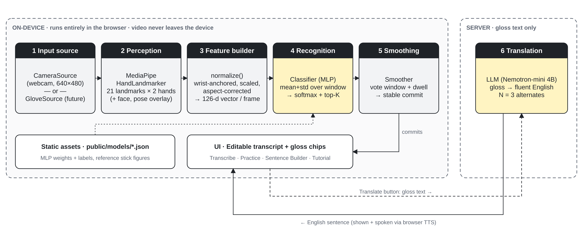
SYSTEM DESIGN
10
System architecture
SignSpeak
Notes:
One recognition core, pluggable inputs, staged outputs. Stages 1–5 run in the browser; only stage 6 (translation) calls a server, and only with gloss text. Static model files are fetched once and cached.

Slide 11
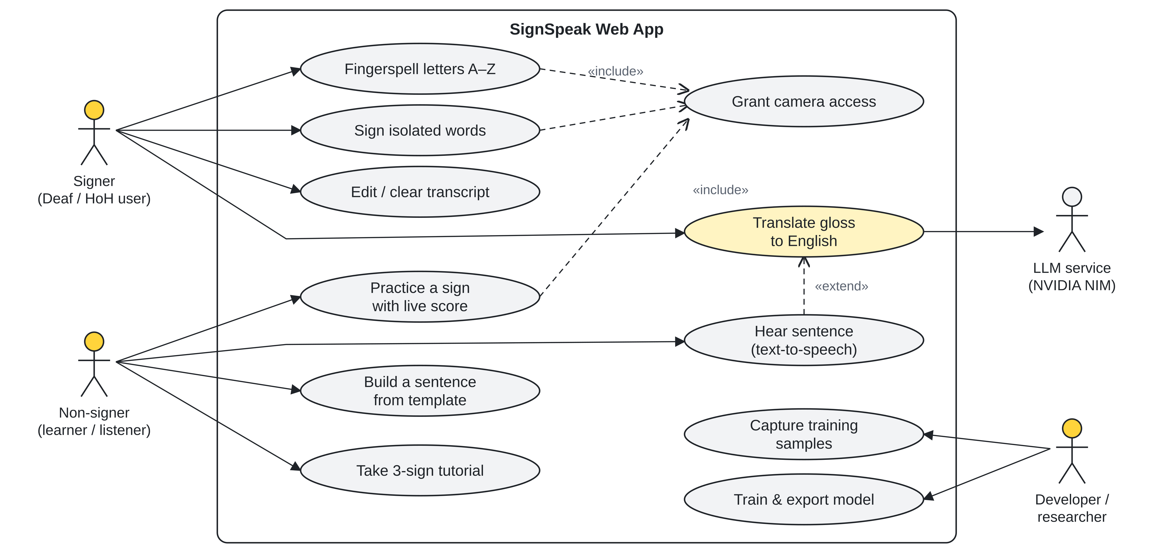
UML · USE CASE
11
Use case diagram
SignSpeak
Notes:
Three human actors and one external system. The signer fingerspells or signs words and edits the transcript; the non-signer learns through Practice, the Sentence Builder and the tutorial, and hears translated sentences. The developer captures samples and retrains models. Camera access is included in every recognition use case; text-to-speech extends Translate.

Slide 12
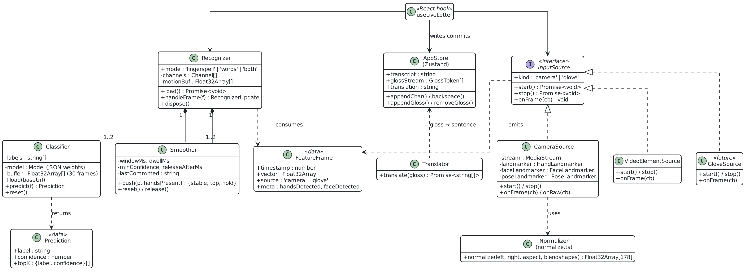
UML · CLASS
12
Class diagram — recognition core
SignSpeak
Notes:
InputSource is the key abstraction: CameraSource, VideoElementSource and a future GloveSource all emit the same FeatureFrame. Recognizer owns one or two channels, each a Classifier plus a Smoother (two in “both” mode). These classes are exported from src/core.ts and contain no React code, so the web app, the golden test and the planned video-call extension share them.

Slide 13
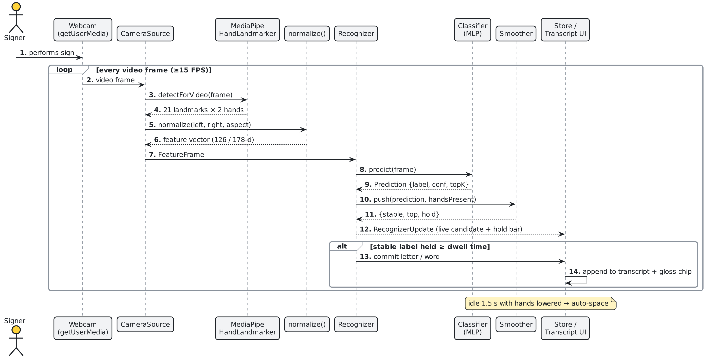
UML · SEQUENCE
13
Sequence diagram — real-time recognition loop
SignSpeak
Notes:
This loop runs on every video frame. The hand landmarker returns up to two hands, normalize() builds the feature vector, the classifier predicts, and the smoother decides whether the prediction is stable enough to commit. A commit appends to the transcript; the UI also shows the live candidate and a hold bar while the user is holding a sign.

Slide 14
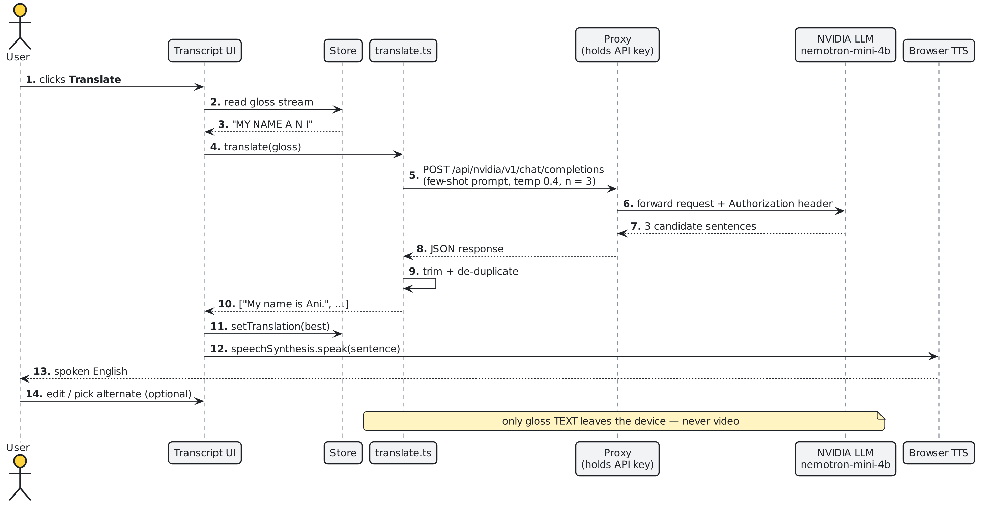
UML · SEQUENCE
14
Sequence diagram — gloss to English translation
SignSpeak
Notes:
Translation is user-triggered. A few-shot prompt at temperature 0.4 asks for three candidate sentences; duplicates are removed. The API key lives in the proxy, never in the browser bundle. The sentence is spoken with the browser’s built-in text-to-speech.

Slide 15
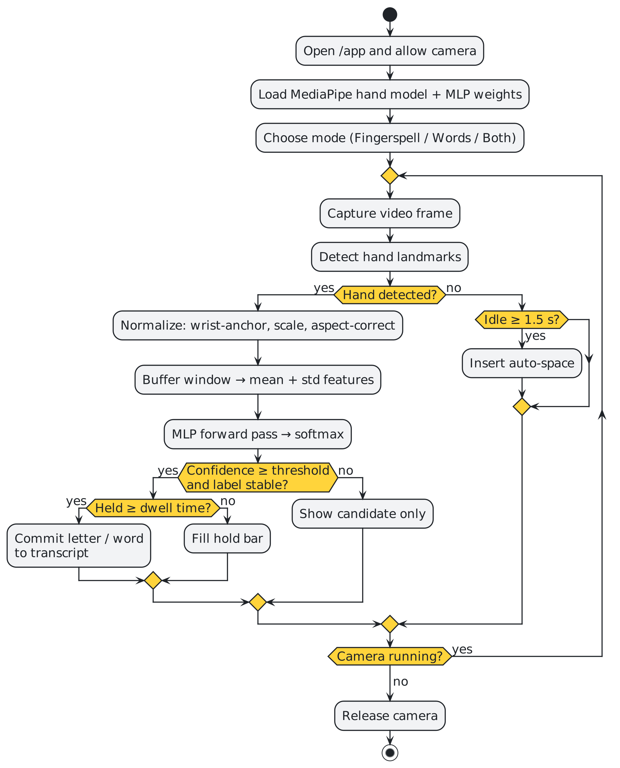
UML · ACTIVITY
15
Activity diagram — from sign to transcript
Key rules
Window: the classifier keeps the last 30 frames and needs at least 5 before predicting.
Features: mean + standard deviation over the window (words: over 5 time chunks, so motion is kept).
Confidence: ≥ 0.60 for letters, ≥ 0.55 for words.
Dwell: a label must hold for 650 ms (letters) or 700 ms (words) before it commits.
Auto-space: 1.5 s with no hand inserts a space between words.
Both mode: motion decides between the letter and word channels, not raw confidence.
SignSpeak
Notes:
Walk through the main decision points: is a hand present, is the prediction confident and stable, and has it been held long enough. With no hand, an idle of 1.5 seconds inserts a space.

Slide 16
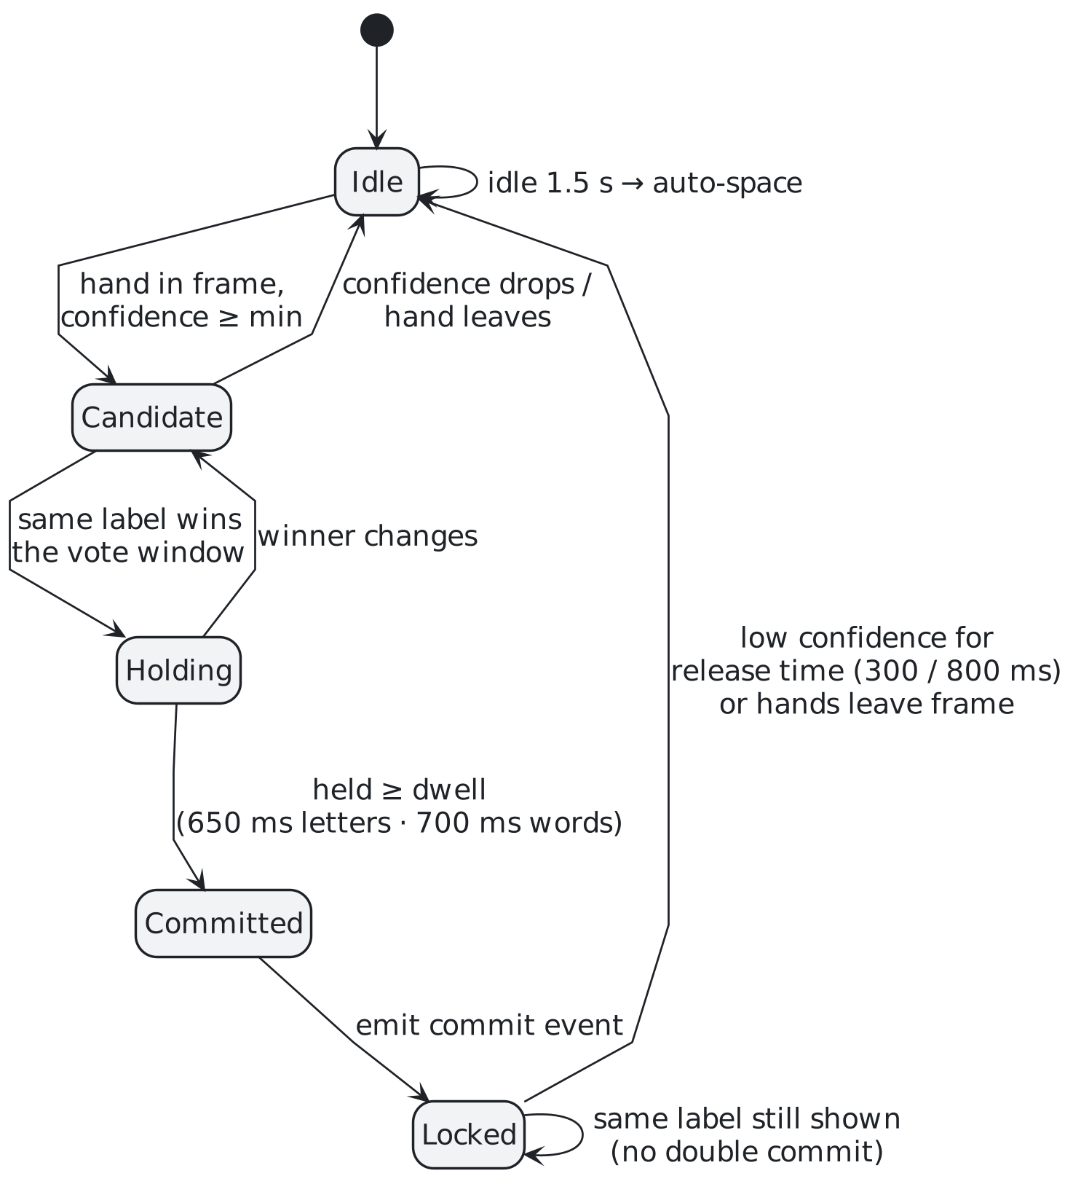
UML · STATE
16
State diagram — the Smoother’s commit logic
Parameter | Letters | Words
Vote window | 550 ms | 700 ms
Min. confidence | 0.60 | 0.55
Dwell to commit | 650 ms | 700 ms
Release after | 300 ms | 800 ms
Winner share | ≥ 70% | plurality
Why it matters Per-frame predictions jump between labels. Voting, dwell and lock turn them into one clean commit per sign — and the release rule still allows repeated letters such as the “OO” in COOL.
SignSpeak
Notes:
The smoother is what makes the app usable: without it the transcript would fill with flicker. After a commit it locks the label, so holding a letter does not repeat it; it releases after a short period of low confidence (300 ms letters, 800 ms words) — that release is what lets double letters like the OO in COOL work.

Slide 17
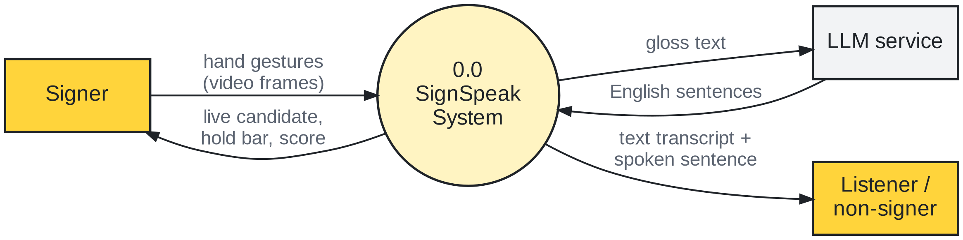
DATA FLOW
17
Data flow diagram — Level 0 (context)
Signer
Listener
LLM service
Sends hand gestures as video; sees the live candidate, hold bar and practice score.
Receives the text transcript and the spoken English sentence.
Receives gloss text only and returns English sentences.
SignSpeak
Notes:
Level 0 shows the whole system as one process with its external entities: the signer, the listener and the LLM service. Note that only gloss text flows to the LLM.

Slide 18
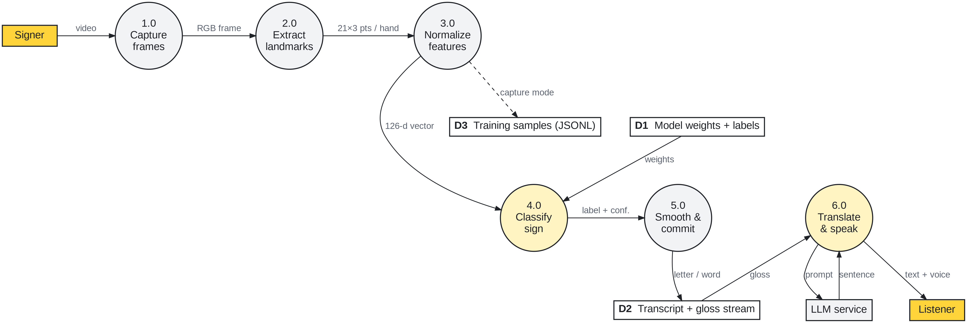
DATA FLOW
18
Data flow diagram — Level 1
SignSpeak
Notes:
Level 1 breaks the system into six processes and three data stores. D1 holds the trained weights, D2 the transcript and gloss stream, and D3 the training samples, which are written only in capture mode when developers record new data.

Slide 19
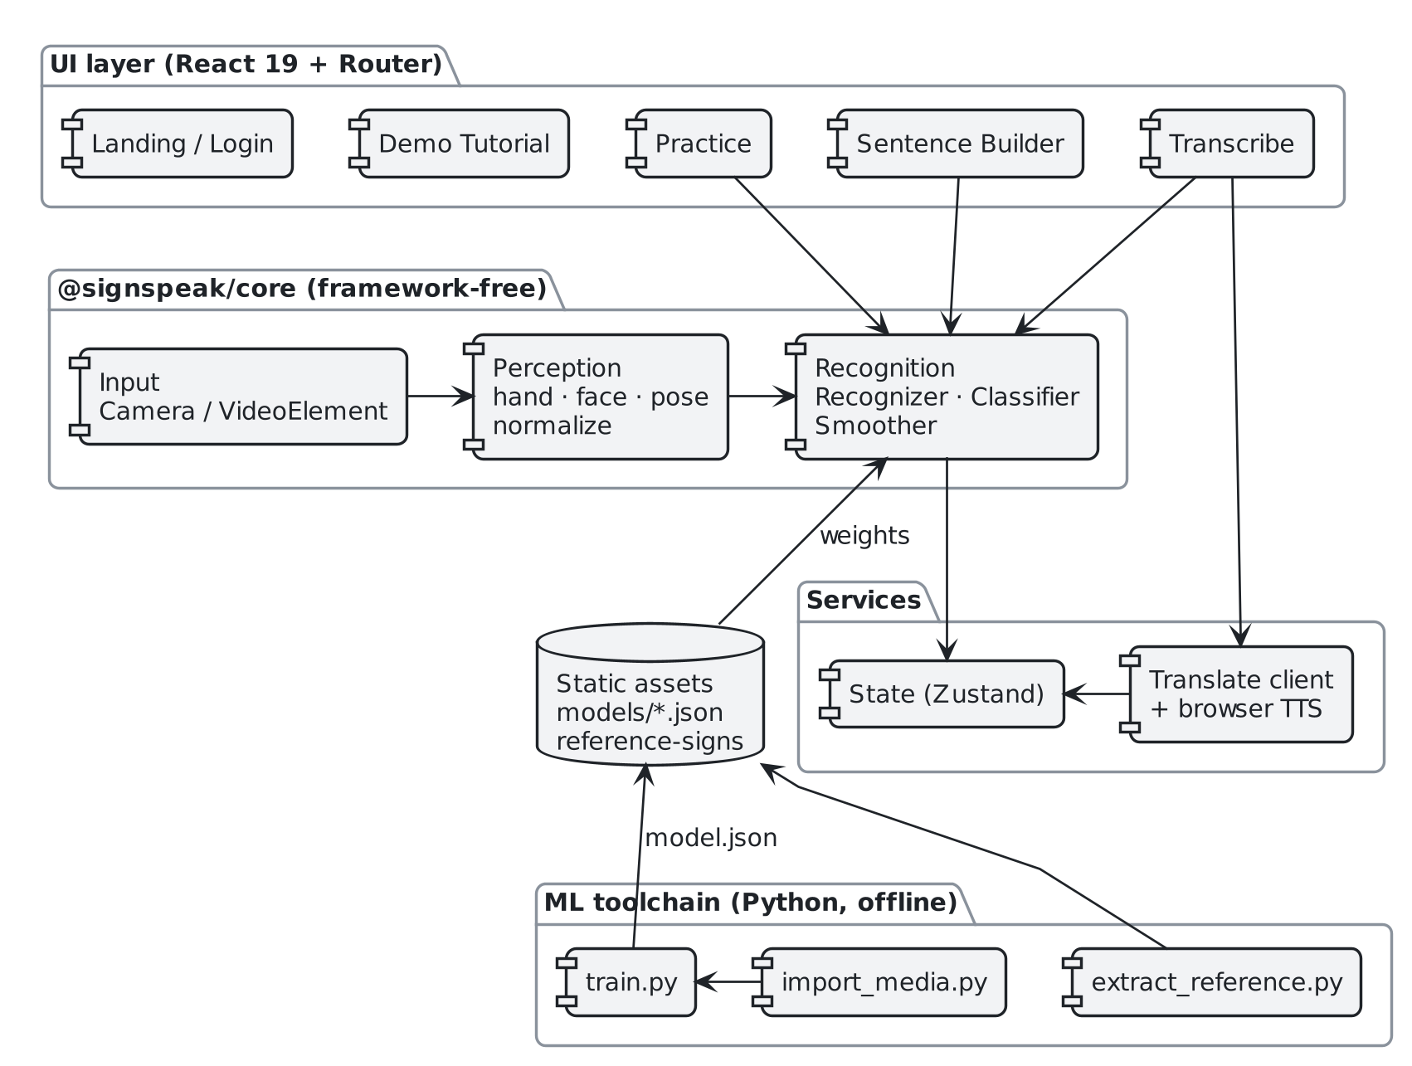
UML · COMPONENT
19
Component diagram
UI layer
Five lazy-loaded screens; each loads only when visited.
@signspeak/core
Input, perception and recognition. No React — reusable by any shell.
ML toolchain
Python scripts import data, train models and export JSON.
SignSpeak
Notes:
The UI layer depends on the framework-free core; the core never imports React. The Python toolchain runs offline and only produces static JSON files that the browser fetches.

Slide 20
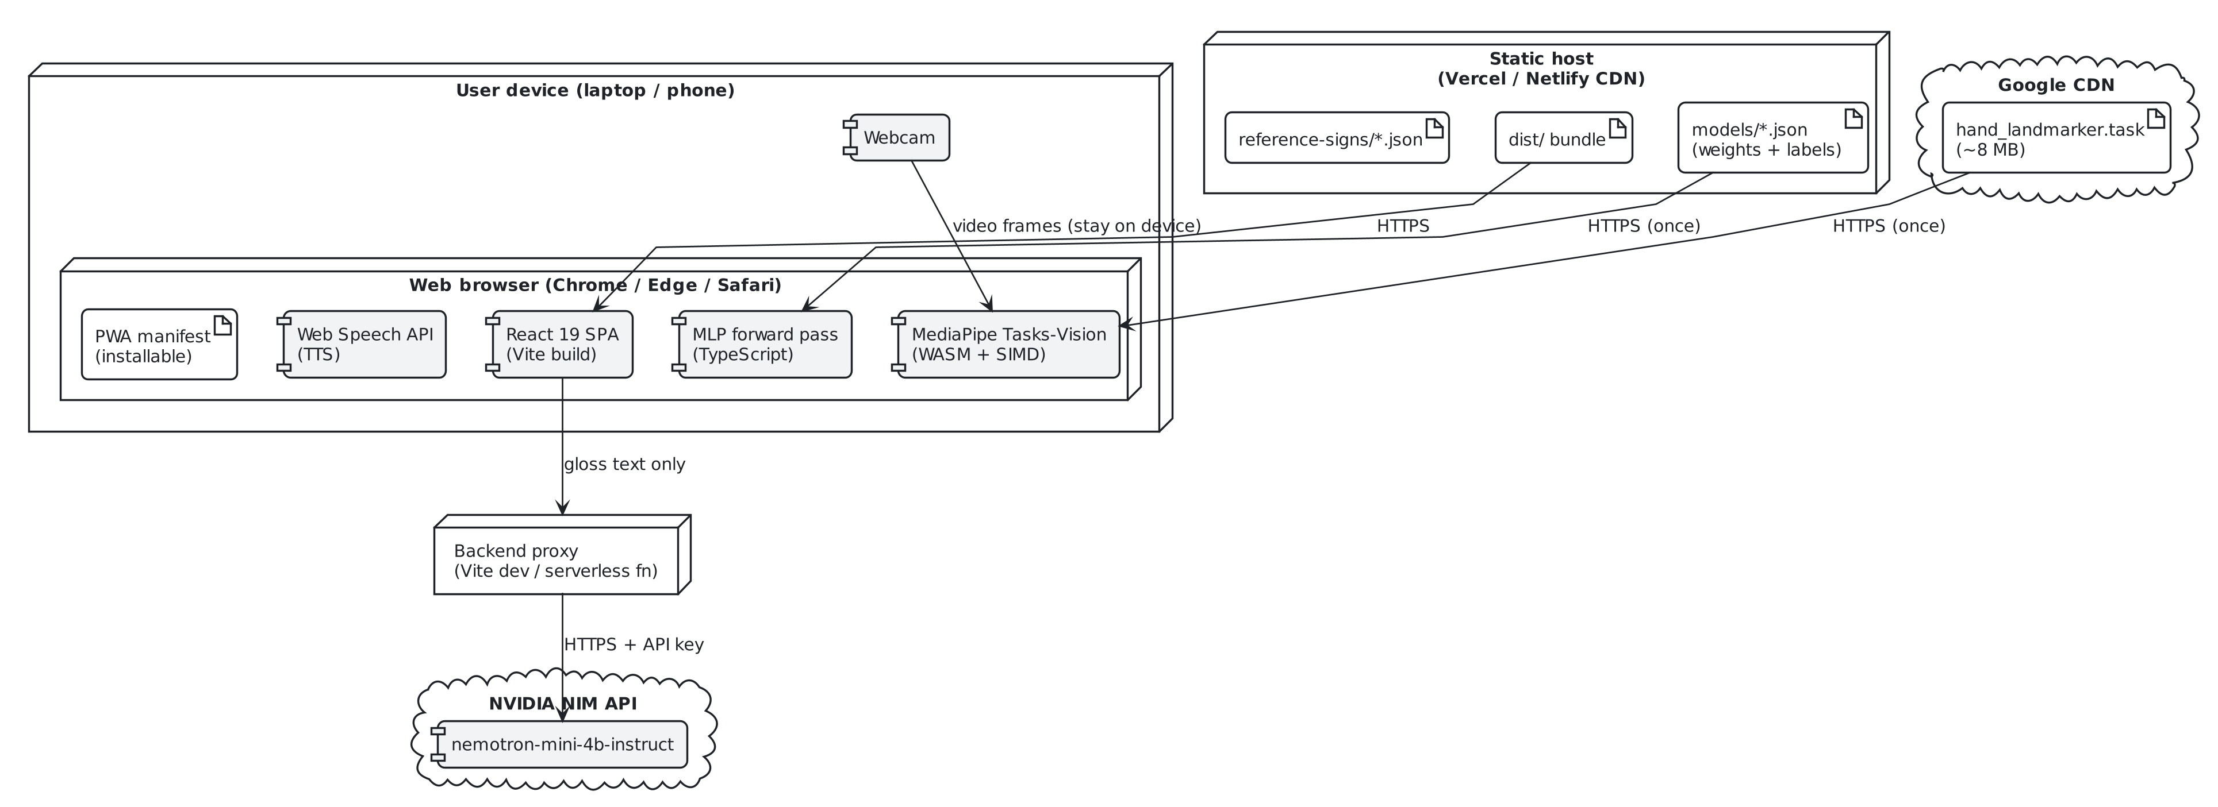
UML · DEPLOYMENT
20
Deployment diagram
Static App, weights and reference clips ship as files — any static host works.
Cached once MediaPipe model (~8 MB) and weights load on first visit.
One server hop Only Translate needs the proxy; it sends gloss text only.
SignSpeak
Notes:
Everything is a static build on a CDN. The browser downloads the app, the MLP weights and the 8 MB MediaPipe hand model once. The only runtime server is the thin proxy for translation, which holds the API key. Without it, every feature except Translate still works.

Slide 21
MACHINE LEARNING
21
ML pipeline and model design
Raw data
›
Import
›
Dataset
›
Train
›
Export
›
Browser
Kaggle ASL alphabet,
WLASL word videos
MediaPipe hand
landmarks (Python)
JSONL landmark
samples, images dropped
dedupe · split ·
augment ×16
model.json +
labels.json
TypeScript
forward pass
Feature vector per frame
Model architecture
Left hand · 63
Right hand · 63
 | Fingerspelling | Word signs
Classes | 26 (A–Z) | 33 glosses
Input | 252 (mean + std) | 1,260 (5 chunks × 252)
Hidden layers | 128 ReLU | 128 → 64 ReLU
Output | softmax · 26 | softmax · 33
Training data | 3,475 samples (Kaggle) | 309 unique WLASL clips
21 landmarks × (x, y, z) per hand = 126 values. Each hand is centred on its wrist, scaled by wrist → middle-knuckle length, and x is multiplied by the camera aspect ratio (4:3). A missing hand is zero-filled. A 52-value face block exists in spec v0.4 but is switched off until there is more data.
SignSpeak
Notes:
Key lesson: use the same MediaPipe HandLandmarker in the Python importer and in the browser. An earlier version used Holistic in the browser and the standalone hand model in training, and live accuracy was poor despite 98% offline. The feature vector is 126 numbers per frame: 2 hands × 21 landmarks × (x, y, z), each hand centred on its wrist and scaled by wrist-to-middle-knuckle distance, with x multiplied by the camera aspect ratio.

Slide 22
IMPLEMENTATION
22
Modules implemented
1
2
Transcribe
Practice
Sign freely into an editable transcript. Fingerspell, Word or Both mode. Gloss chips with confidence; Translate gives 3 English alternates and speaks them.
Pick any of 26 letters or 21 conversational word signs in 5 categories. A reference stick figure shows the sign; the live score tells you when you pass.
3
4
Sentence Builder
Tutorial & capture
Guided templates such as MY NAME [fingerspell] or NICE MEET YOU. Word slots are scored; fingerspell slots collect letters as you hold them.
A 3-sign first-visit tutorial for non-signers. Developer lab mode records new landmark samples and reference clips for retraining.
SignSpeak
Notes:
Demo order suggestion: open the tutorial (HELLO, THANK-YOU, YES), then Transcribe with fingerspelling, then Translate, then Practice. Developer tools such as capture are hidden behind ?lab in the URL.

Slide 23
RESULTS
23
Results
98.3%
fingerspelling accuracy on the Kaggle hold-out — above the 90% target
56.5%
word-sign accuracy (33 classes) on a de-duplicated split
≥ 15 FPS
real-time target; MLP inference is a few matrix multiplies per frame
Earlier 93.5% counted duplicate clips twice; the honest figure shows data volume is the bottleneck.
SignSpeak
Notes:
Be upfront about the word-sign number. The earlier 93.5% figure was inflated: the dataset contained the same WLASL videos imported twice, so 42% of samples were duplicates and most of the test set had also been seen in training. After de-duplication the honest accuracy is 56.5%. Only 309 unique clips exist, and some signs have just 6. This tells us the fix is more data, not more tuning. Fingerspelling at 98.3% exceeds the 90% target.

Slide 24
TESTING
24
Testing and validation
Golden-output regression test
npm run golden replays recorded landmark frames through the real Recognizer and fails on any change in emitted events. Run before every change to recognition code.
✓
Leak-free evaluation
train.py removes duplicate clips by default and uses a stratified random split, because the “signer” field held import-batch names, not people.
✓
Multi-seed comparison
Every model change is compared over at least 3 random seeds; a single seed twice suggested gains that disappeared on re-check.
✓
Live measurement
Seven in-domain HELLO recordings showed the model was right on 40 of 42 held-out frames — the failure was commit timing, not recognition.
✓
SignSpeak
Notes:
The golden test was written before refactoring the recognition hot path out of the React hook, so the extraction could be proven to change nothing. The three-seed rule exists because a single lucky seed twice nearly shipped a regression (for example 0.565 → 0.635 on one seed, but the 4-seed mean went from 0.577 down to 0.512).

Slide 25
FUTURE SCOPE
25
Limitations and future scope
Current limitations
Data expansion
Record 500+ samples per sign across many signers
Word vocabulary is small (33 signs) and only 56.5% accurate
Only 309 unique word clips; some signs have just 6 examples
Facial grammar (eyebrows, mouth) is not used by the classifier yet
Signing is segmented by pauses and dwell, not truly continuous
Translate needs a backend proxy on a static deploy
Face + pose features
Re-enable the 52 face blendshapes once data allows
Video-call extension
Live captions in Google Meet, Teams and Zoom web
Sensor glove input
Plug in through the existing InputSource interface
Continuous recognition
Sequence model with CTC loss for sentence-level signing
SignSpeak
Notes:
The roadmap phases: Phase 14 data expansion, Phase 15 face and pose features, Phase 8 glove, Phase 18 video-call extension (Meet, Teams web, Zoom web).

Slide 26
CONCLUSION
Conclusion
1
Works today
Real-time ASL fingerspelling (98.3%) and 33 word signs, live in a browser with no install.
2
Private
Video stays on the device; only optional gloss text is sent for translation.
3
Usable
Smoothing, an editable transcript, LLM sentences, speech, practice and a tutorial make it more than a recogniser.
4
Honest and extensible
Measured without data leakage, guarded by regression tests, and ready for more data, face features and new inputs.
Notes:
Close by restating the problem and what SignSpeak delivers today, then the single clear next step: more data.

Slide 27
REFERENCES
27
References
World Health Organization, “Deafness and hearing loss,” fact sheet. who.int/news-room/fact-sheets/detail/deafness-and-hearing-loss
World Federation of the Deaf, “FAQs.” wfdeaf.org/contact/faqs
C. Lugaresi et al., “MediaPipe: A Framework for Building Perception Pipelines,” arXiv:1906.08172, 2019.
F. Zhang et al., “MediaPipe Hands: On-device Real-time Hand Tracking,” arXiv:2006.10214, 2020.
D. Li, C. Rodriguez, X. Yu, H. Li, “Word-level Deep Sign Language Recognition from Video: A New Large-scale Dataset and Methods Comparison (WLASL),” WACV 2020.
N. C. Camgoz et al., “Neural Sign Language Translation,” CVPR 2018 (RWTH-PHOENIX-Weather 2014T).
A. Graves et al., “Connectionist Temporal Classification,” ICML 2006.
A. Moryossef et al., sign.mt — open-source sign language translation, github.com/sign/translate.
Kaggle, “ASL Alphabet” dataset (grassknoted/asl-alphabet).
F. Pedregosa et al., “Scikit-learn: Machine Learning in Python,” JMLR 12, 2011.
SignSpeak
Notes:
Academic references for the review report.

Slide 28
Thank you
QUESTION
YOU
HAVE?
→ “Do you have any questions?”
A. Anirudh · D. Srikar Reddy · G. Prashanth
Dept. of CSE, CMR Technical Campus

