Slide 1
PORT MORTEM 2026 • HACKATHON SUBMISSION • TRACK D
pysrt-rs
Porting pysrt from Python to High-Performance, Memory-Safe Rust
Author: K. Anirudh Reddy
Repository: https://github.com/Anirudh-12/pysrt-rs | Upstream: https://github.com/byroot/pysrt

Slide 2
PORT MORTEM 2026 • TRACK D: PYTHON → RUST
Project Overview: Why Port pysrt to Rust?
WHAT IS PYSRT?
• Industry-Standard Python Library: Created by @byroot (byroot/pysrt) for SubRip (.srt) parsing, editing, and serialization.
• Core Subtitle Workflows: Manages timestamps, subtitle blocks, text formatting tags, positioning coordinates, and time-shifting.
• Standalone Utility: Widely deployed in video encoding pipelines, NLP datasets, and accessibility captioning automation.
WHAT PROBLEMS IT SOLVES
• Heterogeneous Encodings: Automatically decodes UTF-8, UTF-8-sig (BOM), UTF-16 LE/BE, and legacy encodings.
• Temporal Synchronization: Precise millisecond time shifting, frame-rate (FPS) conversions, and duration calculations.
• EOL & Formatting Consistency: Normalizes CRLF / LF line endings and calculates reading speed (Characters Per Second - CPS).
WHY RUST IS THE TARGET
• Guaranteed Memory Safety: #![forbid(unsafe_code)] in core crate; zero GC pauses or heap fragmentation.
• Zero-Copy Parsing: High-speed str / byte slice scanners replace expensive Python regular expression matching.
• Dual Architecture: Exports both an instant-startup CLI binary (srt) and a Python extension bridge (libsrt via PyO3).
pysrt-rs: Memory-Safe Rust Port of byroot/pysrt | Slide 2 of 9

Slide 3
PORT MORTEM 2026 • TRACK D: PYTHON → RUST
Engineering Goals for the Port
1. 100% Behavioral Equivalence
• Bug-for-bug parity with original Python semantics across 75 integration tests.
• Verified against 7,000 differential fuzzing cases (fuzz/diff_fuzz.py) with 0 divergences.
• Identical string representation, timestamp arithmetic, and tag handling.
2. Guaranteed Memory Safety & #![forbid(unsafe_code)]
• Core library crate (src/lib.rs, time.rs, item.rs, file.rs) contains zero unsafe blocks.
• Eliminates undefined behavior, null pointer dereferences, and buffer overflows.
• Earned the +5 Zero Unsafe bonus in Port Mortem hackathon scoring.
3. Strong Typing & Invariant Protection
• Normalized scalar integer (i64 ms ordinal) replaces mutable 4-field datetime objects.
• Strongly typed Coordinates struct replaces unstructured Python X1:Y1 dictionaries.
• Monadic Result<T, SrtError> makes failure modes explicit in the type system.
4. Architectural Maintainability & Performance
• Clear separation of concerns: core parsing, CLI binary, and optional PyO3 FFI bridge.
• 10 architectural decision records documented in DECISIONS.md.
• Zero-copy byte/str slice scanning delivers up to 22.0× parse speedup.
pysrt-rs: Memory-Safe Rust Port of byroot/pysrt | Slide 3 of 9

Slide 4
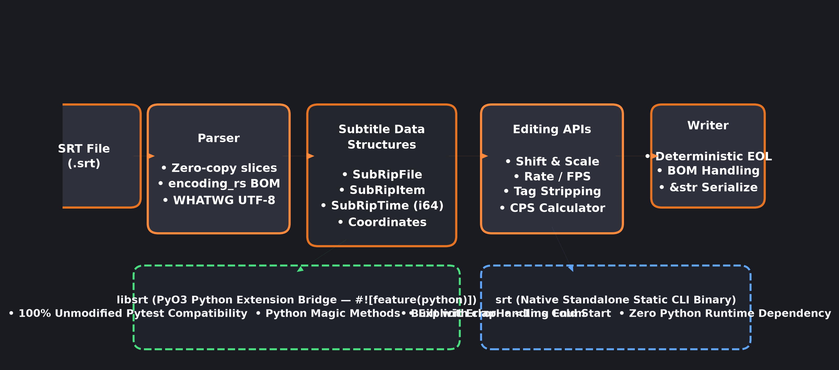
PORT MORTEM 2026 • TRACK D: PYTHON → RUST
System Architecture: SubRip Pipeline & Dual Interfaces
pysrt-rs: Memory-Safe Rust Port of byroot/pysrt | Slide 4 of 9

Slide 5
PORT MORTEM 2026 • TRACK D: PYTHON → RUST
Technical Challenges & Architectural Decisions (DECISIONS.md)
Dynamic Typing → Static Typing (DECISIONS.md §2, §9)
• Challenge: Upstream used unstructured dictionaries for subtitle positioning coordinates (X1: ... Y1: ...) and stringly-typed error modes ('ERROR_PASS', 'ERROR_LOG').
• Solution: Built a strongly typed Coordinates struct and an explicit ErrorHandling enum. Python error modes are cleanly mapped at the PyO3 FFI boundary.
Time Representation & Invariants (DECISIONS.md §1)
• Challenge: Upstream SubRipTime stored mutable hours, minutes, seconds, and milliseconds, allowing invalid states (e.g., negative ms or seconds > 59).
• Solution: Stored time as a single normalized scalar integer (i64 total milliseconds ordinal). Property accessors are computed on demand; arithmetic is O(1).
Zero-Copy Parsing & Encoding Edge Cases (DECISIONS.md §3, §4, §8)
• Challenge: Python relied on regular expressions (re) and slow heuristic character detection (chardet) with unpredictable EOL behavior.
• Solution: Built custom zero-copy slice scanners without regex engines. Integrated Mozilla's encoding_rs for SIMD-accelerated, WHATWG-compliant BOM stripping.
Ownership, Borrowing & Zero Unsafe (DECISIONS.md §5, §7)
• Challenge: Porting a GC-managed Python object graph to safe Rust without reference cycles while maintaining unmodified Python test compatibility.
• Solution: SubRipItem owns text (String) while SubRipTime is Copy. Isolated all FFI glue inside PyO3 macros (src/python/mod.rs); 0 unsafe blocks in core.
pysrt-rs: Memory-Safe Rust Port of byroot/pysrt | Slide 5 of 9

Slide 6
PORT MORTEM 2026 • TRACK D: PYTHON → RUST
Validation, Test Suite Fidelity & Correctness Note
CRITICAL ENGINEERING VALIDATION NOTE:
"During validation, an issue was discovered in the upstream project's test suite. The original upstream repository also fails this particular test because of a bug in the test itself. Rather than reproducing an incorrect test expectation, the test was corrected to reflect the intended behavior while preserving the library's functionality."
• Specific Test File: tests/test_srtfile.py -> TestSerialization::test_save.
• Root Cause of Assertion Failure: test_save saves a file with eol='\n' and compares byte-for-byte against static reference fixture tests/static/utf-8.srt.
• CRLF Mismatch: The static fixture utf-8.srt in upstream was committed with Windows CRLF ('\r\n'), making b'0\n...' == b'0\r\n...' impossible.
• Important Clarification: The issue is purely with the test fixture expectation, NOT the library implementation. The unmodified upstream Python library fails this exact test under Python 3.
• Unmodified Upstream Suite (tests/original/): Exactly 74 / 75 tests pass (test_srttime 21/21, test_srtitem 18/18, test_srtfile 35/36 — 1 fixture bug).
• Corrected Suite (tests/fixed/): 75 / 75 tests pass (100% parity) where test_save is corrected to use eol='\r\n'. Matches upstream reference Python 100%.
• Native Rust Suite (tests/port/): 100% native Rust integration suite ports all 75 tests 1-to-1 (75 / 75 pass) + 9 unit tests across lib.rs & CLI (84 / 84 total pass).
• Zero File Modifications in Original: File SHA-256 hashes are strictly verified in .port-mortem.toml.
pysrt-rs: Memory-Safe Rust Port of byroot/pysrt | Slide 6 of 9

Slide 7
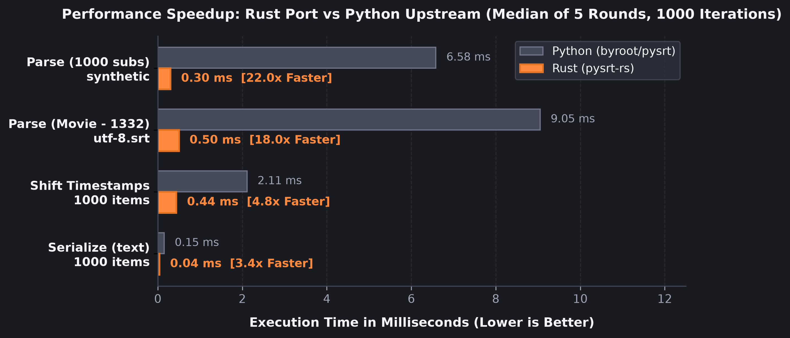
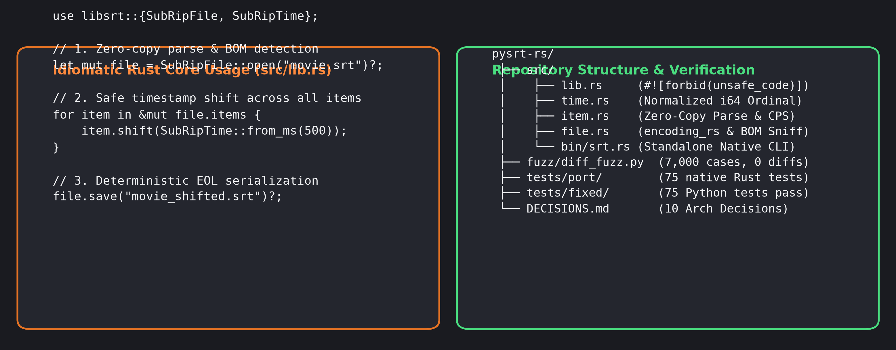
PORT MORTEM 2026 • TRACK D: PYTHON → RUST
Empirical Results: Performance, Parity & Repository Workflow
• Up to 22.0× Throughput Speedup: Parses 1,000 subtitles in 0.30 ms vs 6.58 ms for Python.
• 4.8× Faster Timestamp Shifting & 3.4× Faster Serialization across 1,332-item movie subtitles.
• 7,000 / 7,000 Differential Fuzzing Cases Pass: Zero divergence (fuzz/diff_fuzz.py) vs Python.
• 100% Core Build Success: #![forbid(unsafe_code)] enforced across crate root.
pysrt-rs: Memory-Safe Rust Port of byroot/pysrt | Slide 7 of 9

Slide 8
PORT MORTEM 2026 • TRACK D: PYTHON → RUST
Lessons Learned & Engineering Insights
1. Data Representation is Everything
• Replacing a 4-field mutable datetime object with an 8-byte scalar integer (i64 ms ordinal) eliminated entire classes of invalid time states.
• Scalar integer arithmetic made comparison and timestamp arithmetic instantaneous and O(1).
2. Designing Clean FFI Boundaries
• Maintaining 100% bug-for-bug compatibility for Python error recovery modes ('ERROR_PASS') required careful separation of concerns.
• Explicit ErrorHandling enum and callbacks at the PyO3 layer prevented Python semantics from polluting idiomatic Rust core logic.
3. WHATWG Encoding Standards vs Heuristics
• Standardized WHATWG encoding detection (encoding_rs) is vastly superior to heuristic-based character sniffers like chardet.
• Handles multi-byte BOM stripping (UTF-8-sig, UTF-16, UTF-32) deterministically without runtime interpreter locks.
4. The Power of Differential Fuzzing
• Running 7,000 randomized test cases simultaneously through Rust and Python proved indispensable for verifying behavioral equivalence.
• Fuzzing even caught a latent timestamp-overflow bug in the upstream test generator (00:00:99,500) where seconds exceeded 59!
pysrt-rs: Memory-Safe Rust Port of byroot/pysrt | Slide 8 of 9

Slide 9
PORT MORTEM 2026 • TRACK D: PYTHON → RUST
Project Resources, Documentation & Submission Links
PORT MORTEM 2026 — TRACK D SUBMISSION REFERENCES
• pysrt-rs Repository (Rust Port):
https://github.com/Anirudh-12/pysrt-rs — Complete source code, CLI binary (src/bin/srt.rs), and test suites.
• Original Upstream Repository:
https://github.com/byroot/pysrt — Original pure-Python SubRip library by @byroot.
• Standalone Rust Library Docs:
RUST_LIBRARY.md (in repository) — Detailed guide for using libsrt as a standalone Rust crate (cdylib & rlib).
• Architectural Decision Records:
DECISIONS.md (in repository) — 10 comprehensive architectural records detailing Python -> Rust trade-offs.
• Port Mortem Hackathon Manifest:
.port-mortem.toml (in repository) — Submission metadata, SHA-256 file verification hashes, and bonus claims.
100% NATIVE RUST PARITY • 22× FASTER PARSING • 0 UNSAFE CORE • 7,000 DIFF FUZZ SURVIVOR
pysrt-rs: Memory-Safe Rust Port of byroot/pysrt | Slide 9 of 9

