Slide 1

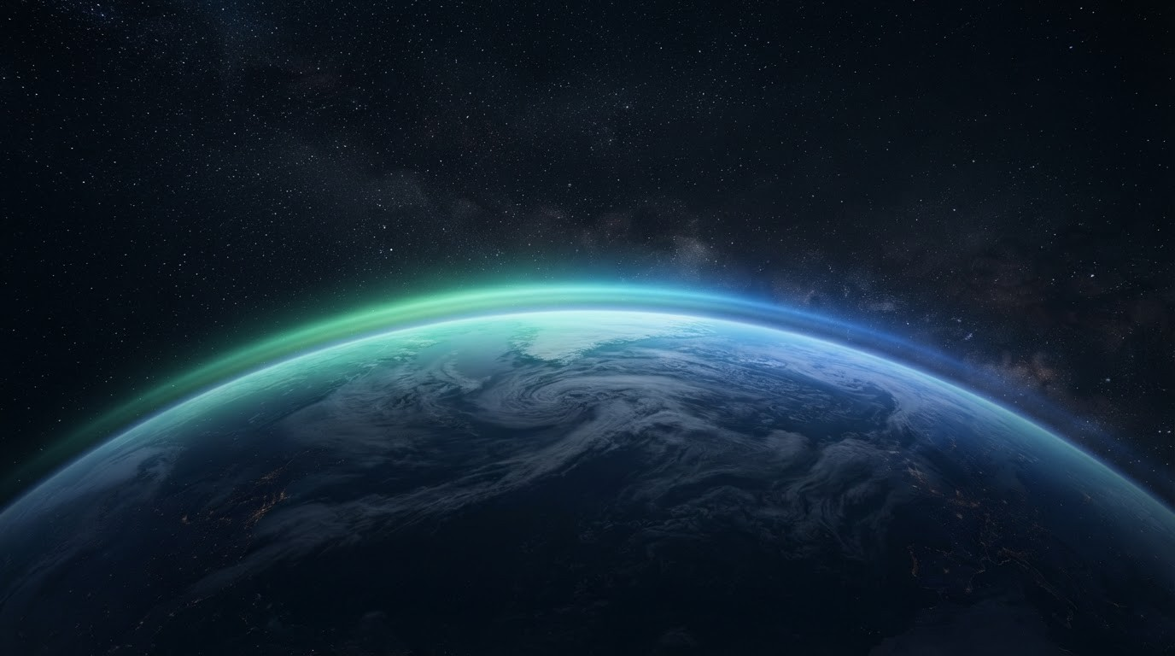
ENVIRONMENTAL MANAGEMENT
Weather & Climate
CREATED & DESIGNED BY ABHISHEK
PRESENTERS: ABHISHEK, AYOUSH, KANISHK, SARTHAK, DHIAAN

Slide 2


Weather vs Climate
Today outside your window — versus the pattern of decades.
Weather
Climate
HERE AND NOW
BIG AND LONG
Short term — here and now.
Can change every hour or day.
Rain, sunshine, wind, clouds.
Measured every single minute.
Long term — the big picture.
Averages over 30+ years.
Deserts, rainforests, seasons.
Shapes plants, animals, and us.
2 / 9

Slide 3


What Shapes Weather & Climate
Atmospheric Pressure
03
Humidity
Sunlight
Seven forces behind every forecast
Rainfall
Clouds
Temperature
Visibility
3 / 9

Slide 4

Why Weather Rules Our Lives
From daily choices to 100-year bridges — weather shapes it all.
Daily Life
What we wear, what we eat, where we live.
Strong Builds
Bridges and airports engineered to beat any storm.
4 / 9

Slide 5
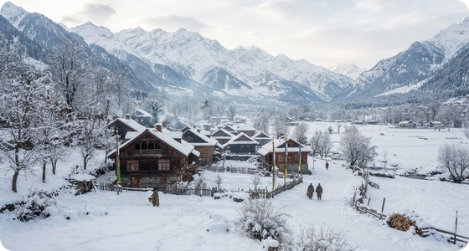

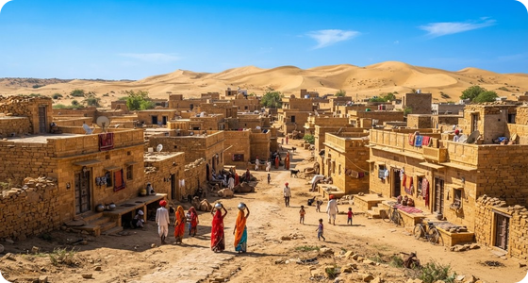

Living With the Climate
We adapt to the weather — and protect the balance.
Build Smart
Slanted roofs shed snow; light flat roofs beat the heat.
Protect Nature
A stable climate keeps forests, farms, and towns thriving.
5 / 9

Slide 6



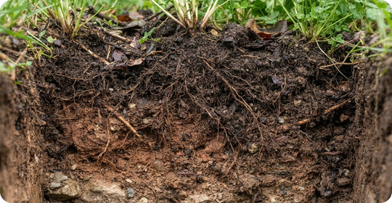
Oceans, Rocks & Soil
Oceans
Rocks
Soil
Currents, salinity, and the water cycle all run on weather.
Wind, water, and ice slowly grind mountains down.
Climate — plus tiny microbes — builds the soil we farm.
6 / 9

Slide 7


Reading the Sky
Old records reveal a region’s true climate.
Why It Matters
Sky science keeps flights, farms, and cities safe.
How We Track It
Experts track heat, pressure, humidity, wind, and rain to decode patterns.
Weather Stations
Nations record sky data every single day.
7 / 9

Slide 8

23
One Sky, One Team
Shared data saves crops and lives.
Weather science, taught to everyone.
Know the sky — stay safe in storms.
MARCH
World Meteorological Day
8 / 9

Slide 9
ENVIRONMENTAL MANAGEMENT
THE END

