Slide 1

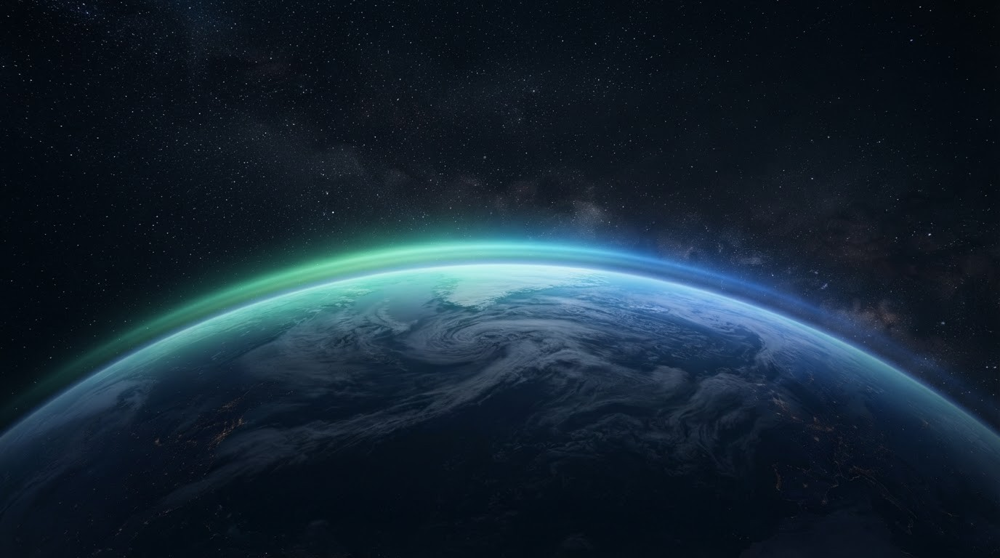
ENVIRONMENTAL MANAGEMENT
Weather & Climate
CREATED & DESIGNED BY ABHISHEK
PRESENTERS—ABHISHEK, AYOUSH, KANISHK, SARTHAK, DHIAAN

Slide 2


Weather & Climate
How short-term weather is different from long-term climate.
Weather
Climate
SHORT-TERM · LOCALIZED
LONG-TERM · REGIONAL
• Short term.
• Can change every day or even every hour.
• Includes rain, sunshine, wind, and clouds.
• Watched and measured all the time.
• Long term.
• Changes after a decade or a century
• Include desert or rainforest
• Shapes seasons, plants, and animals.
2 / 9

Slide 3


Weather-Related/Climate Factors
Atmospheric Pressure
03
Humidity
Sunlight
Weather-related / Climatic Factors
Rainfall
Clouds
Temperature
Visibility
3 / 9

Slide 4

IMPORTANCE OF WEATHER IN THE LIVING WORLD
Daily weather as also long-term climatic conditions influence human lifestyle directly or indirectly
Basic Requirements
Weather affects what people wear, what they eat, and where they choose to live.
Civil Engineering
Engineers design buildings, bridges, and airports to stand up to wind and weather.
4 / 9

Slide 5
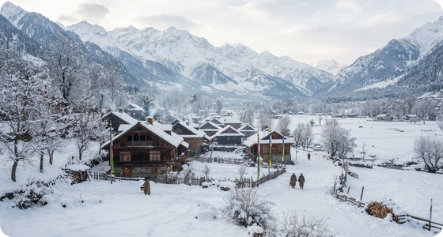

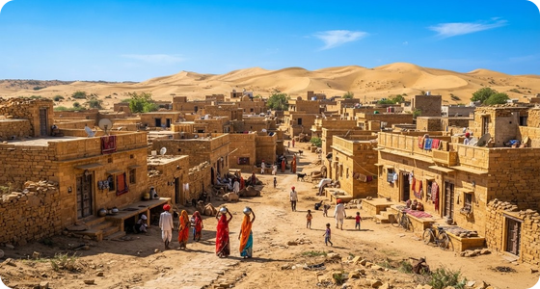

Climate & Regional Adaptation
The relationship between climatic factors and regional environmental adaptations.
Regional Adaptation
People build houses to fit the weather where they live. Cold, snowy places need slanted roofs and thick walls to stay warm, while hot places use flat roofs and light materials to stay cool.
Environmental Protection
When the weather stays calm and stable, plants, animals, and people can all grow together. Predictable climate makes it easier for nature and towns to stay healthy and strong.
5 / 9

Slide 6

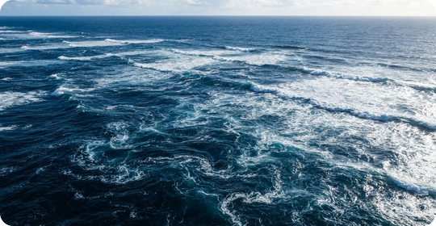

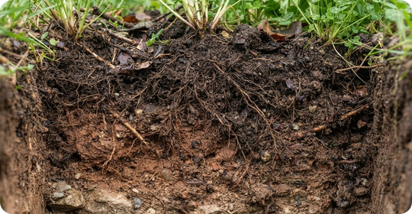
Impact Of Weather On Oceans & Soil
Marine Systems
Geological Processes
Soil
Salinity of marine water, formation of oceanic currents, the water cycle, etc. are all related to various weather and climatic factors.
Various climatic factors bring about the weathering of rocks in the earth's crust.
Climate plays a very important role in the formation and growth of soil. Microbes also play an important role in the formation of oraganic materials.
6 / 9

Slide 7


Meteorology
While studying the climate of a region, it is important to review earlier research on different aspects of climate.
Role of Meteorology
Meteorology is the scientific study of the atmosphere, weather, and climate.
How Weather Is Tracked
Meteorologists monitor temperature, air pressure, humidity, wind speed, and precipitation to understand weather patterns.
Meteorology Departments
Many countries have meteorology departments that make and record observations to understand weather and climate patterns.
7 / 9

Slide 8

23
Global Cooperation
• By sharing weather data worldwide, we protect crops, keep communities safe, and help everyone plan their daily lives.
Teach people about weather science.
Learning about the weather helps us stay safe from storms and make smart choices every day.
MARCH
World Meteorological Day
8 / 9

Slide 9
ENVIRONMENTAL MANAGEMENT
THE END

