Slide 1

ENVIRONMENTAL MANAGEMENT
Weather &
Climate
From daily forecasts to hundred-year climates.
PRESENTED BY
ABHISHEK • AYOUSH • KANISHK • SARTHAK • DHIAAN

Slide 2
Weather vs Climate
Today outside — versus the pattern of decades.
WEATHER • HERE & NOW
CLIMATE • BIG & LONG
• Changes every hour or day
• Rain, sunshine, wind, clouds
• Measured every single minute
• Averages over 30+ years
• Deserts, rainforests, seasons
• Shapes plants, animals, us

Slide 3
What Shapes Weather & Climate
Seven forces behind every forecast
7
Atmospheric Pressure
Sunlight
Clouds
Visibility
Temperature
Rainfall
Humidity
Pressure pushes winds • Sun heats air • Water writes the rest

Slide 4

Why Weather Rules Our Lives
From daily choices to 100-year bridges — weather shapes it all.
Daily Life
What we wear, what we eat, where we live — weather decides daily.
Strong Builds
Bridges and airports engineered to beat any storm.

Slide 5
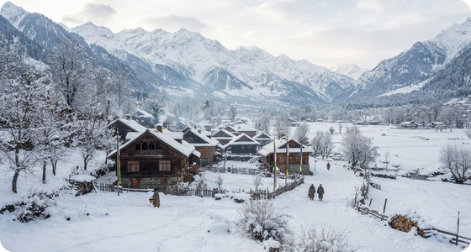
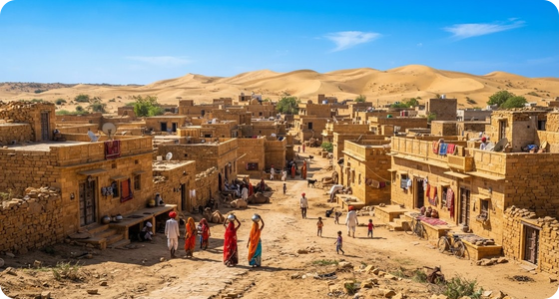
Living With the Climate
We adapt to the weather — and protect the balance.
Build Smart
Slanted roofs shed snow; light flat roofs beat the heat.
Protect Nature
A stable climate keeps forests, farms, and towns thriving.

Slide 6


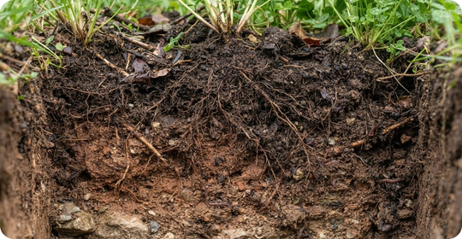
Oceans, Rocks & Soil
Weather sculpts water, stone, and the ground we farm.
Oceans
Currents, salinity, and the water cycle all run on weather.
Rocks
Wind, water, and ice slowly grind mountains down.
Soil
Climate — plus tiny microbes — builds the soil we farm.

Slide 7
Reading the Sky
How humans learned to predict the weather.
01
Weather Stations
Nations record sky data every single day.
02
Old Records
Past data reveals a region’s true climate.
03
Why It Matters
Sky science keeps flights, farms, and cities safe.

Slide 8

WORLD METEOROLOGICAL DAY
23
MARCH
One sky, one team — shared data saves crops and lives.

Slide 9
ENVIRONMENTAL MGMT
THE END
ABHISHEK • AYOUSH • KANISHK • SARTHAK • DHIAAN

