Slide 1
CAR PRICE PREDICTION
Submitted By : -
Anirudh Bhardwaj

Slide 2
Problem statement
With the covid 19 impact in the market, we have seen lot of changes in the car market. Now some cars are in demand hence making them costly and some are not in demand hence cheaper. One of our clients works with small traders, who sell used cars. With the change in market due to covid 19 impact, our client is facing problems with their previous car price valuation machine learning models. So, they are looking for new machine learning models from new data. We have to make car price valuation model. This project contains two phase

Slide 3
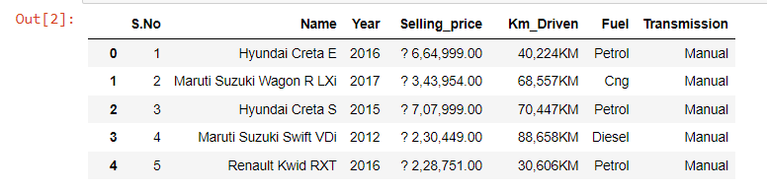
Extracting Car Price Data from Ola Car. With the help of this Data we will prepare our Model and try to
predict the Car Market.

Slide 4
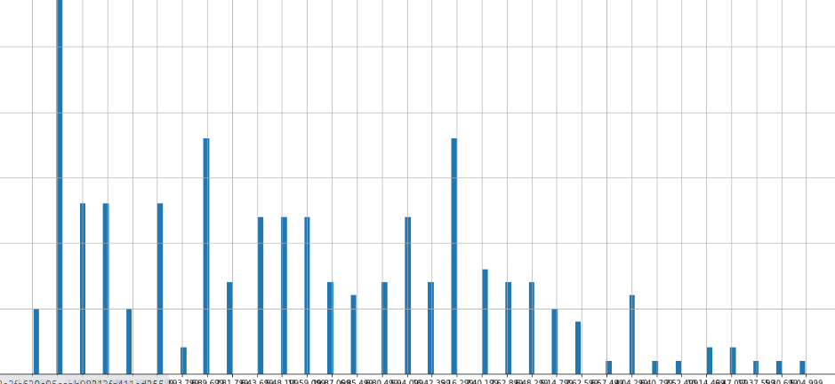

Slide 5
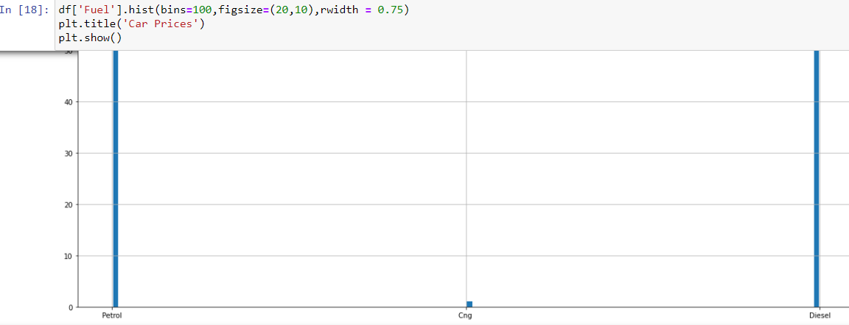

Slide 6
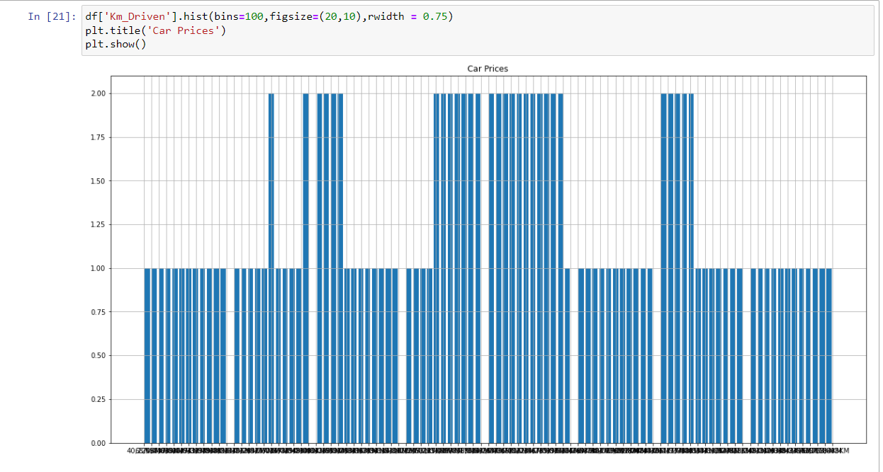
We can see we have quite some range on the prices of the cars.

Slide 7
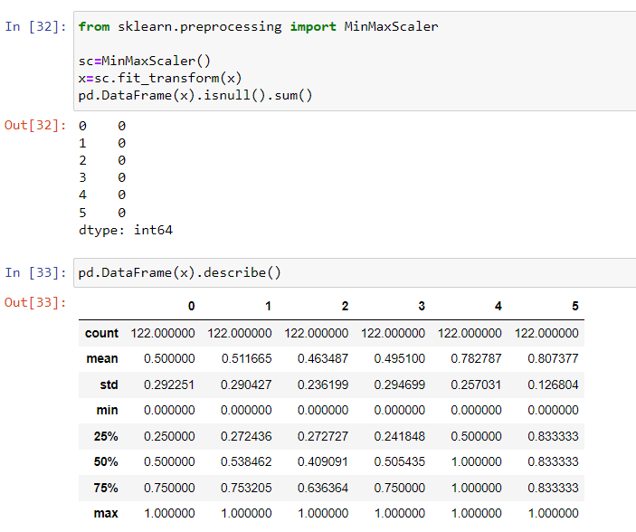
Data pre processing

Slide 8
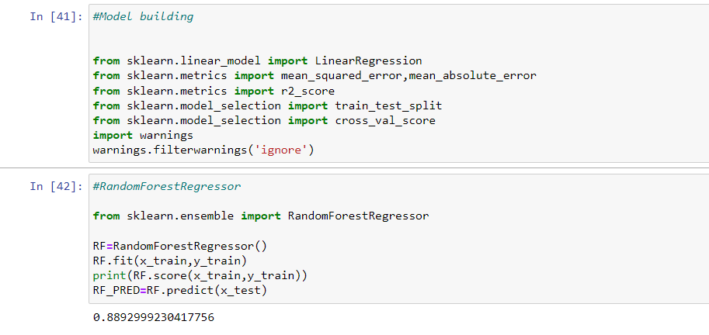
Model building

Slide 9
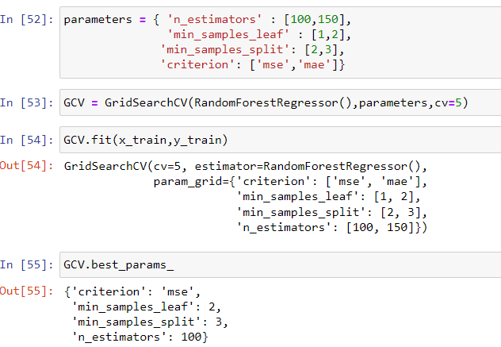
Hyper parameter tuning
Hyper parameter tuning was performed on the best performing algorithm, which was the random forest regression.
These variables were selected, the tuning took many hours to complete.
The best parameters were used to train another accurate model.

Slide 10
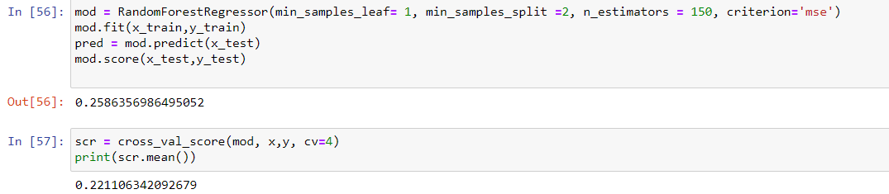
Training best model
This is the best model with a cross validation, R-squared result of 0.943

Slide 11
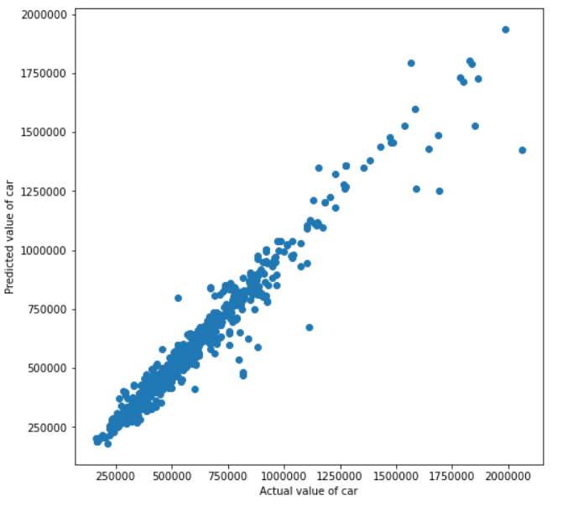
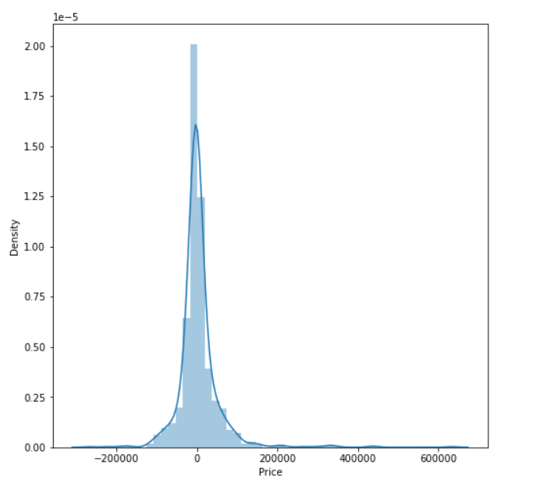
Scatter plot of predicted vs actual price
Distribution plot of (predicted value – actual value)
After observing these graphs we can conclude that the model is performing very well and it can be used by the Vendor.

