Slide 1
Automatic Image Colorization
Predicting colour from grayscale with SVR + MRF (ICM) smoothing
UE24CS352A – Machine Learning · Mini-Project · Problem 150
Based on Ho & Ramesh, “Automatic Image Colorization” (CS229)
Notes:
Introduce the problem and that we reimplemented and extended the Ho & Ramesh paper.

Slide 2
Problem statement
Colorization is ill-posed
Different colours can map to the same gray value, so a grayscale pixel alone does not determine its colour.
Goal
Fully automatic colorization of nature/landscape photos – no scribbles, no reference image.
Input → Output
Input: Y (luminance) channel only. Output: predicted U and V (chrominance) channels.
Y
Luminance (input)
U, V
Chrominance (predict)
RGB
Recombine & convert

Slide 3
Dataset
215
172 / 43
500 px
39,330
colour landscape images
train / test (80 / 20 split)
constant image width
training superpixels
Nature photographs (sky, mountains, water, fields), as in the paper’s Yellowstone-style setting.
Black letterbox bars are auto-cropped; already-grayscale images are removed.
15% of training images (26) held out as validation for hyperparameter tuning; the final SVRs train on all 172.
Targets: mean U and mean V of each superpixel.

Slide 4
Approach: the pipeline
1
YUV conversion
2
SLIC superpixels
3
FFT features
Model sees only Y
~250 segments on Y
10×10 patch at each centroid
4
Two SVRs
5
MRF + ICM
6
Recombine
RBF kernel: Y-features → U, V
Smooth neighbouring segments
Y + U,V → RGB
Predicting per segment (not per pixel) lets colours follow image structure and keeps the problem tractable.

Slide 5
Implementation details
SVR stage
100 FFT-magnitude features (log-compressed) + 4 context features: vertical position, segment mean/std Y, image mean Y
Features standardised; context features weighted ×3
Grid search on validation set: C = 0.125, ε = 0.01 for both U and V
Final fit on 39,330 superpixels (~386 s)
MRF / ICM stage
One MRF per channel; Gaussian local potential around the SVR prediction + neighbour smoothness term
Neighbours kept only if their texture features are similar
Closed-form ICM update, repeated to convergence
Tuned: γ = 128, σ = 0.1, neighbour percentile 90 (paper: γ = 2)
Saturation boost ×1.4 on U, V counters washed-out output
Notes:
Mention libraries: scikit-image (SLIC, YUV), scikit-learn (SVR), scipy.

Slide 6
Results: error drops at every stage
−17.6%
SVR vs. grayscale MSE
−10.3 pts
extra drop from ICM
84%
test images improved by ICM
0.138
final mean RGB distance (0.164 gray)
Notes:
Paper reports 68.1% SVR reduction on Yellowstone with a different error definition; our numbers are on our own test split and are not directly comparable.

Slide 7
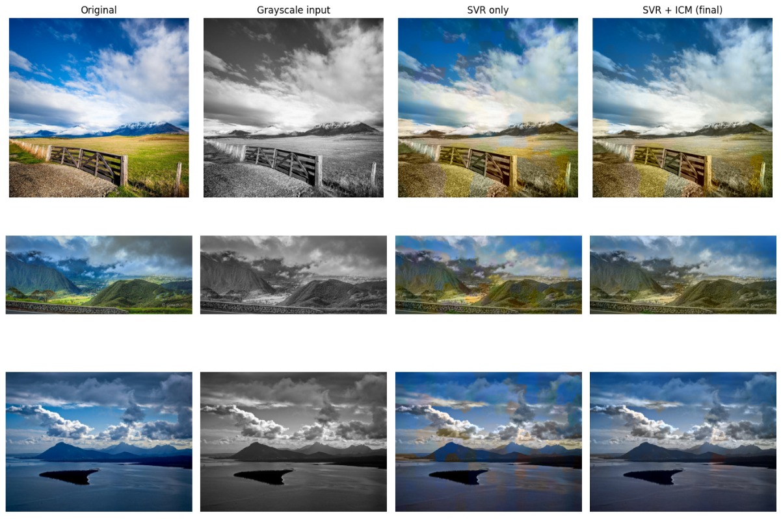
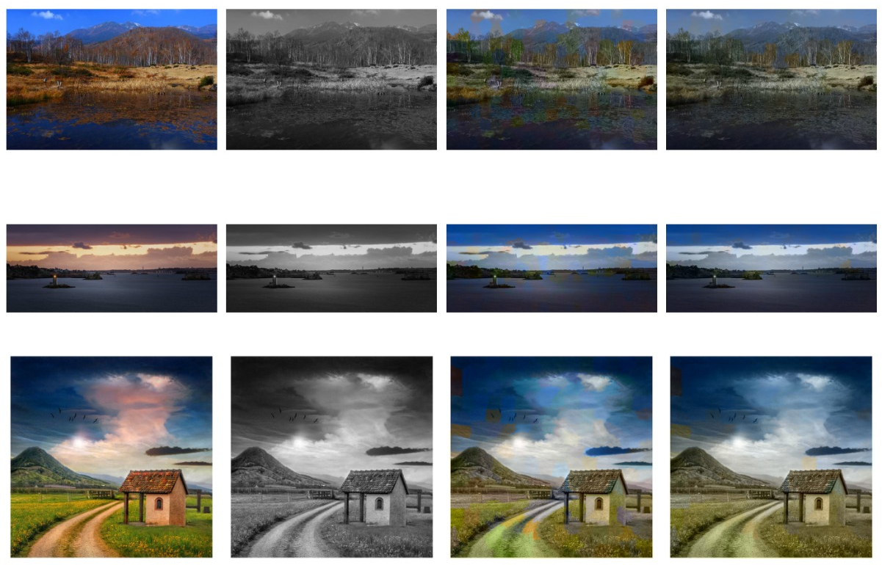
Qualitative results
Columns (left → right): Original · Grayscale input · SVR only · SVR + ICM (final)
Sky, water, grass and mountains receive plausible, distinct colours.
ICM removes isolated colour blotches seen in the SVR-only column.

Slide 8
Limitations and future work
Limitations
Colours are muted and tend toward blue; warm yellows and browns are under-represented
Colour bleeding across segment boundaries and visible patchiness
One colour per segment averages plausible alternatives, lowering saturation
Small dataset limited to landscapes
Future work
Predict colour distributions (multimodal) instead of a single value
Pixel-wise MRF to reduce bleeding
CNN features for global context; richer patch features
CIELAB colour space; larger, more varied training data

Slide 9
Conclusions
Automatic colorization from a training corpus is feasible with classical ML: SLIC + FFT features + SVR.
MRF/ICM smoothing consistently helps: MSE falls from 0.0155 (gray) to 0.0112, improving 84% of test images.
Output is plausible but desaturated; multimodal prediction and deep features are the natural next steps.
Thank you – questions?

