Slide 1


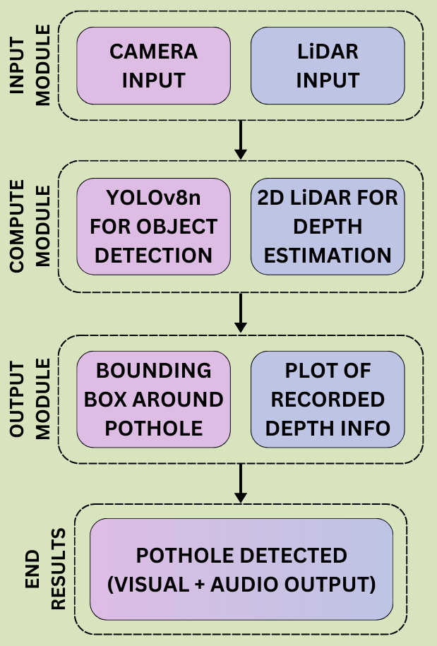
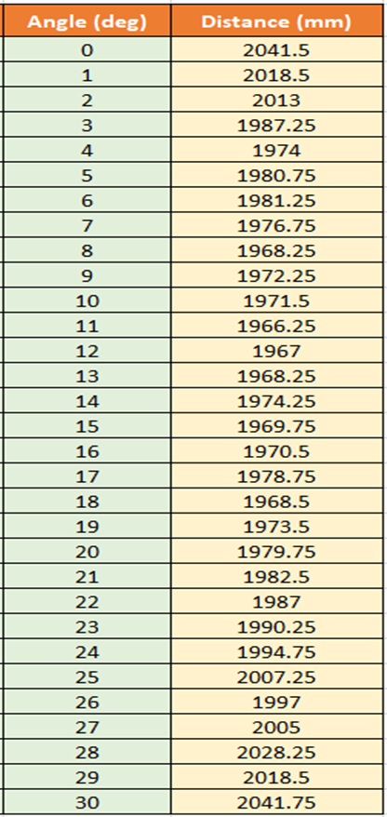
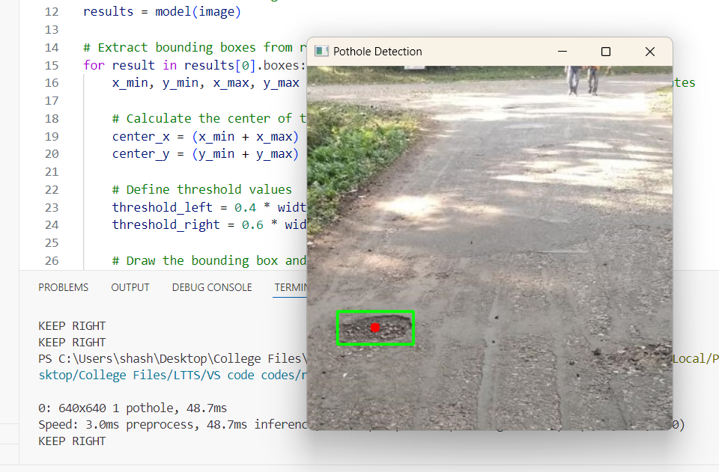
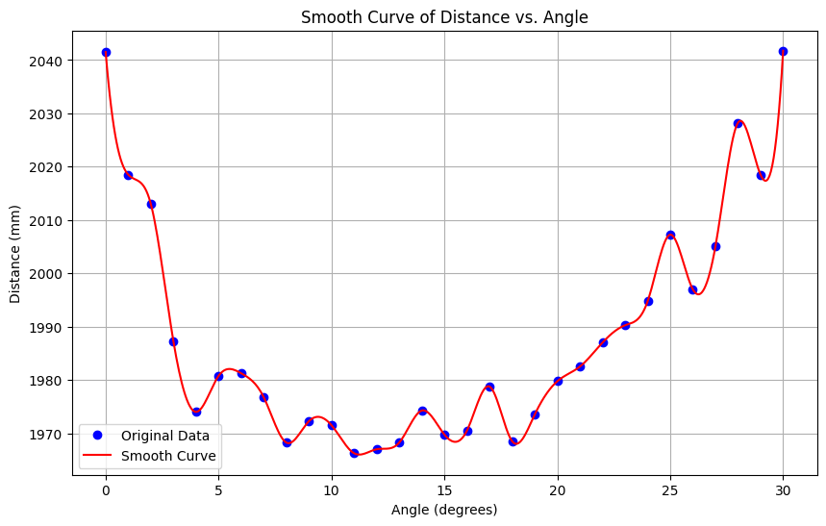
Advanced Pothole Detection and Mitigation
E Sujaya, Anirudh Navalgund, Shashank Padavalkar, Royston Vedamuthu
School of Electronics and Communication
01fe22bec102@kletech.ac.in, 01fe22bec104@kletech.ac.in, 01fe22bec087@kletech.ac.in, 01fe22bei035@kletech.ac.in
Problem Statement
Methodology
Results
Design an innovative and advanced pothole detection system to identify potential road hazards and avoid them.
Pothole at Left
Keep Right
Objectives
Develop a pipelined framework for real-time pothole detection using multi-modal data.
A reliable assistance system for executing safe driving maneuvers in real time.
Provide visual and audio feedback to the user upon pothole detection, ensuring immediate awareness and safety.
Contributions
Enhanced Safety: Alerts drivers to potholes, reducing accidents and vehicle damage.
Cost Savings: Optimizes road repair and maintenance, saving resources.
Environmental Impact: Reduces fuel consumption and pollution from smoother traffic flow.
Technological Innovation: Employs advanced sensors and algorithms for precise detection.
Data-Driven Insights: Provides actionable data for infrastructure planning.
Scalability: Can extend to detect other road anomalies and integrate with smart city systems.
Optimization Details
Implemented the lightweight YOLOv8n model to balance accuracy and computational efficiency.
Fine-tuned LiDAR distance thresholds to effectively filter out minor surface irregularities, enhancing the system's precision in identifying significant potholes.
Optimized the LiDAR and camera synchronization to ensure seamless data acquisition and processing for accurate pothole detection.
Literature Survey
Conducted an exhaustive literature survey, reviewing state-of-the-art advancements and approaches towards pothole detection using computer vision (camera) and LiDAR.
Talha, S. A., Manasreh, D., & Nazzal, M. D. (2024). The Use of Lidar and Artificial Intelligence Algorithms for Detection and Size Estimation of Potholes. Buildings, 14(4), 1078.
Yik, Y. K., Alias, N. E., Yusof, Y., & Isaak, S. (2021, February). A real-time pothole detection based on deep learning approach. In Journal of physics: Conference series (Vol. 1828, No. 1, p. 012001). IOP Publishing.
Conclusions
Our pothole detection and mitigation system combines YOLOv8-based real-time detection with LiDAR-based depth analysis to accurately identify and differentiate potholes, ensuring improved road safety and actionable insights for infrastructure management.
Mini Project-2024-25
Notes:
1

