Slide 1
Abstract
The purpose of the project is to deliver Real Time Recognition of student faces, to grant them security access to the college as well as secured resources within the college. The project can also be extended to use within domestic household as a security measure against imposters.
We implement a Real Time Face Recognition algorithm to a live feed delivered by our android app CCTV Cam. This feed is analysed for recognizable faces and output is delivered in the form of IOT controlled lights and buzzers.
Problem Statement
Designing a Real Time Face Recognition System that can analyse and understand a person’s face as and when they arrive.
Building an Android App that relays video feed from the camera to a socket on the network.
Build IOT module that delivers output for recognized and unrecognized faces, using Arduino.

Slide 2
Introduction
In the modern-day world, many situations arise, where a Real-Time Face Recognition System commits to solve issues that would have otherwise caused a havoc. Its applications are numerous, a few popular ones being:
Security
Social Media
Healthcare
In the field of Security, various law enforcement bodies use this technology not only to find criminals but also to stop crime before it happens by analysing potential risks.
Our model
We developed an Android app called CCTV Cam that relays the feed from the camera of the android phone to our python client which runs the Face Recognition module.
Using OpenCV in Python, we implemented Real Time Face Recognition using the Linear Binary Patterns Histogram (LBPH) algorithm.
We process the images from the frames in the live feed and use them to recognize the faces. The model will need to be trained on student faces before it can correctly identify them to a certain degree of certainty.
Output through an Arduino, that controls buzzers and lights, determine whether the person is a verified individual or not.
With a successful real time working model, security clearance can be granted to students, without the need to show identification cards.

Slide 3
Tools required
OpenCV
OpenCV (Open Source Computer Vision Library) is an open source computer vision and machine learning software library. OpenCV is used to detect faces, train them and correctly classify/recognize them.
Jupyter Notebook
Jupyter Notebook is used as the Python programming IDE to develop the client side Real Time Face Recognition Module
Android Studio
Android App Development is implemented using Android Studio, to create an App that relays video feed from the camera to a dedicated socket on the network.
Arduino IDE
Arduino is used to control lights and buzzers, that act as output when
unrecognized faces are present.
Programming Languages used:
Python
Java
C++

Slide 4
Data flow representation
Android
App
Socket
IP: 192.168.20.10
Port: 5050
Camera video feed
Video feed from the camera is taken in the form of frames by the App, which then compresses them and sends them as JPEG files.
These files are passed through the socket and hosted at the Android phone’s IP and default port:5050
Input frames
Real-time Face Recognition Module
Output
IP: 192.168.20.10
Port: 5050
Arduino
Python Client
The JPEG frames are taken as input by the Python client which runs the LBPH algorithm on each frame and subsequently tries to identify faces.
Output is delivered to the Arduino, which handles the IOT controlled lights and buzzers accordingly.

Slide 5
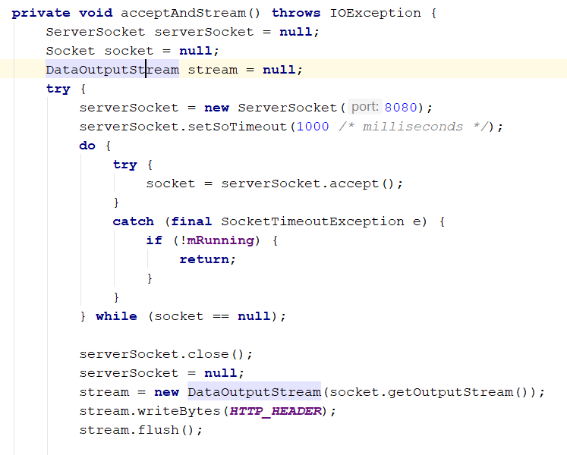
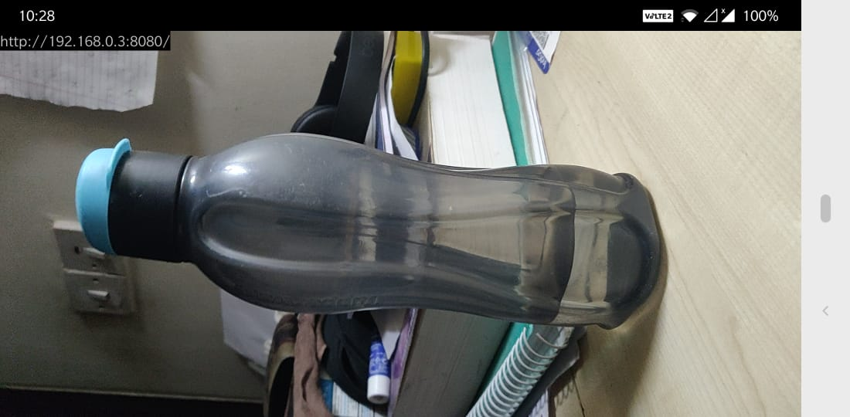
Implementation
Android App (CCTV Cam)
The app opens up the camera on the device and begins recording. The frames are retrieved, buffered and compressed into JPEG style frames.
A server socket is opened at the device’s IP and port:8080. These JPEG frames are then sent across this socket and are hosted at the corresponding URL. In this case, http://192.168.0.3:8080/
Hosting URL

Slide 6
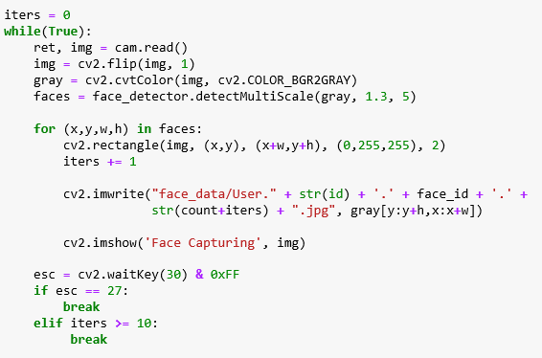
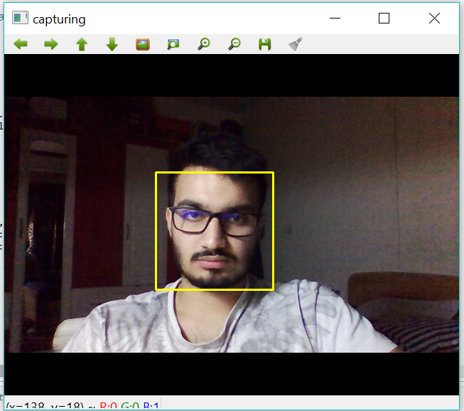
Python Client (Real Time Face Recognition Module)
The python client works in 3 stages:
Captures faces of a person
Trains the classifier on all the faces
Begins real time recognition
Capturing faces
We load the haarcascade classifier called “frontface_default.xml” which is trained on multiple positive and negative images of faces.
Faces from the input stream are detected and stored in greyscale format, with respect to their input name

Slide 7
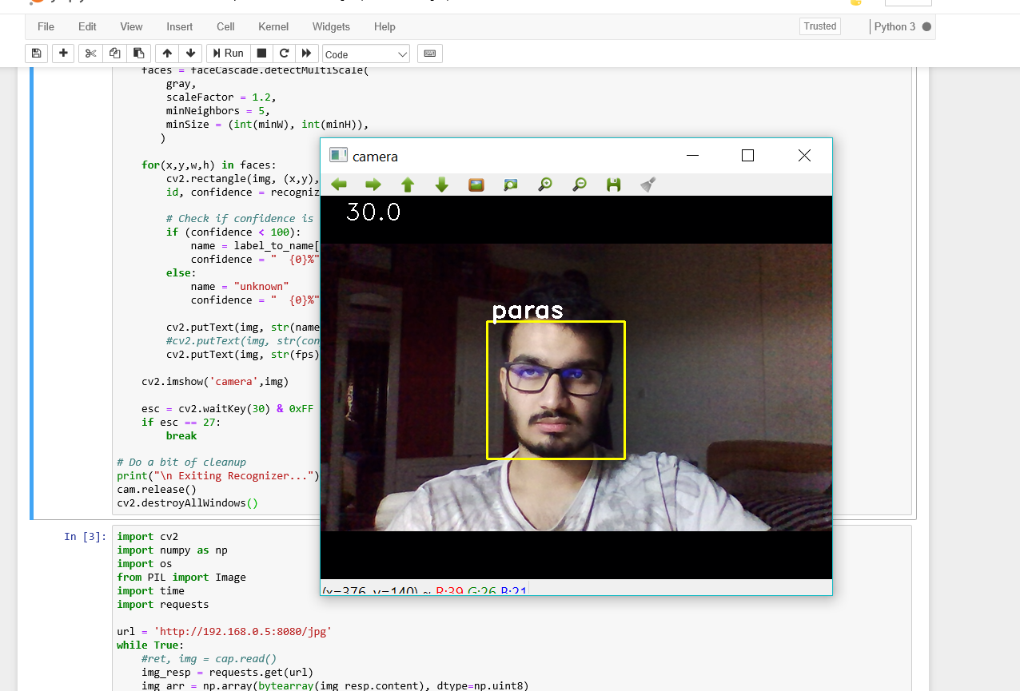
Training faces
Once the faces are captured, we train the faces by using the Linear Binary Patterns Histogram (LBPH) algorithm.
This algorithm treats each image as a matrix of pixels values. These pixels are normalised in the form of 3x3 blocks based on the threshold value of the middle block.
Based on the binary values obtained, histograms are created for each image. These histograms are used as reference while classifying the new images.
Recognizing Faces
In real time, the python client detects faces in the input frame, passes them to the trained classifier.
This classifier determines whether the face is recognized or not and relays output on screen as well as to the Arduino.

Slide 8
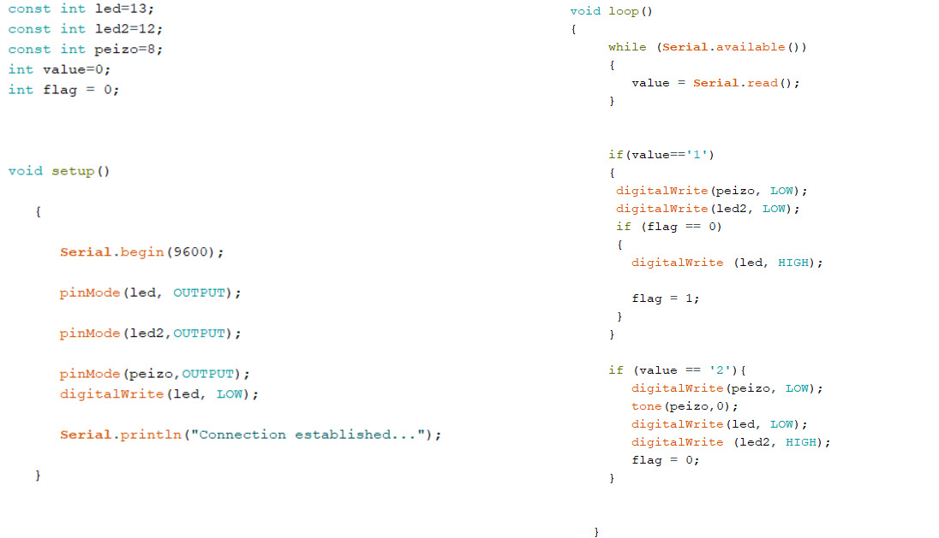
Arduino
The Arduino board receives serial data from the python client, using which it determines whether to buzz the alarm or not.
Serial data 1: Face is recognized, turns LED green
Serial data 2: Face is not recognized, turn LED red and buzz the alarm.

