Slide 1
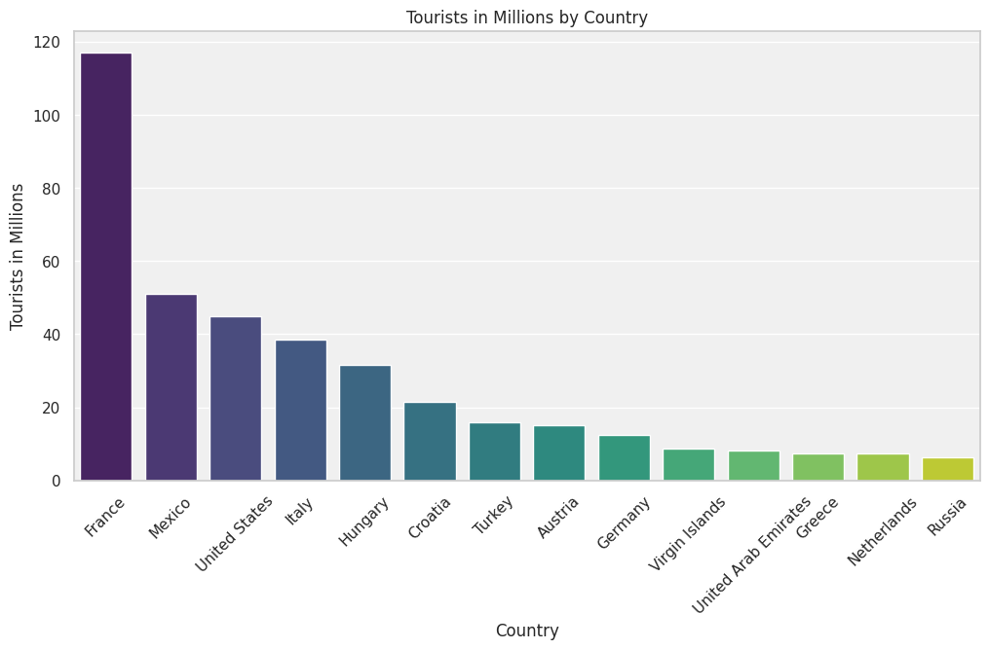
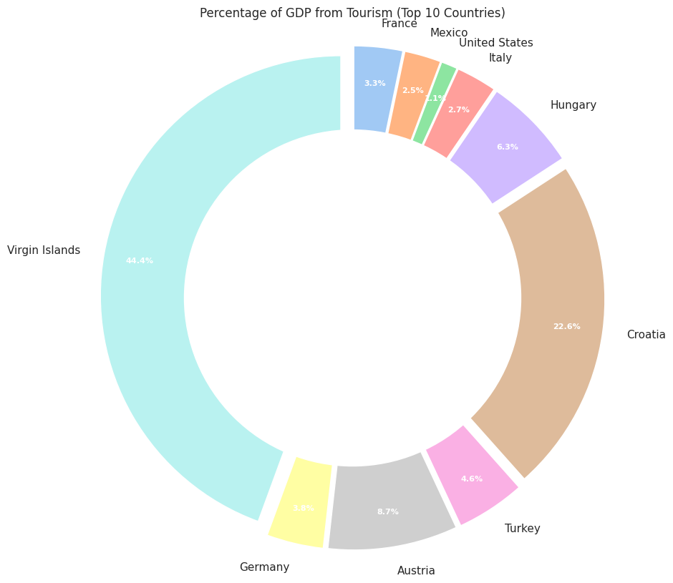
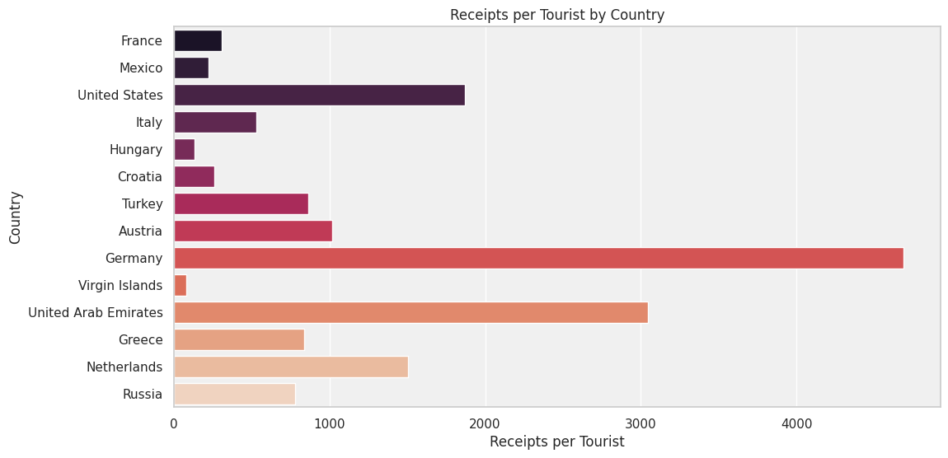
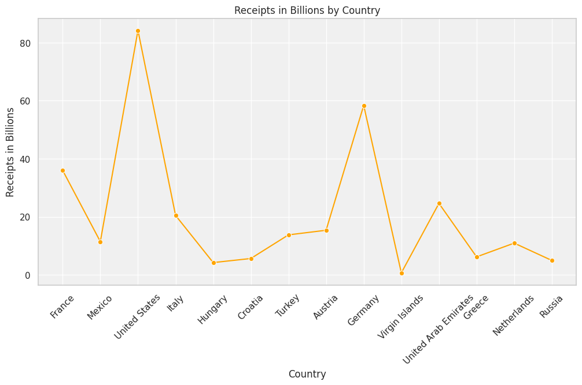
World Tourism Scenario
The Dashboard is showing the tourism scenarios of some countries .
The donut graph shows the percentage of GDP on tourism corruption levels
The horizontal bar graph shows Receipts per tourist by country.
Student Name:
Student ID: 22101110

