Slide 1

Sri Siddhartha Institute of Technology Tumakuru-572105 (A Constituent College of Sri Siddhartha Academy of Higher Education)
Mini-Project(CS6MP2) Presentation On:
ONLINE VOTING SYSTEM V2

Slide 2

Online Voting System
Presented by: Anirudh C M (21CS006) Chandan T O (21CS018) Under the guidance of: Mrs.Bhoomika P Assistant Professor Department of CSE SSIT, Tumakuru-03 .

Slide 3

Agenda
Introduction
Objectives
ER Diagram
Architecture Diagram
Data flow model
Problem statement
Conclusion

Slide 4
Introduction:
The Online voting system is a web-based application that allows voters to cast their votes by being in the comfort of their place.
The proposed system has greater security also has simple and attractive user interface which makes users feel its easy to use.
Privacy of the voters and their votes plays the most important role in voting, The proposed system is secure reliable ensuring that the votes are counted accurately that the results are available in time.

Slide 5
Objectives:
To develop an internet/online web-based voting system that can be used during the election period to vote for the leaders
To come up with a system documentation
To automate votes computations.
To maintain the eligible voter list.
To come up with online voter registration module and online display of election results.

Slide 6
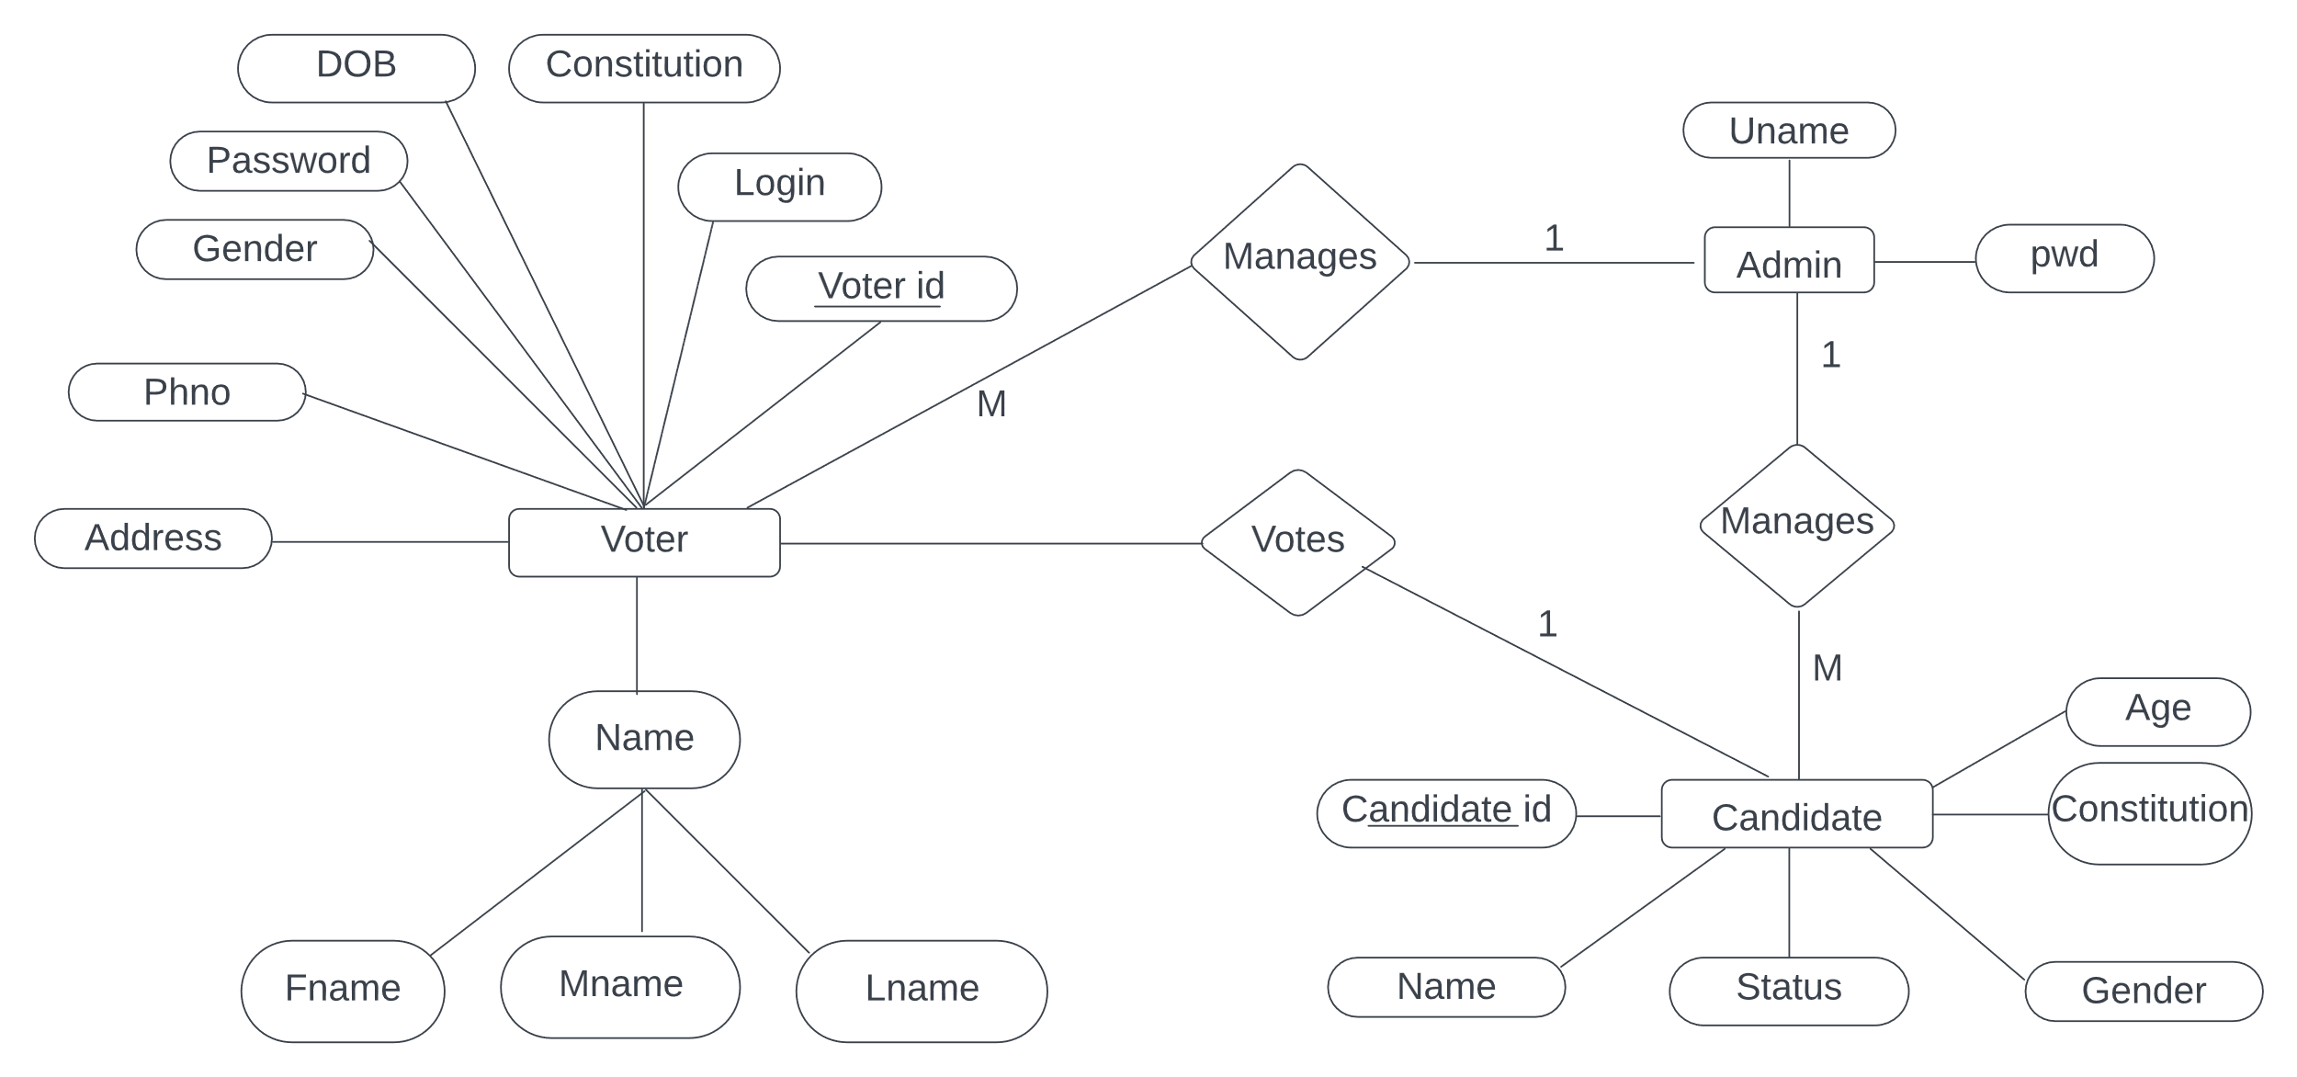
ER Diagram

Slide 7
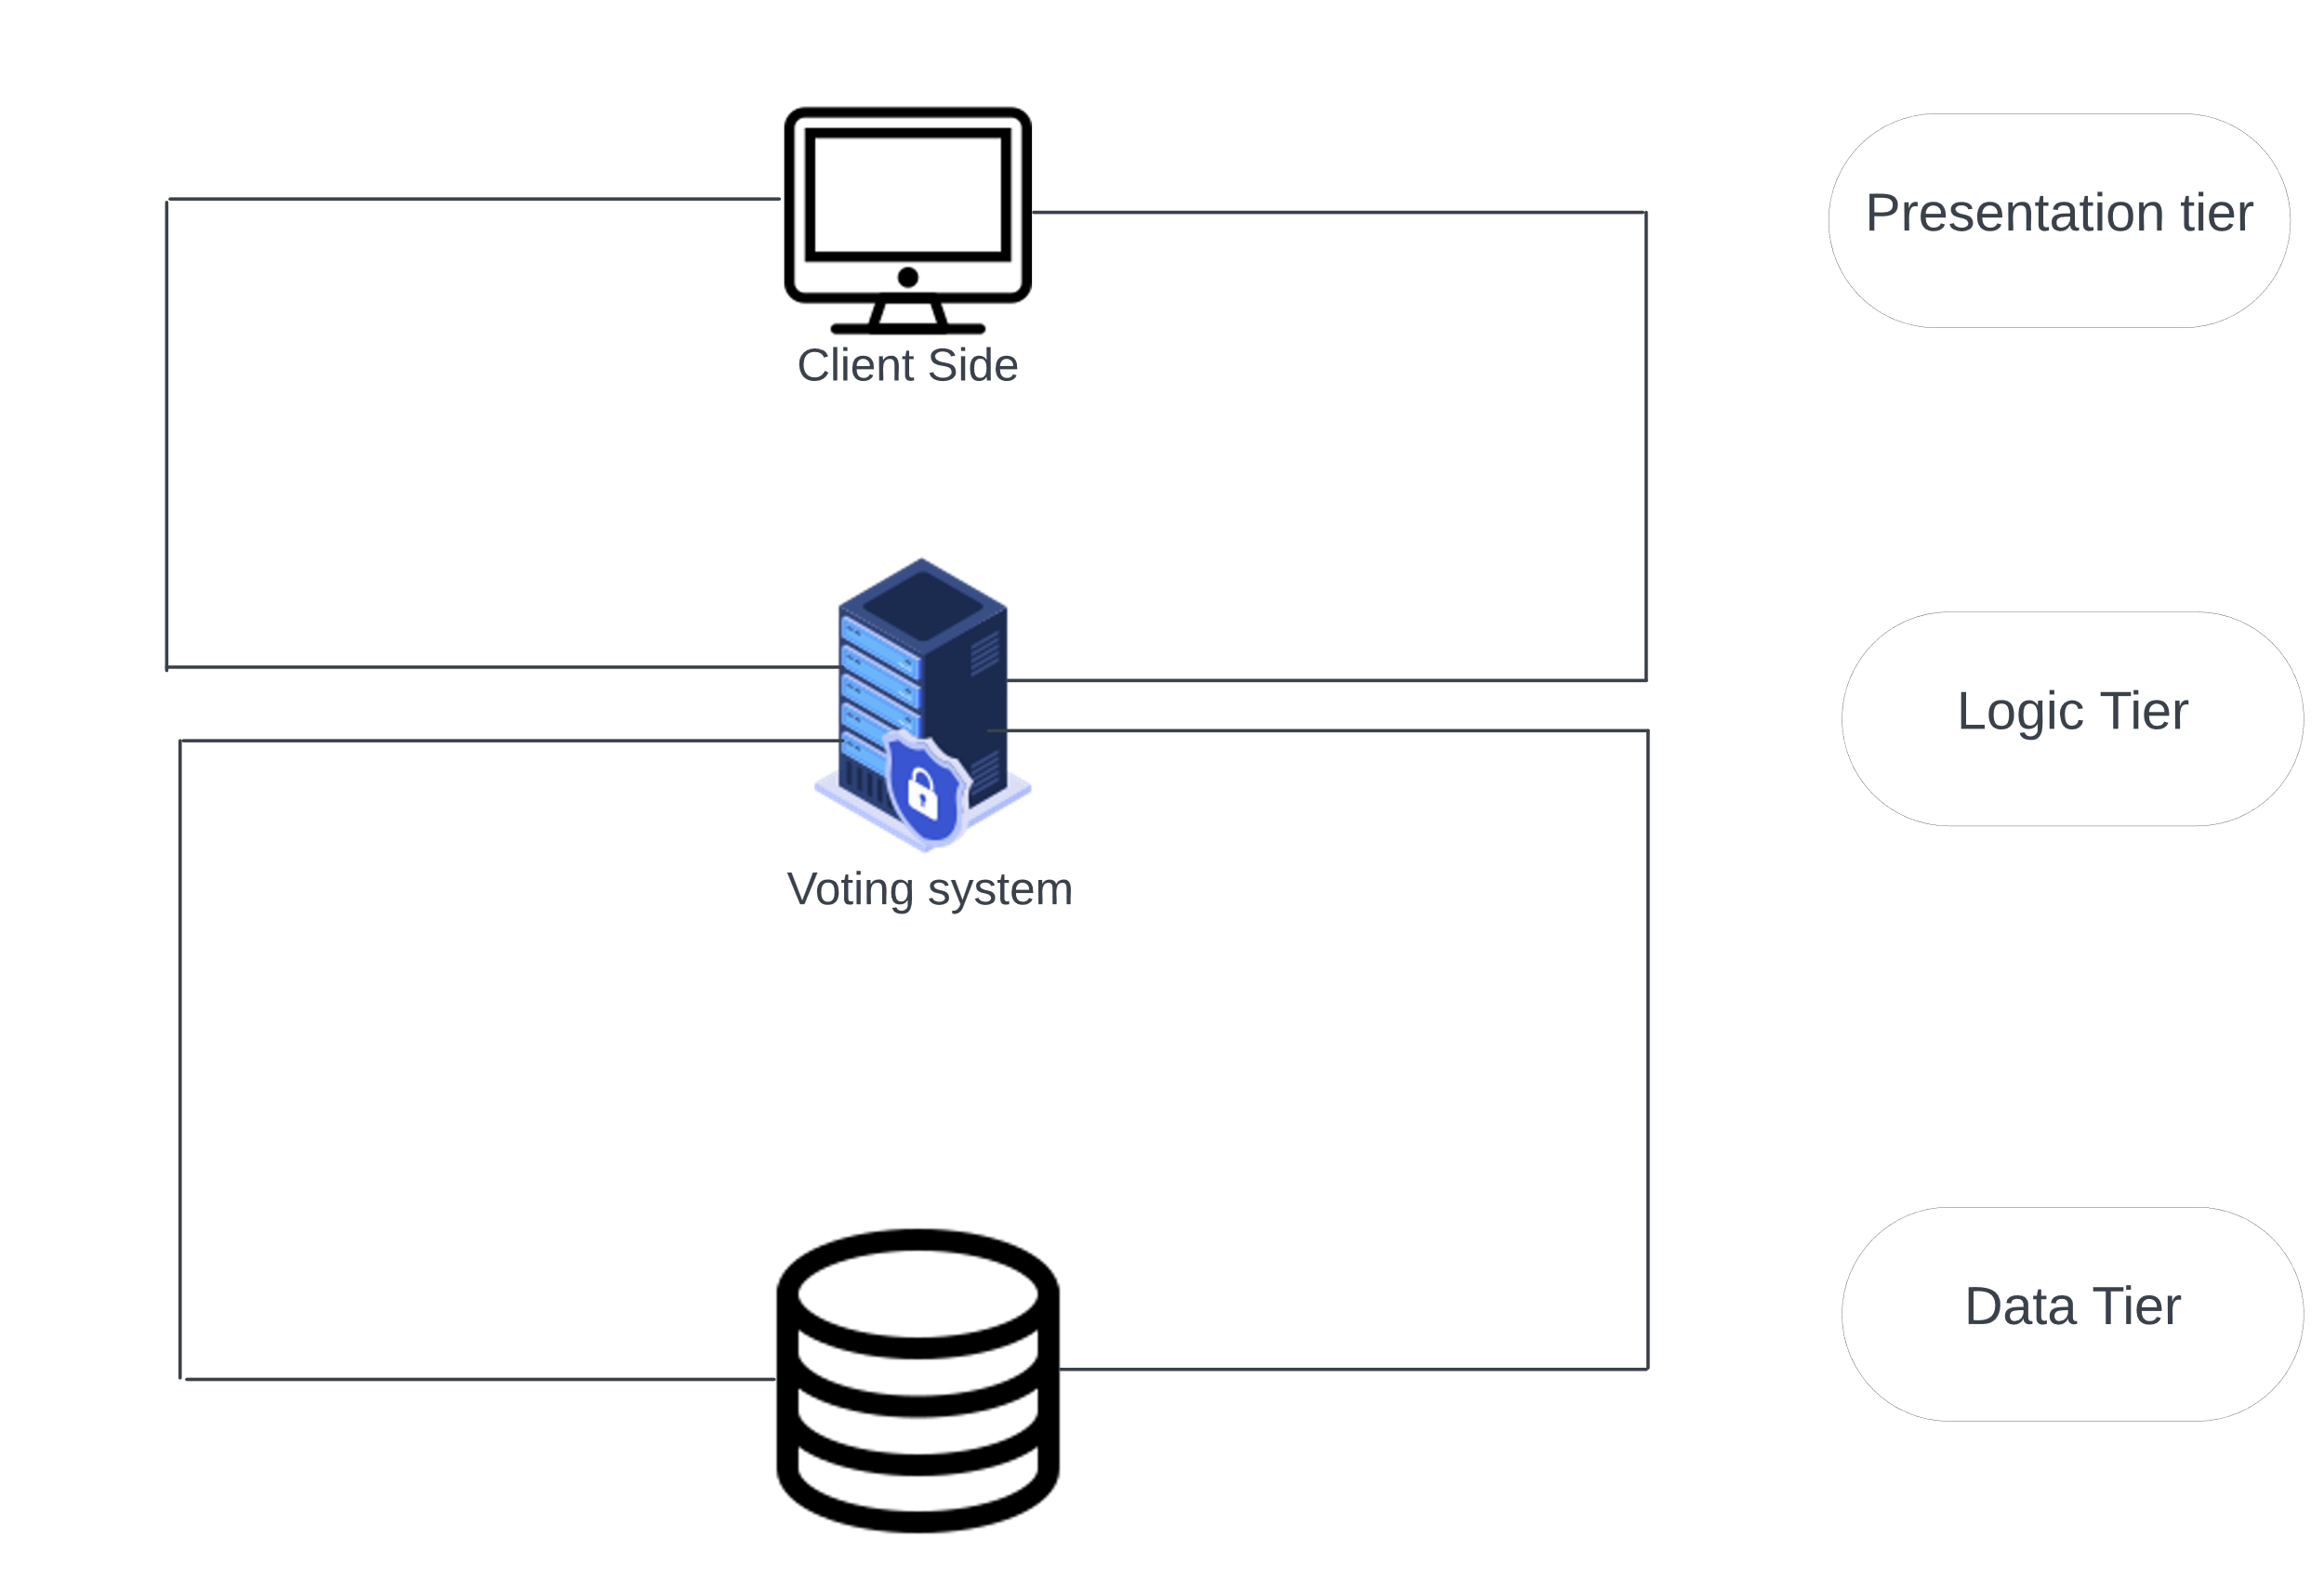
Architecture diagram

Slide 8
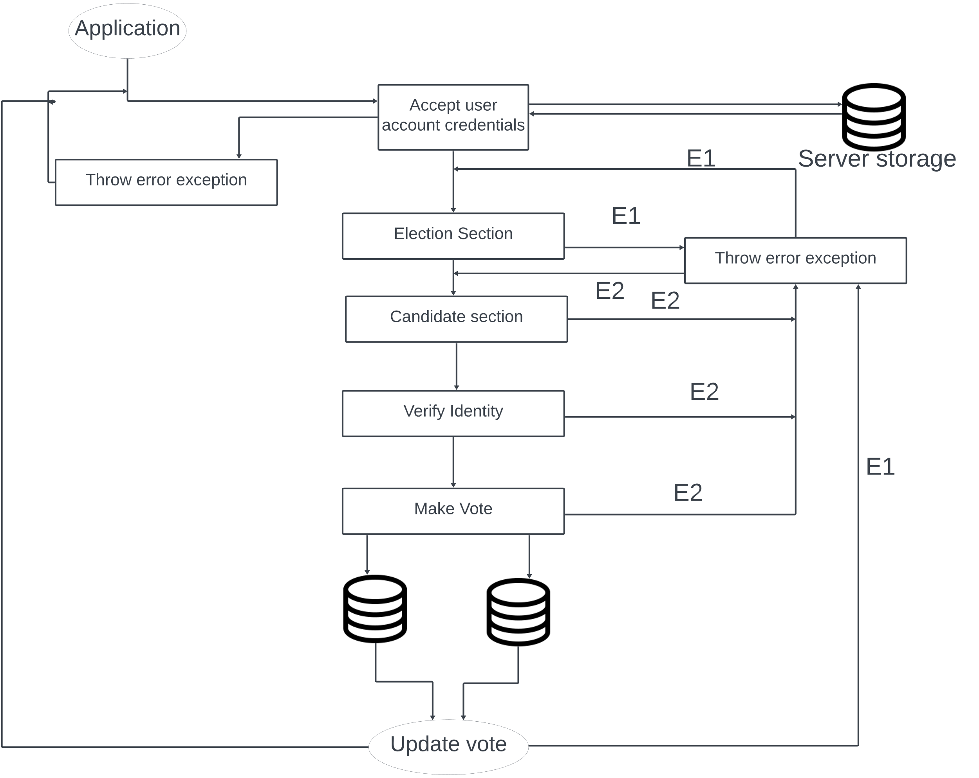
Data flow model

Slide 9
Problem statement
The current voting system in INDIA has several inefficiencies that need to be addressed.
The voter registration process is slow and the manual collection of results take time and gives room for result manipulation .
Inaccessible election venues including long distances voters must travel to their registered location.
If there are lot of people near booth the voter has to wait in queue and wait for his/her chance.

Slide 10
Example
The current election in SSIT conducted manually where the voter has to go near the booth write his/her vote in a chit later the professor has to count the chit manually.
This consumes lot of time sometimes they may miss count so the required accuracy is not met.
On the day of election the voter must be physically present in the campus to vote, students who cant attend the class on the election day they miss out electing their CR’s.

Slide 11
Solution
Considering all the drawbacks mentioned in previous slid we have developed online voting system
Using this module the voter can vote being anywhere around the world.
The accuracy in counting the votes are met.
It reduces manual human efforts, Bulk information can be handled easily by meeting the required accuracy.
Security plays a major role in voting process the proposed system is safe, secure and efficient in conducting elections.
All required safety measures are taken care in the proposed model.

Slide 12
Draw backs of V1
The voter could login at any time and he/she could vote even after or before the election has actually begun.
The admin has lot of work, the admin should add all the voters manually to the voters list.
The passwords were set manually by admin for each voter, since admin was setting the password for the users he was setting randomly what he wants.
This system can only generate voter ID and voters password but there was no media to send this credentials to the voters.
The passwords in the system are stored directly without hashing.
The system wasn’t on the internet it was locally hosted.

Slide 13
How we have overcome it in V2.
. Session in & Session out
. Automatic ID generation
. Automatic Password generation
. Automatic credentials sender
. Automatic voters list addition
. Extra layer of security by hashing the password
. The system is on the internet but not on a server

Slide 14
Conclusion
Online voting systems are a new concept of voting which seems to be revolutionary and a smarter way of conducting elections. They have the potential to make voting more accessible and convenient for people. However, the security of online voting systems is a major concern. The voting system proposed by us is far secure and efficient than the traditional voting systems. Human efforts , accuracy in results, Delays in results and vote manipulation are easily avoided in this system.

Slide 15
Thank you
ONLINE VOTING SYSTEM by:
Anirudh C M & Chandan T O

