Slide 1















Agentic RAG Chatbot for Multi-Format Document QA using MCP
By Anirudh Saukar

Slide 2

Problem Statement
Organizations often store their information in many different formats such as PDFs, PowerPoint presentations, Word documents, spreadsheets, and text files. Manually searching through all these files can be slow and inefficient. To solve this, there is a need for an AI assistant that can read and understand documents in multiple formats, quickly retrieve the right information, and provide clear answers. The system should follow an agent-based RAG structure, where different agents handle reading, searching, and answering, and they communicate using the Model Context Protocol (MCP). It should also support multi-turn conversations, allowing users to ask follow-up questions naturally.

Slide 3
Core Functional Requirements
The system is designed to handle documents in different formats such as PDF, PPTX, DOCX, CSV, TXT, and Markdown. It follows an agent-based RAG architecture, where each agent has a clear role in the workflow. These agents communicate using Model Context Protocol (MCP) to pass information smoothly. A vector database is used to store embeddings and make semantic search efficient. Finally, a user-friendly chat interface allows users to upload documents, ask questions, and get answers with supporting context.
Main Agents used are:
IngestionAgent : Reads and preprocesses documents
RetrievalAgent : Creates embeddings and performs semantic search
LLMResponseAgent : Builds the final query and generates the answer

Slide 4
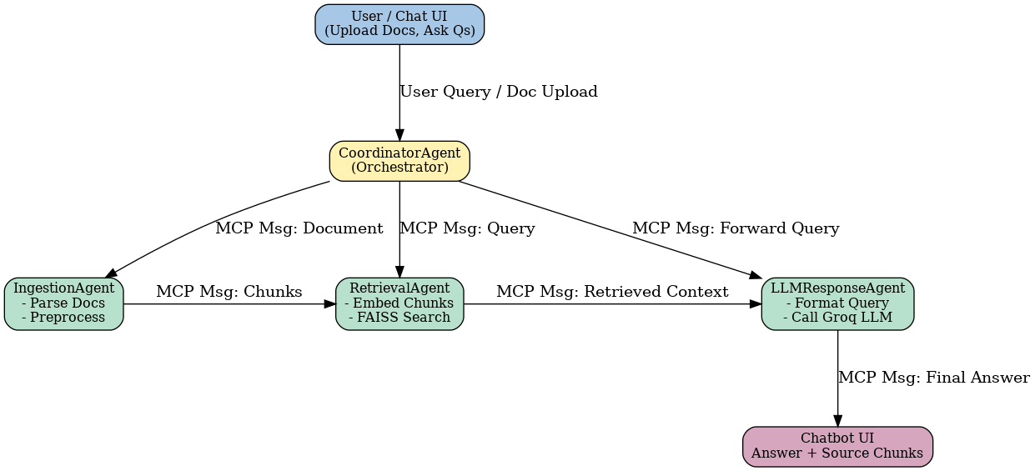
Architecture Diagram

Slide 5
Tech Stack
The solution is built using widely adopted tools and frameworks to ensure flexibility and scalability. Python serves as the backbone, supported by specialized libraries for document parsing, embeddings, and retrieval. The system also integrates a powerful LLM through Groq for generating accurate responses.
Key Components:
Programming Language: Python
Document Parsing: pdfplumber, python-docx, python-pptx, pandas, markdown
Embeddings: SpaCy embeddings
Vector Database: FAISS for efficient semantic search
LLM: Groq API (LLaMA 3.3–70B)
Agent Communication: FastMCP (Model Context Protocol)
UI Framework: MCP Inspector

Slide 6
Challenges
Handling multiple file formats consistently: Each file type (PDF, PPTX, DOCX, CSV, TXT/Markdown) comes with its own structure and parsing issues. Ensuring that all documents are processed uniformly without losing important data was a major challenge.
Ensuring accurate chunking and embeddings: Large documents had to be broken into smaller chunks for retrieval. Designing the right chunk size and overlap was tricky, as poor chunking could lead to loss of context or irrelevant results during search.
Designing structured MCP messages for agent communication: Since agents communicate using MCP, creating a consistent message format that could carry all necessary information (query, context, results) required careful planning and debugging.

Slide 7
Future Improvements
Add support for image-based documents using OCR: Currently, only text-based documents are supported. Extending the system with OCR (Optical Character Recognition) would allow it to process scanned images or photos of documents.
Integrate advanced embedding models (OpenAI, HuggingFace, etc.): Using stronger embedding models could significantly improve retrieval accuracy, especially for complex queries or technical documents.
Extend the architecture with more specialized agents: Additional agents like a SummarizerAgent (to generate concise summaries) or PlannerAgent (to decide workflow steps) could make the system more powerful and flexible.
.

Slide 8
Thank you!

