Slide 1



Week – IV Tree based ML Models
ML Bootcamp 2021
Slido: #gdg_ml_bootcamp_w4

Slide 2
Table of contents
01
05
02
04
06
Decision Trees
Ensemble learning
Advanced algorithms
03
What are they?
The idea of voting to classify
Gradient boosting techniques & XGBoost
Math behind DT
Random forest
Hands-on
How does it work internally?
Random forest and its capabilities
Lets start practicing!
Slido: #gdg_ml_bootcamp_w4

Slide 3
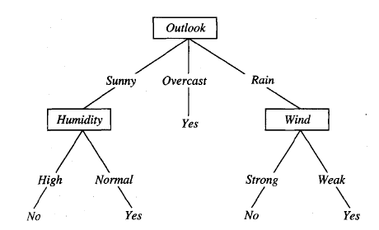
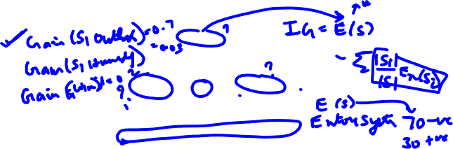
Decision Trees
A machine learning algorithm where the learned function is in the form of a tree
At each node of the tree, it must make a decision on the choice of the attribute (feature/column)
The methodology behind choosing a certain attribute(feature/column) creates multiple algorithms as mentioned below:
ID3 Our focus for today!
C4.5
CART(Classification and Regression Trees)

Slide 4
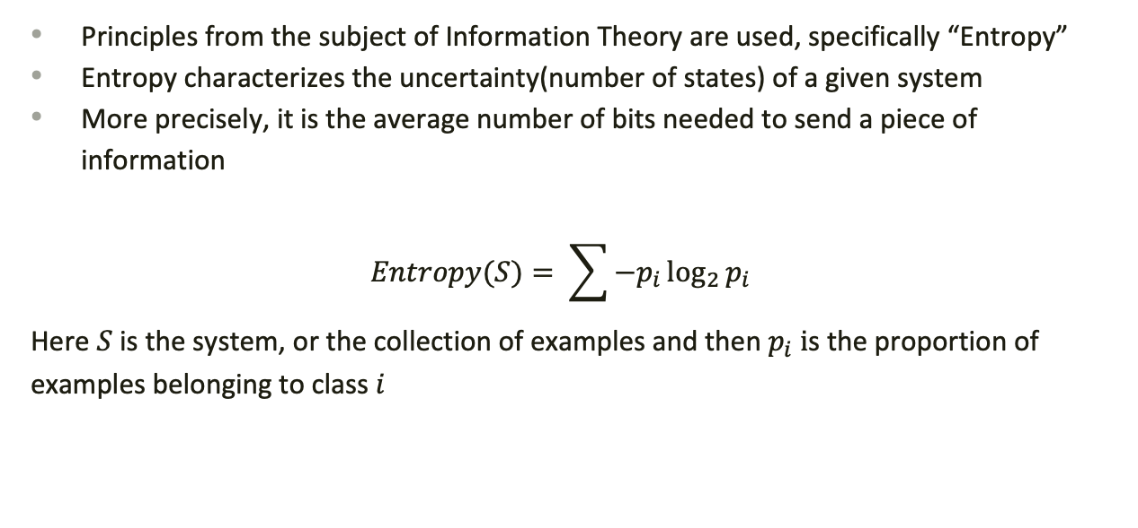
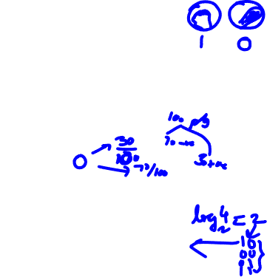
How are the attributes chosen?
Principles from the subject of Information Theory are used, specifically “Entropy”
Entropy characterizes the uncertainty(number of states) of a given system
More precisely, it is the average number of bits needed to send a piece of information
$$Entropy(S)= \sum{−p_{i}\log_{2}{p_{i}}}$$
Here $S$ is the system, or the collection of examples and then $p_{i} i$s the proportion of examples belonging to class $i$

Slide 5
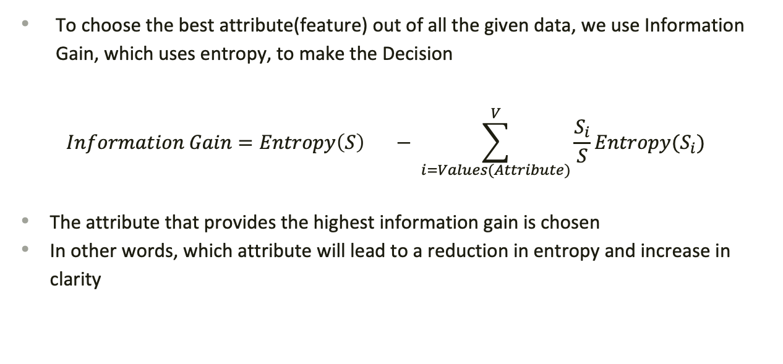

Information Gain – ID3 Algorithm
To choose the best attribute(feature) out of all the given data, we use Information Gain, which uses entropy, to make the Decision
$$Information Gain=Entropy\left(S\right) − \sum_{i=Values(Attribute)}^{V}{\frac{S_{i}}{S}Entropy(S_{i})}$$
The attribute that provides the highest information gain is chosen
In other words, which attribute will lead to a reduction in entropy and increase in clarity

Slide 6
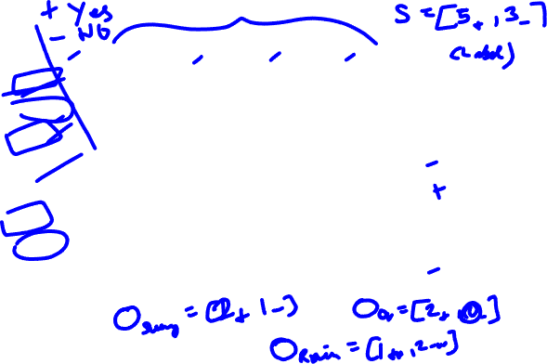
A short example
Outlook | Temperature | Humidity | Wind | Tennis
Sunny | Hot | High | Weak | No
Overcast | Hot | High | Weak | Yes
Sunny | Cold | Normal | Weak | Yes
Rain | Mild | High | Strong | No
Rain | Mild | Normal | Weak | Yes
Sunny | Hot | High | Strong | Yes
Overcast | Hot | Normal | Weak | Yes
Rain | Cool | Normal | Strong | No
Notes:
Example taken from this book: https://www.cs.cmu.edu/~tom/mlbook.html

Slide 7
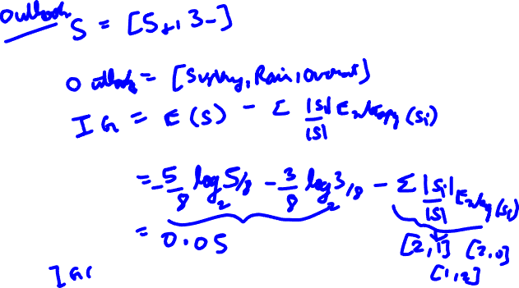

Slide 8

Decision Tree Algorithms
ID3 – Uses Information Gain as the testing criteria
C4.5 – Uses Gain ratio as the testing criteria
CART - Uses Gini index as the testing criteria
And more…
Notes:
https://www.kdnuggets.com/2020/01/decision-tree-algorithm-explained.html

Slide 9
Ensemble Learning
Instead of a single algorithm making predictions on your dataset, why don’t we consider a collection of algorithms and then make a collective decision?
Two most popular approaches: Bagging and Boosting
The Netflix challenge that hyped up the idea of Ensemble Learning: https://blog.echen.me/2011/10/24/winning-the-netflix-prize-a-summary/

Slide 10


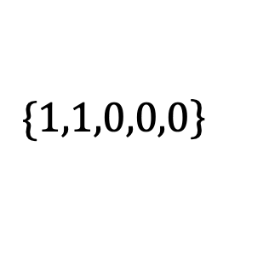

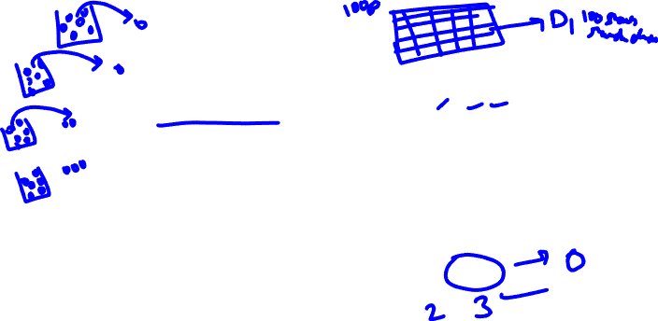
Bagging
Bagging_for_classification():
Create Bootstraps samples from your given dataset: $D_{1},D_{2},D_{3},…$
Train a set of Machine Learning algorithms(2 or more) on these different samples
Combine the predictions of multiple algorithms by taking a majority vote
M_2
$$\{\left.1,1,0,0,0\right\}$$
M_1
M_4
M_3
M_5

Slide 11
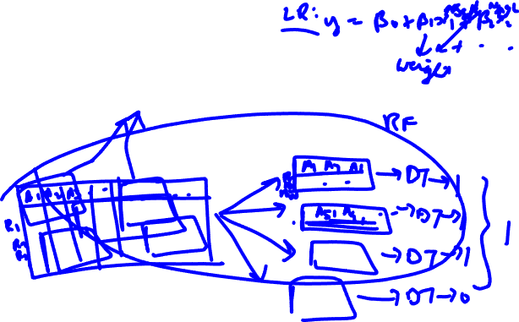
Random Forest
It is a combination of multiple decision trees
Each tree learns a from Random set of datasets, each one generated based on a randomly selected features and rows
Final prediction is based on a combination of predictions from all the Decision Trees

Slide 12
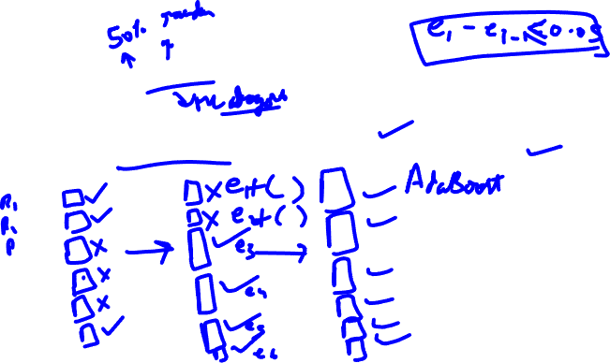
Boosting
Combine a bunch Weak Learners to make a Strong Learner
Boosting_framework():
Train your classifier on the dataset and make predictions
Compute the weighted errors for datapoint based on correct/incorrect prediction
Iterate

Slide 13
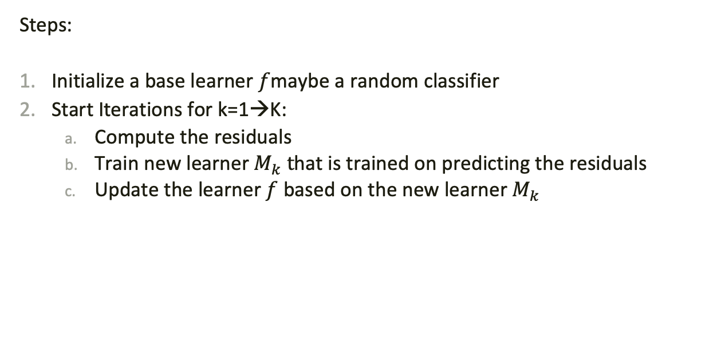
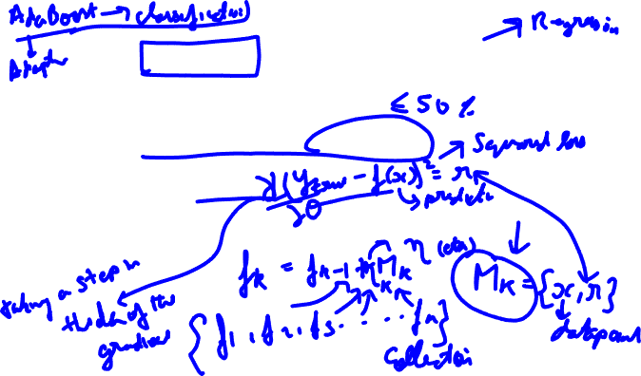
Gradient Boosting Algorithm
Steps:
Initialize a base learner $f$maybe a random classifier
Start Iterations for k=1→K:
Compute the residuals
Train new learner $M_{k} t$hat is trained on predicting the residuals
Update the learner $f$ based on the new learner $M_{k}$

Slide 14


XGBoost Algorithm
eXtreme Gradient Boosting algorithm
This algorithm is same as the Gradient boosting algorithm we have seen before
It has been engineered for better speed, accuracy and distributed computing
One of the most popular algorithms used on Kaggle
https://xgboost.readthedocs.io/en/latest/

Slide 15
Lets start Practicing!
Slido: #gdg_ml_bootcamp_w3

Slide 16
Thanks
Do you have any questions?

Slide 17
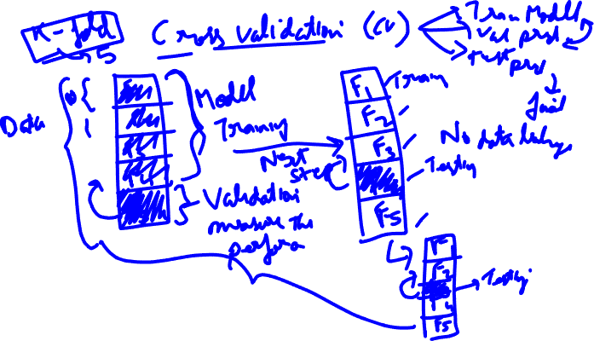

Slide 18


