Slide 1



Week – V Neural Networks a.k.a Deep Learning
ML Bootcamp 2021
Slido: #gdg_ml_bootcamp_w5

Slide 2
Table of contents
01
05
02
04
06
Neural Networks(NN)
Different Types of NN
Convolutional Neural Network
03
What are they and why are they so popular?
The different architectures of NN
A special type of NN popularly used in computer vision
Math behind Neural Networks
Recurrent Neural Networks
Hands-on
How does it work internally? What is that complex network?
A special type of NN for sequential data
Lets start practicing!
Slido: #gdg_ml_bootcamp_w5

Slide 3
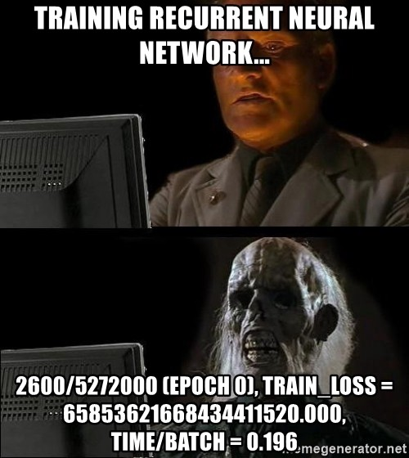
Neural Networks(NN)
They are a class of machine learning algorithms that have been inspired from biological system, specifically from the idea of mimicking the human brain, neurons and various connections
The idea is still the same, learning from the input data to predict something.
Highly complex computations are performed within a NN and it learns and corrects its weights as it learns to recognize the data points

Slide 4
Some terminology first…
Neural Network: A machine learning algorithm which learns the given input data by training its weights. Inspired from the human brain
Neuron: A single unit of a NN that performs certain computations on the given input
Weights: Like Linear regression the weights are the coefficients that the model learns in order to make its predictions. These weights define the model
Layers or Hidden Layers: A stack of Neurons that performs computations on a given input. This is where all the learning happens
Input Layer: This is the input data points. Not exactly considered a layer as there is no learning happening in this part, but some papers might still consider it a layer.
Activation Function: A non-linear function that is part of the computations in order to provide the non-linearity to the model, otherwise it is just the same as a linear model
Epoch: One epoch is equal to passing the entire dataset through the NN once
Batch size: Training the NN happens in batches where the data is split into pieces and fed batch wise

Slide 5
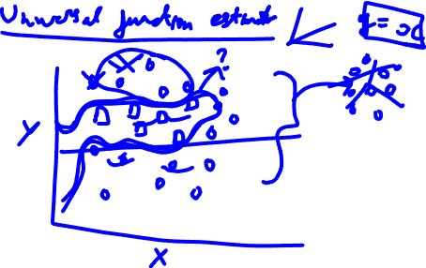
Why do I need Neural Networks?

Slide 6

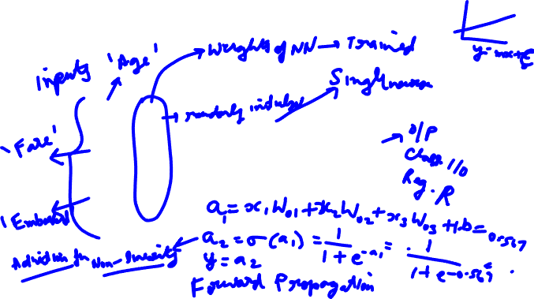









Computation inside a single unit/neuron
A single neuron with a Sigmoid Activation Function
$x_{1}$
$W_{01}$
$$σ$$
$x_{2}$
$W_{02}$
$$y$$
$W_{03}$
$x_{3}$
$$b$$
$1$

Slide 7






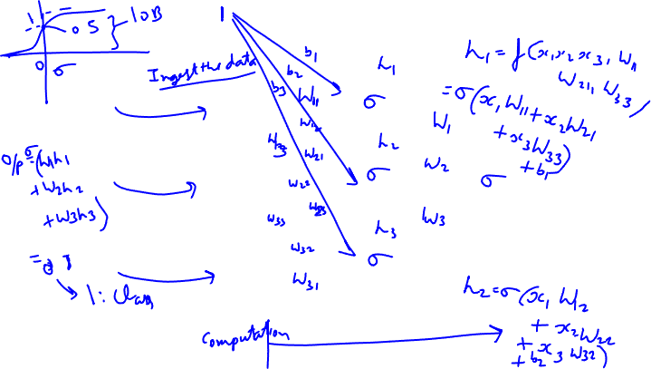
2-Layer Neural Network
$x_{1}$
$x_{1}$
$x_{2}$
$x_{2}$
Output Layer
$x_{3}$
$x_{3}$
Input
Hidden Layer

Slide 8
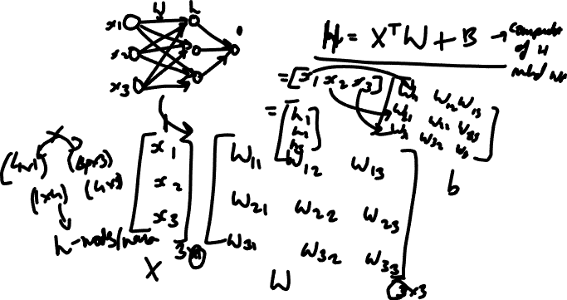

Slide 9
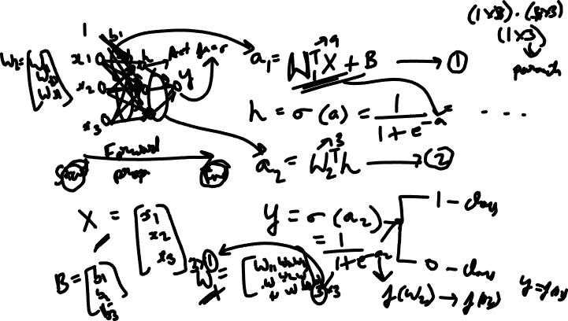
Training - Forward Propagation

Slide 10
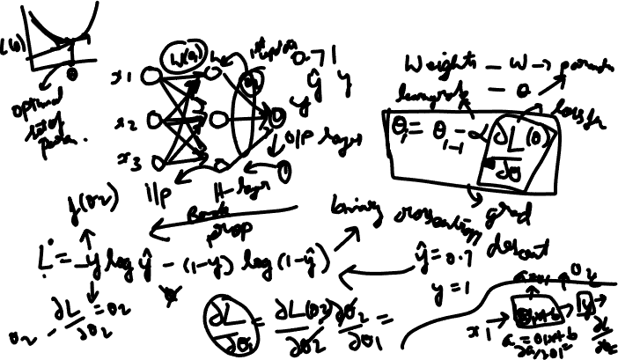
Training- Back Propagation

Slide 11
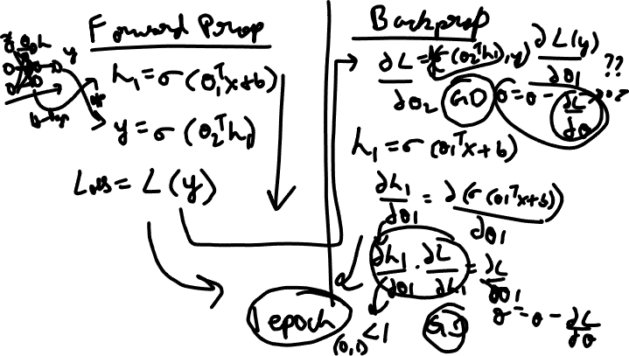

Slide 12
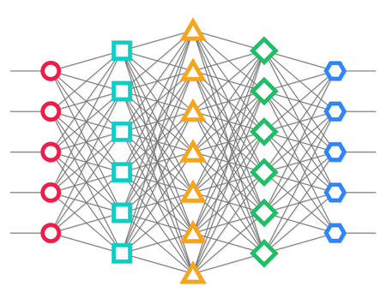
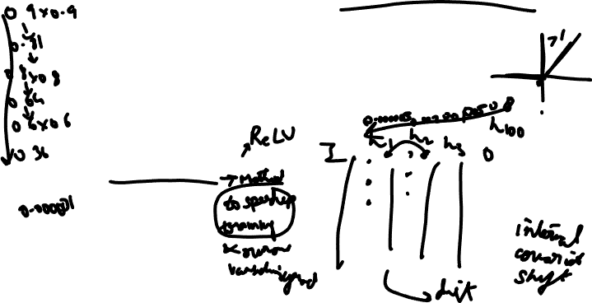
Deep NN/Deep Learning and Vanishing gradients
A Neural Network with multiple hidden layers is called a Deep Neural Network
More layers will result in more complex functions being learned by the model
The issue with having a deep network is that the gradients as they propagate backwards, will become very small and finally the weights will not be updated as expected. This happens because of the sigmoid activation function
Techniques to overcome this:
Using Rectified Linear units
Batch Normalization
Max out units

Slide 13
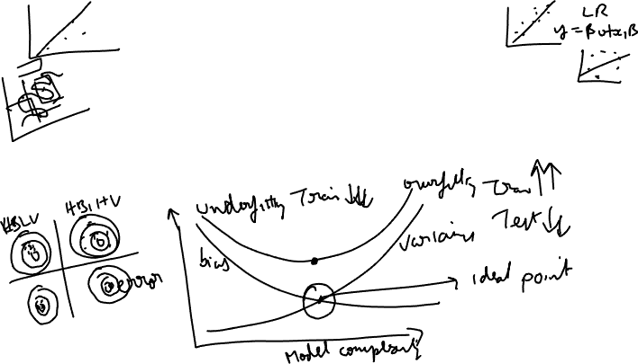
Bias-Variance Trade-off
After training your model it will either have a high/lower bias and high/low variance
Bias is the intrinsic assumptions made by the model and variance represents the variability of the predictions of the data points
Examples of high bias models/low variance include Linear/Logistic Regression which assume linearity in the data. Low bias models/high variance are decision trees, support vector machines etc.
Need to locate the ideal point

Slide 14
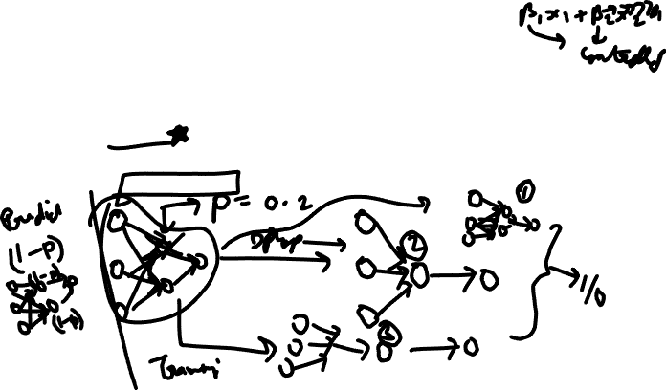
Overfitting
Neural Networks tend to overfit as there are a huge number of parameters and it tried to develop a very complex function in order to learn the data
A common way to overcome overfitting is to use Regularization techniques. In case of NN one idea that worked out very well and is still preferred to be used by many is called Dropout
Idea is to randomly drop certain nodes/neurons during training. This would be, in a sense, ensemble learning as each time a different NN is being trained.

Slide 15

Various types of NN
Artificial Neural Networks
Recurrent Neural Networks
Convolutional Neural Networks
Residual Neural Networks
And more if you can think of various architectures….

Slide 16






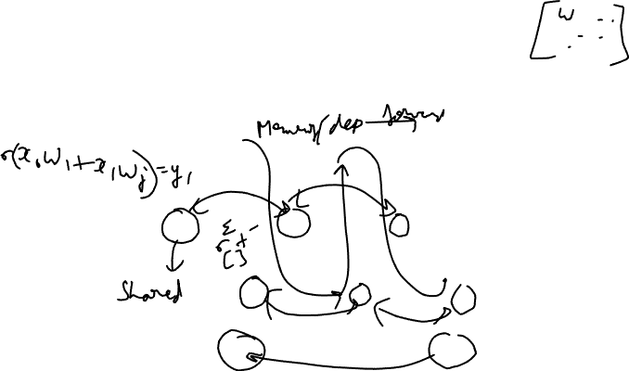







Recurrent Neural Networks
These NN have been designed to learn sequential data points
Examples of sequential data: language, timestamped data, audio signal etc.
French
Je
suis
Ani
$$y_{1}$$
$$y_{2}$$
$$y_{3}$$
$$W_{i}$$
$$W_{i}$$
$$W_{i}$$
$$x_{0}$$
$$W_{j}$$
$$W_{j}$$
$$W_{j}$$
$$x_{1}$$
$$x_{2}$$
$$x_{3}$$
English
I
am
Ani

Slide 17





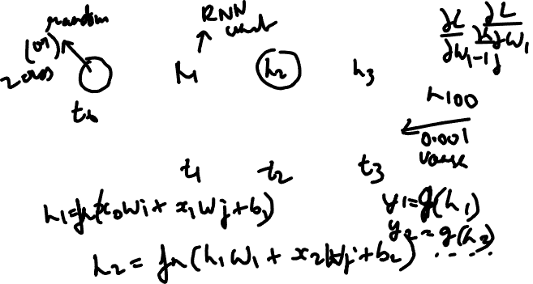







$$y_{1}$$
$$y_{2}$$
$$y_{3}$$
$$W_{i}$$
$$W_{i}$$
$$W_{i}$$
$$x_{0}$$
$$W_{j}$$
$$W_{j}$$
$$W_{j}$$
$$x_{1}$$
$$x_{2}$$
$$x_{3}$$

Slide 18
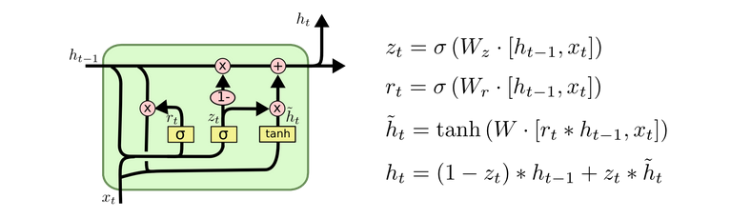
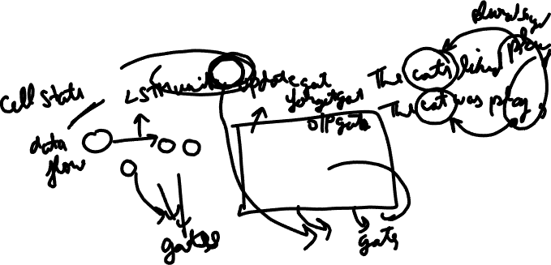
Vanishing Gradients and intro to LSTMs
If the sequence gets too long, then the gradients become small as shown in the previous slides
A solution for this was proposed and a new and more powerful algorithm was created called Long Short Term Memory networks(LSTMs)
Notes:
https://colah.github.io/posts/2015-08-Understanding-LSTMs/

Slide 19

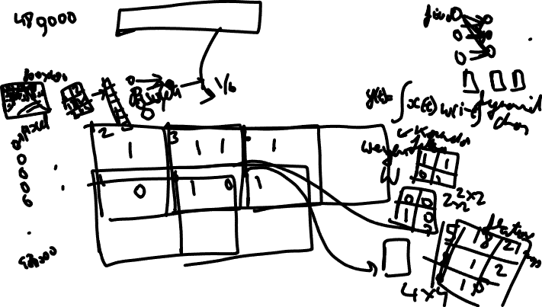
Convolutional Neural Networks
They have been used very commonly in Computer Vision/Image processing tasks
They act as very good feature extractors.
The word “Convolution” refers to the mathematical operation of convolution
$$y\left(i\right)= \sum_{t=−inf}^{inf}{x\left(t\right)w(i−t)}$$
Notes:
https://www.youtube.com/watch?v=F08TkdjdrL8

Slide 20
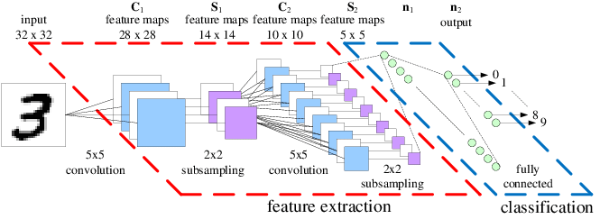
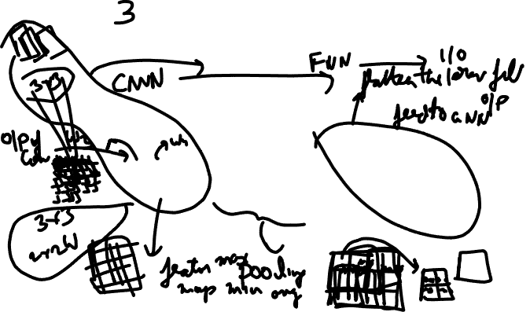
A CNN architecture for digit recognition
Notes:
https://www.researchgate.net/figure/An-Example-CNN-architecture-for-a-handwritten-digit-recognition-task_fig1_220785200

Slide 21
Lets start Practicing!
Slido: #gdg_ml_bootcamp_w3

Slide 22
Thanks
Do you have any questions?

Slide 23


