Slide 1



Week – III Exploratory Data Analysis & Feature Engineering
ML Bootcamp 2021
Slido: #gdg_ml_bootcamp_w3

Slide 2
Table of contents
01
05
02
04
06
What & Why EDA?
Feature Engineering
Hand-crafted features
03
Why can’t I just run model.fit() and be done with it?
Features, features and more features…..that’s how you improve your model
Building features based on you domain knowledge
How to actually do it?
Common packages available for FE
Hands-on
How to think about what kind of exploration I need to do?
Lets start practicing!
Available libraries for automatic feature engineering
Slido: #gdg_ml_bootcamp_w3

Slide 3
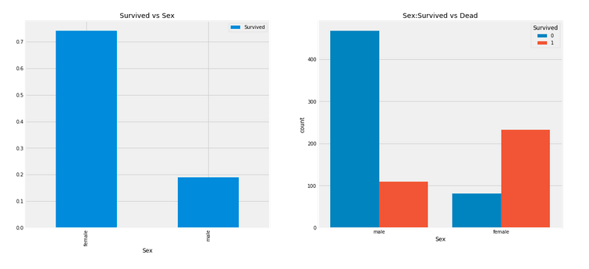
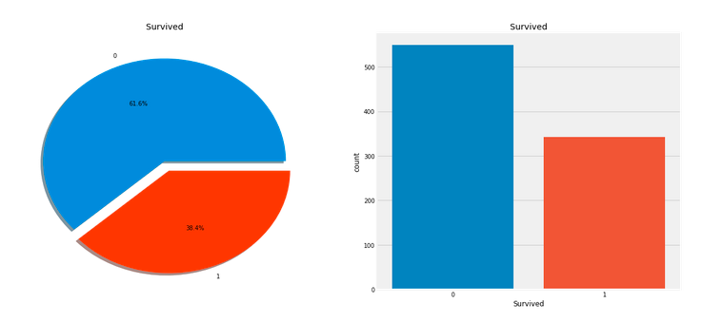
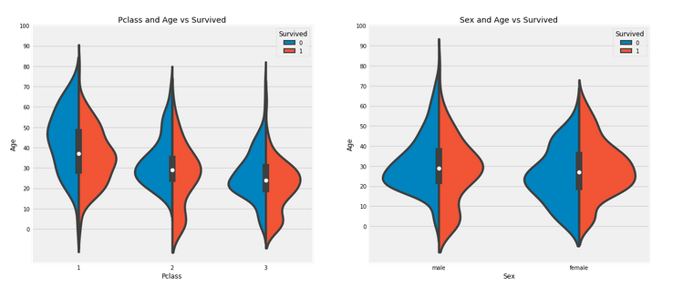
Exploratory Data Analysis
Just as the title says, it is all about exploring your data
You will have lots of data: numerical, categorical, text etc.
Each data needs to be explored in a different way based on the type of the data
Slido: #gdg_ml_bootcamp_w3

Slide 4
EDA is about creating a story…
Exploring the data is all about asking questions
You need to investigate and “Explore” the data
For Example:
How many people survived/didn’t survive?
What is Pclass?
Is there a relationship between Pclass and Survived?
How is age related to the survival rate?
These questions help us move on to the task of Feature Engineering
Slido: #gdg_ml_bootcamp_w3

Slide 5
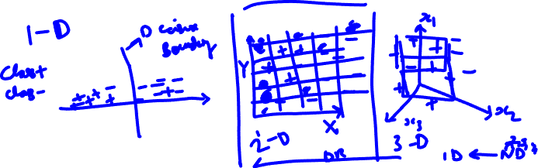
Dimensionality Reduction Techniques
The data that we collect usually has large number of columns. Each column is called a feature
Visualizing beyond 3D is beyond the scope of any human being as of today. Hence, we resort to visualizing data in 1,2 or 3D
Dimensionality reduction allows us to better understand very high dimensional data and helps us deal with the issue of “Curse of Dimensionality”
Slido: #gdg_ml_bootcamp_w3
Notes:
Watch this video from minute 8:00 https://www.youtube.com/watch?v=IbE0tbjy6JQ

Slide 6

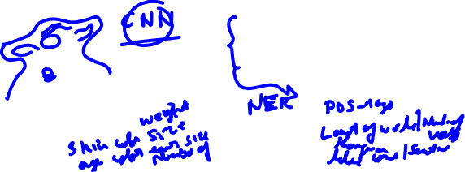
Feature Engineering
”Features” are nothing but the characteristics that define your data.
For example
Height, weight, age are three features that describe a human being or an animal.
Number of pages, color, paperback or hardcover are features that describe a book
Curse of dimensionality is one reason for Feature Engineering or Dimensionality Reduction
Sample Image
Sample Review
The earphones that I purchased were working very well at first but later stopped working completely
Features: ?
Features: ?

Slide 7
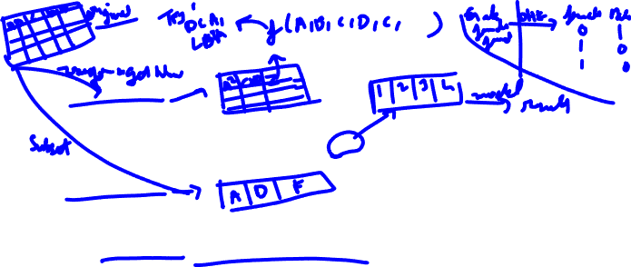
Different Methods of Feature Engineering
Feature Extraction
Derive/create new features from existing features
These features are either derived from existing features based on calculations or dimensionality reduction techniques such as PCA(although originally intended to reduce the dimensions for better visualization) may be used
One hot encoding is another example of generating new features based on existing ones.
Feature Selection
This process involves select a subset of the features from your existing set of features
Various statistical techniques, regularization and feature importance techniques can be used here
SelectKBest and Recursive Feature Elimination(RFE) provided by scikit-learn are a good start
Domain knowledge specific features
This category of feature engineering comes from domain knowledge
A Subject Matter Expert(SME) is a person who is the expert in that field and will be able to judge and help in identifying new and useful features.
Slido: #gdg_ml_bootcamp_w3

Slide 8
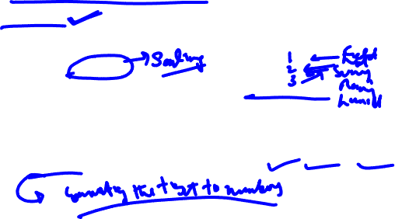
Dealing with Data
A Machine Learning algorithm can only accept number, and hence we need to convert all our data into numbers that the machine can understand
Numerical data:
Since this data is already in the form of numbers some of the work is done
However, looking across different numerical features, sometimes you will notice an imbalance in the scale of the data
Example: Age and Salary.
Categorical data:
This data consists of categories. Eg: Gender, T-shirt size, Weather Condition etc.
All this data is in the form of strings.
You would need to convert it into numbers using techniques such as encoding the categories as numbers(One hot encoding, label encoding etc.)
Text data:
Free text data is also very commonly collected. Eg: Emails, Survey responses, Chats from chatbots etc.
All this text needs to be converted into numbers for the machine to be able to understand it.
Vectorizing these texts using techniques such as Word Embeddings, TF-IDF and CountVectorizer are common methods
Slido: #gdg_ml_bootcamp_w3

Slide 9
Lets start Practicing!
Slido: #gdg_ml_bootcamp_w3

Slide 10
Thanks
Do you have any questions?

Slide 11


