Slide 1



Week – 1I Intro to ML
ML Bootcamp 2021
Slido: #gdg_ml_bootcamp_w2

Slide 2
Table of contents
01
05
02
04
06
What is ML?
03
Logistic Regression
Classification/Regression
Let’s understand this subject better!
The two most common classes of problems
One of the simplest algorithms for Classification
Supervised/
Unsupervised
Linear Regression
Hands-on
Understanding the difference between the approaches through examples
One of the simplest algorithms for Regression
Lets start practicing!
Slido: #gdg_ml_bootcamp_w2

Slide 3
Quick Refresher on ML Concepts
Datasets: The data that you process, transform and use to train your ML models
Features: The individual columns(if it is a table) in your data
Supervised/Unsupervised: Either with or without answers
Classification: Predicting a limited set of outputs Eg: Pos/Neg sentiment, Cat/Dog, Bearish/Bullish
Regression: Output has an infinite possibilities Eg: Housing prices, stock prices, time etc.
Machine Learning: A set of algorithms or a method to learn through experience using data
Training and Testing: We usually split our data into two parts, one to train the model and another to test the model's performance
Decision Boundary: The line separating the classes for a given ML problem
Hypothesis: The model that you would like to determine
Weights/Parameters: This is what defines your model as these are the values that are adjusted to train your model to make accurate predictions
Ground-Truth: The labels/answers that are provided along with the dataset
Slido: #gdg_ml_bootcamp_w2
Notes:
Computer Vision: Phones security cameras and video quality

Slide 4
Supervised Learning
Labels/Answers
Data/Dataset
ML Algorithm
Labels/Ground-Truth provided
New/Unseen Data
Input to the Trained ML Model from STEP 1
Learns to mimic the dataset by understanding the features and correcting its predictions
ML Algorithm
Predictions
STEP 1
STEP 2

Slide 5
Unsupervised Learning
Labels/Answers
Data/Dataset
ML Algorithm
New/Unseen Data
No Labels/Ground-Truth this time
Input to the Trained ML Model from STEP 1
Learns the patterns underlying the data to group them: Clustering
ML Algorithm
Predictions/Clusters
STEP 1
STEP 2

Slide 6
Classification Vs Regression
Problem Definition | Classification or Regression?
Predicting the sentiment of a given Amazon Review. Output/ Ground-Truth: 1 → Positive 0 → Negative
Weather Forecasting Output/ Ground-Truth: The temperature in Celsius or Farenheit
Stock Market Price prediction Output/ Ground-Truth: The next day’s stock price of a given company
Next word prediction in E-mail: Output/ Ground-Truth: The next word based on the previous words
Slido: #gdg_ml_bootcamp_w2

Slide 7

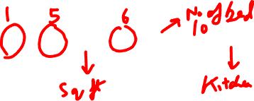
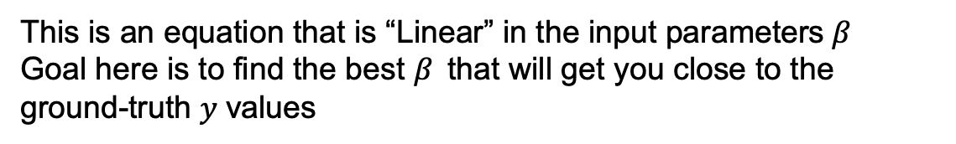
Linear Regression
$$y= β_{o}+ β_{1} ∗x_{1}+β_{2} ∗x_{2}+β_{3} ∗x_{3} …$$
Dependent Variable/ Output/ Prediction
Independent Variable/ Input/ Predictors/ Features
Coefficients / Weights
This is an equation that is “Linear” in the input parameters$β$
Goal here is to find the best $β$that will get you close to the ground-truth $y$values
Slido: #ml_bootcamp_week2
Notes:
https://www.microsoft.com/en-us/research/people/cmbishop/prml-book/

Slide 8


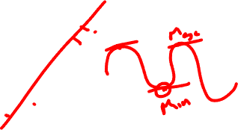
How do we model Linear Regression?
$$y$$
$$x$$
Slido: #gdg_ml_bootcamp_w2

Slide 9


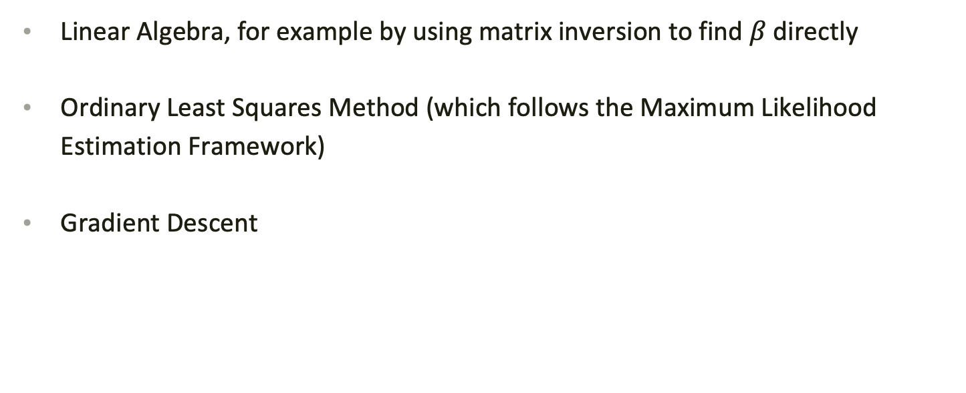
How to find the best $β$?
Linear Algebra, for example by using matrix inversion to find $β$directly
Ordinary Least Squares Method (which follows the Maximum Likelihood Estimation Framework)
Gradient Descent
Slido: #gdg_ml_bootcamp_w2
Notes:
MLE is from a statistical perspective
Maximizing the likelihood will in turn minimize the least squared error

Slide 10
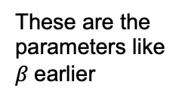


Gradient Descent
Cost Function $J\left(θ\right)= \frac{1}{2}\sum_{i=1}^{N}{{\left(y_{i} −\hat{y}\right)}^{2 }+ }λ{||β||}^{}$
These are the parameters like $β$earlier
The ground-truth value
The model’s predicted value
Slido: #gdg_ml_bootcamp_w2

Slide 11


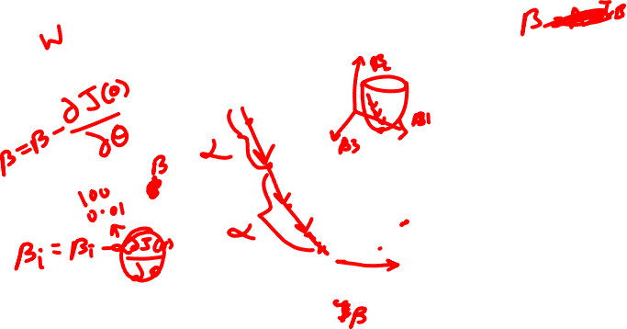
$$J(θ)$$
Convex Optimization Problem
$$θ$$
Slido: #gdg_ml_bootcamp_w2

Slide 12
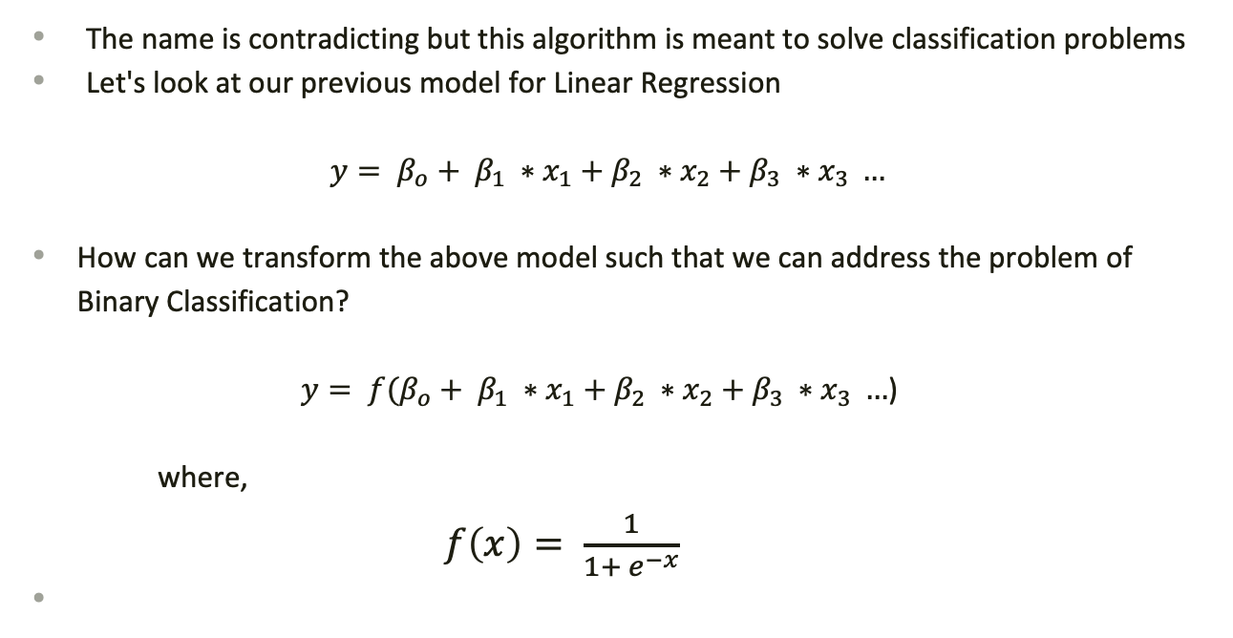
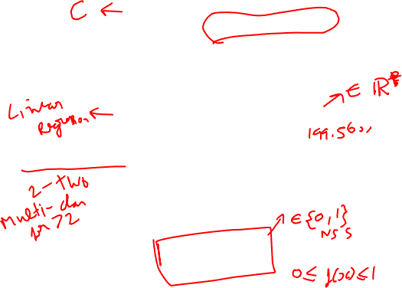
Logistic Regression
The name is contradicting but this algorithm is meant to solve classification problems
Let's look at our previous model for Linear Regression
$$y= β_{o}+ β_{1} ∗x_{1}+β_{2} ∗x_{2}+β_{3} ∗x_{3} …$$
How can we transform the above model such that we can address the problem of Binary Classification?
$y= {f(β}_{o}+ β_{1} ∗x_{1}+β_{2} ∗x_{2}+β_{3} ∗x_{3} …$)
where,
$f\left(x\right)= \frac{1}{1+ e^{−x}}$
Logit Function
Notes:
https://www.microsoft.com/en-us/research/people/cmbishop/prml-book/

Slide 13

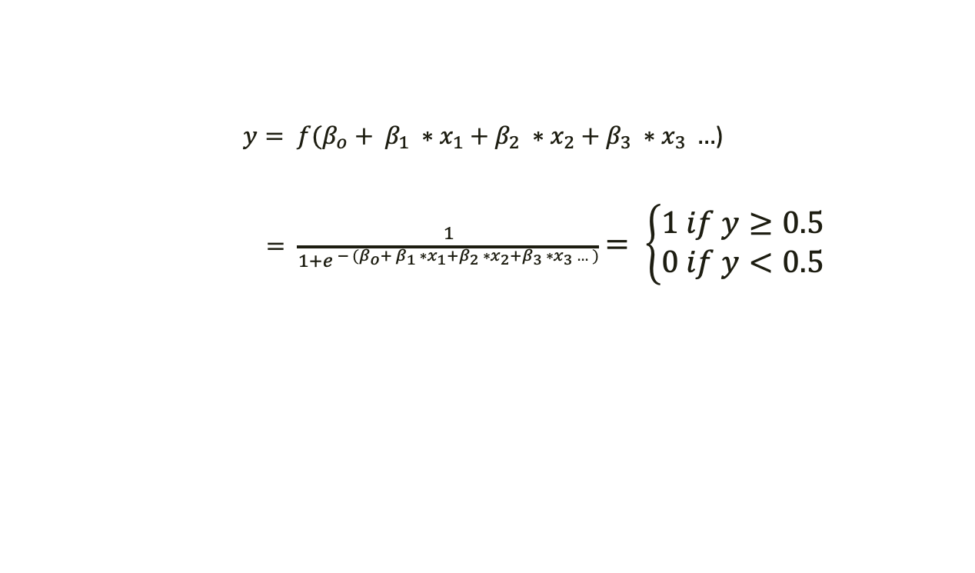
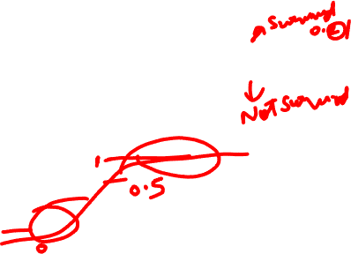

Expanding a bit further
$y= {f(β}_{o}+ β_{1} ∗x_{1}+β_{2} ∗x_{2}+β_{3} ∗x_{3} …$)
$= \frac{1}{1+e^{{ − (β}_{o}+ β_{1} ∗x_{1}+β_{2} ∗x_{2}+β_{3} ∗x_{3} …)}}$ $= \left\{\begin{aligned}1 if y≥0.5 \\ 0 if y<0.5\end{aligned}\right.$
$$f(x)$$
$$x$$
Slido: #gdg_ml_bootcamp_w2

Slide 14
Summary
Machine Learning is a set of algorithms that learn from the data
Supervised learning is a class of problems where the ground-truth/labels are provided
Unsupervised learning problems do not have any explicit labels and the algorithms explore the underlying structure
Classification problems have a finite set of outputs whereas Regression problems deal with the space of real numbers as outputs
Linear Regression: An algorithm originating from Linear Algebra that is used for Regression problems. Eg: Weather Forecasting, House price prediction and Stock market trend analysis
Logistic Regression: An algorithm that converts Linear Regression formulation into a classification problem. Eg: Sentiment Analysis, Titanic survival prediction etc.

Slide 15
Lets start Practicing!
Slido: #gdg_ml_bootcamp_w2

Slide 16
Thanks
Do you have any questions?

Slide 17


