Slide 1
Exploratory ANALYSIS FOR XYZ BANK (Ban-5753, Team Incisive)
MENU
ANALYSIS
Results
Data ANALYSIS
DATA

Slide 2
TABLE OF CONTENT
Introduction
EDA
01
02
Modeling
Results
03
04
MENU
ANALYSIS
CONTACT
Data ANALYSIS

Slide 3

Team Incisive
Anirudh
Bommina
Tharun
ponnaganti
abdul
Mujeeb
Prafulla balasahed
sature

Slide 4
INTRODUCTION
MENU
Data ANALYSIS
XYZ Bank seeks to optimize its direct marketing campaigns for term deposit subscriptions. By applying machine learning models, the bank aims to predict which customers are more likely to subscribe, thus improving the allocation of marketing resources and customer engagement strategies..

Slide 5
Problem Statement
Objective: Classify bank clients by their likelihood to subscribe to a term deposit
Key Points:
Analyze client attributes and campaign interactions.
Binary classification: 'Yes' or 'No' for term deposit subscription.
Perform EDA to reveal influencing patterns and trends.
Goal:
Leverage insights to predict and enhance term deposit subscriptions.

Slide 6
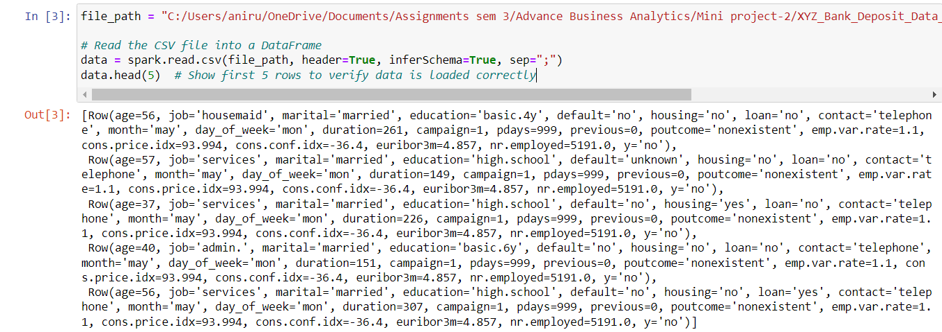
Loading the data
The data is loaded from a CSV file into a Spark DataFrame.

Slide 7
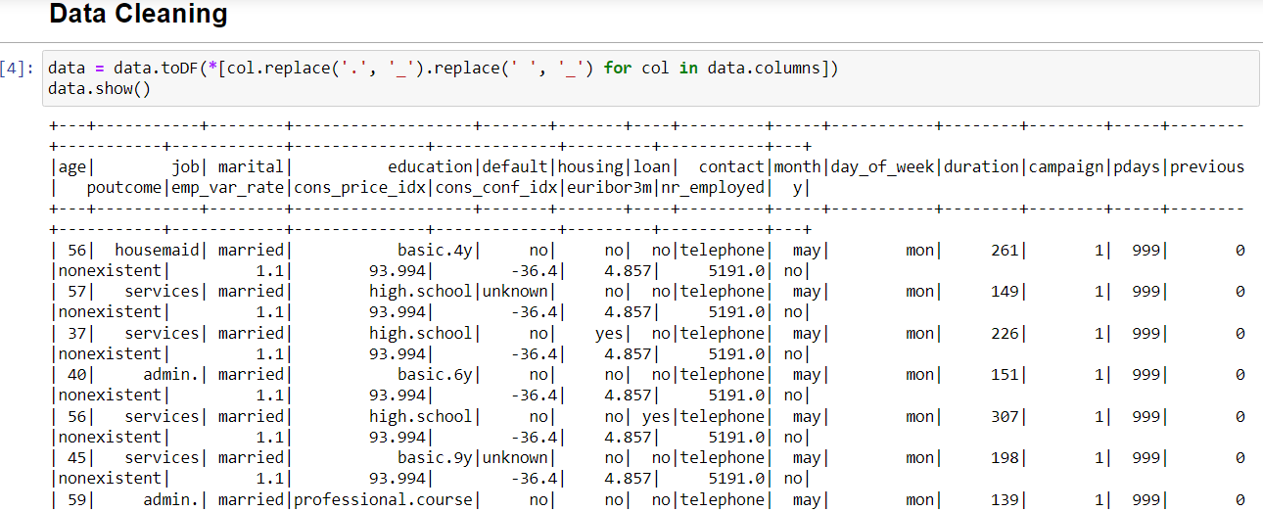
Data Cleaning and transformation
Standardized column names by replacing dots and spaces.
Handled missing values by checking and addressing null values.
Converted data types as needed.

Slide 8
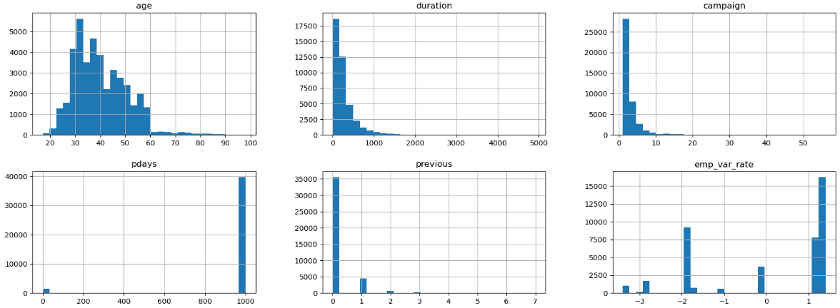
Exploratory data analysis
Dataset presents a mix of numeric and categorical features.
Descriptive stats offer insights into feature distributions.
No data quality issues detected (no missing values).
EDA lays the foundation for deeper analysis and modeling.

Slide 9
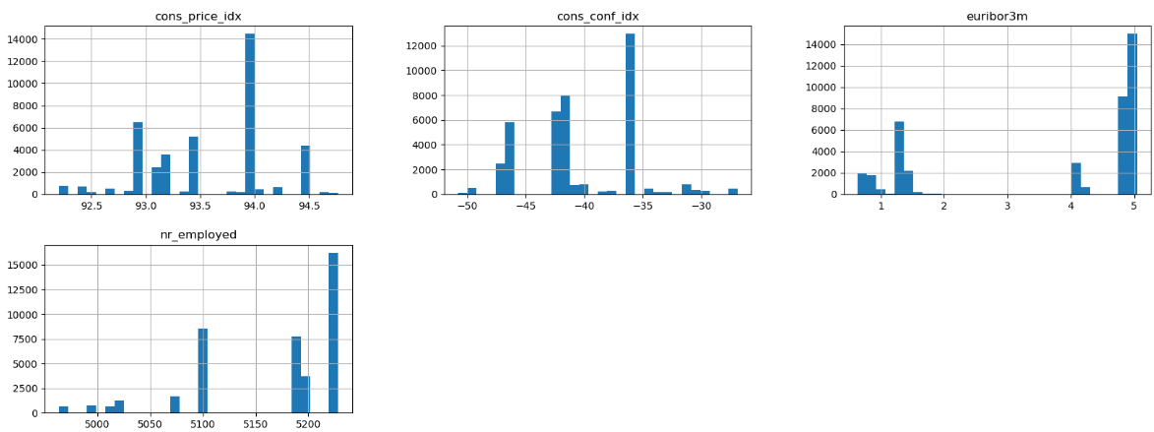
The histograms indicate demographic and economic data: age is centered on a middle-aged group, durations are mostly short, and campaign contacts are typically low with rare higher values.
Economic indicators like the employment variation rate and consumer price index show common ranges, whereas consumer confidence is generally low.
Interest rates (euribor3m) and employment numbers exhibit specific frequent values, suggesting common rates and employment figures within the dataset.

Slide 10
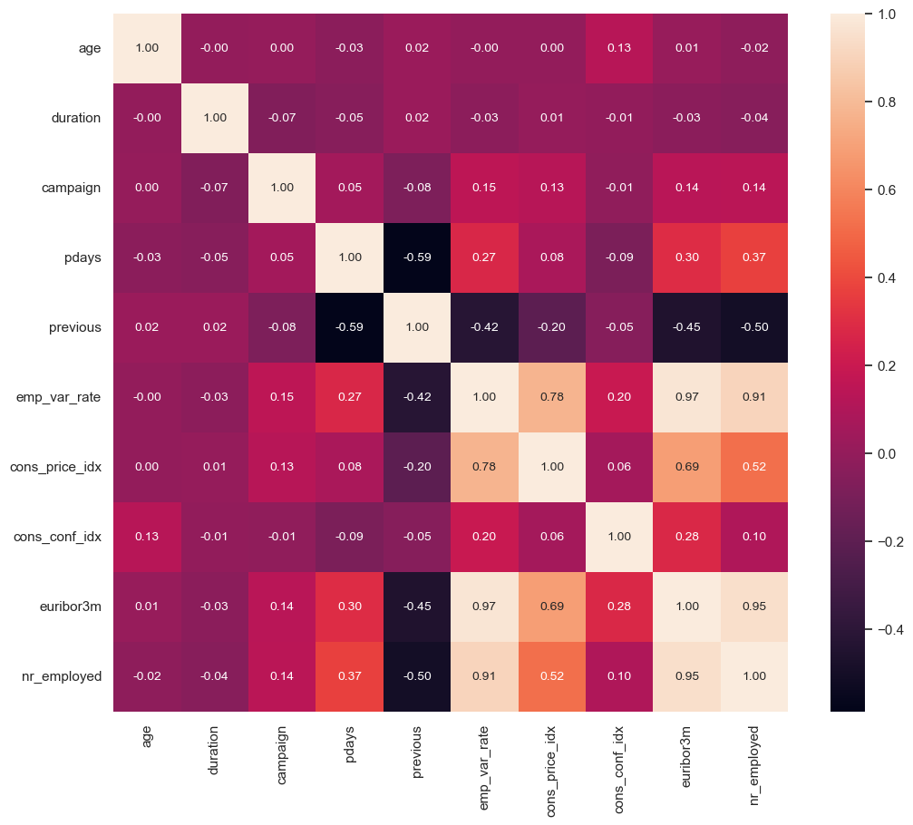
The heat map displays correlations between variables, with dark red indicating strong positive correlations and dark purple indicating strong negative correlations.
emp_var_rate has strong positive correlations with euribor3m and nr_employed, while pdays and previous have a strong negative correlation.
Moderate positive correlations are seen between cons_price_idx and variables like emp_var_rate, euribor3m, and nr_employed.

Slide 11
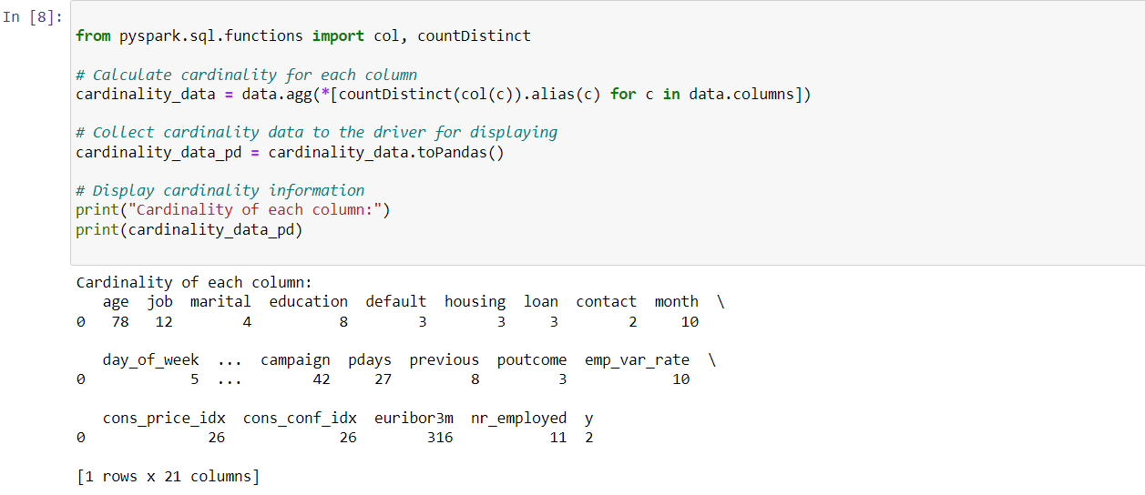
cardinality
Variable Diversity: The table indicates the diversity in each column, with features like job having 12 unique values, suggesting a range of job categories in the dataset.
Categorical Insight: Categorical columns like marital with 4 unique values reveal the distribution of marital statuses, providing insights into the dataset's demographic composition.
Target Variable Format: The y column, likely representing the target variable, has 2 unique values, implying a binary classification task where instances are categorized as either yes or no, indicating a binary outcome or decision.

Slide 12
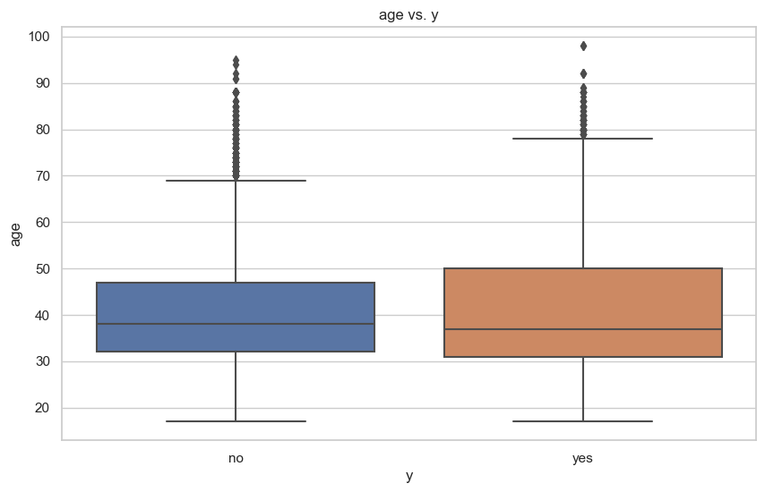
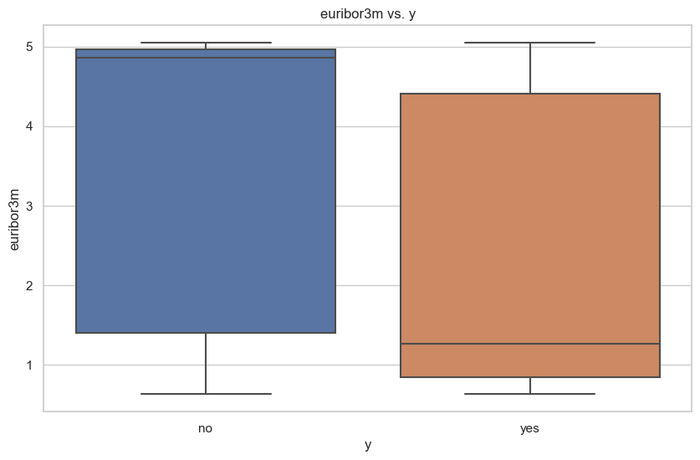
Bi-variate analysis
The first boxplot shows the age distribution for two groups labeled "yes" and "no," possibly indicating a response to a survey or outcome of an event. The "yes" group tends to be older than the "no" group, with a higher median age and more outliers at the upper age range.
The second boxplot compares the 3-month Euribor interest rates between the same two groups. Both groups have similar medians, but the "yes" group has a slightly higher range of rates, indicating more variation in the interest rates for those who responded "yes."

Slide 13
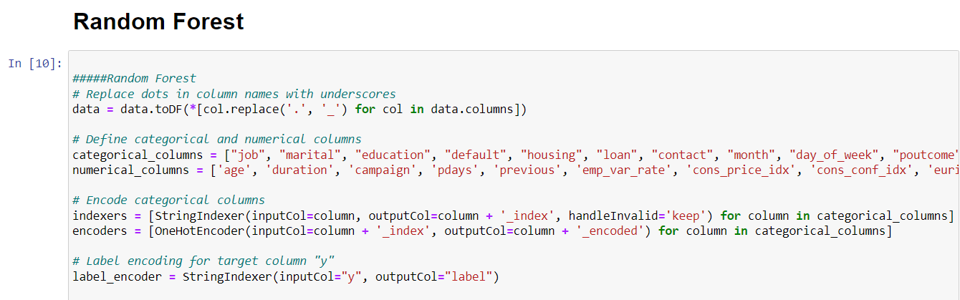
Modeling 1 – Random Forest
The Random Forest model exhibits high predictive accuracy, as reflected by an Area Under the ROC Curve of 0.93. With 20 trees, the model is well-suited for binary classification (numClasses=2) on a dataset with 21 features. This ensemble learning approach combines predictions from multiple decision trees, enhancing overall performance and robustness in distinguishing between the two classes.

Slide 14
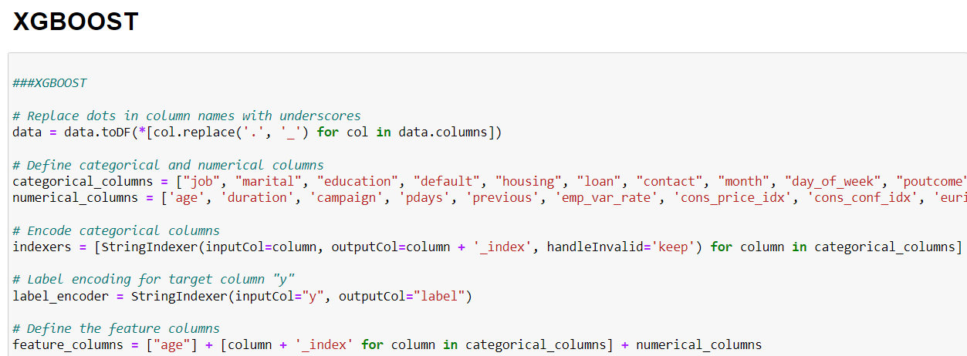
Modeling 2 – XG boost
he XGBoost model demonstrates strong predictive performance with an Area Under the ROC Curve of 0.945. Utilizing 10 trees, this gradient boosting classification model is tailored for binary classification (numClasses=2) on a dataset with 21 features. XGBoost excels in enhancing predictive accuracy by sequentially improving upon the weaknesses of the previous models, making it a powerful algorithm for classification tasks.

Slide 15
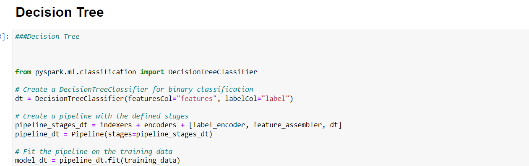
Modeling 3 – Decision tree
The decision tree model exhibits moderate predictive performance, reflected by an Area Under the ROC Curve of 0.575. With a depth of 5, this decision tree classification model consists of 35 nodes and is designed for binary classification (numClasses=2) based on a dataset with 21 features. Decision trees are known for their interpretability and ability to capture complex decision boundaries, although in this case, the model's discriminatory power may be limited compared to more sophisticated algorithms.

Slide 16
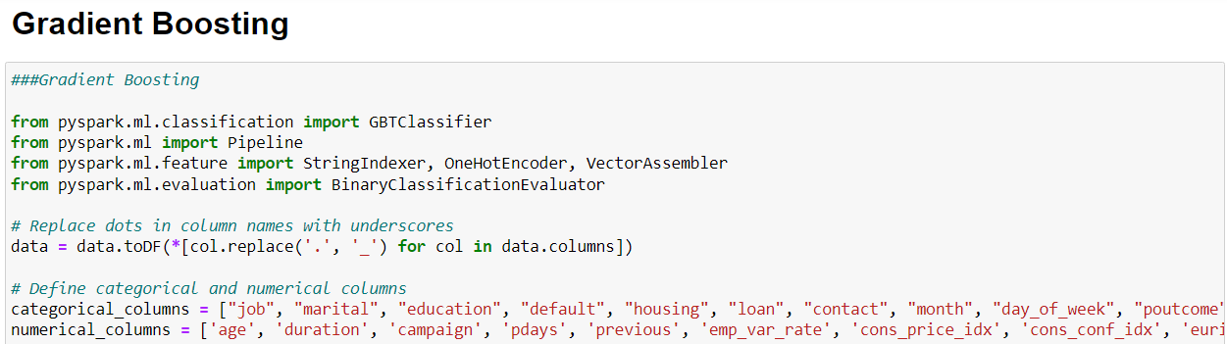
Modeling 4 – Gradient boosting
The Gradient Boosting model with 10 trees achieved strong predictive performance, evidenced by an impressive AUC of 0.945 in binary classification using a dataset with 21 features. This highlights the model's effectiveness in distinguishing between classes, showcasing its suitability for complex tasks.

Slide 17
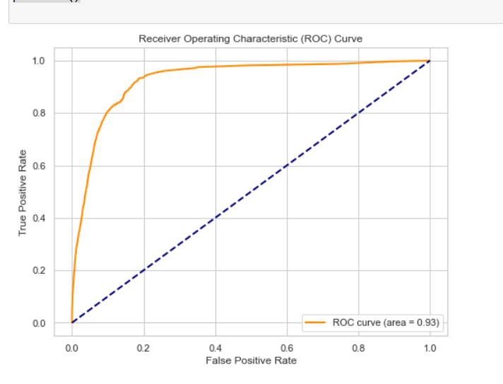
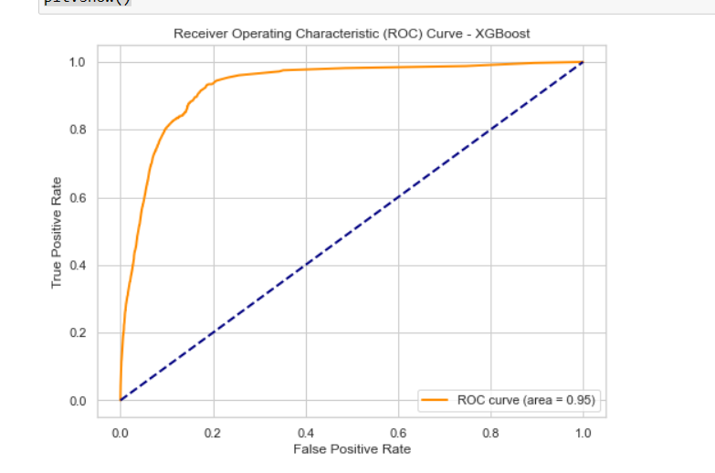
Top 2 Model Comparison
Gradient boost
XG-boost

Slide 18
Model Comparison and selection
The champion model for the task is the Gradient Boosting (GBT) model, which achieved an impressive Area Under the ROC Curve of 0.945. This indicates strong predictive performance and suggests that the GBT model effectively discriminates between the two classes in the dataset. The high AUC value makes the GBT model the preferred choice among the models considered, showcasing its capability as the most effective classifier for the given task.

Slide 19
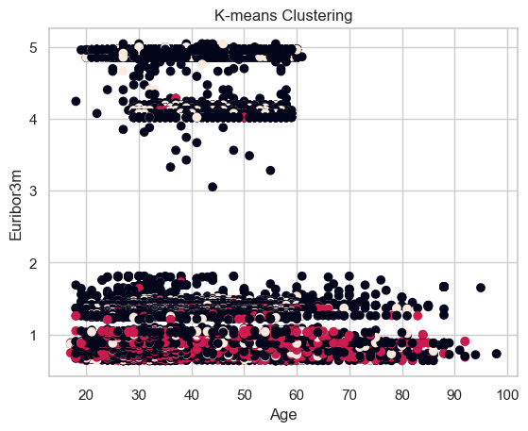
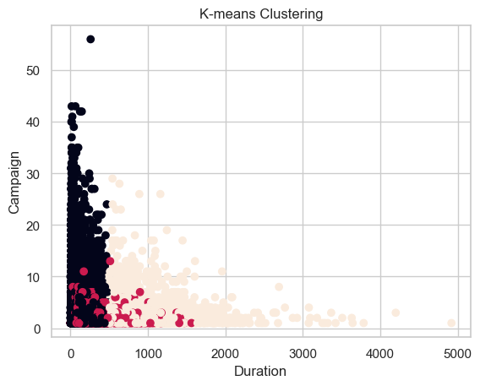
K-means clustering

Slide 20
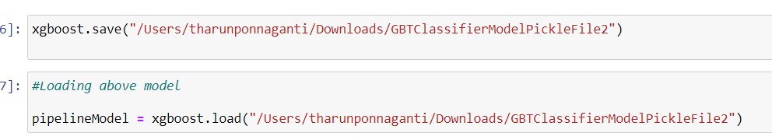
Exporting pickle file
"Saved the best-performing model to the specified directory in Pickle format."

Slide 21
reSults
Objective: Identify clients likely to subscribe to a term deposit at XYZ Bank.
Conducted Exploratory Data Analysis (EDA) on data from May 2008 to November 2010, including 20 columns, focusing on the bank's marketing campaign data.
The data required multiple contacts per client to assess term deposit subscription interest. Developed a predictive model to classify clients into 'yes' or 'no' categories for term deposit subscriptions.
The XGBoost model emerged as the most effective, with an Area Under the ROC Curve (AUC) score of 0.9463.
Conclusion:
-The XGBoost model is robust and accurate for predicting client subscription to term deposits.
-The model is valuable for optimizing future marketing strategies and targeting potential customers.
-Insights from EDA can refine the bank's approach to client interactions and understanding of key decision factors.

Slide 22
references
https://chat.openai.com/
https://hadoop.apache.org/releases.html
https://spark.apache.org/
https://www.analyticsvidhya.com/blog/2019/08/comprehensive-guide-k-means-clustering/

Slide 23
aPPENDIX

Slide 24
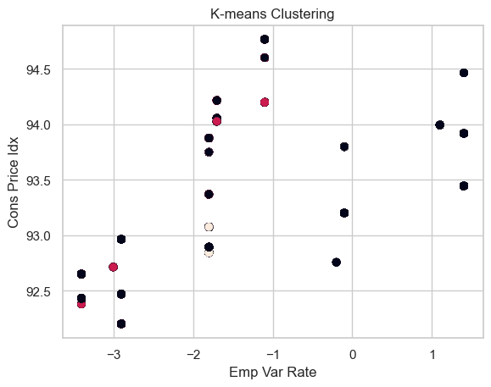
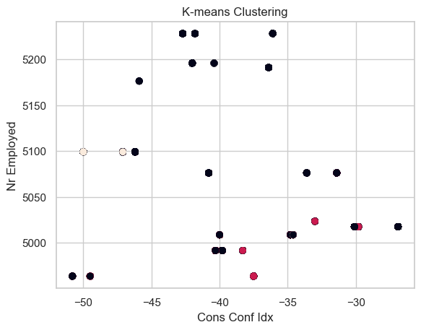

Slide 25
