Slide 1
Rossmann Store Sales Prediction
Presenting
Anirudh Dyaga

Slide 2
About Anirudh
I am a business analyst. I currently work for Landmark group, merchandising industry based out of Middle east.
I consider myself as a data player. I am good at analysing the data and finding hidden patterns which will help solve the business problems. This assignment will help me prove that.

Slide 3
Problem Statement
Rossmann operates over 3,000 stores across Europe. The goal is to predict daily sales for different stores using historical data, store information, promotions, and external factors such as holidays and seasons.

Slide 4
Did you Know?
Imagine you're the manager of a Rossmann store. Tomorrow is a holiday, but you don’t know how much inventory to order. You either overstock and waste money, or understock and lose customers. What if a model could make this decision for you?

Slide 5
Proof-of-Concept (PoC)
Objective:
Demonstrate analytical expertise using Kaggle data.
Deliver a scalable sales forecasting solution for Rossmann.
Approach:
Preprocessing: Handle missing data & feature engineering.
EDA: Identify sales trends & promo effectiveness.
Modeling: Compare Decision Tree, Random Forest.
Evaluation: Use R², RMSE & residual analysis for validation.
Business Impact:
Optimized inventory management & demand forecasting.
Data-driven promo & store expansion strategies.
Higher revenue through stockout & overstock prevention.

Slide 6
Dataset Overview
The data collected had two different data files
1.Rossmann Stores Data:
Historical data including Sales
2. Store:
Supplemental information about the stores

Slide 7
Data Features
Most of the fields are self-explanatory. The following are descriptions for those that aren't.
Id - an Id that represents a (Store, Date) duple within the test set
Store - a unique Id for each store
Sales - the turnover for any given day (this is what you are predicting)
Customers - the number of customers on a given day

Slide 8
Open - an indicator for whether the store was open: 0 = closed, 1 = open
State Holiday - Indicates a state holiday. Normally all stores, with few exceptions, are closed on state holidays. Note that all schools are closed on public holidays and weekends. a = public holiday, b = Easter holiday, c = Christmas, 0 = None
School Holiday - indicates if the (Store, Date) was affected by the closure of public schools.
Store Type - differentiates between 4 different store models: a, b, c, d.
Assortment - describes an assortment level: a = basic, b = extra, c = extended.
Competition Distance - distance in meters to the nearest competitor store.

Slide 9
Competition Open Since [Month/Year] - gives the approximate year and month of the time the nearest competitor was opened.
Promo - indicates whether a store is running a promo on that day.
Promo2 - Promo2 is a continuing and consecutive promotion for some stores: 0 = store is not participating, 1 = store is participating.
Promo2Since[Year/Week] - describes the year and calendar week when the store started participating in Promo2.
Promo Interval - describes the consecutive intervals Promo2 is started, naming the months the promotion is started anew. E.g. "Feb, May, Aug, Nov" means each round starts in February, May, August, November of any given year for that store.

Slide 10
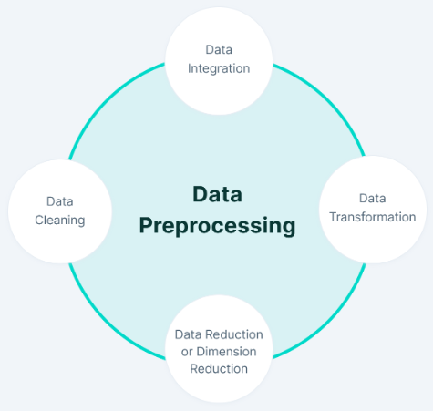
Data Preprocessing

Slide 11
Data Cleaning
Missing Values
CompetitionDistance(NUM) : 0.26 %
CompetitionOpenSinceMonth(CAT) : 31.74 %
CompetitionOpenSinceYear (CAT) : 31.74 %
Promo2SinceWeek (CAT) : 48.78 %
Promo2SinceYear (CAT) : 48.78 %
PromoInterval (CAT) : 48.78%

Slide 12
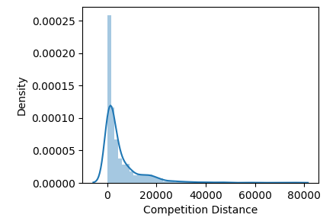
Null value treatment
CompetitionDistance is right skewed so we cannot use mean as it is impacted by outliers. Hence we fill the nulls of this column with median.
Other 5 categoricals are filled with mode imputation.

Slide 13
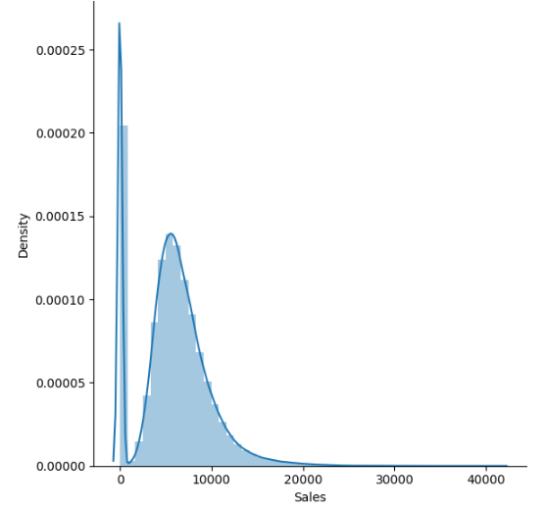
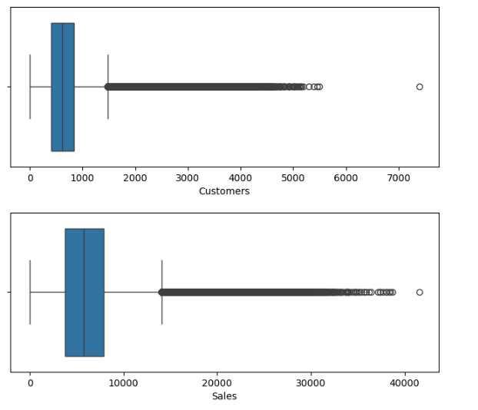
Outlier analysis
There are some values of sales which were zero which are due to stores where closed which are removed.
There are some values in the sales which are higher due to promotion.

Slide 14
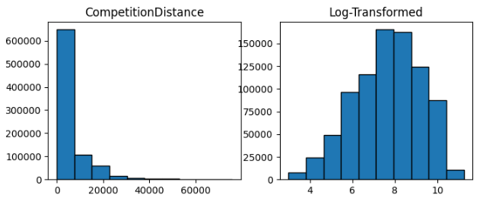
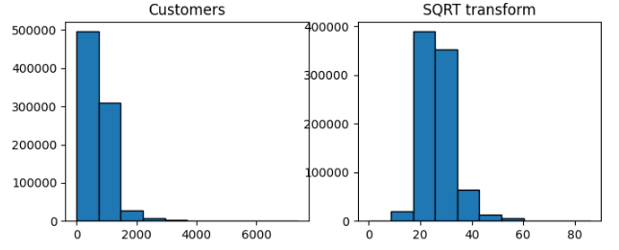
Data transformation / Outlier treatment
There is skewness in the numerical features so some values can be outliers, hence use appropriate transformation mechanism.
Competition Distance undergoes log transformation.
Number of Customers undergoes sqrt transformation.

Slide 15
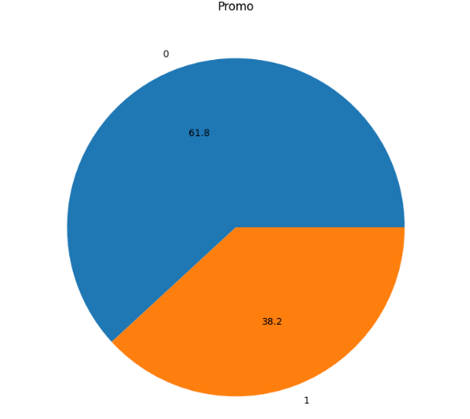
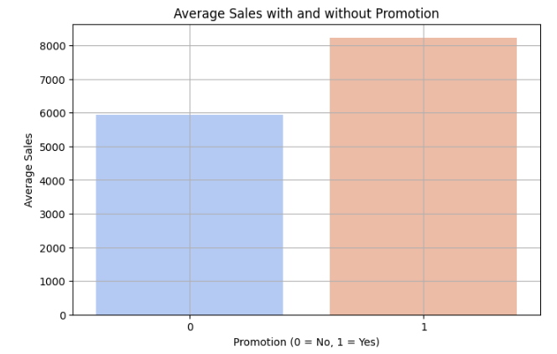
EDA - HYPOTHESIS
1. Is Promo impacting the sales?
About 38% of sales are associated with promo.
2. What are the average sales during promo and during non-promo?
Average sales(8.2k) during promo is higher than no promo(5.9k)

Slide 16
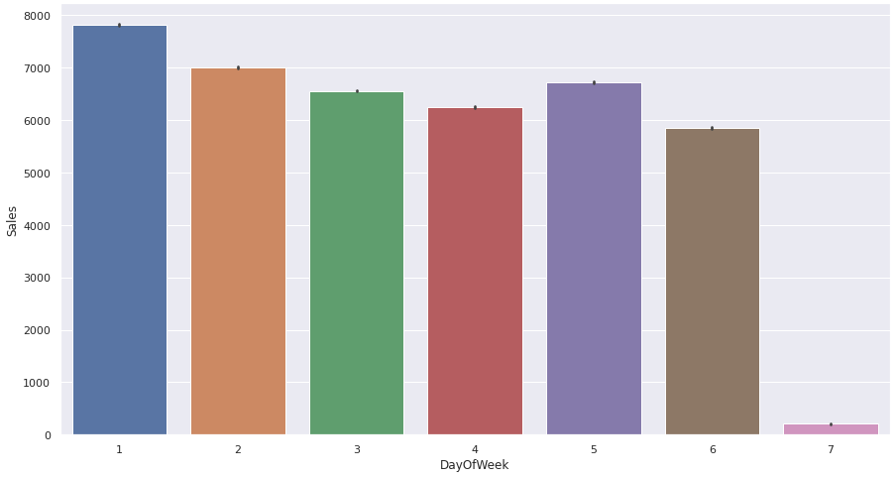
EDA - HYPOTHESIS
3. Which day of the week is favourite day for shoppers?
Clearly, Sunday is a no shopping day.

Slide 17
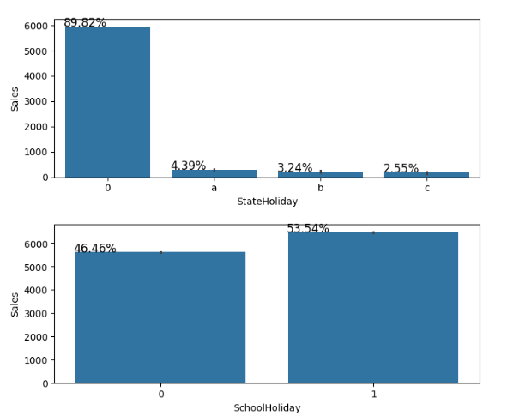
EDA - HYPOTHESIS
4. Will holidays impact sales?
Sales do not happen on state holidays. On contrary, sales are relatively higher if it is a school holiday.

Slide 18
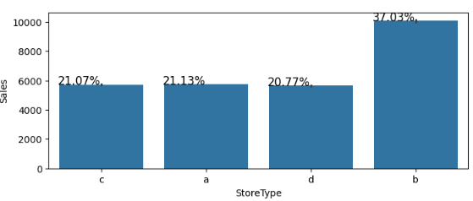
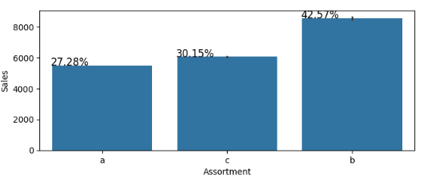
EDA - HYPOTHESIS
5. How are the sales distributed in store types?
Type b store has more sales.
6. How the sales distributed according to the assortment type?
“Extra” type of assortment is driving more sales than ‘basic’ and ‘extended’.

Slide 19
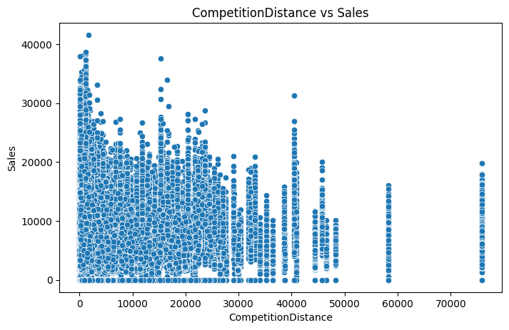
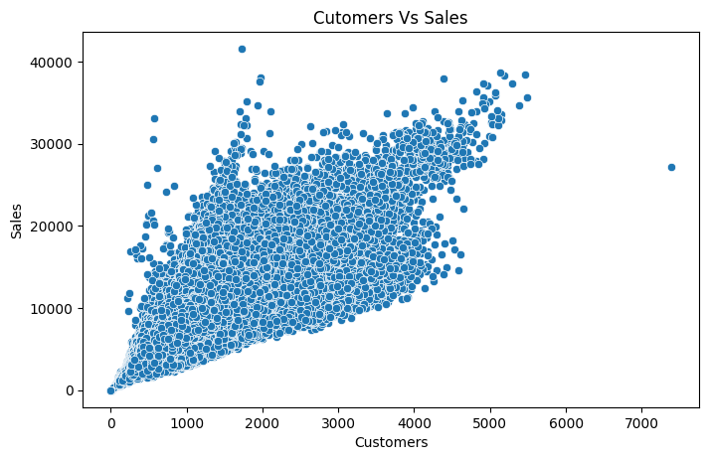
EDA - Bi Variate analysis
1. The competitor stores are close to each other has more sales.
2. We can see that `sales` are positively correlated with customer.

Slide 20
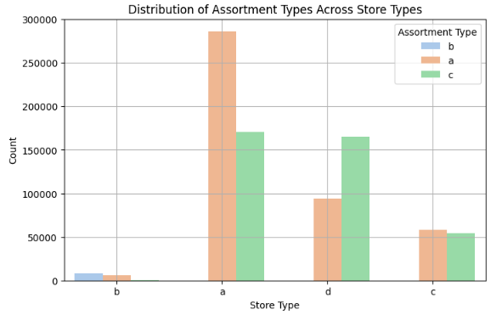
Store type VS Assortment
How is the the assortment types are distributed across each store type?
Store type a,d,c has assortment type a,c and only store type b is having assortment type b(extra) along with type a(basic).

Slide 21
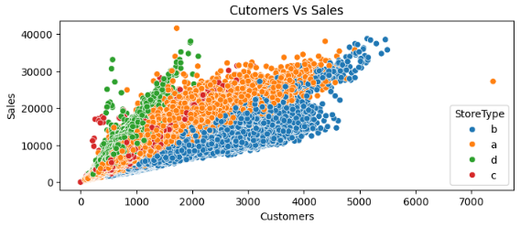
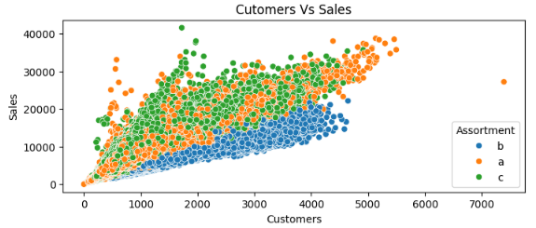
Store type
Assortment type
Least customers interested in assortment type b and high sales are linked to type b, a.
Most customers are found in type b, high sales are linked to type d.

Slide 22
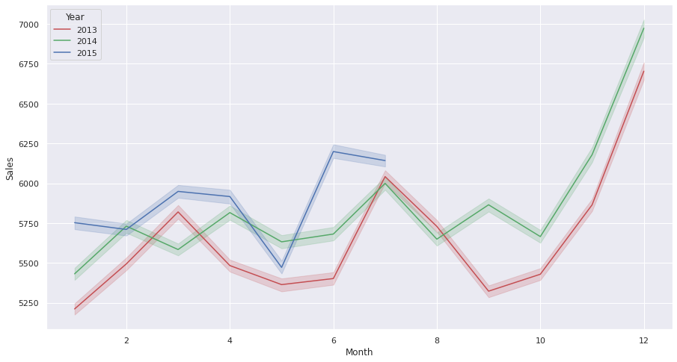
Monthly Sales in Year
The sales in the month of December is highest, compared to other months.

Slide 23
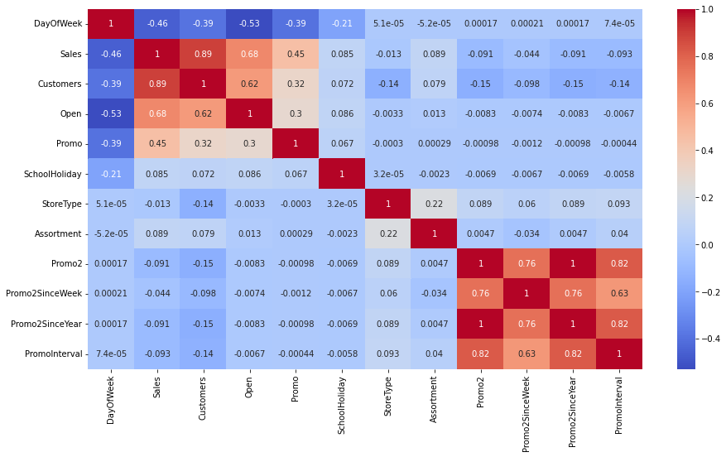
Correlation Heatmap
`Customers,Sales,Open,Promo` are high and positively correlated with each other.
'Promo2', 'Promo2SinceWeek','Promo2SinceYear'` has some correlation with each other.

Slide 24
Model building
Things to note
As we have to predict data of last 6 weeks means we have train on data before the 6 weeks.
Random split of data will leads to data leakage.
So we go with time base split for our best model.
Use scaling techniques like Standard scaler if and only if the features/ data is normally distributed for a linear models or distance-based models.
Due to high volume of data and more categorical features in the data, ensemble methods will work better.

Slide 25
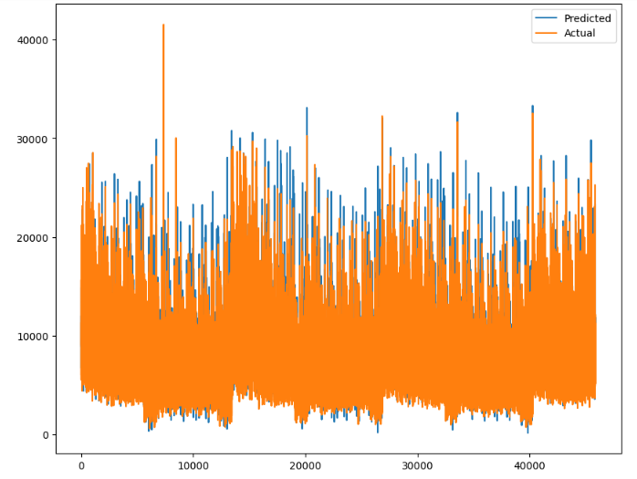
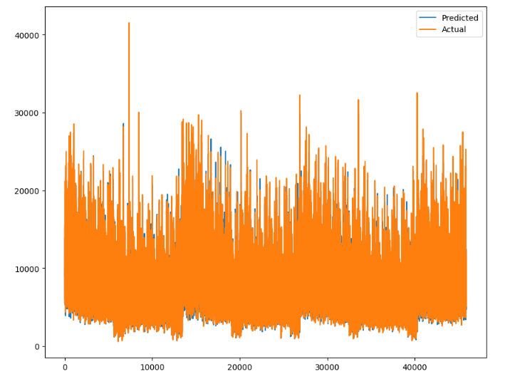
Linear regression
Random forest
Bagging model is learning better and giving better results than the linear model.

Slide 26
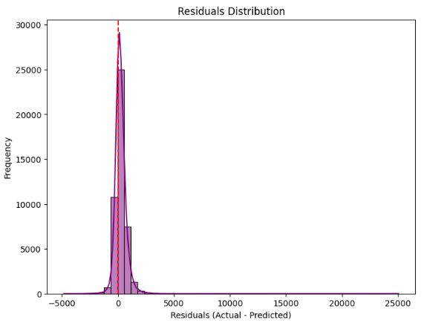
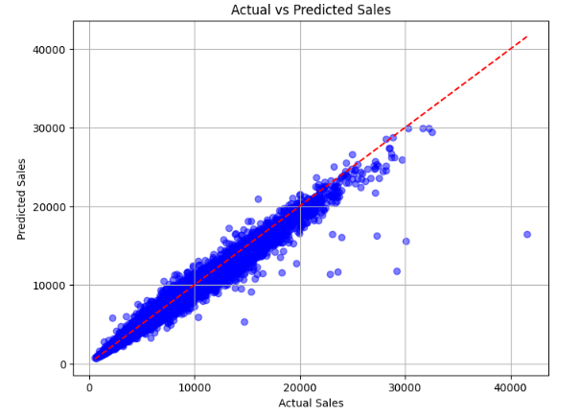
Random forest residual distribution is symmetrical and mostly around zero but right skewed due to outliers.
Random forest actual vs predicted sales graph is densely distributed across the diagonal line.

Slide 27
Model Comparison
 | Regressions | Train Score | Test Score
1 | Linear Regression | 0.86879 | 0.83507
2 | Lasso Regression | 0.86862 | 0.83513
3 | Ridge Regression | 0.86879 | 0.83509
4 | Decision Tree Regressor | 0.99925 | 0.97240
Here we use the Regularization methods to find optimum fit of Linear Regression.
But the best model is Decision Tree Regression.

Slide 28
Advanced Models
Algorithm | r2_train | r2_test
Decision Tree | 0.9992 | 0.972
Decision Tree With Hyper Parameter Tuning | 0.986 | 0.9793
Random Forest | 0.997 | 0.983
The random forest work best without overfitting it give large value for test data.
Other metrics to measure the performance, MAE: 387.8, RMSE: 576.5; Avg_sales: 7000.

Slide 29
Customer-Centric Insights
Title: How Rossmann Benefits?
+38% Sales with Promotions → Boost revenue via targeted promos.
Store Type B = Highest Sales → Guide store expansion plans.
School Holidays ↑ Sales, State Holidays ↓ Sales → Optimize staffing & inventory.
Better Demand Forecasting → Prevent stockouts & excess inventory.
Actionable Insights → Data-driven decision-making for revenue growth.

Slide 30
Conclusion
Recap
From plot Sales and day of week, Sales highest on Monday and start declining from Tuesday to Saturday and on Sunday Sales almost near to Zero.
Plot between Promotion and Sales shows that promotion helps in increasing Sales.
Type of Store plays an important role in opening pattern of stores.
All Type ‘b’ stores have comparatively higher sales and it mostly constant with peaks appears on weekends.
Assortment Level ‘b’ is only offered at Store Type ‘b’.

Slide 31
Recap
We can observe that most of the stores remain closed during State Holidays. But it is interesting to note that the number of stores opened during School Holidays were more than that were opened during State Holidays.
The R Squared score of all Linear Regression Algorithm with or without Regularization are quite good which is 0.86. The R Squared score of the Decision Tree Regressor model we got 0.97 on test set which is also good.
The Random Forest regressor model performed 0.98 which is very well among the others.
We can say that random forest regressor model is our optimal model and can be deploy.

Slide 32


