Slide 1
SPARK- 2024 Closed Loop Speed Control of SynRM
Presented by
Anirudh Bhogi
(SPA2403825),
Part II, Electronics Engineering,
IIT(BHU) VARANASI
Supervisor
Prof. Jeevanand Seshadrinath
Department of Electrical Engineering, IIT Roorkee, Roorkee -247667

Slide 2
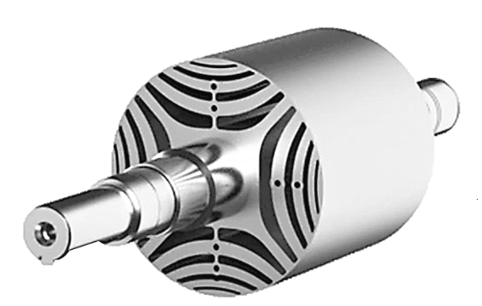
Agenda
Control Algorithm
Software Implementation
Weekly Progress
Results & Approach

Slide 3
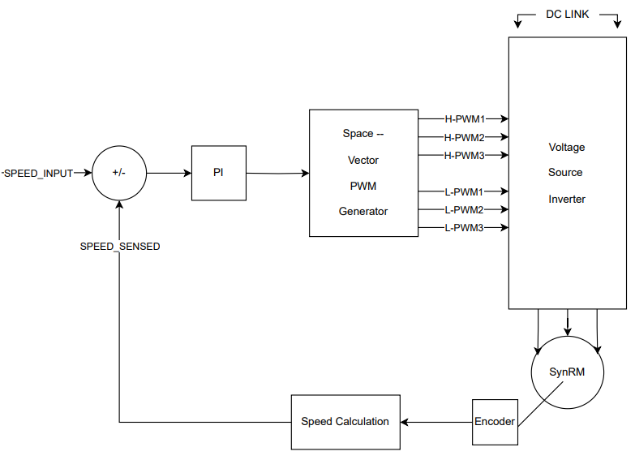
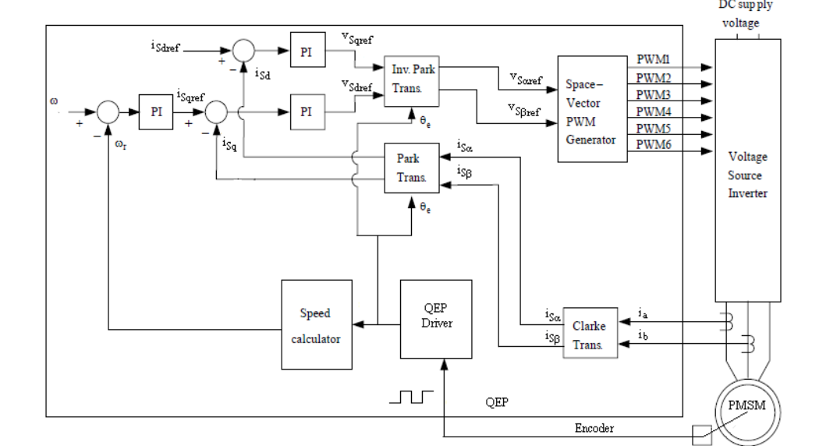
Control Algorithm
MODIFIED TO
SENSORED FIELD ORIENTED CONTROL
SPEED CLOSED-LOOP CONTROL

Slide 4
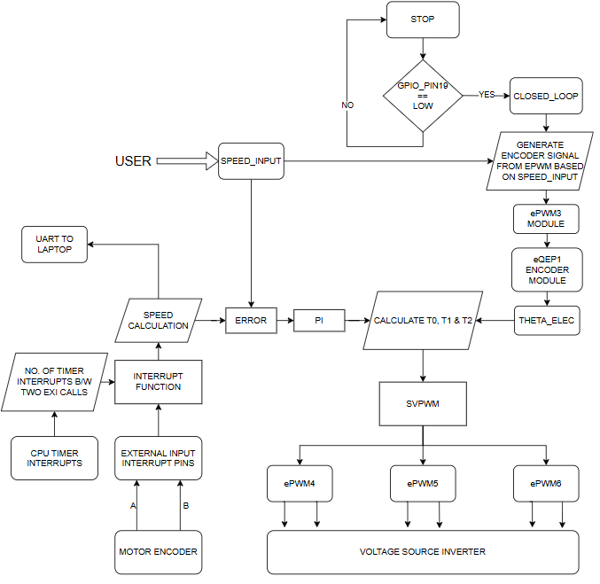
Software Implementation
FOR PI TUNING
LEGEND
IMPLEMENTED CODE BLOCKS –
PROCESSING –
PREDEFINED MODULES OR RESULTS –
DECISION -

Slide 5
Weekly Progress
Week 1
Week 2
Week 3
Week 4
Week 5
Explored DSP F28379D
Implementation of blocks of code
Testing and debugging of code blocks on Hardware
Closed loop control of motor
Worked on Current Closed Implementation
1
2
3
4
5
Software Installation & Setup
Learnt how to use software
Read the User Manual of DSP for required modules
Implemented simple PWM.
Implemented SVPWM.
Configured ADC
Implemented position & speed calculation from the encoder
Replaced the encoder with new connectors for noise removal.
Testing and debugging of SVPWM on 3-phase resistive load to obtain sine wave.
Testing and debugging of ADC code such that a similar waveform is visible in the software also.
Testing and Debugging of position and speed-sensing code
Implemented open loop control with STARTUP.
Running motor in an open loop with and without startup.
PI tuning.
Successfully running motor in complete closed loop.
Implementing Current Sensing and transforms.
Calibrated the current sensors.
Speed Closed loop’s code documentation.

Slide 6
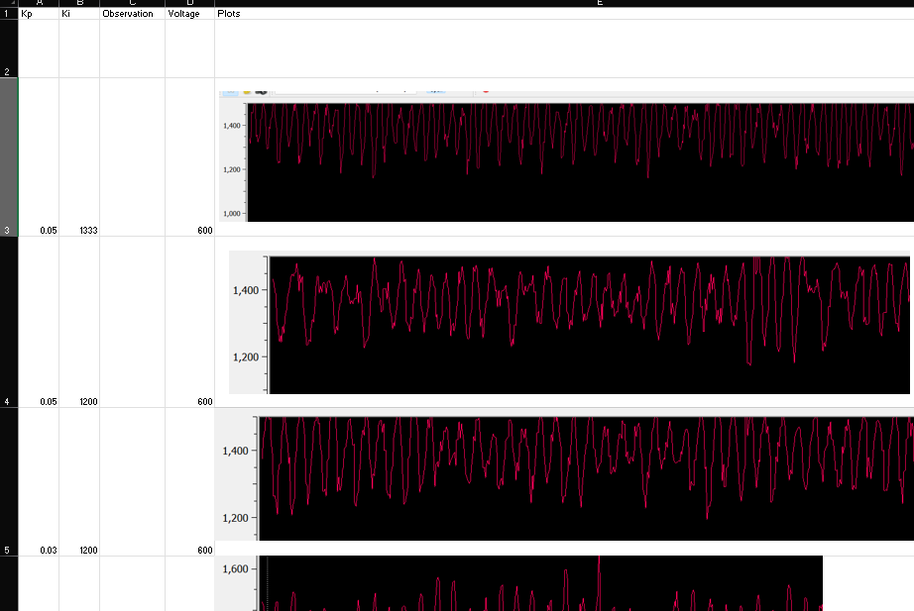
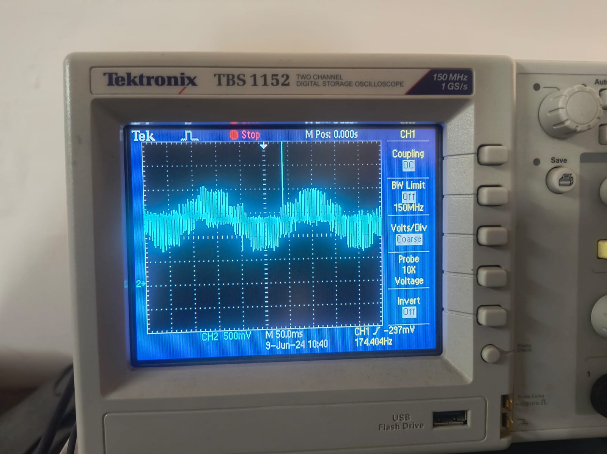
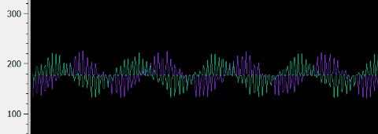
Results & Approach
Current Sensor Waveform on DSO for 3-phase resistive load
=> Testing of SVPWM
For PI Tuning, the Kp and Ki values were continuously documented in Excel along with the waveform of sensed speed.
Tuning was done by observing motor behaviour for different Kp and Ki values.
=> PI TUNING
Current Sensor Waveform in Software for 3 phase resistive load
=> Testing of ADC and calibration of current sensors

Slide 7
Results & Approach
TARGET_RPM | ERROR IN OPEN LOOP WITHOUT STARTUP | ERROR IN CLOSED LOOP
300 | ±6% | ±0.8%
700 | ±10% | ±0.6%
1400 | 100% | ±0.2%
1800 | 100% | ±0.1%
FEW DETAILS:
ENTIRE IMPLEMENTATION WAS DONE THROUGH EMBEDDED C CODING ON TI DSP-F28379D
PWM FREQUENCY USED: 20kHz
SPEED SENSING SAMPLING PERIOD: EVERY 1us
THE MOTOR STARTS TO VIBRATE AND CREATES NOISE FOR HIGHER RPMS ABOVE 1600 RPM AT VOLTAGES ABOVE 550V DC LINK.

Slide 8
THANK YOU

