Slide 1


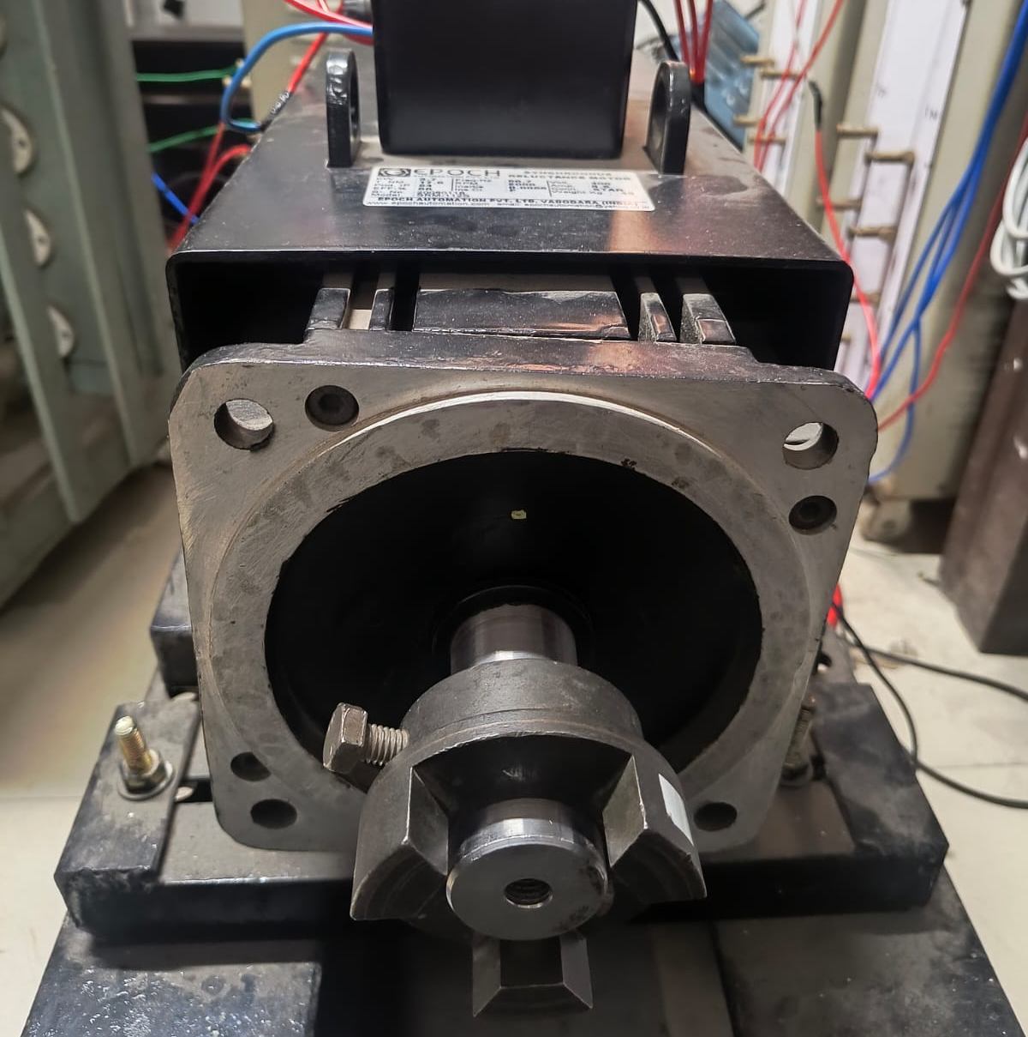
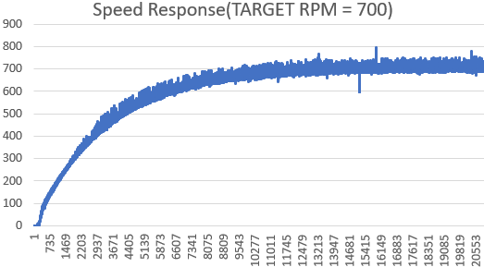
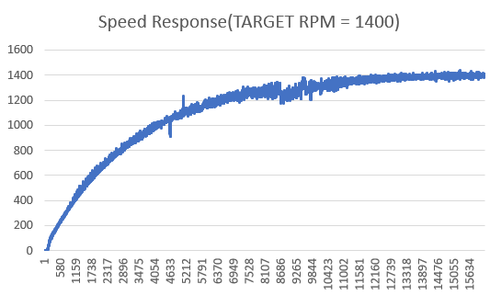
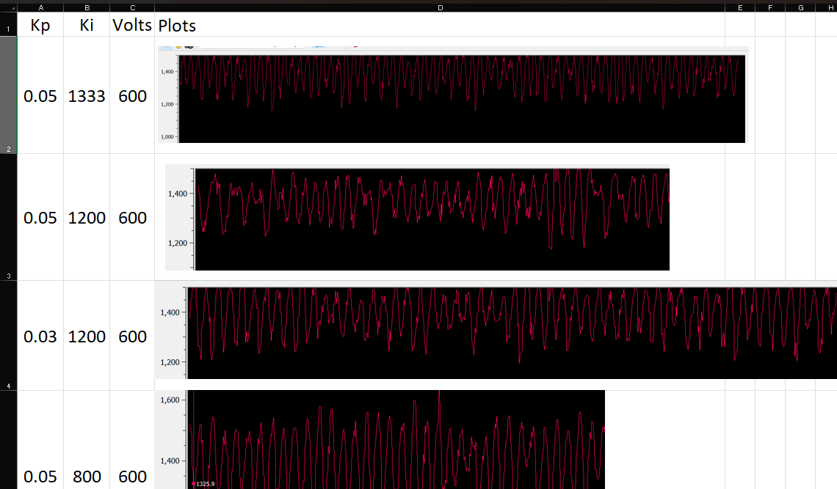
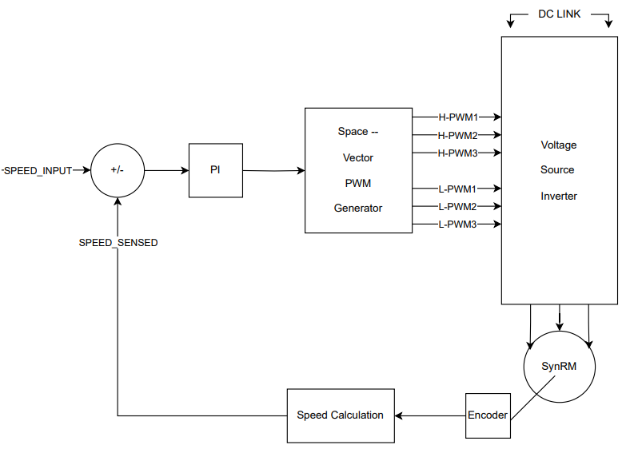
Closed Loop Control for Synchronous Reluctance Motor Using TI DSP-F28379D
Anirudh Bhogi
Electrical Department, Indian Institute of Technology Roorkee
Introduction
Results
The motivation for this project was to design
and implement a fully working simplified
control algorithm which is Closed loop Speed
control for SynRM.
A reluctance motor is a type of electric motor
that induces non-permanent magnetic poles on
the ferromagnetic rotor. The rotor does not
have any windings or permanent magnets
unlike BLDC motors and PMSM. SynRM applications include industrial drives such as pumps, and compressors; automotives such as EVs.
The control algorithm implemented was tested completely on hardware and various speeds(RPM) set by the user.
Target RPM | Error in Open Loop | Error in Closed Loop
300 | ±6% | ±2.8%
700 | ±10% | ±1.6%
1400 | 100% | ±0.9%
1800 | 100% | ±0.7%
The permanent magnets on the rotors of BLDC motors and PMSM make them generally expensive even though efficient. Since COVID, these permanent magnets which are majorly found in China have become highly expensive, increasing the PMSM & BLDC motor’s cost to a great extent. Therefore, in recent times the importance of SynRM (Synchronous Reluctance Motor) has been increasing since the rotor does not have permanent magnets. SynRM is also highly efficient, but it comes at a cost of complex control.
Discussion
Methods
The error % kept on reducing as RPM increased since the oscillations that were observed about target rpm were almost constant irrespective of the target RPM.
It was also observed that SynRM loses complete synchronization with the stator magnetic field generated at higher RPMs in an open loop control.
The major problem faced was PI tuning since the implementation was done entirely through Embedded C. Therefore, the motor behaviour at different PI gains was documented in an Excel sheet and thereby tuned accordingly.
Sensored FOC Scheme
The conventional Sensored FOC which is used for efficient control of PMSM can be modified and used for SynRM also. The only modification is that the direct axis current is made to 0 for PMSM whereas it is made equal to the Quadrature axis current for SynRM.
Though this control is highly efficient, it is a highly complicated algorithm.
Closed Loop Speed Control
The closed-loop speed control of SynRM is a simplified version of Sensored FOC. It involves only encoder feedback and does not include any current feedback from the motor which reduces the complexity of the control to a great extent.
It stabilizes the speed of the motor which is set by the user by approaching the target speed smoothly based on the error between the target speed and the speed sensed.
Indicators used
Adsorption Energies
Bader Charge transfer
Projected Density of states
Decreasing order of corrosion inhibition potential in saline environment
Experimental order: HfO₂ > ZrO₂ > TiO₂ > Al₂O₃
Predicted order: HfO₂ > ZrO₂ > TiO₂ > Al₂O₃
Conclusion
The closed-loop speed control does not maximise the torque the motor produces like Sensored FOC.
It provides a simple approach for precise speed control of SynRM in low/medium torque applications. This control requires no current feedback, thereby no current sensors making the control implementation less expensive also.
References
Sensored FOC of 3-phase Permanent Magnet Synchronous Motors using TMS320F2803x microcontrollers by TI
Acknowledgement
I would like to thank SPARK and my supervisor for the project, Prof. Jeevanand Seshadrinath, for providing me with the wonderful opportunity to implement a control algorithm for the next-generation SynRM, motor.
I would also like to thank my mentor for this project, Mr. Sivarama Krishna(PhD Scholar), for guiding me throughout the project and assisting me in debugging various implementation issues. Special thanks to Mr. Shivateja(PhD Scholar), for helping me out with the poster presentation.

