Slide 1
X-IoTA REPORT
TEAM SSS
Anirudh Bhogi
Banala Sahit Royal

Slide 2

OUR TOPIC
A device that senses heartbeat of a swimmer and signals danger if the person is about to drown. This device is designed to send the signal to the blynk app on any device . This device can be worn by the swimmer like a wrist watch

Slide 3
WHY THIS TOPIC ?
There are many waterfalls in and around Varanasi . We frequently hear news about people , especially youth drowning in these waters . In most cases these people do not get immediate help because the people around just fail to realise that the person is drowning . Generally its just takes about 60sec for a person to drown and loose his life . This device helps taking immediate action which can possibly save many lives .
6 die after drowning in Ramdaha waterfall in Chhattisgarh, 1 rescued
56 drowning incidents since 2019 in Thane, Navi Mumbai

Slide 4
WHAT RESEARCH SAYS ?
What happens to a person when he drowns?
Heart Rate : BPM drops to 43BPM within minutes and fluctuates steadily between 35BPM and 78BPM . So we take a critical case of 50BPM .
SpO2 : The usual SpO2 level of a person is 95-100% , anything lower is a concern .
Depth : If a person is under a threshold depth of 1.52m(115kPa) for a stipulated time , he is most likely unconscious .

Slide 5
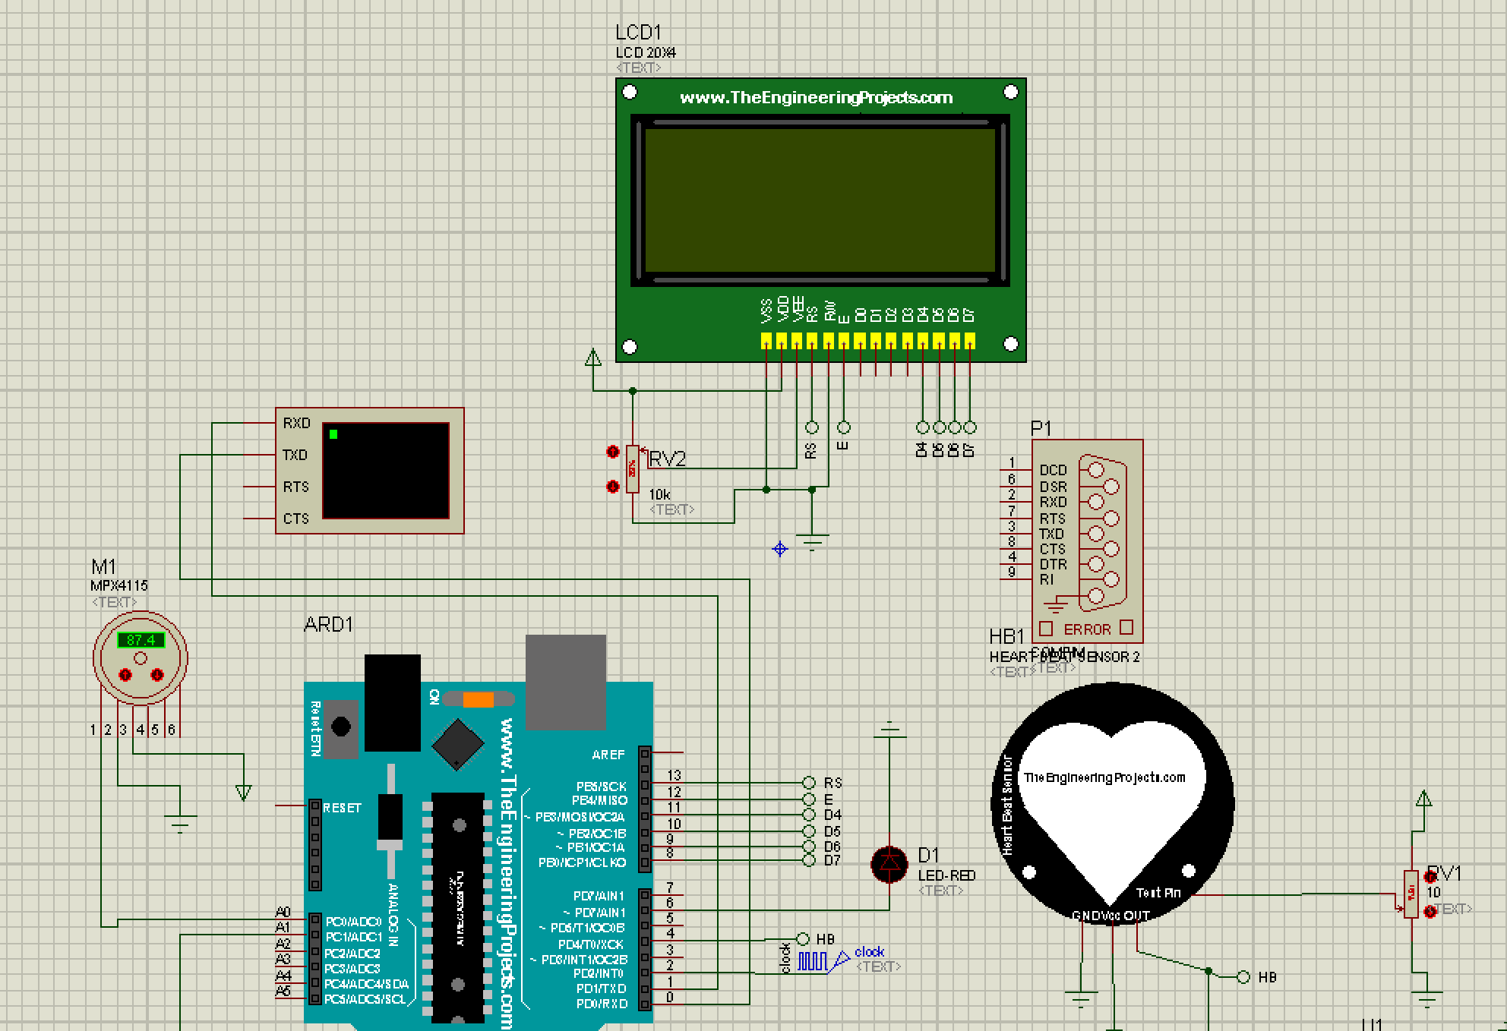
OUR MODEL(QUICK OVERVIEW)
LCD DISPLAY
PRESSURE
SENSOR
HEART BEAT
SENSOR
ARDUINO
UNO
LED TO SIGNAL DANGER

Slide 6
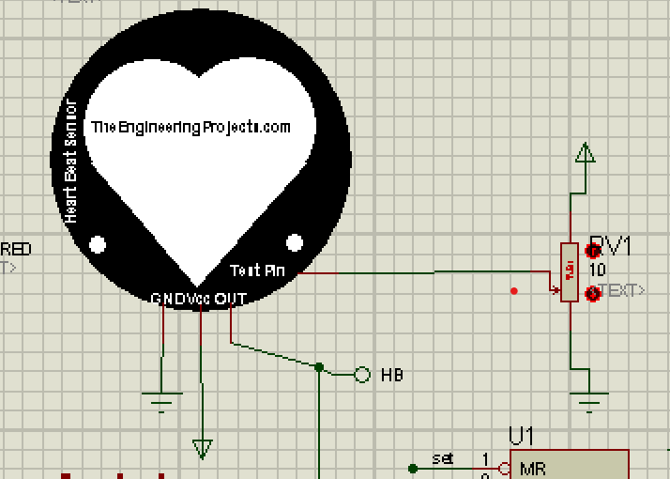
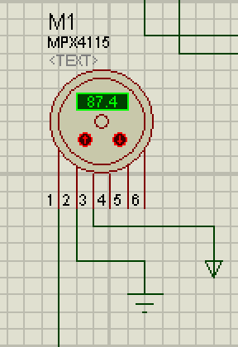
SENSORS AND OTHER COMPONENTS
Heart Sensor : This sensor helps us sense the rate at which the heart is beating . The rate can be changed by changing the value of variable resistance . The OUT pin gives output in the form of 1 and 0 .
Pressure Sensor : This sensor detects the amount of pressure applied on it . The pressure can be increased or decreased using the up and down arrows .

Slide 7
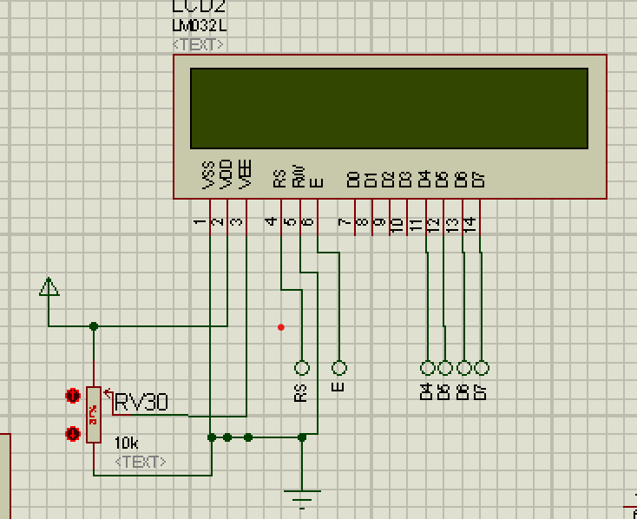
LCD Display : This displays the BPM of the person and the time .

Slide 8
HOW DOES THIS FUNCTION?
When the heart beat calculated by the heart beat sensor drops below 50bpm or when the depth of the person is more than 1.52m (pressure = 115kPa) for a stipulated time , then the alarm goes off . The signal will also be shown on the blynk window of the device to which our Arduino board is connected .
Because we have very less time to react , the heart beat rate is measured only for 10sec and the BPM is calculated by multiplying it with 6 .

Slide 9
COST OF THE DEVICE
COMPONENT COST
Arduino UNO R3 ₹ 199
LCD Display(16 x 2 module) ₹ 261
Heart Beat Sensor ₹ 295
Pressure Sensor ₹ 129
TOTAL
₹884

