Slide 1
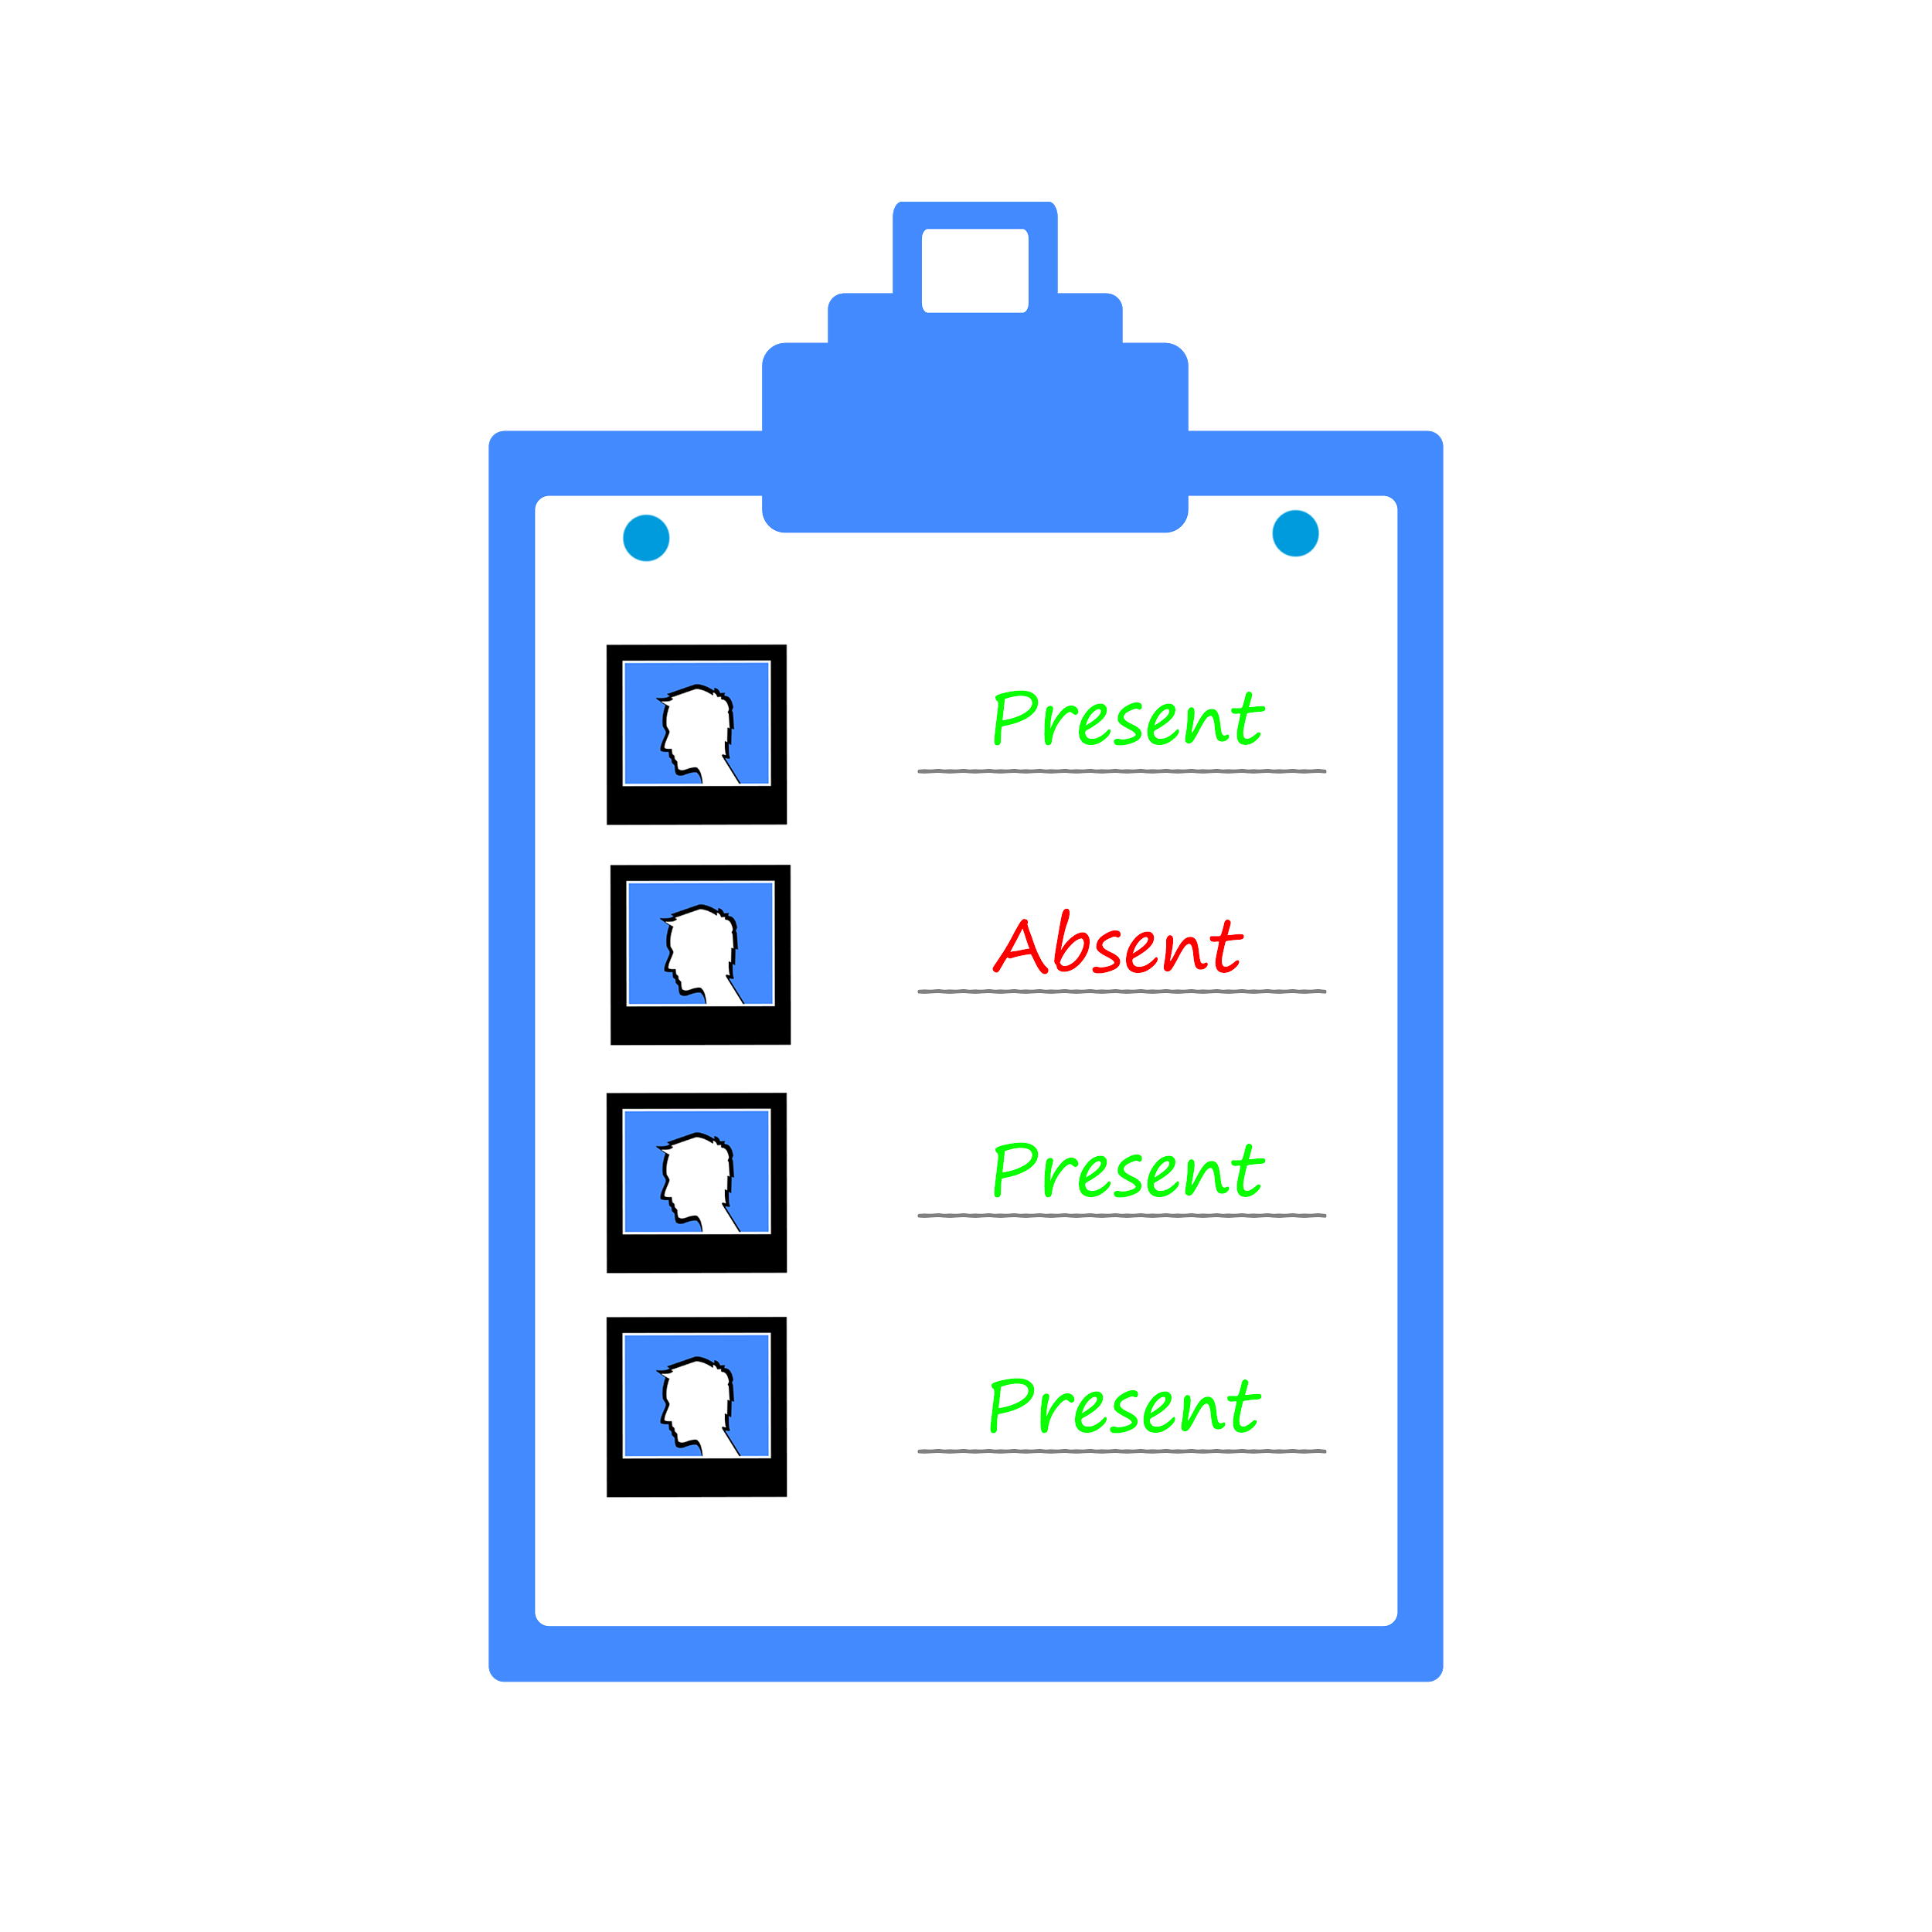
Phottendance
Making attendance time 300X shorter
Team Name-Phottandence
Participant 1- Yogeshwar Dan Charan
Participant 2- Anirudh Goel

Slide 2
Purpose
Faculty wastes 5 mins in each lecture for attendance.
Students can barely tolerate another 5 mins of torture after lecture.
A mundane and repetitive task; good for computers, not for humans.

Slide 3
Working
Faculty clicks a picture of whole class.
REST ALL IS HANDLED BY US !!

Slide 4
Architecture
Face Recognition Engine
Photo
Phottandence
Cloud Backend
Face Features
Send Attandence

Slide 5
Edge over other solutions
Current Scenario- Hardware based attendance trackers; Cost Involved: Purchase, Installation, Maintenance.
Phottendance- A Smartphone; Cost Involved- I guess everyone has a smartphone !

Slide 6
Edge over other solutions
No Biometric Data collected.

Slide 7
Why Students may hate us ?
Sorry, Proxies are Impossible. :(

Slide 8
Thank You !
Hope you liked it.

