Slide 1
OCR Based document scanner (Aadhar card specific)
Presented By-
Anirudh Hosur

Slide 2

Flipr Innovation labs
A company which forms a bridge between students and industry professionals.
A product based company.
Conducts hackathons seasonally, and selects top performers for industry-relevant projects.

Slide 3
Project requirements
1) Anaconda Navigator – Spyder IDE
2) Python
3) GPU accelerated computer
4) Strong sense of DL and OpenCV.

Slide 4
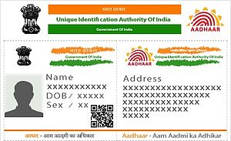
The problem statement
Extract information from a scanned picture of any document, preferably, Aadhar card.
The information should be crisp and without faults.
A classic FinTech problem, mostly in the banking sector.
An advanced machine learning & computer vision
approach.

Slide 5
Literature survey
Existing Solution – A simple optical character recognition (OCR) solution, that reads the image and simply displays the contents. Further, image pre-processing is done to improve the quality of the scanned documents.
Proposed Solution – With the help of GANs, generate more and more images of the pre-processed scanned documents, select the best one out. Consider the image, and extract relevant information with maximum accuracy.

Slide 6
Approach
Click a picture of the document to be scanned.
Using OpenCV, a strong computer vision library, read the image.
Convert the image into black & white and extract the information.
Improve the quality of scanned images, by image pre-processing techniques.

Slide 7
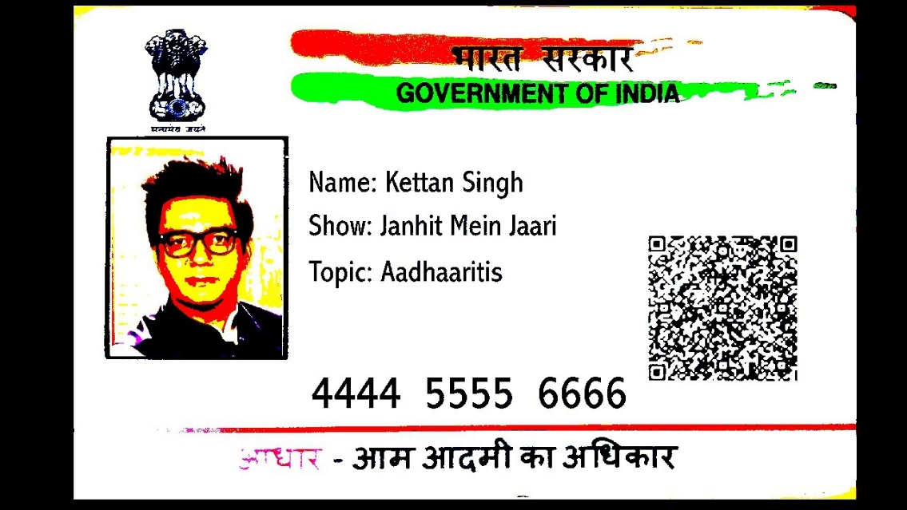
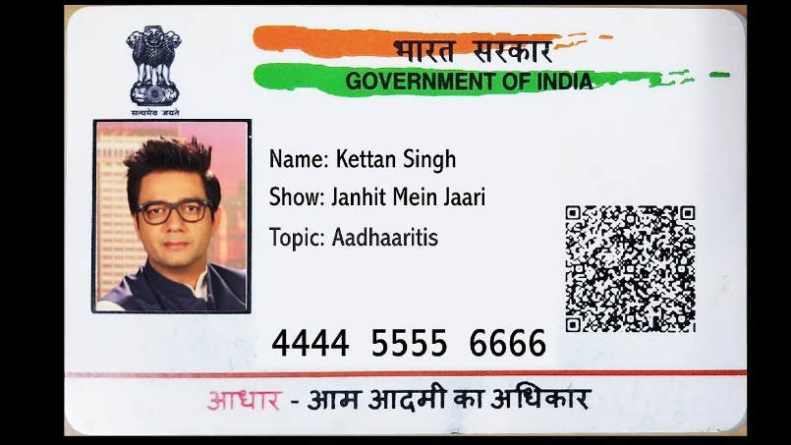
AN ideal scenario
The scanned image is of good quality and image pre-processing is not required.
Simple bi-latteral filtering to improve the sharpness of the image.

Slide 8
Real world scenario
Sometimes, the quality of image itself isn’t good, and thus, the OCR does not work.
Advanced image pre-processing techniques are thus used.
A special approach – Generative Adversarial Networks (GANs)

Slide 9
Algorithms used
1) Gaussian blur – smoothen the image
2) Median blur – To reduce noise
3) Bilateral filter – further noise removal, keeping edges sharp
4) Image Segmentation – edge detection & extracting region of intrests

Slide 10
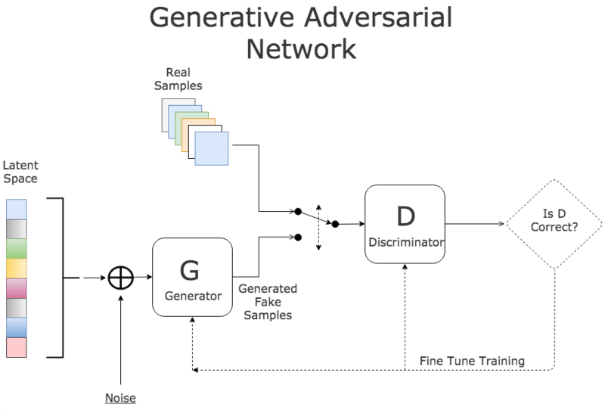
GANs – A deep learning approach

Slide 11
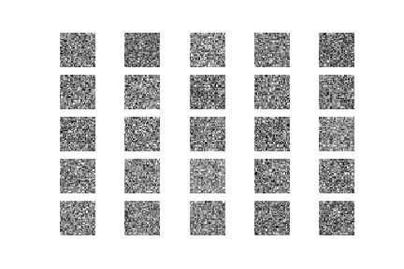
GANs – Working
An unsupervised model.
Started in 2014, to reduce computational cost and errors within neural networks.
[The forger is trying not to get caught, and the detective is trying to catch the forger.]
Forger – Generator
Investigator – Discriminator
Thus, generate more Aadhar
Card images, with higher quality.

Slide 12
It’s future prospects
Government banks can get rid of their paperwork.
Organizations can slowly go digital, in this internet era.
In placement season, upload your resume & details fill up !!!

Slide 13
THANK YOU

