Slide 1

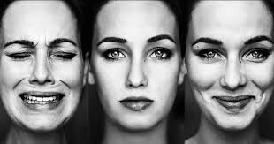
EMOTION RECOGNITION USING SPEECH SIGNALS
Team Members
Dharahasini.G - 17BLC1001
Tushar Nama - 17BLC1161
Anirudh Hosur -17BLC1147

Slide 2
Introduction
An important part of human intelligence is recognizing emotion. With the rise of personal assistants such as Google Assistant , Apple Siri and Amazon Alexa and many more like this ,It becomes very important to give meaningful responses to queries based on the users mood. So recognizing emotion from the user queries will be very much a added advantage and also it will become neccessity in the future to give relevant answers to the users based on their emotion.

Slide 3
Objective
The prime objective of this project is to recognize emotions based on speech audio samples using various linear models , Non-Linear models such as Support Vector Machine, K-Nearest Neighbor, Random Forest and Neural Network and classify them in 8 emotion output classes namely, neutral, happy, sad, anger, disgust, Fearful, surprise, calm

Slide 4
Description of Dataset
Dataset- The Ryerson Audio-Visual Database of Emotional Speech and Song (RAVDESS)
The database contains 24 professional actors (12 female, 12 male), vocalizing two lexically-matched statements in a neutral North American accent. Speech includes calm, happy, sad, angry, fearful, surprise, and disgust expressions.

Slide 5
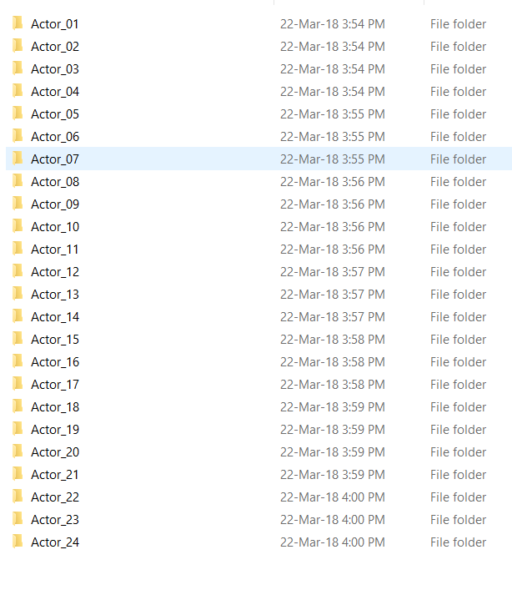
Each expression is produced at two levels of emotional intensity (normal, strong), with an additional neutral expression.
All conditions are available in three modality formats: Audio-only, Audio-Video and Video-only (no sound).
In our project ,we are only using audio speech signals.

Slide 6
File naming convention Each of the 7356 RAVDESS files has a unique filename. The filename consists of a 7-part numerical identifier (e.g., 02-01-06-01-02-01-12.mp4). These identifiers define the stimulus characteristics:
Filename identifiers
Modality (01 = full-AV, 02 = video-only, 03 = audio-only).
Vocal channel (01 = speech, 02 = song).
Emotion (01 = neutral, 02 = calm, 03 = happy, 04 = sad, 05 = angry, 06 = fearful, 07 = disgust, 08 = surprised).
Emotional intensity (01 = normal, 02 = strong). NOTE: There is no strong intensity for the 'neutral' emotion.
Statement (01 = "Kids are talking by the door", 02 = "Dogs are sitting by the door").
Repetition (01 = 1st repetition, 02 = 2nd repetition).
Actor (01 to 24. Odd numbered actors are male, even numbered actors are female).

Slide 7
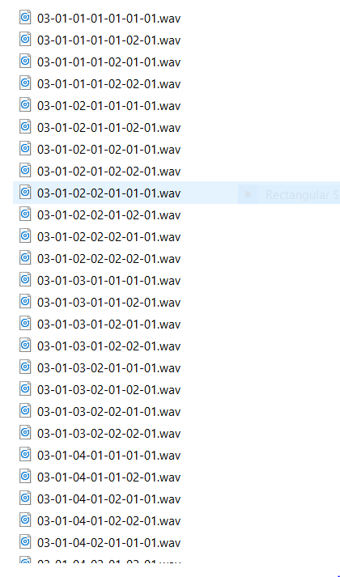
Filename example: 02-01-06-01-02-01-12.mp4
Video-only (02)
Speech (01)
Fearful (06)
Normal intensity (01)
Statement "dogs" (02)
1st Repetition (01)
12th Actor (12)
Female, as the actor ID number is even.

Slide 8
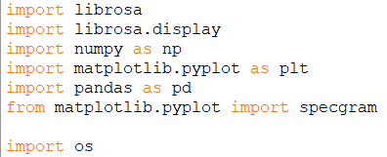
Details of Data Pre-processing
We first labeled the data using python and then extracted the features using librosa library.

Slide 9
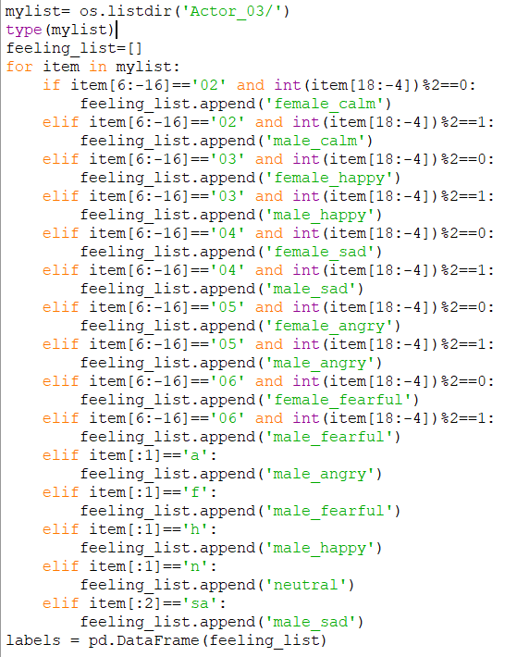
Python code for labeling data
as in the naming convention we saw that from 6 to -16 represents the emotion part and 18 to -4 represented the actor number
And in the dataset all the odd numbered actors are male and all the female numbered actors are female.
So based on these , we labeled the data

Slide 10
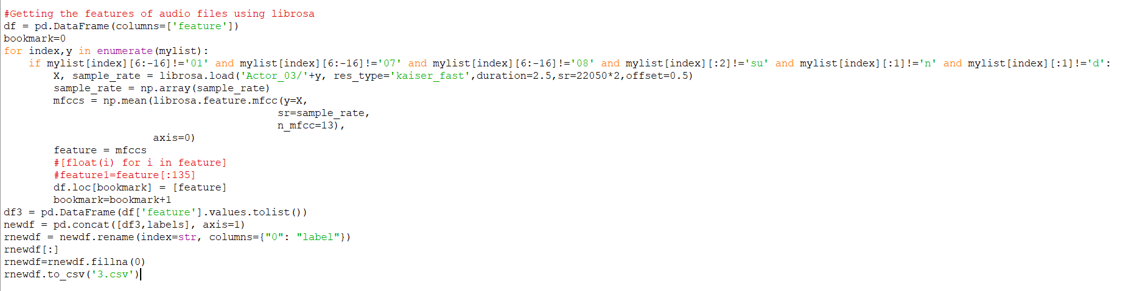
Feature extraction
We Extracted the features based on sampling rate , as general approach of extracting by length of audio file cannot be used because all audio wave files have same length in this dataset.

Slide 11
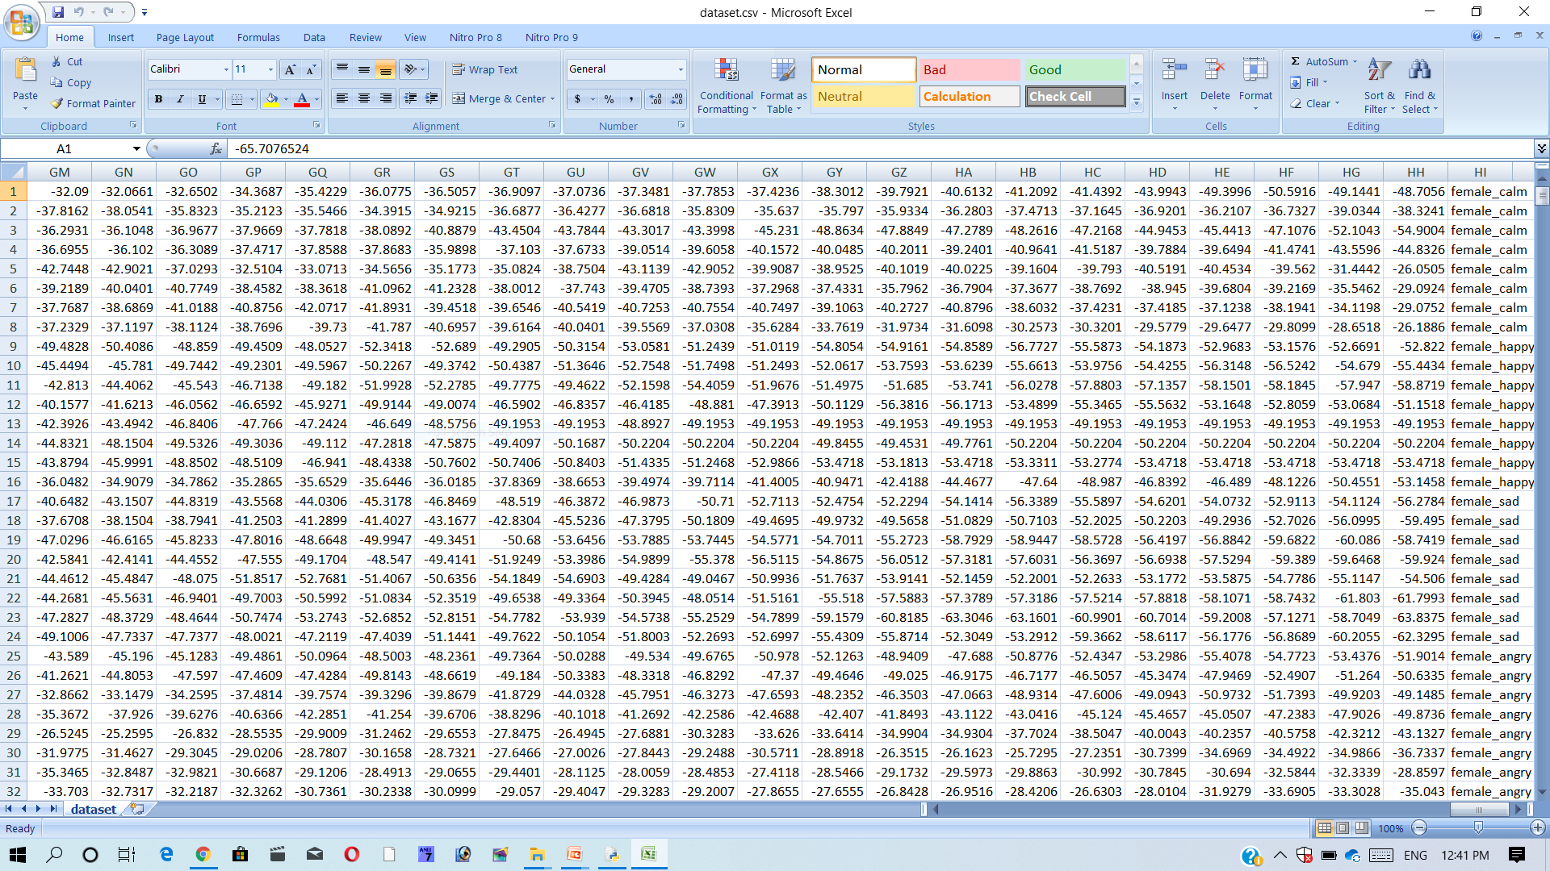
Dataset after labeling and feature extraction

Slide 12
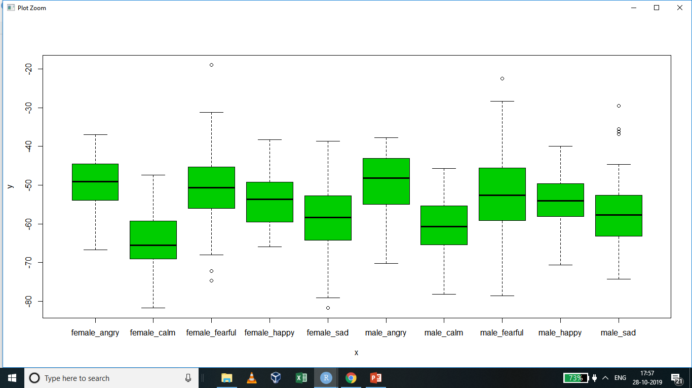
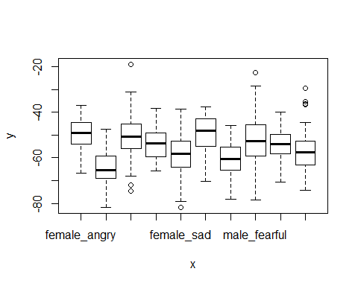
Analyzing The Data
In this we have plot the output vs one input column.
So we can see the average value of every emotions

Slide 13
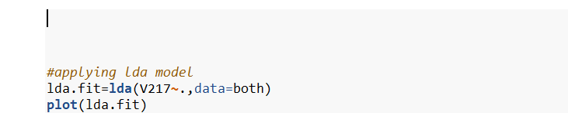
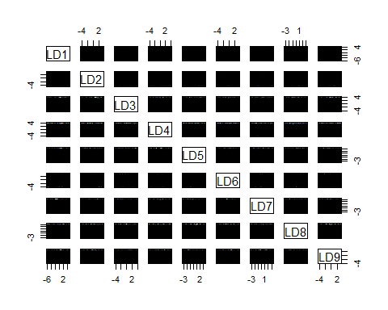
Overview of Linear models used
Linear models describe a continuous response variable as a function of one or more predictor variables. They can help you understand and predict the behavior of complex systems or analyze experimental, financial, and biological data.
As our dataset is of multi class classification we have used LDA (Linear Discriminant Analysis).

Slide 14
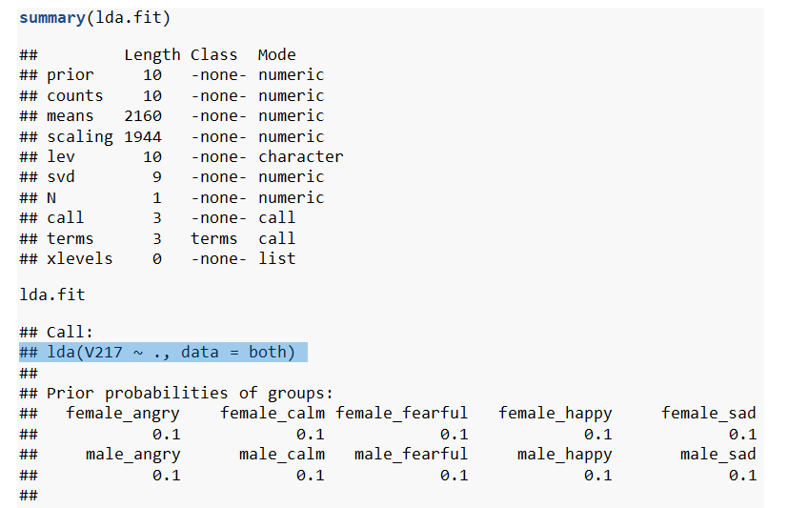

Summary of linear model

Slide 15
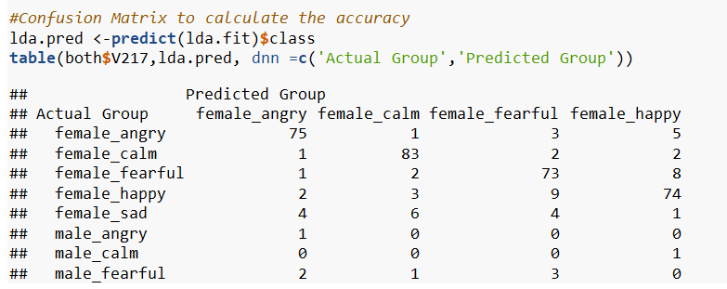
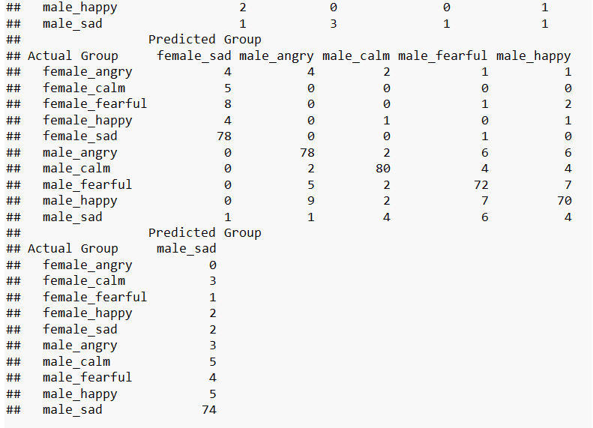
Confusion matrix
We are using Confusion Matrix to calculate the accuracy
lda.pred <- predict(lda.fit,testing)$class
table1<-table(testing$V217,lda.pred, dnn = c('Actual Group','Predicted Group'))
table1 //will display the confusion matrix
accuracy_Test1 <- sum(diag(table1)) / sum(table1)
print(paste('Accuracy for test', accuracy_Test1*100,"%"))

Slide 16


OUTPUT
IN THIS WE CAN SEE THAT ACCURACY OF LDA OF TRAINING DATA IS AROUND 85 % BUT FOR THE TEST DATA WE CAN SEE THE ACCURACY IS 28%

Slide 17
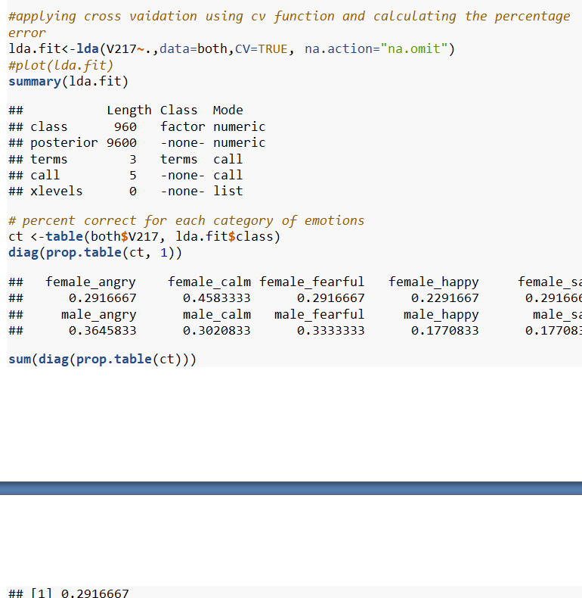
Cross Validation
Applying cross validation using cv function and calculating the percentage error

Slide 18
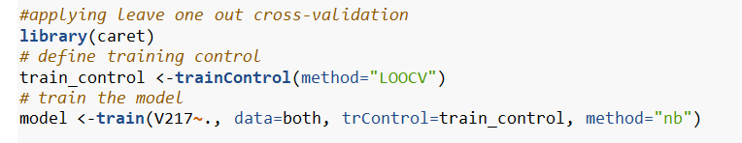
Leave one out cross validation

Slide 19
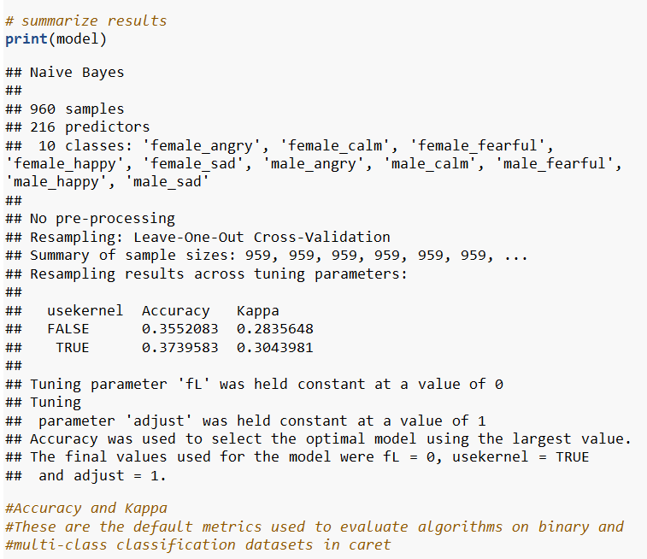
Summary of LOOCV

Slide 20
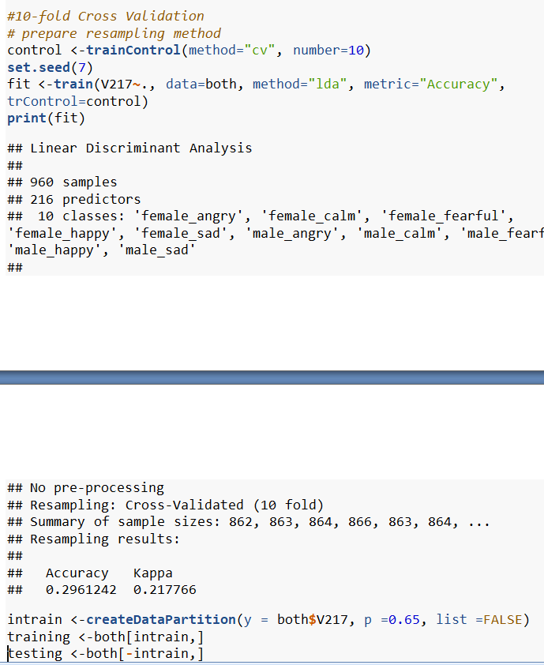
10-fold Cross validation

Slide 21
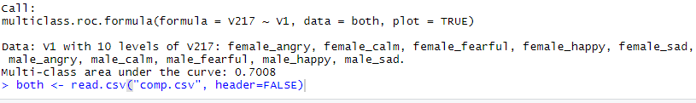
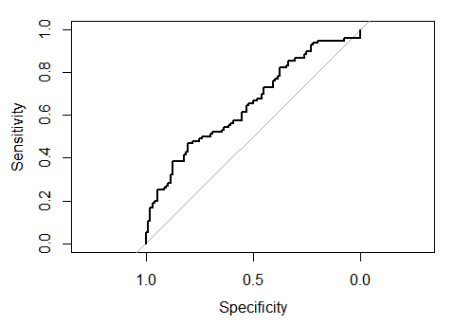
ROC CURVE
We used pROC library to plot
The ROC Curve for multi class
Classification.

Slide 22
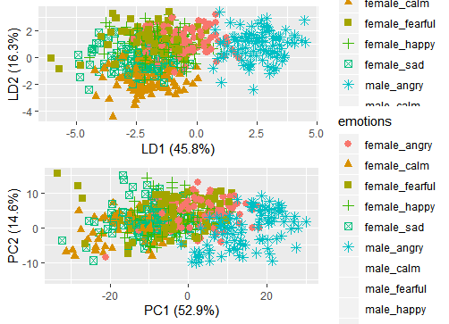
Analysing the LDA AND PCA

Slide 23
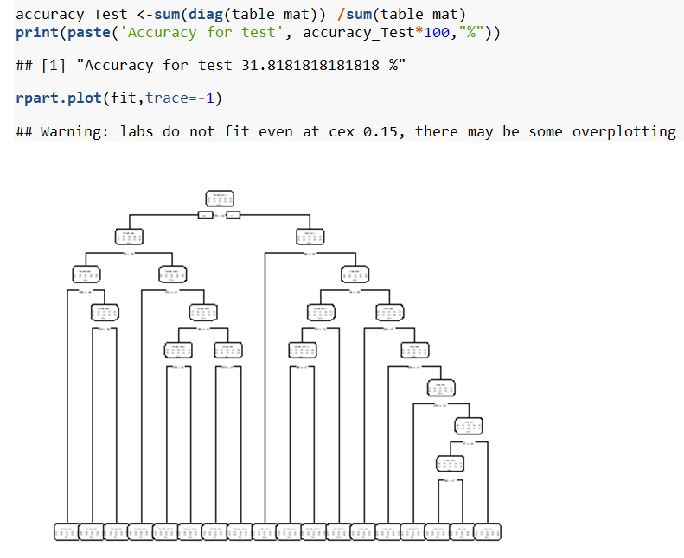
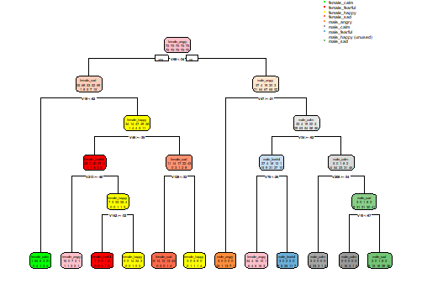
Overview of Non-Linear models (Decision trees)
table_mat <-table(testing$V217, decision_tree)
Using the above command ,we calculate the confusion matrix
And from the confusion matrix we have calculated the accuracy for test data that is coming around 31.81%

Slide 24
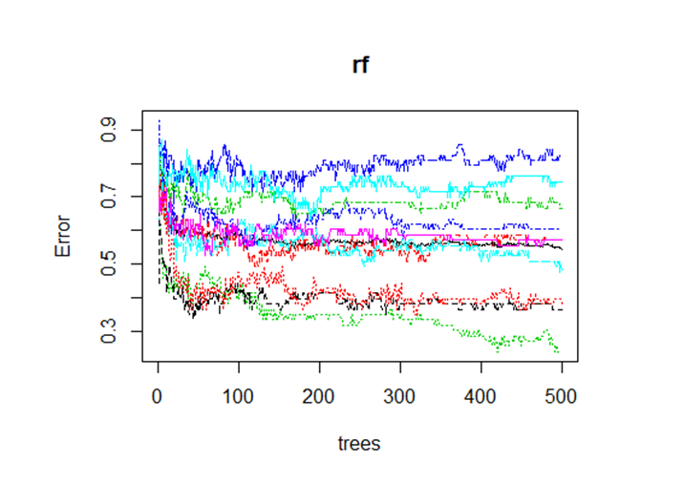
Random Forest
Now we took one step forward of decision tree by using the collection of trees or known as random forest
This is the error rate of random forest with the number of trees.

Slide 25
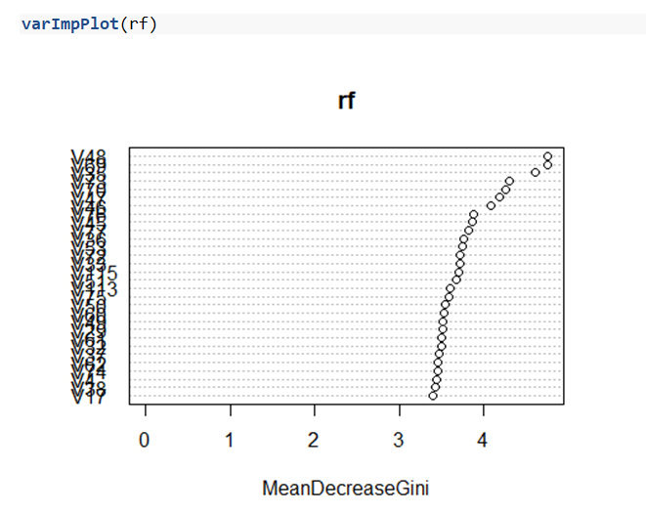
Random Forest
Mean Decrease in Gini is the average (mean) of a variable's total decrease in node impurity, weighted by the proportion of samples reaching that node in each individual decision tree in the random forest

Slide 26
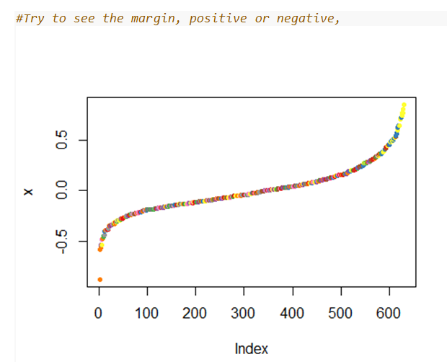
Random Forest
See the margin, positive or negative, if positive it means correct classification
In Random Forest ,
"Accuracy for test is 46.3636363636364 %“

Slide 27
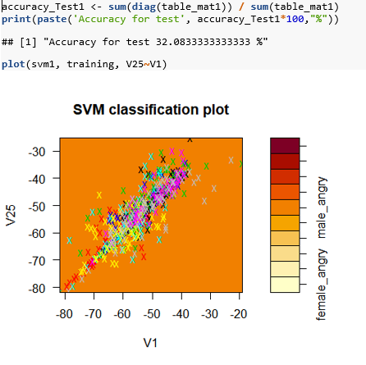
Support Vector Machines
In our SVM Model we have set the cost as 0.1 and gamma as 4 .we are getting the accuracy as 32%

Slide 28
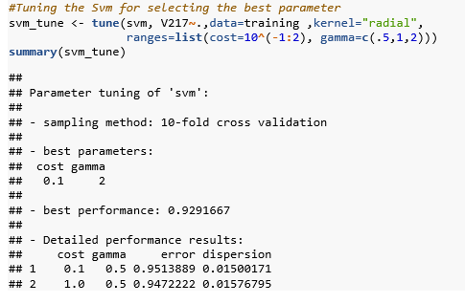
Support Vector Machines after Tuning
So from the tuning parameter we have calculated that the best parameters are
Cost=0.1
Gamma=2

Slide 29
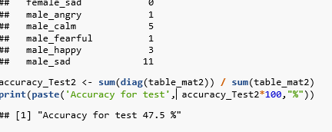
OUTPUT WITH TUNING PARAMETERS
After we get the tuning parameters we will again fit the model and predict the accuracy from the confusion matrix.
From the output we can see our accuracy has increased from 32% to 47.5%.

Slide 30
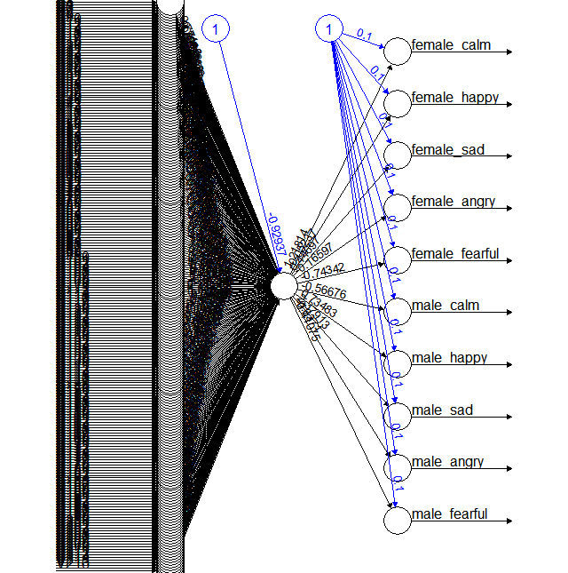
Neural Networks(with 1 hidden layer)

Slide 31
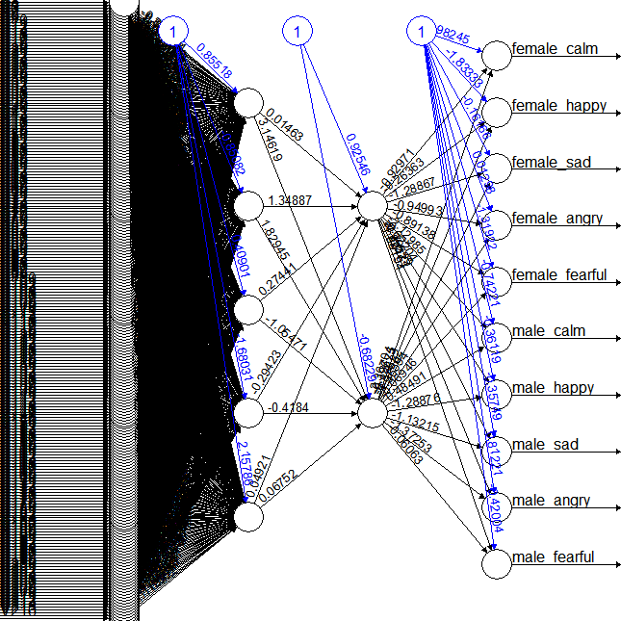
Neural Networks(with 2 hidden layers)

Slide 32
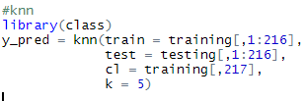
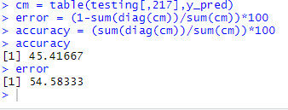
K-NEAREST NEIGHBOUR
The accuracy and error for knn is coming 45% and 54.58 % respectively.

Slide 33
Overall Summary of all models implemented
Accuracy plot
Here we have compared all the linear and non linear models we have implemented.
We can clearly see that svm( with tuning parameter) have got the highest accuracy compared with the all other models.
And lda has got the least accuracy.

Slide 34
THANK YOU

