Slide 1
Dictionary Abstract Data Structure Hash functions
Marzieh Eskandari
NJIT

Slide 2
Dictionary
We assign keys to elements and then use those keys later to look up or remove elements: (k,e)
This functionality defines a data structure known as a dictionary or map.
This structure supports methods for the insertion, removal, and searching of values in terms of keys associated with those values.
Keys are like labels assigned to file folders

Slide 3
Definition: map
A map stores a collection of key-value pairs, (k, v), which we call items, where k is a key and v is a value that is associated with that key.
For example, in a map storing student records (such as the student’s name, address, and course grades), the key might be the student’s ID number.
We assume here that keys are unique then the key associated with an object can be viewed as an “address” for that object in memory.

Slide 4
Definition: Multimap
A map that allows for multiple values for the same key is called a multimap.

Slide 5
Methods
As map data structure, M, supports the following fundamental methods:
get(k): If M contains an item with key equal to k, then return the value of such an item; else return a special element NULL.
put(k, v): Insert an item with key k and value v; if there is already an item with key k, then replace its value with v.
remove(k): Remove from M an item with key equal to k, and return this item. If M has no such item, then return the special element NULL.

Slide 6
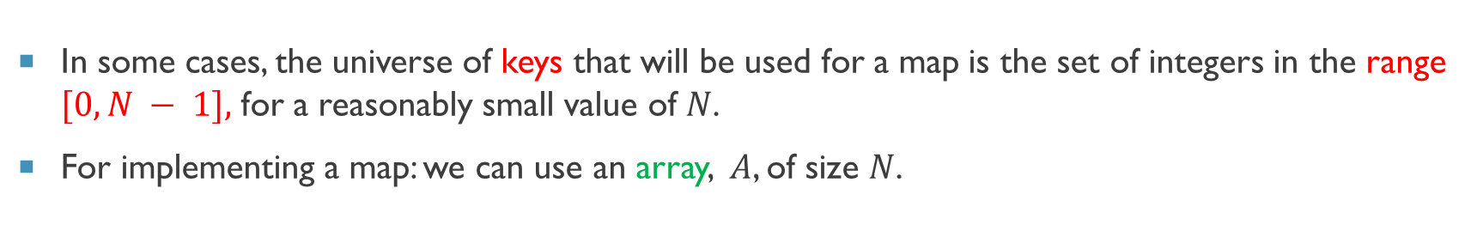
Implementing a map
In some cases, the universe of keys that will be used for a map is the set of integers in the range $[0,N − 1],$ for a reasonably small value of $N$.
For implementing a map: we can use an array, $A$, of size $N$.
0 | 1 | 2 |  | … |  | … |  |  | N-1
A

Slide 7
Lookup Tables
We can use A to store any key-value pair (k, v) by placing that pair in the cell $A[k]$. We refer to this implementation as a lookup table.
0 | 1 | 2 | … | k |  | … |  |  | N-1
 |  |  |  | (k,v)
A

Slide 8
Example
(3,v)
(2,d)
(6,h)
(0,b)
(9,m)
(5,e)
0 | 1 | 2 | 3 | 4 | 5 | 6 | 7 | 8 | 9
B
(0,b)
(2,d)
(3,v)
(5,e)
(6,h)
(9,m)

Slide 9
Lookup Tables
We perform the map operations as follows:
To perform a put(k, v) operation, we assign (k, v) to A[k].
To perform a get(k) operation, we return A[k].
To perform a remove(k) operation, we return A[k] and then we assign the NULL item to A[k].
O(1)

Slide 10
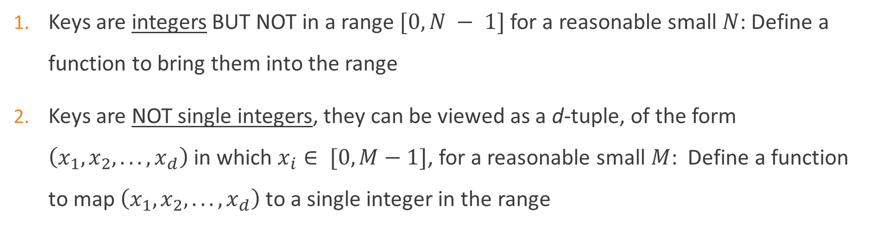
Generalization
Keys are integers BUT NOT in a range $[0,N − 1]$ for a reasonable small $N$: Define a function to bring them into the range
Keys are NOT single integers, they can be viewed as a d-tuple, of the form $\left(x_{1}, x_{2}, . . . , x_{d}\right)$ in which $x_{i}∈ [0, M−1]$, for a reasonable small $M$: Define a function to map $\left(x_{1}, x_{2}, . . . , x_{d}\right)$ to a single integer in the range

Slide 11
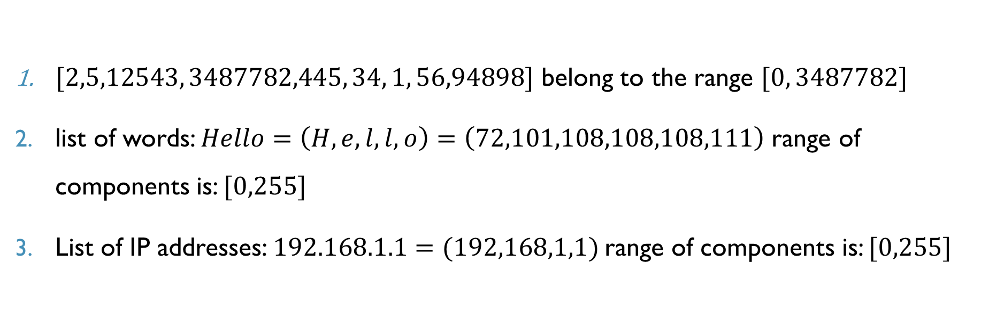
Example
$[2,5,12543, 3487782,445, 34, 1, 56,94898]$ belong to the range $[0, 3487782]$
list of words: $Hello=\left(H,e,l,l,o\right)=\left(72,101,108,108,108,111\right)$ range of components is: $[0,255]$
List of IP addresses: $192.168.1.1=(192,168,1,1)$range of components is: $[0,255]$

Slide 12
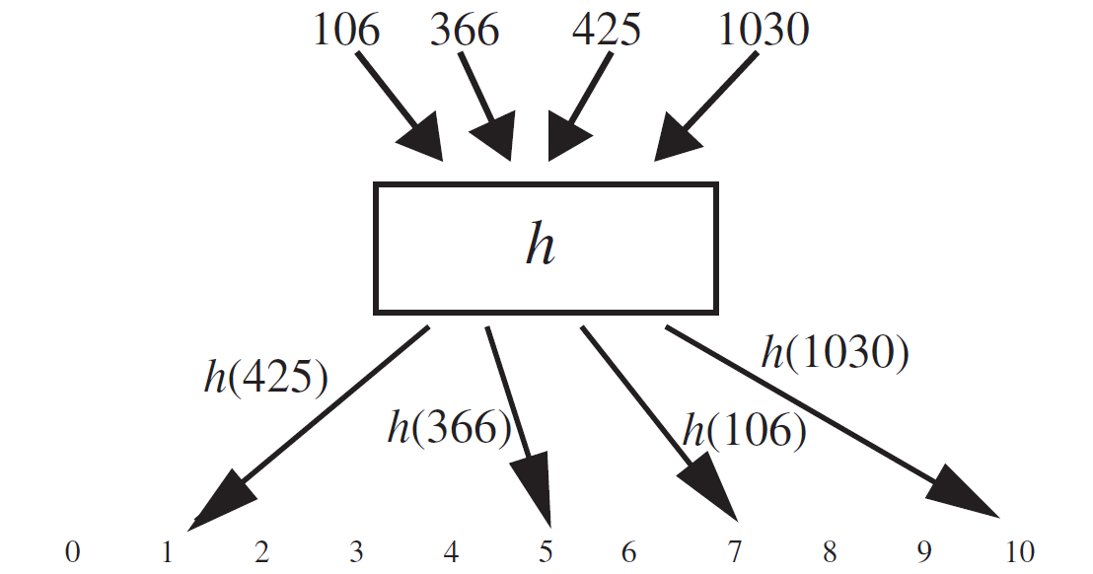
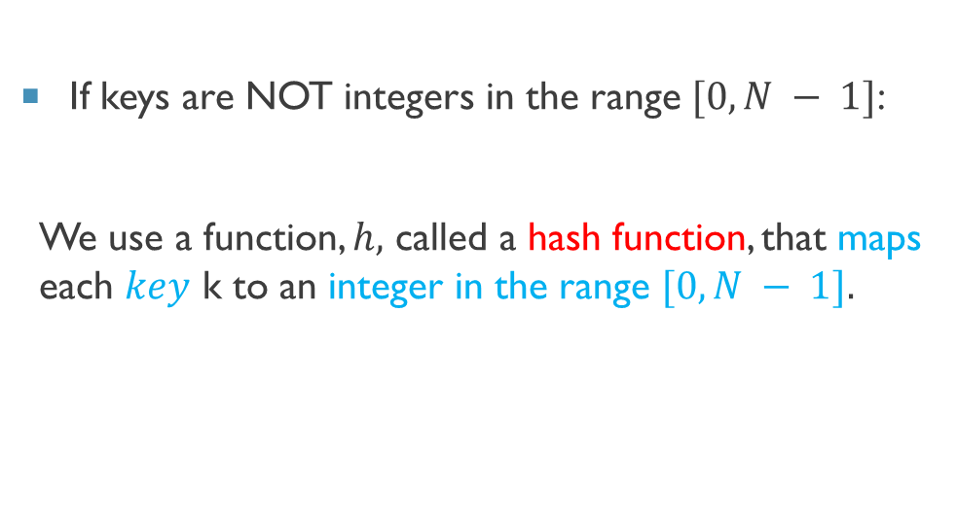
Hash Function
If keys are NOT integers in the range $[0,N − 1]$:
We use a function, $h,$ called a hash function, that maps each $key$ k to an integer in the range $[0,N − 1].$

Slide 13
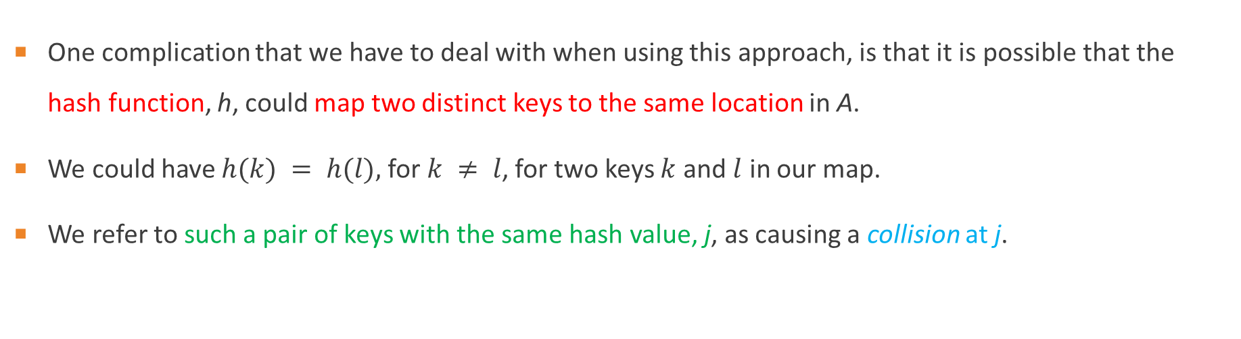
Hash Function: Collision
One complication that we have to deal with when using this approach, is that it is possible that the hash function, h, could map two distinct keys to the same location in A.
We could have $h(k) = h(l),$ for $k ≠ l$, for two keys $k$ and $l$ in our map.
We refer to such a pair of keys with the same hash value, j, as causing a collision at j.

Slide 14
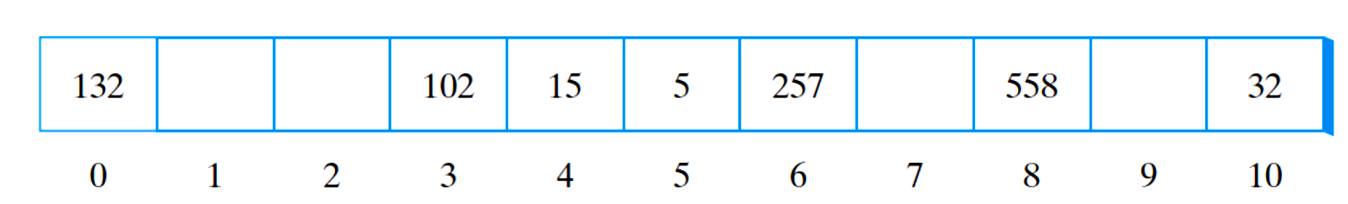


Hash Functions: Example
Suppose that we want to store $257$. If $h(257) = 4$, then $257$ should be stored at location 4$;$
This position is already occupied. In this case we say that a collision has occurred.
$$257$$

Slide 15
Hash functions on integer keys
In the case that we can view the key k as a single integer, there are a number of different kinds of hash functions, such as:
Modular Division
Random Linear Functions
Random Polynomial Functions

Slide 16

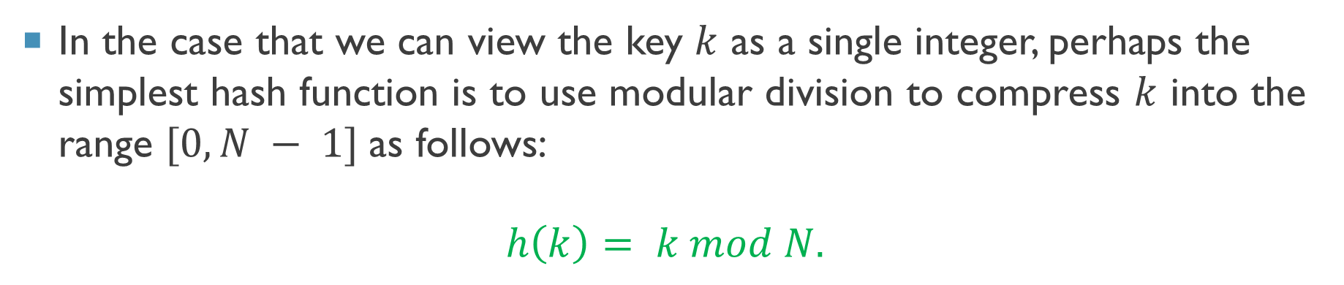
Modular Division
In the case that we can view the key $k$ as a single integer, perhaps the simplest hash function is to use modular division to compress $k$ into the range $[0,N − 1]$as follows:
$$h\left(k\right)= k mod N.$$
$$h(k)=k mod 11$$

Slide 17
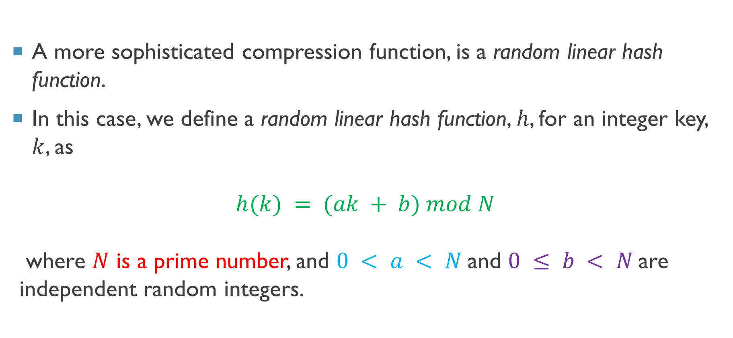
Random Linear Functions
A more sophisticated compression function, is a random linear hash function.
In this case, we define a random linear hash function, $h$, for an integer key, $k$, as
$$h(k) = (ak + b) mod N$$
where $N$ is a prime number, and $0 < a < N$and $0 ≤ b < N$are independent random integers.

Slide 18
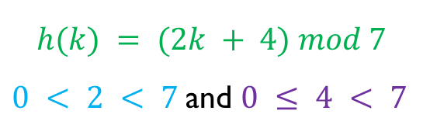
Example
$$h(k) = (2k + 4) mod 7$$
$0 < 2 < 7$and $0 ≤ 4 < 7$
0 | 1 | 2 | 3 | 4
44 | 25 | 23 | 67 | 32
1 | 5 | 1 | 5 | 5
0 | 1 | 2 | 3 | 4 | 5 | 6
 | 44 23 |  |  |  | 25 67 32

Slide 19
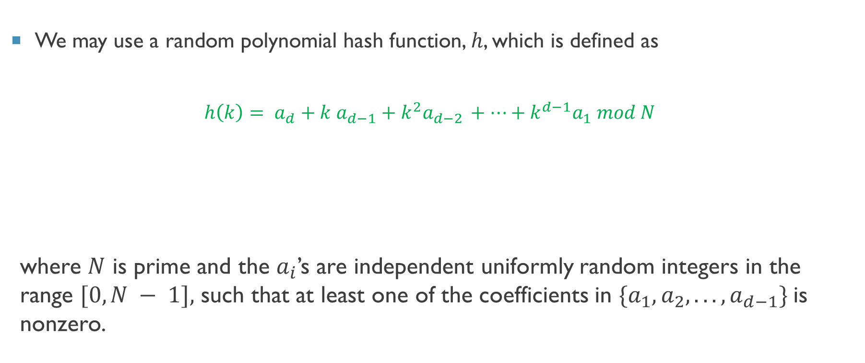
Random Polynomial Functions
We may use a random polynomial hash function, $h$, which is defined as
$$h\left(k\right)= a_{d}+k a_{d−1}+k^{2}a_{d−2 }+…+k^{d−1}a_{1} mod N$$
where $N$ is prime and the $a_{i}$’s are independent uniformly random integers in the range $[0,N − 1],$ such that at least one of the coefficients in $\{a_{1}, a_{2}, . . . , a_{d−1}\}$is nonzero.
By Horner’s rule
$$h\left(k\right)= a_{d}+k\left(a_{d−1}+k\left(a_{d−2}+…+k\left(a_{3} + k\left(a_{2} + ka_{1}\right)\right)… \right)\right)mod N$$

Slide 20
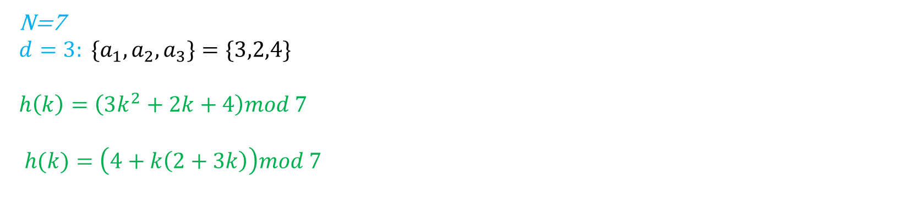
Example
N=7
$$d=3: \{a_{1},a_{2},a_{3}\}=\{3,2,4\}$$
$$h\left(k\right)=\left(3k^{2}+2k+4\right)mod 7$$
$$h(k)=\left(4+k\left(2+3k\right)\right)mod 7$$
0 | 1 | 2 | 3 | 4 | 5
44 | 25 | 23 | 67 | 32 | 89
6 | 4 | 6 | 4 | 4 | 5
0 | 1 | 2 | 3 | 4 | 5 | 6
 |  |  |  | 25 67 32 | 89 | 44 23

Slide 21
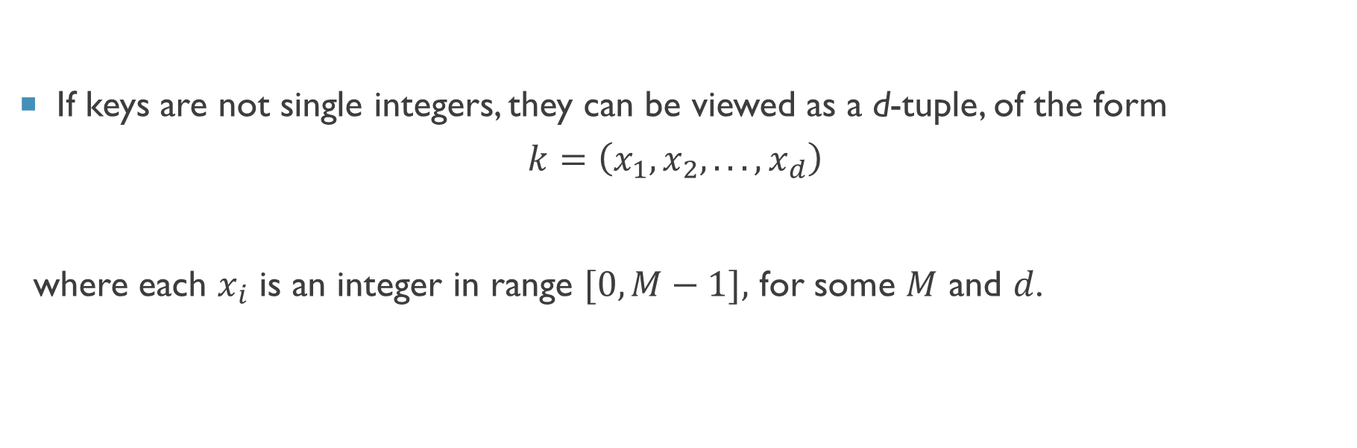
Viewing Keys as Tuples
If keys are not single integers, they can be viewed as a d-tuple, of the form
$$k=\left(x_{1}, x_{2}, . . . , x_{d}\right)$$
where each $x_{i}$ is an integer in range $[0,M−1],$ for some $M$ and $d$.

Slide 22
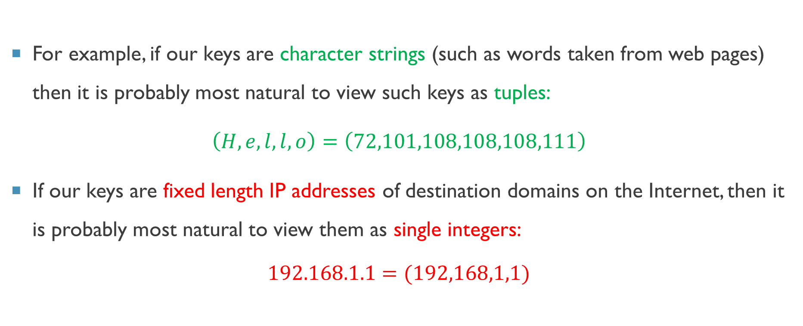
Viewing Keys as Tuples: Example
For example, if our keys are character strings (such as words taken from web pages) then it is probably most natural to view such keys as tuples:
$\left(H,e,l,l,o\right)=\left(72,101,108,108,108,111\right)$
If our keys are fixed length IP addresses of destination domains on the Internet, then it is probably most natural to view them as single integers:
$$192.168.1.1=(192,168,1,1)$$

Slide 23

Hash functions on tuples
In the case when each of our keys, $k$, is a d-tuple, of the form
$$k=\left(x_{1}, x_{2}, . . . , x_{d}\right)$$
There are a number of different kinds of hash functions, such as:
Summing Components
Polynomial-Evaluation
Tabulation-based

Slide 24
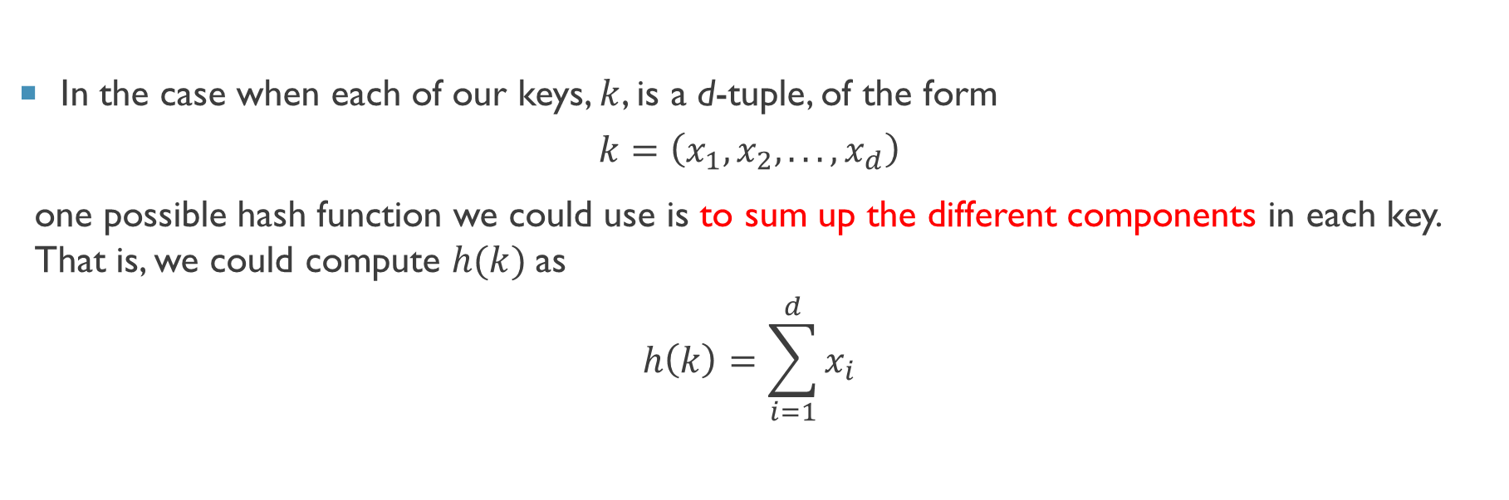
Hash function: Summing Components
In the case when each of our keys, $k$, is a d-tuple, of the form
$$k=\left(x_{1}, x_{2}, . . . , x_{d}\right)$$
one possible hash function we could use is to sum up the different components in each key. That is, we could compute $h(k)$as
$$h\left(k\right)=\sum_{i=1}^{d}{x_{i}}$$

Slide 25
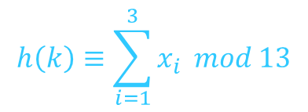
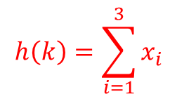
Example
0 | 1 | 2 | 3 | 4 | 5 | 6 | 7 | 8 | 9
(2,9,1) | (3,8,8) | (4,3,0) | (2,2,4) | (5,3,3) | (1,8,0) | (4,1,5) | (9,1,6) | (2,2,1) | (4,6,4)
$$h\left(k\right)=\sum_{i=1}^{3}{x_{i}}$$
12 | 19 | 7 | 8 | 11 | 9 | 10 | 16 | 5 | 14
$$h\left(k\right)≡\sum_{i=1}^{3}{x_{i}} mod 13$$
12 | 6 | 7 | 8 | 11 | 9 | 10 | 3 | 5 | 1
0 | 1 | 2 | 3 | 4 | 5 | 6 | 7 | 8 | 9 | 10 | 11 | 12
 | (4,6,4) |  | (9,1,6) |  | (2,2,1) | (3,8,8) | (4,3,0) | (2,2,4) | (1,8,0) | (4,1,5) | (5,3,3) | (2,9,1)

Slide 26
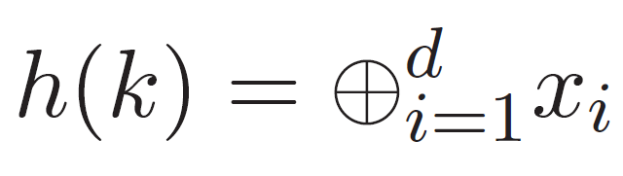
XORing Components
A slight variation on this theme is to compute an exclusive-or of all the components of a key, which could be written mathematically as:
where ⊕ denotes the bitwise exclusive-or (XOR) operation

Slide 27

Example
0 | 1 | 2 | 3 | 4 | 5 | 6 | 7 | 8 | 9
(2,9,1) | (3,8,8) | (4,3,0) | (2,2,4) | (5,3,3) | (1,8,0) | (4,1,5) | (9,1,6) | (2,2,1) | (4,6,4)
$$h\left(k\right)=⊕_{i=1}^{3}x_{i}$$
10 | 3 | 7 | 4 | 5 | 9 | 0 | 14 | 1 | 6
0 | 1 | 2 | 3 | 4 | 5 | 6 | 7 | 8 | 9 | 10 | 11 | 12 | 13 | 14
(4,1,5) | (2,2,1) |  | (3,8,8) | (2,2,4) | (5,3,3) | (4,6,4) | (4,3,0) |  | (1,8,0) | (2,9,1) |  |  |  | (9,1,6)

Slide 28
Summing Components: Collision
Unfortunately, such hash functions, which consist of either summing or XORing the components of each key, are actually not that good in most applications.
Such a function is fairly poor at avoiding collisions for some cases.
For example, consider such a hash function for a character string s that sums the ASCII values of the characters in s.
This hash function produces lots of unwanted collisions for some words such as:
"stop", "tops", "pots", "spot"

Slide 29
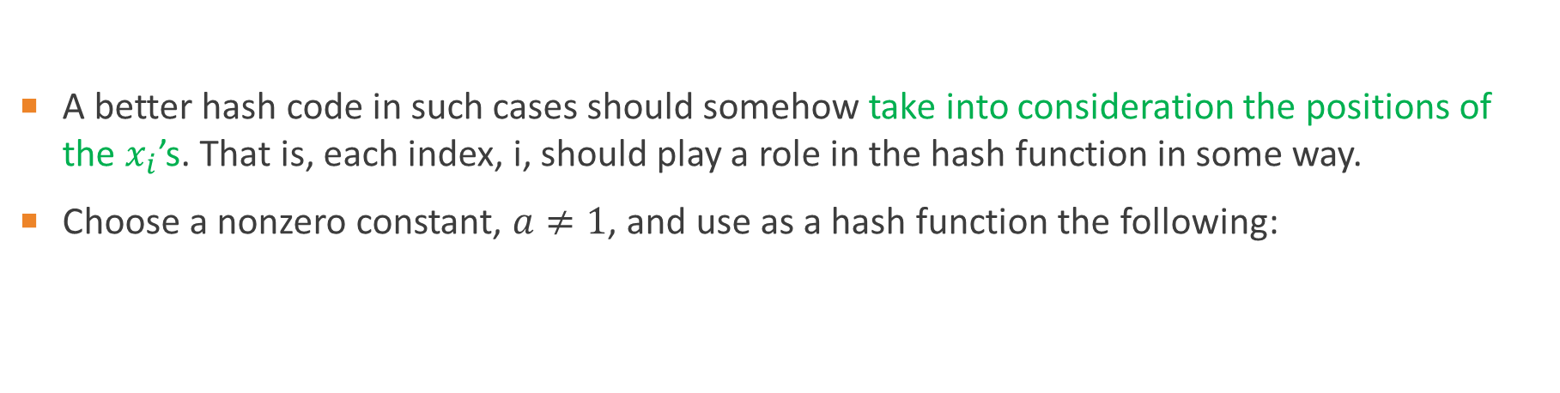
Polynomial-Evaluation Functions
A better hash code in such cases should somehow take into consideration the positions of the $x_{i}$’s. That is, each index, i, should play a role in the hash function in some way.
Choose a nonzero constant, $a≠1$, and use as a hash function the following:
By Horner’s rule

Slide 30
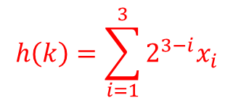
Example
0 | 1 | 2 | 3 | 4 | 5 | 6 | 7 | 8 | 9
(2,9,1) | (3,8,8) | (4,3,0) | (2,2,4) | (5,3,3) | (1,8,0) | (4,1,5) | (9,1,6) | (2,2,1) | (4,6,4)
$$h\left(k\right)=\sum_{i=1}^{3}{{2^{3−i}x}_{i}}$$
27 | 36 | 22 | 16 | 29 | 20 | 23 | 44 | 13 | 32
… | 13 | … | 16 | … | 20 | … | 22 | 23 | … | 27 | … | 29 | … | 32 | … | 36 | … | 44
… | (2,2,1) | … | (2,2,4) | … | (1,8,0) | … | (4,3,0) | (4,1,5) | … | (2,9,1) | … | (5,3,3) | … | (4,6,4) | … | (3,8,8) | … | (9,1,6)

Slide 31
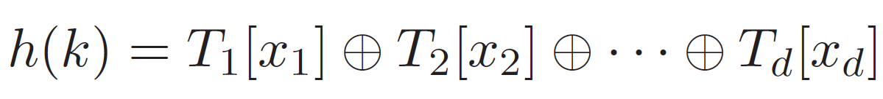
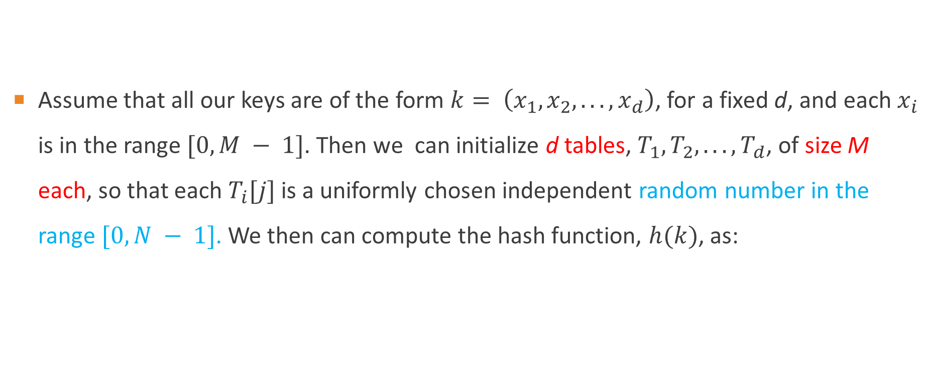
Tabulation-based hash functions
Assume that all our keys are of the form $k= \left(x_{1}, x_{2}, . . . , x_{d}\right)$, for a fixed d, and each $x_{i}$ is in the range $[0,M − 1]$. Then we can initialize d tables, $T_{1}, T_{2}, . . . , T_{d}$, of size M each, so that each $T_{i}[j]$ is a uniformly chosen independent random number in the range $[0,N − 1]$. We then can compute the hash function, $h(k)$, as:

Slide 32
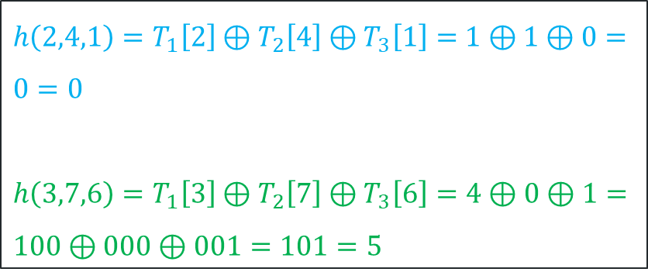
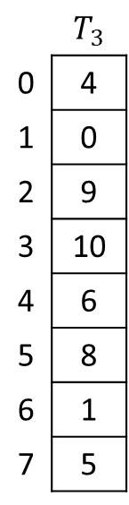
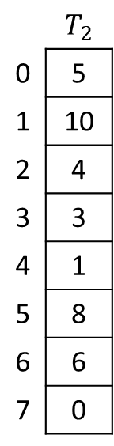
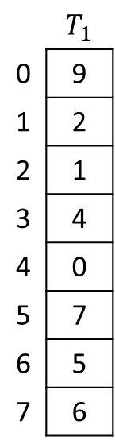
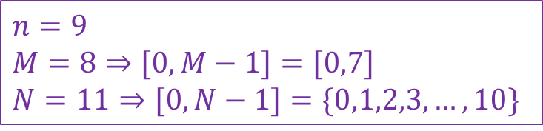
Example
0 | 1 | 2 | 3 | 4 | 5 | 6 | 7 | 8
(2,4,1) | (3,7,6) | (4,3,0) | (2,2,4) | (5,3,3) | (1,2,0) | (4,1,5) | (5,1,6) | (2,1,6)
 | $$T_{1}$$
0 | 9
1 | 2
2 | 1
3 | 4
4 | 0
5 | 7
6 | 5
7 | 6
 | $$T_{2}$$
0 | 5
1 | 10
2 | 4
3 | 3
4 | 1
5 | 8
6 | 6
7 | 0
 | $$T_{3}$$
0 | 4
1 | 0
2 | 9
3 | 10
4 | 6
5 | 8
6 | 1
7 | 5
$$n=9$$
$$M=8⇒[0,M−1]=[0,7]$$
$$N=11⇒[0,N−1]=\{0,1,2,3,…,10\}$$
M
$h\left(2,4,1\right)=T_{1}\left[2\right]⊕T_{2}\left[4\right]⊕T_{3}\left[1\right]=$ $1⊕1⊕0=0=0$
$h\left(3,7,6\right)=T_{1}\left[3\right]⊕T_{2}\left[7\right]⊕T_{3}\left[6\right]=4⊕0⊕1=$ $100⊕000⊕001=101=5$
d

Slide 33
Handling Collisions and Rehashing
There are some methods for handling collisions:
Chaining Method
Linear Probing
Quadratic Probing
Double Hashing
Cuckoo Hashing
Open address

Slide 34
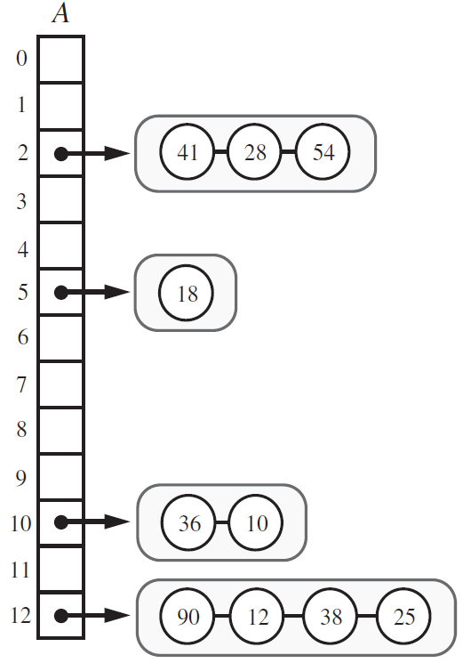
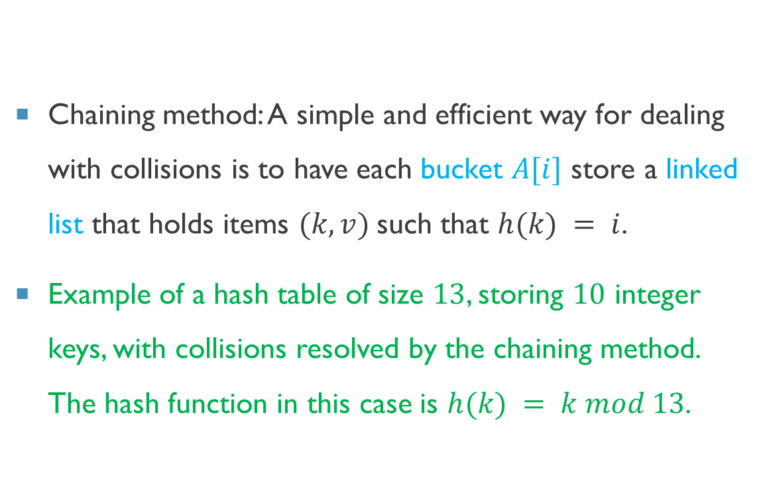
Chaining method
Chaining method: A simple and efficient way for dealing with collisions is to have each bucket $A[i]$ store a linked list that holds items $(k, v)$such that $h(k) = i$.
Example of a hash table of size $13$, storing $10$ integer keys, with collisions resolved by the chaining method. The hash function in this case is $h(k) = k mod 13$.

Slide 35
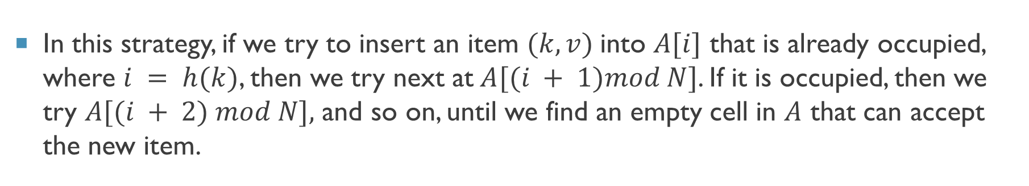
Linear Probing
In this strategy, if we try to insert an item $(k, v)$into $A[i]$ that is already occupied, where $i = h(k)$, then we try next at$A[(i + 1)mod N]$. If it is occupied, then we try $A[(i + 2) mod N],$ and so on, until we find an empty cell in $A$ that can accept the new item.
25
h(k) = k mod 11

Slide 36
Linear Probing
In this strategy, if we try to insert an item $(k, v)$into $A[i]$ that is already occupied, where $i = h(k)$, then we try next at$A[(i + 1)mod N]$. If it is occupied, then we try $A[(i + 2) mod N],$ and so on, until we find an empty cell in $A$ that can accept the new item.
25
h(k) = k mod 11

Slide 37
Linear Probing
In this strategy, if we try to insert an item $(k, v)$into $A[i]$ that is already occupied, where $i = h(k)$, then we try next at$A[(i + 1)mod N]$. If it is occupied, then we try $A[(i + 2) mod N],$ and so on, until we find an empty cell in $A$ that can accept the new item.
25
h(k) = k mod 11

Slide 38
Linear Probing
In this strategy, if we try to insert an item $(k, v)$into $A[i]$ that is already occupied, where $i = h(k)$, then we try next at$A[(i + 1)mod N]$. If it is occupied, then we try $A[(i + 2) mod N],$ and so on, until we find an empty cell in $A$ that can accept the new item.
25
h(k) = k mod 11

Slide 39
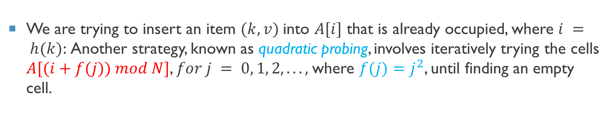
Quadratic Probing
We are trying to insert an item $(k, v)$into $A[i]$ that is already occupied, where $i = h(k):$Another strategy, known as quadratic probing, involves iteratively trying the cells $A[(i+f(j)) mod N]$, $for j = 0, 1, 2, . . .,$where $f(j)=j^{2}$, until finding an empty cell.
Add(25)
h(k) = k mod 11

Slide 40
Quadratic Probing
We are trying to insert an item $(k, v)$into $A[i]$ that is already occupied, where $i = h(k):$Another strategy, known as quadratic probing, involves iteratively trying the cells $A[(i+f(j)) mod N]$, $for j = 0, 1, 2, . . .,$where $f(j)=j^{2}$, until finding an empty cell.
25
h(k) = k mod 11

Slide 41
Quadratic Probing
We are trying to insert an item $(k, v)$into $A[i]$ that is already occupied, where $i = h(k):$Another strategy, known as quadratic probing, involves iteratively trying the cells $A[(i+f(j)) mod N]$, $for j = 0, 1, 2, . . .,$where $f(j)=j^{2}$, until finding an empty cell.
25
h(k) = k mod 11

Slide 42
Quadratic Probing
We are trying to insert an item $(k, v)$into $A[i]$ that is already occupied, where $i = h(k):$Another strategy, known as quadratic probing, involves iteratively trying the cells $A[(i+f(j)) mod N]$, $for j = 0, 1, 2, . . .,$where $f(j)=j^{2}$, until finding an empty cell.
25
h(k) = k mod 11

Slide 43
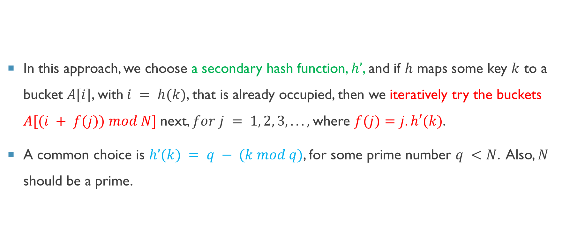
Double Hashing
In this approach, we choose a secondary hash function, $h’$, and if $h$ maps some key $k$ to a bucket $A[i]$, with$i = h(k)$, that is already occupied, then we iteratively try the buckets $A[(i + f(j)) mod N]$next, $for j = 1, 2, 3, . . .,$where $f(j)=j.h′(k)$.
A common choice is $h’(k) = q − (k mod q)$, for some prime number $q <N$. Also, $N$ should be a prime.

Slide 44
Example
$h\left(k\right)=\left(3k^{2}+2k+4\right)mod 7$ Random Polynomial Functions
0 | 1 | 2 | 3 | 4 | 5
44 | 25 | 23 | 67 | 32 | 89
6 | 4 | 6 | 4 | 4 | 5
0 | 1 | 2 | 3 | 4 | 5 | 6
 |  |  |  | 25 67 32 | 89 | 44 23

Slide 45
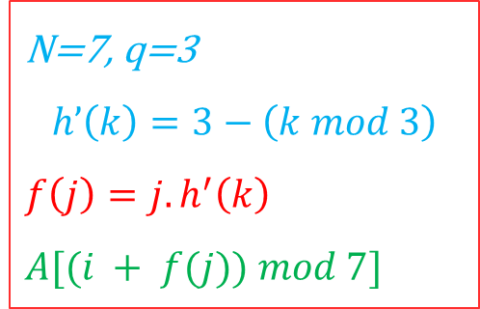
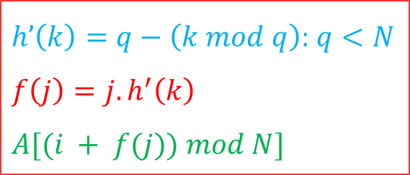
Example
$h’\left(k\right)=q−\left(k mod q\right)$: $q<N$
$$f\left(j\right)=j.h^{′}\left(k\right)$$
$$A[(i + f(j)) mod N]$$
0 | 1 | 2 | 3 | 4 | 5
44 | 25 | 23 | 67 | 32 | 89
6 | 4 | 6 | 4 | 4 | 5
N=7, q=3
$$h’\left(k\right)=3−\left(k mod 3\right)$$
$$f\left(j\right)=j.h^{′}\left(k\right)$$
$$A[(i + f(j)) mod 7]$$
0 | 1 | 2 | 3 | 4 | 5 | 6
 |  |  |  | 25 67 32 | 89 | 44 23

Slide 46
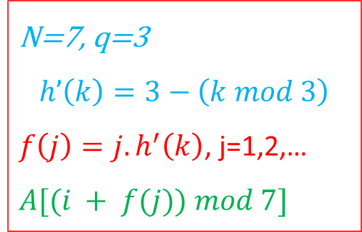
Example
0 | 1 | 2 | 3 | 4 | 5
44 | 25 | 23 | 67 | 32 | 89
N=7, q=3
$$h’\left(k\right)=3−\left(k mod 3\right)$$
$f\left(j\right)=j.h^{′}\left(k\right)$, j=1,2,…
$$A[(i + f(j)) mod 7]$$
6 | 4 | 6 | 4 | 4 | 5
 |  | ? | ? | ? | ? | ? | ?
0 | 1 | 2 | 3 | 4 | 5 | 6

Slide 47

Example
0 | 1 | 2 | 3 | 4 | 5
44 | 25 | 23 | 67 | 32 | 89
N=7, q=3
$$h’\left(k\right)=3−\left(k mod 3\right)$$
$f\left(j\right)=j.h^{′}\left(k\right)$, j=1,2,…
$$A[(i + f(j)) mod 7]$$
6 | 4 | 6 | 4 | 4 | 5
 |  | 6 | 4 | ? | ? | ? | ?
0 | 1 | 2 | 3 | 4 | 5 | 6
 |  |  |  | 25 |  | 44

Slide 48
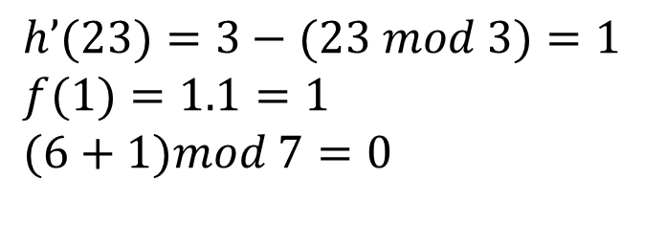

Example
0 | 1 | 2 | 3 | 4 | 5
44 | 25 | 23 | 67 | 32 | 89
N=7, q=3
$$h’\left(k\right)=3−\left(k mod 3\right)$$
$f\left(j\right)=j.h^{′}\left(k\right)$, j=1,2,…
$$A[(i + f(j)) mod 7]$$
6 | 4 | 6 | 4 | 4 | 5
$$h’(23)=3−(23 mod 3)=1$$
$$f(1)=1.1=1$$
$$(6+1)mod 7=0$$
 |  | 6 | 4 | ? | ? | ? | ?
0 | 1 | 2 | 3 | 4 | 5 | 6
 |  |  |  | 25 |  | 44

Slide 49

Example
0 | 1 | 2 | 3 | 4 | 5
44 | 25 | 23 | 67 | 32 | 89
N=7, q=3
$$h’\left(k\right)=3−\left(k mod 3\right)$$
$f\left(j\right)=j.h^{′}\left(k\right)$, j=1,2,…
$$A[(i + f(j)) mod 7]$$
6 | 4 | 6 | 4 | 4 | 5
$$h’(23)=3−(23 mod 3)=1$$
$$f(1)=1.1=1$$
$$(6+1)mod 7=0$$
 |  | 6 | 4 | 0 | ? | ? | ?
0 | 1 | 2 | 3 | 4 | 5 | 6
23 |  |  |  | 25 |  | 44

Slide 50
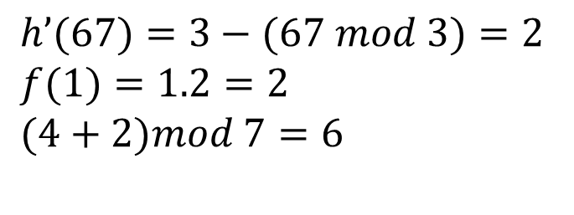
Example
0 | 1 | 2 | 3 | 4 | 5
44 | 25 | 23 | 67 | 32 | 89
N=7, q=3
$$h’\left(k\right)=3−\left(k mod 3\right)$$
$f\left(j\right)=j.h^{′}\left(k\right)$, j=1,2,…
$$A[(i + f(j)) mod 7]$$
6 | 4 | 6 | 4 | 4 | 5
$$h’(67)=3−(67 mod 3)=2$$
$$f(1)=1.2=2$$
$$(4+2)mod 7=6$$
X
 |  | 6 | 4 | 0 | ? | ? | ?
0 | 1 | 2 | 3 | 4 | 5 | 6
23 |  |  |  | 25 |  | 44

Slide 51
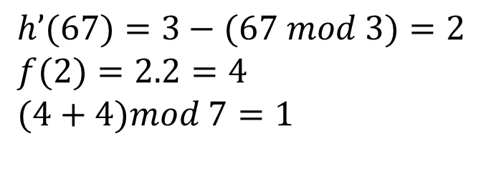
Example
0 | 1 | 2 | 3 | 4 | 5
44 | 25 | 23 | 67 | 32 | 89
N=7, q=3
$$h’\left(k\right)=3−\left(k mod 3\right)$$
$f\left(j\right)=j.h^{′}\left(k\right)$, j=1,2,…
$$A[(i + f(j)) mod 7]$$
6 | 4 | 6 | 4 | 4 | 5
$$h’(67)=3−(67 mod 3)=2$$
$$f(2)=2.2=4$$
$$(4+4)mod 7=1$$
 |  | 6 | 4 | 0 | ? | ? | ?
0 | 1 | 2 | 3 | 4 | 5 | 6
23 | 67 |  |  | 25 |  | 44

Slide 52
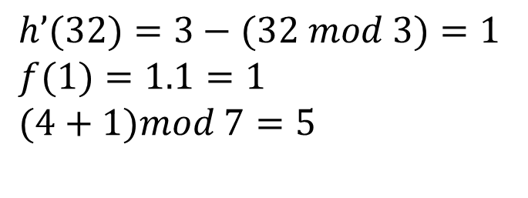

Example
0 | 1 | 2 | 3 | 4 | 5
44 | 25 | 23 | 67 | 32 | 89
N=7, q=3
$$h’\left(k\right)=3−\left(k mod 3\right)$$
$f\left(j\right)=j.h^{′}\left(k\right)$, j=1,2,…
$$A[(i + f(j)) mod 7]$$
6 | 4 | 6 | 4 | 4 | 5
$$h’(32)=3−(32 mod 3)=1$$
$$f(1)=1.1=1$$
$$(4+1)mod 7=5$$
 |  | 6 | 4 | 0 | ? | ? | ?
0 | 1 | 2 | 3 | 4 | 5 | 6
23 | 67 |  |  | 25 | 32 | 44

Slide 53
Cuckoo Hashing
Cuckoo hashing is a type of hashing algorithm used in hash tables to resolve collisions. The idea behind cuckoo hashing is to use multiple hash functions and two (or more) hash tables. If a collision occurs, the existing element is "kicked out" and reinserted using another hash function. This process can repeat until all elements are placed or a maximum number of displacements is reached, at which point the hash table may be resized.

Slide 54
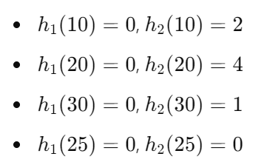
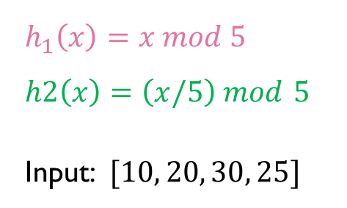
Example
$$h_{1}​\left(x\right)=x mod 5$$
$$h2\left(x\right)=\left(x/5\right) mod 5$$
Input: $[10, 20, 30, 25]$
0 | 1 | 2 | 3 | 4
0 | 1 | 2 | 3 | 4
0 | 1 | 2 | 3 | 4
10
0 | 1 | 2 | 3 | 4
0 | 1 | 2 | 3 | 4
20
0 | 1 | 2 | 3 | 4
 |  | 10
0 | 1 | 2 | 3 | 4
30
0 | 1 | 2 | 3 | 4
 |  | 10 |  | 20
0 | 1 | 2 | 3 | 4
25
0 | 1 | 2 | 3 | 4
 | 30 | 10 |  | 20

Slide 55
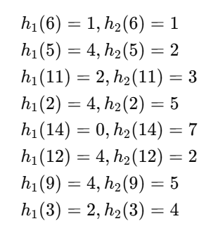
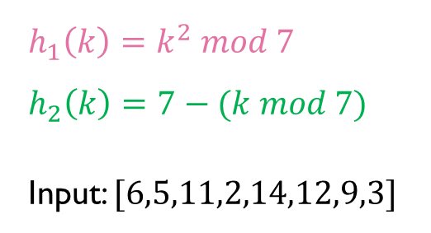
Example
$$h_{1}\left(k\right)=k^{2} mod 7$$
$$h_{2}\left(k\right)=7−(k mod 7)$$
Input: $[6,5,11,2,14,12,9,3]$
0 | 1 | 2 | 3 | 4 | 5 | 6
0 | 1 | 2 | 3 | 4 | 5 | 6 | 7
0 | 1 | 2 | 3 | 4 | 5 | 6
 | 6 | 11 |  | 5
0 | 1 | 2 | 3 | 4 | 5 | 6 | 7
0 | 1 | 2 | 3 | 4 | 5 | 6
 | 6 | 11 |  | 2
0 | 1 | 2 | 3 | 4 | 5 | 6 | 7
 |  | 5
0 | 1 | 2 | 3 | 4 | 5 | 6
14 | 6 | 11 |  | 12
0 | 1 | 2 | 3 | 4 | 5 | 6 | 7
 |  | 5 |  |  | 2

Slide 56
Example
$$h_{1}\left(k\right)=k^{2} mod 7$$
$$h_{2}\left(k\right)=7−(k mod 7)$$
Input: $[6,5,11,2,14,12,9,3]$
9
0 | 1 | 2 | 3 | 4 | 5 | 6
14 | 6 | 11 |  | 12
0 | 1 | 2 | 3 | 4 | 5 | 6 | 7
 |  | 5 |  |  | 2

Slide 57
Example
$$h_{1}\left(k\right)=k^{2} mod 7$$
$$h_{2}\left(k\right)=7−(k mod 7)$$
Input: $[6,5,11,2,14,12,9,3]$
0 | 1 | 2 | 3 | 4 | 5 | 6
14 | 6 | 11 |  | 9
0 | 1 | 2 | 3 | 4 | 5 | 6 | 7
 |  | 5 |  |  | 2
12

Slide 58
Example
$$h_{1}\left(k\right)=k^{2} mod 7$$
$$h_{2}\left(k\right)=7−(k mod 7)$$
Input: $[6,5,11,2,14,12,9,3]$
5
0 | 1 | 2 | 3 | 4 | 5 | 6
14 | 6 | 11 |  | 9
0 | 1 | 2 | 3 | 4 | 5 | 6 | 7
 |  | 12 |  |  | 2

Slide 59
Example
$$h_{1}\left(k\right)=k^{2} mod 7$$
$$h_{2}\left(k\right)=7−(k mod 7)$$
Input: $[6,5,11,2,14,12,9,3]$
0 | 1 | 2 | 3 | 4 | 5 | 6
14 | 6 | 11 |  | 5
0 | 1 | 2 | 3 | 4 | 5 | 6 | 7
 |  | 12 |  |  | 2
9

Slide 60
Example
$$h_{1}\left(k\right)=k^{2} mod 7$$
$$h_{2}\left(k\right)=7−(k mod 7)$$
Input: $[6,5,11,2,14,12,9,3]$
2
0 | 1 | 2 | 3 | 4 | 5 | 6
14 | 6 | 11 |  | 5
0 | 1 | 2 | 3 | 4 | 5 | 6 | 7
 |  | 12 |  |  | 9

Slide 61
Example
$$h_{1}\left(k\right)=k^{2} mod 7$$
$$h_{2}\left(k\right)=7−(k mod 7)$$
Input: $[6,5,11,2,14,12,9,3]$
0 | 1 | 2 | 3 | 4 | 5 | 6
14 | 6 | 11 |  | 2
0 | 1 | 2 | 3 | 4 | 5 | 6 | 7
 |  | 12 |  |  | 9
5

Slide 62
Example
$$h_{1}\left(k\right)=k^{2} mod 7$$
$$h_{2}\left(k\right)=7−(k mod 7)$$
Input: $[6,5,11,2,14,12,9,3]$
12
0 | 1 | 2 | 3 | 4 | 5 | 6
14 | 6 | 11 |  | 2
0 | 1 | 2 | 3 | 4 | 5 | 6 | 7
 |  | 5 |  |  | 9

Slide 63
Example
$$h_{1}\left(k\right)=k^{2} mod 7$$
$$h_{2}\left(k\right)=7−(k mod 7)$$
Input: $[6,5,11,2,14,12,9,3]$
0 | 1 | 2 | 3 | 4 | 5 | 6
14 | 6 | 11 |  | 12
0 | 1 | 2 | 3 | 4 | 5 | 6 | 7
 |  | 5 |  |  | 9
2

Slide 64
Example
$$h_{1}\left(k\right)=k^{2} mod 7$$
$$h_{2}\left(k\right)=7−(k mod 7)$$
Input: $[6,5,11,2,14,12,9,3]$
9
0 | 1 | 2 | 3 | 4 | 5 | 6
14 | 6 | 11 |  | 12
0 | 1 | 2 | 3 | 4 | 5 | 6 | 7
 |  | 5 |  |  | 2

Slide 65
Example
$$h_{1}\left(k\right)=k^{2} mod 7$$
$$h_{2}\left(k\right)=7−(k mod 7)$$
Input: $[6,5,11,2,14,12,9,3]$
0 | 1 | 2 | 3 | 4 | 5 | 6
14 | 6 | 11 |  | 9
0 | 1 | 2 | 3 | 4 | 5 | 6 | 7
 |  | 5 |  |  | 2
12
Endless loop: Return to slide 57!!

Slide 66
Any Question??
Have a nice day!

