Slide 1
Greedy+DP

Slide 2
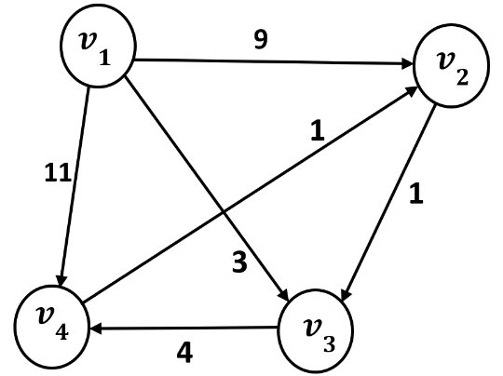
Find the all shortest paths from v1 to the other vertices using Dijkstra Algorithm:

Slide 3
Dijkstra(W)
FOR i=2 TO n DO
D[i]=W[1][i]
P[i]=1
FOR i=1 TO n-1 DO
m=index of minimum in D
FOR EACH j in D:
IF D[m]+W[m][j]<D[j] THEN
D[j]=D[m]+W[m][j]
P[j]=m
PRINT D[m]
D.delete(m)
$$D^{new}\left[i\right]=min⁡\left\{D^{old} , \left[i\right] D^{old}\left[m\right]+W\left[m\right]\left[i\right]\right\}$$

Slide 4
 | V2 | V3 | V4 |  |  | V2 | V3 | V4
D | 9 | 3 | 11 |  | P | 1 | 1 | 1
m=3
D[2]=min{D[2],D[3]+W[3][2]}=min{9,3+inf}=9
D[4]=min{D[4],D[3]+W[3][4]}=min{11,3+4}=7
 | V2 | V3 | V4 |  |  | V2 | V3 | V4
D | 9 | 3 | 7 |  | P | 1 | 1 | 3
m=4
D[2]=min{D[2],D[4]+W[4][2]}=min{9,7+1}=8
 | V2 | V3 | V4 |  |  | V2 | V3 | V4
D | 8 | 3 | 7 |  | P | 4 | 1 | 3

Slide 5
Calculating shortest paths using P matrix:
 | V2 | V3 | V4
P | 4 | 1 | 3
SP(1,2)=(1,…,2)=(1,…,4,2)=(1,3,4,2)
SP(1,3)=(1,3)
SP(1,4)=(1,…,4)=1,3,4

Slide 7

Binomial Coefficients/ Pascal triangle
$${\left(x+y\right)}^{n}=\sum_{r=0}^{n}{\left({n \atop r}\right)x^{r}y^{n−r}}$$
$$\left({n \atop r}\right)=\left({n−1 \atop r−1}\right)+\left({n−1 \atop r}\right)$$
$$0≤r≤n$$
$$\left({n \atop 0}\right)=1$$
$$\left({r \atop r}\right)=1$$
n=0 |  |  |  |  |  | 1
n=1 |  |  |  |  | 1 |  | 1
n=2 |  |  |  | 1 |  | 2 |  | 1
n=3 |  |  | 1 |  | 3 |  | 3 |  | 1
n=4 |  | 1 |  | 4 |  | 6 |  | 4 |  | 1
n=5 | 1 |  | 5 |  | 10 |  | 10 |  | 5 |  | 1
Notes:
n choose r

Slide 8
Binomial Coefficients: without DP
$n≥r:BC(r,r)=BC(n,0)=1, BC(n,r)=BC(n−1,r−1)+BC(n−1,r)$
BC(n,r):
if r==0 or n==r then
return 1
return BC(n-1,r)+BC(n-1,r-1)
$$Exponential complexity!$$

Slide 9
Binomial Coefficient
BC(4,2)
BC(3,2)
BC(3,1)
BC(2,2)
BC(2,1)
BC(2,1)
BC(2,0)
BC(1,1)
BC(1,0)
BC(1,1)
BC(1,0)

Slide 10
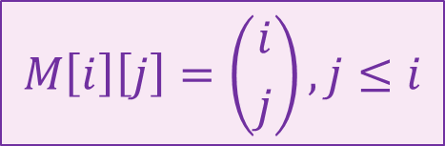
Binomial Coefficient: using DP
$$M\left[i\right]\left[j\right]=\left({i \atop j}\right), j≤i$$
 | 0 | 1 | ... | r
0
1
2
:
n

Slide 11

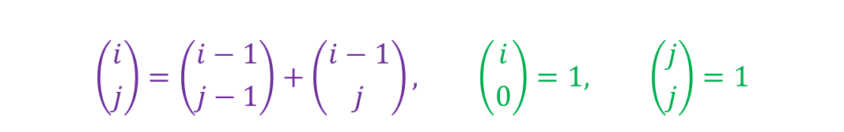
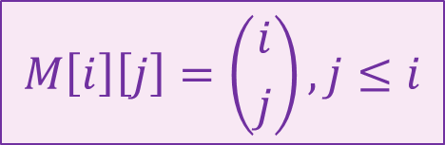
Binomial Coefficient
$$\left({i \atop j}\right)=\left({i−1 \atop j−1}\right)+\left({i−1 \atop j}\right), \left({i \atop 0}\right)=1, \left({j \atop j}\right)=1$$
$$M\left[i\right]\left[j\right]=\left({i \atop j}\right), j≤i$$
 | 0 | 1 | ... | r
0 | 1
1 | 1 | 1
2 | 1 |  | 1
: | 1
n | 1
$$M\left[i\right]\left[j\right]=M\left[i−1\right]\left[j−1\right]+M\left[i−1\right]\left[j\right],$$
$$M\left[i\right][0]=1, M[j][j]=1$$

Slide 12

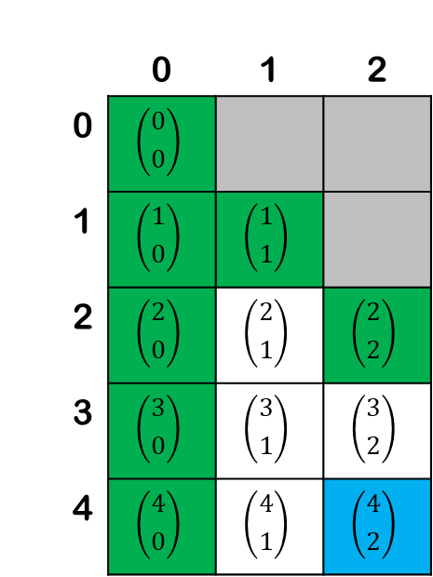
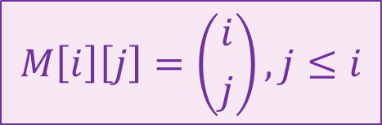
Binomial Coefficient
$$M\left[i\right]\left[j\right]=\left({i \atop j}\right), j≤i$$
 | 0 | 1 | 2
0 | $$\left({0 \atop 0}\right)$$
1 | $$\left({1 \atop 0}\right)$$ | $$\left({1 \atop 1}\right)$$
2 | $$\left({2 \atop 0}\right)$$ | $$\left({2 \atop 1}\right)$$ | $$\left({2 \atop 2}\right)$$
3 | $$\left({3 \atop 0}\right)$$ | $$\left({3 \atop 1}\right)$$ | $$\left({3 \atop 2}\right)$$
4 | $$\left({4 \atop 0}\right)$$ | $$\left({4 \atop 1}\right)$$ | $$\left({4 \atop 2}\right)$$
BC(n,r):
for i=0 to n do
for j=0 to r do
if i>=j then
if j==0 or i==j then
M[i][j]=1
else
M[i][j]=M[i-1][j]+M[i-1][j-1]
return M[n][r]
$$O(nr)$$

Slide 13
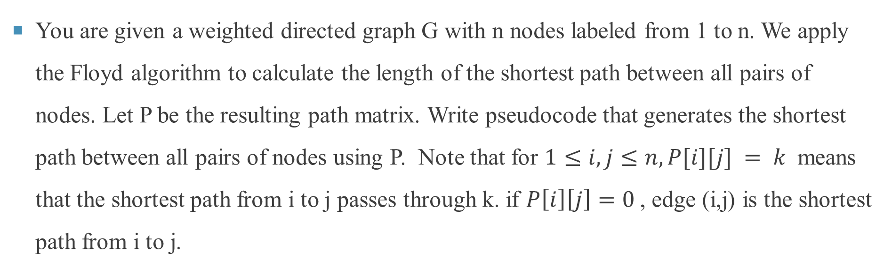
Floyd-Warshall
You are given a weighted directed graph G with n nodes labeled from 1 to n. We apply the Floyd algorithm to calculate the length of the shortest path between all pairs of nodes. Let P be the resulting path matrix. Write pseudocode that generates the shortest path between all pairs of nodes using P. Note that for $1≤i,j≤n, P[i][j] = k$ means that the shortest path from i to j passes through k. if $P\left[i\right]\left[j\right]=0$, edge (i,j) is the shortest path from i to j.

Slide 14
Floyd-Warshall
 | 1 | 2 | 3 | 4 | 5
1 | 0 | 0 | 4 | 0 | 3
2 | 4 | 0 | 0 | 5 | 3
3 | 0 | 1 | 0 | 0 | 0
4 | 0 | 1 | 2 | 0 | 0
5 | 0 | 0 | 4 | 1 | 0
2
4

Slide 15
Floyd-Warshall
 | 1 | 2 | 3 | 4 | 5
1 | 0 | 0 | 4 | 0 | 3
2 | 4 | 0 | 0 | 5 | 3
3 | 0 | 1 | 0 | 0 | 0
4 | 0 | 1 | 2 | 0 | 0
5 | 0 | 0 | 4 | 1 | 0
2
4
5

Slide 16
Floyd-Warshall
 | 1 | 2 | 3 | 4 | 5
1 | 0 | 0 | 4 | 0 | 3
2 | 4 | 0 | 0 | 5 | 3
3 | 0 | 1 | 0 | 0 | 0
4 | 0 | 1 | 2 | 0 | 0
5 | 0 | 0 | 4 | 1 | 0
2
4
3
1
5

Slide 17
Floyd-Warshall
 | 1 | 2 | 3 | 4 | 5
1 | 0 | 0 | 4 | 0 | 3
2 | 4 | 0 | 0 | 5 | 3
3 | 0 | 1 | 0 | 0 | 0
4 | 0 | 1 | 2 | 0 | 0
5 | 0 | 0 | 4 | 1 | 0
2
4
3
1
5

Slide 18
Floyd-Warshall
shortest_path(i, j, P):
path = ""
k = P[i][j]
if k == 0 then
return ""
path += shortest_path(i, k, P)
path += str(k)
path += shortest_path(k, j, P)
return path
for i=1 to n do
for j=1 to n do
path=""
path += str(i)
path += shortest_path(i, j, P)
path += str(j)
print(path)

Slide 19
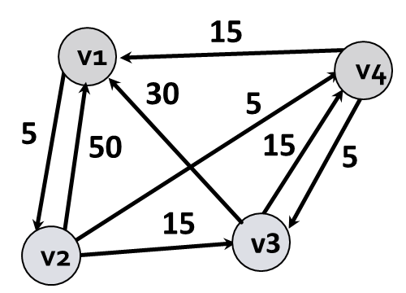
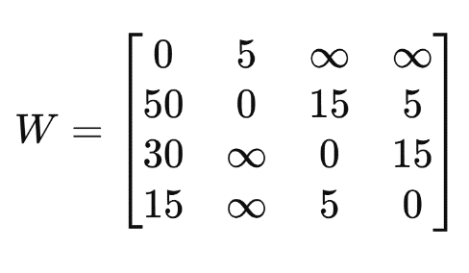
Floyd-Warshall
Find all shortest paths between all pairs by using Floyd algorithm.

Slide 20
Floyd-Warshall algorithm
FloydWarshall(W[][],n)
D=W
P=0 //initializing matrix P
for k=1 to n do
for i=1 to n do
for j=1 to n do
if D[i][k]+D[k][j]<D[i][j] then
D[i][j]=D[i][k]+D[k][j]
P[i][j]=k
return D

Slide 21
D_0 | v1 | v2 | v3 | v4
v1 | 0 | 5 | ∞ | ∞
v2 | 50 | 0 | 15 | 5
v3 | 30 | ∞ | 0 | 15
v4 | 15 | ∞ | 5 | 0
P | v1 | v2 | v3 | v4
v1 | 0 | 0 | 0 | 0
v2 | 0 | 0 | 0 | 0
v3 | 0 | 0 | 0 | 0
v4 | 0 | 0 | 0 | 0
$${D^{(k+1)}\left[i\right]\left[j\right]=min\{D}^{(k)}\left[i\right]\left[k+1\right]+D^{(k)}\left[k+1\right]\left[j\right],D^{(k)}\left[i\right][j]\}$$
NOTE: In the following calculations:
1) The red highlights indicate where the shortest path is updated. These will be used to construct the path matrix.
2) The purple highlights indicate values that do not need to be computed, as they will not change.

Slide 22
K=1
D[1][j]=min{D[1][j],D[1][1]+D[1][j]}=D[1][j] for j=2,3,4
D[2][j]=min{D[2][j],D[2][1]+D[1][j]}= min{D[2][j],50+D[1][j]}, for j=1,3,4 D[2][1]=50, D[2][3]=15, D[2][4]= 5
D[3][j]=min{D[3][j],D[3][1]+D[1][j]}= min{D[3][j],30+D[1][j]}, for j=1,2,4 D[3][1]=30, D[3][2]=35, D[3][4]=15
D[4][j]=min{D[4][j],D[4][1]+D[1][j]}= min{D[4][j],15+D[1][j]}, for j=1,2,3 D[4][1]=15, D[4][2]=20, D[4][3]=5
D_1 | v1 | v2 | v3 | v4
v1 | 0 | 5 | ∞ | ∞
v2 | 50 | 0 | 15 | 5
v3 | 30 | 35 | 0 | 15
v4 | 15 | 20 | 5 | 0
P | v1 | v2 | v3 | v4
v1 | 0 | 0 | 0 | 0
v2 | 0 | 0 | 0 | 0
v3 | 0 | 1 | 0 | 0
v4 | 0 | 1 | 0 | 0

Slide 23
K=2
1. D[1][j]=min{D[1][j],D[1][2]+D[2][j]}= min{D[1][j],5+D[2][j]} for j=2,3,4
D[1][2]=5, D[1][3]=20, D[1][4]=10
2. D[2][j]=min{D[2][j],D[2][2]+D[2][j]}=D[2][j] for j=1,3,4
3. D[3][j]=min{D[3][j],D[3][2]+D[2][j]}= min{D[3][j],35+D[2][j]} for j=1,2,4
D[3][1]=30, D[3][2]=35, D[3][4]=15
4. D[4][j]=min{D[4][j],D[4][2]+D[2][j]}= min{D[4][j],20+D[2][j]}, for j=1,2,3
D[4][1]=15, D[4][2]=20, D[4][3]=5
D_2 | v1 | v2 | v3 | v4
v1 | 0 | 5 | 20 | 10
v2 | 50 | 0 | 15 | 5
v3 | 30 | 35 | 0 | 15
v4 | 15 | 20 | 5 | 0
P | v1 | v2 | v3 | v4
v1 | 0 | 0 | 2 | 2
v2 | 0 | 0 | 0 | 0
v3 | 0 | 1 | 0 | 0
v4 | 0 | 1 | 0 | 0

Slide 24
K=3
1. D[1][j]=min{D[1][j],D[1][3]+D[3][j]}= min{D[1][j],20+D[3][j]} for j=2,3,4
D[1][2]=5, D[1][3]=20, D[1][4]=10
2. D[2][j]=min{D[2][j],D[2][3]+D[3][j]}= min{D[2][j],15+D[3][j]} for j=1,3,4
D[2][1]=45, D[2][3]=15, D[2][4]=5
3. D[3][j]=min{D[3][j],D[3][3]+D[3][j]}=D[3][j] for j=1,2,4
4. D[4][j]=min{D[4][j],D[4][3]+D[3][j]}= min{D[4][j],5+D[3][j]}, for j=1,2,3
D[4][1]=15, D[4][2]=20, D[4][3]=5
D_3 | v1 | v2 | v3 | v4
v1 | 0 | 5 | 20 | 10
v2 | 45 | 0 | 15 | 5
v3 | 30 | 35 | 0 | 15
v4 | 15 | 20 | 5 | 0
P | v1 | v2 | v3 | v4
v1 | 0 | 0 | 2 | 2
v2 | 3 | 0 | 0 | 0
v3 | 0 | 1 | 0 | 0
v4 | 0 | 1 | 0 | 0

Slide 25
K=4
1. D[1][j]=min{D[1][j],D[1][4]+D[4][j]}= min{D[1][j],10+D[4][j]} for j=2,3,4
D[1][2]=5, D[1][3]=15, D[1][4]=10
2. D[2][j]=min{D[2][j],D[2][4]+D[4][j]}= min{D[2][j],5+D[4][j]}, for j=1,3,4
D[2][1]=20, D[2][3]=10, D[2][4]=5
3. D[3][j]=min{D[3][j],D[3][4]+D[4][j]}= min{D[3][j],15+D[4][j]} for j=1,2,4
D[3][1]=30, D[3][2]=35, D[3][4]=15
4. D[4][j]=min{D[4][j],D[4][4]+D[4][j]}=D[4][j] for j=1,2,3
D_4 | v1 | v2 | v3 | v4
v1 | 0 | 5 | 15 | 10
v2 | 20 | 0 | 10 | 5
v3 | 30 | 35 | 0 | 15
v4 | 15 | 20 | 5 | 0
P | v1 | v2 | v3 | v4
v1 | 0 | 0 | 4 | 2
v2 | 4 | 0 | 4 | 0
v3 | 0 | 1 | 0 | 0
v4 | 0 | 1 | 0 | 0

Slide 26
Calculating shortest paths using P matrix
• v1​ to v2​: Direct path, v1→ v2​
• v1to v3​: Passes through v4 :v1→v2→v4→v3​
• v1​ to v4​: Passes through v2 :v1→v2→v4​
• v2 to v1​: Passes through v4, v2→v4→v1 ​
• v2​ to v3​: Passes through v4​, v2→v4→v3​
• v2​ to v4​: Direct path, v2→v4
• v3​ to v1​: Direct path, v3→v1
• v3 to v2​: Passes through v1, v3​→v1​→v2​
• v3​ to v4​: Direct path, v3→v4​
• v4​ to v1​: Direct path, v4→v1​
• v4​ to v2​: Passes through v1, v4→v1​→v2​
• v4​ to v3​: Direct path, v4→v3​
P | v1 | v2 | v3 | v4
v1 | 0 | 0 | 4 | 2
v2 | 4 | 0 | 4 | 0
v3 | 0 | 1 | 0 | 0
v4 | 0 | 1 | 0 | 0

