Slide 1
Greedy
Practice problems

Slide 2





Kruskal: Example
 | v₁ | v₂ | v₃ | v₄ | v₅
v₁ | 0 | 6 | 1 | 4 | 5
v₂ | 6 | 0 | ∞ | ∞ | ∞
v₃ | 1 | ∞ | 0 | ∞ | 1
v₄ | 4 | ∞ | ∞ | 0 | 2
v₅ | 5 | ∞ | 1 | 2 | 0
$$v_{1}$$
1
4
$$v_{3}$$
$$v_{4}$$
6
5
1
2
$$v_{2}$$
$$v_{5}$$
W

Slide 3
Kruskal: Example
Kruskal(E)
E.sort
F=[]
FOR k=1 to n DO S[k]=k
WHILE len(F)!=n-1 DO
e=(v_{i},v_{j})=min_length_edge
IF S[i]!=S[j] THEN
F.add(e)
Min=min(S[i],S[j])
Max=max(S[i],S[j])
FOR k=1 to n DO
IF S[k]==Max THEN S[k]=Min
E.del(e)
RETURN F
 | v₁ | v₂ | v₃ | v₄ | v₅
v₁ | 0 | 6 | 1 | 4 | 5
v₂ | 6 | 0 | ∞ | ∞ | ∞
v₃ | 1 | ∞ | 0 | ∞ | 1
v₄ | 4 | ∞ | ∞ | 0 | 2
v₅ | 5 | ∞ | 1 | 2 | 0
W

Slide 4
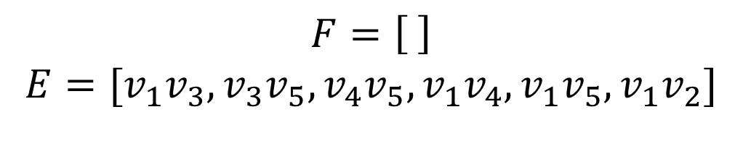
E.sort() F=[]
 | v₁ | v₂ | v₃ | v₄ | v₅
v₁ | 0 | 6 | 1 | 4 | 5
v₂ | 6 | 0 | ∞ | ∞ | ∞
v₃ | 1 | ∞ | 0 | ∞ | 1
v₄ | 4 | ∞ | ∞ | 0 | 2
v₅ | 5 | ∞ | 1 | 2 | 0
W
$$F=\left[ \right]$$
$$E=[v_{1}v_{3},v_{3}v_{5},v_{4}v_{5},v_{1}v_{4},v_{1}v_{5},v_{1}v_{2}]$$

Slide 5
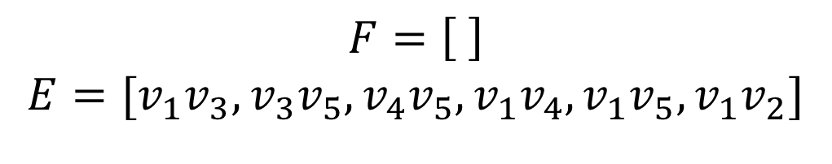
FOR k=1 to n DO S[k]=k
 | v₁ | v₂ | v₃ | v₄ | v₅
v₁ | 0 | 6 | 1 | 4 | 5
v₂ | 6 | 0 | ∞ | ∞ | ∞
v₃ | 1 | ∞ | 0 | ∞ | 1
v₄ | 4 | ∞ | ∞ | 0 | 2
v₅ | 5 | ∞ | 1 | 2 | 0
 | 1 | 2 | 3 | 4 | 5
S | 1 | 2 | 3 | 4 | 5
W
$$F=\left[ \right]$$
$$E=[v_{1}v_{3},v_{3}v_{5},v_{4}v_{5},v_{1}v_{4},v_{1}v_{5},v_{1}v_{2}]$$

Slide 6
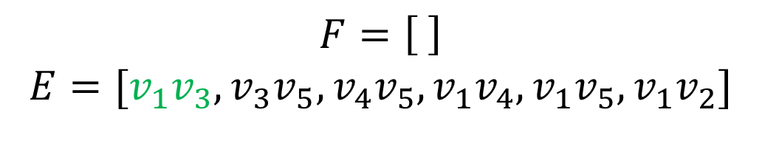
e=(v_{i},v_{j})=min_length_edge IF S[i]!=S[j] THEN F.add(e) Min, Max=min(S[i],S[j]), max(S[i],S[j]) FOR k=1 to n DO IF S[k]==Max THEN S[k]=Min
 | v₁ | v₂ | v₃ | v₄ | v₅
v₁ | 0 | 6 | 1 | 4 | 5
v₂ | 6 | 0 | ∞ | ∞ | ∞
v₃ | 1 | ∞ | 0 | ∞ | 1
v₄ | 4 | ∞ | ∞ | 0 | 2
v₅ | 5 | ∞ | 1 | 2 | 0
 | 1 | 2 | 3 | 4 | 5
S | 1 | 2 | 3 | 4 | 5
W
$$F=\left[ \right]$$
$$E=[v_{1}v_{3},v_{3}v_{5},v_{4}v_{5},v_{1}v_{4},v_{1}v_{5},v_{1}v_{2}]$$

Slide 7
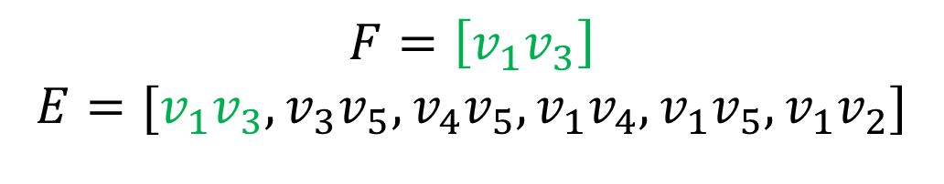
e=(v_{i},v_{j})=min_length_edge IF S[i]!=S[j] THEN F.add(e) Min, Max=min(S[i],S[j]), max(S[i],S[j]) FOR k=1 to n DO IF S[k]==Max THEN S[k]=Min
 | v₁ | v₂ | v₃ | v₄ | v₅
v₁ | 0 | 6 | 1 | 4 | 5
v₂ | 6 | 0 | ∞ | ∞ | ∞
v₃ | 1 | ∞ | 0 | ∞ | 1
v₄ | 4 | ∞ | ∞ | 0 | 2
v₅ | 5 | ∞ | 1 | 2 | 0
 | 1 | 2 | 3 | 4 | 5
S | 1 | 2 | 1 | 4 | 5
W
$$F=\left[v_{1}v_{3}\right]$$
$$E=[v_{1}v_{3},v_{3}v_{5},v_{4}v_{5},v_{1}v_{4},v_{1}v_{5},v_{1}v_{2}]$$

Slide 8
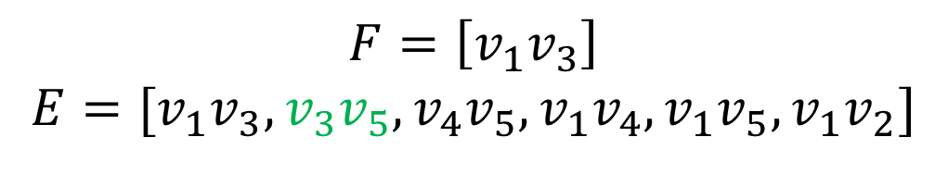
e=(v_{i},v_{j})=min_length_edge IF S[i]!=S[j] THEN F.add(e) Min, Max=min(S[i],S[j]), max(S[i],S[j]) FOR k=1 to n DO IF S[k]==Max THEN S[k]=Min
 | v₁ | v₂ | v₃ | v₄ | v₅
v₁ | 0 | 6 | 1 | 4 | 5
v₂ | 6 | 0 | ∞ | ∞ | ∞
v₃ | 1 | ∞ | 0 | ∞ | 1
v₄ | 4 | ∞ | ∞ | 0 | 2
v₅ | 5 | ∞ | 1 | 2 | 0
 | 1 | 2 | 3 | 4 | 5
S | 1 | 2 | 1 | 4 | 5
W
$$F=\left[v_{1}v_{3}\right]$$
$$E=[v_{1}v_{3},v_{3}v_{5}, v_{4}v_{5},v_{1}v_{4},v_{1}v_{5},v_{1}v_{2}]$$

Slide 9
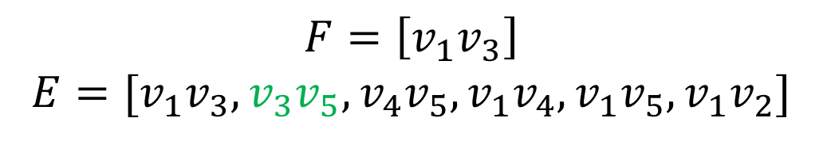
e=(v_{i},v_{j})=min_length_edge IF S[i]!=S[j] THEN F.add(e) Min, Max=min(S[i],S[j]), max(S[i],S[j]) FOR k=1 to n DO IF S[k]==Max THEN S[k]=Min
 | v₁ | v₂ | v₃ | v₄ | v₅
v₁ | 0 | 6 | 1 | 4 | 5
v₂ | 6 | 0 | ∞ | ∞ | ∞
v₃ | 1 | ∞ | 0 | ∞ | 1
v₄ | 4 | ∞ | ∞ | 0 | 2
v₅ | 5 | ∞ | 1 | 2 | 0
 | 1 | 2 | 3 | 4 | 5
S | 1 | 2 | 1 | 4 | 5
W
$$F=\left[v_{1}v_{3}\right]$$
$$E=[v_{1}v_{3},v_{3}v_{5},v_{4}v_{5},v_{1}v_{4},v_{1}v_{5},v_{1}v_{2}]$$

Slide 10
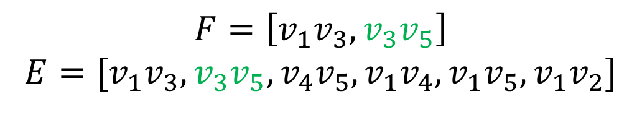
e=(v_{i},v_{j})=min_length_edge IF S[i]!=S[j] THEN F.add(e) Min, Max=min(S[i],S[j]), max(S[i],S[j]) FOR k=1 to n DO IF S[k]==Max THEN S[k]=Min
 | v₁ | v₂ | v₃ | v₄ | v₅
v₁ | 0 | 6 | 1 | 4 | 5
v₂ | 6 | 0 | ∞ | ∞ | ∞
v₃ | 1 | ∞ | 0 | ∞ | 1
v₄ | 4 | ∞ | ∞ | 0 | 2
v₅ | 5 | ∞ | 1 | 2 | 0
 | 1 | 2 | 3 | 4 | 5
S | 1 | 2 | 1 | 4 | 1
W
$$F=\left[v_{1}v_{3},v_{3}v_{5}\right]$$
$$E=[v_{1}v_{3},v_{3}v_{5},v_{4}v_{5},v_{1}v_{4},v_{1}v_{5},v_{1}v_{2}]$$

Slide 11
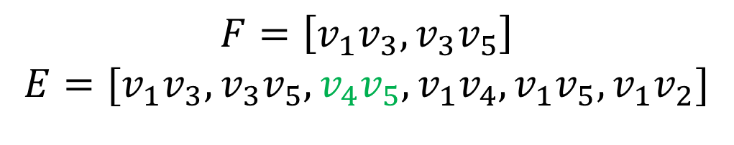
e=(v_{i},v_{j})=min_length_edge IF S[i]!=S[j] THEN F.add(e) Min, Max=min(S[i],S[j]), max(S[i],S[j]) FOR k=1 to n DO IF S[k]==Max THEN S[k]=Min
 | v₁ | v₂ | v₃ | v₄ | v₅
v₁ | 0 | 6 | 1 | 4 | 5
v₂ | 6 | 0 | ∞ | ∞ | ∞
v₃ | 1 | ∞ | 0 | ∞ | 1
v₄ | 4 | ∞ | ∞ | 0 | 2
v₅ | 5 | ∞ | 1 | 2 | 0
 | 1 | 2 | 3 | 4 | 5
S | 1 | 2 | 1 | 4 | 1
W
$$F=\left[v_{1}v_{3},v_{3}v_{5}\right]$$
$$E=[v_{1}v_{3},v_{3}v_{5},v_{4}v_{5}, v_{1}v_{4},v_{1}v_{5},v_{1}v_{2}]$$

Slide 12

e=(v_{i},v_{j})=min_length_edge IF S[i]!=S[j] THEN F.add(e) Min, Max=min(S[i],S[j]), max(S[i],S[j]) FOR k=1 to n DO IF S[k]==Max THEN S[k]=Min
 | v₁ | v₂ | v₃ | v₄ | v₅
v₁ | 0 | 6 | 1 | 4 | 5
v₂ | 6 | 0 | ∞ | ∞ | ∞
v₃ | 1 | ∞ | 0 | ∞ | 1
v₄ | 4 | ∞ | ∞ | 0 | 2
v₅ | 5 | ∞ | 1 | 2 | 0
 | 1 | 2 | 3 | 4 | 5
S | 1 | 2 | 1 | 4 | 1
W
$$F=\left[v_{1}v_{3},v_{3}v_{5}\right]$$
$$E=[v_{1}v_{3},v_{3}v_{5},v_{4}v_{5},v_{1}v_{4},v_{1}v_{5},v_{1}v_{2}]$$

Slide 13
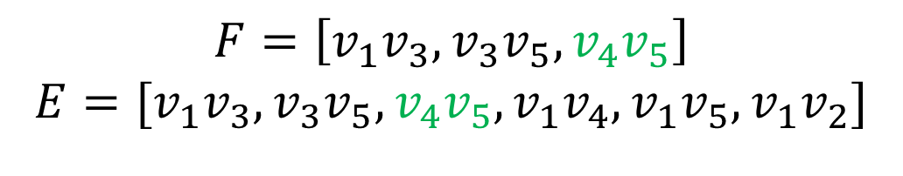
e=(v_{i},v_{j})=min_length_edge IF S[i]!=S[j] THEN F.add(e) Min, Max=min(S[i],S[j]), max(S[i],S[j]) FOR k=1 to n DO IF S[k]==Max THEN S[k]=Min
 | v₁ | v₂ | v₃ | v₄ | v₅
v₁ | 0 | 6 | 1 | 4 | 5
v₂ | 6 | 0 | ∞ | ∞ | ∞
v₃ | 1 | ∞ | 0 | ∞ | 1
v₄ | 4 | ∞ | ∞ | 0 | 2
v₅ | 5 | ∞ | 1 | 2 | 0
 | 1 | 2 | 3 | 4 | 5
S | 1 | 2 | 1 | 1 | 1
W
$$F=\left[v_{1}v_{3},v_{3}v_{5},v_{4}v_{5}\right]$$
$$E=[v_{1}v_{3},v_{3}v_{5},v_{4}v_{5},v_{1}v_{4},v_{1}v_{5},v_{1}v_{2}]$$

Slide 14
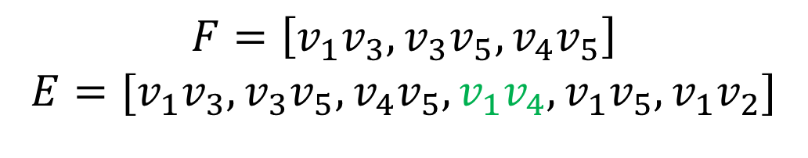
e=(v_{i},v_{j})=min_length_edge IF S[i]!=S[j] THEN F.add(e) Min, Max=min(S[i],S[j]), max(S[i],S[j]) FOR k=1 to n DO IF S[k]==Max THEN S[k]=Min
 | v₁ | v₂ | v₃ | v₄ | v₅
v₁ | 0 | 6 | 1 | 4 | 5
v₂ | 6 | 0 | ∞ | ∞ | ∞
v₃ | 1 | ∞ | 0 | ∞ | 1
v₄ | 4 | ∞ | ∞ | 0 | 2
v₅ | 5 | ∞ | 1 | 2 | 0
 | 1 | 2 | 3 | 4 | 5
S | 1 | 2 | 1 | 1 | 1
W
$$F=\left[v_{1}v_{3},v_{3}v_{5},v_{4}v_{5}\right]$$
$$E=[v_{1}v_{3},v_{3}v_{5},v_{4}v_{5},v_{1}v_{4},v_{1}v_{5},v_{1}v_{2}]$$

Slide 15
e=(v_{i},v_{j})=min_length_edge IF S[i]!=S[j] THEN F.add(e) Min, Max=min(S[i],S[j]), max(S[i],S[j]) FOR k=1 to n DO IF S[k]==Max THEN S[k]=Min
 | v₁ | v₂ | v₃ | v₄ | v₅
v₁ | 0 | 6 | 1 | 4 | 5
v₂ | 6 | 0 | ∞ | ∞ | ∞
v₃ | 1 | ∞ | 0 | ∞ | 1
v₄ | 4 | ∞ | ∞ | 0 | 2
v₅ | 5 | ∞ | 1 | 2 | 0
 | 1 | 2 | 3 | 4 | 5
S | 1 | 2 | 1 | 1 | 1
Reject
W
$$F=\left[v_{1}v_{3},v_{3}v_{5},v_{4}v_{5}\right]$$
$$E=[v_{1}v_{3},v_{3}v_{5},v_{4}v_{5},v_{1}v_{4},v_{1}v_{5},v_{1}v_{2}]$$

Slide 16
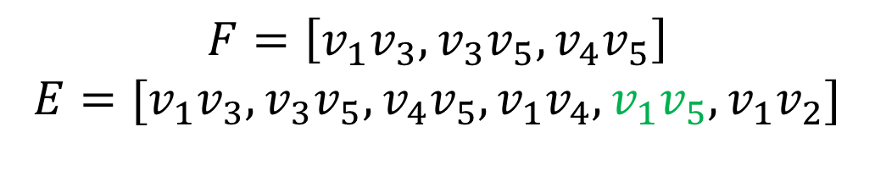
e=(v_{i},v_{j})=min_length_edge IF S[i]!=S[j] THEN F.add(e) Min, Max=min(S[i],S[j]), max(S[i],S[j]) FOR k=1 to n DO IF S[k]==Max THEN S[k]=Min
 | v₁ | v₂ | v₃ | v₄ | v₅
v₁ | 0 | 6 | 1 | 4 | 5
v₂ | 6 | 0 | ∞ | ∞ | ∞
v₃ | 1 | ∞ | 0 | ∞ | 1
v₄ | 4 | ∞ | ∞ | 0 | 2
v₅ | 5 | ∞ | 1 | 2 | 0
 | 1 | 2 | 3 | 4 | 5
S | 1 | 2 | 1 | 1 | 1
W
$$F=\left[v_{1}v_{3},v_{3}v_{5},v_{4}v_{5}\right]$$
$$E=[v_{1}v_{3},v_{3}v_{5},v_{4}v_{5},v_{1}v_{4},v_{1}v_{5},v_{1}v_{2}]$$

Slide 17
e=(v_{i},v_{j})=min_length_edge IF S[i]!=S[j] THEN F.add(e) Min, Max=min(S[i],S[j]), max(S[i],S[j]) FOR k=1 to n DO IF S[k]==Max THEN S[k]=Min
 | v₁ | v₂ | v₃ | v₄ | v₅
v₁ | 0 | 6 | 1 | 4 | 5
v₂ | 6 | 0 | ∞ | ∞ | ∞
v₃ | 1 | ∞ | 0 | ∞ | 1
v₄ | 4 | ∞ | ∞ | 0 | 2
v₅ | 5 | ∞ | 1 | 2 | 0
 | 1 | 2 | 3 | 4 | 5
S | 1 | 2 | 1 | 1 | 1
Reject
W
$$F=\left[v_{1}v_{3},v_{3}v_{5},v_{4}v_{5}\right]$$
$$E=[v_{1}v_{3},v_{3}v_{5},v_{4}v_{5},v_{1}v_{4},v_{1}v_{5},v_{1}v_{2}]$$

Slide 18
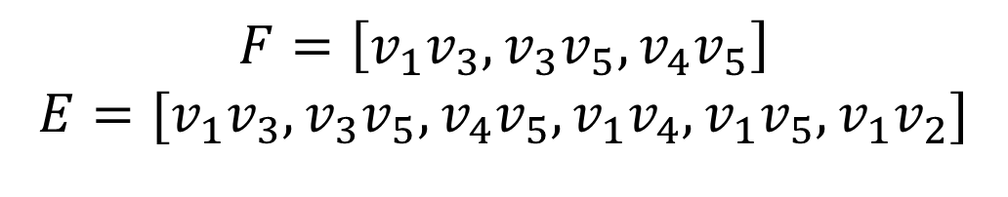
e=(v_{i},v_{j})=min_length_edge IF S[i]!=S[j] THEN F.add(e) Min, Max=min(S[i],S[j]), max(S[i],S[j]) FOR k=1 to n DO IF S[k]==Max THEN S[k]=Min
 | v₁ | v₂ | v₃ | v₄ | v₅
v₁ | 0 | 6 | 1 | 4 | 5
v₂ | 6 | 0 | ∞ | ∞ | ∞
v₃ | 1 | ∞ | 0 | ∞ | 1
v₄ | 4 | ∞ | ∞ | 0 | 2
v₅ | 5 | ∞ | 1 | 2 | 0
 | 1 | 2 | 3 | 4 | 5
S | 1 | 2 | 1 | 1 | 1
W
$$F=\left[v_{1}v_{3},v_{3}v_{5},v_{4}v_{5}\right]$$
$$E=[v_{1}v_{3},v_{3}v_{5},v_{4}v_{5},v_{1}v_{4},v_{1}v_{5},v_{1}v_{2}]$$

Slide 19
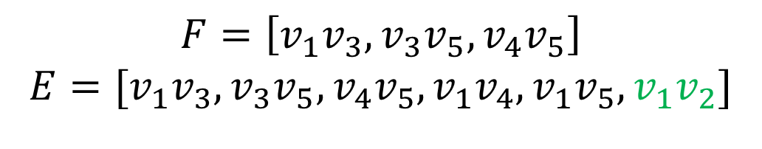
e=(v_{i},v_{j})=min_length_edge IF S[i]!=S[j] THEN F.add(e) Min, Max=min(S[i],S[j]), max(S[i],S[j]) FOR k=1 to n DO IF S[k]==Max THEN S[k]=Min
 | v₁ | v₂ | v₃ | v₄ | v₅
v₁ | 0 | 6 | 1 | 4 | 5
v₂ | 6 | 0 | ∞ | ∞ | ∞
v₃ | 1 | ∞ | 0 | ∞ | 1
v₄ | 4 | ∞ | ∞ | 0 | 2
v₅ | 5 | ∞ | 1 | 2 | 0
 | 1 | 2 | 3 | 4 | 5
S | 1 | 2 | 1 | 1 | 1
W
$$F=\left[v_{1}v_{3},v_{3}v_{5},v_{4}v_{5}\right]$$
$$E=[v_{1}v_{3},v_{3}v_{5},v_{4}v_{5},v_{1}v_{4},v_{1}v_{5},v_{1}v_{2}]$$

Slide 20
e=(v_{i},v_{j})=min_length_edge IF S[i]!=S[j] THEN F.add(e) Min, Max=min(S[i],S[j]), max(S[i],S[j]) FOR k=1 to n DO IF S[k]==Max THEN S[k]=Min
 | v₁ | v₂ | v₃ | v₄ | v₅
v₁ | 0 | 6 | 1 | 4 | 5
v₂ | 6 | 0 | ∞ | ∞ | ∞
v₃ | 1 | ∞ | 0 | ∞ | 1
v₄ | 4 | ∞ | ∞ | 0 | 2
v₅ | 5 | ∞ | 1 | 2 | 0
 | 1 | 2 | 3 | 4 | 5
S | 1 | 2 | 1 | 1 | 1
W
$$F=\left[v_{1}v_{3},v_{3}v_{5},v_{4}v_{5}\right]$$
$$E=[v_{1}v_{3},v_{3}v_{5},v_{4}v_{5},v_{1}v_{4},v_{1}v_{5},v_{1}v_{2}]$$

Slide 21
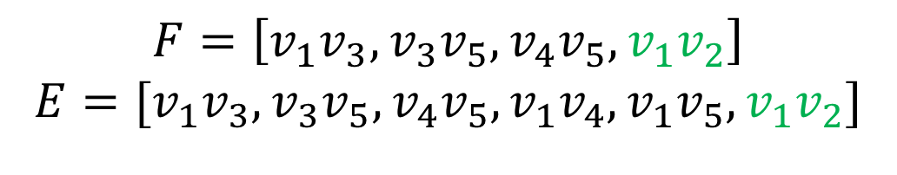
e=(v_{i},v_{j})=min_length_edge IF S[i]!=S[j] THEN F.add(e) Min, Max=min(S[i],S[j]), max(S[i],S[j]) FOR k=1 to n DO IF S[k]==Max THEN S[k]=Min
 | v₁ | v₂ | v₃ | v₄ | v₅
v₁ | 0 | 6 | 1 | 4 | 5
v₂ | 6 | 0 | ∞ | ∞ | ∞
v₃ | 1 | ∞ | 0 | ∞ | 1
v₄ | 4 | ∞ | ∞ | 0 | 2
v₅ | 5 | ∞ | 1 | 2 | 0
 | 1 | 2 | 3 | 4 | 5
S | 1 | 2 | 1 | 1 | 1
W
$$F=\left[v_{1}v_{3},v_{3}v_{5},v_{4}v_{5},v_{1}v_{2}\right]$$
$$E=[v_{1}v_{3},v_{3}v_{5},v_{4}v_{5},v_{1}v_{4},v_{1}v_{5},v_{1}v_{2}]$$

Slide 22
e=(v_{i},v_{j})=min_length_edge IF S[i]!=S[j] THEN F.add(e) Min, Max=min(S[i],S[j]), max(S[i],S[j]) FOR k=1 to n DO IF S[k]==Max THEN S[k]=Min
 | v₁ | v₂ | v₃ | v₄ | v₅
v₁ | 0 | 3 | 1 | 4 | ∞
v₂ | 3 | 0 | 8 | ∞ | 3
v₃ | 1 | 8 | 0 | ∞ | 1
v₄ | 4 | ∞ | ∞ | 0 | 2
v₅ | ∞ | 3 | 1 | 2 | 0
 | 1 | 2 | 3 | 4 | 5
S | 1 | 1 | 1 | 1 | 1
|F|=n-1
W
$$F=\left[v_{1}v_{3},v_{3}v_{5},v_{4}v_{5},v_{1}v_{2}\right]$$
$$E=[v_{1}v_{3},v_{3}v_{5},v_{4}v_{5},v_{1}v_{4},v_{1}v_{5},v_{1}v_{2}]$$

Slide 23
Prim: Example
 | v₁ | v₂ | v₃ | v₄ | v₅
v₁ | 0 | 10 | 3 | ∞ | 8
v₂ | 10 | 0 | ∞ | 11 | 5
v₃ | 3 | ∞ | 0 | ∞ | 6
v₄ | ∞ | 11 | ∞ | 0 | 14
v₅ | 8 | 5 | 6 | 14 | 0
$$v_{1}$$
3
$$v_{3}$$
$$v_{4}$$
10
8
6
11
14
$$v_{2}$$
$$v_{5}$$
5
W

Slide 24
Prim: Example
Prim(W)
F=Ø
FOR i=2 TO n DO
nearest[i]=1
distance[i]=W[1][i]
FOR j=1 TO n-1 DO
b=index of minimum element in distance
a=nearest[b]
F.add((a,b))
distance.delete(b)
nearest.delete(b)
FOR EACH i in distance DO
IF W[i][b]<distance[i] THEN
distance[i]=W[i][b]
nearest[i]=b
RETURN F
 | v₁ | v₂ | v₃ | v₄ | v₅
v₁ | 0 | 10 | 3 | ∞ | 8
v₂ | 10 | 0 | ∞ | 11 | 5
v₃ | 3 | ∞ | 0 | ∞ | 6
v₄ | ∞ | 11 | ∞ | 0 | 14
v₅ | 8 | 5 | 6 | 14 | 0
W

Slide 25
Prim: Example
 | v₁ | v₂ | v₃ | v₄ | v₅
v₁ | 0 | 10 | 3 | ∞ | 8
v₂ | 10 | 0 | ∞ | 11 | 5
v₃ | 3 | ∞ | 0 | ∞ | 6
v₄ | ∞ | 11 | ∞ | 0 | 14
v₅ | 8 | 5 | 6 | 14 | 0
 | 1 | 2 | 3 | 4 | 5
nearest | - | - | - | - | -
 | 1 | 2 | 3 | 4 | 5
distance | - | - | - | - | -
W

Slide 26
FOR i=2 TO n DO
nearest[i]=1
distance[i]=W[1][i]
vertices | 1 | 2 | 3 | 4 | 5
nearest | - | 1 | 1 | 1 | 1
distance | - | 10 | 3 | ∞ | 8

Slide 27
b=index of minimum element in distance
a=nearest[b]
F.add((a,b))
vertices | 1 | 2 | 3 | 4 | 5
nearest | - | 1 | 1 | 1 | 1
distance | - | 10 | 3 | ∞ | 8
b=3
a=1
F={(3,1)}

Slide 28
distance.delete(b)
nearest.delete(b)
vertices | 1 | 2 | 3 | 4 | 5
nearest | - | 1 | - | 1 | 1
distance | - | 10 | - | ∞ | 8

Slide 29
if(W[2][3] < distance[2]):
distance[2] = W[2][3]
nearest[2] = 3
if(W[4][3] < distance[4]):
distance[4] = W[4][3]
nearest[4] = 3
if(W[5][3] < distance[5]):
distance[5] = W[5][3]
nearest[5] = 3
vertices | 1 | 2 | 3 | 4 | 5
nearest | - | 1 | - | 1 | 1
distance | - | 10 | - | ∞ | 8
nearest | - | 1 | - | 1 | 3
distance | - | 10 | - | ∞ | 6

Slide 30
b=index of minimum element in distance
a=nearest[b]
F.add((a,b))
vertices | 1 | 2 | 3 | 4 | 5
nearest | - | 1 | - | 1 | 1
distance | - | 10 | - | ∞ | 8
nearest | - | 1 | - | 1 | 3
distance | - | 10 | - | ∞ | 6
b=5
a=3
F={(3,1),(3,5)}

Slide 31
distance.delete(b)
nearest.delete(b)
vertices | 1 | 2 | 3 | 4 | 5
nearest | - | 1 | - | 1 | -
distance | - | 10 | - | ∞ | -
nearest | - | 1 | - | 1 | -
distance | - | 10 | - | ∞ | -

Slide 32
if(W[2][5] < distance[2]):
distance[2] = W[2][5]
nearest[2] = 5
if(W[4][5] < distance[4]):
distance[4] = W[4][5]
nearest[4] = 5
vertices | 1 | 2 | 3 | 4 | 5
nearest | - | 1 | - | 1 | -
distance | - | 10 | - | ∞ | -
nearest | - | 1 | - | 1 | -
distance | - | 10 | - | ∞ | -
nearest | - | 5 | - | 5 | -
distance | - | 5 | - | 14 | -

Slide 33
b=index of minimum element in distance
a=nearest[b]
F.add((a,b))
vertices | 1 | 2 | 3 | 4 | 5
nearest | - | 1 | - | 1 | -
distance | - | 10 | - | ∞ | -
nearest | - | 1 | - | 1 | -
distance | - | 10 | - | ∞ | -
nearest | - | 5 | - | 5 | -
distance | - | 5 | - | 14 | -
b=2
a=5
F={(3,1),(3,5),(2,5)}

Slide 34
distance.delete(b)
nearest.delete(b)
vertices | 1 | 2 | 3 | 4 | 5
nearest | - | - | - | 1 | -
distance | - | - | - | ∞ | -
nearest | - | - | - | 1 | -
distance | - | - | - | ∞ | -
nearest | - | - | - | 5 | -
distance | - | - | - | 14 | -

Slide 35
if(W[4][2]<distance[4])
distance[4]=W[4][2]
nearest[4]=2
vertices | 1 | 2 | 3 | 4 | 5
nearest | - | - | - | 1 | -
distance | - | - | - | ∞ | -
nearest | - | - | - | 1 | -
distance | - | - | - | ∞ | -
nearest | - | - | - | 5 | -
distance | - | - | - | 14 | -
nearest | - | - | - | 2 | -
distance | - | - | - | 11 | -

Slide 36
b=index of minimum element in distance
a=nearest[b]
F.add((a,b))
vertices | 1 | 2 | 3 | 4 | 5
nearest | - | - | - | 1 | -
distance | - | - | - | ∞ | -
nearest | - | - | - | 1 | -
distance | - | - | - | ∞ | -
nearest | - | - | - | 4 | -
distance | - | - | - | 14 | -
nearest | - | - | - | 2 | -
distance | - | - | - | 11 | -
b=4
a=2
F={(3,1),(3,5),(2,5),(2,4)}

Slide 37
distance.delete(b)
nearest.delete(b)
vertices | 1 | 2 | 3 | 4 | 5
nearest | - | - | - | - | -
distance | - | - | - | - | -
nearest | - | - | - | - | -
distance | - | - | - | - | -
nearest | - | - | - | - | -
distance | - | - | - | - | -
nearest | - | - | - | - | -
distance | - | - | - | - | -
nearest | - | - | - | - | -
distance | - | - | - | - | -
F={(3,1),(3,5),(2,5),(2,4)}

Slide 38
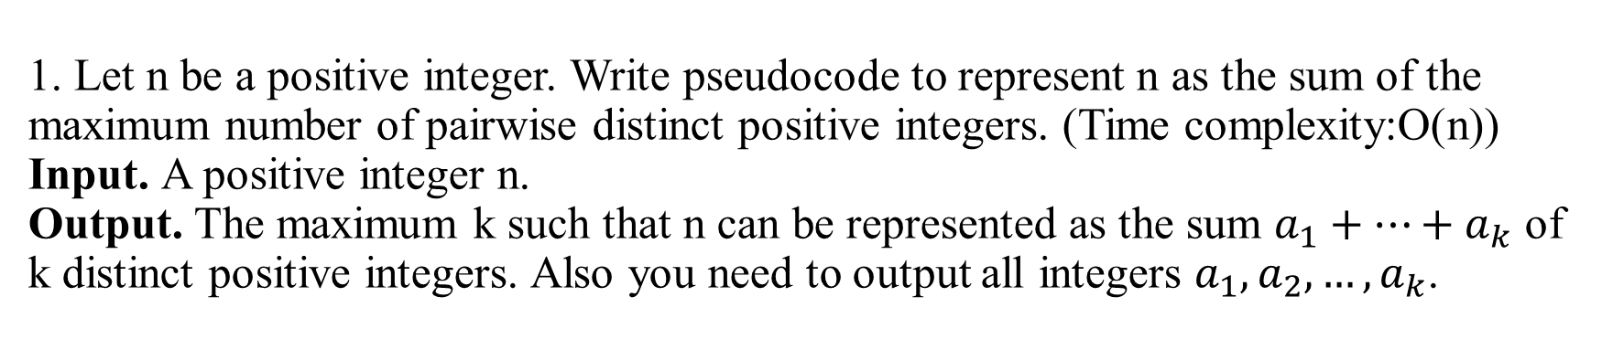
1. Let n be a positive integer. Write pseudocode to represent n as the sum of the maximum number of pairwise distinct positive integers. (Time complexity:O(n)) Input. A positive integer n. Output. The maximum k such that n can be represented as the sum $a_{1}+…+a_{k}$ of k distinct positive integers. Also you need to output all integers $a_{1}, a_{2},…,a_{k}$.
Input: n=8,
Output: return 3 and 1,2,5
8=1+2+5
Input: n=17
Output: return 5 and 1,2,3,4,7
17=1+2+3+4+7
Input: n=27
Output: 6 and 1,2,3,4,5,12
27=1+2+3+4+5+12
Pick the smallest unused positive integer (starting from 1),

Slide 39
1. Let n be a positive integer. Write pseudocode to represent n as the sum of the maximum number of pairwise distinct positive integers. (Time complexity:O(n)) Input. A positive integer n. Output. The maximum k such that n can be represented as the sum $a_{1}+…+a_{k}$ of k distinct positive integers. Also you need to output all integers $a_{1}, a_{2},…,a_{k}$.
Example: n=10
n=10
sum=0
0 | 1 | 2 | 3 | 4 | 5 | 6

Slide 40
1. Let n be a positive integer. Write pseudocode to represent n as the sum of the maximum number of pairwise distinct positive integers. (Time complexity:O(n)) Input. A positive integer n. Output. The maximum k such that n can be represented as the sum $a_{1}+…+a_{k}$ of k distinct positive integers. Also you need to output all integers $a_{1}, a_{2},…,a_{k}$.
Example: n=10
n=10
sum=1
0 | 1 | 2 | 3 | 4 | 5 | 6
1

Slide 41
1. Let n be a positive integer. Write pseudocode to represent n as the sum of the maximum number of pairwise distinct positive integers. (Time complexity:O(n)) Input. A positive integer n. Output. The maximum k such that n can be represented as the sum $a_{1}+…+a_{k}$ of k distinct positive integers. Also you need to output all integers $a_{1}, a_{2},…,a_{k}$.
Example: n=10
n=10
sum=3
0 | 1 | 2 | 3 | 4 | 5 | 6
1 | 2

Slide 42
1. Let n be a positive integer. Write pseudocode to represent n as the sum of the maximum number of pairwise distinct positive integers. (Time complexity:O(n)) Input. A positive integer n. Output. The maximum k such that n can be represented as the sum $a_{1}+…+a_{k}$ of k distinct positive integers. Also you need to output all integers $a_{1}, a_{2},…,a_{k}$.
Example: n=10
n=10
sum=6
0 | 1 | 2 | 3 | 4 | 5 | 6
1 | 2 | 3

Slide 43
1. Let n be a positive integer. Write pseudocode to represent n as the sum of the maximum number of pairwise distinct positive integers. (Time complexity:O(n)) Input. A positive integer n. Output. The maximum k such that n can be represented as the sum $a_{1}+…+a_{k}$ of k distinct positive integers. Also you need to output all integers $a_{1}, a_{2},…,a_{k}$.
Example: n=10
n=10
sum=10
0 | 1 | 2 | 3 | 4 | 5 | 6
1 | 2 | 3 | 4

Slide 44
1. Let n be a positive integer. Write pseudocode to represent n as the sum of the maximum number of pairwise distinct positive integers. (Time complexity:O(n)) Input. A positive integer n. Output. The maximum k such that n can be represented as the sum $a_{1}+…+a_{k}$ of k distinct positive integers. Also you need to output all integers $a_{1}, a_{2},…,a_{k}$.
Example: n=8
n=8
sum=0
0 | 1 | 2 | 3 | 4 | 5 | 6

Slide 45
1. Let n be a positive integer. Write pseudocode to represent n as the sum of the maximum number of pairwise distinct positive integers. (Time complexity:O(n)) Input. A positive integer n. Output. The maximum k such that n can be represented as the sum $a_{1}+…+a_{k}$ of k distinct positive integers. Also you need to output all integers $a_{1}, a_{2},…,a_{k}$.
Example: n=8
n=8
sum=1
0 | 1 | 2 | 3 | 4 | 5 | 6
1

Slide 46
1. Let n be a positive integer. Write pseudocode to represent n as the sum of the maximum number of pairwise distinct positive integers. (Time complexity:O(n)) Input. A positive integer n. Output. The maximum k such that n can be represented as the sum $a_{1}+…+a_{k}$ of k distinct positive integers. Also you need to output all integers $a_{1}, a_{2},…,a_{k}$.
Example: n=8
n=8
sum=3
0 | 1 | 2 | 3 | 4 | 5 | 6
1 | 2

Slide 47
1. Let n be a positive integer. Write pseudocode to represent n as the sum of the maximum number of pairwise distinct positive integers. (Time complexity:O(n)) Input. A positive integer n. Output. The maximum k such that n can be represented as the sum $a_{1}+…+a_{k}$ of k distinct positive integers. Also you need to output all integers $a_{1}, a_{2},…,a_{k}$.
Example: n=8
n=8
sum=6
0 | 1 | 2 | 3 | 4 | 5 | 6
1 | 2 | 3

Slide 48
1. Let n be a positive integer. Write pseudocode to represent n as the sum of the maximum number of pairwise distinct positive integers. (Time complexity:O(n)) Input. A positive integer n. Output. The maximum k such that n can be represented as the sum $a_{1}+…+a_{k}$ of k distinct positive integers. Also you need to output all integers $a_{1}, a_{2},…,a_{k}$.
Example: n=8
n=8
sum=6
0 | 1 | 2 | 3 | 4 | 5 | 6
1 | 2 | 3+2

Slide 49
1. Let n be a positive integer. Write pseudocode to represent n as the sum of the maximum number of pairwise distinct positive integers. (Time complexity:O(n)) Input. A positive integer n. Output. The maximum k such that n can be represented as the sum $a_{1}+…+a_{k}$ of k distinct positive integers. Also you need to output all integers $a_{1}, a_{2},…,a_{k}$.
def MaxDistinctSum(n):
sum=0
k=1
result=[]
while sum + k <= n:
result.append(k)
sum= sum + k
k=k+1
result[-1]+= n - sum
return len(result),result

Slide 50
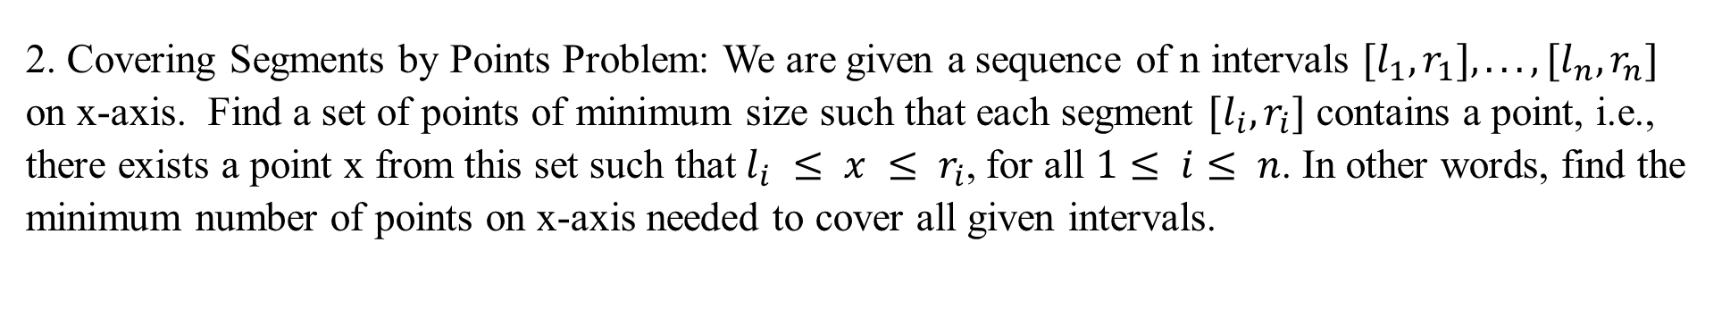
2. Covering Segments by Points Problem: We are given a sequence of n intervals $[l_{1},r_{1}],...,[l_{n},r_{n}]$ on x-axis. Find a set of points of minimum size such that each segment $[l_{i},r_{i}]$ contains a point, i.e., there exists a point x from this set such that$l_{i} ≤ x ≤ r_{i}$, for all $1≤ i≤ n$. In other words, find the minimum number of points on x-axis needed to cover all given intervals.

Slide 51
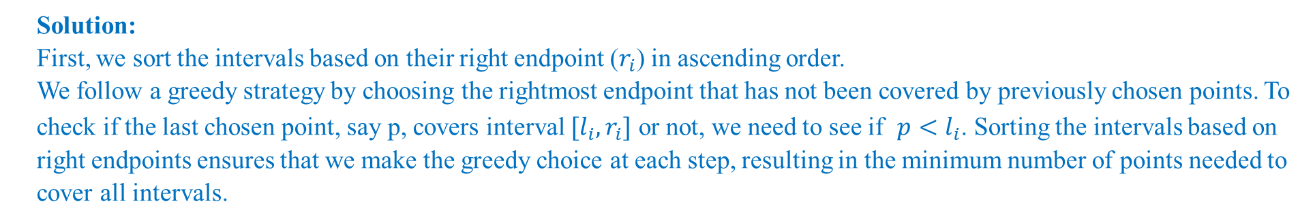
Solution:
First, we sort the intervals based on their right endpoint ($r_{i}$) in ascending order.
We follow a greedy strategy by choosing the rightmost endpoint that has not been covered by previously chosen points. To check if the last chosen point, say p, covers interval $[l_{i},r_{i}]$ or not, we need to see if ${p<l}_{i}$. Sorting the intervals based on right endpoints ensures that we make the greedy choice at each step, resulting in the minimum number of points needed to cover all intervals.
minimum_cover(intervals):
sort intervals by right endpoint r_i in increasing order
S = empty set #output
p = -∞
for each interval (l_i, r_i):
if p < l_i:
p = r_i
add p to S
return S

Slide 52
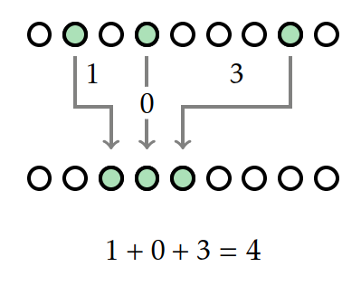
3. Given positions of n friends in the first row of a theater, find the minimal number of moves to sit all friends together. In each move, a friend moves to a seat to the left or a seat to the right. Input: A set of n distinct positive integers in the interval from 1 to N. This set represents positions of n friends that have bought individual (not necessarily adjacent) seats in the first row of a theater. Since all other seats in the first row turned out to be empty, the friends want to start moving to the neighboring seats (to the left or to the right) and continue until they all sit together in n consecutive chairs. Output: Find the minimal number of moves to sit all friends together.

Slide 53
Solution: To design an optimal greedy algorithm, we sort the positions of friends in increasing order. To minimize the number of moves, we need to move all friends next to the person at the middle position. let P be an array of positions of friends. P[i]= seat number of person i+1. See the following example:
They should move next to person at position 9. These are the moves:
For the left side: 5 to 8: 3 moves: =9-5-1
2 to 7: 5 moves=9-2-2
For the right side:
11 to 10: 1 move=11-9-1
14 to 11: 3 moves=14-9-2
1 | 2 | 3 | 4 | 5 | 6 | 7 | 8 | 9 | 10 | 11 | 12 | 13 | 14 | 15
P
2 | 5 | 9 | 11 | 14

Slide 54
def min_moves(P):
P.sort()
n = len(P)
m = n // 2 # median index
moves = 0
# left side
gap = 1
for i in range(m - 1, -1, -1):
moves += P[m] - P[i] - gap
gap += 1
# right side
gap = 1
for i in range(m + 1, n):
moves += P[i] - P[m] - gap
gap += 1
return moves
2 | 5 | 9 | 11 | 14

Slide 55
Any Question??
Have a nice day!

