Slide 1
SYSTEM-DESIGN PRESENTATION ON QUERY HANDLING SYSTEM
BY
17311A1205(N.SAHITHI)
17311A1221(K.ANIRUDH)
17311A1230(M.MOUNIKA)
17311A1252(M.REVATHI)

Slide 2
OBJECTIVE:
This project aims at providing convenient environment for college students to get their doubts clarified by posting their queries at one platform.

Slide 3
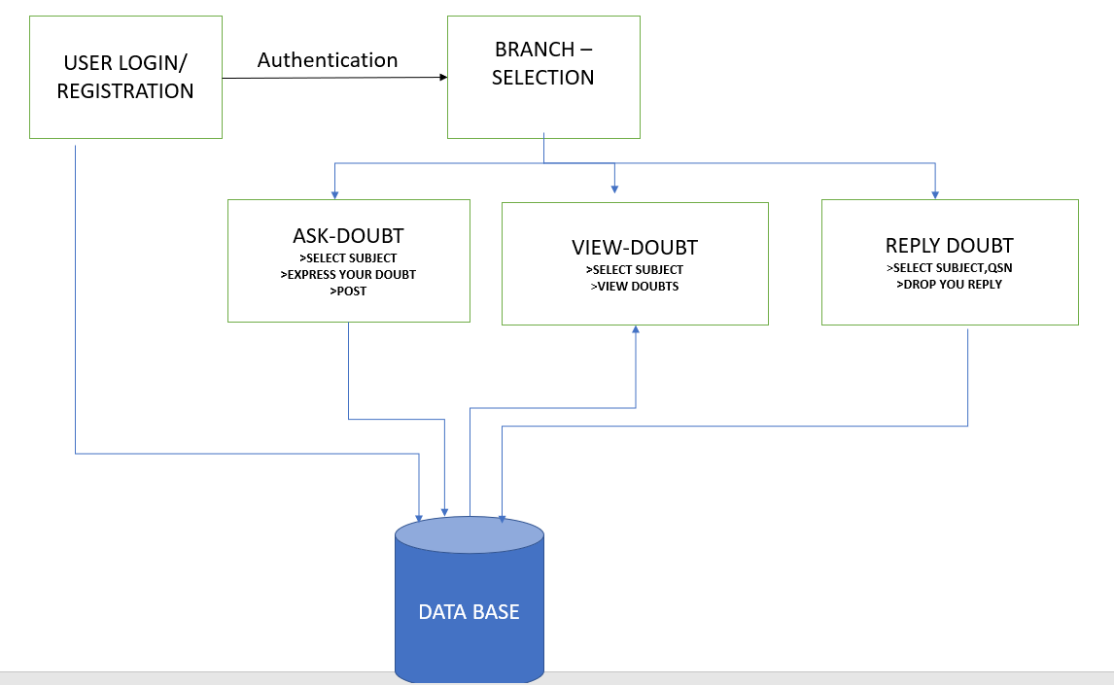
ARCHITECTURE :

Slide 4
REQUIREMENTS:
Hardware Requirements:
PROCCESSOR:Pentium or higher
RAM:>1GB
Software Requirements:
Front end tools : HTML , CSS , JSP
Back end tools : mysql

Slide 5
MODULES:
LOGIN/REGISTRATION MODULE
SELECTION and QUERY POSTING MODULE
DATABASE INTERACTION MODULE

Slide 6
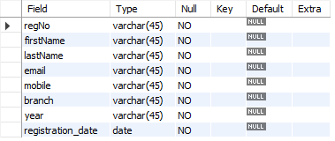
DATABASE INTERACTION MODULE :
Registration table:

Slide 7
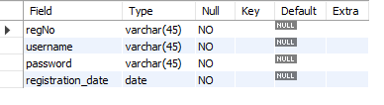
Login table :

Slide 8
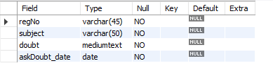
AskDoubt :

Slide 9
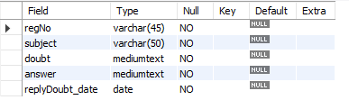
ReplyDoubt :

Slide 10
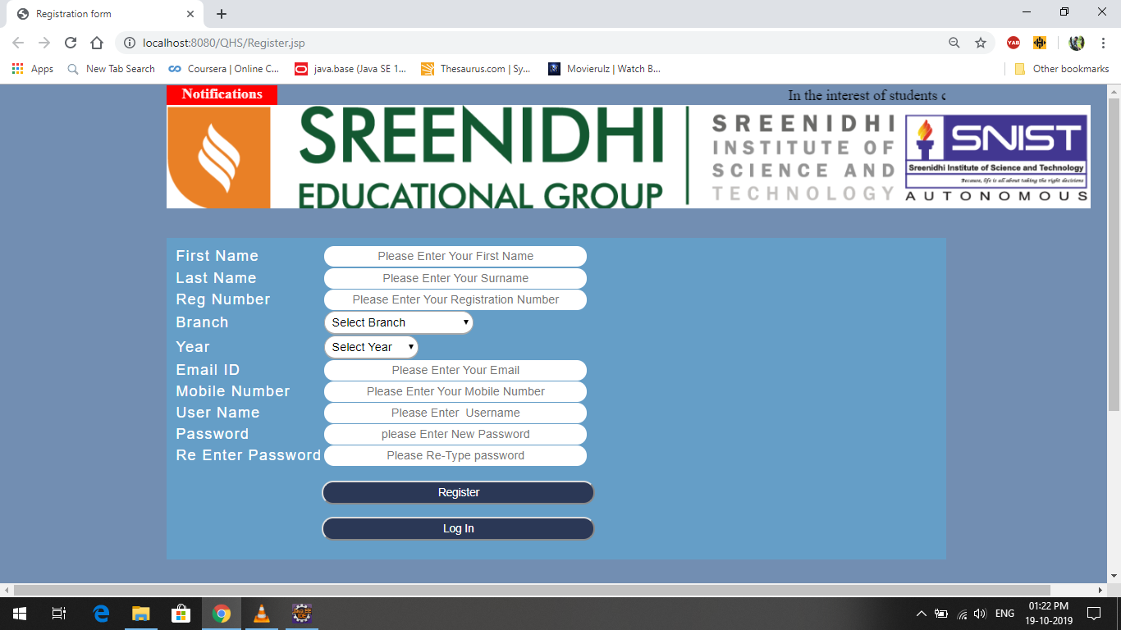
LOGIN/REGISTRATION MODULE : >To enter into this site user has to register himself first input : user details output : registration is successful

Slide 11
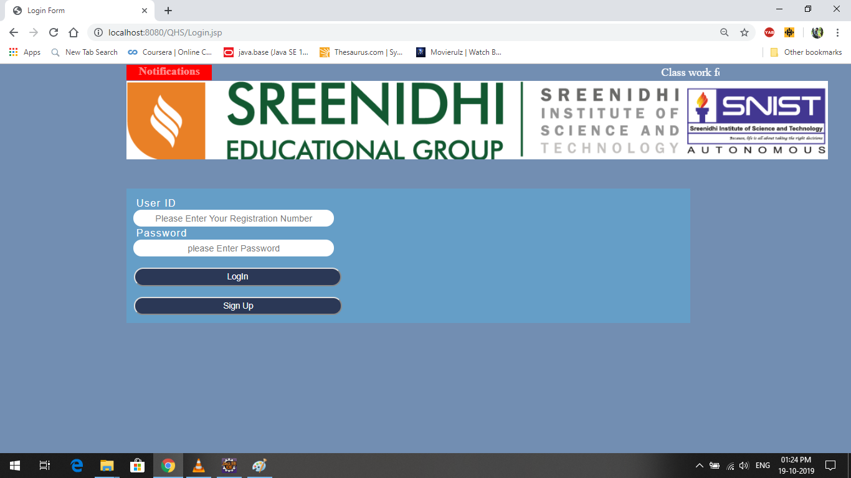
USER LOGIN : > The system provides facility to login into the system Input : enter user Id and password output : Branch selection page

Slide 12
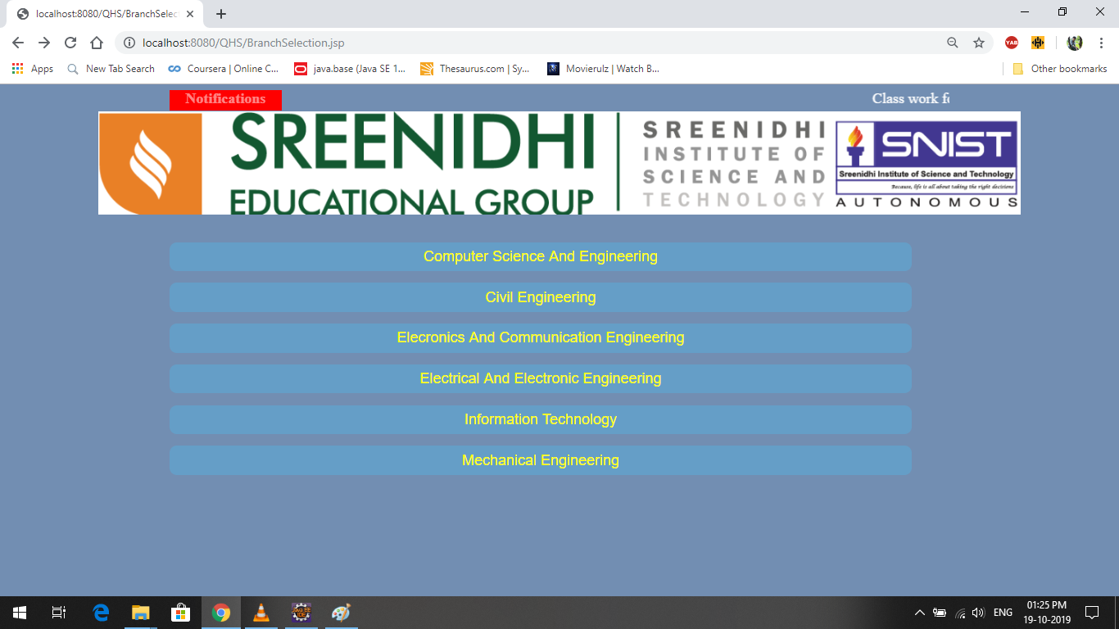
BRANCH SELECTION MODULE : >The user can select the appropriate branch output : opens homepage of selected branch

Slide 13
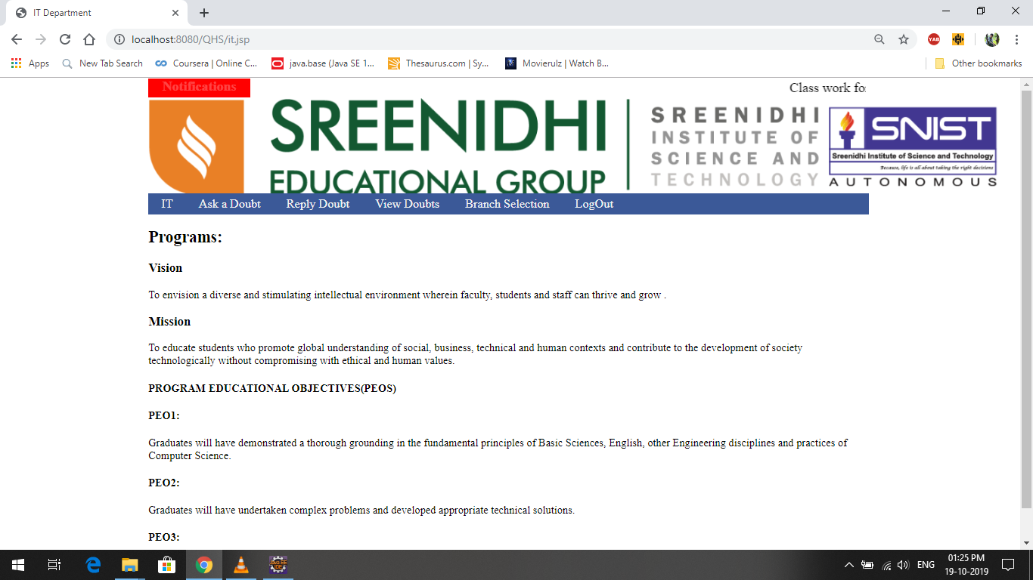
User can select an option of their choice

Slide 14
QUERY POSTING AND RESPONSE MODULE :
ASK – DOUBT
VIEW – DOUBT
REPLY- DOUBT

Slide 15
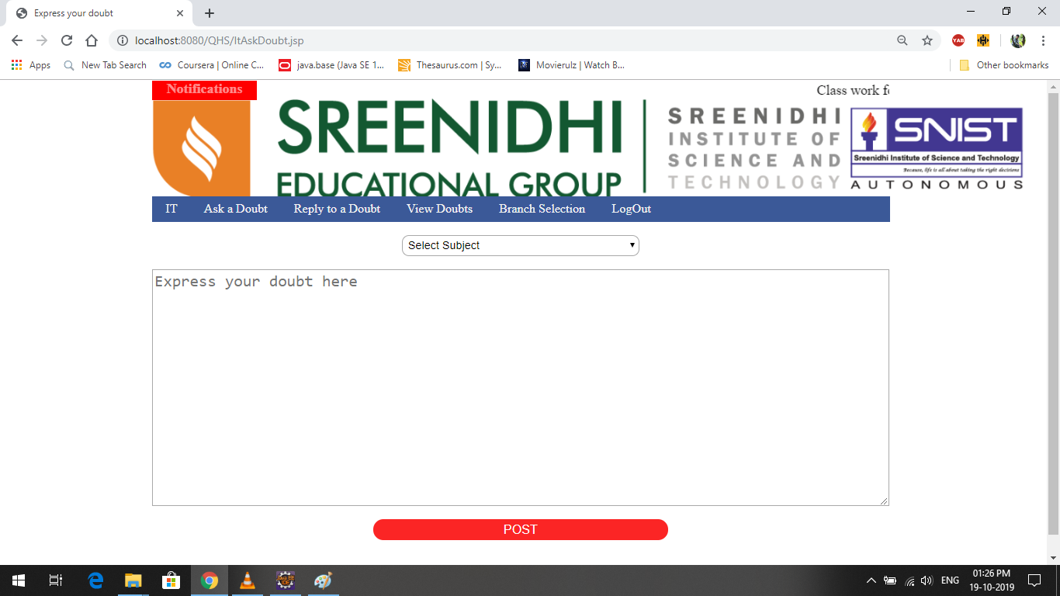
ASK DOUBT: >students can post their queries here .User has to select a subject. Input : Enter your queries in the rectangular box shown and press submit ouput : Query is submitted

Slide 16
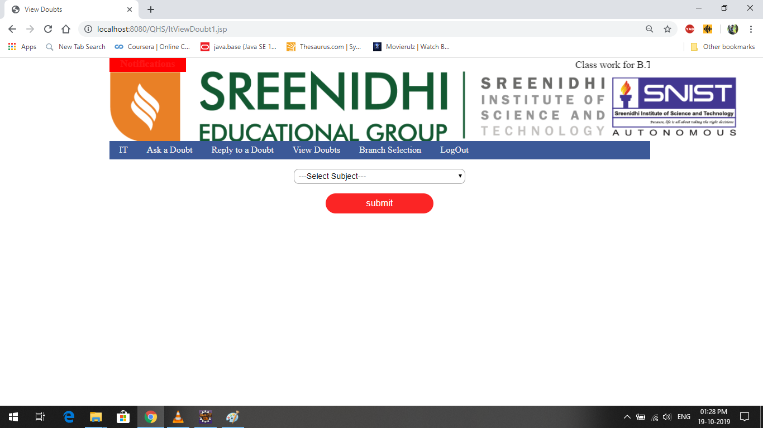
VIEW DOUBT : >To see the posted queries ,the user has to select a subject of his choice

Slide 17
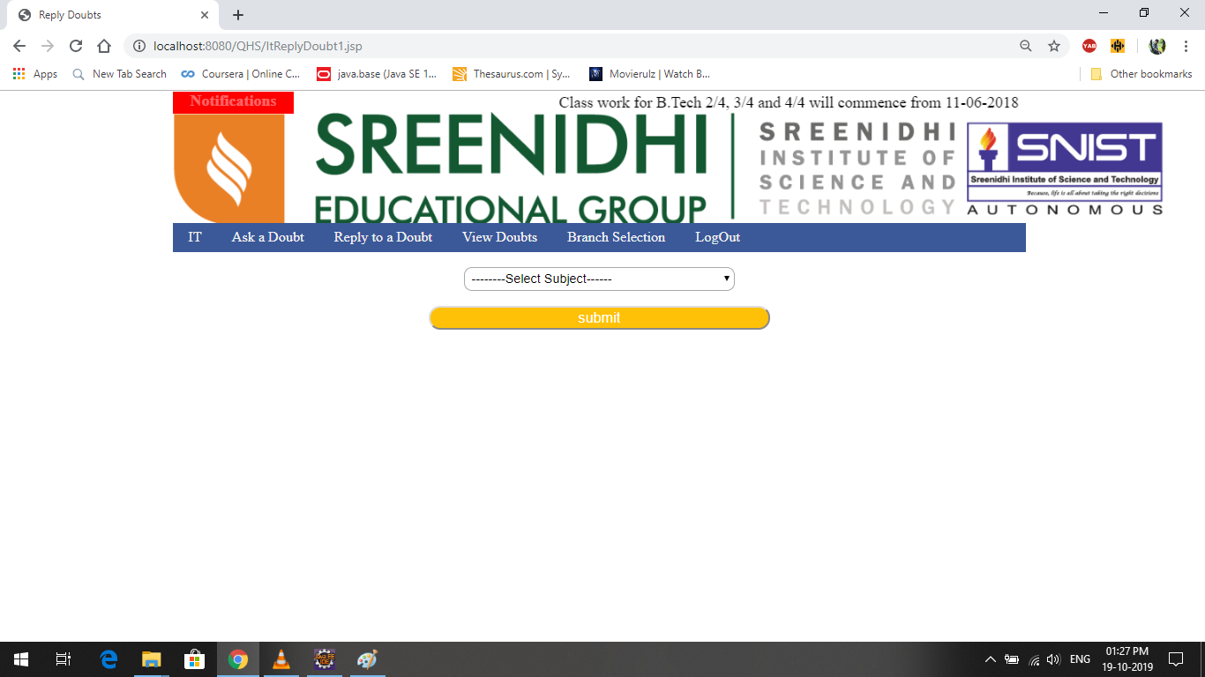
REPLY DOUBT :
>Queries can be answered here by selecting the subject and query.

Slide 18
CONCLUSION
This project is expected to create a more convenient system for use by students to the existing one.

