Slide 1

Paderborn university
Research Group:
High-Performance It Systems
MASTER THESIS DEFENSE
Analysis of job traces in hpc systems
Anirudh madhigiri gopinath
Supervisors:
Prof. Dr. Christian plessl
Prof. dr. Marco platzner
Notes:
Motivation -> Job characterization, cluster analysis, and resource prediction.
Research Problem
Research Design
Finally discussion of results and conclude.

Slide 2



Motivation 1/2
Job submission to NOCTUA System
more unutilized resources
Biology
Physics
Over Estimations
Users
Jobs
Resource Estimation such as nodes, and time limit
Computers
Under Estimations
Job terminates
Chemical industry
The required resources can be predicted using machine learning.
Notes:
Users over or under estimate the resources required.
Characterization of jobs.
Analysis of

Slide 3

Motivation 2/2
Job characterization
Results
Results
Run time estimations
Wait time and resources
Jobs from workload log
Analyzed using data analytics
Large data sets
Failed or canceled jobs
Results
Results
Projects

Slide 4
Research problem
Problem Definition: The thesis aims to analyze,
The job’s resources such as job size, partitions, and QoS.
The wait time, run time, time limit estimations
Failed or canceled jobs.
Cluster utilization.
Machine learning algorithms are used to classify the failed jobs and predict the resources required for the job.
Task 1: Data pre-processing and basic statistics .
Task 2: Deep understanding of job characteristics using data analytics.
Task 3: Analysis of the cluster utilization.
Task 4: Unsupervised learning to create the clusters.
Task 5: Supervised learning to predict the resources required for the jobs.
Task 6: Analysis of failed and canceled jobs, classify the failed jobs.

Slide 5
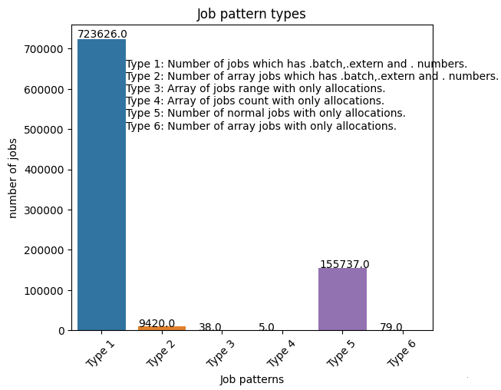
Data pre-processing and basic statistics
Python libraries
Preprocessing
SLURM workload log on the Noctua system is used for the analysis.
Pandas
Matplotlib
Scikit
Numpy
The fields such as user id, account, user name, group id, working directories are anonzmized.
The job features are transformed to its desired formats and units.
Jobs, users, and types
900,000 jobs were submited from March 2019 to January 2022.
150 users are using the cluster over the whole period.

Slide 6
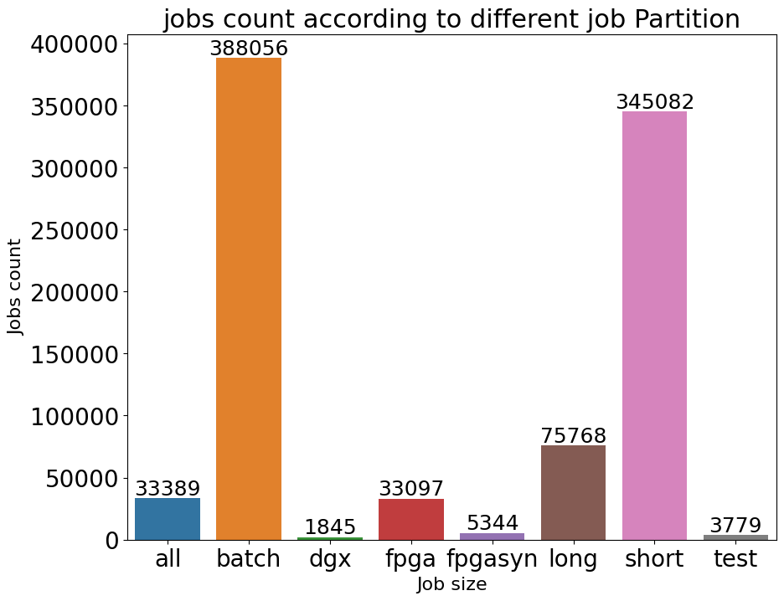
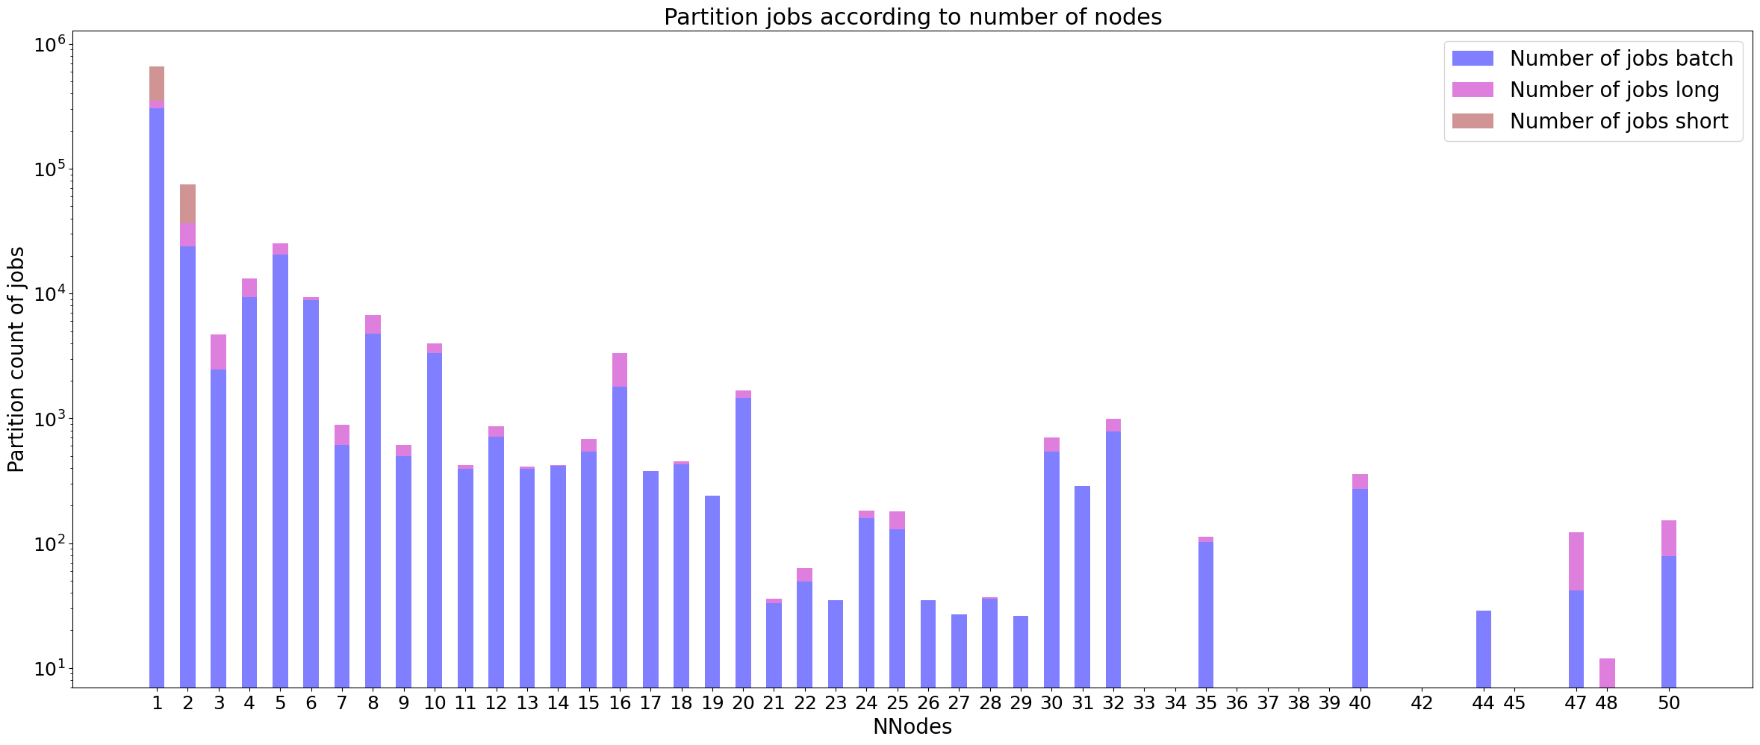
Deep understanding of job characteristics
Job partition analysis
The partitions test, dgx, and fpga syn have very few jobs.
Most of the jobs are short or batch partitions of smaller job sizes.
Batch jobs
Short jobs
Long jobs

Slide 7
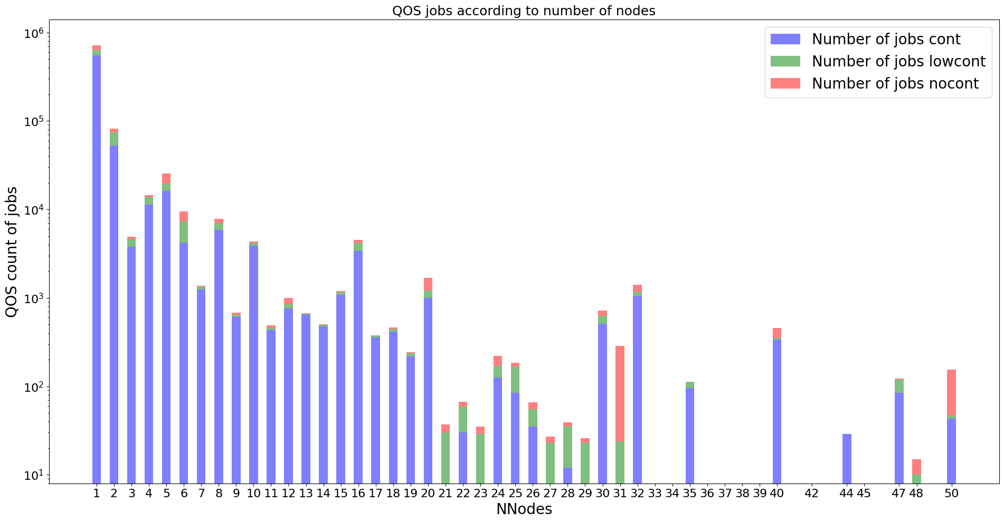
Deep understanding of job characteristics
Job quality OF SERVICE analysis
Number of jobs according to QoS
There are mainly 3 priorities which are cont, low cont, and no cont in order.
Majority of the jobs have cont priority.
Cont – 667,742
Cont jobs
Nocont jobs
low cont – 116,686
Lowcont jobs
no cont – 101,098

Slide 8
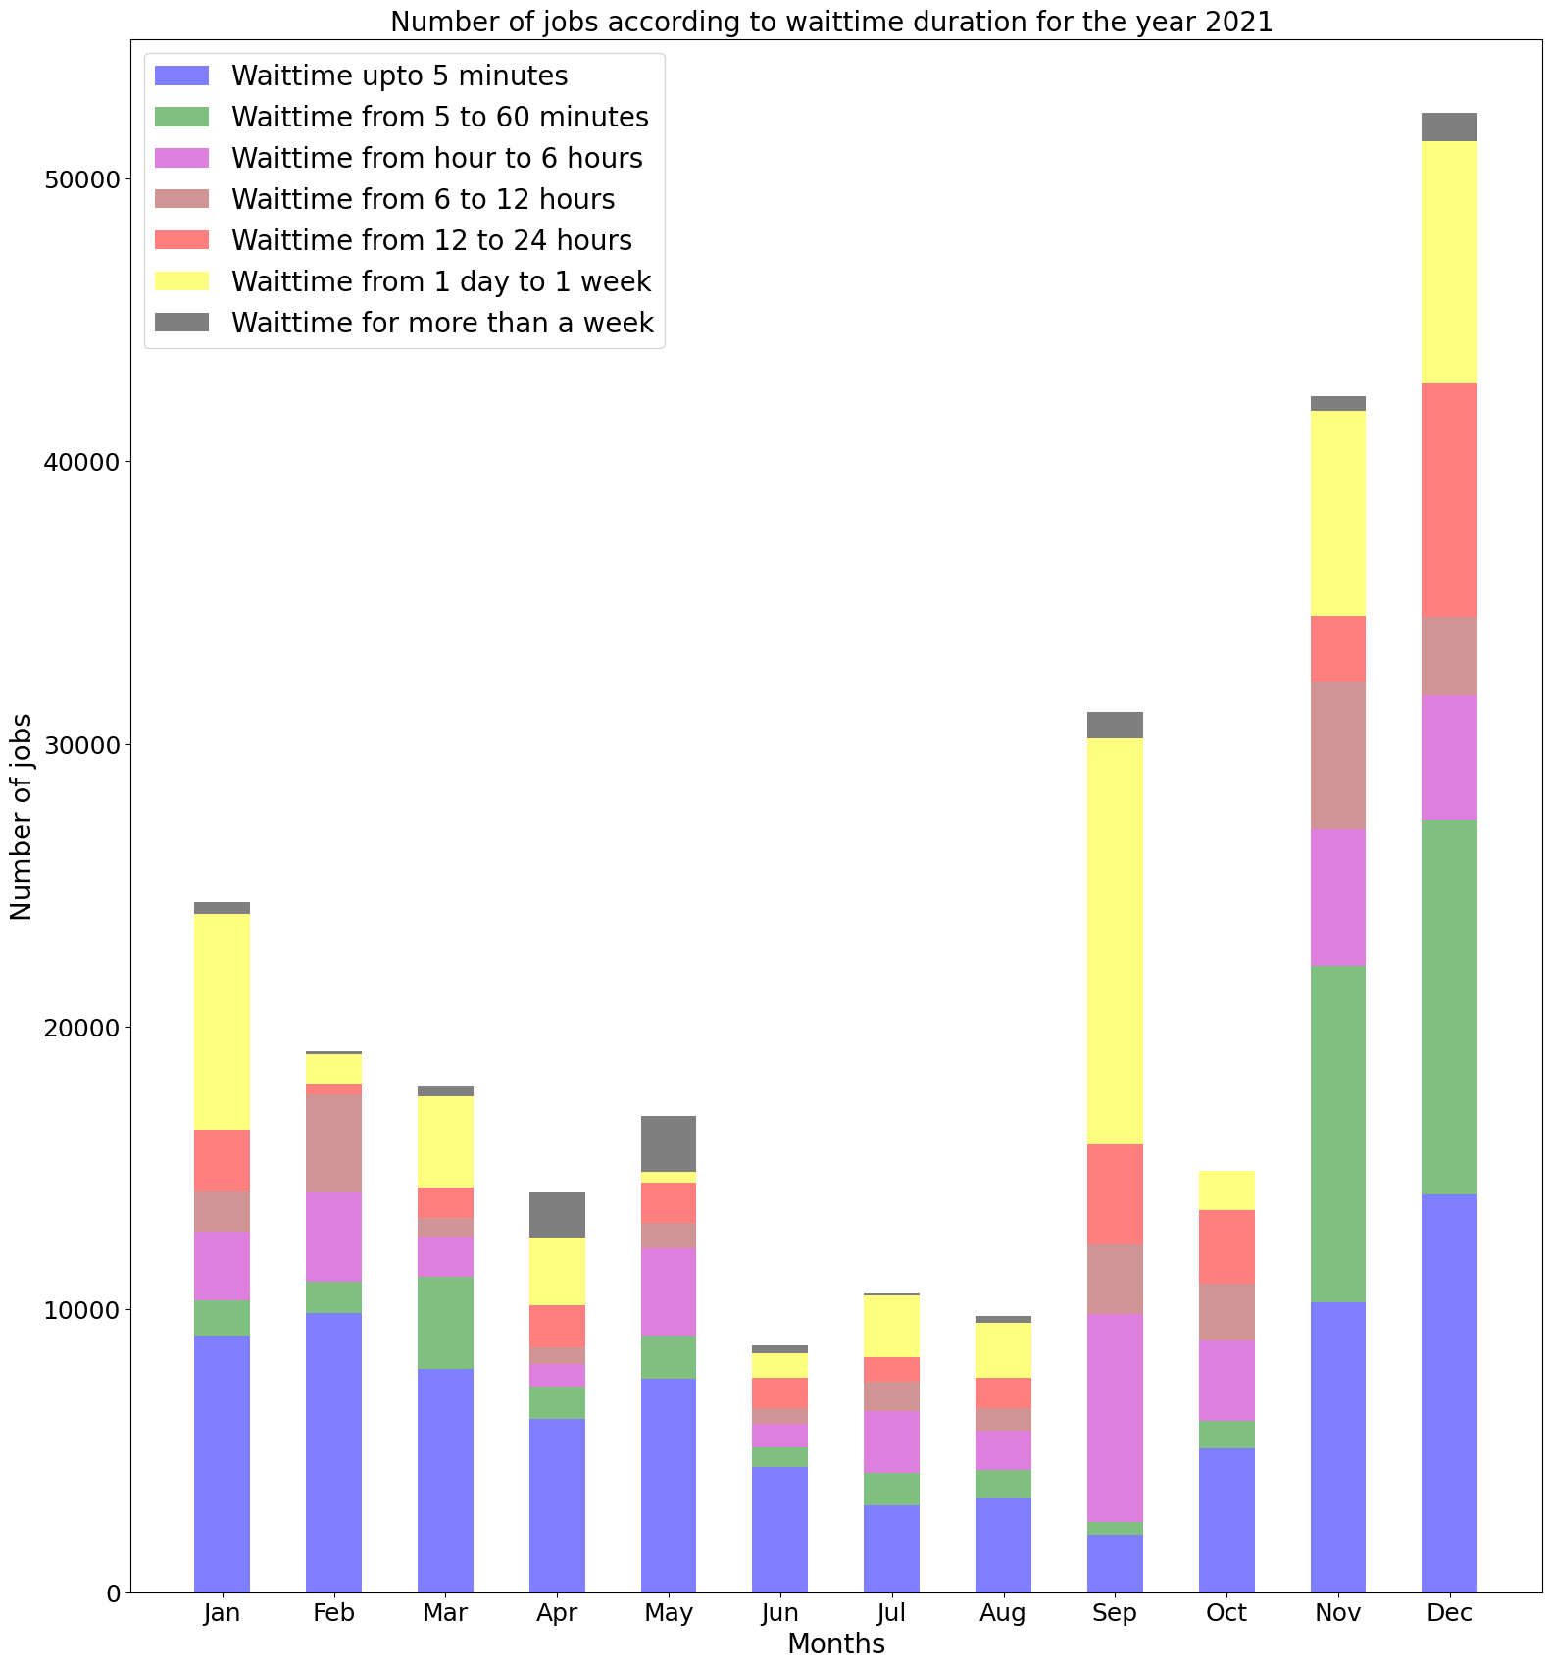
Deep understanding of job characteristics
Wait time analysis
The mean wait times are increasing from less than 10 hours to 60 hours every year.
Jobs having wait times more than a day are high in January, September, November, and December.
Also, 10,000 jobs submitted every month have waited up to 5 minutes.
Wait time from 1 day to week
Wait time up to 5 minutes

Slide 9
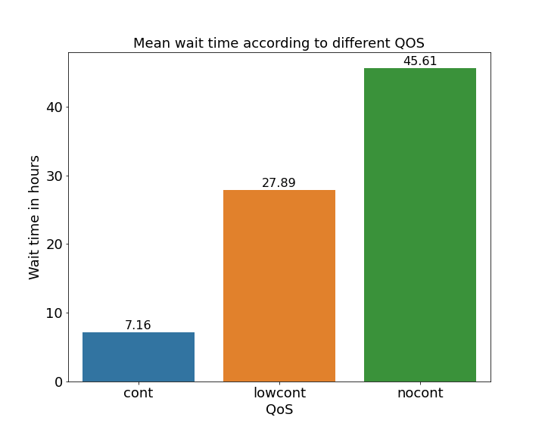
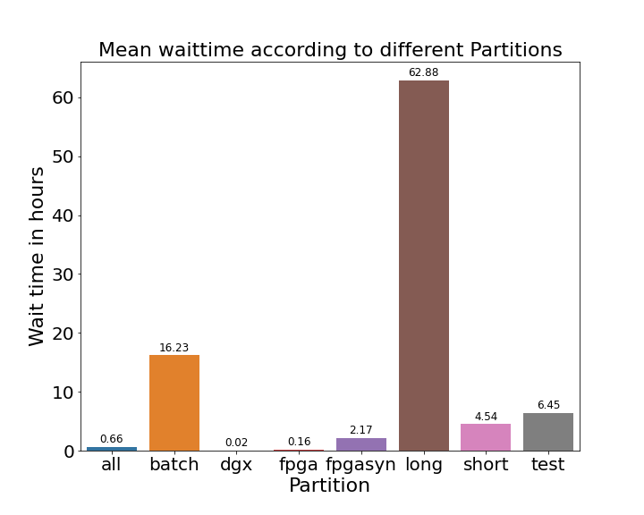
Deep understanding of job characteristics
Wait time analysis
Some projects with batch or long partitions have less than a thousand jobs but a wait time of 150 hours.
Also, few projects with short jobs of more than 200,000 have mean wait time of 15 hours.
Priority cont jobs have less wait time compared to lowcont and nocont.

Slide 10
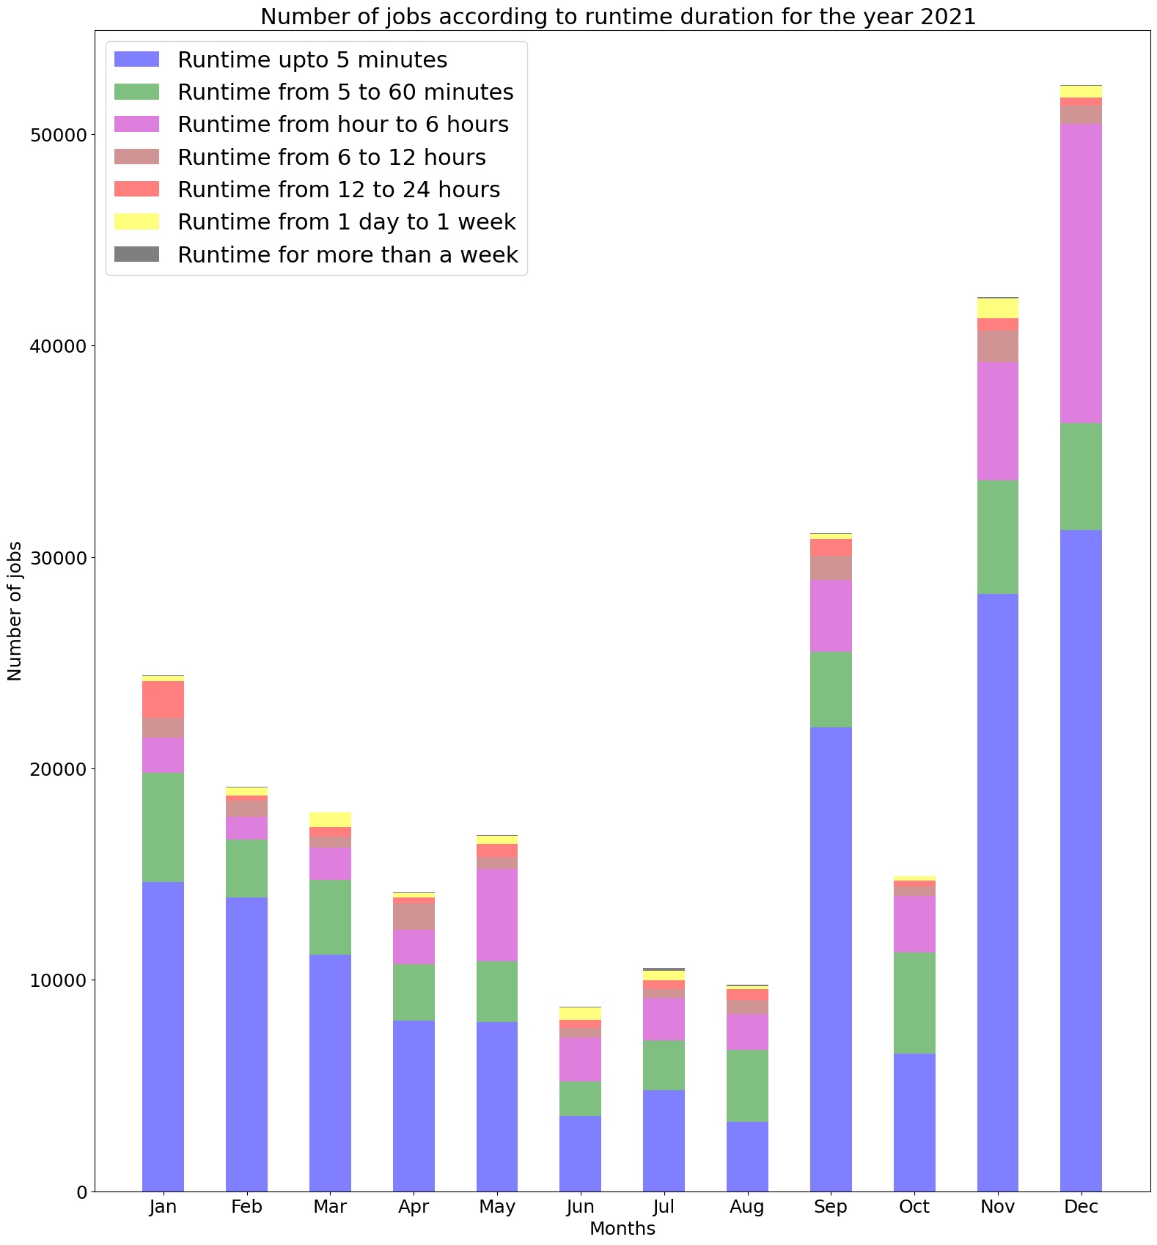
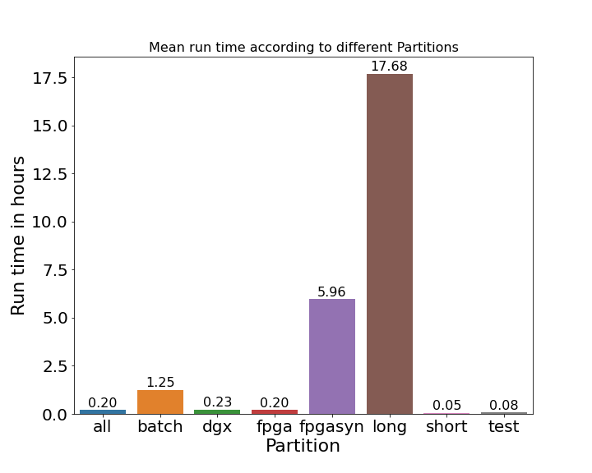
Deep understanding of job characteristics
Run time analysis
More than 50 percent of the jobs were executed within 5 minutes.
Run time from 1 to 6 hours
Run time up to 5 minutes
Long partition has maximum wall time of 21 days, and fpga synthesis has 3 days as it is used for QMA computations.
Short partition has maximum wall time of 30 minutes; hence the run time is very less.

Slide 11
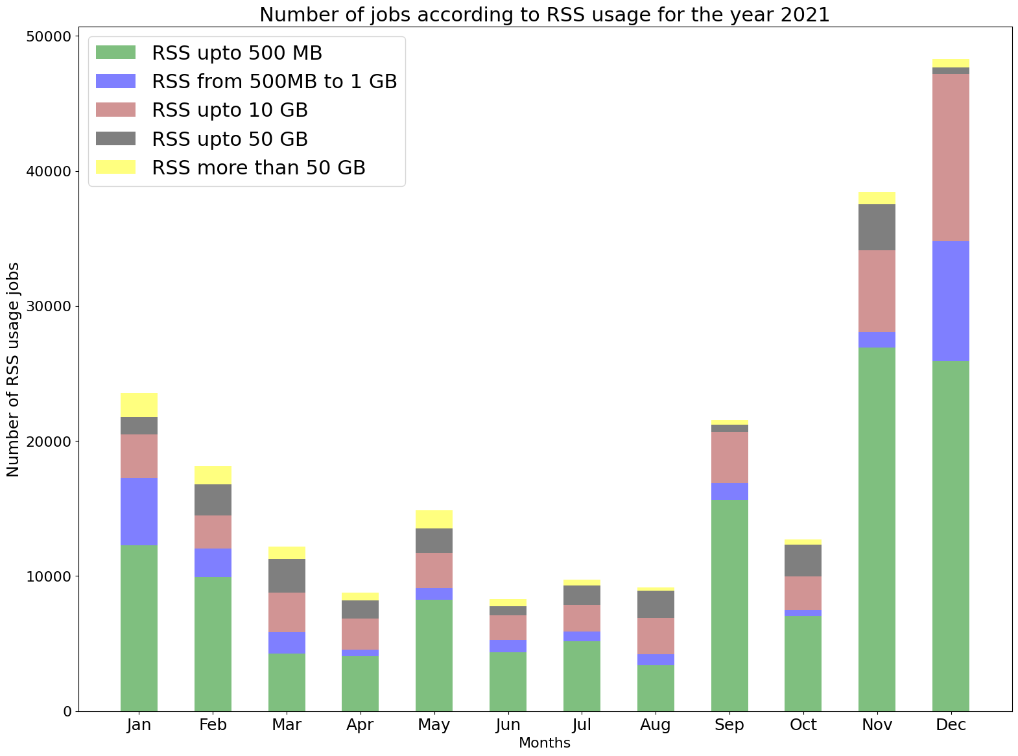
Deep understanding of job characteristics
Maximum resident set size analysis
Almost 60 percent of jobs submitted every month used 500 megabytes.
If the jobs cross the maximum 150 GB, they get canceled.
MaxRSS up to 500 MB
MaxRSS more than 50 GB

Slide 12
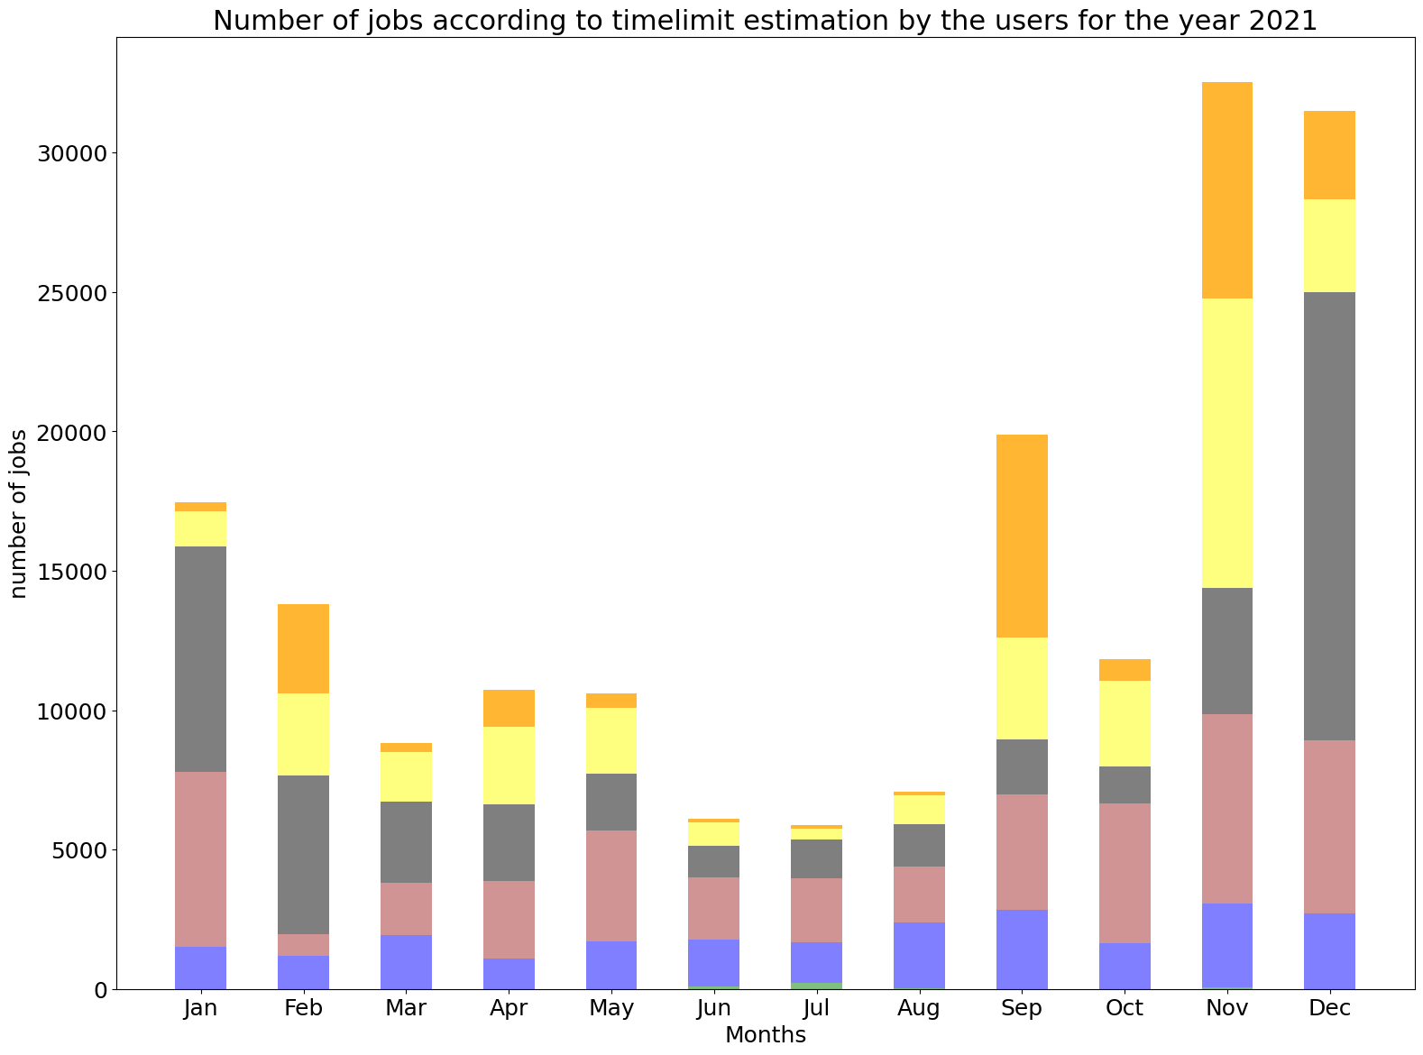
Deep understanding of job characteristics
Time limit estimation analysis
The users have estimated the time limit poorly.
10 to 100 times
The time limit estimations also depends on individual projects.
Estimations from 100 to 1000 times
Almost 80 percent of the jobs are estimated time limit from twice to 100 times the actual run time.
More than 1000 times
Twice to 10 times

Slide 13
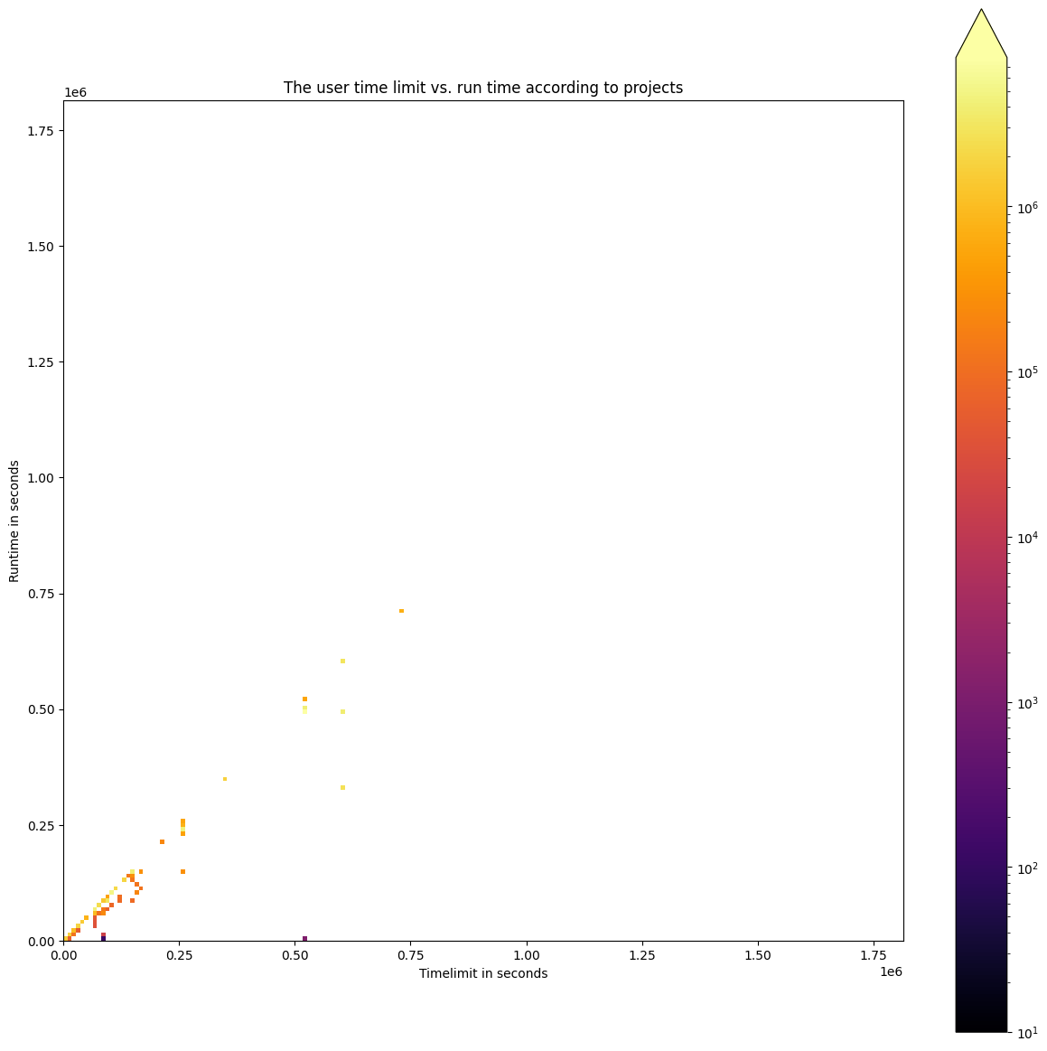
Deep understanding of job characteristics
TIME LIMIT ESTIMATION ANALYSIS
But, even if the estimated run time is twice the actual makes a big difference for larger jobs.
Jobs near the diagonal represent good estimations
More resources are used for short jobs and still clinched better estimations.

Slide 14
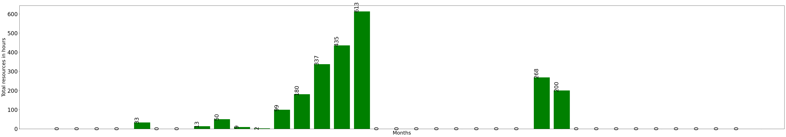
Analysis of cluster utilization
Individual project
Some projects are idle and the cluster utilization is not continues.
Used plenty of resources altogether.
2019 - March
2022- January
Note: The resources are considered as the job's submission date and the total resources used by the jobs over time.​

Slide 15
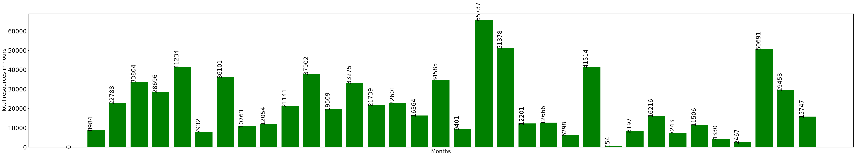
Analysis of cluster utilization
Individual project and Overall usage
Some projects have utilized the cluster continuously.
2019 - March
2019 - September
2022- January
The overall cluster utilization were continues from the beginning till now. In September 2019, the resource usage was less as the HPC system was under maintenance.
If most of the projects does not use the cluster continuously, then the jobs will be overloaded at some point.

Slide 16
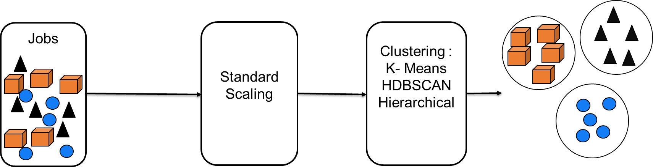
Unsupervised learning to create
clusters of jobs
Creating clusters from the jobs of similar types.
The created clusters can be further analyzed together.

Slide 17
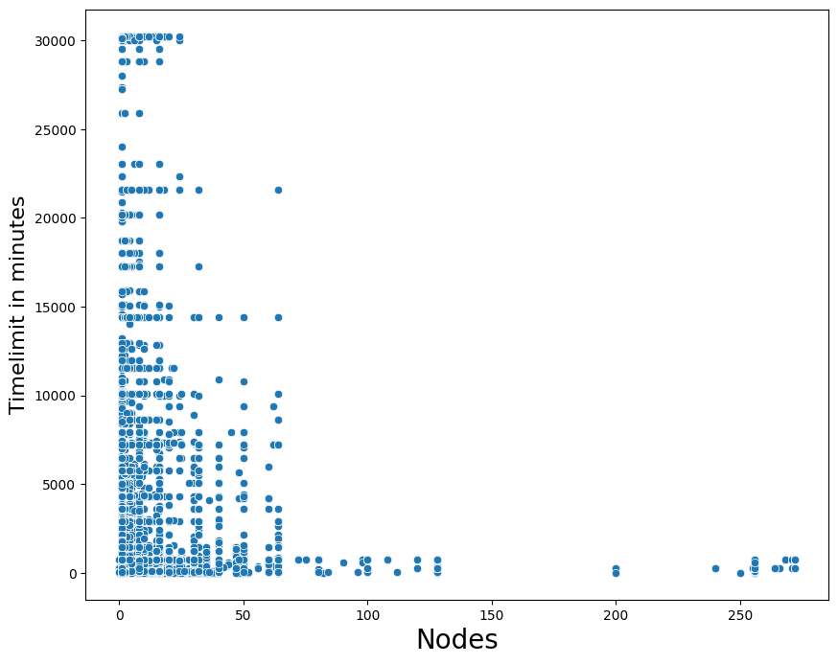
Unsupervised learning to create
clusters of jobs
Nodes and time limit
The nodes and time limit are partilly interdependent as the nodes increase, the time limits decreases.

Slide 18
Unsupervised learning to create
clusters of jobs
K – Means : Nodes and time limit
The time limit and nodes are scaled.
Scaling
Standard scaling : neg – pos.
Normalization : 0 to 1.
Non-linear scaling : 1/2 , 1/3 .
All three scaling methods yield the same results, but standard scaling works in all situations.
Determining number of clusters
Elbow method.
Created maximum of 5 large clusters.
Silhouette score.
Gives the maximum number of possible small clusters.
Silhouette scores are good in estimating the number of clusters than K – Means.

Slide 19
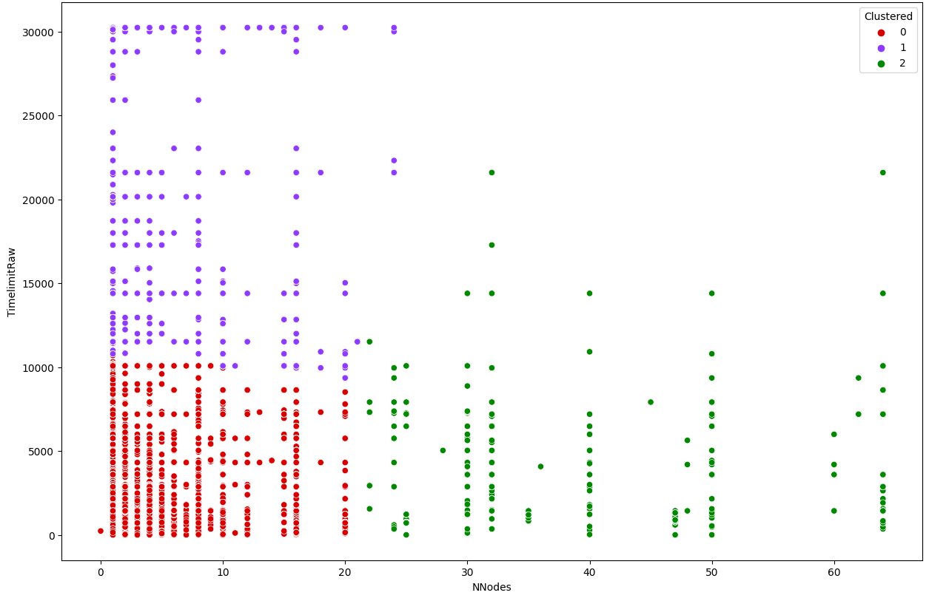
Unsupervised learning to create
clusters of jobs
K – Means : Nodes and time limit according to partition
The K – Means algorithm did not work well for some of the partitions like long.
Only 3 clusters are created out of 75,000 jobs.

Slide 20
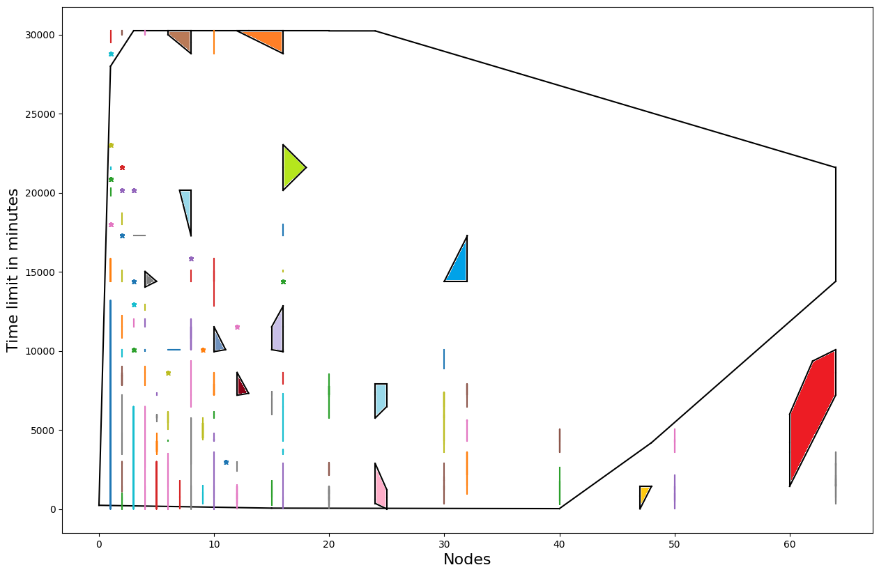
Unsupervised learning to create
clusters of jobs
HDBSCAN : Nodes and time limit according to partition
The clusters are small compared to K – Means for the long partition.
The convex hull colored for long partition represents the clusters range, dots represents cluster itself, and the lines have range in either nodes or time limit.
Outlier cluster
Similarly, HDBSCAN created small clusters for nodes and run time as well.

Slide 21
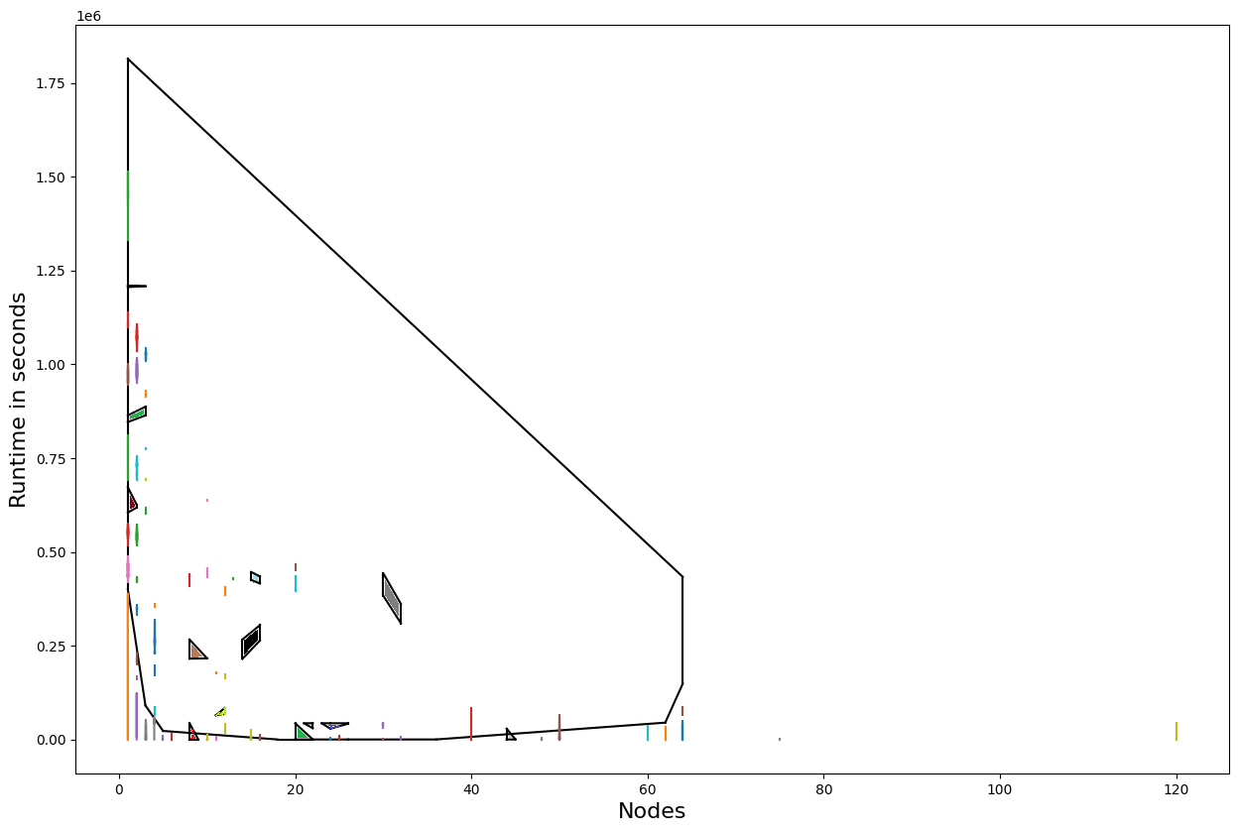
Unsupervised learning to create
clusters of jobs
HDBSCAN : Nodes and Run time according to Project
HDBSCAN has created even smaller clusters according to projects than for the partitions.
Suppose we do clustering according to the project for each partition, we get even better clusters.
Outlier

Slide 22
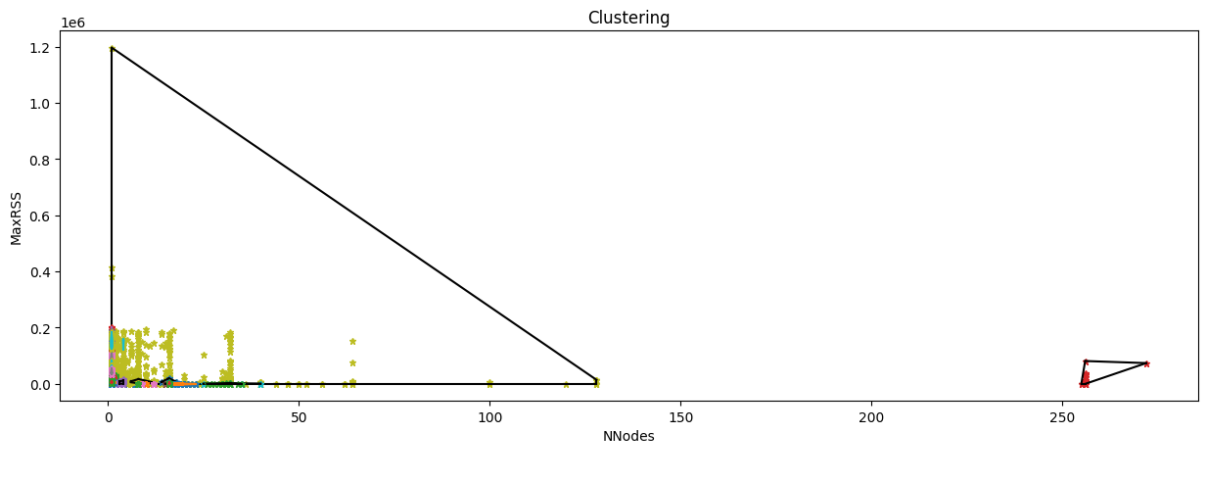
Unsupervised learning to create
clusters of jobs
HDBSCAN : Multi - dimensional
The features MaxRSS, nodes, each node CPU, and run time are used for clustering.
Each node CPU time = Total CPU time / nodes.
The data are sampled with 50,000 jobs using cluster sampling.
The multi – dimensional clustering pushes most of the jobs to outliers and create pretty large clusters.
Outlier
The silhouette scores gave good clusters for K – Means clustering.
HDBSCAN model performed well in creating better and small clusters than K – Means.
Agglomerative hierarchical clustering takes too much time to run because, it runs on O(n*n) complexity.

Slide 23
Supervised learning to predict job resources
Decision tree and random forest regressor
The features used to predict run time are nodes, account, time llimit, and partition.
These features mainly gives information on the project, user estimations while submitting the job.
Categorical values
Label encoding – apply dummies.
One hot encoding – create features of binary values.
Completed jobs
Train set : 70% of the total jobs – 431,388
Test set : 30% of the total jobs – 143,797
The label encoding is faster than the one hot encoded features though the accuracy using both are same.

Slide 24
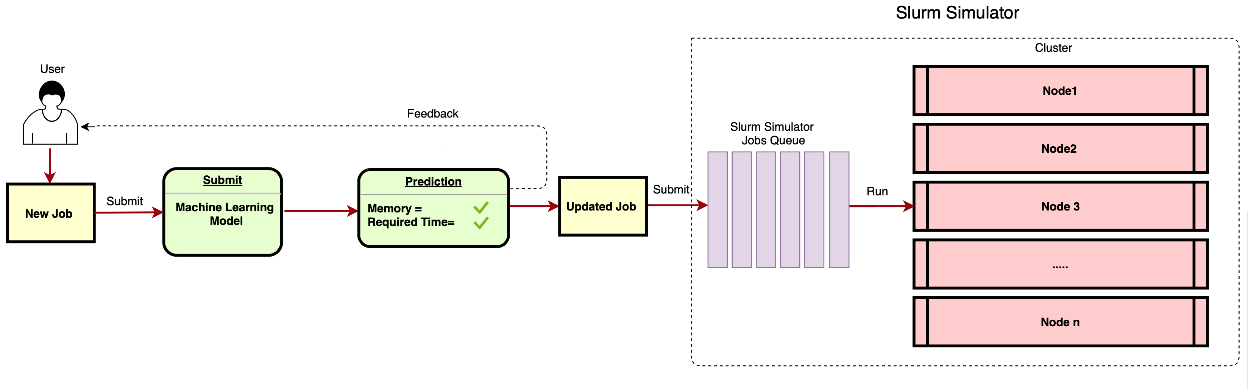
Related work
Predictive analysis
The literature by Mohammed Tanash, Brandon Dunn, Daniel Andresen, William Hsu, Huichen Yang, and Adedolapo Okanlawon. Improving hpc system performance by predicting job resources via supervised machine learning in 2019.
The literature created a machine learning model using supervised machine learning to predict the resources required, such as memory and run time of the jobs.
For the inputs, the SLURM jobs of 14 million are taken that were submitted to the HPC system beocat from Kansas State University.
The decision tree performed well compared to all other models achieving 0.6 R squared.
Figure: Work Flow Diagram for Model.

Slide 25
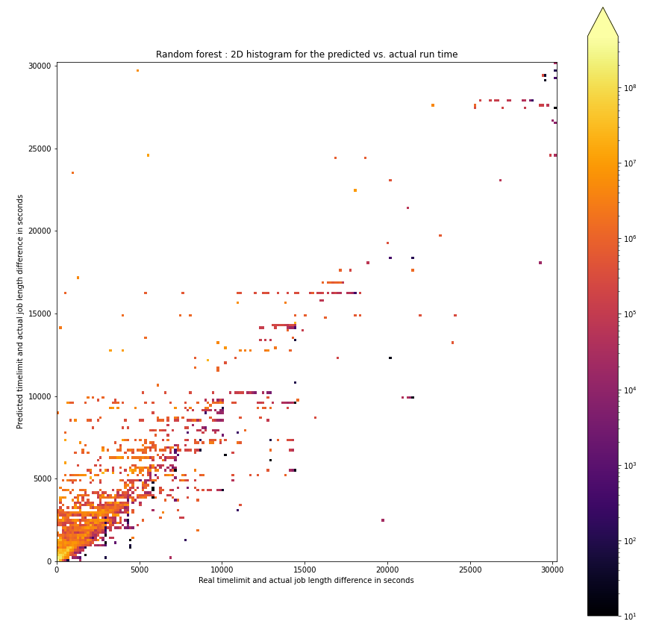
Supervised learning to predict job resources
Feature Extraction
Run time difference = Time limit – actual run time.
Predicting the run time difference using regression models with the data set.
The model trained is evaluated using r squared method.
r2 score = the sum of squares due to regression / total sum of squares.
Good estimations near the diagonal line
Both models achieved 94 percent for the test data.
Overpredicted run time difference
Underpredicted run time difference

Slide 26
Supervised learning to predict job resources
Approaches to deal underprediction of run time difference
Approaches
Approach 1
Approach 2
Modified target
Run time difference= (Run time difference− ((Run time difference∗ 30 or any int)/100))
The over prediction of the run time difference or the under prediction of the run time has been reduced from 53,000 to 16,000.
Classify the predicted run time difference
Jobs annotated as under or over predicted
Regression trained model output
Classification model – Decision tree
Logistic regression
Classified over predicted
Classified under predicted
Decision tree and logistic regression have predicted only 33 percent of the jobs are over predicted the run time difference correctly.

Slide 27
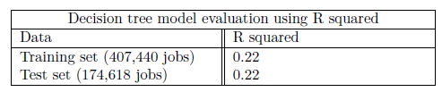
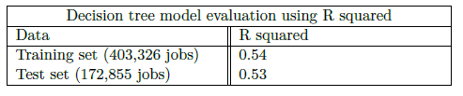
Evaluation
Regression models to predict the nodes
Regression models to predict the MaxRSS
Both the models did not perform well predicting the nodes and MaxRSS due to less dependent features.
The model is good if it achieves at least 0.70 R squared value.

Slide 28
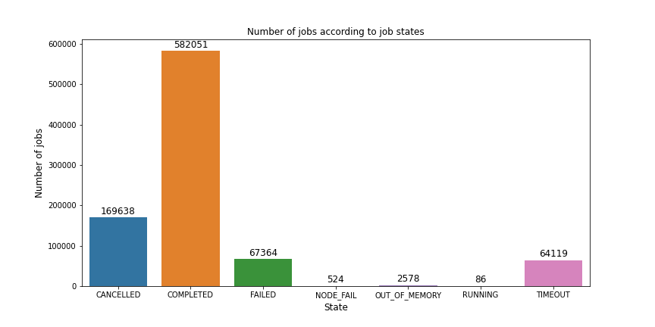
Analyzation of failed and canceled jobs
From the total of 870,000 jobs, around 240,000 jobs have either failed, canceled or node failed.
The canceled jobs includes the jobs which are canceled by users.

Slide 29
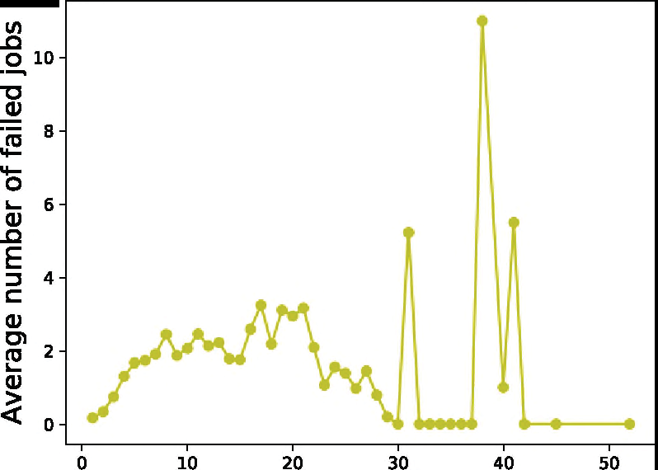
Related work
Workload characterization
The literature by Wenxiang Yang, Zhigong Yang, Yongguo Zhou, Fang Wang, Cheng Chen, and Yueqing Wang. A comprehensive analysis of user job data on a petascale supercomputer dedicated to cfd. https://ieeexplore.ieee.org/abstract/document/9064094, 2019.
This paper mainly concentrated on analyzing failed jobs and the waiting time of the job using the SLURM log submitted to FT-2000, from Natural science Foundation of China.
Number of simultaneous submitted jobs
The paper represents most failed jobs are submitted by same user or due to batch submissions.
Batch submissions are likely to wait for long time in queue.

Slide 30
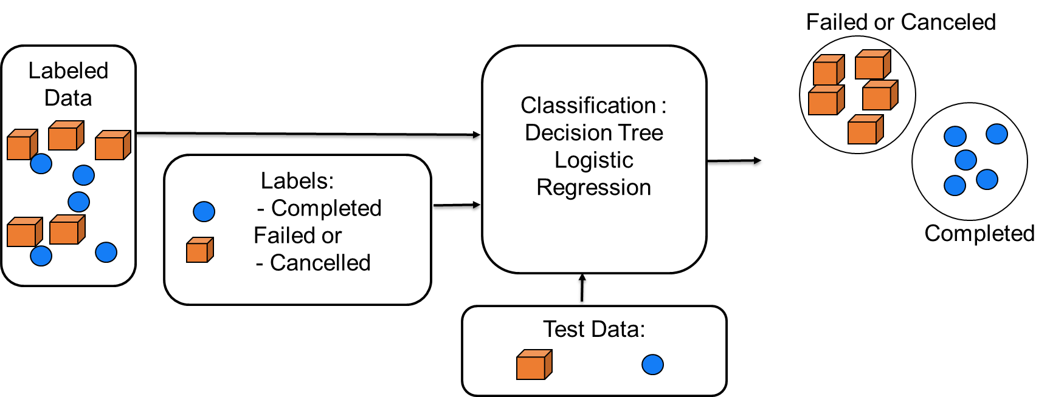
Analyzation of failed and canceled jobs
Classification of jobs as failed or canceled and completed
The features used are the resources users estimate while submitting a job, such as nodes, time limit, partition, account, number of CPUs, and user id.
Classes to predict
The Accuracy of 89% is achieved for the decision tree classifier.
Canceled, failed
Completed
The logistic regression model achieved 70% accuracy, but only classified completed jobs correctly.
Using a decision tree classifier, the failed or canceled jobs and completed jobs can be classified

Slide 31
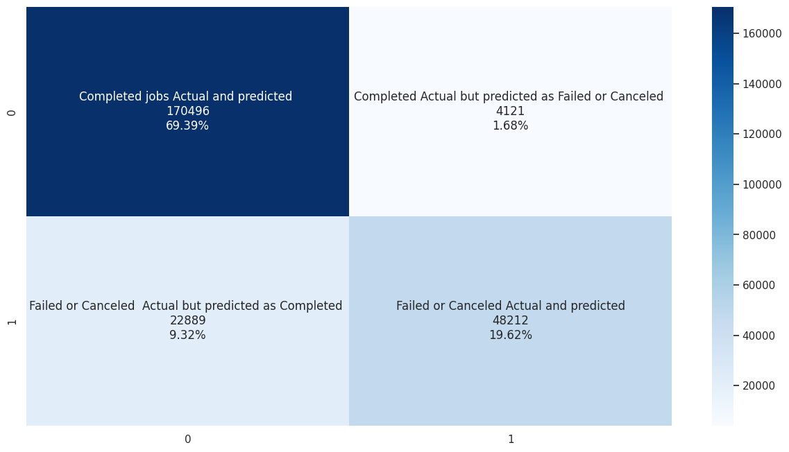
Evaluation
Classification models to classify the failed or canceled and completed jobs
Decision tree confusion matrix
Accuracy – 89%
Out of 71,000 jobs, 48,200 jobs are predicted correctly as failed or canceled.
The logistic regression model underperformed by classifying only the completed jobs accurately.

Slide 32
Conclusion and future work (1/2)
Analysis of job geometrics
Long and batch jobs tend to wait more time in a queue.
Majority of the jobs are cont QoS having high priority and less wait time.
How good are the users in estimating the time limit of their jobs ?
Most users estimated the run time bad; around 80% estimated an average of 10 to 100 times the actual run time.
How continues is the cluster usage per project?
The overall cluster utlization is continuous for all the years.
Many projects have not used the cluster continuously. In some months, the submitted jobs are too high which overloads the cluster.
Can one identify the job classes with similar properties?
The silhouette score is better to automate the K-Means clustering.
HDBSCAN worked well in creating the small clusters than K-Means.

Slide 33
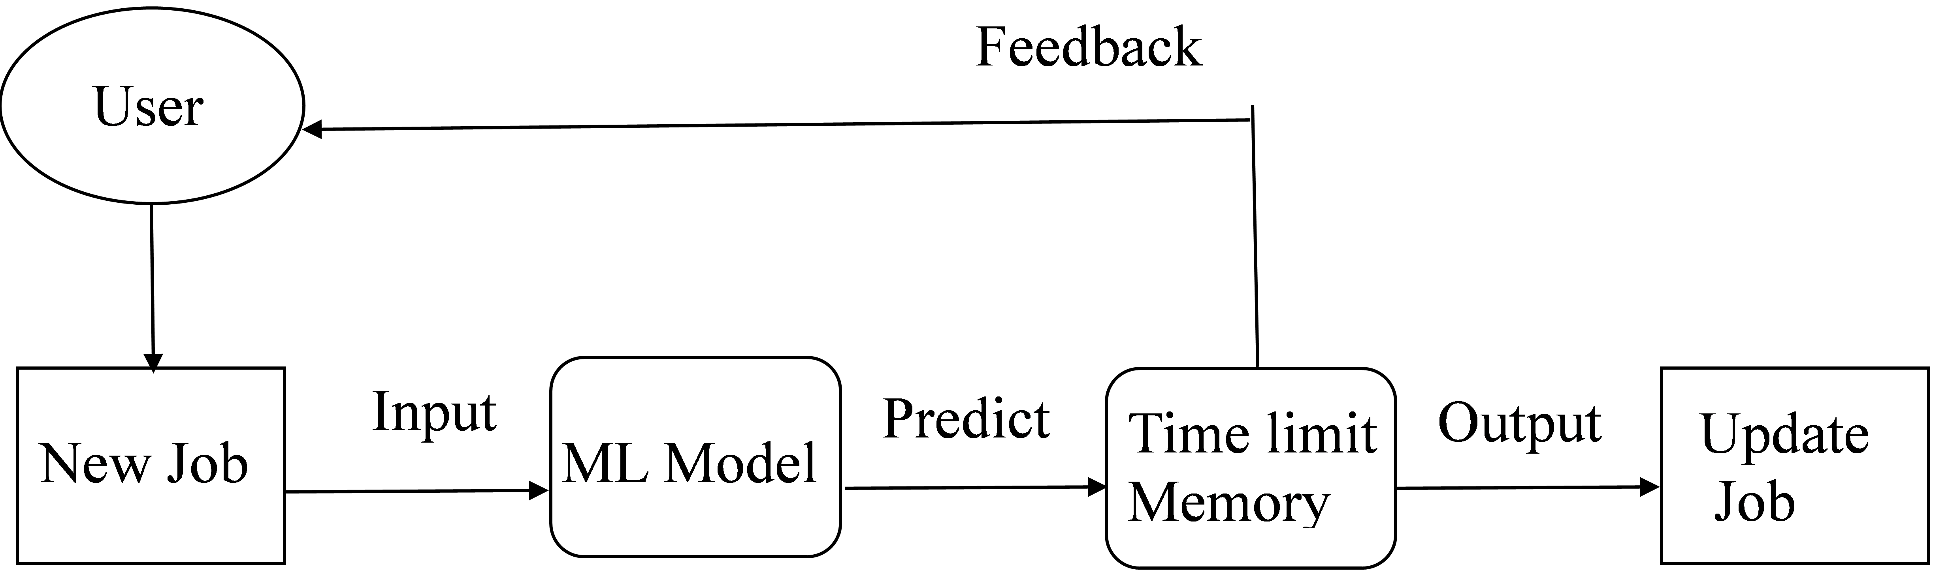
Conclusion and future work (2/2)
Supervised learning to predict job resources
Decision tree and random forest models achieved 94% of r2 score in predicting job's run time.
These predictions can be used to suggest the users to change their estimations.
The under predicted run times are handled by training the modified target approach.
Is there any correlation between certain job properties? The probability of a job failing or getting canceled?
The jobs around 200,000 out of 870,000 have either failed, canceled, or node fail.
Many failed or canceled jobs are related to MaxRSS, nodes, and the time limit estimated by the users.
The decision tree model achieved 67% accuracy in classifying the failed or canceled jobs and more than 95% in classifying completed jobs.
Future work
Neural networks optimize the classification accuracy.
Creating more clusters based on different features using other models.
User recommendations and scheduler optimizations.

Slide 34
Bibliography
Wenxiang Yang, Zhigong Yang, Yongguo Zhou, Fang Wang, Cheng Chen, and Yueqing Wang. A comprehensive analysis of user job data on a petascale supercomputer dedicated to cfd. https://ieeexplore.ieee.org/abstract/document/9064094, 2019.
Mohammed Tanash, Brandon Dunn, Daniel Andresen, William Hsu, Huichen Yang, and Adedolapo Okanlawon. Improving hpc system performance by predicting job resources via supervised machine learning. In Proceedings of the Practice and Experience in Advanced Research Computing on Rise of the Machines (learning), pages 1–8. 2019.
Leo Breiman. Random forests. Machine learning, 45(1):5–32, 2001.
partition. https://pc2.uni-paderborn.de/fileadmin/pc2/lecture_APRS19/ Ueb2_Noctua.pdf.
Slurm workload manager. https://slurm.schedmd.com/documentation.html.
Jeannette M. Wing. The Data Life Cycle. Harvard Data Science Review, 1(1), jul 1 2019. https://hdsr.mitpress.mit.edu/pub/577rq08d.

