Slide 1
Power BI Showcase
Supply Chain Risk Intelligence
Power BI dashboard project
Prepared by Anirudh Shukla | Global risk visibility across suppliers, regions and logistics networks
01

Slide 2
Project Objective
Prepared by Anirudh Shukla
O
Program Goal
What this dashboard delivers
Build a Power BI dashboard to analyze and monitor global supply chain risks using large-scale datasets with 100,000+ rows.
Identify vulnerabilities across suppliers, regions and logistics networks
Track exposure linked to geopolitical issues, climate events and operational disruptions
Use data-driven intelligence to support strategic planning, risk mitigation and efficiency
100,000+
Rows
Suppliers
Risk
Regions
Exposure
Actions
Insights
02

Slide 3
Project Roadmap
Objective driven workflow for the Power BI build
1
2
3
4
Understand Dataset
Ensure Data Quality
Define Business Problem
Prepare for Dashboard Building
Review structure, fields and source coverage
Validate records, formats, nulls and duplicates
Translate supply-chain pain points into analytics goals
Model data and design reporting views for Power BI
03

Slide 4
Data Collection and Validation
Prepared by Anirudh Shukla
I
Data Collection and Validation
Data
Downloaded main and backup datasets
Checked row counts across all loaded files
Removed duplicates, inconsistencies and structural errors
Risk
Insight
04

Slide 5
Data Dictionary
Power BI workflow and dashboard development
I
Data Dictionary
Data
Documented each column name and business meaning
Validated data types for dates, currency and categories
Reviewed example values to confirm consistency and usability
Risk
Insight
05

Slide 6
Data Loading in Power BI
Power BI workflow and dashboard development
I
Data Loading in Power BI
Data
Imported cleaned datasets into Power BI Desktop
Rechecked row counts and detected type mismatches
Created relationships between key supplier, trade and logistics tables
Risk
Insight
06

Slide 7
Exploratory Data Analysis
Power BI workflow and dashboard development
I
Exploratory Data Analysis
Data
Studied distributions, trends and operational variability
Identified outliers in shipping cost, delays and trade exposure
Used basic visuals to reveal early patterns and risk signals
Risk
Insight
07

Slide 8
Missing Data Handling
Power BI workflow and dashboard development
I
Missing Data Handling
Data
Identified nulls and incomplete operational fields
Removed, replaced or retained gaps based on business importance
Improved reporting accuracy without overstating certainty
Risk
Insight
08

Slide 9
Core Business Questions
Questions the dashboard should answer clearly
R
Which regions carry the highest supply-chain risk
S
Which suppliers appear most unreliable or concentrated
D
What are the major causes of delays and disruption
T
Which transportation modes create the most exposure
C
Where are cost spikes and trade volatility most visible
V
Which dependencies threaten resilience the most
09

Slide 10
Dataset Foundation
Power BI workflow and dashboard development
I
Dataset Foundation
Data
Integrated supplier, logistics, shipping cost and trade datasets
Blended operational metrics with structured trade data
Prepared and shaped data using Power Query workflows
Risk
Insight
10

Slide 11
Data Model and DAX
Power BI workflow and dashboard development
I
Data Model and DAX
Data
Built clean relationships across supplier, region and logistics tables
Created measures for trade value, shipping cost, delay rate and risk score
Enabled drill-down analysis through slicers, filters and dynamic KPI logic
Risk
Insight
11

Slide 12
Executive Overview Page
Microsoft-style Power BI dashboard mock preview
Trade Value
$42.8M
Suppliers
128
High Risk
19
+8.4%
+5.1%
-2.7%
Filters Region Supplier Mode
Risk trend by month
Exposure by mode
Risk mix
Top KPI cards for trade value, suppliers and high-risk exposure | Quick view of global posture for faster decisions | Presentation-ready layout with strong filter navigation
12

Slide 13
Supplier and Region Analysis
Microsoft-style Power BI dashboard mock preview
Trade Value
$42.8M
Suppliers
128
High Risk
19
+8.4%
+5.1%
-2.7%
Filters Region Supplier Mode
Risk trend by month
Exposure by mode
Risk mix
Deep dive into supplier reliability and concentration | Regional view of risk hotspots and disruption trends | Supports mitigation planning and sourcing alternatives
13

Slide 14
Key Business Insights
Executive summary from the analysis
T
Trade exposure is concentrated in a limited set of major corridors
M
Road and rail show the highest logistics exposure in the analysis
S
Supplier dependency creates concentrated operational risk
G
Cross-border volatility directly affects resilience and planning
14

Slide 15
Project Outcome
Power BI workflow and dashboard development
I
Project Outcome
Data
Delivered a Power BI solution for supply-chain intelligence
Supports strategic planning, risk mitigation and operational efficiency
Demonstrates practical BI reporting, transformation and analytics capability
Risk
Insight
15

Slide 16
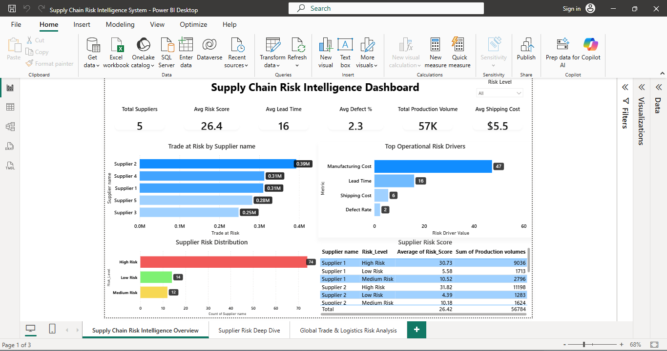

Slide 17
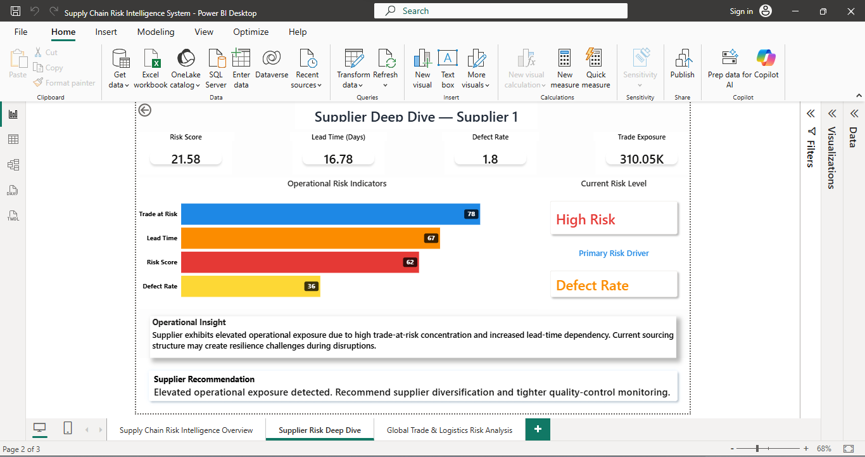

Slide 18
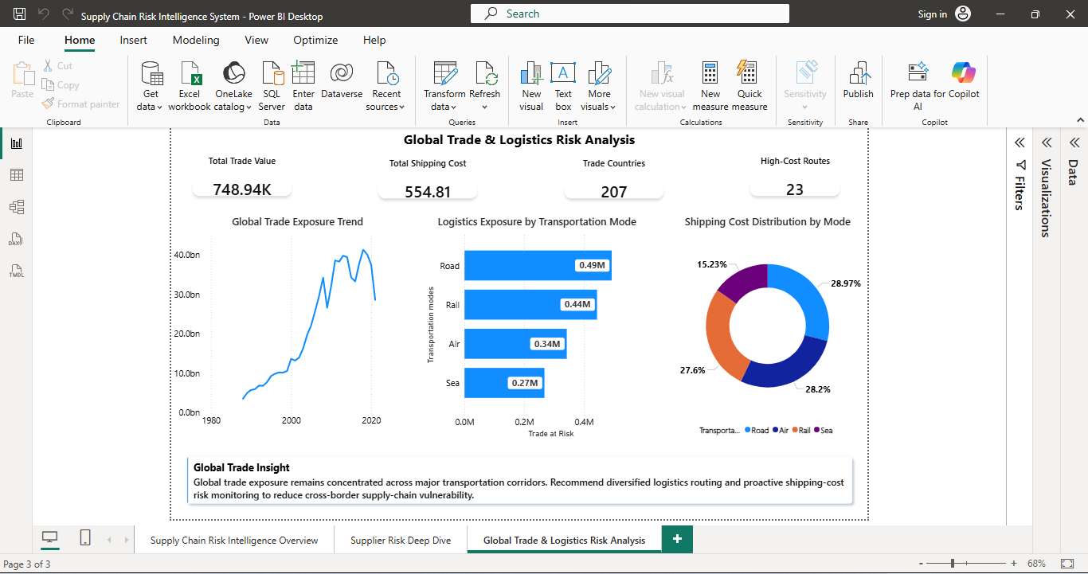

Slide 19
Power BI Showcase
Thank You
Supply Chain Risk Intelligence System
Prepared by Anirudh Shukla
16

