Slide 1
Netflix Dataset Analysis
Presented by: Anirudh Pratap Singh Yadav
PRN: 24070722004(AIML)
PROJECT: Software Tools

Slide 2
OVERVIEW
This project is an interactive desktop application built using:
Python
Tkinter(GUI)
Pandas, NumPy, Matplotlib (Data Handling and Visualization)
It allows users to:
Load a Netflix dataset (CSV)
Preprocess it
Visualize key insights interactive Using different libraries like Numpy, Pandas, Matplotlib

Slide 3
Tools & Technologies
Python – core language for logic
Tkinter – for building GUI
Pandas/NumPy – data manipulation
Matplotlib – visualization
PIL (Python Imaging Library) – to add background image
Date/time Module- For Date format
VSCODE- IDE

Slide 4
Dataset Description
• Source: Kaggle (Netflix Movies and TV Shows Dataset)
• Size: 8807 records
Features:
Titles, Director, Cast
Release Date, Country, Category
Rating, Duration, Listed Genres
Preprocessing includes:
Handling missing values
Converting release dates
Creating new columns like Year
•Purpose: Analyze Netflix content trends and characteristics

Slide 5
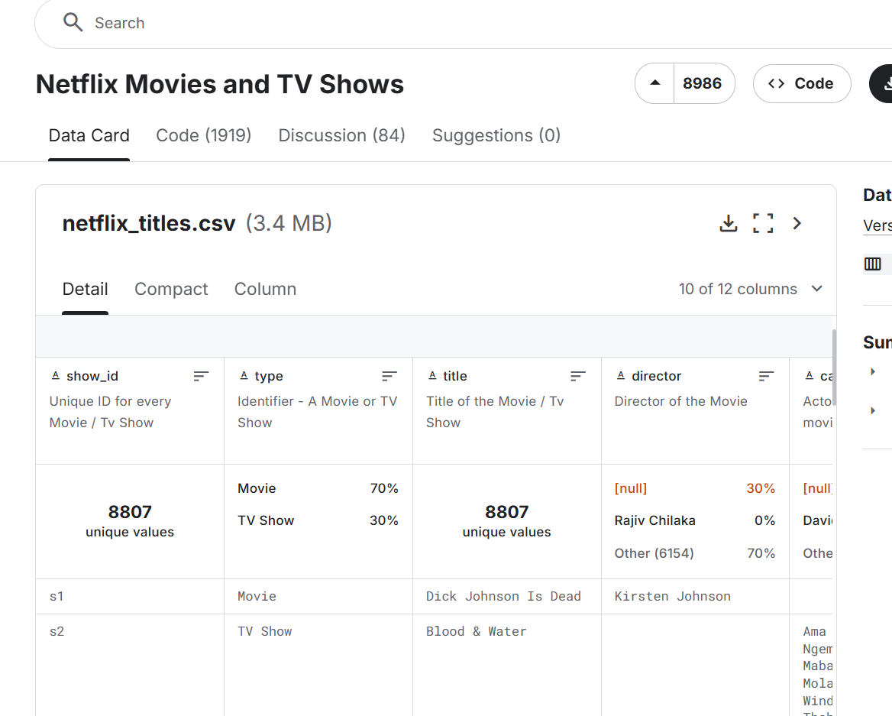
Kaggle Screenshot

Slide 6
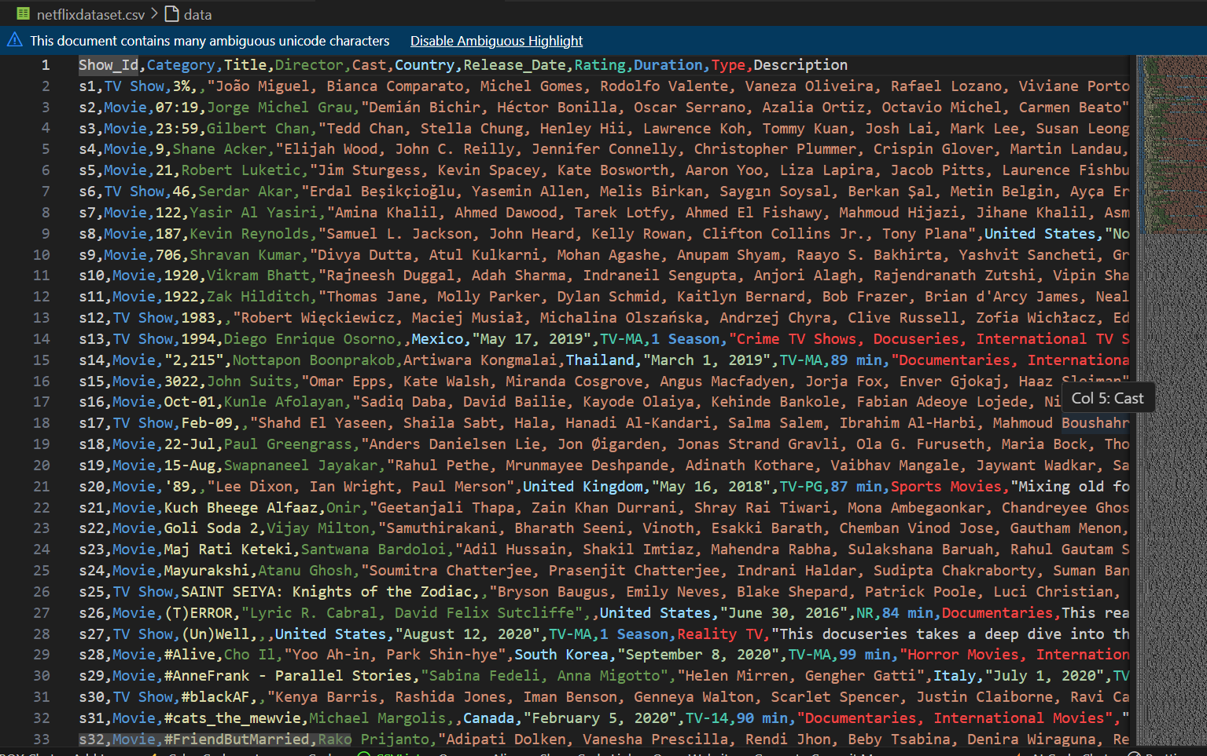
DATA IN CSV FORMAT

Slide 7
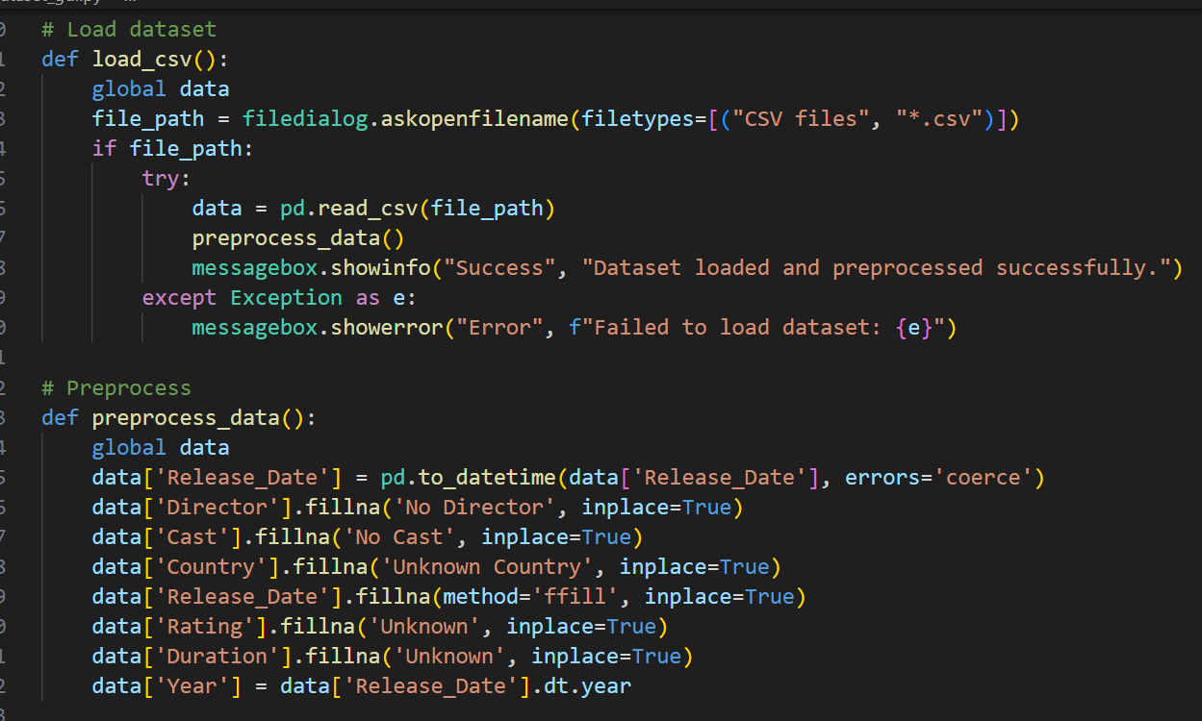
Data Loading & Preprocessing
Loaded the Data using filedialougebox from my Computer System
Added YEAR extension to it
Handled some parsing errors using Exceptional Handling

Slide 8
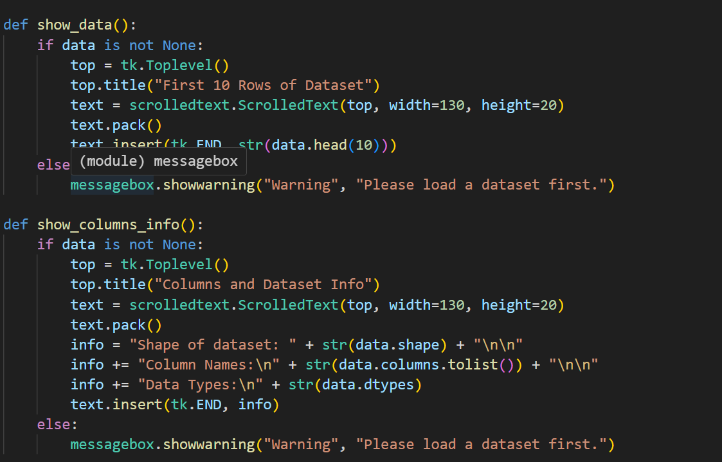
Displaying Data Info
Gave command to show 10 rows in a scrollable tkinter window
Also, gave command to show column info which shows- shape, column, names, data ,types, etc

Slide 9
Data Cleaning Techniques
• Removed null values in key columns (e.g., title, type)
• Converted date columns to datetime format
• Stripped whitespace and unified text formatting
• Extracted numerical duration from 'duration' column

Slide 10
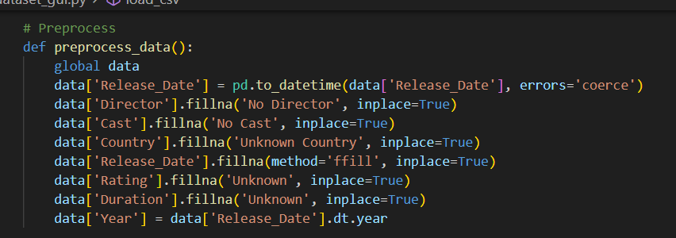
Data CLEANING/PREPROCESSING

Slide 11
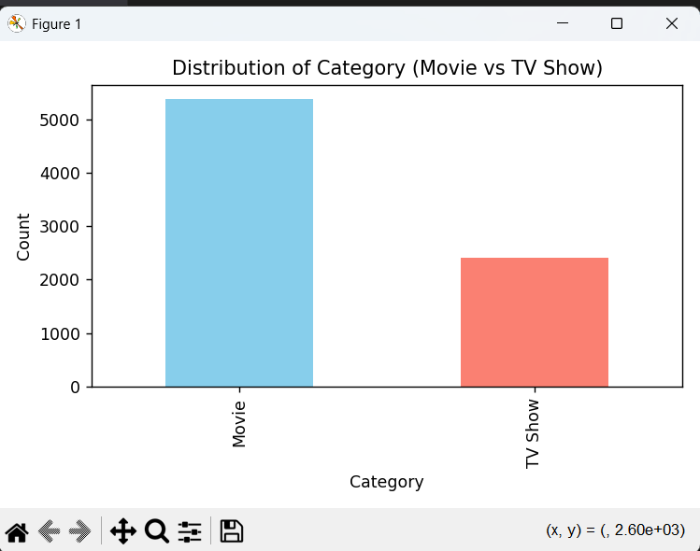
Visualization 1 – Category Distribution
Bar chart: Movies vs TV Shows Helps analyze which type dominates Netflix's catalog whether it is Movies more or TV Shows

Slide 12
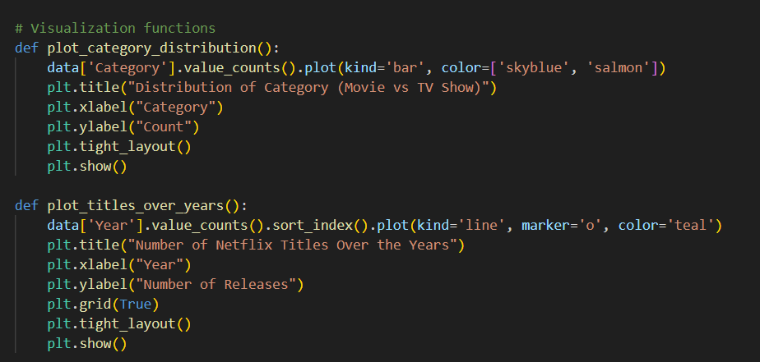
CODE

Slide 13
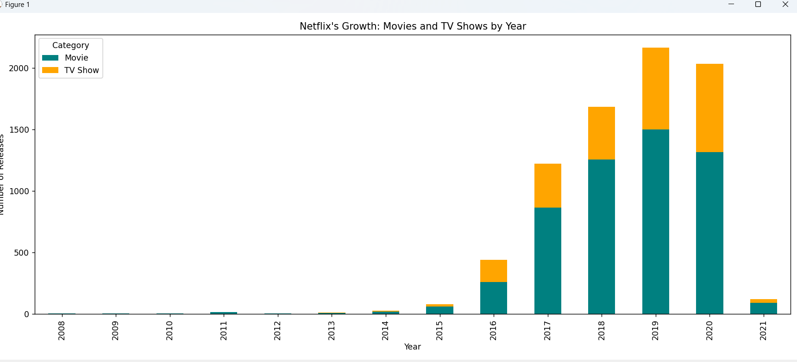
COMPARISON

Slide 14
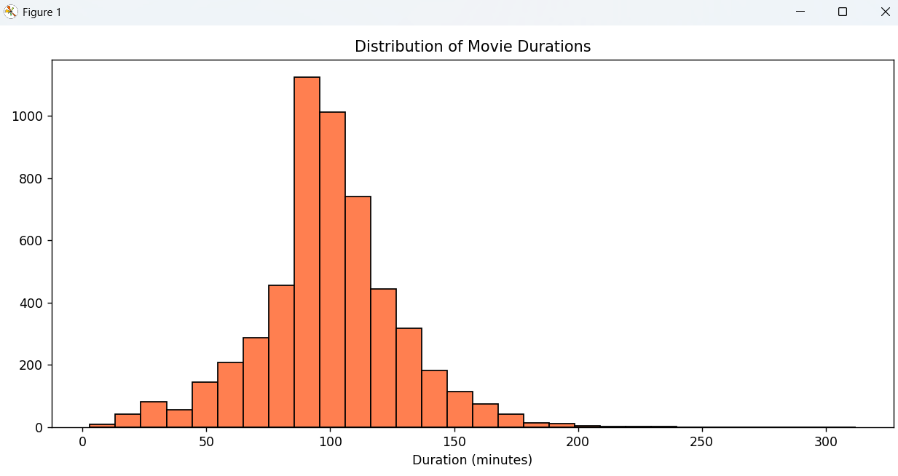
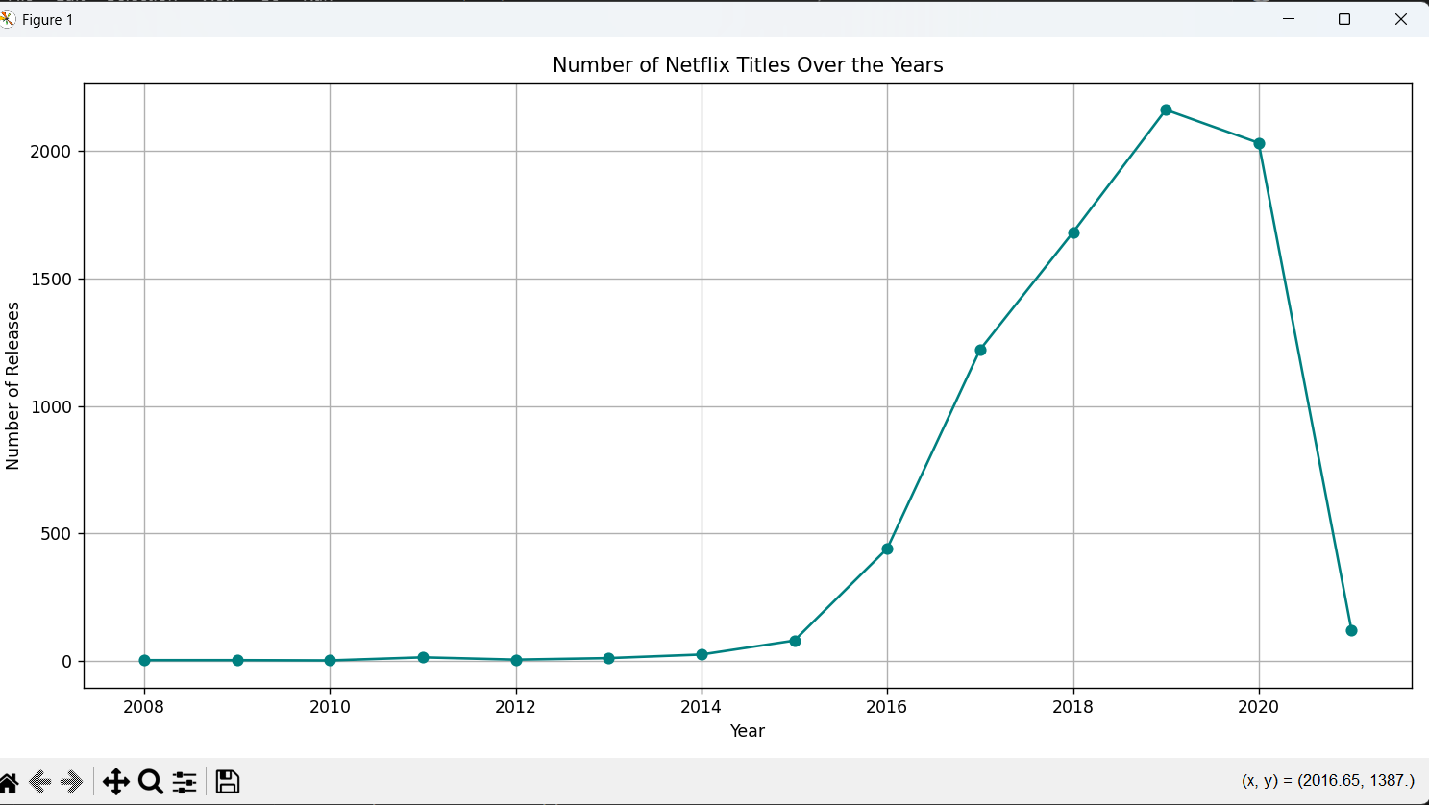
Visualization 2 – Growth Trends
• Line plots: Content added per year(shows a sharp increase)
• Pie charts: Country-wise content share
• Word clouds: Most common genres

Slide 15
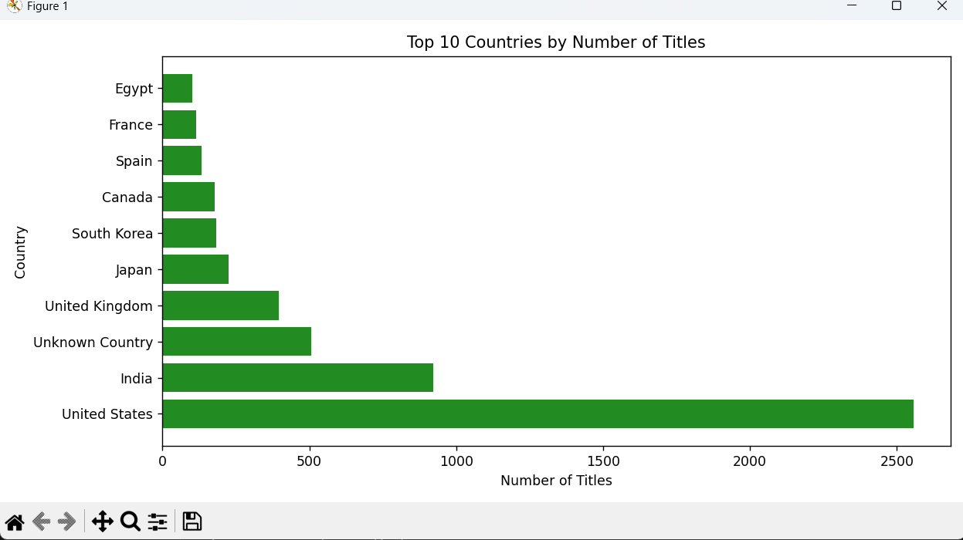
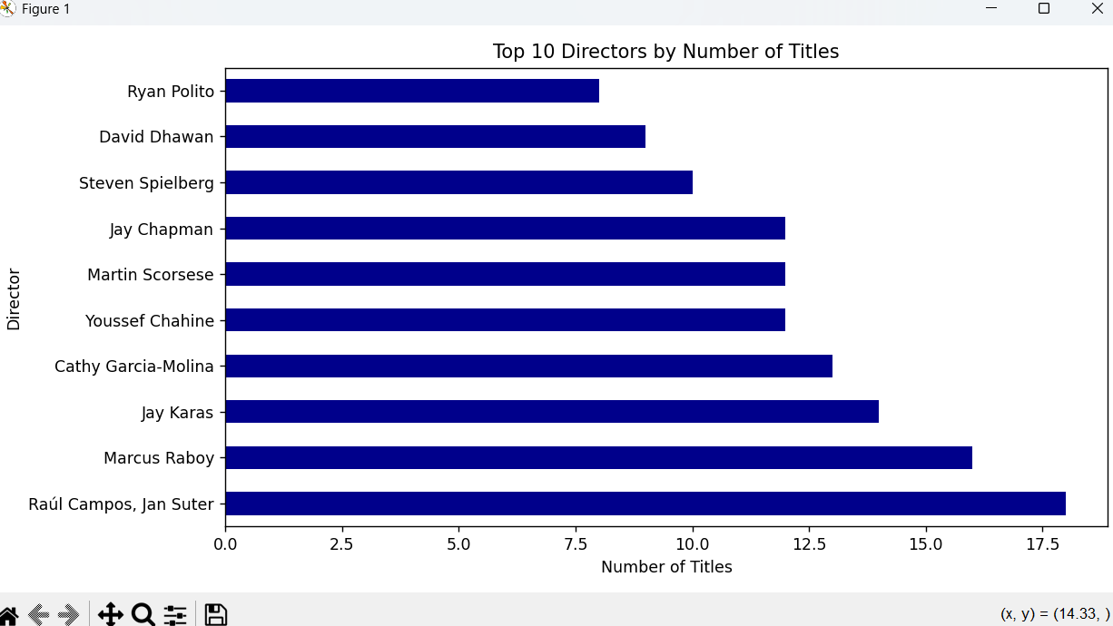
Visualization 3 – Top Contributors
“Top Countries, Top Directors, Top Cast Members” Helps find the major sources and creators of Netflix content from countries to members all in one go!

Slide 16
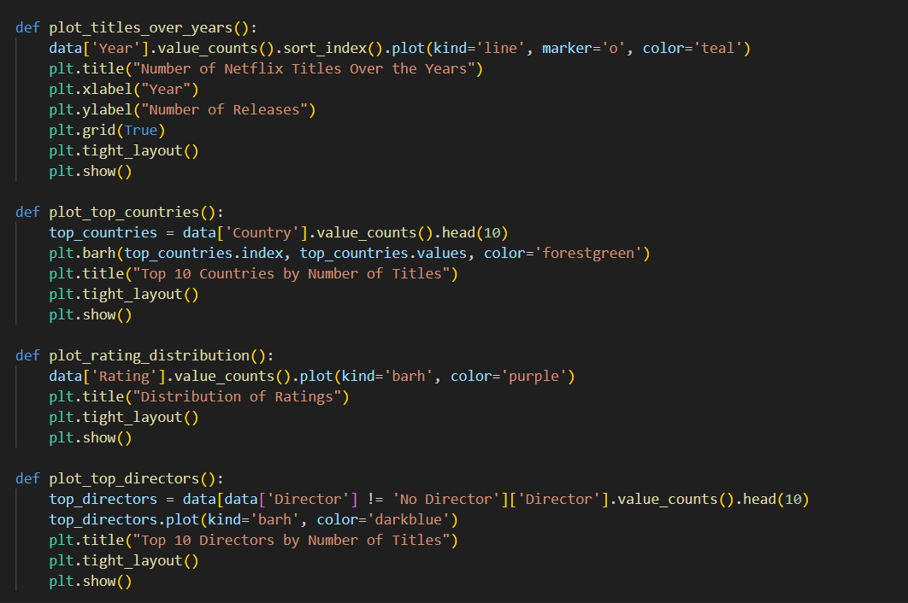

Slide 17
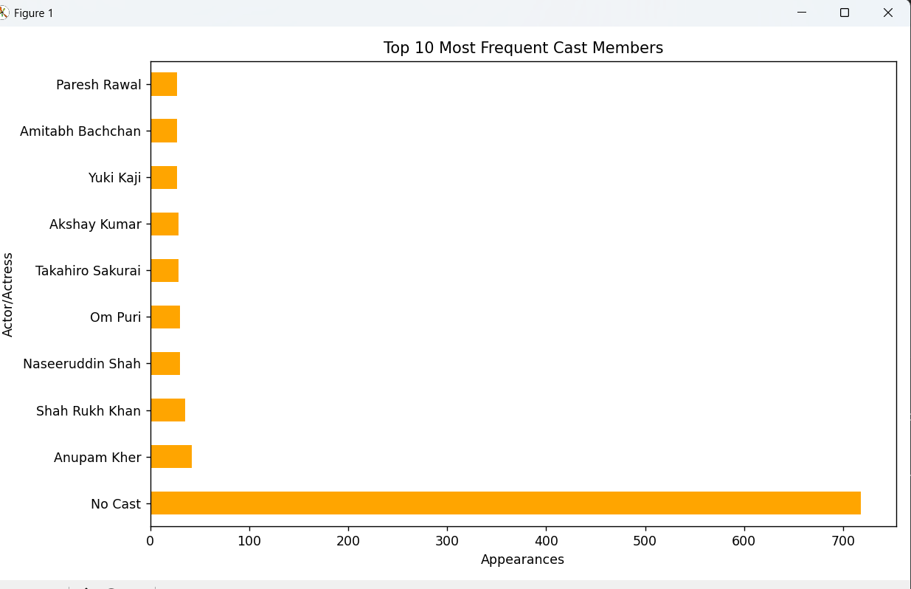

Slide 18
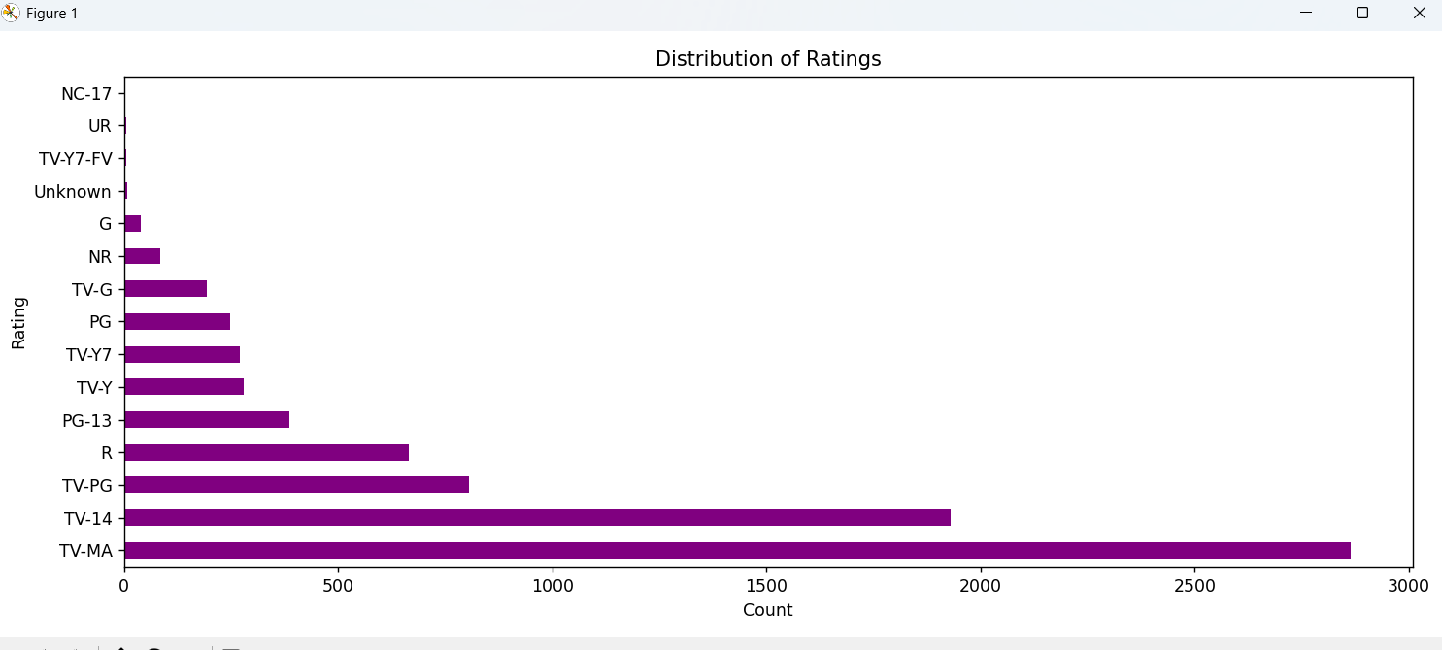
Visualization 4 – Content Analysis
Ratings Distribution – audience targeting
Movie Duration – average length of movies
Top Genres – most featured content types
Unknown Data – data quality check

Slide 19
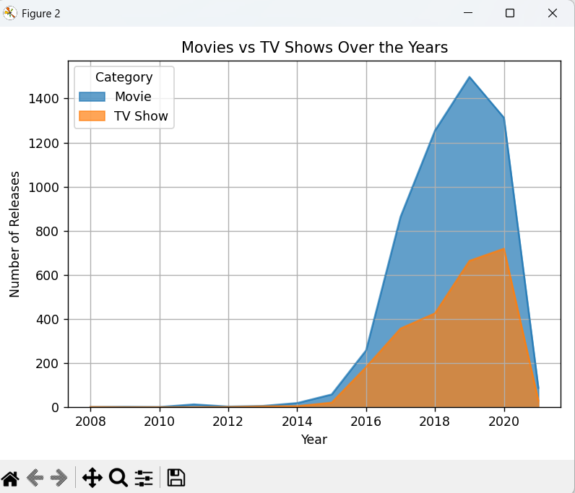

Slide 20
Analysis Methods Used
• Count and group-by operations using Pandas
• Value counts for categorical variables
• Date-based filtering (e.g., yearly trends)
• Correlation and distribution analysis

Slide 21
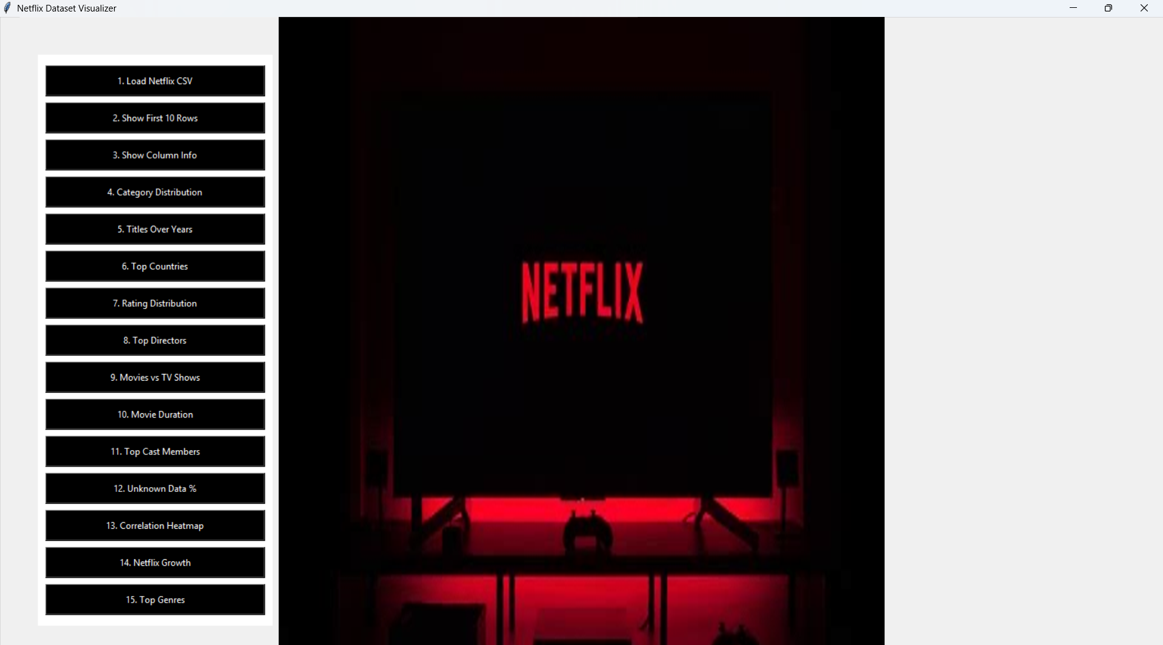
With GUI(Tkinter)

Slide 22
VIDEO

Slide 23
HOW COULD I MAKE IT MORE BETTER?
→If there was much time and not much assessments during the project preparation time, I would have relentlessly went to create :
Whole new website being published this
More effective data cleaning methods
More visualisations
More Libraries like Scikit Learn

Slide 24
PROBLEMS FACED?
While working on this project, I faced some major problems like:
How to import dataset from Kaggle
Modules not working in VS Code due to version issue
I completely forgot Tkinter (GUI) but revised to work.
Error Handling

Slide 25
RESOURCES USED
I used a lot of resources to complete this project which includes:
Kaggle Dataset
My Tkinter Notes
Saw a random YouTube video to learn in deep about data cleaning techniques
Wikipedia for Netflix photo

Slide 26


