Slide 1
Group 3: Smart Traffic Prediction
Final Project Presentation
Anirudh Shetty Yatindra Shahsi Sarjo Das
Telecommunication Networks Group | Sensor Networks Lab Project

Slide 2

Outline
Background
Goal Statement
Functional Specification
Architecture
Demonstration
Conclusion
Challenges Faced
Project Organization
Smart Traffic Prediction: Final Project Presentation | Group 3 | Sensor Networks Lab Project
Slide <number>

Slide 3
Outline
Background
Goal Statement
Functional Specification
Architecture
Demonstration
Conclusion
Challenges Faced
Project Organization
Smart Traffic Prediction: Final Project Presentation | Group 3 | Sensor Networks Lab Project
Slide <number>

Slide 4
Background
Big cities around the world need an smart traffic detection system to reduce traffic congestion.
Huge number of road accidents take place each year due to human error, implementing an automated system will help reduce human intervention.
Various countries around the world are developing smart cities. Smart Transport system is an integral part of smart cities.
Smart Traffic Prediction: Final Project Presentation | Group 3 | Sensor Networks Lab Project
Slide <number>

Slide 5
Outline
Background
Goal Statement
Functional Specification
Architecture
Demonstration
Conclusion
Challenges Faced
Project Organization
Smart Traffic Prediction: Final Project Presentation | Group 3 | Sensor Networks Lab Project
Slide <number>

Slide 6
Goal Statement
Traffic prediction system.
Each road has a traffic controller station, at a point where traffic can be diverted or can be let through.
All the vehicles are the moving nodes, with can transmit at very low power and small range.
Vehicles always pass through a controller, before reaching a major junction and makes itself known with an polling acknowledgement.
Traffic controllers sample the traffic density at a regular interval.
Smart Traffic Prediction: Final Project Presentation | Group 3 | Sensor Networks Lab Project
Slide <number>

Slide 7
Goal Statement
Traffic controllers can pair with nearby controllers to access traffic situation.
When the incoming traffic from other pair would result in a heavy traffic in next junction, the controller decides how many vehicles needs to be diverted.
The traffic controller picks the vehicles, and sends them alert to divert by indicating on LEDs.
Base station (Traffic Administrator) is picking up these communications and displaying traffic conditions, with details.
Base station (T.A.) can also be used to set the threshold for traffic management system, and send it to controllers.
Smart Traffic Prediction: Final Project Presentation | Group 3 | Sensor Networks Lab Project
Slide <number>

Slide 8
Outline
Background
Goal Statement
Functional Specification
Architecture
Demonstration
Conclusion
Challenges Faced
Project Organization
Smart Traffic Prediction: Final Project Presentation | Group 3 | Sensor Networks Lab Project
Slide <number>

Slide 9
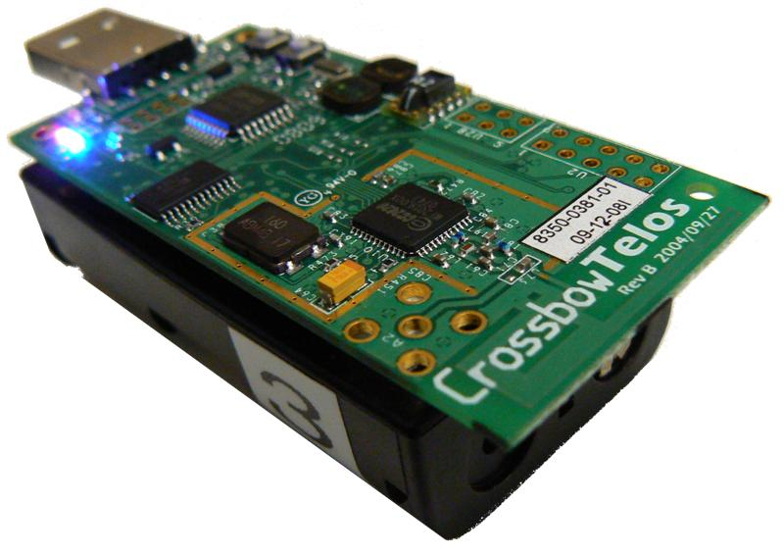
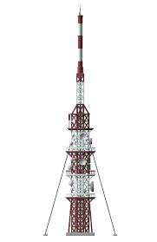
Functional Specification
Traffic Management
  Standard TelosB PppRouter
  Monitors controllers.
  Helps in managing thresholds.
  Keeps track of traffic and displays it.
Traffic Controller
  Standard TelosB
  Can talk to vehicle, other controller,
  and management center.
  Detects vehicles, and current traffic density.
  Alerts vehicles to upcoming traffic.
Smart Traffic Prediction: Final Project Presentation | Group 3 | Sensor Networks Lab Project
Slide <number>

Slide 10

Functional Specification
Vehicles
  Standard TelosB with
  transmission power controlled.
  Sends vehicle registration acknowledgement,
  with vehicle details to traffic controller.
  Receives traffic alert from traffic controller.
  Shows it recieved alert.
Smart Traffic Prediction: Final Project Presentation | Group 3 | Sensor Networks Lab Project
Slide <number>

Slide 11

Central Controller
SET
PEAK ALLOWED TRAFFIC (T).
GIVE LIVE STATUS OF TRAFFIC.
If c l traffic > c ll
Traffic diverted at coordinator ii for some cards over thresh hold on heavy traffic.
ALL BLOCKS ARE MOTES.
Traffic Coordinator l
Traffic Coordinator ll
1.Detect vehicles and register.
2. Send a report to next controller.
3. Get the traffic report from other coordinators.
4. Make a combined report to decide on upcoming traffic status.
5. Determine if traffic is going to be high in next crossover.
6. Alert relevant vehicles over threshold to reduce the traffic.
CAR 1
CAR 2
CAR 3
CAR 4
CAR 5
CAR 6

Slide 12
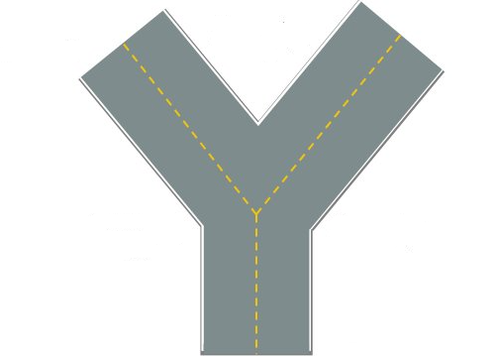
Coordinator X
Smart Traffic Prediction: Final Project Presentation | Group 3 | Sensor Networks Lab Project
Slide <number>

Slide 13
Outline
Background
Goal Statement
Functional Specification
Architecture
Demonstration
Conclusion
Challenges Faced
Project Organization
Smart Traffic Prediction: Final Project Presentation | Group 3 | Sensor Networks Lab Project
Slide <number>

Slide 14
Architecture
TRAFFIC CONTROLLER
Boot
TrfcMngSend
AlarmSend
ControllerP
MainC
PollSend
CarCountSend
Leds
SettingSend
RadioControl
ReadCmd
LedsC
UDPSocketC
SendTimer
TrfcTimer
NewThresh
IPStackC
TimmerMilliC
ShellCommandC
Smart Traffic Prediction: Final Project Presentation | Group 3 | Sensor Networks Lab Project
Slide <number>

Slide 15
Architecture
VEHICLE
Boot
PollSend
MainC
TrafficP
UDPSocketC
Leds
AlarmSend
RadioControl
ResetTimer
Random
LedsC
RandomTimer
RandomC
IPStackC
TimmerMilliC
Smart Traffic Prediction: Final Project Presentation | Group 3 | Sensor Networks Lab Project
Slide <number>

Slide 16
Outline
Background
Goal Statement
Functional Specification
Architecture
Demonstration
Conclusion
Challenges Faced
Project Organization
Smart Traffic Prediction: Final Project Presentation | Group 3 | Sensor Networks Lab Project
Slide <number>

Slide 17
Outline
Background
Goal Statement
Functional Specification
Architecture
Demonstration
Conclusion
Challenges Faced
Project Organization
Smart Traffic Prediction: Final Project Presentation | Group 3 | Sensor Networks Lab Project
Slide <number>

Slide 18
Challenges
Synchronizing and interference handling.
Power Regulation.
Interfacing with python GUI.
Serial port snooping, and serial forwarding
Smart Traffic Prediction: Final Project Presentation | Group 3 | Sensor Networks Lab Project
Slide <number>

Slide 19
Outline
Background
Goal Statement
Functional Specification
Architecture
Demonstration
Conclusion
Challenges Faced
Project Organization
Smart Traffic Prediction: Final Project Presentation | Group 3 | Sensor Networks Lab Project
Slide <number>

Slide 20
Conclusion
Smart Traffic Detection can lead to reduction in traffic congestion and achievement of traffic fluency.
Automated systems lower the risk of human errors, as a result number of accidents can be reduced considerably.
The model shown here is just a basic prototype which can be modified and extended in the future to construct a Intelligent Traffic Management System.
  Smart Traffic Prediction: Final Project Presentation | Group 3 | Sensor Networks Lab Project
  Slide <number>

Slide 21
Outline
Background
Goal Statement
Functional Specification
Architecture
Demonstration
Conclusion
Challenges Faced
Project Organization
Smart Traffic Prediction: Final Project Presentation | Group 3 | Sensor Networks Lab Project
Slide <number>

Slide 22
Project Organization
Anirudh
  Contribution to the creation of the program architecture
  Contribution to the implementation of various software parts.
  Transmission power management, and serial port snooping.
  Issue fixes, final presentation,
  Project report, and project documentation.
Yatindra
  Contribution to the creation of the program architecture.
  Contribution to the implementation of various software parts.
  Final testing.
  Initial short presentation.
Sarjo
  Evaluating GUI interface.
  Implementation of the Python Tools.
  Final testing.
  First short presentation.
Smart Traffic Prediction: Final Project Presentation | Group 3 | Sensor Networks Lab Project
Slide <number>

Slide 23
Git Repository
https://github.com/AnirudhShetty/SNL_Group_3
Smart Traffic Prediction: Final Project Presentation | Group 3 | Sensor Networks Lab Project
Slide <number>

