Slide 1






Traffic and Women's Safety
TEAM NAME
Notes:
1

Slide 2

Problem Statement and description
AI-based Smart Traffic Management System along with
the capability to detect suspect and suspicious activities
(Specially for Women Safety-1090)
This is needed to efficiently manage increasing urban traffic, reduce congestion and accidents, and enhance public safety, with a focus on improving women’s safety through real-time monitoring and detection of suspicious activities.

Slide 3
SOLUTION
Goal :
Our goal is to use the existing urban infrastructure such as CCTV cameras with an AI model to address two critical challenges :
Traffic Congestion in rapidly urbanizing areas.
Public Safety, particularly for women.
Key Features :
Real-time Traffic Density Detection :
AI model which will find the average speed of the vehicles using the live feed of the CCTV cameras and will count the number of vehicles for an instance and then will calculate the traffic density.
Predictive Traffic Analysis :
Predictive analysis to suggest alternate routes to minimize congestion, ensuring smoother traffic.

Slide 4
Accident Detection and Alerts :
Detect accidents or mishaps in real time through AI algorithms like outlier detection.
Unsafe Area Alerts for Women :
Notifying women of potentially unsafe areas or roads using AI insights allowing them to avoid risky situations.
Suspicious Behavior Detection :
Behavior analysis and anomaly detection to flag potential threats.
GPS-based Congestion Detection :
Using the GPS based dataset to configure the AI model for roads without CCTV accessibility.
Immediate Reporting to Authorities :
After the detection of suspicious activities or unsafe scenarios authorities are notified like the Women Power Line (1090) in real time.

Slide 5
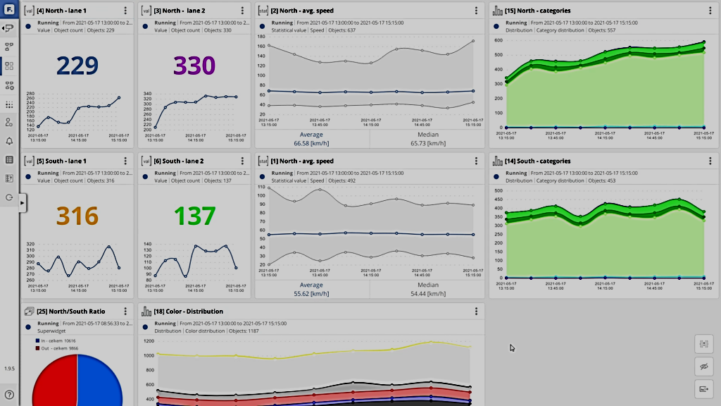
Expected Dashboard

Slide 6
IMPACT
Reduced traffic congestion and shorter travel times.
Quicker detection of incidents.
Positive environmental impact due to lower fuel consumption resulting from reduced traffic.
Enhanced safety for everyone.
Faster response and availability of emergency services.

Slide 7
IMPLEMENTATION
Use computer vision (OpenCV) to analyze real-time traffic footage and classify vehicle density
Build a pipeline to analyze traffic at each intersection.
Train an ML model to predict optimal signal durations based on vehicle density.
Use IoT devices to connect traffic lights to the control system for automated adjustments.
Use Maps API or for route visualization. Build a reinforcement learning model to recommend optimal routes dynamically.
Collect historical traffic data and train the model to learn patterns.
Develop a mobile app to share real-time alternate routes with drivers.

Slide 8
IMPLEMENTATION
Train a deep learning model to identify accidents, broken-down vehicles, or roadblocks using real-time CCTV feeds.
Use pre-trained models like Faster R-CNN, YOLO for object detection.
Integrate with alert systems to notify authorities.
Train an AI model for activity recognition to detect distress or suspicious behavior in public places.
Use CCTV feeds and train models using action datasets.
Alert authorities through automated SMS or email systems upon detecting threats.

Slide 9






Technology Stack
Computer Vision libraries like OpenCV, etc.
Objection detection frameworks like YOLO.
Integration with CCTVs and IoT devices.
Computer Vision, Deep Learning, Neural networks, Regression Models.
Dashboard or Mobile app for monitoring.
Flutter
NodeJS
AI/ML Libraries:
TensorFlow : For training machine learning models.
OpenCV: For analyzing traffic footage and images.
YOLO (You Only Look Once): For real-time object detection
Python
JavaScript
HTML
CSS

