Slide 1
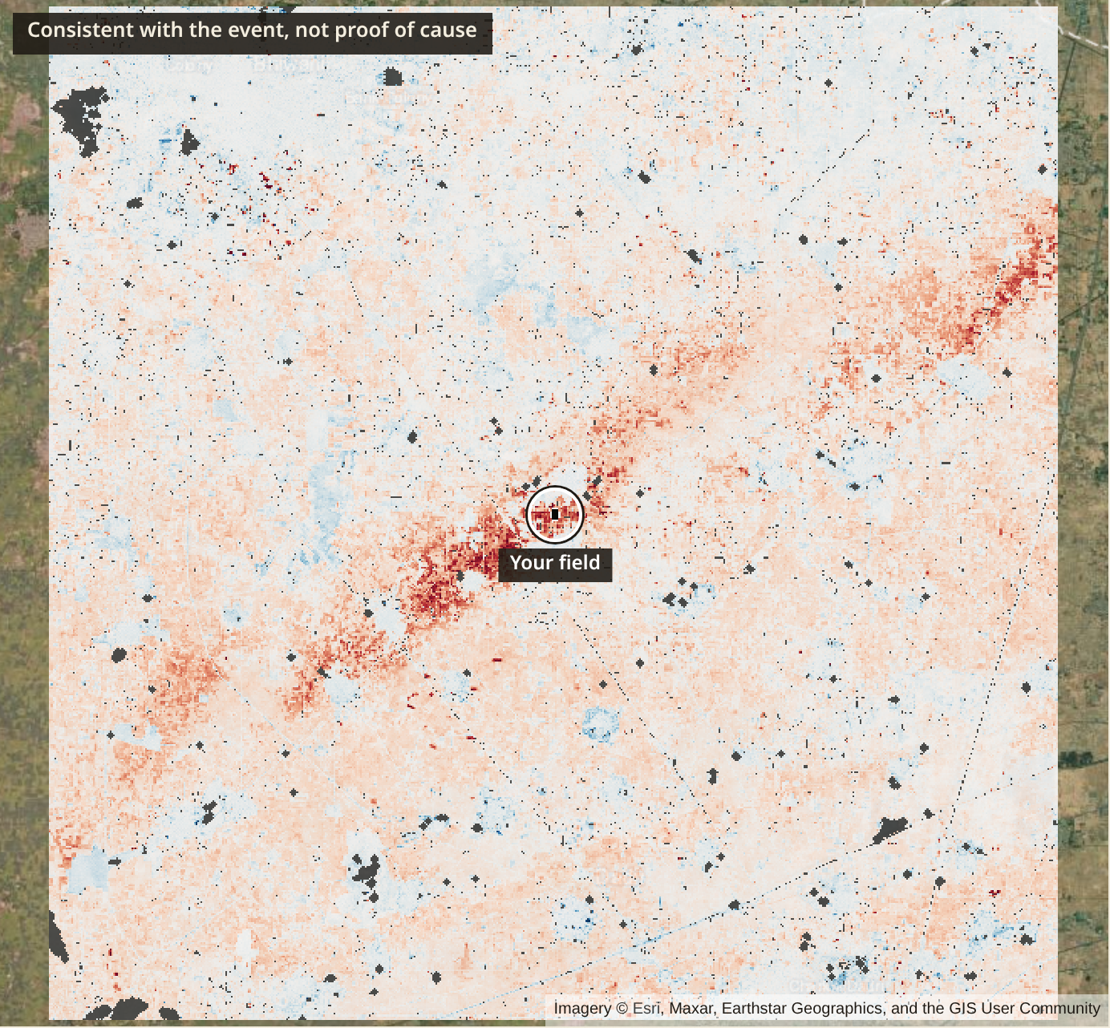
FasalSaakshi
फसल साक्षी
A witness for the farmer's field.
A field's own satellite evidence, which anyone can recompute.
Team FasalSaakshi
Aaryan Dadu
Anirudh Singh Rajora
Naman Khandelwal
Forge '26 Gen AI Buildathon · Theme 2, Problem 2
Hail of 2-3 March 2024, Bhiwani. A band consistent with a hail swath, not proof of cause. Marked plot: strongest of 200 scanned.
Notes:
Saakshi means witness. A witness has to survive cross-examination, and anyone must be able to check what it said. That map is real public satellite data from a hail event in Haryana, and the plot marked on it is the strongest of 200 we scanned, not a typical one. We will show you a typical one too.

Slide 2
Farmers can contest, but they have no evidence of their own to contest with
92.46 crore
₹4,107.47 crore
About ₹350 crore
"more than 92.46 crore farmer applications have been insured" since Kharif 2016. Applications are not farmers.
of claims pending, as on 31.12.2025. Official causes are mainly State share, bank data and yield disputes.
In 2025, Bhiwani and Charkhi Dadri farmers sat on dharna from 16 July. They say satellite-based yield cut about ₹350 crore from CCE-based claims.
Two systems, kept apart
YES-TECH, basic cover. Yield estimated "at Gram Panchayat (GP) level", rolled out from Kharif 2023. This is area yield, not a survey of one claim.
Localized claims, individual farm. A joint survey, or above 25% of insured area under intimation, a sample of 10 randomly selected parcels. Satellite indices enter only in a dispute.
Sources: PIB backgrounder, 29 Aug 2026; Lok Sabha Unstarred Q662, 3 Feb 2026, Annexure-I; Lok Sabha Q3825, 11 Aug 2026 (causes); The Tribune, 25 Aug 2025 (what farmers say, not confirmed); PMFBY Operational Guidelines 2023, paras 2.17, 21.5.8, 21.5.9.4. All via docs/submission/facts.md.
Notes:
A contest route exists: written notice within seven days, then the district and State committees, and the 14447 helpline. What a farmer lacks is evidence of her own. Please keep two systems apart. YES-TECH sets yield at Gram Panchayat level under basic cover. A localized claim goes to a joint survey, or to a ten-parcel sample above 25 percent. And nobody should hear that the pending money comes from satellites, because the source does not say that.

Slide 3
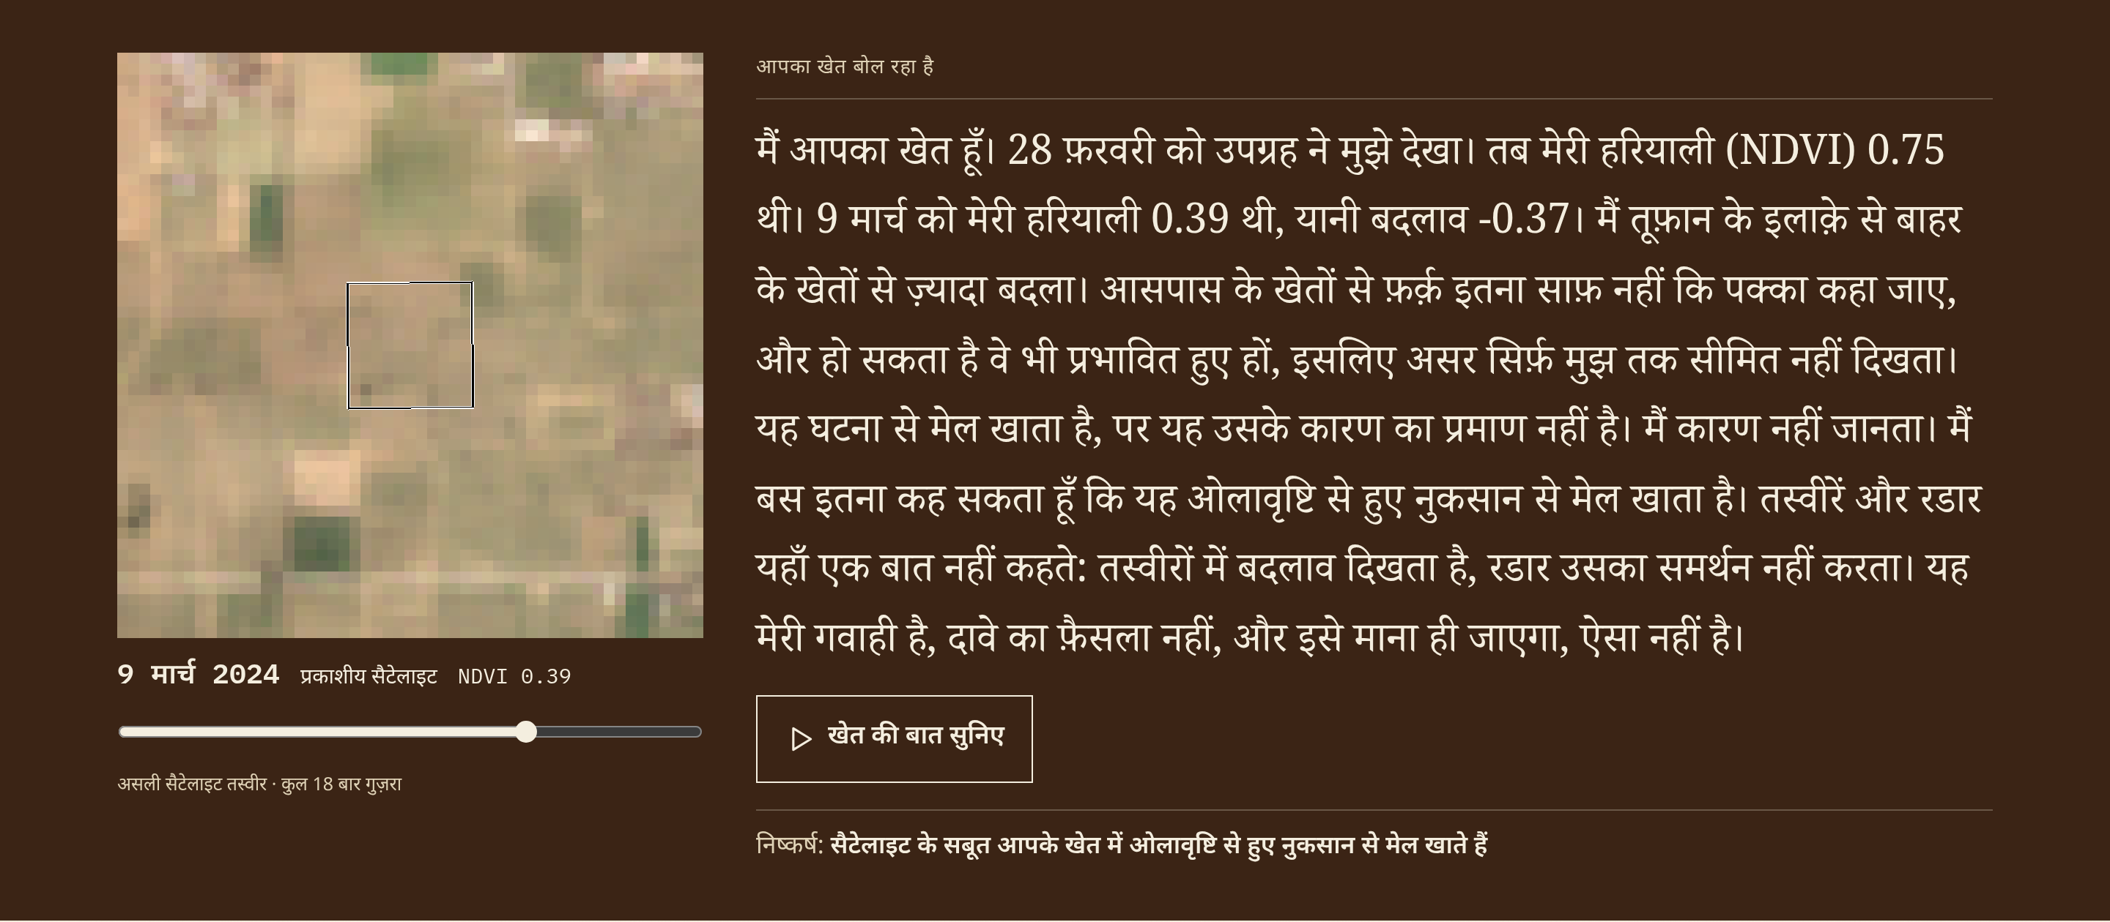
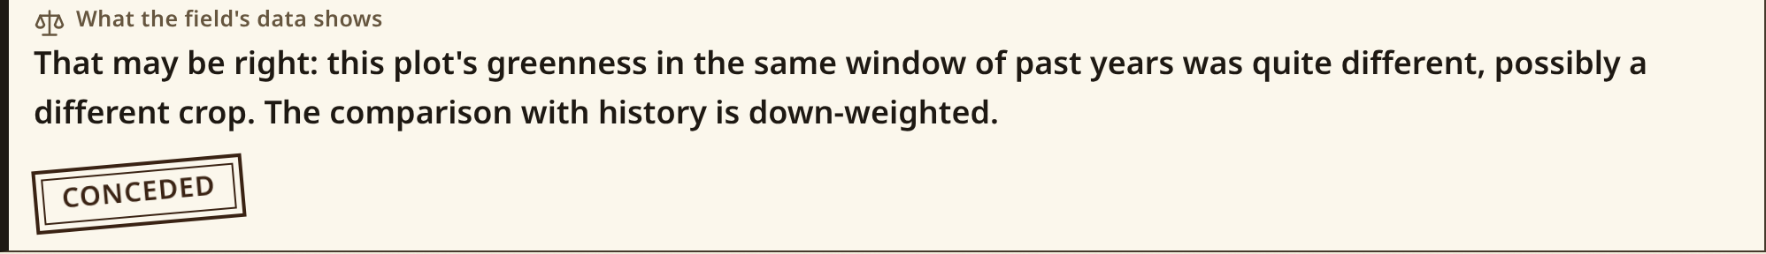
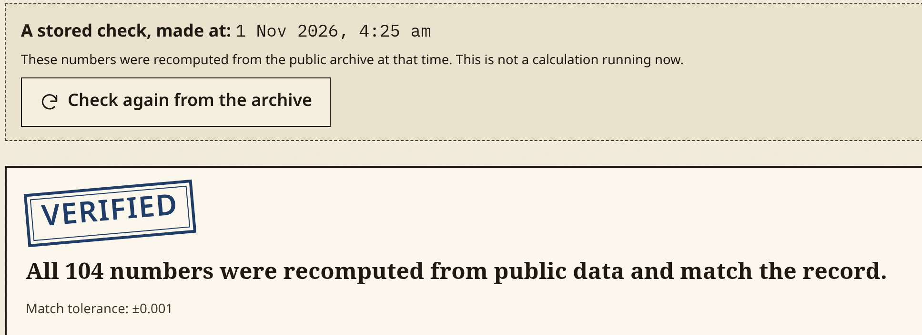
A witness who can say "your field doesn't show this"
The field testifies
The surveyor cross-examines
Its own record, with its caveats, in Hindi, Telugu or English.
Nine objections, tested on real values. It can concede: typical plot.
Anyone can recompute it
Public recompute of satellite numbers. Verdict, weather: tamper check.
A stored full check. Strongest of 200 scanned.
Separate clean-database runs gave identical hashes on all three records.
The testimony, in Hindi. Strongest of 200 scanned.
Gemini understands, explains and questions. Code measures and decides. A model can't talk the verdict up.
Understands Hindi, Telugu and Hinglish reports
"Ask the witness" answers from the farmer's own record, with a number check
Flags contradictions as a question
Advisory second opinion on images
Reads the testimony aloud
Finds related reports
Status: the live app runs on Gemini 3.6 Flash. The demo film's AI answers came from Claude standing in, and it says so on screen.
Sources: live sealed records /case/1ce7e64b754248abb18f0d29ac6203eb and /case/c157d2d75ce94501ad08930624a10e76; /verify/6092fe1c9ef12f2933ac9aa7fbc8b0737e9a306fdd6a071b159e64ea4dd7c58b. Identical hashes: README.md, final sealed records. Gen AI: docs/plan/07-build-contract.md Addenda 8 and 9.
Notes:
Three things make this a witness and not a dashboard. The field tells its own story, with its caveats, in the farmer's language. A hostile surveyor raises nine objections, and on our typical plot the field gives way on two of them. And anyone can check the record: the page you see is a stored full check and says so, and separate runs from a clean database gave identical hashes. This is a Gen AI build, so here is the line we hold: Gemini understands, explains and questions, while code measures and decides, so a model can't talk the verdict up. Be plain about the status: the live app runs on Gemini 3.6 Flash, and the demo film's AI answers came from Claude standing in, which the film labels. The verdict never depends on a model.

Slide 4
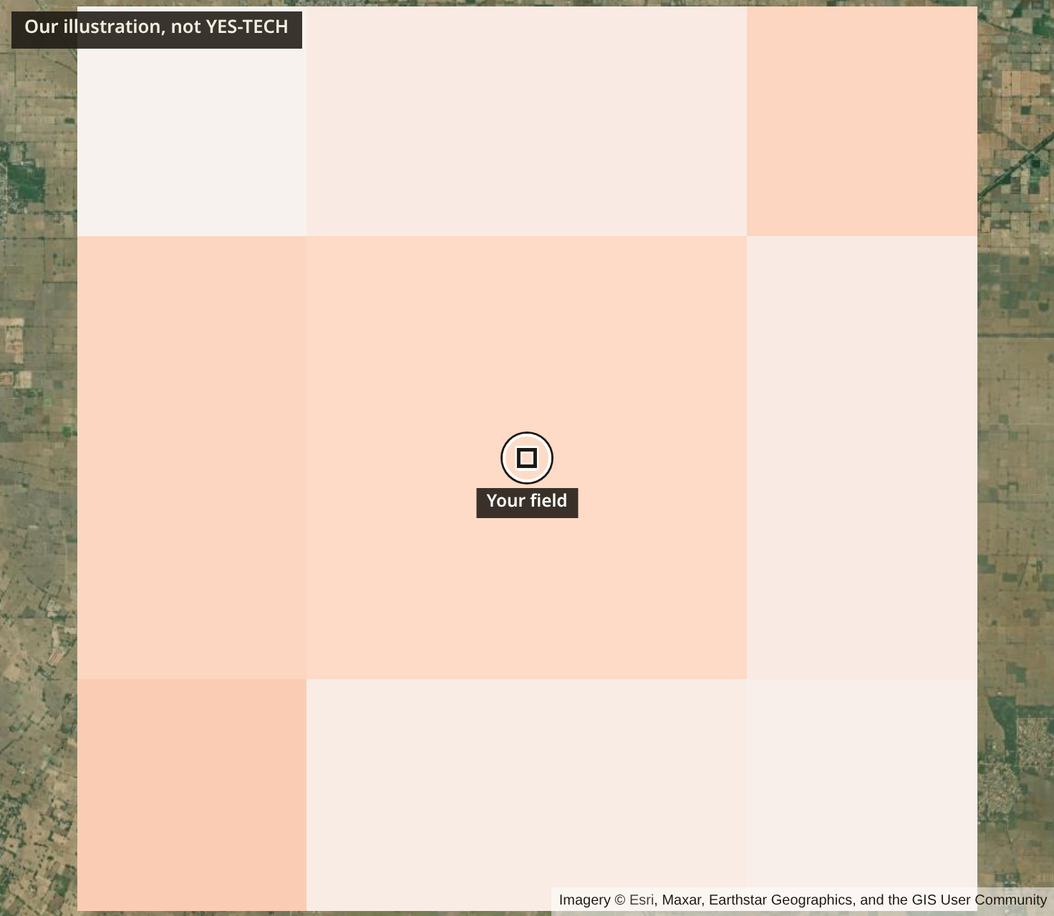
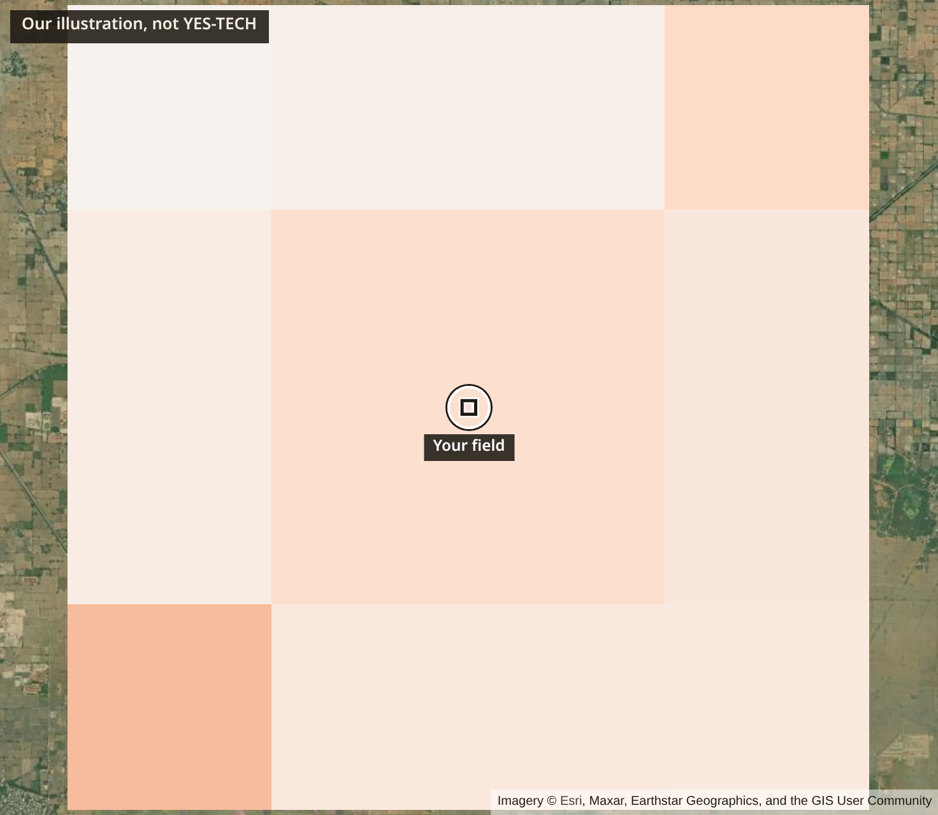
Two questions, and what a wider average keeps
Unlike comparable fields outside the storm?
Unlike its own neighbours?
Yes
No, but near the line
0 of 200 changed as much. p = 0.005
11 of 200 changed as much. p = 0.0597
The Vanishing: same change, 3 km cells. Our illustration, not YES-TECH.
Strongest of 200 scanned
Typical, median of original 40
Field −0.369
3 km −0.098
27% remains
Verdict: strong
Field −0.126
3 km −0.081
64% remains
Verdict: weak
Hail of 2-3 March 2024, Bhiwani. Consistent with a hail swath, not proof of cause. Plot: strongest of 200 scanned.
Ten-Field Draw, bounds not an estimate: −0.07 for all cropland, −0.245 for only fields that visibly dropped. The average depends heavily on who is on the list, and nobody outside the insurer can see that list.
Corroboration on the strongest plot: modelled rain of 18.4 mm in a day, with zero hail-code hours (live record).
Sources: sealed records 6092fe1c (strongest of 200 scanned, 1.27 ha; weather from its evidence record) and 56aadcb6 (typical, 1.09 ha), live app; Draw medians across 40 in-band plots, docs/validation/engine-results.md section 3e; Addendum 6. Imagery: Sentinel-2; base map credited on image.
Notes:
The band does not repeat in 2022, 2023 or 2025, and it is consistent with hail, nothing more. This plot is the strongest of 200 we scanned. It differs from fields outside the storm, but not clearly from its neighbours, so the effect does not look limited to this field. Its level also rests on weather-model rain of 18.4 millimetres, with no hail code in the model. Beside it is a typical plot, chosen by rule, and it stays weak. When a field is hit harder than its surroundings, a coarse average can't show it. The Draw's two figures are bounds, not a finding, and it does not say the rule is unfair.

Slide 5
One container. An explicit agent. Code decides.
Farmer's phone → React + MapLibre web app → FastAPI (one URL, live trace over SSE) → LangGraph state graph
The graph, with real branches
parse → plot → weather and alerts → optical search and QA → compare, or switch to radar → history → cross-examine (can loop back) → verdict → route → explain → exhibits → seal
Measures and decides: code
Sentinel-2 L2A and Sentinel-1 RTC, windowed reads from Planetary Computer, Earth Search as fallback.
Scene QA. Placebo tests on same-shape plots, near and 5-12 km away.
Fixed verdict rubric. Weather from Open-Meteo and NASA POWER, alerts from NDMA SACHET.
Understands and explains: LLM
Report parsing, Ask the witness, contradiction question, advisory image reading, speech.
Number and phrase checks, grounded in the case record and clauses from PMFBY Guidelines 2023.
Stored outside the seal. Falls back to fixed text. It can't change a verdict.
Seals and proves
SHA-256 over polygon, scene ids, seed, engine version, numbers, and a digest of verdict and weather.
A public page recomputes satellite numbers from the archives, caches bypassed.
Separate clean runs gave identical hashes.
Python, FastAPI, LangGraph, rasterio, numpy, shapely, SQLite or Postgres, WeasyPrint, one Docker image. Source and setup: github.com/AnirudhSinghRajora/Forge
Notes:
The design rule is simple. Code measures and decides; the language model understands and explains. Branching is an explicit state graph, not a model's choice, so the same evidence gives the same verdict every time, and anyone can recompute the satellite numbers.

Slide 6
What we measured, and what we didn't
False alarms, two locked no-event windows | 2.0-2.5% | 2.0% strong, 2.5% moderate field conditions, 200 plots per window, rubric frozen beforehand. Each window is one scene pair, so the CIs are too narrow.
Independent event: Sirsa hail, 14 Mar 2025 | 0 of 200 | Not a pass. The Tribune called the damage "minor", and we cannot tell little damage from a miss.
Punjab floods 2025, pre-registered | Partial | New water on 28.3% of plots against 0.0% in the control: passes. Radar placebo 1.7% against 8.3%: fails.
Detection through the field test | Bhiwani only | Shown only on Bhiwani, the event the far test and post-scene rule were designed on. Radar there does not confirm it: the orbits disagree.
Verdicts near the threshold | Fragile | Near p 0.025 the level flipped on up to a third of 30 seeds, on plots picked for being near that line. A slightly different drawing can change the result. Clear cases held.
Ground truth | None | No plot-level ground truth for any event. This work shows consistency, not accuracy.
Sources: docs/validation/engine-results.md sections 3c, 7, 7a, 7b, 7c; docs/plan/07-build-contract.md Addendum 7. CIs: 0.8-5.0% strong, 1.1-5.7% moderate. Field conditions: the plot rule without corroboration. Thirty seeds do not bound another seed: the sealed strongest plot's ring p 0.0597 sits just above that table's range, with no change of level (7c).
Notes:
This is the slide we most want you to read. False alarms were low on two windows we locked in advance, though each is a single scene pair. Then the hard part. The independent hail event gave zero of 200, and that is not a pass, because we can't tell little damage from a miss. Punjab, which we pre-registered, came out partial and we report it as partial. So detection through the field test is shown only on the event we designed on. Near the threshold a slightly different drawing of a field can flip the result, and thirty seeds don't bound what another seed can give. And we have no ground truth, so this shows consistency, not accuracy.

Slide 7
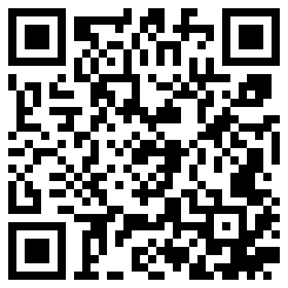
Who this could help, and what comes next
241.38 lakh
Next, in order
Re-check Arnab at the next clear passes: Sentinel-2 about 2 Nov, radar about 4 Nov. No signal is established yet.
Test sensitivity on an independent event with real damage.
Test against real records: crop-cutting or joint survey results for specific plots.
Complete the Gemini run, and get Telugu reviewed by a native speaker.
Pilot with an FPO or KVK. Ask an insurer and a State team what they'd need.
Verify State notifications, so routes stop saying "confirm with 14447".
farmers insured in Kharif 2026, as of 27 Aug 2026.
Of 2024-25 farmer applications, 17.6% are marginal, 6.5% tenant and 48% loanee farmers.
74% of the ₹4,107.47 crore pending is in Andhra Pradesh, where Arnab just hit. That is not a claim that satellites caused it, and this does not fix a State's unpaid share.
No measured farmer outcomes yet. No insurer or State has reviewed this.
Try it live
exercise-instance-promptly-proxy.trycloudflare.com
Anyone can check what it said.
Sources: PIB backgrounder, 29 Aug 2026; PIB 2148513, 25 Jul 2025; Lok Sabha Unstarred Q662, 3 Feb 2026, as on 31.12.2025, our arithmetic (₹3,041.66 crore), all via docs/submission/facts.md sections 2, 3, 5. Radar date: docs/validation/engine-results.md section 4.
Notes:
The scale is large, but we have to say this plainly: we have no measured farmer outcomes yet, and no insurer or State has reviewed this. The state with the most pending claims is where Cyclone Arnab just hit. The official reasons for those claims are mainly money and data flow, so this does not fix them. What comes next is an independent event with real damage, real survey records, a check of the Gemini paths, then a pilot with an FPO or KVK. If you take one thing away: anyone can check what it said.

