Slide 1
Pseudo code for the Division operator
Input : Two n-digit unsigned integers N and D
Output : A whole number
If N > D
Then Swap(N,D)
END
While N>=D
Then N=N-D
Q=Q-1
END
Return Q

Slide 2
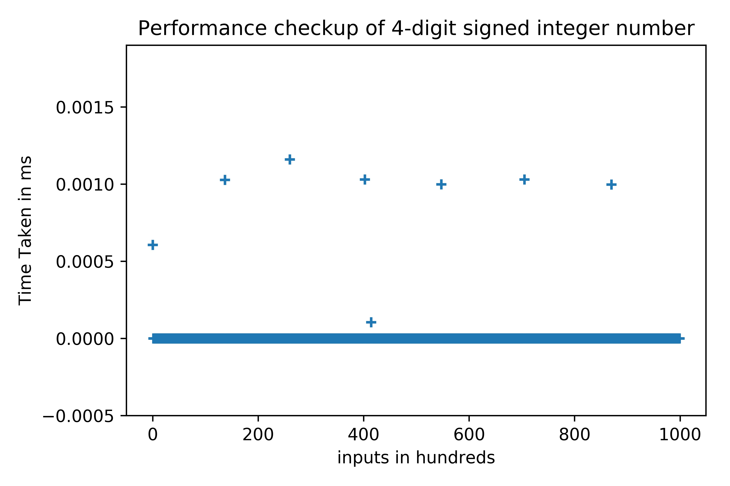
Average time is 0.000005 ms

Slide 3

Average time is 0.000009 ms

Slide 4

Average time is 0.000010 ms

Slide 5
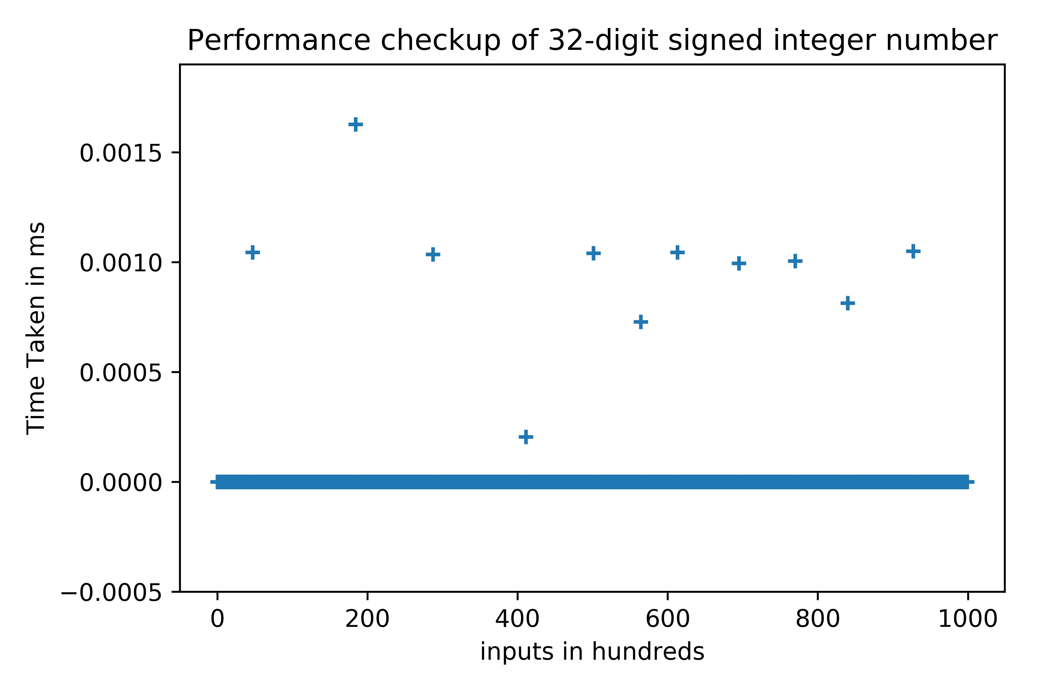
Average time is 0.00006 ms

Slide 6

Average time is 0.000011 ms

Slide 7
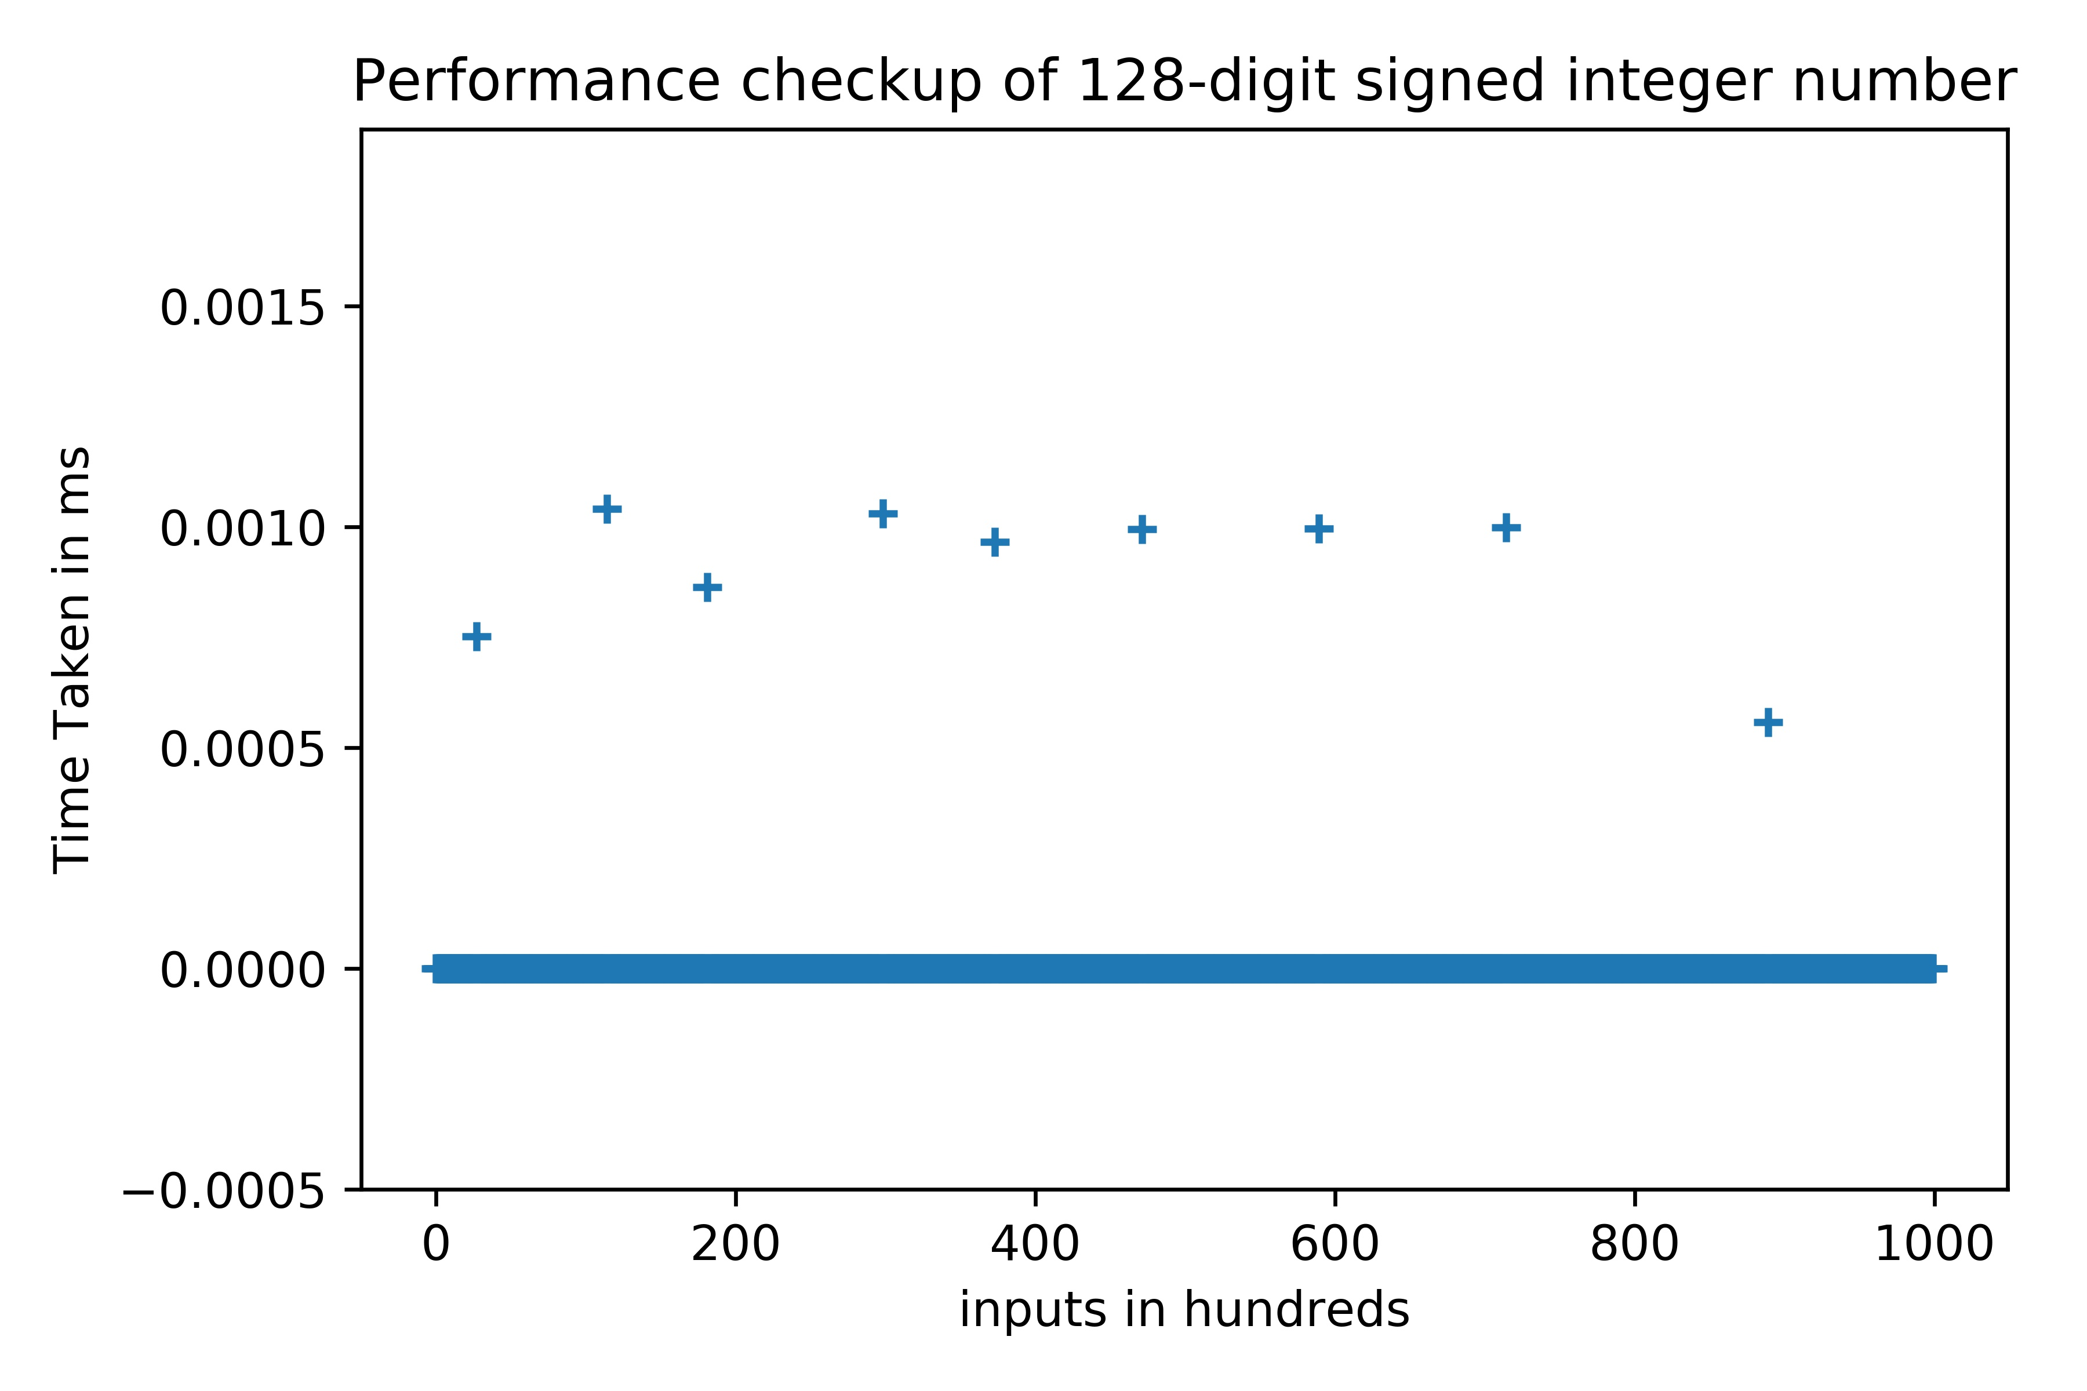
Average time is 0.000007 ms

Slide 8

Average time is 0.000010 ms

Slide 9

Average time is 0.000015 ms

Slide 10
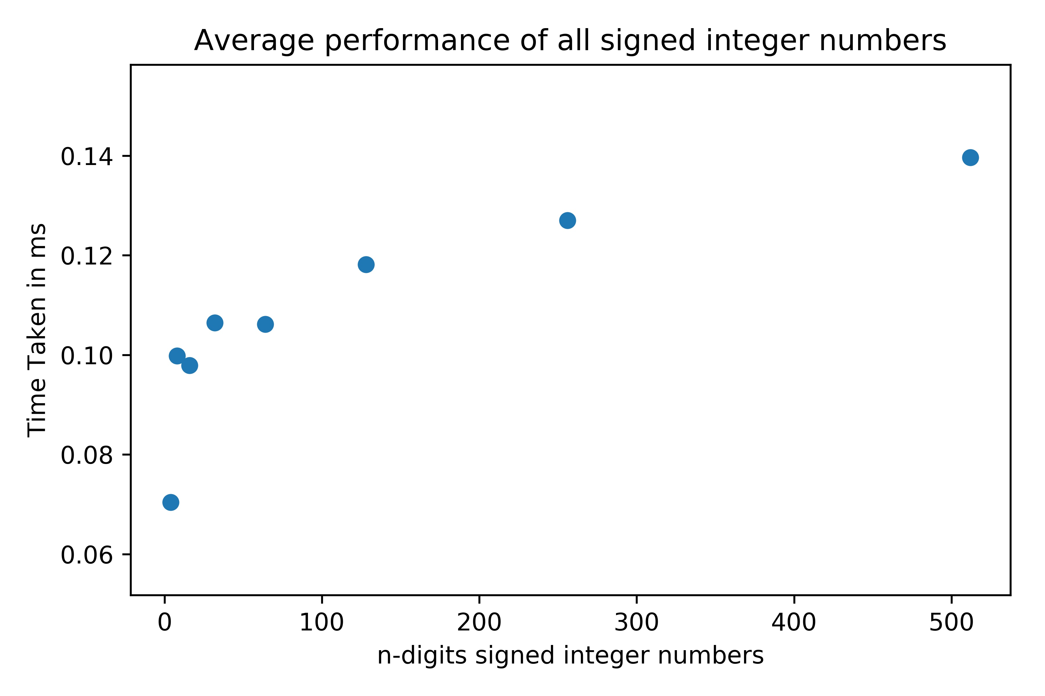
Conjecture
From the graph we can conclude that as the number of digits increases the time taken will also increase.
Space complexity will remain as it because few variables are used.

Slide 11
Analyzing the code
As the division function consists of subtraction of two numbers the time complexity will be of O(1).
As the division function consists of few variables we can consider space complexity as O(1).

Slide 12
Git link: https://github.com/Anirudha-N/Programming-Assignment-1

