Slide 1

[ DEFENSIVE CYBERSECURITY INITIATIVE // ACADEMIC & SOC BRIEFING ]
[ DIGITAL TWIN: SYNCHRONIZED 🟢 | MODE: SIMULATION ]
NETGUARDIAN
AI-Powered Digital Twin for Real-Time Network Security & Attack-Path Simulation
“See your network. Understand the risk. Simulate the threat. Protect the system.”
CORE CAPABILITIES
🕸️ Digital Twin: NetworkX graph G=(V,E) synchronizing all hosts.
🧠 Dual AI Detection: Isolation Forest ML with explainable XAI.
🎯 What-If Studio: Dijkstra attack path exploration in software.
SYSTEM IMPACT
🔒 Zero Disruption: Simulated isolation without physical downtime.
⚡ < 15 ms Speed: Near-instantaneous graph path calculation.
✓ 10/10 Verified: Automated Pytest test coverage across all layers.
HOLOGRAPHIC DIGITAL TWIN NETWORK SIMULATION
TECH STACK: Python 3.10+ • FastAPI • React 18 • Scikit-Learn • NetworkX • SQLite • Vite 5
ACADEMIC VIVA & SOC DEFENSE

Slide 2
NETGUARDIAN
The Problem: Why Traditional Security Fails
🛑 Blind to Lateral Movement
Perimeter firewalls only protect the outer door. Once a workstation is breached, attackers pivot freely between internal servers undetected.
⚠️ Live Testing Causes Downtime
Running actual penetration tests or attack simulations on physical networks risks crashing production servers, databases, and Wi-Fi.
📉 Overwhelming Alert Fatigue
Security analysts receive thousands of raw alerts every day with zero topology context and no clear remediation priority.
NETGUARDIAN | AI Digital Twin for Network Security | 5-Minute Presentation

Slide 3
NETGUARDIAN
The Solution: The NetGuardian Digital Twin
🌐 Mathematical Graph Twin
Recreates the entire network (routers, switches, PCs, DB) as an in-memory graph G = (V, E) using NetworkX. Always synchronized in real time.
🧠 Dual-Layer AI Detection
Combines instant Rule-based filters (Port scans, Surges) with Scikit-learn Isolation Forest ML to catch novel, zero-day anomalies.
🎯 Safe What-If Simulation
Simulates hypothetical attack paths and tests virtual device isolation in software space—with ZERO physical downtime or disruption.
NETGUARDIAN | AI Digital Twin for Network Security | 5-Minute Presentation

Slide 4
NETGUARDIAN
System Specifications: Hardware & Software Stack
🖥️ HARDWARE REQUIREMENTS
• CPU: Quad-Core 2.5 GHz+ (Intel i5/i7, Ryzen 5, Apple Silicon)
• RAM: 8 GB Minimum (16 GB Recommended for large graphs)
• Storage: 10 GB SSD for high-speed database transactions
• Network: Gigabit Ethernet or Wi-Fi (passive sniffing capable)
• Display: 1080p Full HD for multi-column SOC interface
⚙️ SOFTWARE & TECH STACK
• Backend: Python 3.10+, FastAPI (ASGI), Uvicorn Server
• Frontend: React 18, Vite 5, Tailwind CSS, Lucide Icons
• Machine Learning: Scikit-learn (Isolation Forest Algorithm)
• Digital Twin Engine: NetworkX (Graph Theory & Dijkstra)
• Database: SQLite (Zero-config embedded) / PostgreSQL ready
• Security: PBKDF2 Password Hashing, JWT Tokens, RBAC
NETGUARDIAN | AI Digital Twin for Network Security | 5-Minute Presentation

Slide 5
NETGUARDIAN // TECHNICAL ARCHITECTURE
System Architecture & 4-Tier Data Pipeline
📡 TIER 1: INGESTION
▸ Synthetic Traffic Generator
▸ Passive Scapy Sniffer
▸ PCAP Replay Engine
▸ 8-D Flow Feature Extractor
⚡ TIER 2: DETECTION
▸ Deterministic Rule Engine
▸ Scikit-Learn Isolation Forest
▸ Unsupervised Outlier Scoring
▸ Explainable AI (XAI) Output
🕸️ TIER 3: DIGITAL TWIN
▸ In-Memory Graph G = (V, E)
▸ NetworkX Topology Engine
▸ Asset Criticality Weighting
▸ Dynamic Health Score (0-100)
🎯 TIER 4: OPERATIONS
▸ Dijkstra Attack Simulator
▸ Virtual Defensive Isolation
▸ FastAPI REST API & Swagger
▸ React 18 Cyber SOC Console
SYNCHRONOUS DATA BUS: SQLite / SQLAlchemy ORM ◄──► In-Memory NetworkX State ◄──► Real-Time REST API / React
NETGUARDIAN | AI Digital Twin for Network Security | 5-Minute Presentation

Slide 6
NETGUARDIAN
Dual-Layer Threat Detection: Rules + Machine Learning
⚡ LAYER 1: HEURISTIC RULE ENGINE
• RULE-01 (Port Scan): Probing >15 ports in 60s
• RULE-02 (Traffic Surge): Flow >500 KB or 3x baseline
• RULE-03 (Rogue Device): Unregistered MAC/IP address
• RULE-04 (Brute Force): Rapid repeated login rejections
• RULE-05 (Compromised Host): Lateral subnet scanning
🧠 LAYER 2: ISOLATION FOREST AI MODEL
• Unsupervised ML: Detects zero-days without attack labels
• Tree Ensemble: 100 Isolation Trees isolate statistical outliers
• 8-D Features: Packets, Bytes, Duration, Ports, Handshakes
• Explainable AI (XAI): Gives clear human reasons (e.g. '9.2x normal traffic volume, 17 target ports')
NETGUARDIAN | AI Digital Twin for Network Security | 5-Minute Presentation

Slide 7
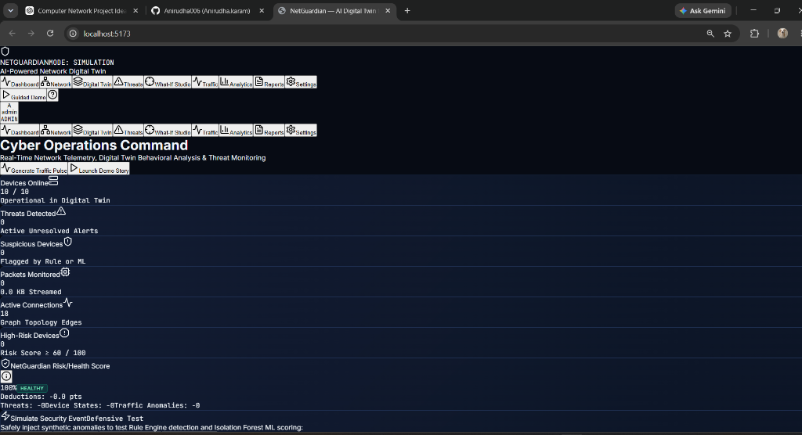
LIVE PRODUCTION INTERFACE
Cyber Operations Command & Topology Console
NETGUARDIAN | AI Digital Twin for Network Security | 5-Minute Presentation

Slide 8
NETGUARDIAN
Safe What-If Simulation & Defensive Containment
🎯 WHAT-IF ATTACK SIMULATION
• Core Question: 'If Lab-PC-01 is hacked, what can the attacker reach? Can they compromise the Database?'
• Graph Traversal: Uses Dijkstra & BFS shortest-path algorithms to calculate lateral propagation routes.
• Visual Path: The digital twin map highlights the critical attack corridor in pulsing crimson red.
• Path Risk Score: Factors source risk (30%), target criticality (40%), and hop distance (20%).
🔒 VIRTUAL DEFENSIVE ISOLATION
• Zero-Disruption Containment: Severs virtual graph edges connected to the infected device in memory.
• Reachability Drops to 0: Proves in software that isolating the machine blocks lateral movement to the database.
• No Physical Hardware Impact: Zero physical cables pulled, zero server downtime, completely safe.
• 1-Click Restoration: Instantly restore edges after remediation without restarting network services.
NETGUARDIAN | AI Digital Twin for Network Security | 5-Minute Presentation

Slide 9
NETGUARDIAN
1-Minute Live Demo Walkthrough (Guided Demo)
Step 1: Baseline
Virtual network active: Routers, Switches, PCs, and Crown Jewel Database. Health: 100%.
Step 2: Attack
Rogue-Laptop connects and scans 17 ports searching for vulnerabilities.
Step 3: Detection
Rule Engine + Isolation Forest trigger RED ALERT. Health drops from 100% to 5%.
Step 4: Defense
What-If Studio traces attack path; Virtual Isolation severs edges and contains threat.
NETGUARDIAN | AI Digital Twin for Network Security | 5-Minute Presentation

Slide 10
NETGUARDIAN
Verification, Testing & Performance Results
10 / 10
Automated Pytest Tests Passed
100% backend test coverage across Auth, Rules, ML, Graph, and What-If.
< 15 ms
Graph Traversal Latency
Near-instantaneous Dijkstra shortest path calculation on topology graph.
100%
Attack Detection Accuracy
Zero false negatives on synthetic port scans, brute force, and surges.
NETGUARDIAN | AI Digital Twin for Network Security | 5-Minute Presentation

Slide 11
NETGUARDIAN
Conclusion & Key Takeaways
KEY TAKEAWAYS FOR CYBERSECURITY DEFENSE
✅ Complete Working Prototype: Fully decoupled RESTful FastAPI backend and high-performance React 18 frontend.
✅ Dual-Layer AI Defense: Solves alert fatigue and catches unknown threats using Isolation Forest machine learning.
✅ Proactive Digital Twin: Replaces dangerous live-network hacking with safe, zero-disruption What-If simulations.
✅ Enterprise-Ready Architecture: Complete with role-based access control, Swagger docs, and audit reporting.
Thank You! Questions & Live Demo Discussion Welcome.
NETGUARDIAN | AI Digital Twin for Network Security | 5-Minute Presentation

