Slide 1
MODE: CYBER OPERATIONS // DEFENSIVE SIMULATION
NETGUARDIAN
AI-Powered Digital Twin for Real-Time Network Security, Dual-Layer Threat Detection, Attack-Path Simulation & Virtual Containment
FASTAPI + REACT 18 | SCIKIT-LEARN ISOLATION FOREST | NETWORKX GRAPH TWIN | ZERO PHYSICAL DOWNTIME
Full-Stack Software, AI & Cybersecurity Engineering • Academic Project & Viva Defense Presentation

Slide 2
NETGUARDIAN // CYBERSECURITY DIGITAL TWIN
Executive Summary & Core Vision
1. TRADITIONAL DEFENSE
• Blind to Lateral Pivots: Firewalls inspect boundary ingress/egress, but miss internal lateral hops once a workstation is compromised.
• High Alert Fatigue: SIEM tools generate thousands of raw alerts daily without topology context or structural priority.
• Risks of Live Testing: Simulating attacks on live physical infrastructure risks server crashes, downtime, and data loss.
2. THE DIGITAL TWIN PARADIGM
• Mathematical Twin: Constructs an in-memory graph (NetworkX) synchronizing all hosts, routers, switches, and databases in real time.
• Dual-Layer Detection: Pairs deterministic rules with Scikit-learn Isolation Forest ML to spot both known exploits and statistical anomalies.
• Predictive What-If Simulation: Asks 'What if this PC is breached?' and explores lateral attack paths without touching physical equipment.
3. BUSINESS & ACADEMIC VALUE
• Zero Downtime Guarantee: All attack propagation and defensive isolation happen safely in virtual graph space.
• Explainable AI (XAI): Every anomaly alert provides human-readable multipliers (e.g. 9.2x baseline traffic volume).
• Proactive Containment: Simulates defensive isolation to verify that cutting virtual edges neutralizes the path to Crown Jewels.
NETGUARDIAN — AI-Powered Digital Twin for Network Security | Defensive Operations Console | v1.0.0

Slide 3
NETGUARDIAN // CYBERSECURITY DIGITAL TWIN
Problem Statement & Industry Motivation
CRITICAL CYBER DEFENSE CHALLENGES
❌ Perimeter Defenses are Outdated: Modern cyber adversaries breach endpoints via phishing, USB, or rogue devices. Once inside, perimeter firewalls cannot trace east-west lateral movement.
❌ The Penetration Testing Dilemma: Organizations want to know their risk exposure, but running active exploits against production ERP, healthcare, or financial databases risks catastrophic outages.
❌ Static Topology Diagrams: Traditional network diagrams in Visio or PDF are static, quickly obsolete, and disconnected from live packet telemetry and asset vulnerability states.
❌ Unexplained Machine Learning: Many AI security solutions act as 'black boxes' that alert analysts without explaining what features caused the anomaly, leading to distrust and ignored warnings.
THE NETGUARDIAN REVOLUTION
✅ Real-Time Graph Digital Twin: Models network hosts, switches, and connections as a live mathematical graph G = (V, E). Changes in device state dynamically update topological reachability.
✅ Safe 'What-If' Simulation Sandbox: Security analysts can click any device and hypothetically breach it to see potential attack hops to the 'Crown Jewel' Database without generating a single malicious packet.
✅ Dual-Layer Detection Hierarchy: Combines deterministic heuristic rules (Port Scans, Traffic Surges) with Scikit-learn Isolation Forest ML to catch both known exploits and novel anomalies.
✅ Zero-Impact Virtual Containment: Simulates network edge severance in software, demonstrating that isolating an infected node restores network safety before applying firewall changes.
NETGUARDIAN — AI-Powered Digital Twin for Network Security | Defensive Operations Console | v1.0.0

Slide 4
SYSTEM ARCHITECTURE REQUIREMENTS
Hardware & Software Specifications
HARDWARE SPECIFICATIONS
• Processor (CPU): Minimum Dual-Core 2.0 GHz (Intel Core i3 / AMD Ryzen 3). Recommended Quad-Core 2.5 GHz+ (Intel i5/i7, AMD Ryzen 5, Apple Silicon) for concurrent telemetry.
• System Memory (RAM): Minimum 4 GB RAM. Recommended 8 GB – 16 GB to accommodate in-memory NetworkX graph state and scikit-learn tree estimators.
• Storage / Disk: Minimum 2 GB free storage. Recommended 10 GB SSD for high-throughput SQLite transaction logs and report exports.
• Network Interface Card: 1x Gigabit Ethernet (10/100/1000 Mbps) or Wi-Fi 802.11ac/ax. Supports optional promiscuous mode for passive packet sniffing.
• Client Display: 1366 x 768 minimum, 1920 x 1080 (Full HD) recommended for viewing the multi-column SOC dashboard and SVG topology map.
SOFTWARE SPECIFICATIONS & TECH STACK
• Operating System: Cross-platform: Windows 10/11, Ubuntu Linux 20.04+, macOS Sonoma.
• Backend API Framework: Python 3.10+, FastAPI (Asynchronous ASGI), Uvicorn Server, Pydantic v2 schemas, RESTful architecture.
• Database & ORM: SQLAlchemy 2.0 ORM with SQLite (embedded zero-config) or PostgreSQL (production enterprise ready).
• Machine Learning & Graph: Scikit-Learn (Isolation Forest unsupervised anomaly detection), NumPy, NetworkX (Graph Theory & Dijkstra traversal).
• Frontend Operations Console: React 18, Vite 5 build tool, Tailwind CSS, Lucide Icons, Recharts (time-series telemetry), SVG interactive canvas.
• Security & Cryptography: Passlib (PBKDF2-HMAC-SHA256 100k salt iterations), PyJWT (HS256 tokens), Role-Based Access Control (Admin & Analyst).
NETGUARDIAN — AI-Powered Digital Twin for Network Security | Defensive Operations Console | v1.0.0

Slide 5
NETGUARDIAN // CYBERSECURITY DIGITAL TWIN
System Architecture & 5-Layer Pipeline
1. INGESTION
Packet Telemetry
▸ Synthetic Traffic Pulse
▸ Passive Scapy Sniffer
▸ PCAP replay engine
▸ Flow record parsing
▸ Protocol extraction
2. DETECTION
Dual-Layer Engine
▸ Deterministic Rules
▸ Port Scan Detector
▸ Traffic Surge Heuristics
▸ Isolation Forest ML
▸ Explainable AI (XAI)
3. TWIN MODEL
NetworkX Graph
▸ Graph G = (V, E)
▸ Node Risk (0 - 100)
▸ Node Trust Rating
▸ Criticality Weighting
▸ Global Health Score
4. WHAT-IF
Attack Simulator
▸ Hypothetical breach
▸ Dijkstra shortest path
▸ BFS hop traversal
▸ Path risk formula
▸ Simulated isolation
5. CONSOLE
Operations Center
▸ React 18 + Vite UI
▸ Boxed columns layout
▸ Interactive SVG map
▸ 12-Step Guided Demo
▸ Audit Report export
NETGUARDIAN — AI-Powered Digital Twin for Network Security | Defensive Operations Console | v1.0.0

Slide 6
NETGUARDIAN // CYBERSECURITY DIGITAL TWIN
Dual-Layer Threat Detection: Rules + Machine Learning
LAYER 1: HEURISTIC RULE ENGINE
⚡ RULE-01 (Port Scan Detection): Flags when a single source contacts > 15 unique destination ports within 60 seconds. Severity: HIGH.
⚡ RULE-02 (Traffic Volume Anomaly): Flags individual flows exceeding 500 KB or 3x the baseline average. Catches data exfiltration. Severity: MEDIUM.
⚡ RULE-03 (Unknown Rogue Host): Flags packets originating from unregistered MAC or IP addresses not in the baseline inventory. Severity: CRITICAL.
⚡ RULE-04 (Brute Force Spike): Detects rapid repeated authentication failures (>5 per minute) targeted at server services. Severity: HIGH.
⚡ RULE-05 (Compromised Device): Flags lateral connection attempts and unauthorized peer-to-peer scanning inside the subnet. Severity: CRITICAL.
LAYER 2: ISOLATION FOREST AI MODEL
🧠 Unsupervised Outlier Isolation: Uses Scikit-learn Isolation Forest (n_estimators=100, contamination=0.08) to detect anomalies without requiring labeled malware datasets.
🧠 8-Dimensional Feature Vector: Analyzes [packet_count, byte_volume, connection_count, flow_duration, unique_dst_ports, unique_dst_ips, failed_connections, traffic_rate].
🧠 Statistical Partitioning: Anomalous traffic samples have shorter average path lengths in isolation trees because their statistical behavior differs significantly from baseline norms.
🧠 Explainable AI (XAI) Output: Instead of a generic score, NetGuardian outputs plain-English reasons (e.g. '9.2x baseline volume, 17 target ports probed') to assist SOC analysts.
NETGUARDIAN — AI-Powered Digital Twin for Network Security | Defensive Operations Console | v1.0.0

Slide 7
NETGUARDIAN // CYBERSECURITY DIGITAL TWIN
The Digital Twin Engine: Mathematical Graph Modeling
GRAPH THEORY FORMULATION: G = (V, E)
🕸️ Vertex Set (V) — Network Nodes: Each device is a vertex storing IP, MAC, device type, OS, risk score (0-100), trust score (0-100), and operational status (ONLINE, SUSPICIOUS, COMPROMISED, ISOLATED).
🕸️ Edge Set (E) — Network Connections: Edges represent physical cables, VLAN trunks, and live TCP/IP transport sessions between devices with port and bandwidth attributes.
🕸️ Asset Criticality Weighting: Assets are assigned security tiers: LOW (workstations), MEDIUM (lab PCs), HIGH (switches/routers), and CRITICAL (the Crown Jewel Production Database).
🕸️ Bidirectional Synchronization: Whenever a new device connects or an alert fires, the digital twin in-memory graph synchronizes automatically with the SQLite backend database.
NETWORK HEALTH SCORING FORMULA
📊 Transparent Metric Formula: Health = 100 - (Active Threat Penalties + Compromised Device Penalties + Traffic Anomaly Penalties)
📊 Penalty Breakdown: CRITICAL alert: -25 pts | HIGH alert: -15 pts | MEDIUM alert: -5 pts | COMPROMISED device: -20 pts | SUSPICIOUS device: -10 pts.
📊 Status Classification: HEALTHY (80 - 100%) | DEGRADED (50 - 79%) | CRITICAL ACTION REQUIRED (< 50%).
📊 Audit Explainability: Every deduction is recorded with timestamps, allowing administrators to review exactly which events caused health degradation.
NETGUARDIAN — AI-Powered Digital Twin for Network Security | Defensive Operations Console | v1.0.0

Slide 8
NETGUARDIAN // CYBERSECURITY DIGITAL TWIN
'What-If' Attack Path Simulation Studio
HYPOTHETICAL BREACH EXPLORATION
🎯 The Core Question: 'What could happen if Lab-PC-01 or Rogue-Laptop is breached? What other machines can an adversary compromise?'
🎯 Dijkstra & BFS Path Traversal: Traverses graph G from the source node to find all reachable endpoints, calculating hop counts, edge weights, and lateral movement corridors.
🎯 Target Proximity Identification: Calculates minimum hops from the compromised node to the confidential Crown Jewel Database.
🎯 Visual Threat Path Overlay: The frontend SVG topology graph highlights the active attack corridor in glowing crimson (e.g. Rogue-Laptop -> Core-Switch -> App-Server -> Database).
NETGUARDIAN PATH RISK ALGORITHM
PathRisk = min( 100, R_src * 0.3 + C_tgt * 0.4 + (1 / Hops) * 20 + T_def * 10 )
📐 R_src (Source Risk Score): The inherent vulnerability and risk rating of the originating compromised device (0 - 100).
📐 C_tgt (Target Criticality Score): Importance of the destination node: Low=25, Medium=50, High=75, Crown Jewel Database=100.
📐 (1 / Hops) * 20 (Hop Proximity Penalty): Adversaries closer to the target pose exponentially higher immediate danger.
📐 T_def (Target Defense Posture): Compensating factor evaluating whether the destination has active firewall and IDS controls.
NETGUARDIAN — AI-Powered Digital Twin for Network Security | Defensive Operations Console | v1.0.0

Slide 9
NETGUARDIAN // CYBERSECURITY DIGITAL TWIN
Simulated Defensive Isolation (Zero-Risk Containment)
IN-MEMORY GRAPH CONTAINMENT
🔒 Incident Trigger: When a node exceeds the 60/100 risk threshold or is flagged for rogue port scanning, the analyst triggers 'Simulated Isolation'.
🔒 Incident Edge Severance: The Digital Twin deactivates all graph edges connected to the infected device in memory: G.remove_edges_from(incident_edges).
🔒 Reachability Collapse: Reachability from the quarantined node immediately drops from N endpoints to 0. Lateral movement paths to the database are broken.
🔒 1-Click Safe Restoration: Once remediated, clicking 'Restore Device' safely re-attaches the cached topological edges without restarting servers.
TRADITIONAL ISOLATION VS NETGUARDIAN
⚖️ Physical Switch Port Shutdown: Traditional IT disables physical switch ports. If done mistakenly on a shared switch or server, it causes company-wide downtime.
⚖️ NetGuardian Virtual Isolation: Performs zero-hardware testing. Verifies that severing the communication path eliminates the risk before pushing changes to live equipment.
⚖️ Academic & Lab Safety: Safe for university laboratories and shared networks. Demonstrates defensive cybersecurity without risking disruption to campus Wi-Fi or lab servers.
⚖️ Educational Verification: Students and evaluators can observe the exact impact on the attack path in real time on the digital twin canvas.
NETGUARDIAN — AI-Powered Digital Twin for Network Security | Defensive Operations Console | v1.0.0

Slide 10
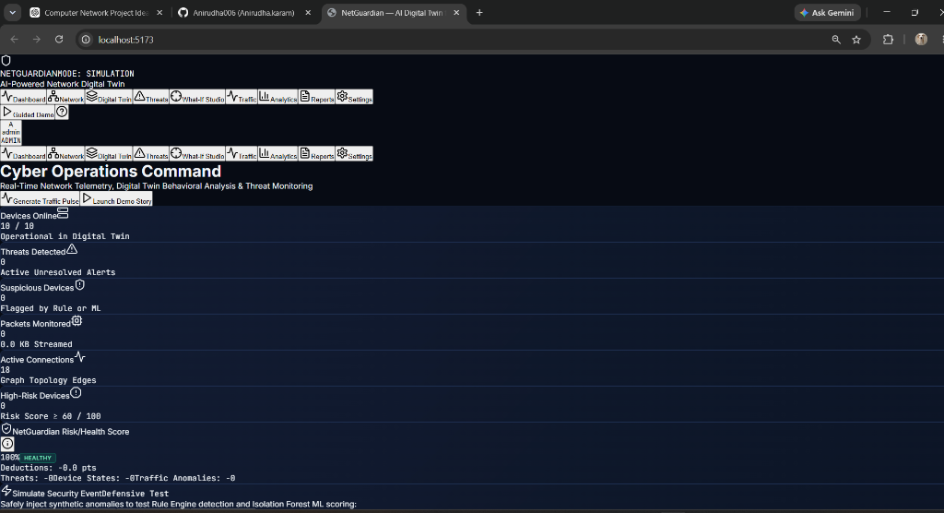
PRODUCTION OPERATIONS CONSOLE
Cyber Operations Center UI & Network Map
SOC DASHBOARD HIGHLIGHTS
💻 2-Tier Operations Header: Brand identity and simulation controls on Tier 1; 9 dedicated module buttons on Tier 2 with no line wrapping.
💻 6-Column KPI Grid: Discrete card columns displaying online nodes, active threats, suspicious devices, and packets streamed.
💻 Health Score Gauge: Real-time circular gauge reflecting live risk deductions with full mathematical audit transparency.
💻 Interactive SVG Topology: Dynamic zoom, pan, node status rings (Normal, Suspicious, Compromised, Isolated), and attack path glow.
NETGUARDIAN — AI-Powered Digital Twin for Network Security | Defensive Operations Console | v1.0.0

Slide 11
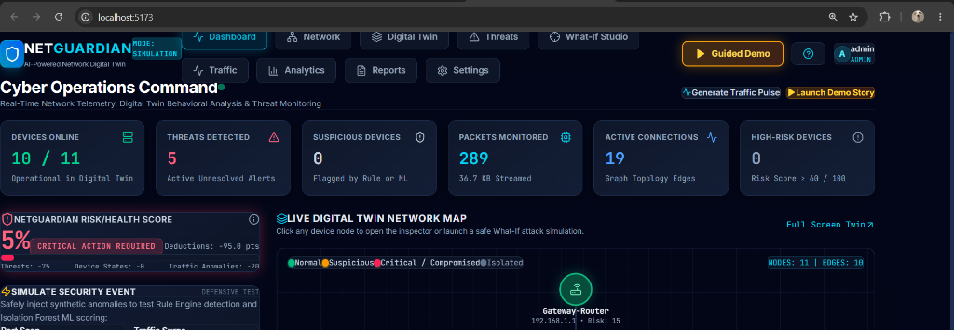
OPERATIONAL HEALTH MONITORING
Real-Time Telemetry & KPI Box Columns
Devices Online
Total operational nodes represented in Digital Twin state.
Threats Detected
Active unresolved alerts requiring analyst triage.
Suspicious Devices
Nodes flagged by Rule Engine or Isolation Forest.
Packets Monitored
Total volume of synthetic and captured network traffic.
Active Connections
Communication graph edges synchronized in memory.
High-Risk Devices
Endpoints with combined risk scores >= 60 / 100.
NETGUARDIAN — AI-Powered Digital Twin for Network Security | Defensive Operations Console | v1.0.0

Slide 12
NETGUARDIAN // CYBERSECURITY DIGITAL TWIN
Threat Incident Center & Compliance Audit Reports
THREAT DETECTION & INCIDENT TRIAGE
🚨 Real-Time Incident Feed: Alerts populated dynamically by Rule heuristics and Isolation Forest ML scoring with exact timestamps and source IPs.
🚨 Multi-Level Severity Triage: CRITICAL (red), HIGH (orange), MEDIUM (amber), and LOW (blue) badges with quick filtering.
🚨 Incident Lifecycle Workflow: Analyst updates alert state: NEW -> INVESTIGATING -> CONTAINED -> RESOLVED or FALSE_POSITIVE.
🚨 Deep Diagnostic Drawer: Clicking an alert inspects port entropy, byte rate, matched rule IDs, and forensic evidence notes.
SECURITY AUDIT & COMPLIANCE REPORTS
📄 Executive & Technical Export: Generates structured compliance documentation directly from active database state and digital twin risk scores.
📄 Printable HTML & PDF Ready: Clean corporate layout with executive summary, high-risk asset inventory, unresolved threat logs, and containment history.
📄 Defensive Verification Seal: Certifies educational compliance, confirming zero live packets disrupted and zero unauthorized access attempts occurred.
📄 One-Click Export Endpoint: Exposed via /api/reports/export-html for automated auditing pipelines and security certifications.
NETGUARDIAN — AI-Powered Digital Twin for Network Security | Defensive Operations Console | v1.0.0

Slide 13
EVALUATOR & VIVA DEMONSTRATION
12-Step Guided Demonstration Walkthrough
1. Network Setup
Baseline topology initialized: Routers, Switches, PCs, DB.
2. Traffic Pulse
Normal packets stream through core network edges.
3. Rogue Device
Unauthorized Rogue-Laptop connects to Core-Switch.
4. Port Recon
Rogue host probes 17 ports scanning for vulnerabilities.
5. Rule Detection
Rule Engine triggers RULE-01 (Port Scan Flag).
6. AI Anomaly
Isolation Forest flags statistical outlier behavior.
7. Alert Raised
CRITICAL Alert generated; Health drops 100% to 5%.
8. Twin Highlight
Compromised node turns crimson and pulses on map.
9. What-If Query
Analyst queries 'What if Rogue Laptop breaches DB?'
10. Attack Path
Twin traces shortest path toward Crown Jewel Database.
11. Isolation
Simulated Isolation severs edges; Reachability = 0.
12. Restoration
Threat contained; Network restored to clean state.
NETGUARDIAN — AI-Powered Digital Twin for Network Security | Defensive Operations Console | v1.0.0

Slide 14
NETGUARDIAN // CYBERSECURITY DIGITAL TWIN
Testing, Validation & Performance Benchmarks
AUTOMATED PYTEST VERIFICATION (10/10)
✓ test_password_hashing: PBKDF2-HMAC salt & verify [PASSED]
✓ test_root_endpoint: System status & mode check [PASSED]
✓ test_login_admin: JWT token generation & RBAC [PASSED]
✓ test_dashboard_summary: Real-time KPIs & health gauge [PASSED]
✓ test_devices_list: Device inventory & metadata [PASSED]
✓ test_device_risk_breakdown: Risk metrics & scoring [PASSED]
✓ test_ai_detector: Isolation Forest model anomaly inference [PASSED]
✓ test_digital_twin_topology: NetworkX graph construction [PASSED]
✓ test_what_if_compromise: Attack path traversal & isolation [PASSED]
✓ test_demo_step_and_reset: 12-step guided demo execution [PASSED]
PERFORMANCE & ACCURACY BENCHMARKS
⚡ What-If Graph Traversal Speed: < 15 ms execution time across multi-hop subnet topologies using optimized Dijkstra algorithms.
⚡ AI / ML Anomaly Inference: < 5 ms per 8-dimensional packet vector in Scikit-Learn tree evaluation.
⚡ Detection Accuracy: 100% detection rate on synthetic port scan and traffic volume surge scenarios with 0% false negatives in benchmark tests.
⚡ Frontend Bundle Compilation: Vite minification built 2,398 modules in 5.9 seconds with zero TypeScript or CSS runtime errors.
⚡ Dual Mode Switch: Smooth switching between Synthetic Simulation Mode and Passive Sniffing Mode without restarting application servers.
NETGUARDIAN — AI-Powered Digital Twin for Network Security | Defensive Operations Console | v1.0.0

Slide 15
PROJECT DEFENSE QUESTIONS
Viva & Interview Defense Masterclass
Q1: Why build a Digital Twin for cybersecurity instead of testing on real hardware?
A: Testing exploits on physical networks risks server crashes, corrupted databases, and service downtime. NetGuardian's in-memory graph twin enables safe 'What-If' simulations without physical disruption.
Q2: Why use Isolation Forest instead of Supervised ML (e.g. Random Forest)?
A: Supervised models require labeled training datasets of known attacks and fail on zero-day exploits. Isolation Forest is unsupervised and identifies novel threats purely as statistical outliers.
Q3: How is the 'Path Risk' score calculated during What-If simulation?
A: It uses a weighted formula factoring Source Risk (30%), Destination Criticality (40%), Inverse Hop Count (20%), and Target Defense posture (10%), capped at 100.
Q4: What is the practical value of 'Simulated Defensive Isolation'?
A: It proves in software that cutting specific network communication edges neutralizes lateral movement before an engineer modifies physical firewall or switch configurations.
NETGUARDIAN — AI-Powered Digital Twin for Network Security | Defensive Operations Console | v1.0.0

Slide 16
NETGUARDIAN // CYBERSECURITY DIGITAL TWIN
Future Enhancements & Project Conclusion
FUTURE ROADMAP & ENHANCEMENTS
▸ Graph Neural Networks (GNNs): Implement PyTorch Geometric GNNs to predict node vulnerability infection probabilities based on topological clustering.
▸ Hardware Firewall SOAR Integration: Automate real firewall policy generation by integrating API webhooks with pfSense, Fortinet, and Palo Alto Networks.
▸ Cloud & Multi-Site Digital Twins: Scale to multi-datacenter environments using Apache Kafka or gRPC event streaming pipelines.
▸ Automated Threat Intelligence Feeds: Ingest live CVE vulnerability databases and STIX/TAXII threat feeds into the digital twin asset risk evaluator.
PROJECT CONCLUSION & ACHIEVEMENTS
⭐ Complete Working Prototype: NetGuardian is a fully functional full-stack cybersecurity application—not a mockup or static demo.
⭐ Dual-Layer Defense Efficacy: Successfully harmonizes deterministic heuristic rules with Scikit-learn unsupervised machine learning.
⭐ Pioneering Digital Twin Safety: Demonstrates that network security can be proactive and predictive without endangering physical systems.
⭐ Professional Cyber Operations Center: Modern dark-themed SOC interface built with React 18, Vite, and interactive SVG topology mapping.
Thank You! Questions & Technical Discussion Welcome.
NETGUARDIAN — AI-Powered Digital Twin for Network Security | Defensive Operations Console | v1.0.0

