Slide 1
Lab Automation using Arduino
UML Diagrams

Slide 2
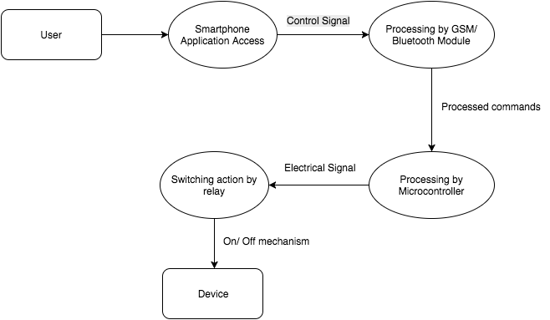

Slide 3
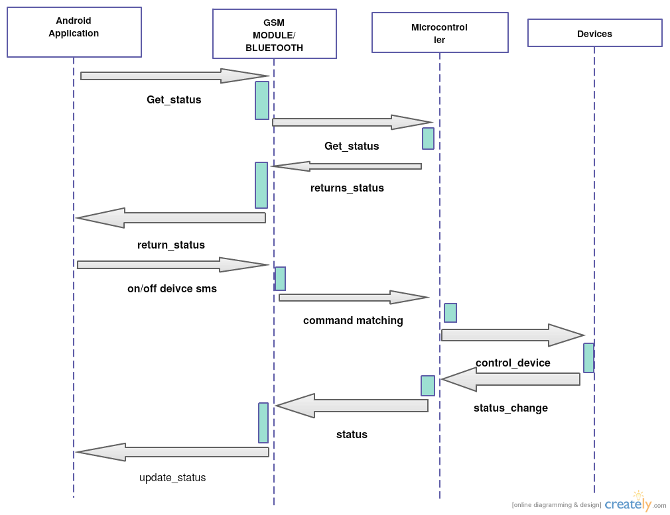

Slide 4
