Slide 1
SIH26207 · SOFTWARE
AICTE · MIC – STUDENT INNOVATION
AVANCE
A game layer for real-world work.
“Smart Education — a concept that describes learning in the digital age; helping learners learn more efficiently, effectively, flexibly and comfortably.”
TEAM NAME
TEAM LEADER
Team Members
Avance
K N Anirudh
Daivaansh Chandok
Akash Sharma
Divya Shree N
4. Keshav
5. Vedant

Slide 2
02 THE IDEA
See it before the deadline does.
Digital learning tools track content delivery — not follow-through. Institutions learn a student is behind only when the deadline already has.
LIVE ON THE PLATFORM (swap for your screenshot)
CURRENT QUEST
“Not a to-do list with XP — a progress-visibility system with a motivation layer.”
Build the Banking System
60%
Checkpoint: Testing
Deadline: 3d 14h
PERSONALIZED
GAMIFIED
Next: Documentation
Rank #12 / 58
AI Quest Builder turns each assignment into a per-student checkpoint path
XP, streaks and a group leaderboard wrapped around real checkpoints
CLASS COMMAND CENTER
41 ON TRACK
13 AT RISK
6 CRITICAL
DATA-DRIVEN
ACCESSIBLE
Requirements
96%
Command Center: on-track / at-risk / critical + bottleneck analytics
Big assignments become small linear steps — no confusing skill trees
Testing
43% ⚠
SIH26207 · AVANCE — SMART EDUCATION
02 / 06

Slide 3
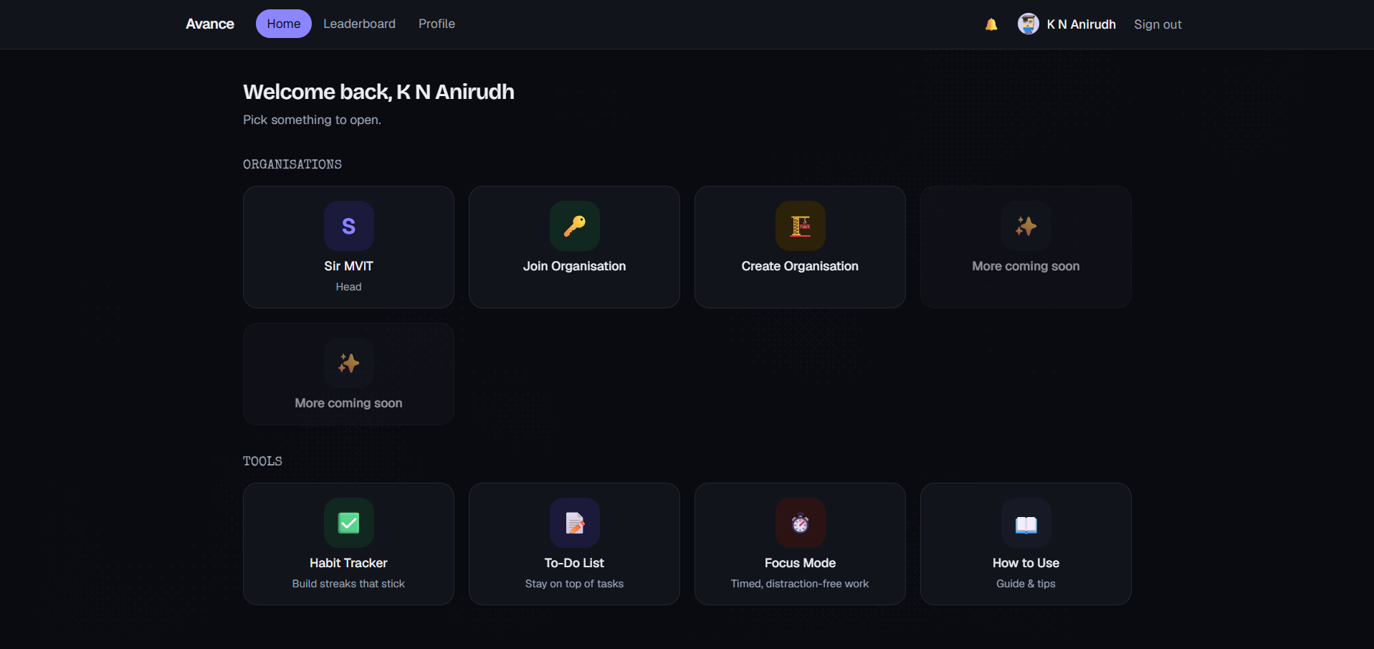
03 TECHNICAL APPROACH
From assignment to early warning.
Assignment
Uploaded
→
AI
Decomposition
→
Human
Approval
↓
Student
Progress
→
→
Org
Analytics
Leaderboard based competative
AI SAFETY BY DESIGN
PRODUCTION STACK
AI proposes checkpoints — it never auto-publishes them
Next.js 16
Prisma
Supabase
Tailwind v4
GSAP
Every generated field is human-editable before Approve & Publish
SIH26207 · AVANCE — SMART EDUCATION
03 / 06

Slide 4
04 FEASIBILITY & VIABILITY
A running app, not a concept slide.
ALREADY BUILT, END-TO-END
RISK → MITIGATION
✓
Auth & organisation / group roles
Lecturer adoption friction
✓
AI Quest Builder (PDF, DOCX, text)
Manual fallback always works; join-code onboarding; zero AI dependency
✓
Linear checkpoints with locked / current / done states
AI mis-generates checkpoints
✓
PDF submission — automatic or host-approval verification
Mandatory human approval; every field editable; clearly AI-labeled
✓
Command Center: risk + checkpoint bottleneck analytics
Scaling to large classes
✓
XP, streaks, group leaderboard
Aggregate stats from objective platform signals, not device monitoring
✓
Personal habit tracker
✓
In-app notifications & audit logging
Student data privacy
Server-side authorization on every action; auditable Fair Play changes
SIH26207 · AVANCE — SMART EDUCATION
04 / 06

Slide 5
05 IMPACT & BENEFITS
Three days early beats too late.
TODAY
WITH AVANCE
The problem isn’t identifying struggling students .
It’s identifying them early enough to help .
Command Center flags the Testing checkpoint stalled at 43%.
Testing
43% ⚠
Discovered on Day 14 of 14 — too late to help
Flagged on Day 11 of 14 — 3 days to intervene
STUDENTS
INSTITUTIONS
SCALABILITY
Always know what's next — less deadline panic, motivation without humiliation
See who needs attention before the deadline, not after
Org → Group → Project → Checkpoint model reuses for clubs, teams, future workplaces
SIH26207 · AVANCE — SMART EDUCATION
05 / 06

Slide 6
06 RESEARCH & REFERENCES
Grounded in research, not guesswork.
1
National Education Policy 2020 — flexible, learner-centred, technology-enabled education
2
Learning-analytics / early-warning-system research on formative, in-progress assessment
3
Gamification-in-education research on engagement effects of streaks & leaderboards
4
Positioning: Classroom/Moodle track endpoints only; Duolingo-style apps gamify without institutional visibility — Avance sits in the gap.
🧠 BEHAVIOURAL DESIGN
Streaks, small linear checkpoints and immediate visible progress are deliberately modeled on James Clear's Atomic Habits — identity-based habits, “don't break the chain,” and immediate reward loops.
Thank you.
[ QR: live demo ] Live demo: [https://avance-tufk.vercel.app/] · Repo: [github link]
SIH26207 · AVANCE — SMART EDUCATION
06 / 06

