Slide 1
Adaptive Agentic Directed Evolution
01
96 assays. Four rounds. One hidden GB1 landscape.
IYGV 4.388
Best observed fitness after exactly 96 hidden-lab measurements
OmniEvo • development run seed 0 • paired baselines required for performance claims

Slide 2
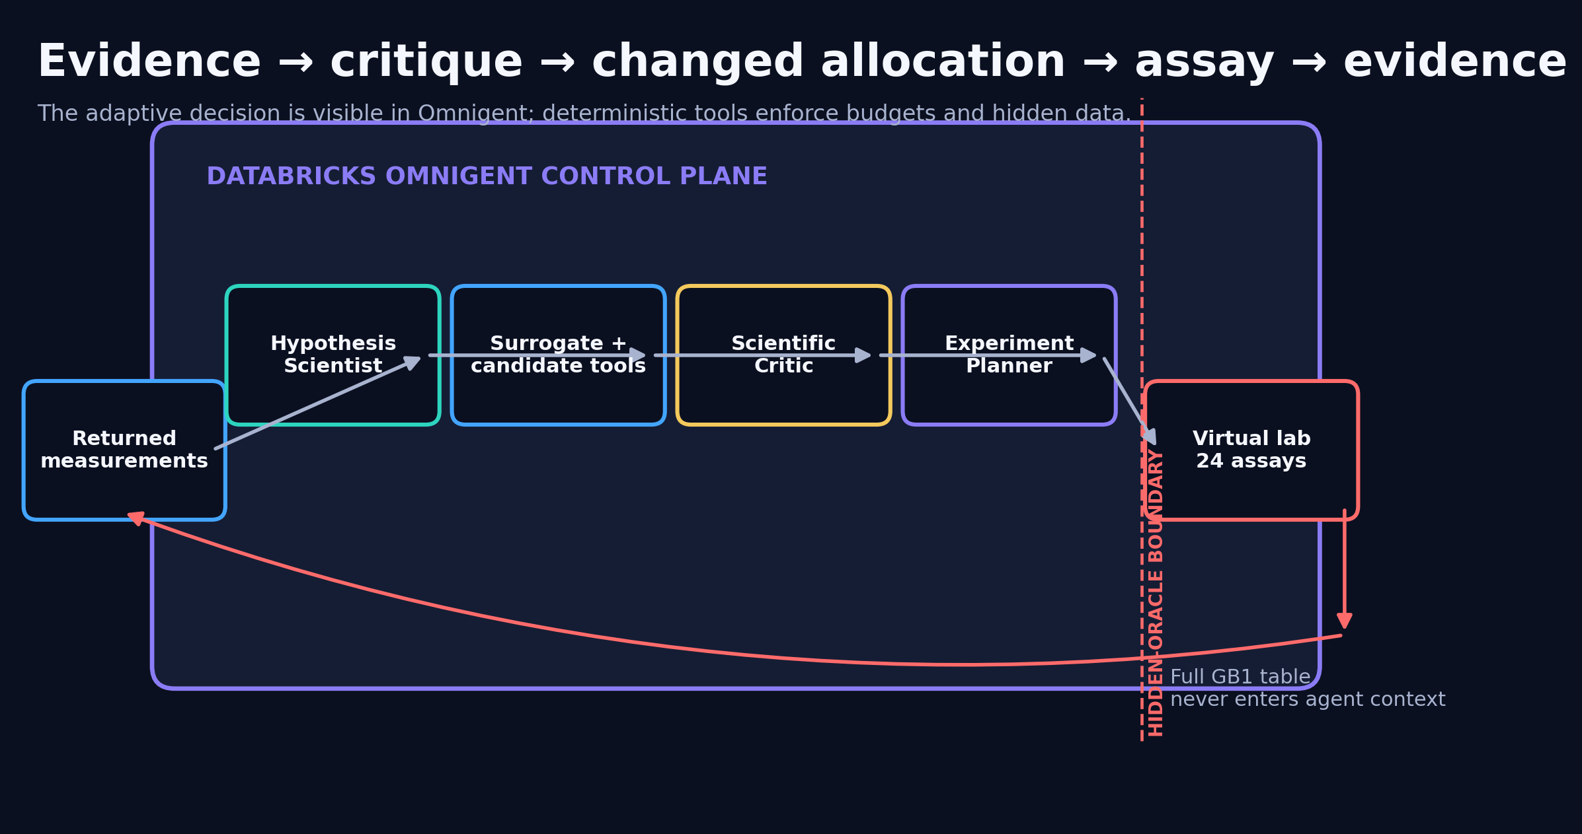
The scientific question
02
Does evidence-driven strategy switching add value beyond the same surrogate model?
OmniEvo • development run seed 0 • paired baselines required for performance claims

Slide 3
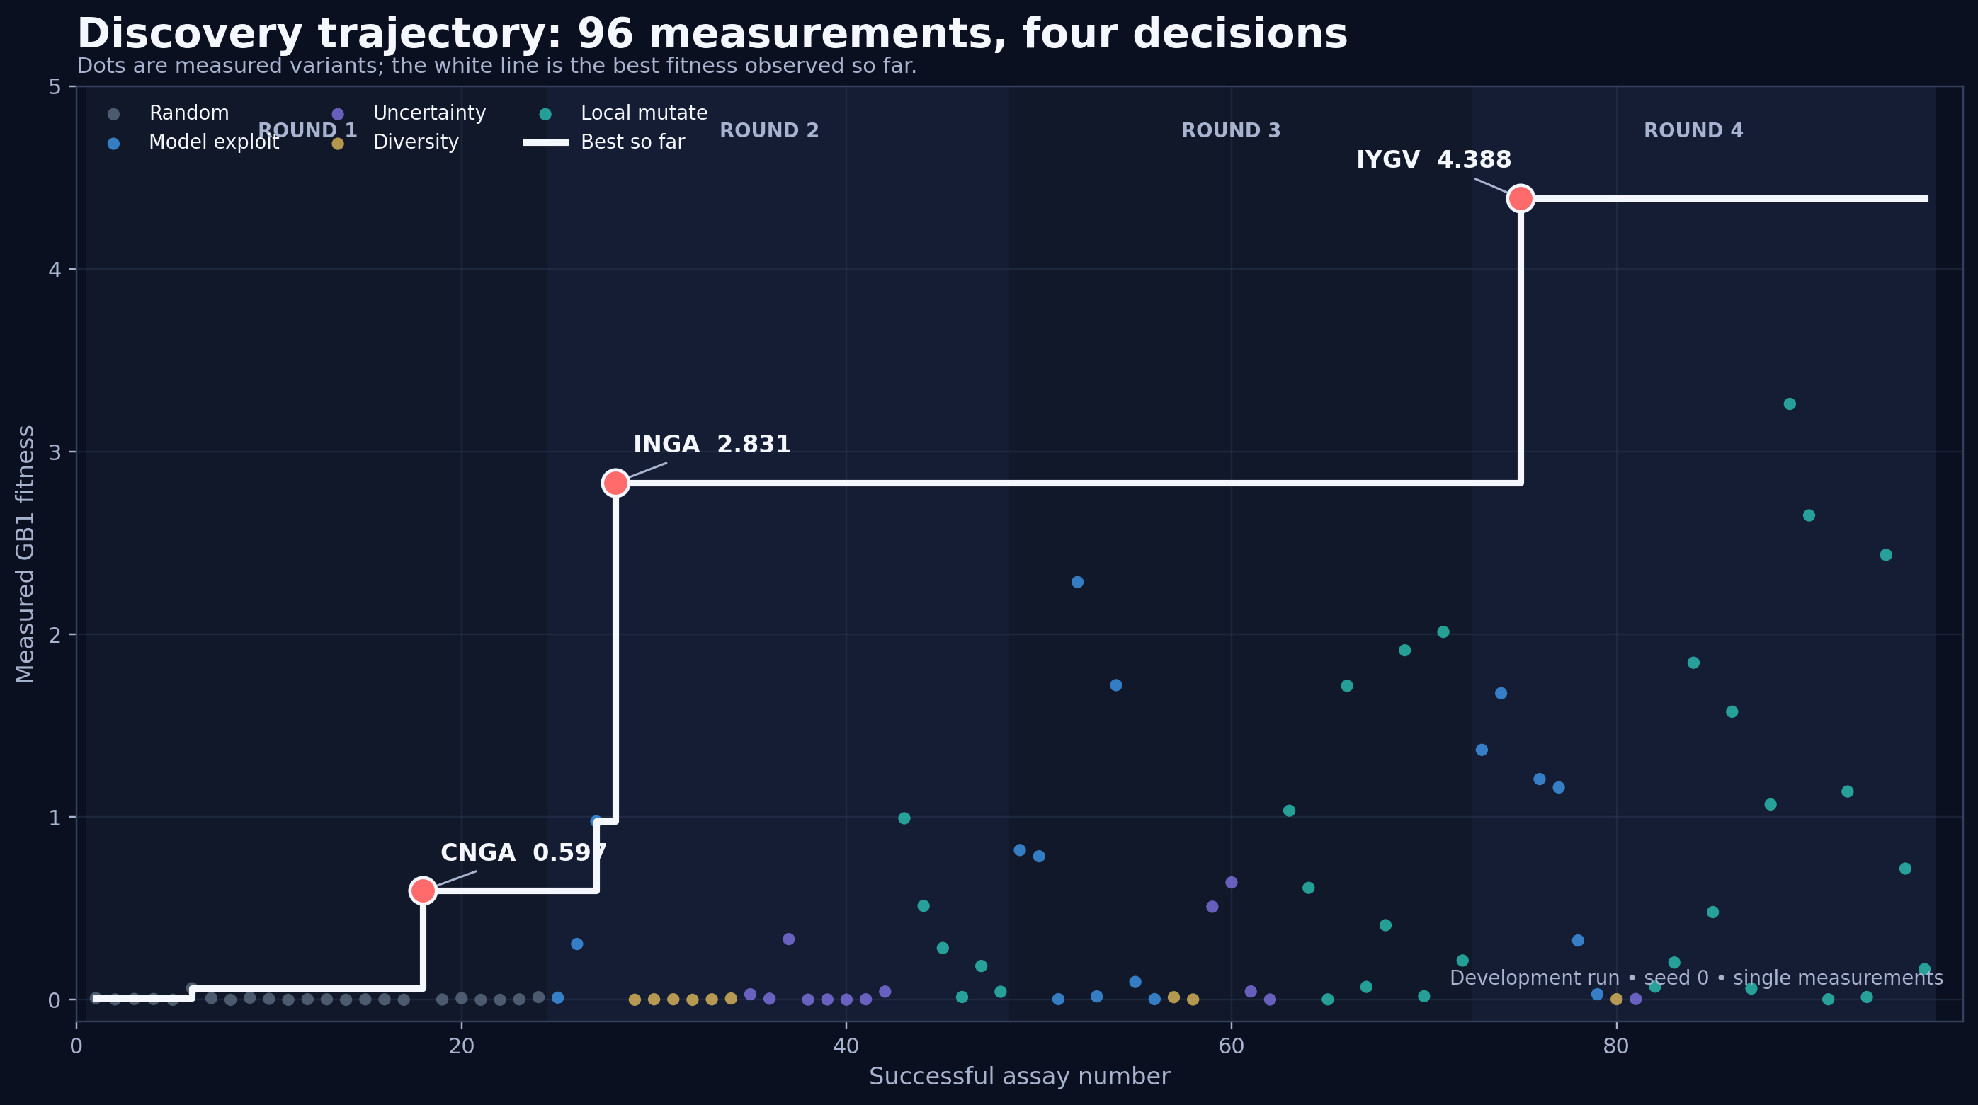
The discovery run
03
A visible 4-round trajectory from initialization to a high-fitness double mutant.
OmniEvo • development run seed 0 • paired baselines required for performance claims

Slide 4
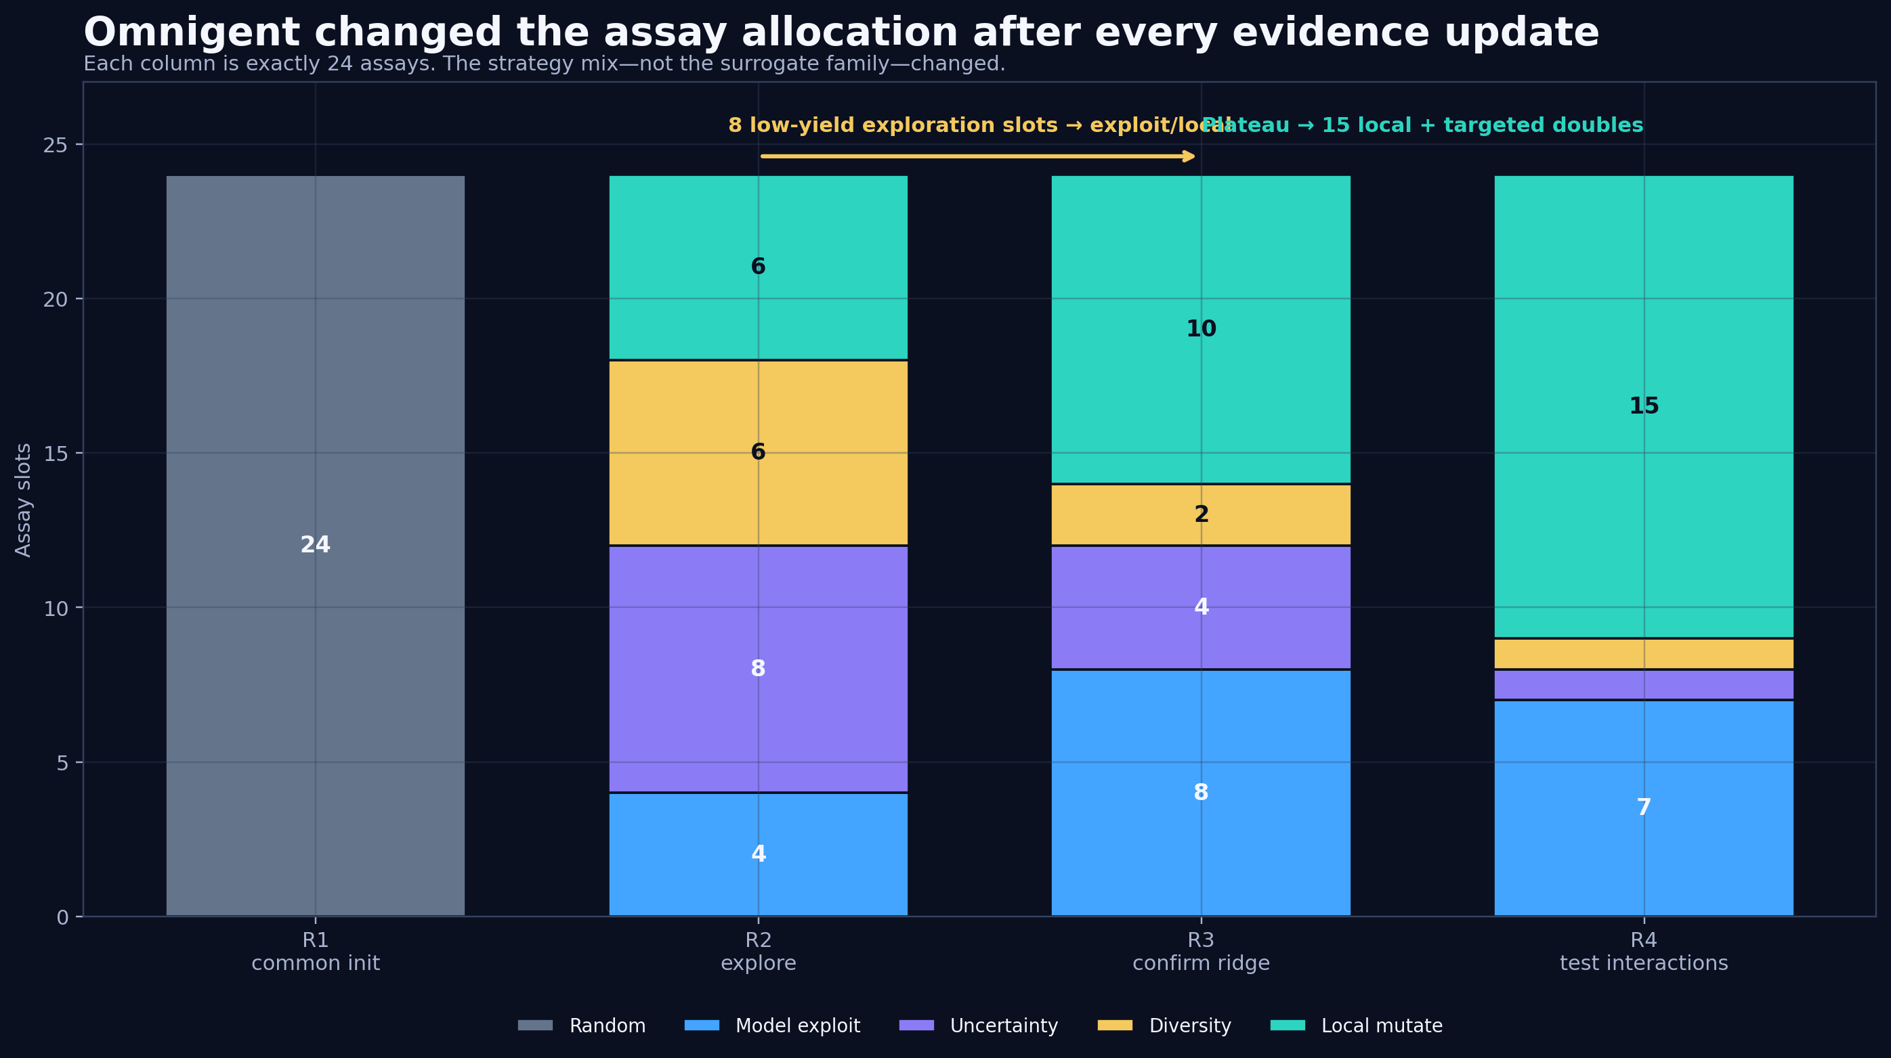
The agent changed its mind
04
Omnigent shifted budget away from low-yield exploration and toward local/interaction tests.
OmniEvo • development run seed 0 • paired baselines required for performance claims

Slide 5
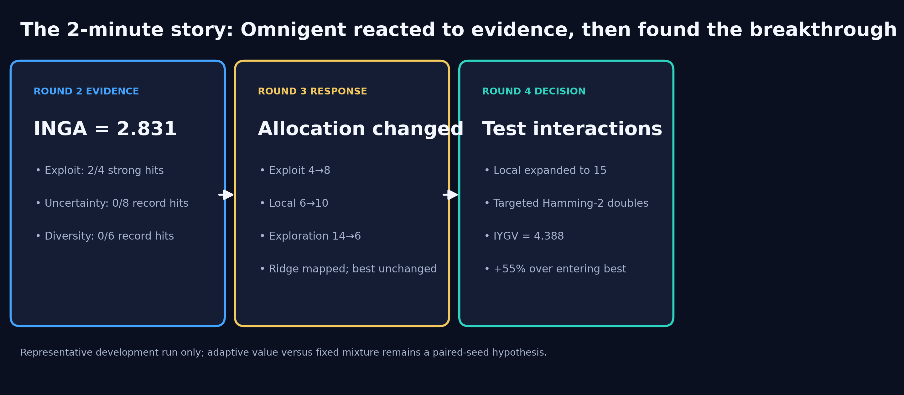
Evidence → strategy change → result
05
The core Omnigent transition for the demo video.
OmniEvo • development run seed 0 • paired baselines required for performance claims

Slide 6
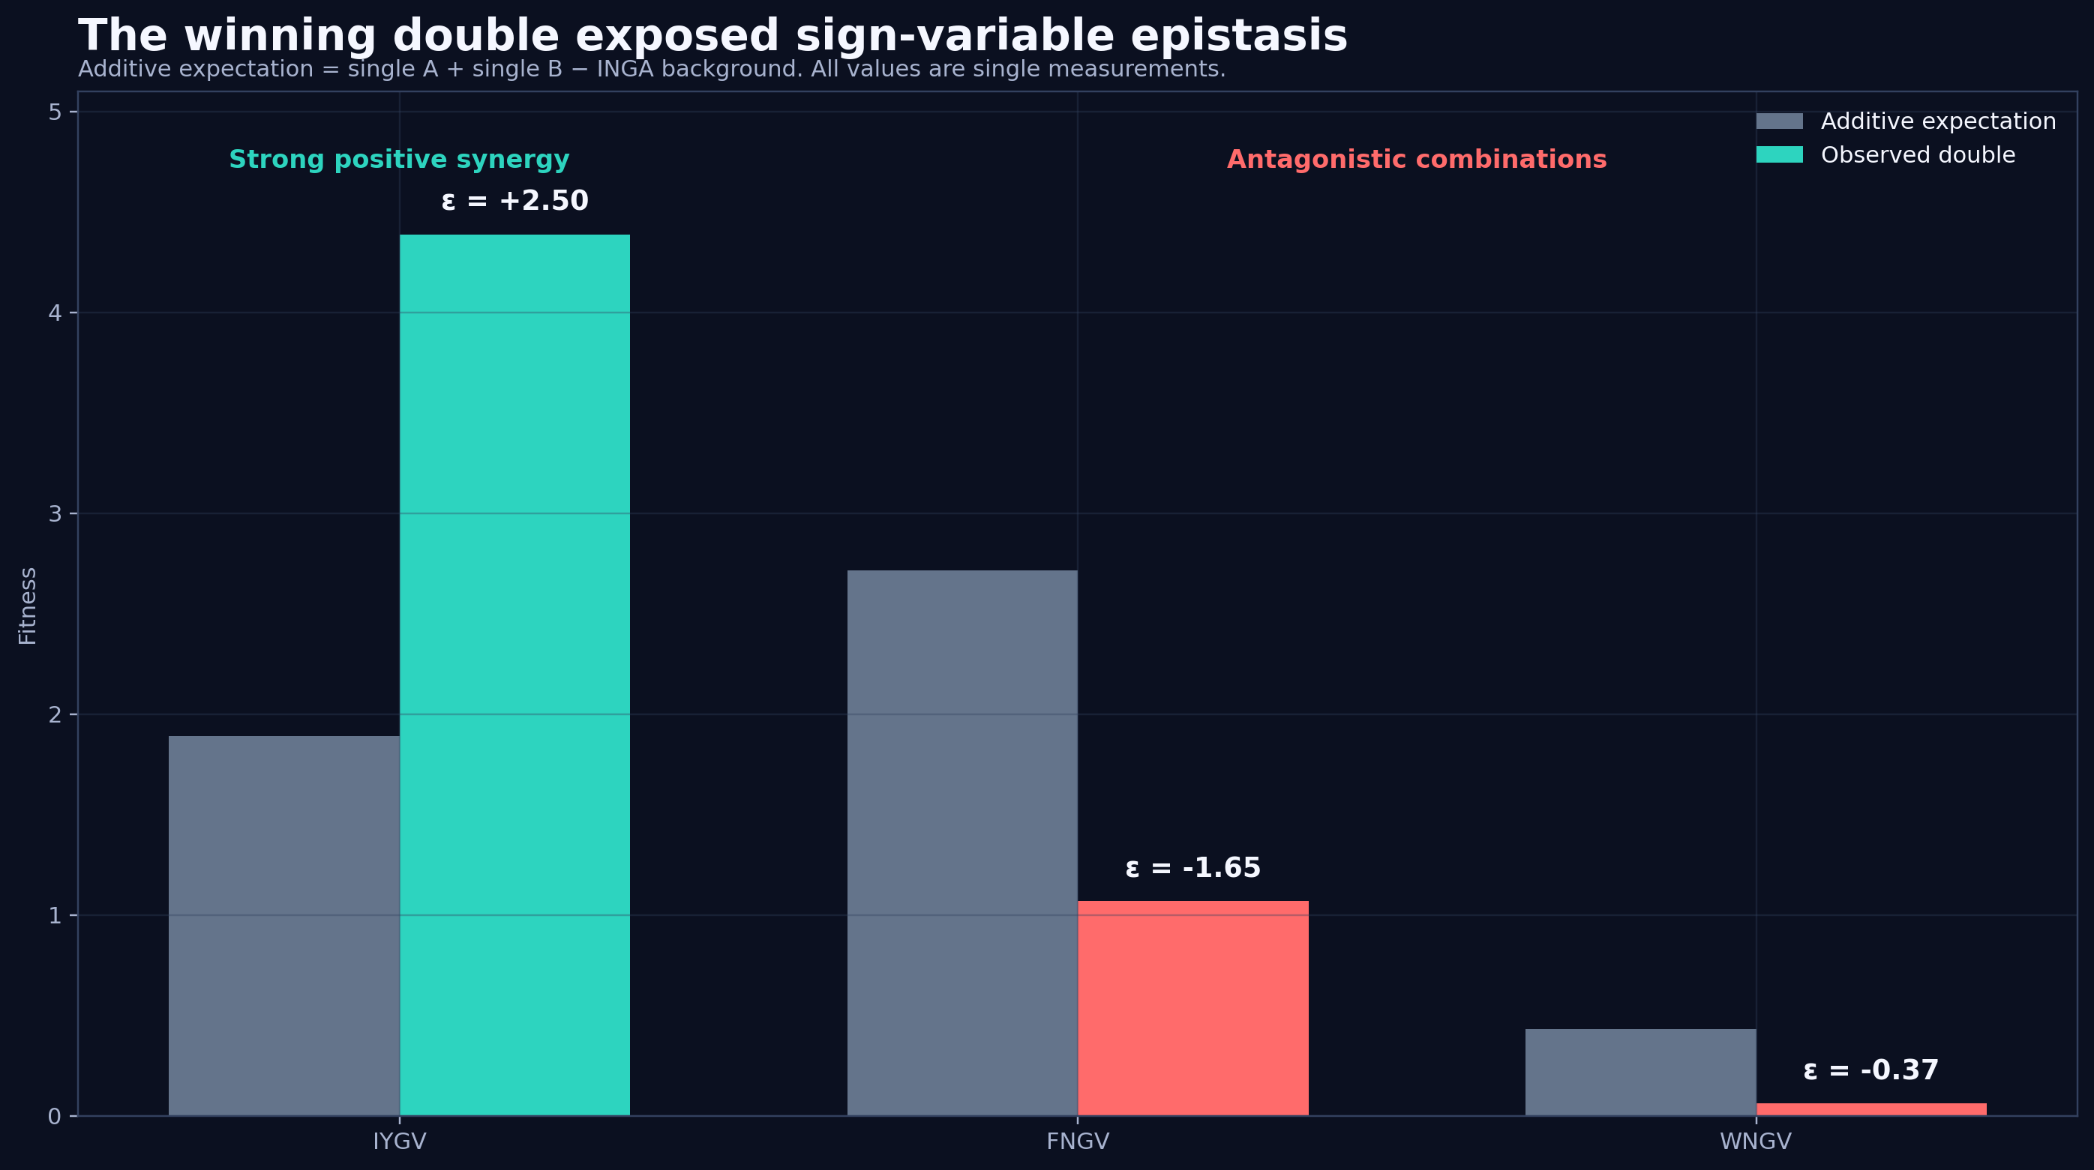
The biological surprise
06
IYGV showed strong positive epistasis while related combinations were antagonistic.
OmniEvo • development run seed 0 • paired baselines required for performance claims

Slide 7
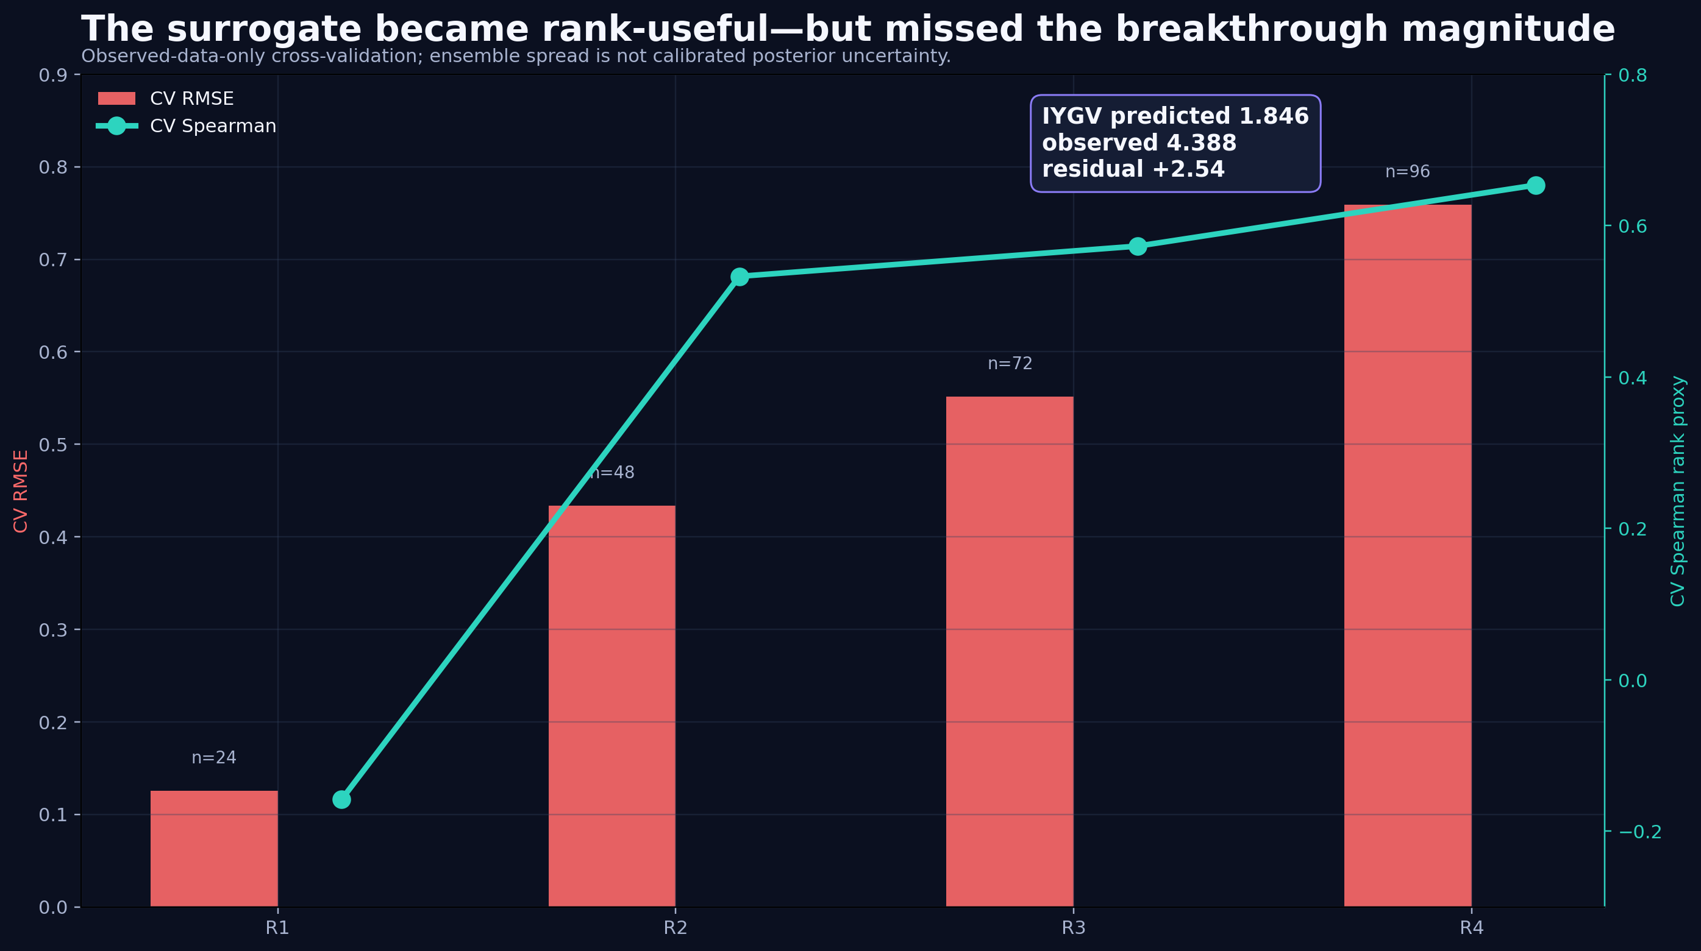
Why both model and agent mattered
07
The surrogate ranked the winner—but badly underpredicted its magnitude.
OmniEvo • development run seed 0 • paired baselines required for performance claims

Slide 8
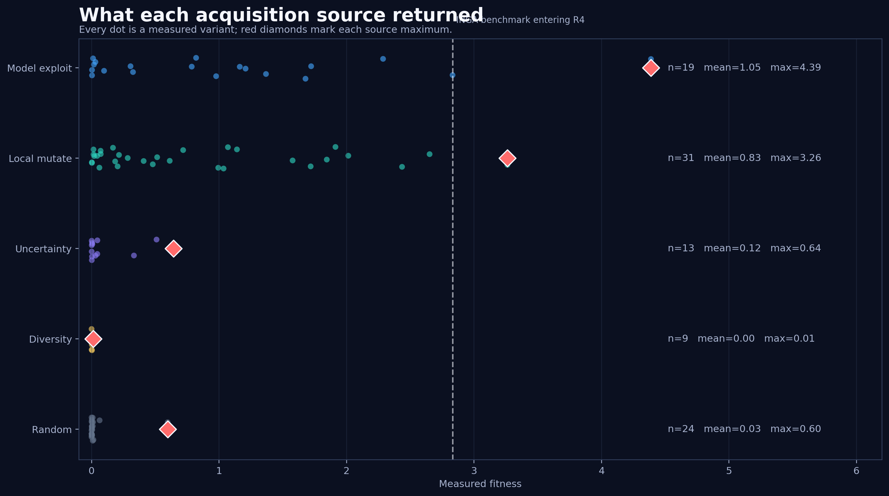
Where the assays paid off
08
Model exploitation found the terminal best; local mutation found the best single.
OmniEvo • development run seed 0 • paired baselines required for performance claims

Slide 9
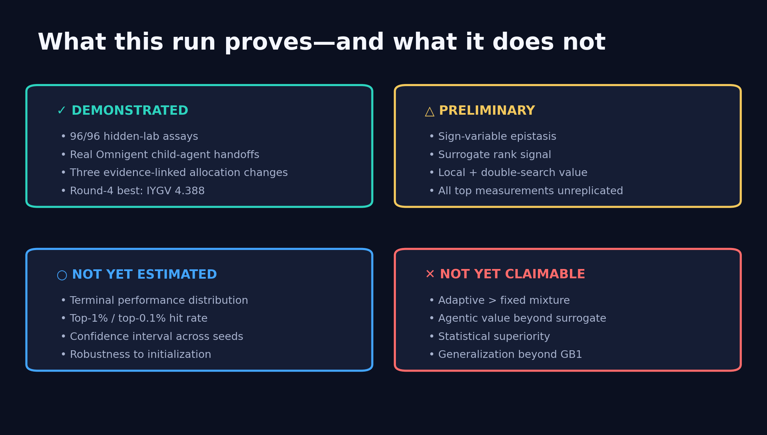
The honest conclusion
09
A compelling development run, not yet a causal superiority result.
OmniEvo • development run seed 0 • paired baselines required for performance claims

