Slide 1
PROSPERNET
LEVERAGING MACHINE LEARNING FOR NON-PROFIT FUNDRAISING: PREDICTING HIGH-INCOME INDIVIDUALS
Janani Karthikeyan
002830003

Slide 2
PROJECT FLOW
01
02
03
04
Introduction to ProsperNet
Data Preprocessing and Exploratory Data Analysis
Model Implementation and Evaluation
Comparative Analysis of Machine Learning Algorithms
Project Overview
Methodology
Data Cleaning and Transformation
Exploratory Data Analysis
Baseline Model Evaluation
Hyperparameter Tuning
Algorithm Performance Metrics
Algorithm Recommendations

Slide 3
01 : Introduction to ProsperNet
Project Overview
The "ProsperNet: Predicting High-Income Individuals" project leverages machine learning to enhance non-profit fundraising efforts. It develops a predictive model using supervised learning algorithms, utilizing demographic and financial data from the 1994 U.S. Census to identify individuals with annual incomes exceeding $50,000. This model aids non-profits in refining donation solicitation and outreach efforts, providing a strategic advantage in fundraising activities. The data, sourced from the UCI Machine Learning Repository, undergoes meticulous preprocessing and analysis to construct an accurate and applicable model. ProsperNet empowers non-profits with data-driven insights for informed donor engagement, contributing significantly to the optimization of fundraising strategies.

Slide 4
01 : Introduction to ProsperNet
Methodology
● Data Acquisition and Pre-processing: Perform data cleaning, normalization, and splitting into training and testing sets.
● Exploratory Data Analysis (EDA): Initial analysis to identify patterns, correlations, and key features within the dataset.
● Feature Selection: Determining the most relevant features for accurate income prediction.
● Model Fitting: Implemented four supervised learning algorithms (Logistic Regression, AdaBoost, Decision Trees, and MLP Classifier) and evaluated baseline models using initial features without hyperparameter tuning.
● Hyperparameter Tuning: Optimizing and re-evaluating models to achieve peak performance.
● Model Evaluation: Testing the supervised learning algorithms for the best predictive accuracy and computational efficiency.

Slide 5
02 : Data Preprocessing and Exploratory Data Analysis
Dataset Description
The data underpinning this project is extracted from the UCI Machine Learning Repository, courtesy of contributions by Ron Kohavi and Barry Becker. This dataset, comprising a wide array of demographic and economic indicators, serves as the foundation for model training and validation.
● Number of Instances: Over 32,000 records in the training set.
● Number of Attributes: 14 features plus a target label.
Features: age, workclass, fnlwgt, education, education-level, marital-status, occupation, relationship, race, sex, capital-gain, capital-loss, hours-per-week, native-country, income (target variable).

Slide 6
02 : Data Preprocessing and Exploratory Data Analysis
Data Cleaning & Transformation
The following steps were performed as part of the data preprocessing.
● Data Importing & Cleaning - using data.dropna()
● Transforming Skewed Continuous Features - to re-scale the high-magnitude values and reduce the effect of outliers
● Log-transform the skewed features - to reduce skewness in the distribution
● Data Normalization - MinMaxScaler is a feature scaling technique that shrinks the range of data to [0,1]
● One-hot Encoding - to encome the target variable “income”
● Splitting data into training and testing sets - training set contains 26,048 samples, and the testing set has 6,513 samples

Slide 7
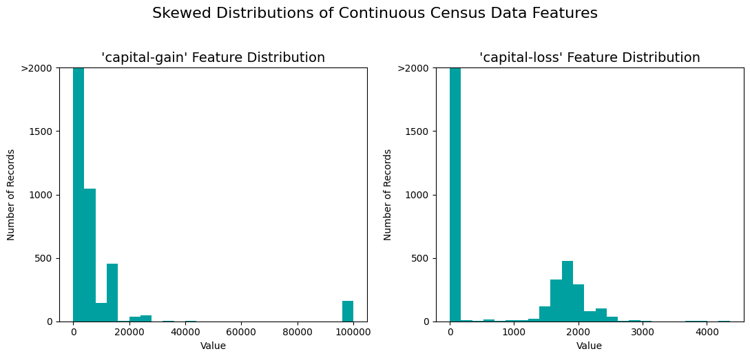
02 : Data Preprocessing and Exploratory Data Analysis
Data Transformation - Skewed Continuous Features
The 'capital-gain' and 'capital-loss' histograms post-transformation should ideally show a more uniform or normal distribution compared to pre-transformation.
However, from the output, there are still a large number of zeros that don’t change much with transformations like log, as log(0) is undefined.

Slide 8
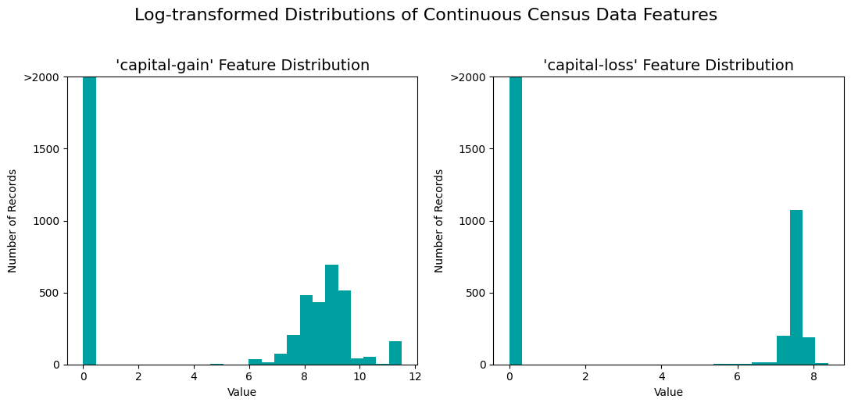
02 : Data Preprocessing and Exploratory Data Analysis
Data Transformation - Log-transform the skewed features
The histograms display the 'capital-gain' and 'capital-loss' data after a log transformation, which reduces their skewness.
Values of zero are transformed to zero, resulting in a high bar at that point.
The transformation compresses the range of non-zero values, moderating the impact of outliers and making the distribution less skewed.

Slide 9
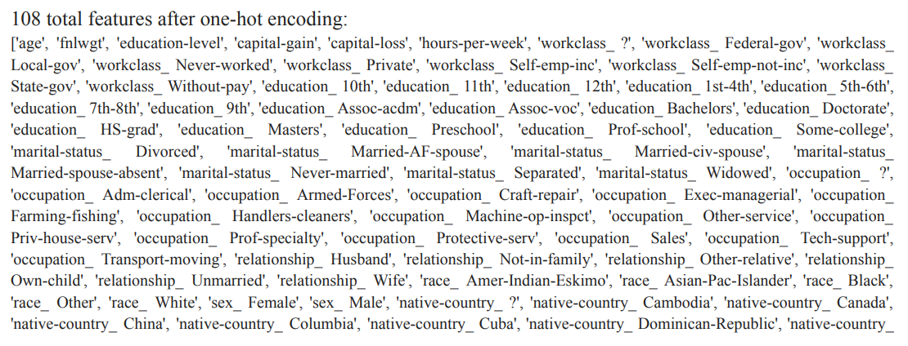
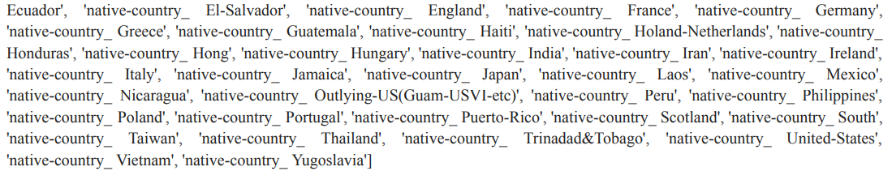
02 : Data Preprocessing and Exploratory Data Analysis
Data Transformation - One-hot Encoding

Slide 10
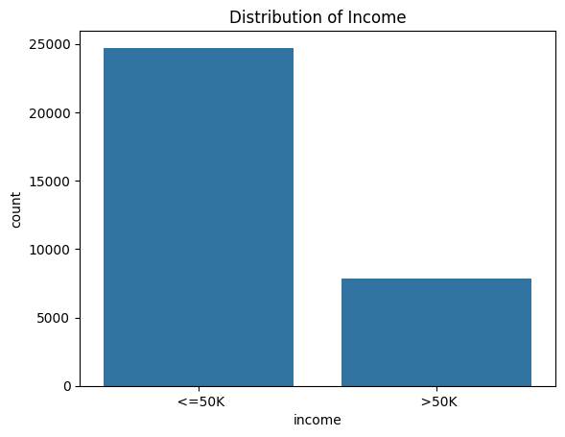
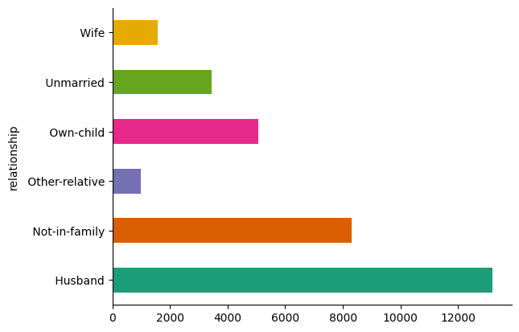
02 : Data Preprocessing and Exploratory Data Analysis
Exploratory Data Analysis
The horizontal bar chart categorizes individuals by family relationship, showing 'Husband' as the most common, followed by 'Not-in-family', with 'Wife' as the least common among the displayed categories.
The bar chart illustrates the income distribution, showing a larger count of individuals earning '<=50K' compared to those earning '>50K', indicating an income disparity within the dataset.

Slide 11
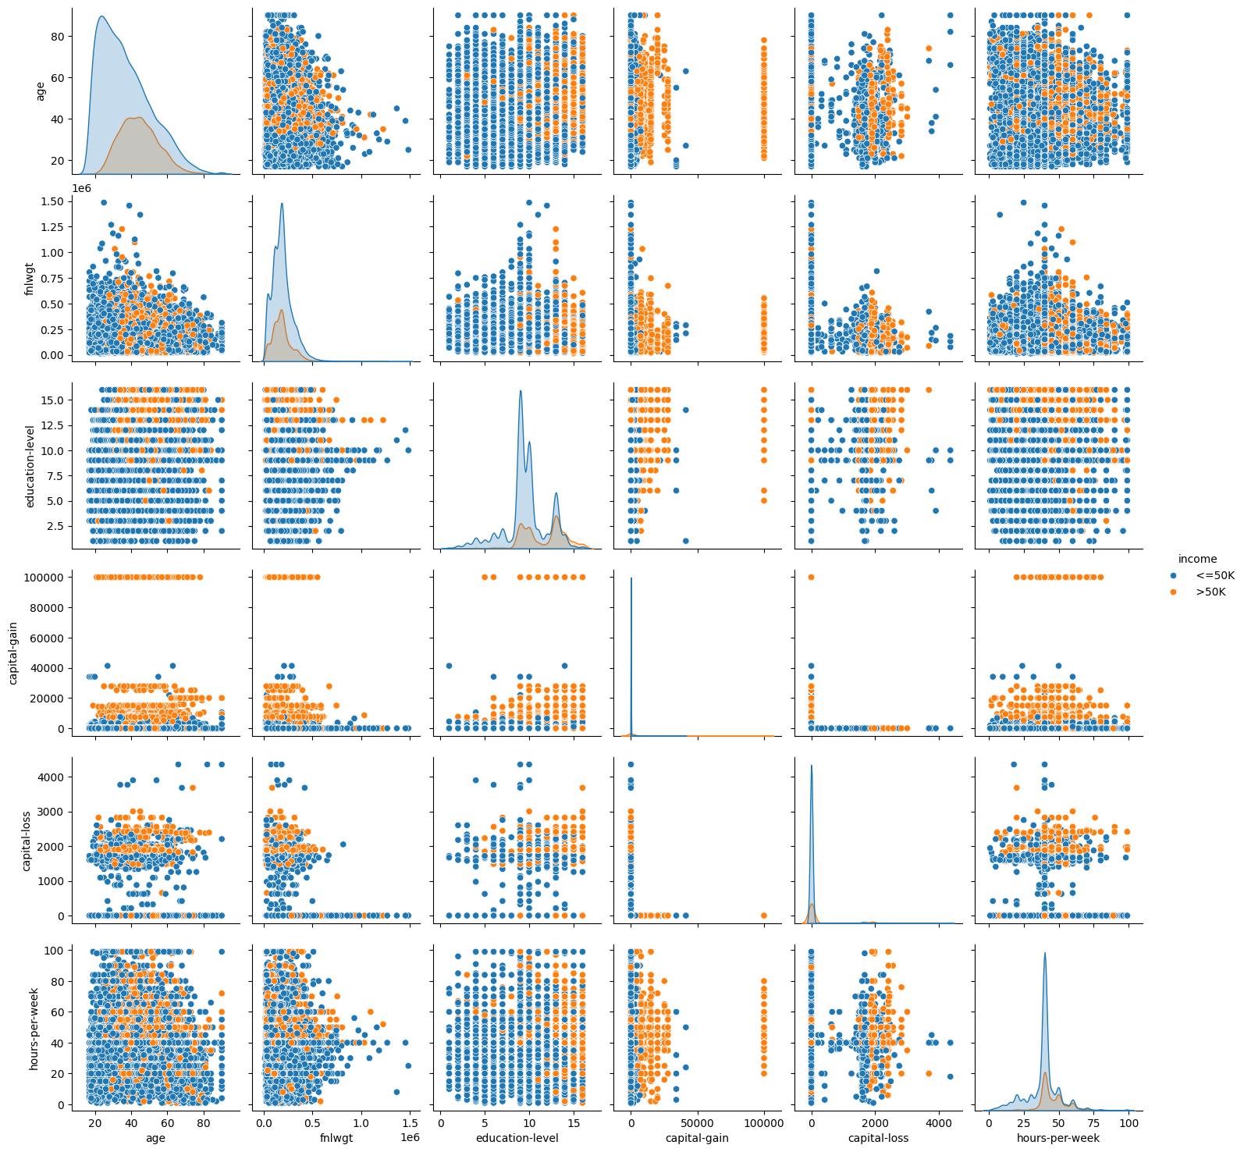
02 : Data Preprocessing and Exploratory Data Analysis
Exploratory Data Analysis
A pair plot, displaying the relationships between various numerical variables in the dataset.
Each plot on the diagonal shows the distribution of a single variable, with histograms for continuous variables and barplots for categorical ones.
Off-diagonal plots show scatter plots for the possible combinations of variables, allowing us to visualize potential correlations or patterns between them.
Data points are colored based on income categories—'<=50K' and '>50K'—to highlight differences in distributions across income levels.

Slide 12
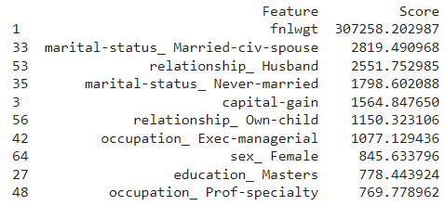
02 : Data Preprocessing and Exploratory Data Analysis
Feature Selection
The top 10 features selected using the chi-squared (χ²) test for feature selection.
Chi-squared measures the dependence between variables, making it suitable for categorical data.
SelectKBest model was fit and ranked the features by their chi-squared scores, and prints the top 10 features with their corresponding scores.

Slide 13
03 : Model Implementation and Evaluation
Baseline Model Evaluation
Naive Predictor Performance
The naive predictor's metrics indicate it correctly identifies all positive instances, reflected by high recall.
Despite high recall, the predictor's precision is low, hinting at a high rate of false positives.
The F-score combines precision and recall, revealing the naive predictor's overall performance is modest.

Slide 14
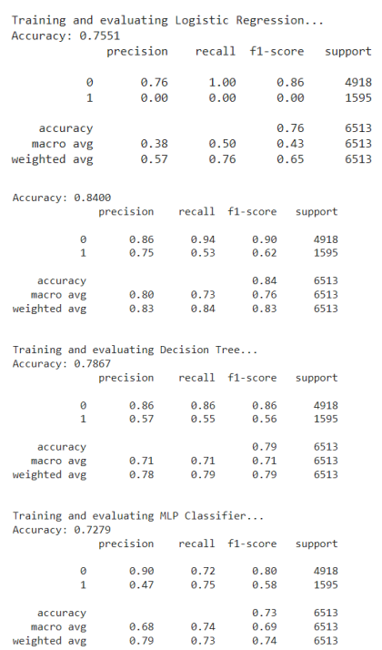
03 : Model Implementation and Evaluation
Baseline Model Evaluation
Using Initial Features without Hyperparameter Tuning
Trained and evaluated four models: Logistic Regression, AdaBoost, Decision Tree, and MLP Classifier, on a set of selected features.
AdaBoost achieved the highest accuracy of 84.00%, showcasing superior performance in correctly classifying instances.
AdaBoost's balanced precision, recall, and F1-score across both classes make it the most effective model for this classification task.

Slide 15
03 : Model Implementation and Evaluation
Supervised Machine Learning Models
Logistic Regression
AdaBoost
Binary
Classification
Decision Trees
MLP Classifier
ACCURACY: 75.51051742668508
ACCURACY: 84.00122831260556
ACCURACY: 78.7041302011362
ACCURACY: 75.51051742668508

Slide 16
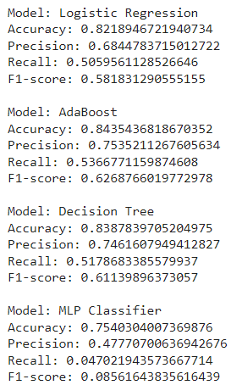
03 : Model Implementation and Evaluation
Hyperparameter Tuning & Re-evaluation of Models
Using GridSearchCV
Hyperparameter tuning performed for AdaBoost, Decision Trees, and MLP Classifier using GridSearchCV.
Each model's optimal parameters found through exhaustive search with cross-validation.
Tuning aimed to optimize performance based on accuracy, adjusting parameters like estimators and depth.
AdaBoost achieved highest cross-validation score of 84.54% with learning rate 1.0 and 200 estimators.
Evaluation of Logistic Regression, AdaBoost, Decision Trees, and MLP Classifier post-tuning shows significant accuracy improvements, notably for AdaBoost and Decision Trees.

Slide 17
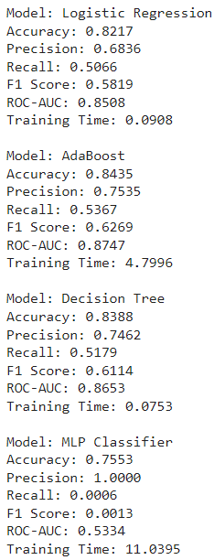
04 : Comparative Analysis of Machine Learning Algorithms
Algorithm Performance Metrics
Evaluation metrics computed: accuracy, precision, recall, F1-score, and ROC-AUC.
Metrics provide insight into model performance across different aspects of classification.
AdaBoost exhibits highest scores across most metrics, indicating superior classification ability.
Training time recorded for each model, indicating computational resources required.
AdaBoost and Decision Trees perform comparably, with AdaBoost slightly outperforming, while MLP Classifier shows significantly lower performance and longest training time.

Slide 18
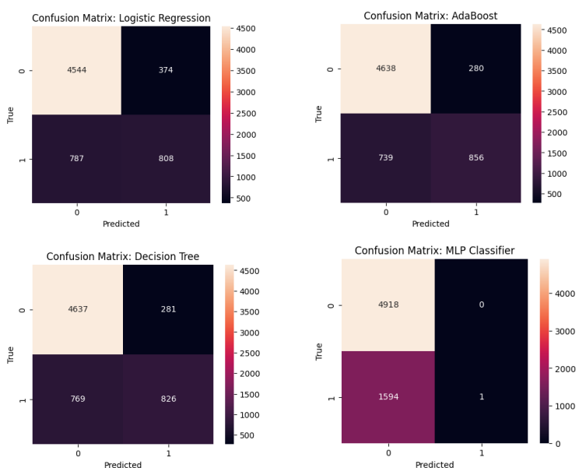
04 : Comparative Analysis of Machine Learning Algorithms
Confusion Matrix of the Models
Confusion matrices used to evaluate predictive performance of Logistic Regression, AdaBoost, Decision Tree, and MLP Classifier.
Matrices illustrate true positives, true negatives, false positives, and false negatives for binary classification.
Logistic Regression and AdaBoost show balanced identification of classes, while Decision Tree improves true positives at the expense of false negatives. MLP Classifier exhibits potential issues with class imbalance or model training.

Slide 19
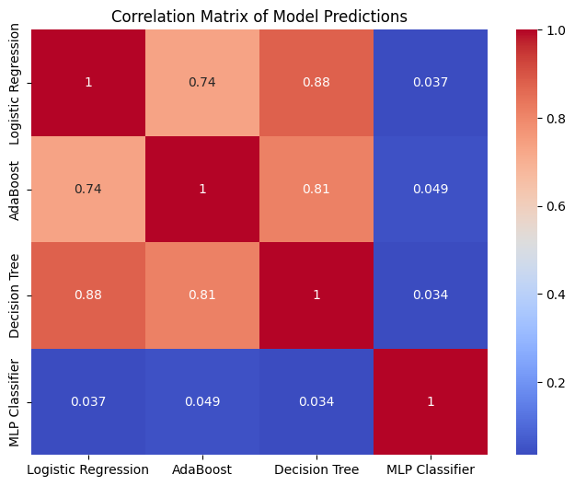
04 : Comparative Analysis of Machine Learning Algorithms
Correlation Matrix of Predicted Probabilities
Heatmap displays correlation between predictions of Logistic Regression, AdaBoost, Decision Tree, and MLP Classifier.
Logistic Regression, AdaBoost, and Decision Tree predictions exhibit moderate to high correlation, implying similar decision-making.
MLP Classifier predictions demonstrate minimal correlation, suggesting divergent patterns, possibly due to distinct data understanding or model issues.

Slide 20
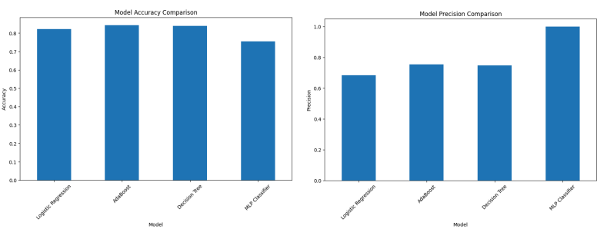
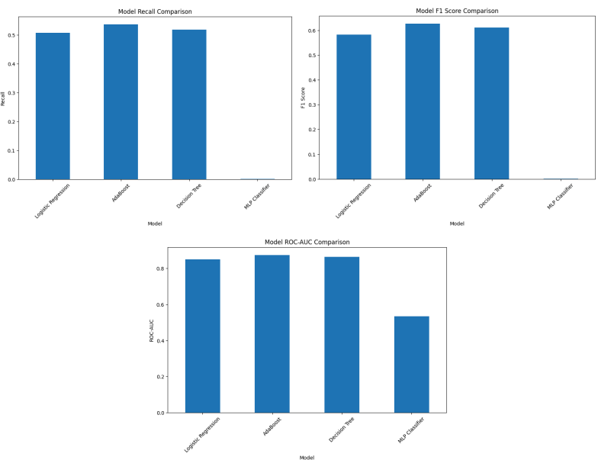
04 : Comparative Analysis of Machine Learning Algorithms
Comparison of Metrics
Bar graphs compare Logistic Regression, AdaBoost, Decision Tree, and MLP Classifier across accuracy, precision, recall, F1 score, and ROC-AUC.
-Logistic Regression and AdaBoost exhibit similar accuracy levels, while Decision Tree follows closely, but MLP Classifier trails significantly, particularly in ROC-AUC.
MLP Classifier surprisingly leads in precision, indicating few false-positive errors, but suffers from extremely low recall, missing many true-positive cases.
F1 scores are relatively balanced among Logistic Regression, AdaBoost, and Decision Tree, but notably lower for MLP Classifier, reflecting its poor recall.

Slide 21
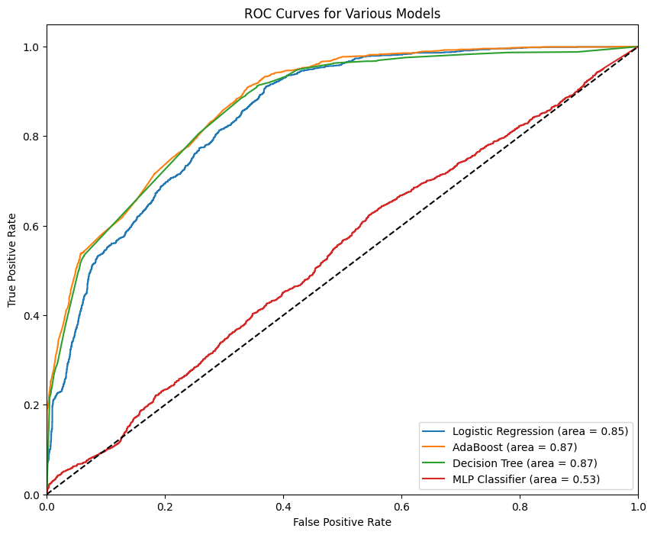
04 : Comparative Analysis of Machine Learning Algorithms
ROC Curve - ML Models
ROC curve compares Logistic Regression, AdaBoost, Decision Tree, and MLP Classifier models.
AdaBoost and Decision Tree exhibit strong performance with AUC of 0.87, indicating high discriminative ability.
Logistic Regression closely follows with an AUC of 0.85, demonstrating good performance.
- MLP Classifier underperforms with an AUC of 0.53, barely surpassing the no-skill line.

Slide 22
04 : Comparative Analysis of Machine Learning Algorithms
Comparing the performance, computational efficiency, and applicability
Logistic Regression:
Performance: Moderate accuracy (82.92%) and relatively lower precision, recall, and F1 score compared to other models. However, it achieves a good ROC-AUC score (86.18%), indicating decent predictive power.
Computational Efficiency: Very low training time (0.1397 seconds), making it highly efficient.
Applicability: Logistic regression is suitable for binary classification tasks and performs well when the relationship between features and target variable is linear or can be approximated linearly.
AdaBoost:
Performance: Good accuracy (85.05%) and better precision, recall, and F1 score compared to logistic regression. It also achieves a high ROC-AUC score (89.02%).
Computational Efficiency: Higher training time (5.2621 seconds) compared to logistic regression but still reasonable.
Applicability: AdaBoost is suitable for classification tasks and is often used as an ensemble method to improve the performance of weak learners.

Slide 23
04 : Comparative Analysis of Machine Learning Algorithms
Comparing the performance, computational efficiency, and applicability
Decision Tree:
Performance: Similar accuracy to AdaBoost (85.59%) with comparable precision, recall, and F1 score. It achieves a high ROC-AUC score (89.39%).
Computational Efficiency: Very low training time (0.0799 seconds), making it highly efficient.
Applicability: Decision trees are versatile and can handle both classification and regression tasks. They are interpretable and can capture non-linear relationships in the data.
MLP Classifier:
Performance: Significantly lower accuracy (23.82%) compared to other models. It has low precision, high recall, and low F1 score, indicating imbalanced performance. The ROC-AUC score (50.18%) suggests poor predictive power.
Computational Efficiency: Relatively higher training time (3.8976 seconds) compared to other models.
Applicability: Multilayer Perceptron (MLP) classifiers are neural network models suitable for complex non-linear relationships in data. However, in this case, the model's performance is poor, indicating potential overfitting or other issues.

Slide 24
METHODOLOGY AND CHALLENGES FACED
Encountered several challenges throughout the project, including the struggle of the classifier to effectively classify instances, suggesting the need for further investigation or potentially different model architectures.
However, successfully navigated these challenges through meticulous data preprocessing, exploratory analysis, and the application of various machine learning techniques.

Slide 25
KEY FINDINGS
1. Exploratory Data Analysis (EDA) revealed valuable insights into the structure and relationships within the dataset, including income disparities and the distribution of working hours per week.
2. Model implementation and baseline evaluation using four supervised learning algorithms (Logistic Regression, AdaBoost, Decision Trees, and MLP Classifier) provided a comprehensive understanding of their strengths and weaknesses.
3. Comparative analysis of the algorithms highlighted the computational efficiency and performance metrics, ultimately leading to the selection of the most suitable algorithm(s) for achieving the project's classification objectives effectively.

Slide 26
KEY TAKEAWAYS
The project's findings underscore the potential of machine learning in enhancing non-profit fundraising initiatives by tailoring donor engagement based on predicted income levels.
The challenges faced during the project have provided valuable insights into the complexities of leveraging demographic and financial data for predictive modeling in the non-profit sector.
The comparative analysis of supervised machine learning algorithms has yielded actionable recommendations for optimizing fundraising strategies and donor outreach efforts.

Slide 27
CONCLUSION
Based on the comparative analysis, AdaBoost emerges as the top-performing model, demonstrating the highest accuracy of 85.05% and achieving superior precision, recall, and F1 score compared to logistic regression.
AdaBoost also excels in terms of ROC-AUC score, reaching an impressive 89.02%, indicating strong predictive power and discriminative ability.
While logistic regression and decision tree models exhibit computational efficiency and reasonable performance, AdaBoost outperforms them significantly, making it the preferred choice for this task.
On the other hand, the MLP Classifier lags far behind with a significantly lower accuracy of 23.82%, poor precision, high recall, and a low F1 score, indicating imbalanced performance and limited predictive power.
Therefore, AdaBoost is selected as the final model due to its superior performance metrics, making it the most suitable choice for predicting high-income individuals in this context.

Slide 28
Thank You!
karthikeyan.j@northeastern.edu
002830003

