Slide 1
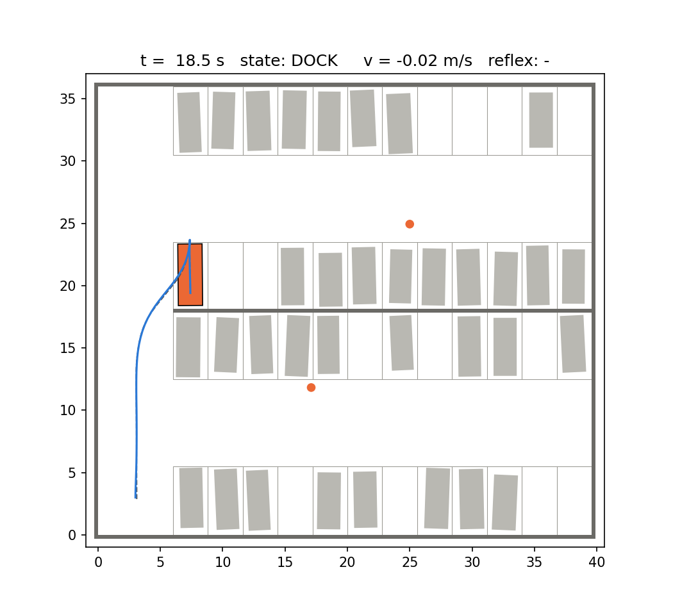
Saurabh Kumar
CSAI4014 Algorithms for Intelligent Systems and Robotics | B.Tech CSE (AI & ML), Sem VII
Autonomous Valet Parking Agent
Hybrid A* planning · Pure Pursuit + PID · reflexive safety layer · Webots
Project P13 | Group G14 | Batch B2
Faculty: Course Faculty, CSAI4014, School of Computer Science, UPES
Saurabh Kumar | 500124288
Naman Chanana | 500119485
Anirvan Ranjan | 500119330
Aditya Pratap Singh Sisodia | 500121985
Priyal Sharma | 500122041
Notes:
SAURABH (about 1 min). Good morning. We are group G14 and our project is P13, the Autonomous Valet Parking Agent. Each member now says name and SAP ID on camera. Then: our car finds a free slot in a crowded parking lot, plans a drivable route, reverses into the slot and stays safe around pedestrians. Everything runs in Webots with Python.

Slide 2
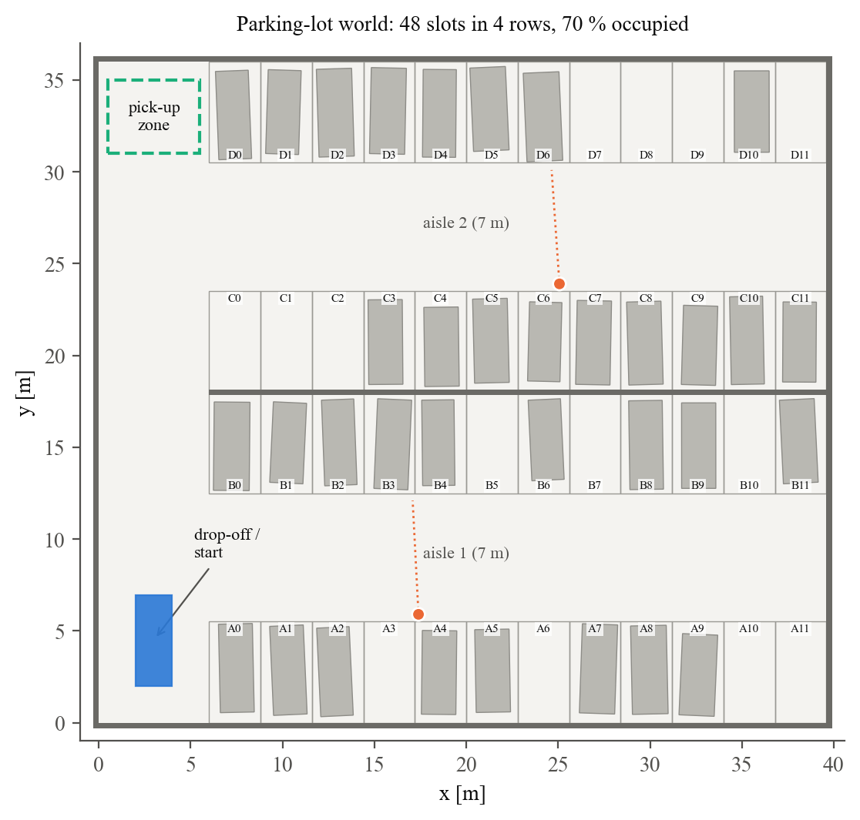
Problem and motivation
Saurabh Kumar
Parking: slow, stressful, and where most low-speed scrapes happen
Automated valet parking (AVP): leave the car at drop-off, it parks itself and comes back to pick-up
Industry: Bosch + Mercedes Level-4 AVP, Stuttgart airport (2022); ISO 23374 standard
Hard because: a car can't turn on the spot (R_min = 4.87 m), must reverse, and must react to people
Our lot: 48 slots, 2 aisles, 50-92 % full, crossing pedestrians
Notes:
SAURABH (1 min). Explain the real problem and the industry context. Point at the lot: start bottom-left, pick-up top-left, grey boxes are parked cars, orange dots are pedestrians.

Slide 3
Objectives: target vs achieved
Saurabh Kumar
# | Measurable objective | Target | Achieved
O1 | Success rate, 70 % full lot, zero collisions | ≥ 95 % | 100 % (30/30)
O2 | Final parking accuracy | < 10 cm, < 2° | 4.2 cm, 1.2°
O3 | Planning time in Python | < 5 s | 1.65 s mean
O4 | Pedestrian contacts (4 crossing people) | 0 % | 0 %
O5 | Methods compared per layer | ≥ 2 | 2 planners, 2 steering laws, 3 reflexes, 2 slot policies
Notes:
SAURABH (1 min). Read each objective and show that every target was met. Numbers come from 525 simulated missions.

Slide 4
Existing solutions and the gap
Naman Chanana
Approach | Strength | Gap
Grid A* (Hart et al. 1968) | Fast, optimal on grid | Ignores heading: path not drivable
Hybrid A* (Dolgov et al. 2010) | Drivable, obstacle-aware | Slow to hit a narrow slot pose
Pure Pursuit / Stanley | Simple, proven | Stanley weak in reverse
Park-assist rules | Cheap ultrasonic stop | Fixed distance misses side-swipes
Industry AVP (Bosch, ISO 23374) | Certified, Level 4 | Closed source, costly infrastructure
Gap we target: fast slot planning + turning-aware safety + choosing the slot for the whole valet cycle
Notes:
NAMAN (1.5 min). Walk through the table quickly; stress the three gaps in the yellow box, which our novelty fills.

Slide 5
Novelty: what is new, with evidence
Naman Chanana
5.5× fewer
0 % contacts
node expansions with our slot "goal funnel" in Hybrid A* (success 80 % → 100 %)
with the swept-footprint TTC reflex (17 % fixed-distance, 20 % none)
−7.6 %
100 % vs 20 %
valet cycle length (drive in + out) with the utility-based slot choice
success at 0.3 m GPS noise: Kalman filter vs raw GPS
Notes:
NAMAN (1.5 min). Four novelty points, each backed by a number from our experiments. Also mention: one agent code base runs both Webots and the headless twin.

Slide 6
AISR syllabus mapping
Anirvan Ranjan
Syllabus topic | Where we use it
Declarative–procedural–reflexive hierarchy | The three layers of the agent
Intelligent agents | Utility-based slot choice, mission state machine
Path planning, planning to move | Grid A*, Hybrid A* + goal funnel
Moving (ground robots) | Ackermann bicycle model, reversing
Closed-loop control, time/frequency domain | PID speed loop, step response, Bode, phase margin
Perception, uncertain movement | 26 range sensors, Kalman filter, Monte Carlo tests
Notes:
ANIRVAN (1 min). Map each syllabus topic to the module that uses it.

Slide 7
System architecture: three-layer agent
Anirvan Ranjan
Facility: free slots,
parked cars
DECLARATIVE
slot utility J(s) → Hybrid A* + goal funnel
once per mission and on events
GPS + IMU + wheels
→ Kalman filter
PROCEDURAL
Pure Pursuit steering → speed profile → PID
every 48 ms
REFLEXIVE
e-stop · swept TTC · docking · re-plan
every 48 ms, overrides
Webots Driver
steer + speed
26 range sensors
Mission FSM: SELECT → PLAN → DRIVE → DOCK → PARKED (re-select if slot taken, re-plan if blocked)
Notes:
ANIRVAN (1.5 min). Slow layers plan, fast layers react; lower layers can override. Explain the state machine and the two events: slot taken by another car, and blocked by a pedestrian.

Slide 8
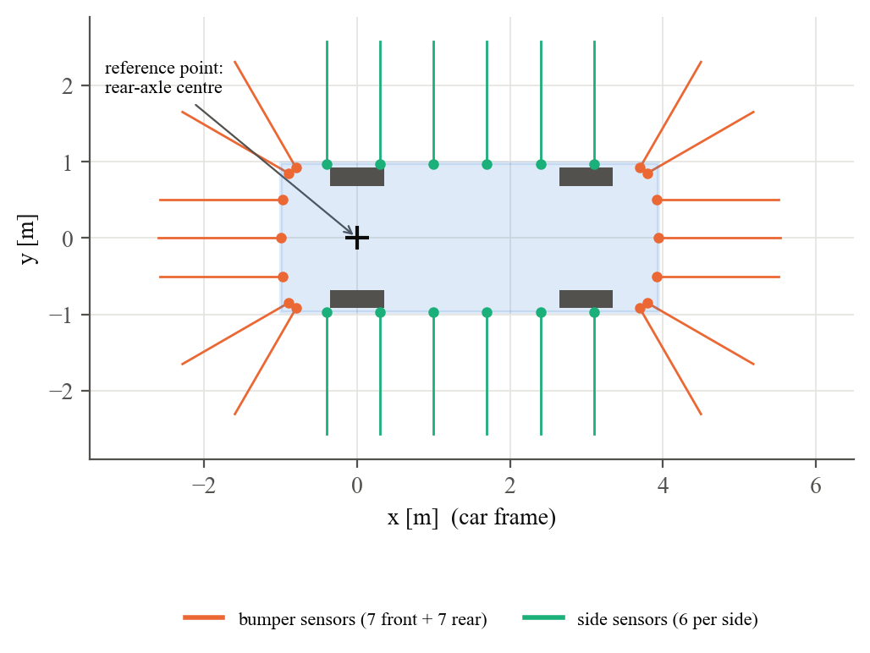
Robot and environment model
Saurabh Kumar
Car: Webots BMW X5, Ackermann
Bicycle model: θ̇ = v·tan δ / L, L = 2.995 m
R_min = L / tan δ_max = 4.87 m
26 range sensors, GPS, IMU, wheel speed
World generated from the same Python lot model (no drift between Webots and twin)
Notes:
SAURABH (1 min). Explain the reference point at the rear axle, the turning radius and why we needed side sensors. Mention make_world.py generates the Webots world.

Slide 9
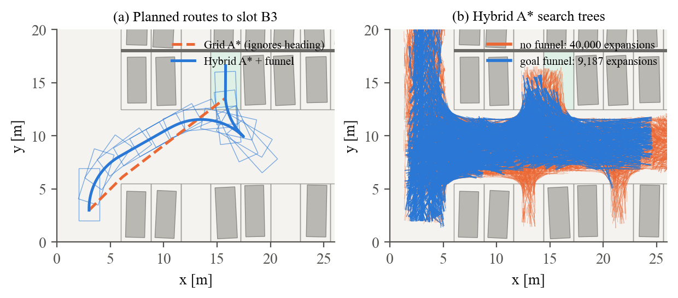
Algorithm 1: Hybrid A* with goal funnel
Naman Chanana
1
Expand Ackermann primitives (5 steers × fwd/rev, 1 m)
2
Cost: length, reverse ×1.6, steering, gear changes
3
Funnel: stop on the slot axis (±0.2 m, ±6°), finish with a straight reverse
Notes:
NAMAN (1.5 min). Left: the grid path cuts a corner the car cannot drive; Hybrid A* drives past and reverses in. Right: search tree without funnel (orange) vs with funnel (blue): 5.5 times fewer nodes.

Slide 10
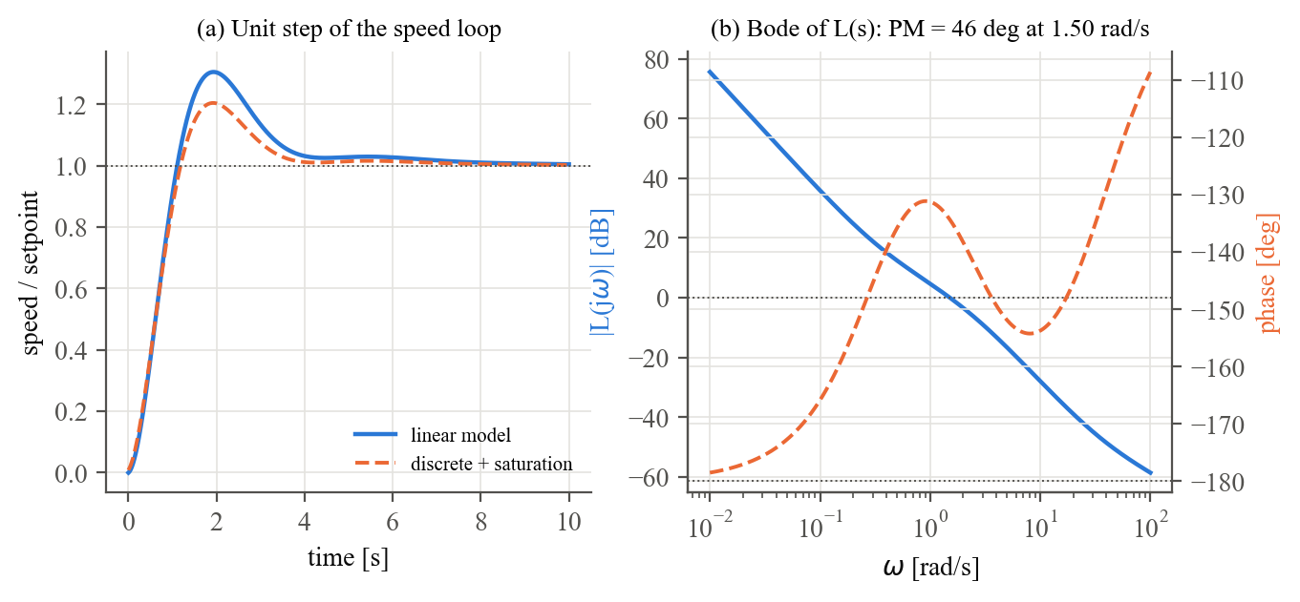
Algorithm 2: path tracking and speed control
Aditya P. S. Sisodia
Pure Pursuit: κ = 2 sin α / L_d, δ = ±atan(L κ) (sign flips in reverse)
Look-ahead tuned: L_d = max(1.6, 0.8|v|)
PID speed: Kp 1.8, Ki 0.6, Kd 0.05, anti-windup
Lag-aware braking removed a 0.35 m stop overshoot
Plan with 88 % steering → reserve for feedback
Phase margin 46° · rise 0.85 s · overshoot 20 % (with saturation)
Stanley compared: tracks forward well, but only 57 % of missions park within tolerance (Pure Pursuit 100 %)
Notes:
ADITYA (1.5 min). Explain the pure pursuit geometry and reversing, the PID, the Bode plot and the two bugs we fixed (overshoot at stop, full-lock planning).

Slide 11
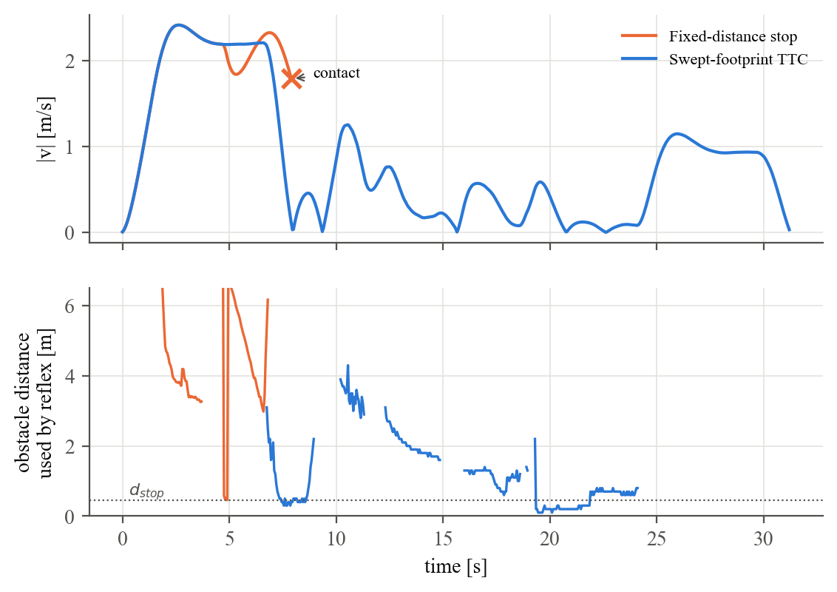
Algorithm 3: reflexive layer (swept TTC)
Priyal Sharma
R1 e-stop if contact distance < 0.45 m
R2 v ≤ (s_c − 0.45) / 2.5 s − v_obstacle
R3 docking: centre in slot, rear gap stop
R4 blocked 4 s → re-plan around it
s_c: move the car outline along the current steering arc; first sensed point it touches
Fixed-distance rule hits the pedestrian (×); swept TTC slows smoothly and parks
Notes:
PRIYAL (1.5 min). Why a straight corridor is not enough: the side of a turning car sweeps through people. Show the timeline: same lot, same pedestrians.

Slide 12
Simulation setup and live demo
Saurabh + Aditya
python tools/make_world.py
# Webots: open valet_parking.wbt, Run
python sim/run_demo.py
python experiments/run_experiments.py
Webots R2025a, BmwX5 PROTO, Python 3.11 controller
Headless twin: same agent code, 525 Monte Carlo missions
Control period 48 ms; 30 random lots per setting
▶ Switch to Webots now (≈ 6 min live demo)
Notes:
SAURABH + ADITYA (6 min LIVE). Share the Webots window: car starts, console prints SELECT/PLAN/DRIVE/DOCK/PARKED, pedestrian crosses and the car slows. Then show run_demo.py in the twin and, if time, the 'slot taken' run: python sim/run_demo.py --seed 3 --steal.

Slide 13
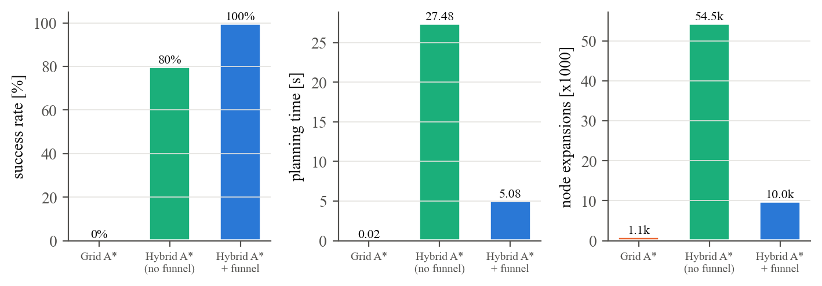
Results 1: planning and tracking
Aditya P. S. Sisodia
0 %
100 %
4.2 cm · 1.2°
grid A* success (cannot be driven)
Hybrid A* + funnel success
final lateral / heading error
Notes:
ADITYA (1.5 min). E1: grid A* never parks; Hybrid A* without funnel 80 %, with funnel 100 % and 5.5x fewer nodes. Tracking error 3.3 cm mean.

Slide 14
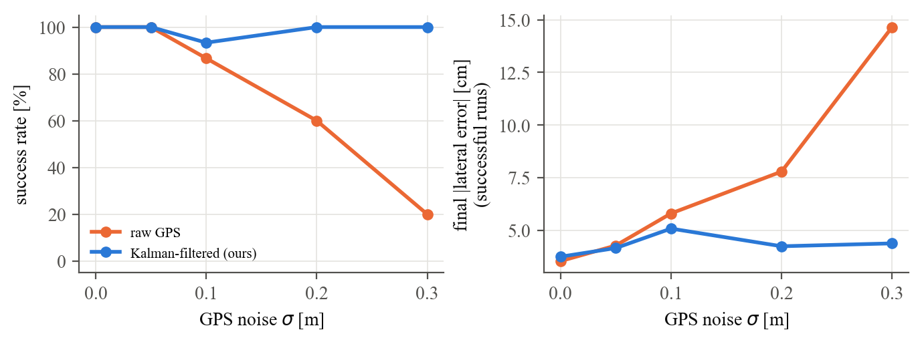
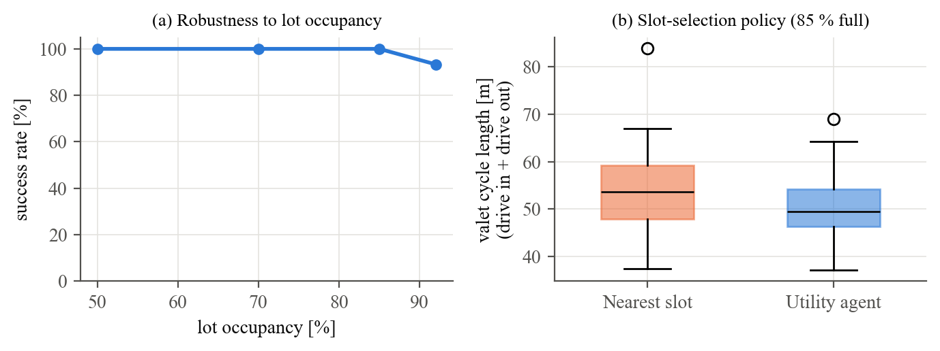
Results 2: safety, robustness, comparison
Anirvan Ranjan
Experiment | Baseline | Ours
E3 pedestrian contacts | 17 % fixed-distance / 20 % none | 0 % (swept TTC)
E4 valet cycle length | 54.9 m (nearest slot) | 50.7 m (utility agent)
E5 success at 0.3 m GPS noise | 20 % (raw GPS) | 100 % (Kalman filter)
E6 / E7 92 % full / slot taken | – | 93 % / 100 %
Notes:
ANIRVAN (1.5 min). Pedestrian safety, slot choice, noise robustness, full lots and the dynamic event. Be honest about limits: kinematic twin for statistics, Python planning 1-3 s.

Slide 15
Team contribution (traceable to GitHub)
Priyal Sharma
Member | Module and files
Saurabh Kumar (lead) | Lot model, costmap, Webots world generator and controller
Naman Chanana | Grid A*, Hybrid A* + goal funnel, path, unit tests
Anirvan Ranjan | Agent + state machine, utility slot selection, Kalman filter
Aditya P. S. Sisodia | PID, Pure Pursuit, Stanley, path tracker, tuning
Priyal Sharma | Reflex layer (swept TTC), simulator twin, experiments
Report written equally: about 5 pages each, plus own contribution row and reflection
Notes:
PRIYAL (1 min). Each member owns a module and committed it from their own GitHub account.

Slide 16
Conclusion and industry use
All members
Findings
Industry use
Future scope
Kinematic planning is essential
Funnel: 5.5× faster search
Swept TTC: 0 % contacts
Utility + KF: robust agent
Infrastructure-supported AVP (ISO 23374)
Factory yards and ports
Robotaxi parking and charging
Real car: lidar or ultrasonic sensors, C++
Parallel and angled slots
Pedestrian prediction
Many valet cars sharing a lot
Notes:
ALL (1.5 min). Each member says one thing they learned as a team. Then summarise the findings and industrial use.

Slide 17
All members
Thank you
Questions?
GitHub: github.com/<team-lead>/g14-valet-parking
Video: youtu.be/<video-id> (unlisted)
Contact: team e-mails in the repository README
Saurabh Kumar · Naman Chanana · Anirvan Ranjan · Aditya Pratap Singh Sisodia · Priyal Sharma
Notes:
ALL. Thank the faculty; take questions.

