Slide 1

AMD DEVELOPER HACKATHON ACT II · TRACK 3
Anirvium AI
The control plane
for AI agents
Sarvagun governed execution ×
SuperTuriya trajectory intelligence
POWERED BY AMD ROCm + vLLM
github.com/Anirvium/AMD_Anirvium

Slide 2
THE PROBLEM
02
A final answer cannot prove an agent acted safely
Enterprise agents now touch payments, identity, refunds, security, and SLA commitments.
Most teams still review only a transcript.
01
Which evidence drove the decision?
02
Which tool acted and what changed?
03
Where did policy or approval intervene?
04
Why did the same failure return?
Anirvium turns the hidden path into operational evidence.
ANIRVIUM AI · AMD DEVELOPER HACKATHON ACT II · TRACK 3

Slide 3
THE PRODUCT INSIGHT
03
Execution and intelligence must be designed as one loop
SARVAGUN
SUPERTURIYA
Governed execution
Trajectory intelligence
Routes to the least-complex correct path
Observes agents, tools, evidence, and risk
Reads exact operational truth
Scores and diagnoses every run
Retrieves governed evidence
Compares execution paths
Audits tools and holds sensitive actions
Stores evaluated advisory intelligence
CURRENT POLICY ALWAYS WINS
No automatic prompt, policy, or code deployment
ANIRVIUM AI · AMD DEVELOPER HACKATHON ACT II · TRACK 3

Slide 4

SARVAGUN WORKSPACE
04
The operator sees the case, safe draft, and full execution state
PRESENTATION RENDER · STATIC SYNTHETIC DEMO · LIVE AMD EVIDENCE IS SEPARATE

Slide 5
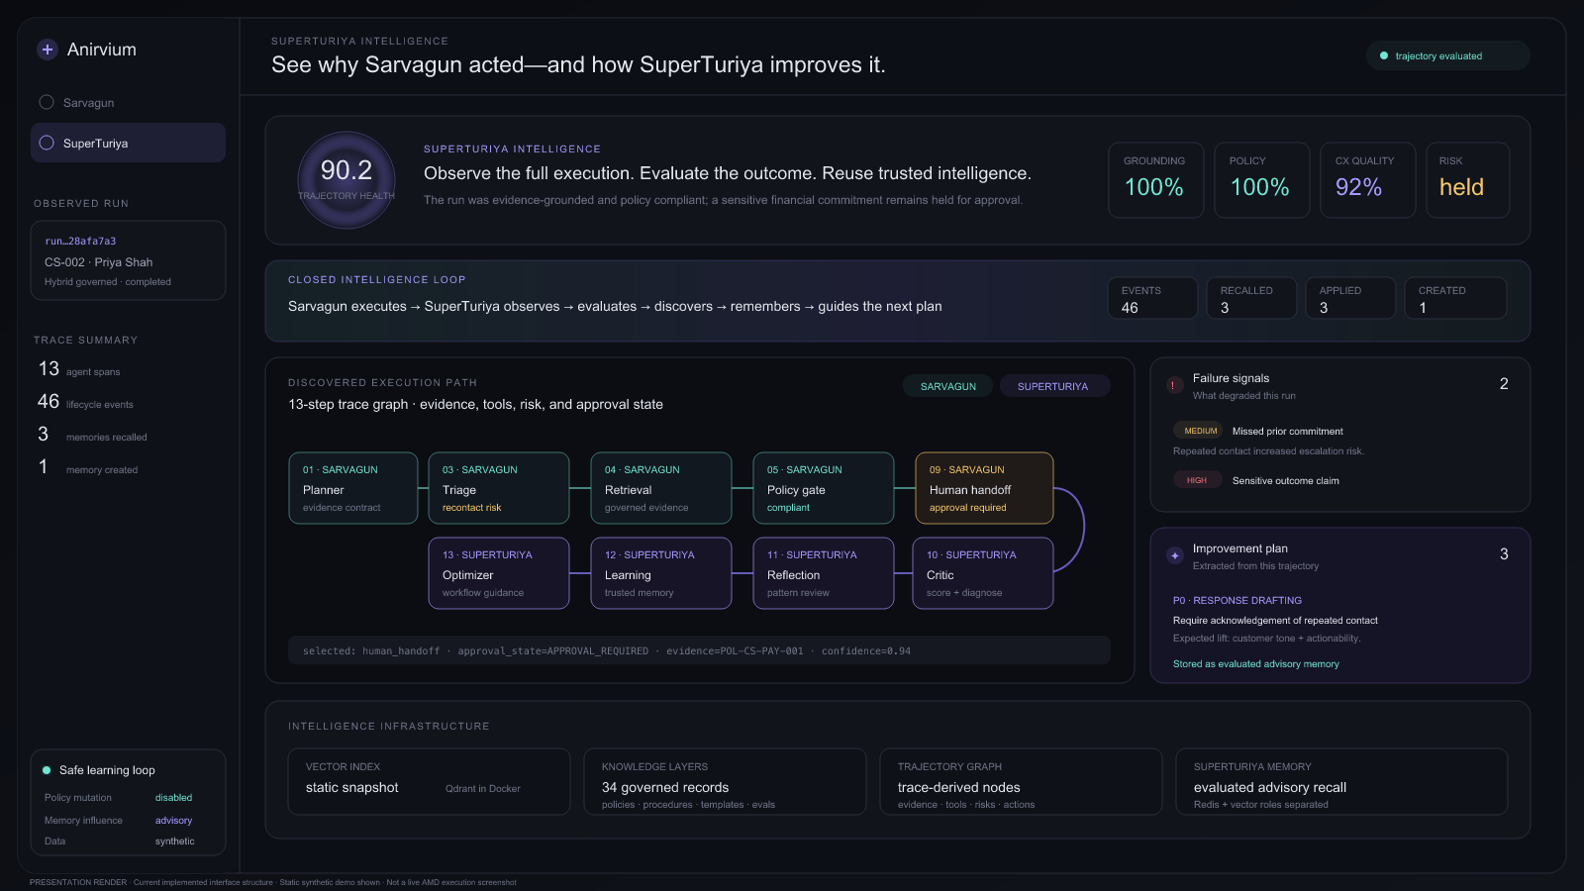
SUPERTURIYA WORKSPACE
05
Traces become evaluated intelligence, not another log archive
PRESENTATION RENDER · STATIC SYNTHETIC DEMO · AUTOMATIC POLICY MUTATION DISABLED

Slide 6
CANONICAL DEMO
06
A third unresolved withdrawal contact exposes the entire control loop
1
Preserve identity and linked case
CS-002
Priya Shah
2
Detect recontact, frustration, and missed commitment
“My withdrawal says processed, but the bank has not received it. Nobody replied to the promised update.”
3
Retrieve governed policy and procedure evidence
4
Execute audited case and payment tools
THIRD CONTACT
APPROVAL REQUIRED
5
Hold the sensitive commitment for approval
Synthetic data · simulated enterprise tools
6
Evaluate, diagnose, recommend, and remember
ANIRVIUM AI · AMD DEVELOPER HACKATHON ACT II · TRACK 3

Slide 7
ARCHITECTURE
07
Every request follows a typed path and every governed run becomes intelligence
USER + UI
TYPED ROUTER
SARVAGUN
Qwen drafts responses →
AMD QWEN
→
→
exact reads
observes ↓
↑ guides future plans
SUPERTURIYA · TRAJECTORY INTELLIGENCE
SQLITE
exact operational truth
REDIS + QDRANT
operational + semantic memory
DOCKER COMPOSE · FASTAPI · REACT · 95 BACKEND TESTS
ANIRVIUM AI · AMD DEVELOPER HACKATHON ACT II · TRACK 3

Slide 8
MEANINGFUL AMD USE
08
Open AMD infrastructure powers the model where generation adds value
47.98
Qwen3
13
72.53
GiB visible VRAM
8B served by vLLM
trajectory spans
average tokens/s
Verified path
AMD Developer Cloud → ROCm → vLLM OpenAI-compatible endpoint
Claim boundary
Qwen drafts customer responses and routed public-knowledge answers
Observed runtime: 47.98 GiB, gfx1100.
The 192GB MI300X profile is a target, not a measured result.
Internal metrics are product diagnostics, not a Track 3 score.
Deterministic policy, compliance, approvals, and safe fallback surround the model
Evidence: amd/benchmark_results_real.md
ANIRVIUM AI · AMD DEVELOPER HACKATHON ACT II · TRACK 3

Slide 9
PRODUCT AND MARKET
09
Start where opaque agent decisions create real operating risk
BEACHHEAD BUYER
INITIAL VALUE
Support & AI-operations leaders
Catch unsafe commitments before delivery
Deploying agents in payment, identity, security, refund, or SLA-sensitive workflows.
Reduce manual trajectory review
Shorten root-cause diagnosis
Turn failures into reusable regression evidence
Business model hypothesis
EXPANSION
Platform fee + evaluated-trajectory usage, with private-cloud and compliance tiers.
Support → claims → lending ops → ITSM → procurement
ANIRVIUM AI · AMD DEVELOPER HACKATHON ACT II · TRACK 3

Slide 10
ANIRVIUM AI
Sarvagun executes.
SuperTuriya understands the execution.
That understanding becomes safer future work—without allowing memory to bypass policy.
What exists now
The ask
A complete synthetic-data prototype, a reproducible container path, and a verified AMD/Qwen text-generation path.
Design partners operating high-volume, high-risk enterprise agents.
PUBLIC REPOSITORY
github.com/Anirvium/AMD_Anirvium
MIT · SYNTHETIC DATA · SIMULATED CONNECTORS · HONEST PROTOTYPE BOUNDARY

