Slide 1


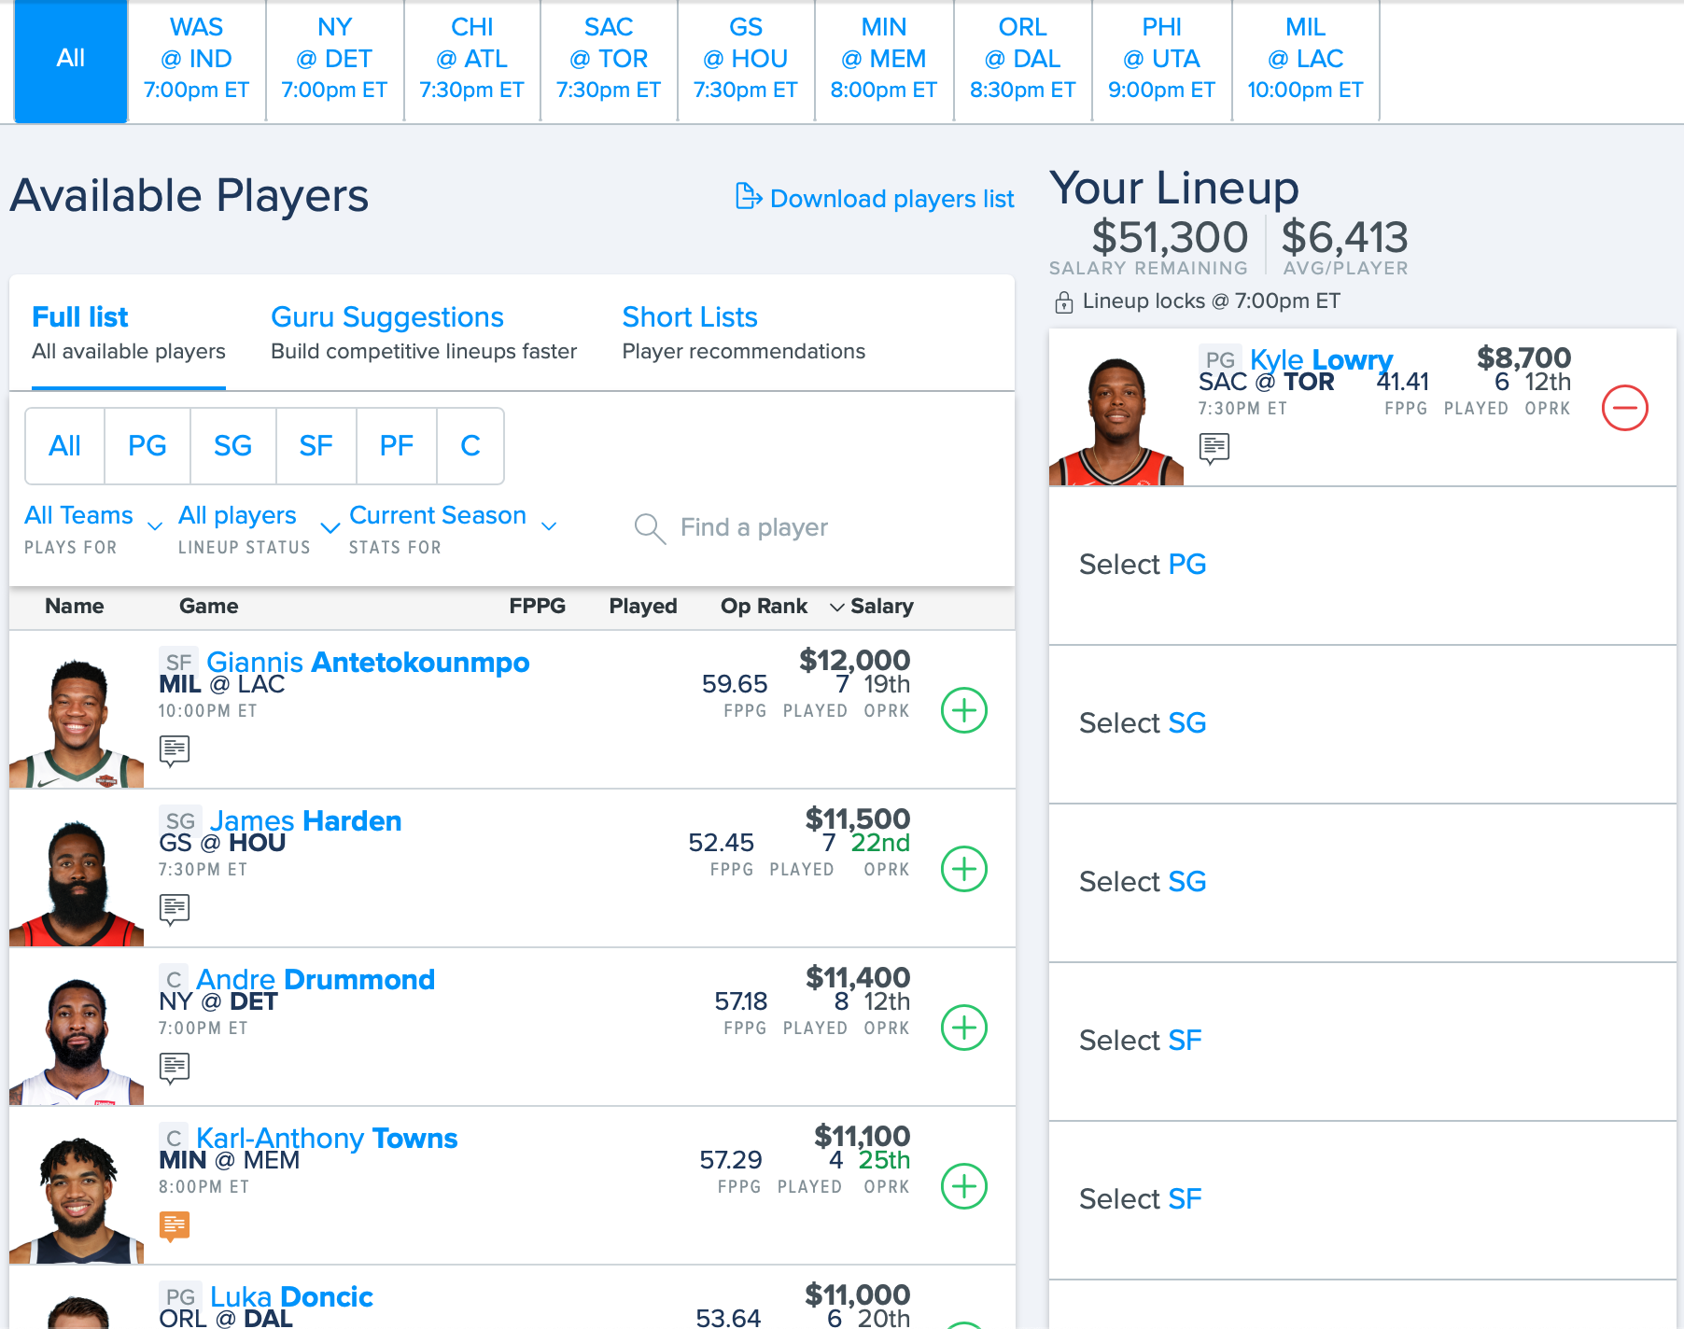
Optimizing Fantasy Basketball Lineups
Asher Wright – 913725516
Anis Ben Said – 9XXX
Introduction & Problem Description
We will start with the first step of the process, in which we tried many different models. This model takes as input all of the information for a given NBA game. It has a list of players for both teams. For each of these players, it takes as input the player’s recent stats (average of last 5 games), and their last season’s stats. These stats include blocks, rebounds, steals, field goals made, etc., as all of these are important in fantasy points.
Online fantasy sports are played by around 60 million North Americans each year and make up a field that is ripe with opportunity for analytics. There is an abundance of clean data, and more data is created every day as real athletes compete. This project targeted one subset of the fantasy competitions, namely, daily fantasy NBA (basketball) competitions. An example competition can be seen in Figure 1. The top row shows the NBA games that are
Conclusion
Figure 1: Sample fantasy basketball competition
Happening on that night. The left column shows the players in the game, along with a fictitious salary based on how many fantasy points they have scored in the past. Then, it is up to each competitor to select 8 of these players (adhering to positional constraints) such that the total summed salary is less than the total budget. The competitors with the highest scoring lineups win.
System Overview
Results
This project was approached as a prediction and optimization problem. However, we aimed to use the prediction model while performing the optimization, such that it is not a “predict-then-optimize” system.
Acknowledgements
Optimization
10 lineups
Historical player data
Model (OCT)
Daily player prediction

