Slide 1


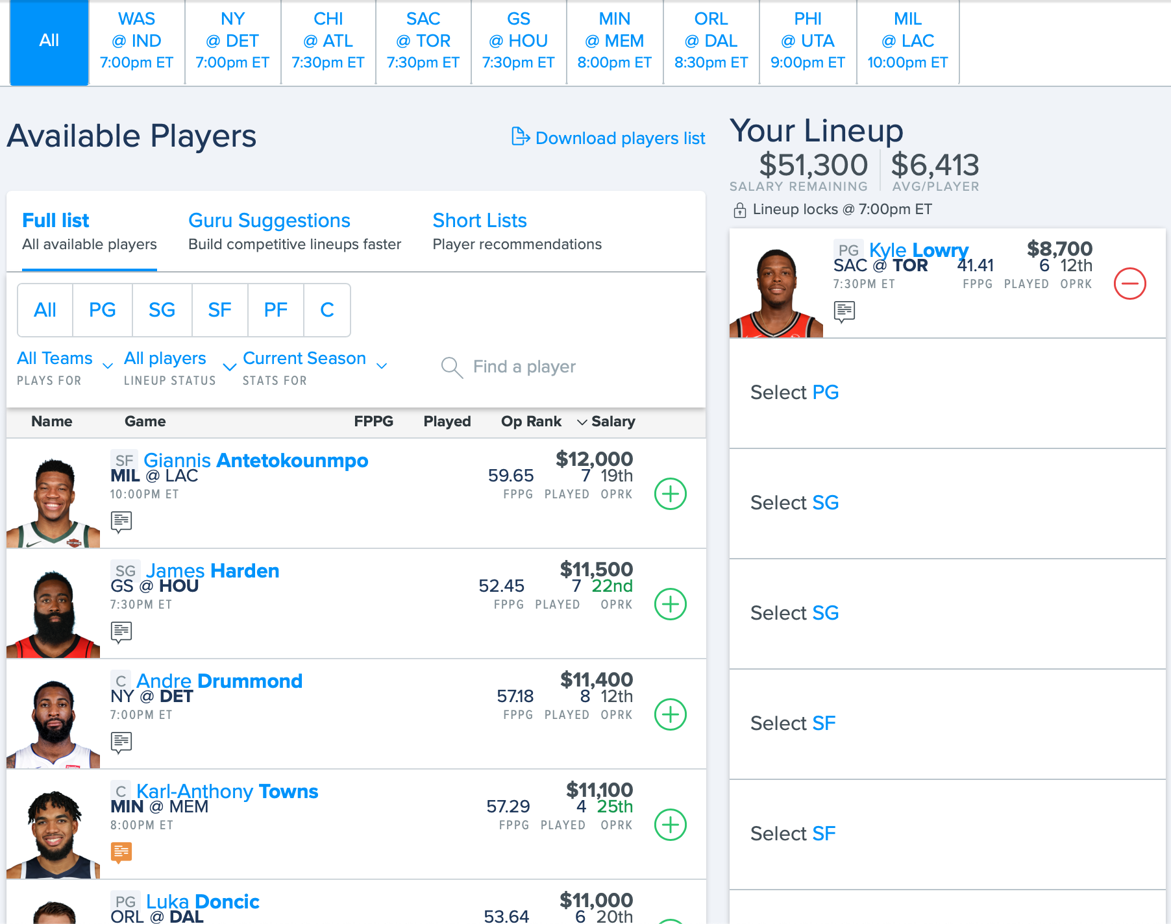
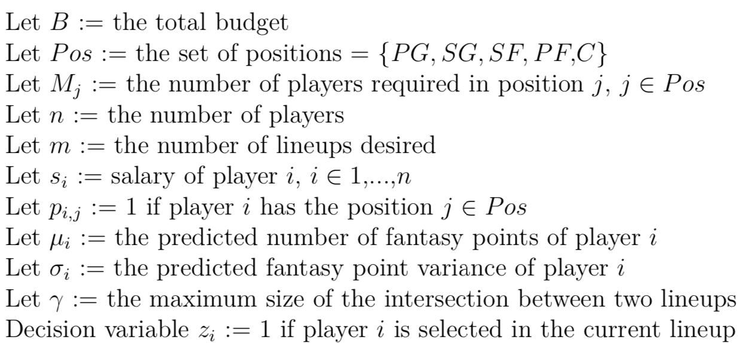
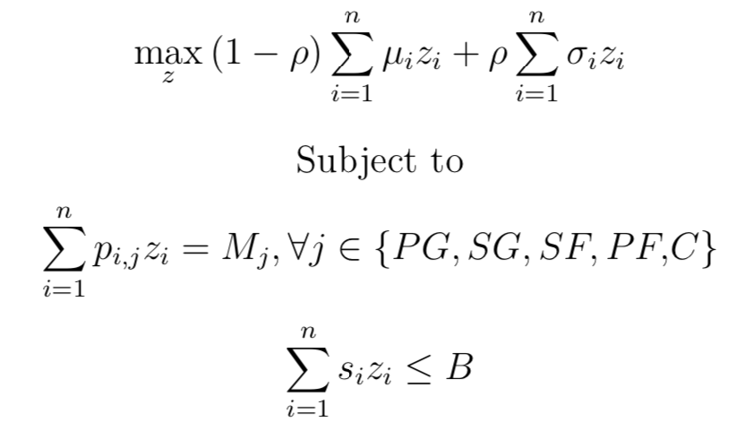
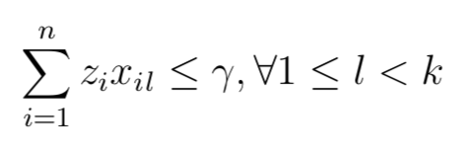
Optimizing Fantasy Basketball Lineups
Anis Ben Said – 911617154
Asher Wright – 913725516
Introduction & Problem Description
Thus, we will explain both parts of the system: prediction, and optimization.
In addition to the system defined above (maximize score and variance), we tested a baseline version using point-predictions only, as well as one that used the variances to adjust the point-predictions, without using it directly in the optimization model.
Online fantasy sports are played by around 60 million North Americans each year. It is a field ripe with opportunity for analytics, as there is an abundance of clean data, and more data is created every day as real athletes compete. This project targeted a subset of fantasy competitions: top-heavy daily fantasy NBA (basketball) competitions. An example competition can be seen in Figure 1.
1. Prediction
The prediction model takes as input all of the information for a given NBA game. It has a list of players for both teams. For each of these players, it takes as input the player’s recent stats (average of last 5 games), and their last season’s stats. These stats include blocks, rebounds, steals, field goals made, etc., as all of these are important in fantasy points. Figure 2 shows the inputs and outputs for the models.
Results
There are two parts of the system to test. First, the prediction model can be tested, and second, the overall lineups can be tested. Table 1 shows the mean absolute error (MAE) for each of the models used. With typical scores of 30, an MAE of 8 corresponds to being off by 25%, which is significant, and higher than predictions given by professional services. However, we believed that this tradeoff was worth it in order to have more than just point predictions.
Team A Player 1 stats
Game Model(s)
(ORT, XGBoost, NN)
Team A Player 1 predicted points
…
…
Team A Player 7 stats
Team A Player 7 predicted points
Team B Player 1 stats
Team B Player 1 predicted points
…
…
Table 1: Performances of different models (predictions)
Team B Player 7 stats
Team B Player 7 predicted points
Model | MAE
XGBoost | 8.00
Neural Network | 8.35
Random Forest | 8.18
ORT* | 7.66
Figure 3: Player fantasy points prediction model
An optimal regression tree (ORT) was chosen as it is a model that allows us to “decompose” predictions into which training data created the prediction (similarly to prescriptive trees)
2. Optimization
*The performance boost for ORTs is partially due to extra work on it vs. others
Figure 1: Sample fantasy basketball competition
Rather than only using the ORT’s point-predictions, we added pseudo “variance” to the predictions. To do this, for each new test sample, we examined the training data that was in the same leaf as the new sample. We then looked at the variance of the training data in that same leaf, and added this variance as an input to the optimization model.
Second, to score the lineups, we could not directly calculate the profitability, since we did not have historical FanDuel competition data. Instead, we defined a performance metric of how good our best lineup is relative to the best possible lineup. We empirically found that, when submitting 50 lineups, having at least one lineup’s score 90% of the maximum leads to profitability. Table 2 shows the different systems we used and their metric scores.
The top row shows the real NBA games happening on that night. The left column shows the real players in the games, along with a fictitious salary based on how many fantasy points they have scored in the past. Then, it is up to each competitor to select 8 of these players (adhering to positional constraints) such that the total summed salary is less than the total budget. Lineups are scored based on the players’ performances in real life, and the competitors with the highest scoring lineups win. With these “top-heavy” competitions, most of the prize money is awarded to the top 10 competitors. When submitting many lineups, this means that only one needs to perform well in order to earn a profit. Thus, we aimed to produce many lineups, of which at least one was high-performing.
…
Training set:
Player A (19.1), Player F (62.3), Player R (49.2), Player Z (71.4)
Table 2: Performances of different systems (lineups)
predict
50.5
Avg: 50.5
Stdev: 22.8
Optimization model
System | Avg performance | Prob of > 90% | Prob of > 95%
Point predictions (baseline) | 85 % | 25 % | 6 %
Maximize score and variance | 84 % | 14 % | 7 %
Maximize adjusted score | 85 % | 28 % | 7 %
1. New data ends up in leaf
2. Training samples for leaf are found, and used
3. Optimization uses mean and standard deviation
One can see that on average we are unable to reach the 90% profitability mark in any of our three designs. However, some of our lineups hit 95% with a non negligible probability.
Data
Figure 4: Using ORT model to compute pseudo “standard deviations”
Once the standard deviations and point predictions for each player are computed, the optimization model aims to choose lineups such that the best score across all of the lineups is the highest. To do this, we aim to choose high variance and high mean lineups. We also aim to reduce similarity across lineups. The idea is that having highly different high-variance lineups should maximize the chance that there is at least one exceptional lineup (which is all we need to be profitable). The base version of the optimization model is as follows:
Conclusion
We collected data from basketball-reference.com using the Python scraper basketball_reference_web_scraper^{[1]}. We collected data for every player for every match since 2010 (178000 rows), and for every season (5000 rows). These data were used to train a model to predict the players’ daily performances.
Using techniques similar to those in prescriptive analysis (using the underlying model when optimization) may be an effective way to gain an edge in fantasy sports, but the model and assumptions need to be accurate. Our prediction model wasn’t accurate enough to yield a profitable system, and the heuristic for variance was not as helpful as we hoped. However, many improvements can be made, such as adding professional predictions as input to the model, and redefining the optimization model to better use the prediction model. Some improvements will be tested before the completion of the project, and will be included in the report. Finally, there are other ways to approach these competitions that have been shown to work in certain sports^{[2]}, and these could be adapted for the NBA.
System Overview
We solve the following optimization problem m times
This project was approached as a prediction and optimization problem. However, we aimed to use the prediction model while performing the optimization, different from “predict-then-optimize”.
Optimization
n lineups
Each time we solve, we store the lineups in matrix x. Then we add constraints to ensure lineups are different (k = current lineup to find).
Historical player data
Model (ORT)
Daily player prediction
References
Figure 2: High level system overview
We then resolve the model to get the k^{th} lineup
[1] https://github.com/jaebradley/basketball_reference_web_scraper
[2] Hunter et. Al. Picking Winners in Daily Fantasy Sports Using Integer Programming, 2016.
[3] Bertsimas & Dunn. Machine Learning Under a Modern Optimization Lens, 2019. Dynamic Ideas LLC.

