Slide 1

"PointFusion: Deep Sensor Fusion for 3D Bounding Box Estimation"
Danfei Xu Dragomir Anguelov Ashesh Jain
Stanford University Zoox Inc. Zoox Inc.

Slide 2

Introduction
Research problem: Estimating 3D bounding boxes of objects using sensor fusion
Importance of accurate 3D object detection in applications like autonomous driving
A Resnet and Pointnet Architecture is combinely used by Fusion Network.

Slide 3
Some Key Terminology
Point Cloud Network
Fusion
Point Fusion
process of combining or integrating multiple sensor data sources to obtain more comprehensive and reliable information.
the specific method or algorithm proposed in the research paper for performing sensor fusion to estimate 3D bounding boxes.
Takes the raw point clouds as input and process it using Pointnet architecture variant to learn spatial encoding.

Slide 4
Methodology
Datasets
Algorithm
Point Fusion Network
KITTI dataset: Adatasets of Outdoor Scenes.
SUN-RGBD dataset: A dataset of images of indoor scenes.
A point cloud network that processes the raw point cloud data.
An image network that processes the input image.
A fusion network that combines the features from the point cloud network and the image network to predict the 3D bounding box.
Metrics
Evaluation
Average precision (AP): The average precision is a measure precision-recall curve.
Intersection over union (IoU): The IoU is a measure of the overlap between two bounding boxes.
PointFusion was evaluated on the KITTI and SUN-RGBD datasets with same hyperparameters

Slide 5
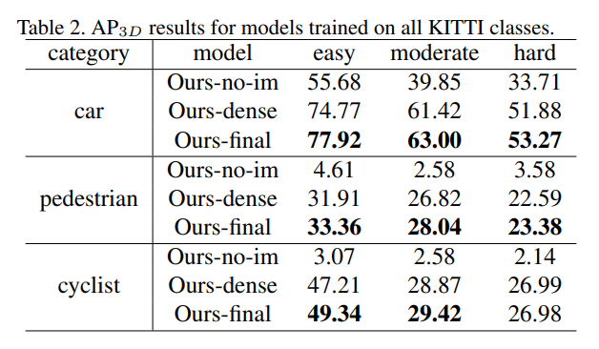
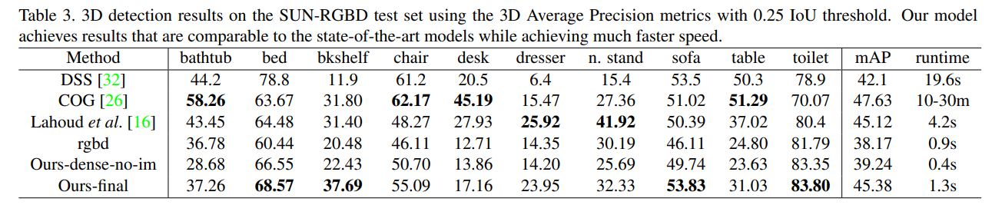
RESULTS ON KITTI DATASETS
Findings
RESULTS ON SUN-RGBD DATASETS

Slide 6

Thank You

