Slide 1
Identity Document Similarity Scoring System
Integrating Face Recognition & Vision-Language Models for Document Verification

Slide 2
Contents
Introduction & Motivation
Overview of the System
High Level Architecture
Workflow Diagram
Key Technologies and Process
Final Score Calculation
Conclusion & Future Work

Slide 3
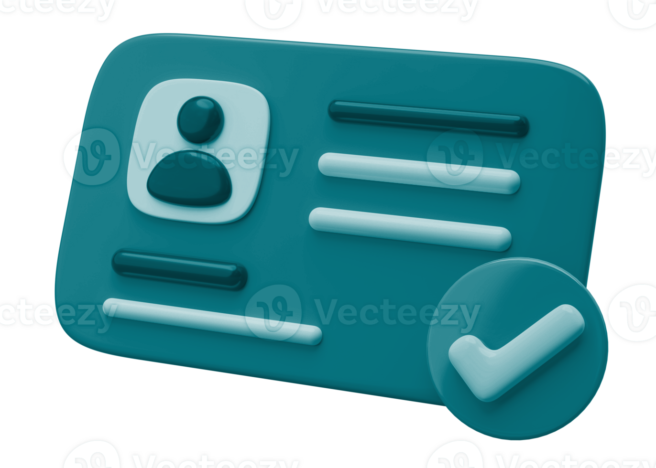
Introduction & Motivation
The Aadhaar card is a unique identification number assigned to each resident of India, serving as a centralized and standardized form of identity.
This project focuses specifically on the verification and extraction of key information from the front side of two Aadhaar cards, which is a critical step in authenticating the legitimacy of these identity documents.

Slide 4
Overview of the System
Objective:
Compare two Aadhaar card images by:
Extracting and comparing face features.
Extracting text (Name & DOB) using a vision-language model.
End Result:
A final similarity score (0.0 to 1.0) that aggregates both modalities.

Slide 5
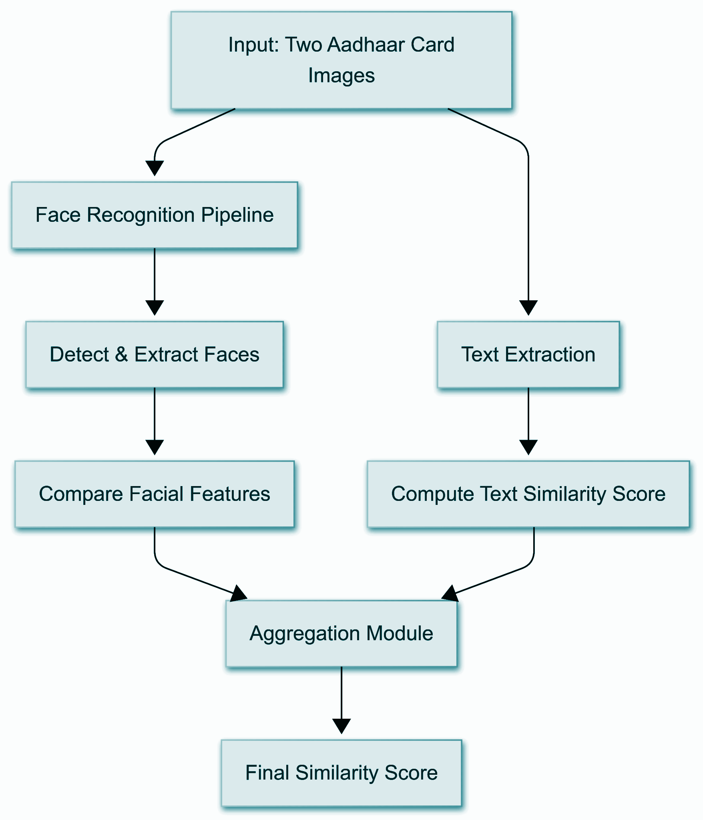
High Level Architecture

Slide 6
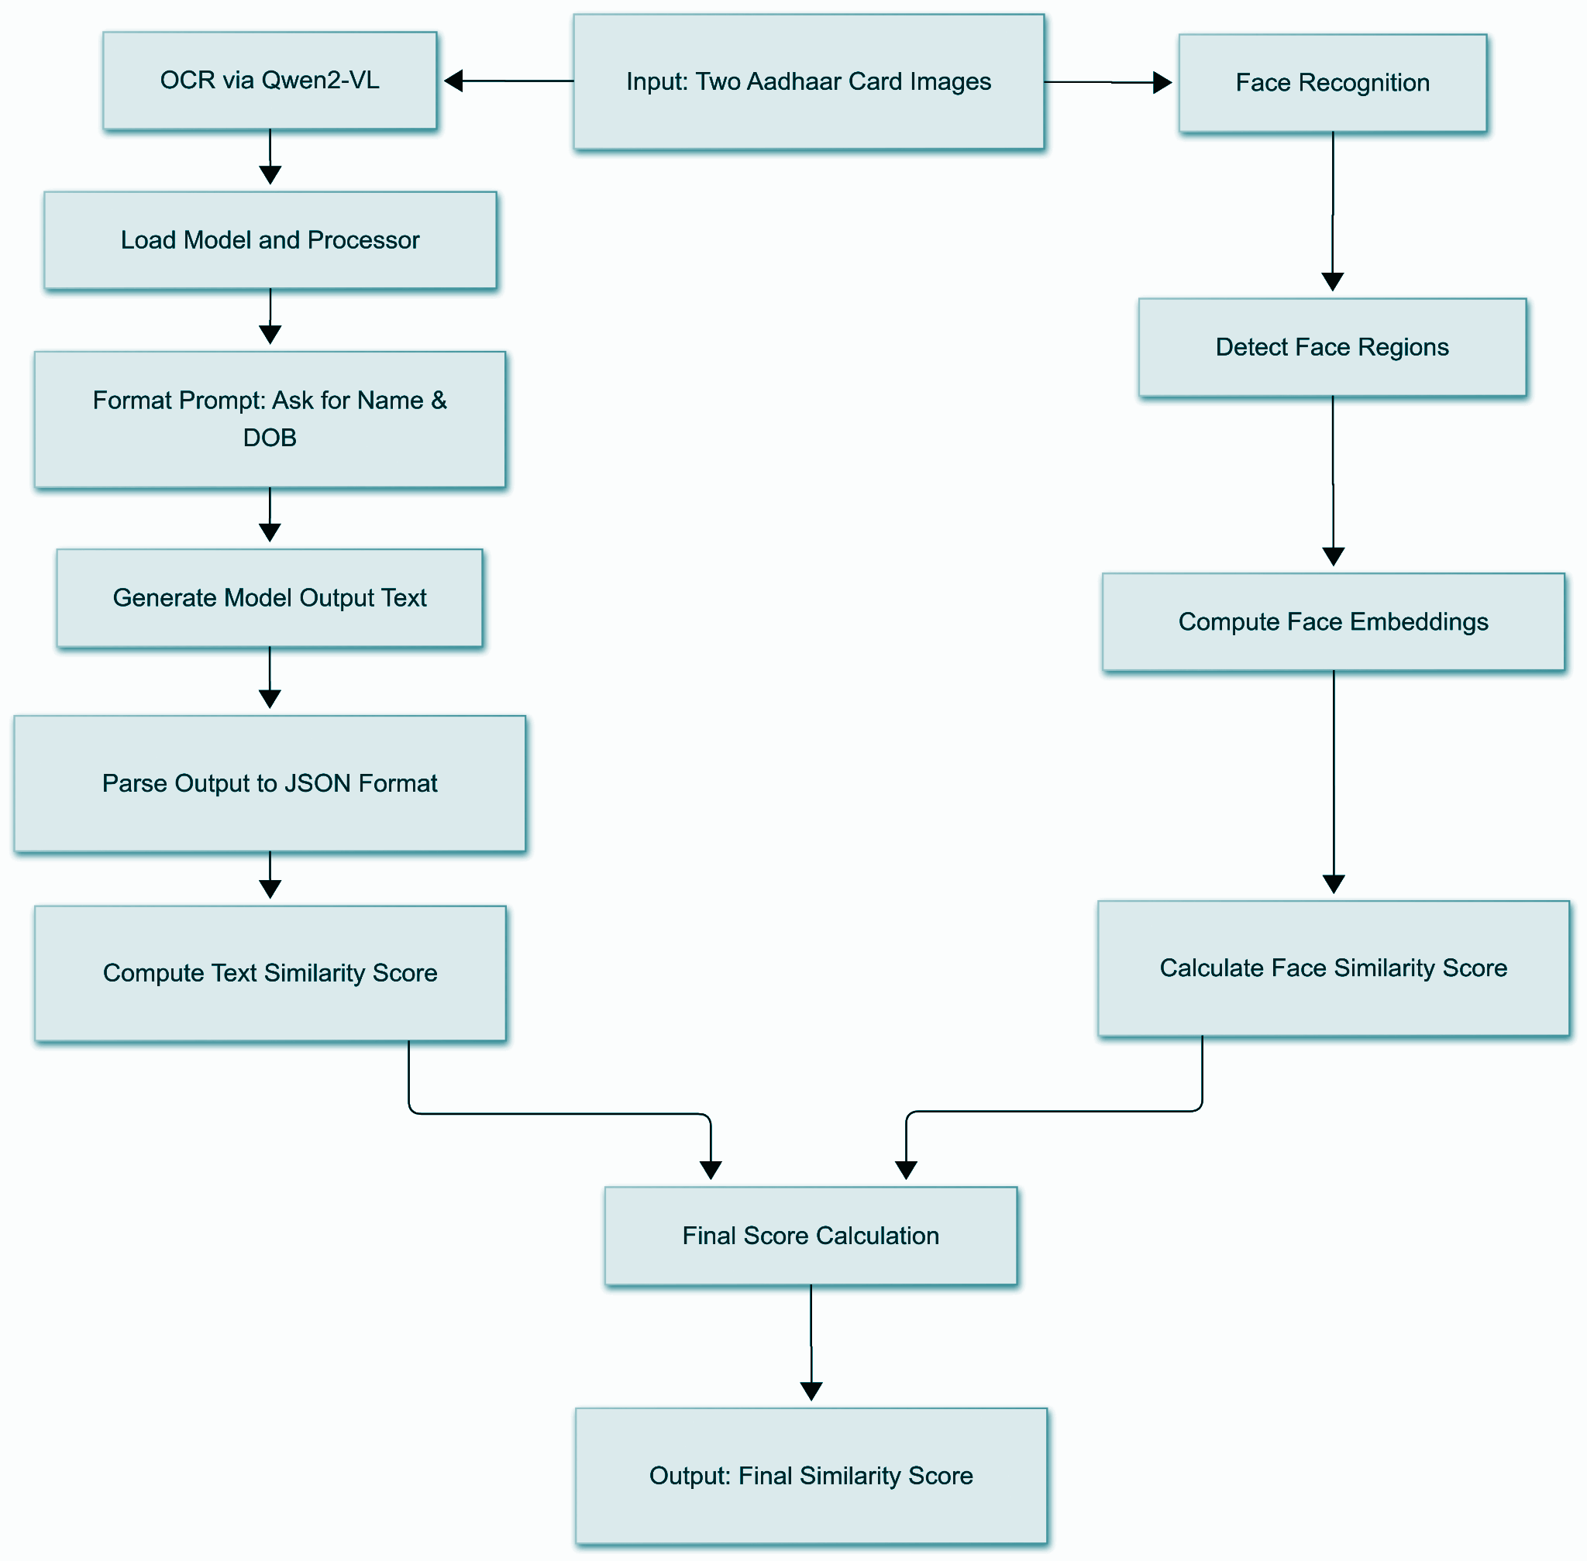
Workflow Diagram

Slide 7
Key Technologies and Process
Face Recognition:
face_recognition library for face detection and encoding.
How It Works:
Loads both images of Aadhar documents
Detects and encodes faces into vectors encodings
Computes face distance which returns a Euclidean distance between encodings.
Converts the distance into a similarity score using:
[ \text{similarity} = 1 - \text{distance} ]

Slide 8
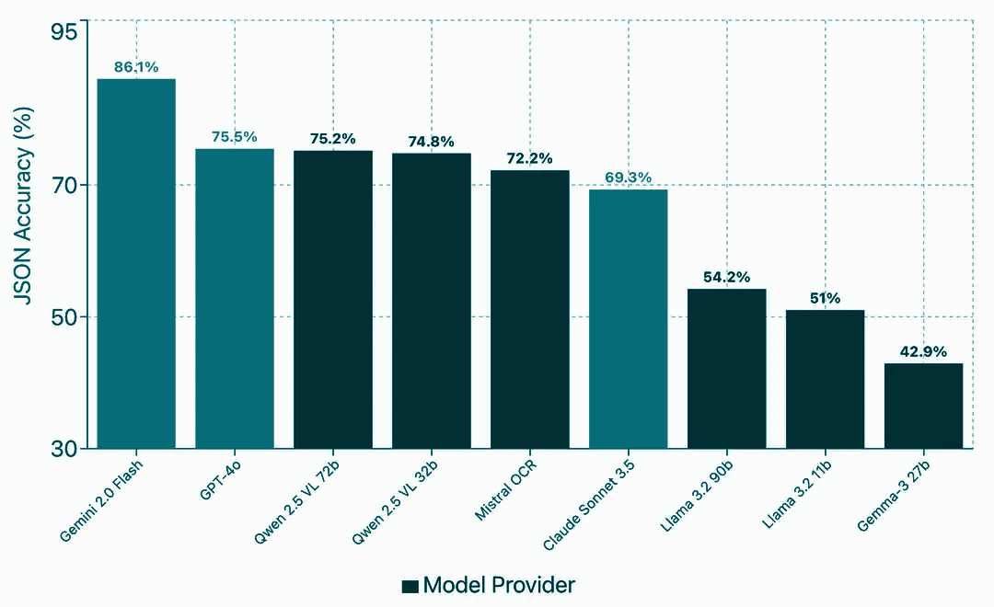
Key Technologies and Process
Vision-Language Model:
Qwen2-VL is a sophisticated vision-language model based on the Qwen2 architecture, designed to achieve state-of-the-art performance in image understanding across diverse resolutions and aspect ratios, as well as in processing longer video sequences.

Slide 9
Key Technologies and Process
Preparation of Input Prompt
Inputs include two image paths and a natural language prompt asking for:
name
dob (date of birth)
The instruction specifies that results must be returned as a list of dictionaries in a specific format.

Slide 10
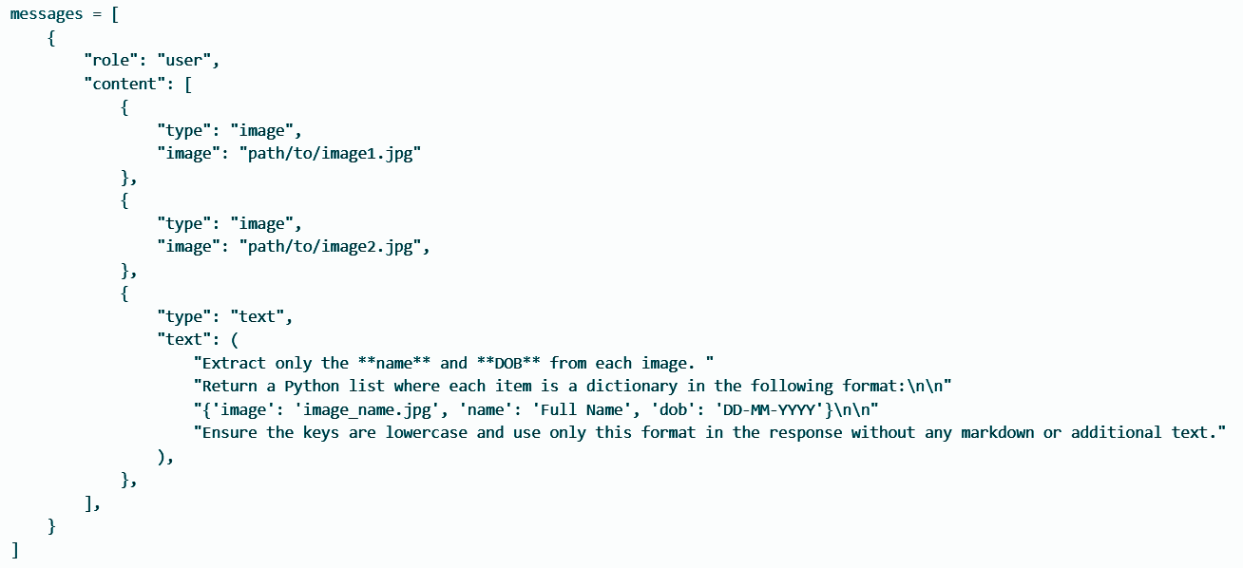
Key Technologies and Process

Slide 11
Key Technologies and Process
Visual Preprocessing
Uses process_vision_info() to load and prepare images for model consumption.
Tokenization and Tensor Conversion
Combines prompt and image data using the processor.
Converts to PyTorch tensors and pushes them to the appropriate device (cuda in this case).
Text Generation (Inference)
Uses model.generate() to produce a response.
Extracts only the new tokens generated (excluding the original input).
Decodes the generated tokens into plain text output.

Slide 12
Key Technologies and Process
Output:
The model returns list of dictionaries containing the extracted name and date of birth from each image.
Example output:
[{'image': '2front_contrast_adjusted.jpg', 'name': 'Rahul Sharma', 'dob': '05-07-1992'}, {'image': '7front_scaled_down.jpg', 'name': 'Anjali Mehta', 'dob': '18-11-1986'}]

Slide 13
Final Score Calculation
Purpose:
Aggregate the similarity scores from both the face and text analysis.
Method:
Uses a weighted average
final_score=(face_score×0.6)+(text_score×0.4)
Key Takeaway:
Balances visual and textual evidence to provide an overall similarity metric.

Slide 14
Conclusion & Future Work
Extend to additional document types.
Add additional feature extraction techniques.
Improve error handling.
Explore advanced multimodal Vision Language models for better accuracy.

