Slide 1

Going further in Protein Units Recognition and prediction of the classification using embedding and triplet networks
Presented by:
Anis Merabet
Supervised by
Dr. Jean-Christophe Gelly Dr. Gabriel Cretin
05/02/2024

Slide 2
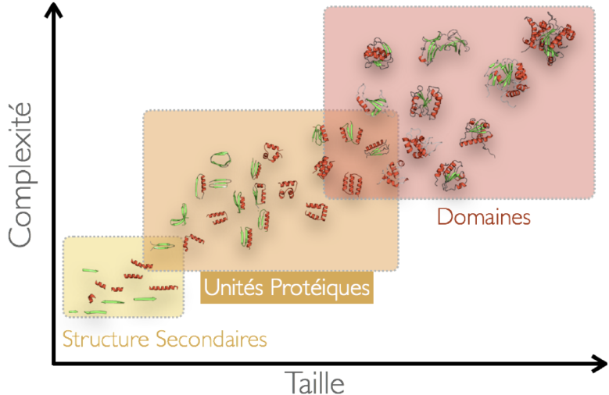
Context
Protein Units (PUs)
Intermediary level.
CPUs are topologically simple, highly compact, recurrent, and energetically favorable.
Source: presentation document of the long project.

Slide 3
Context
Protein Units (PUs)
1 - ab initio prediction of protein structures (using mini-threading).
2 - offer valuable insights into their functions.
3 - introduces large possibilities in protein engineering.
Source: presentation document of the long project.

Slide 4
Context
Protein Units (PUs)
Indermediary level.
Identified using Peeling algorithm: systematic analysis of an evolutionarily non-redundant set of protein structures.
Iterative hierarchical segmentation algorithm
Source: presentation document of the long project.

Slide 5
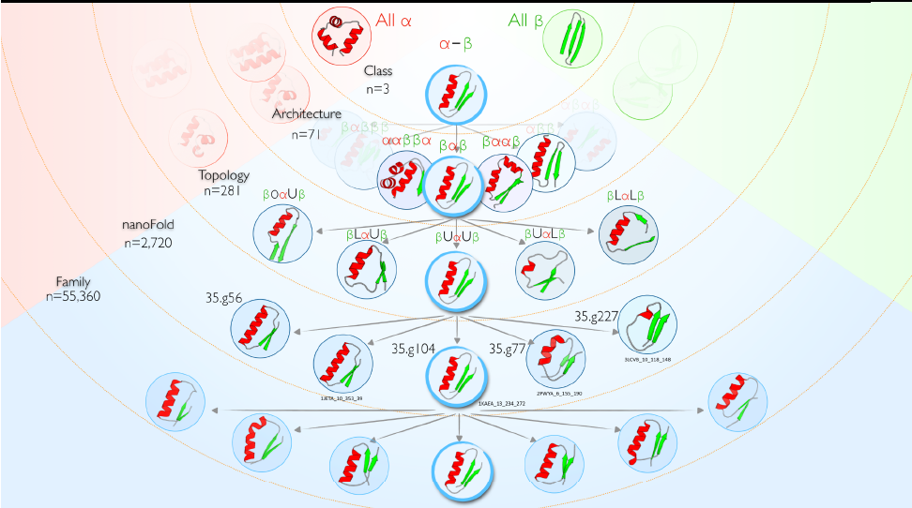
Context
Protein Units (PUs)
PUs were clustered by utilizing the Markov Clustering Algorithm (MCL).
Identifying groups within a weighted graph through random walks.
- Successfully classified: CPUs
- Non-successfully classified: NCPUs
Source: presentation document of the long project.

Slide 6
Objectives
1 Generate an embedding for PUs using a pre-trained model to capture semantic information within the protein sequences
2 Build a model to distinguish between CPUs and NCPUs
3 Build models to predict classification of CPUs according to Class, Architecture, Topology and NanoFold levels.
The models should handle:
Category imbalance
Limited number of examples for certain categories

Slide 7
Workflow
Handle duplicates and overlapping classifications
Convert PDB IDs into Uniprot IDs using a modified version of pdb2uniprot
Combine NCPU and CPU lists into one list
Downloading protein sequences
110379 CPUs
2981 NCPUs
Global local search using glsearch36 for mapping CPU/NCPU sequences to protein sequences and retrieval of nucleotide coordinates
Generate protein sequence embedding using Ankh and extract PU embedding
Triplet dataset preparation
Also perform One-Hot Encoding.
Model construction and training
Model evaluation

Slide 8
Workflow
Triplet dataset preparation
Triplet: anchor + positive + negative
60% train dataset
15% validation dataset
15% test dataset
Total of 15 datasets
3 for each model
Datasets for Type (CPUs/NCPUs), Class, Architrecture, Topology, NanoFold
Oversampling strategy
The algorithm detect the category with the highest number of PUs, then construct the same number of triplets of each category.
The negative and the positive examples are randomly chosen so that to limit duplicated triplets

Slide 9
Workflow
Triplet dataset preparation
Triplet: anchor + positive + negative
60% train dataset
15% validation dataset
15% test dataset
1000 triplets
Total of 15 datasets
3 for each model
Datasets for Type (CPUs/NCPUs), Class, Architrecture, Topology, NanoFold
Oversampling strategy
The algorithm detect the category with the highest number of PUs, then construct the same number of triplets of each category.
Type and Class finished, but Architecture, topology and NanoFold are still ongoing
The negative and the positive examples are randomly chosen so that to limit duplicated triplets

Slide 10
Workflow
Model construction and training
Ankh-embedding based models:
One-hot encoding based models
Type
Type
Fine-tuning
Fine-tuning
Class
Class
Fine-tuning
Fine-tuning
Architecture
Architecture
Fine-tuning
Fine-tuning
Topology
Topology
Fine-tuning
Fine-tuning
NanoFold
NanoFold

Slide 11
Workflow
Model construction and training
Ankh-embedding based models:
One-hot encoding based models
Type
Type
Fine-tuning
Fine-tuning
Class
Class
Fine-tuning
Fine-tuning
Architecture
Architecture
Fine-tuning
Fine-tuning
Topology
Topology
Fine-tuning
Fine-tuning
NanoFold
NanoFold

Slide 12
Workflow
Model construction and training
Ankh-embedding based models:
One-hot encoding based models
Type
Type
Fine-tuning
Fine-tuning
Class
Currently running
Class
Fine-tuning
Fine-tuning
Architecture
Architecture
Fine-tuning
Fine-tuning
Topology
Topology
Fine-tuning
Code is ready
Time is the limiting factor
Fine-tuning
NanoFold
NanoFold

Slide 13
Workflow
Model construction and training
Using PyTorch library
Triplet network (few shot learning strategy)
GRU layer followed by Fully Connected (FC) layer
Triplet loss based on the cosine distance
Early stopping strategy
Model saves the embedding of the train dataset at the best epoch
Hyperparameter optimization was done using 2.5% to 10%
Learning rate, batch size, margin value of the triplet loss calculation, presence or absence of dropout layer and dropout rate, number of GRU layers, simple or bidirectional GRU layer, GRU hidden size, output size of the fully connected layer, presence or absence of sigmoid activation function applied to the fully connected layer.

Slide 14

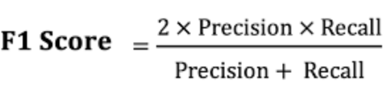
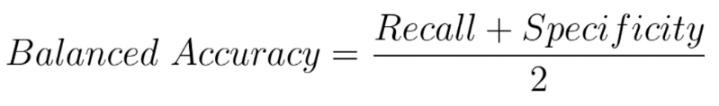

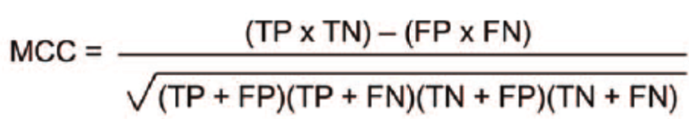
Workflow
Model evaluation
For each of the 10 models
For train dataset
For the test dataset
Confusion matrix.
Receiver Operating Characteristic (ROC).
Precision-Recall curve.
PCA
MDS
t-SNE
UMAP
PCA
MDS
t-SNE
UMAP
Evaluation metrics based on the cosine distance
Precision (Pr)
F1-score
Balance Error Rate (BER):
Recall (SPE)
Matthews Correlation Coefficient (MCC)

Slide 15
Workflow
Model evaluation
For each of the 10 models
Cosine distance with all PUs saved during training
Ranking in an increasing way
For each PU of the test dataset
First closest strategy
Correct prediction if: Category of test PU = Category of the first closest train PU
Five closest strategy
At least one of the categories of the five closest train PUs
Correct prediction if: Category of test PU =

Slide 16
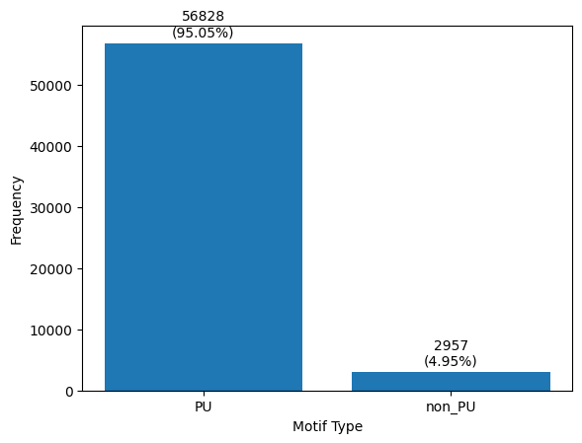
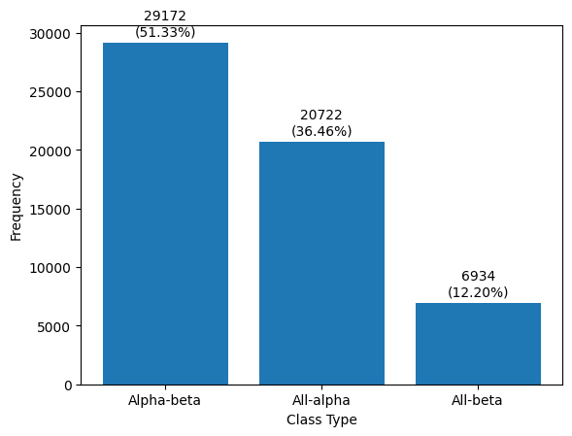
Results and discussion
Data exploration:
CPUs: 29979
NCPSs: 2957

Slide 17
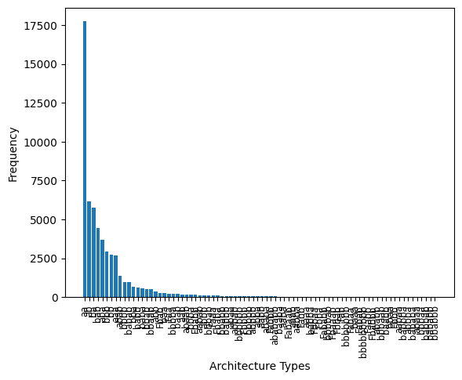
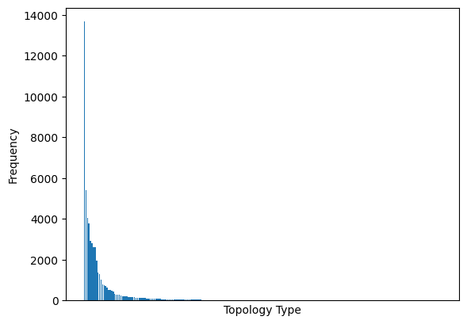
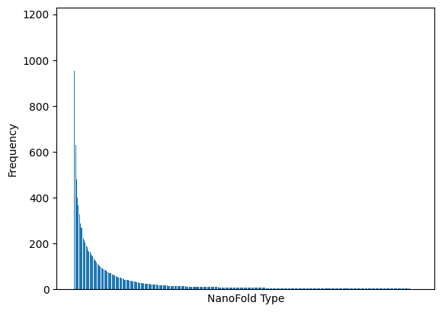
Results and discussion
Data exploration:
CPUs: 29979
NCPSs: 2957

Slide 18
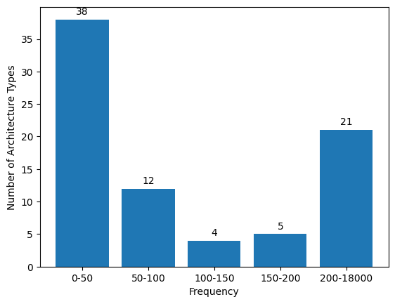
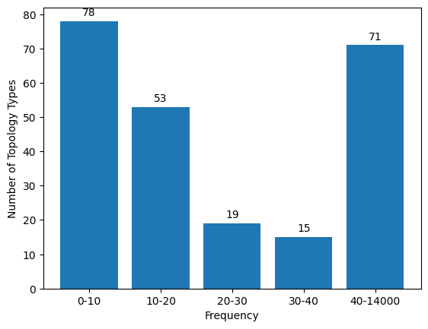
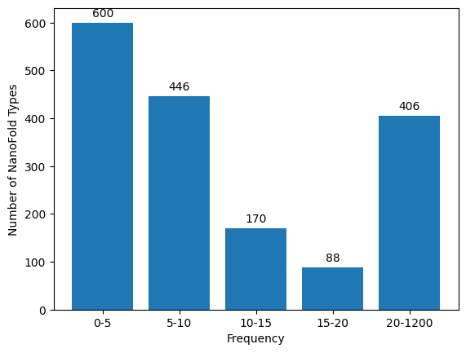
Results and discussion
Data exploration:
CPUs: 29979
NCPSs: 2957
Large data imbalance and and very few examples for certain categories

Slide 19
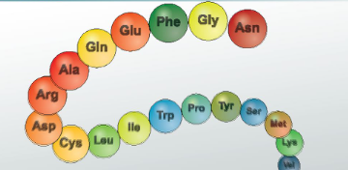
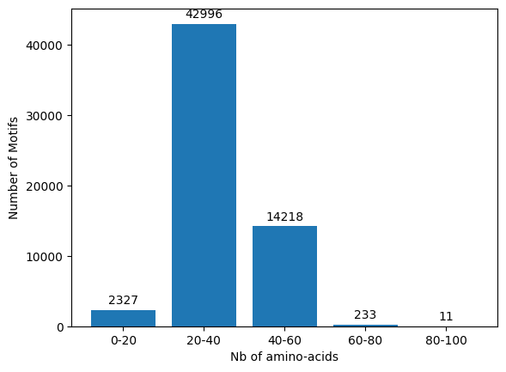
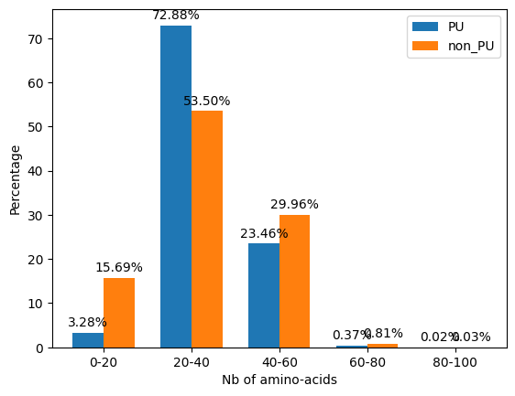
Results and discussion
Data exploration:
Length of protein sequences
Relative difference between CPUs and NCPUs

Slide 20
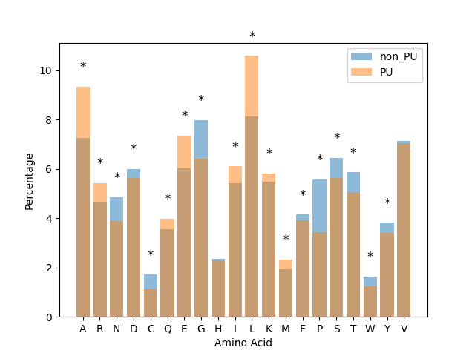
Results and discussion
Data exploration:
Amino-acid composition

Slide 21
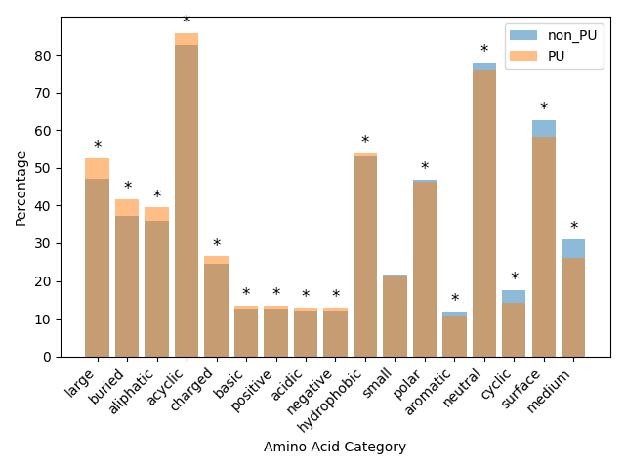
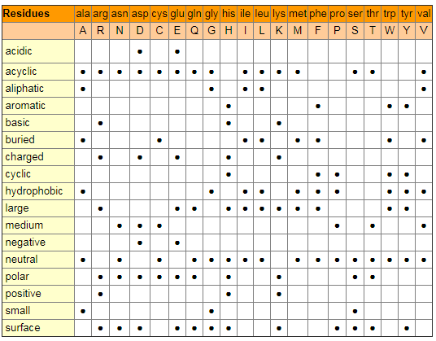
Results and discussion
Data exploration:
Amino-acid composition
Significantly different amino acid composition between CPUs and NCPUs

Slide 22

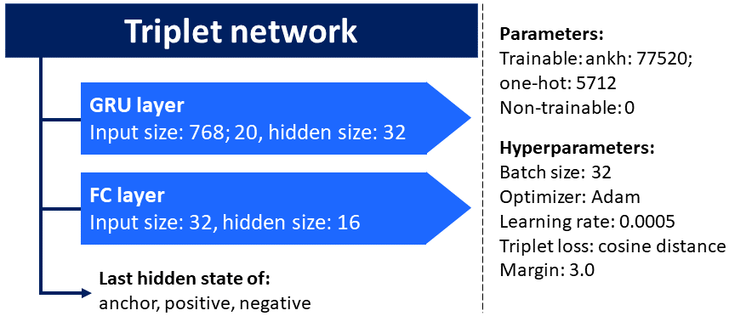
Results and discussion
Datasets and model
Expected nb of triplets for the train dataset:
Datasets:
851 040
1 935 672
1 201 446
Models:

Slide 23
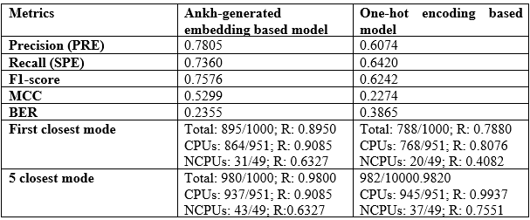
Results and discussion
Results for models distinguishing CPUs and NCPUs
Ankh-generated embedding based model performs better than one-hot encoding based model.
Better prediction for CPUs than NCPUs

Slide 24
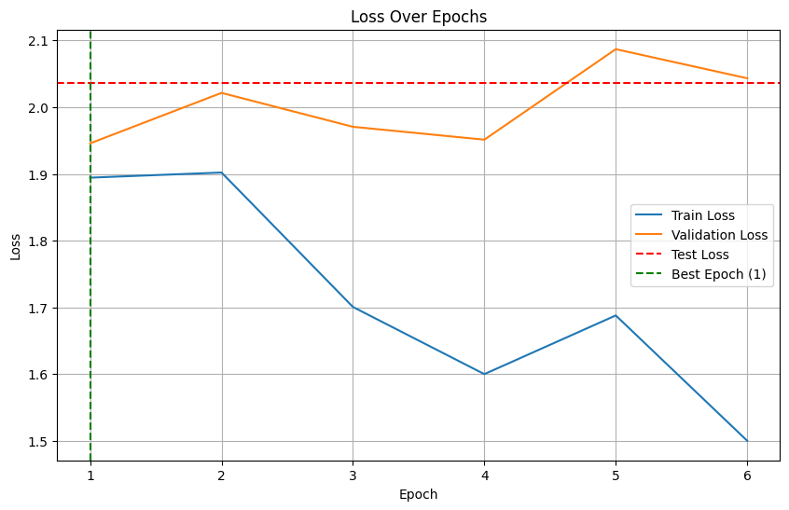
Results and discussion
Results for models distinguishing CPUs and NCPUs
Hyperperparameter tuning should be reviewed.
Because of time constrains, it was mainly conducted on 2.5% of the data

Slide 25
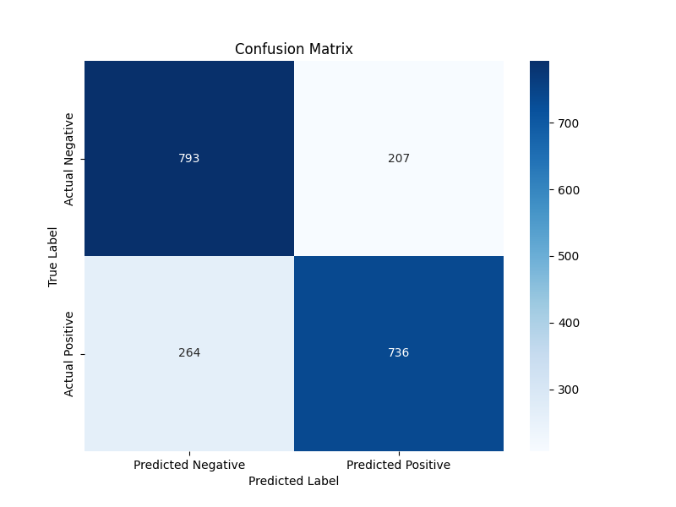
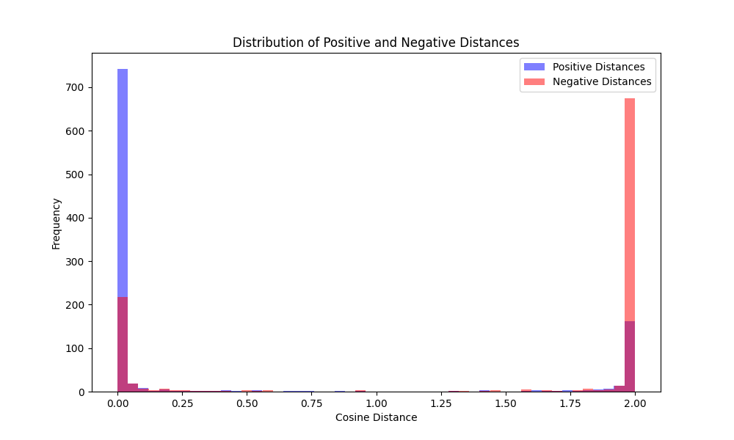
Results and discussion
Results for models distinguishing CPUs and NCPUs

Slide 26
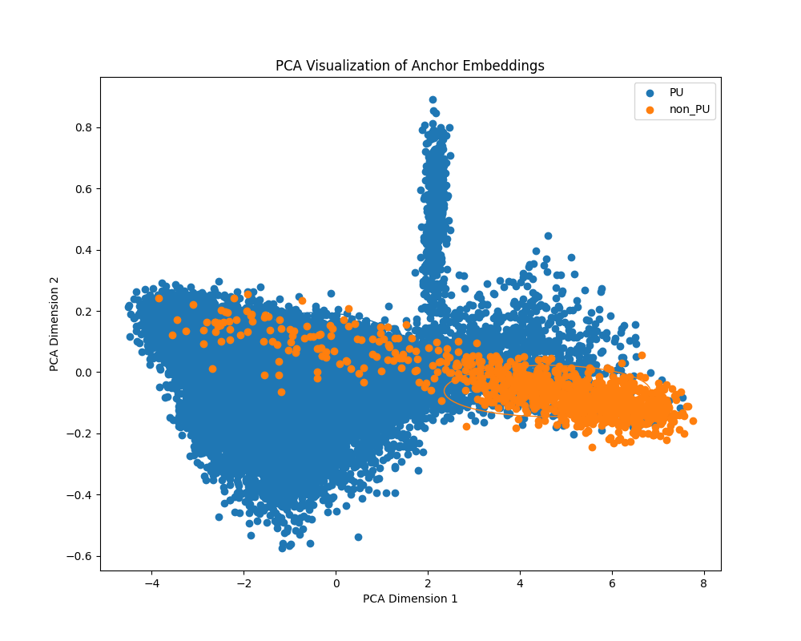
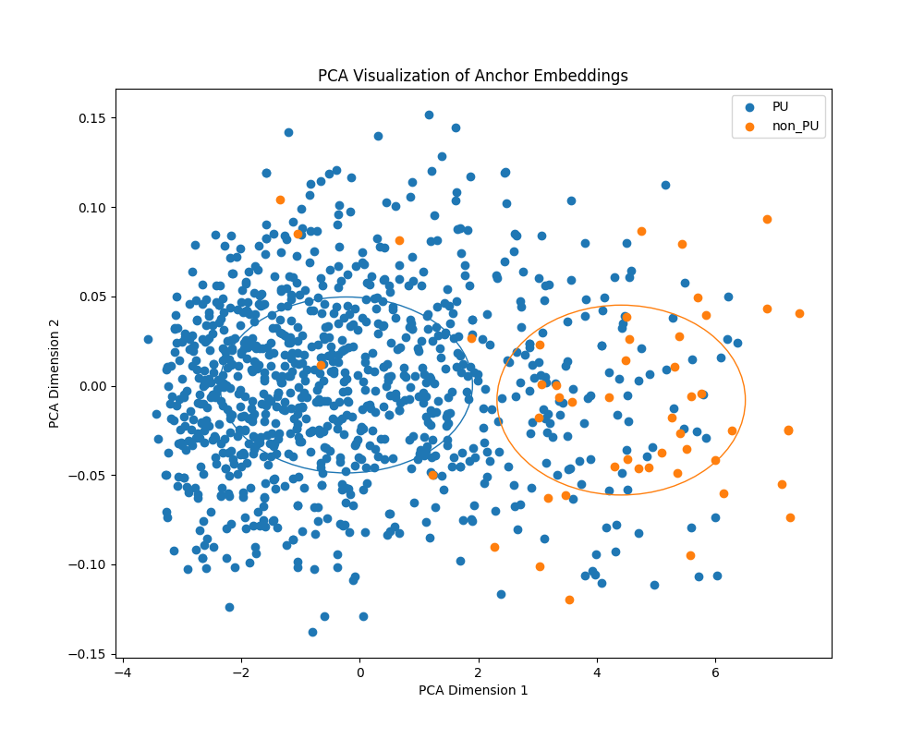
Results and discussion
Results for models distinguishing CPUs and NCPUs
Train dataset
Test dataset

Slide 27
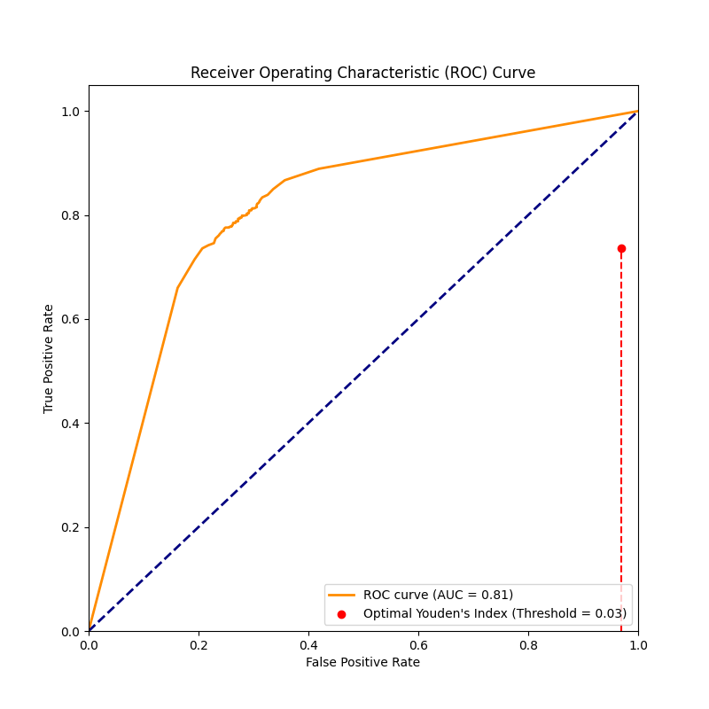
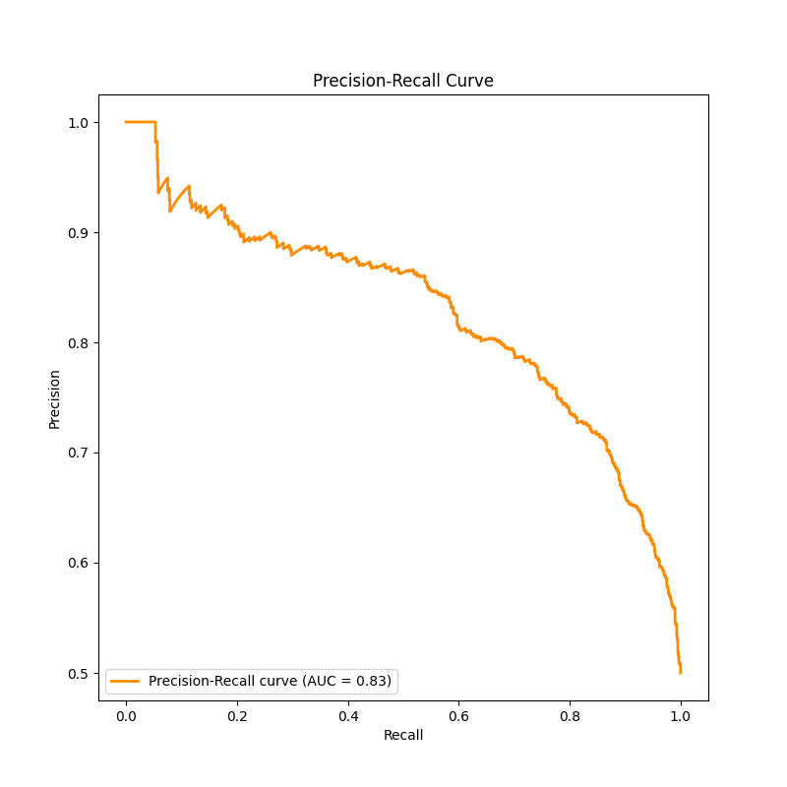
Results and discussion
Results for models distinguishing CPUs and NCPUs

Slide 28
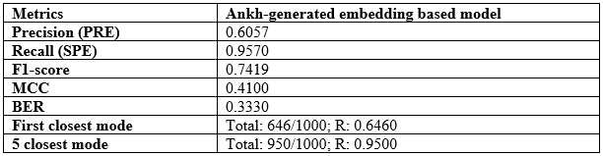
Results and discussion
Results for models predicting category according to “Class” level
The recall is very high comparing to the precision, which suggests that the model is good at identifying all instances of the positive class but may have a higher false positive rate.

Slide 29
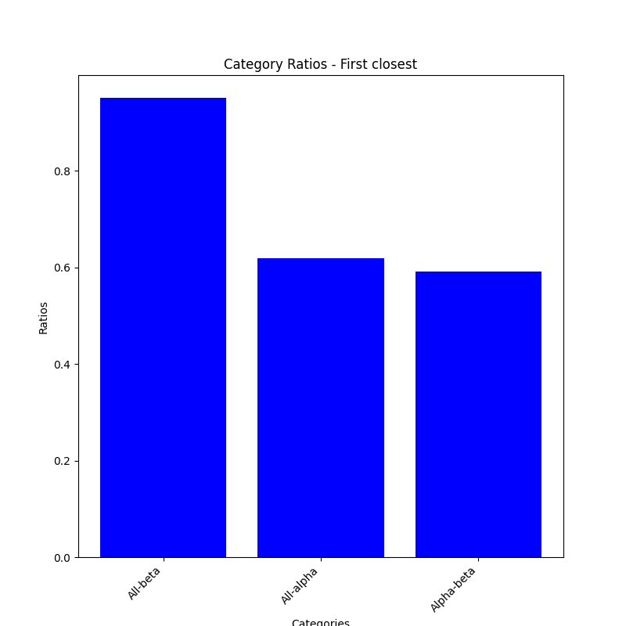
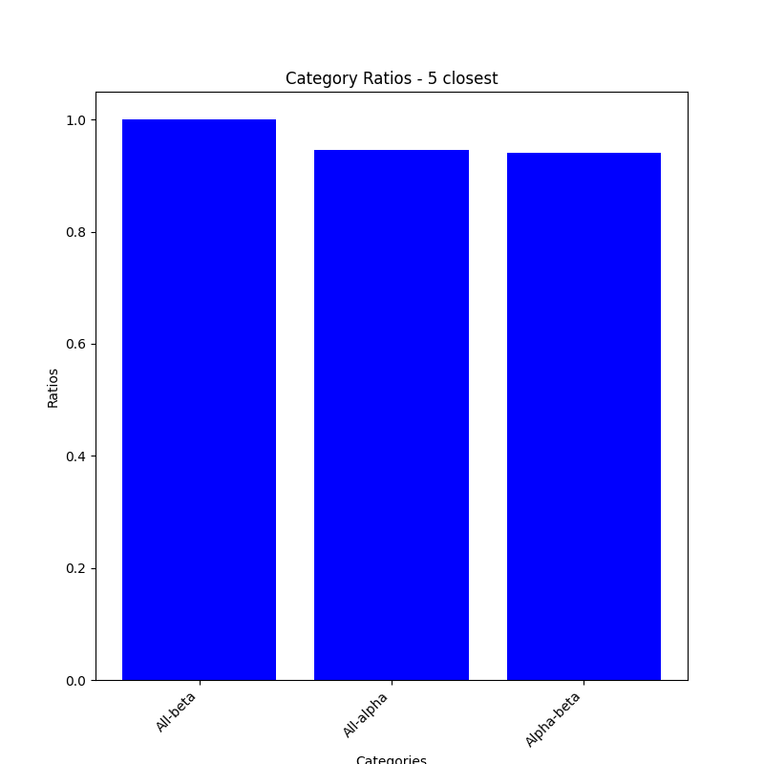
Results and discussion
Results for models predicting category according to “Class” level
Different performance prediction considering the first closest evaluation strategy

Slide 30
Conclusion
Oversampling and few shot-learning strategy using triplet network was revealed to be very efficient, but yet, not perfect.
Hyperparameter tuning strategy should be repeated and evaluation of the models on the whole test dataset should be conducted to extract better conclusions.

Slide 31
Thank you for your attention

