Slide 1

Sales and Profit Analysis by Product Category
Using Sample Superstore Dataset
Anisa Dwi Alfira
Tools: Microsoft Excel
2025

Slide 2
Probem Statement and Object
Probem Statement:
Understanding sales and profit performance across product categories is essential for supporting data-driven business decisions. This analysis aims to identify which product categories contribute the most to total sales and profit, evaluate their overall performance, and provide insights that can support strategic planning and resource allocation.
Object:
To analyze total sales by product category
To analyze total profit by product category
To compare sales and profit performance across categories

Slide 3
Dataset: Sample Superstore
Total records: ±9,994 rows
Key variables:
Category
Sales
Profit
Quantity
Discount
Dataset Overview

Slide 4
Data Preparation & Cleaning
01
Data types were adjusted to ensure numerical and categorical accuracy
Each column was reviewed and converted into the appropriate data type (numeric, text, or date) to prevent calculation and aggregation errors during analysis.
02
Missing values (blanks) were checked and validated
The dataset was examined for missing values to ensure data completeness and to confirm that blanks did not affect the reliability of the analysis.
03
Sales and profit values were reviewed to ensure consistency
Sales and profit figures were checked to identify potential anomalies or inconsistencies that could distort the analysis results.

Slide 5
Methodology
Data aggregation was performed using Pivot Tables to summarize sales and profit by category
Total sales and profit were calculated to compare category performance
Bar charts were used to clearly visualize differences across categories

Slide 6
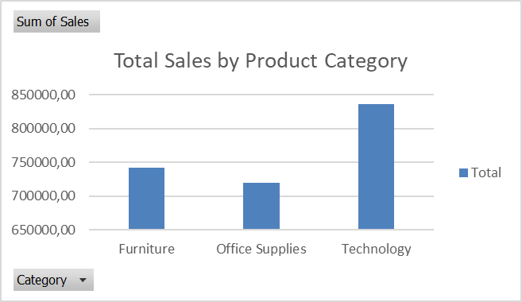
Profit Analysis Result
Sales Analysis by Product Category
Based on the Pivot Table analysis, the Technology category records the highest total sales compared to Furniture and Office Supplies.This indicates that technology products are the primary contributors to overall sales and may represent a key focus for business strategy.

Slide 7
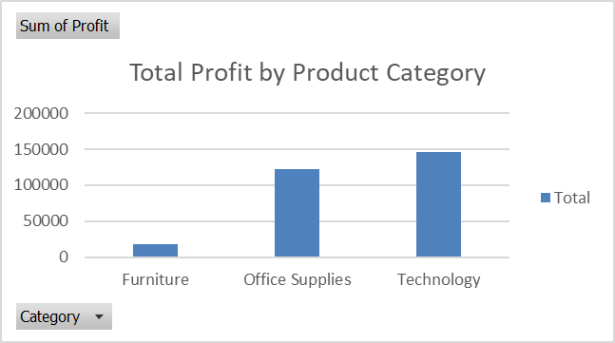
Profit Analysis Result
Provit Analysis by Product Category
The Technology category generates the highest total profit, followed by Office Supplies.
In contrast, Furniture records the lowest profit contribution among all categories.

Slide 8
Key Insight
Technology consistently shows the strongest performance in both sales and profit.
High sales do not always translate into high profit, as seen in the Furniture category.
Furniture’s low profit despite relatively high sales suggests potential issues in pricing or discount strategy.
Product categories with higher profit margins should be prioritized for business growth.

Slide 9
Business Recommendations
Focus on high-performing categories to maximize revenue contribution.
Investigate factors driving high profitability in the Technology category.
Evaluate low-performing products to optimize pricing or discount strategies
Helene Paquet

Slide 10



Contact Information
Anisa Dwi Alfira
Data Analysis / Mathematics Student
adwi52731@gmail.com
linkedin.com/in/anisa-dwi-alfira-b66aab326
github.com/AnisaDwiAlfira

