Slide 1

Cardio Good Fitness Dataset
Anisah Inua Mohammed

Slide 2


Description
This dataset is a market research that chooses to explore whether there are contrasts across the product lines as for client characteristics. The team decides to retrieve data on individuals who purchased a treadmill at a CardioGoodFitness retail store during a period of three months.
The market research decides to investigate whether there are differences across the product lines with respect to customer characteristics.

Slide 3
Objective
Create a customer profile of various insights
Perform univariate and bivariate analysis
Generate a set of insights and recommendations that will help the company to target new customers

Slide 4

The research analyses these as variables for the dataset:
Product model purchased: TM195, TM498, or TM798
Gender; Male or Female
Age:in years
Education: in years
Relationship status: single or partnered
Annual household income
Average number of times the customer plans to use the treadmill each week
Average number of miles the customer expects to walk/run each week
Self-rated fitness on an 1-to-5 scale, where 1 is poor shape and 5 is excellent shape

Slide 5
Importing the Dataset and Library
Anisah Inua Mohammed

Slide 6
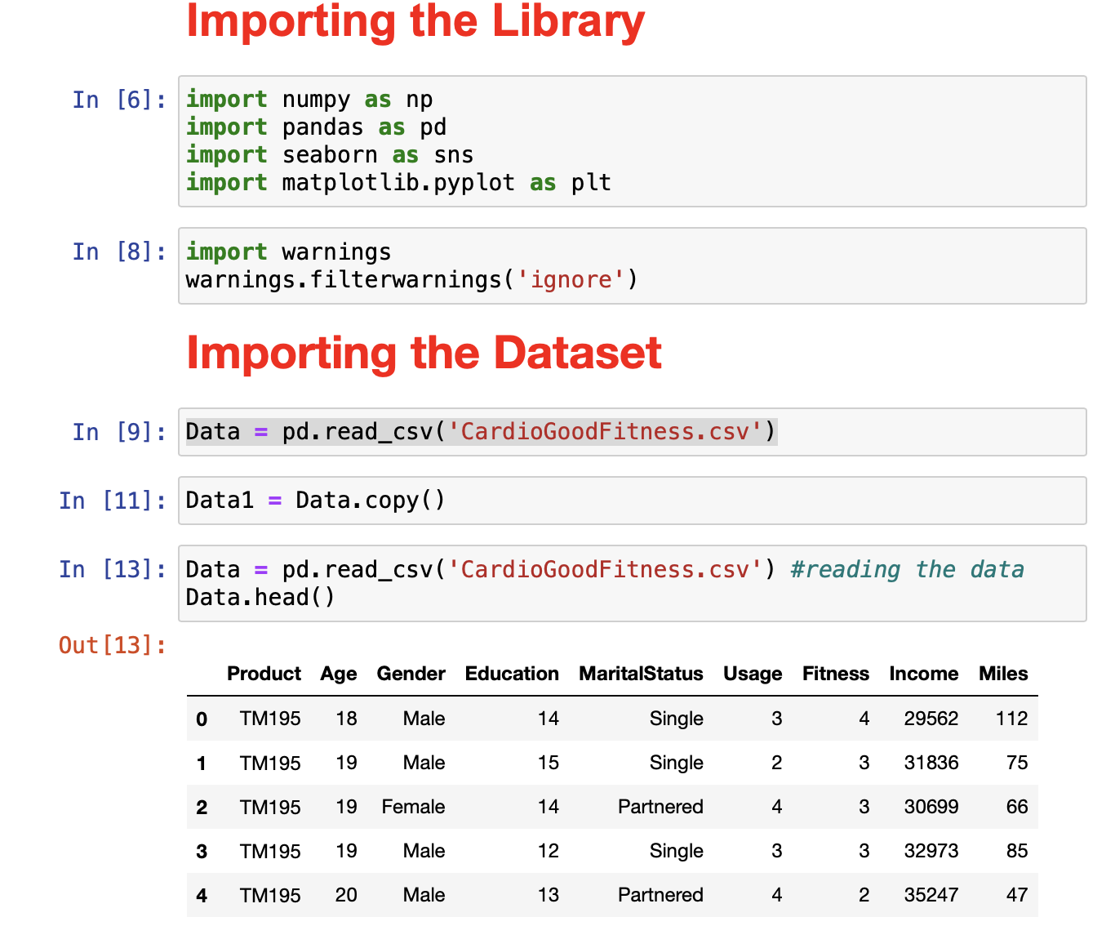
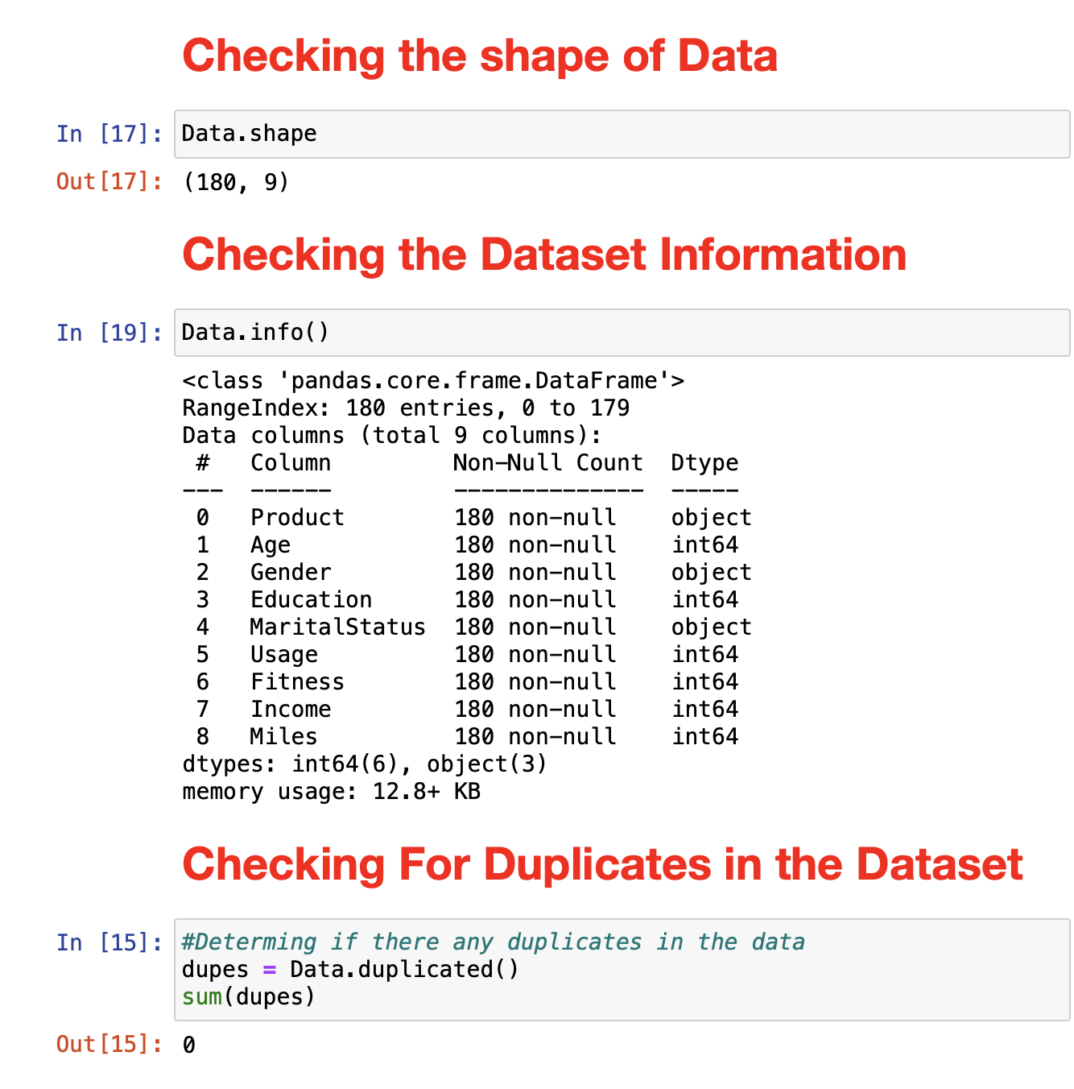

Slide 7
Observations
From the previous slide here are some observations
There are no missing values in this dataset
There are no null values in this dataset
There are no duplicates in this dataset.

Slide 8
Histograms
Anisah Inua Mohammed

Slide 9
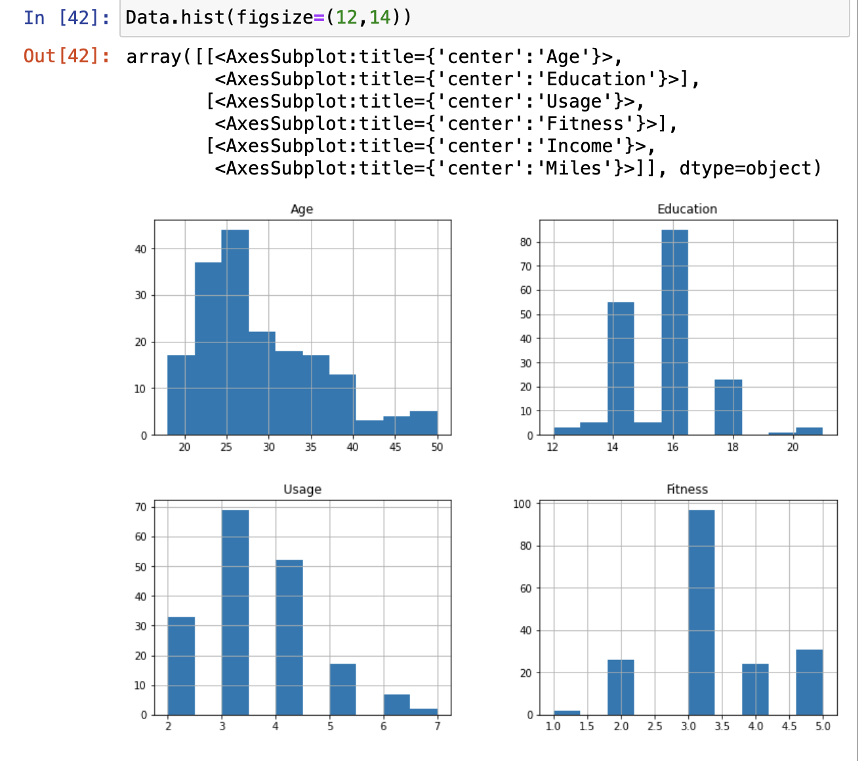
This histogram represents the distribution of data by forming bins along the range of the data and then drawing bars to show the number of observations that fall in each bin.

Slide 10
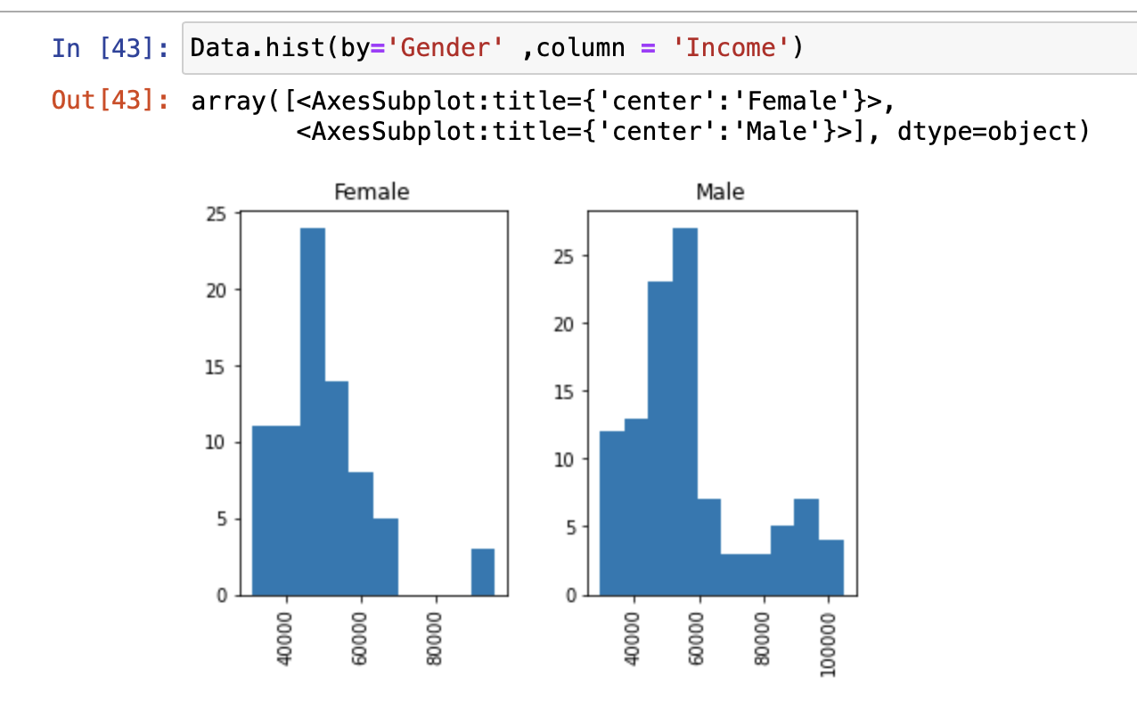
Income generated by the Genders
This visualisation represents the income generated by both genders in the datasets and the most annual household income generated by both genders is most in between 40,000-60,000.

Slide 11
Boxplots
Anisah Inua Mohammed

Slide 12
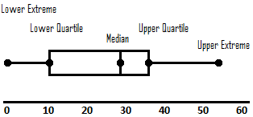
Description
Box plots visually show the distribution of numerical data and skewness through displaying the data quartiles.

Slide 13
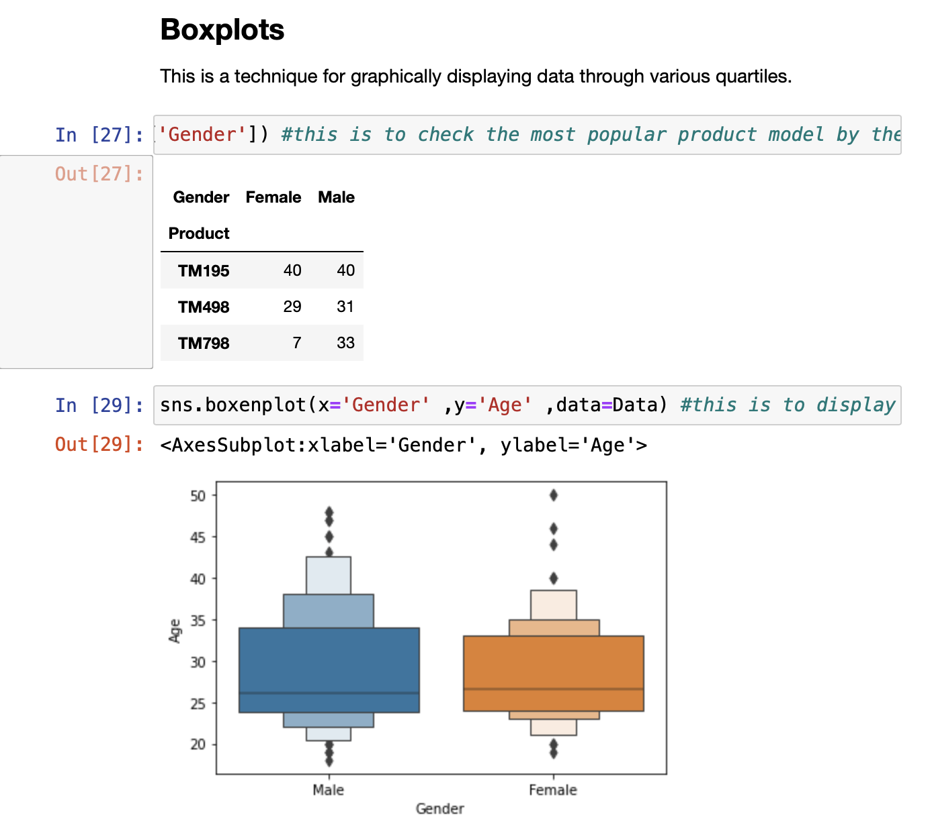
Which is the most popular model by gender?
The most popular product used by both gender is TM195
The age group which uses these equipment the most is from Ages 30-35

Slide 14
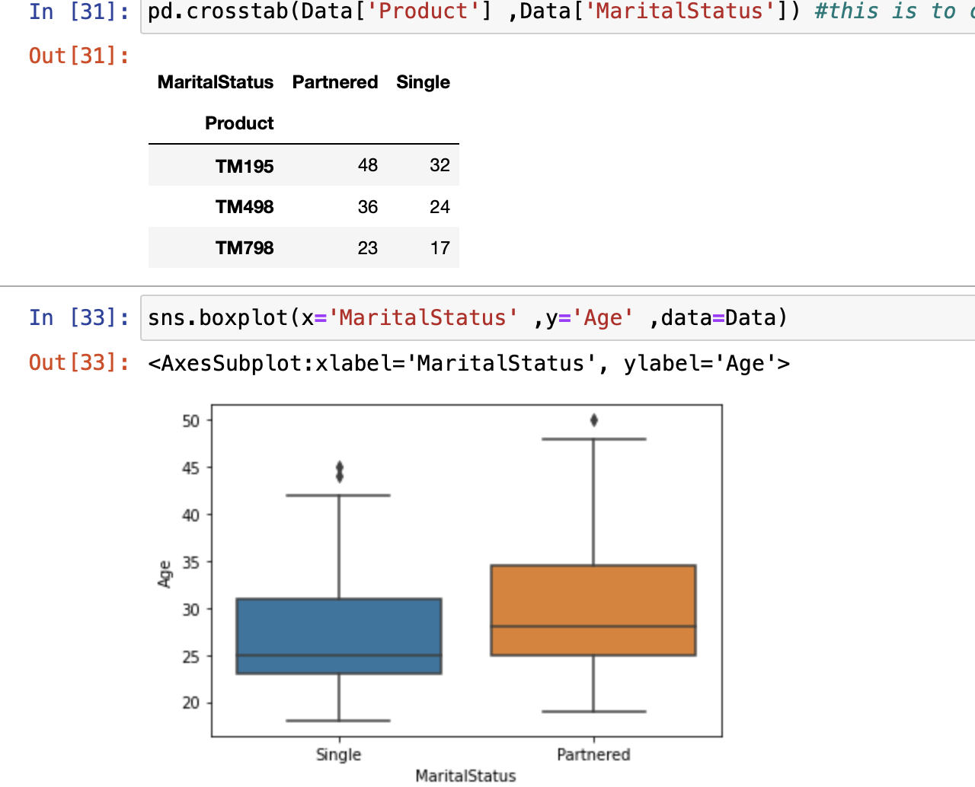
Which Product is used by people who are Partnered?
Generally both partners and singles prefer the product model 'TM195'
There are more "Partnered" who prefer the CardiGoodFitness equipment.
The "Partnered" age in this dataset begins from the age "26"
While the "Single" people in this data set bein from the ages of "23-24”

Slide 15
Univariate
Anisah Inua Mohammed

Slide 16
Univariate Analysis of Dataset
Description
Univariate is means analysis of one variable or one feature.
It essentially reveals to us how information in each component is disseminated and furthermore delineates for central tendencies like mean, median, and mode.
For MaritalStatus: There is more partner individuals than single. Is it since Single individuals get greater opportunity and time to do outside exercises?
For Age: There are more customers which are fairly young. Almost 80% of the dataset age ranges from 24 to 40 years of age.
For Education: Shows that more than 70% of the dataset is educated.

Slide 17
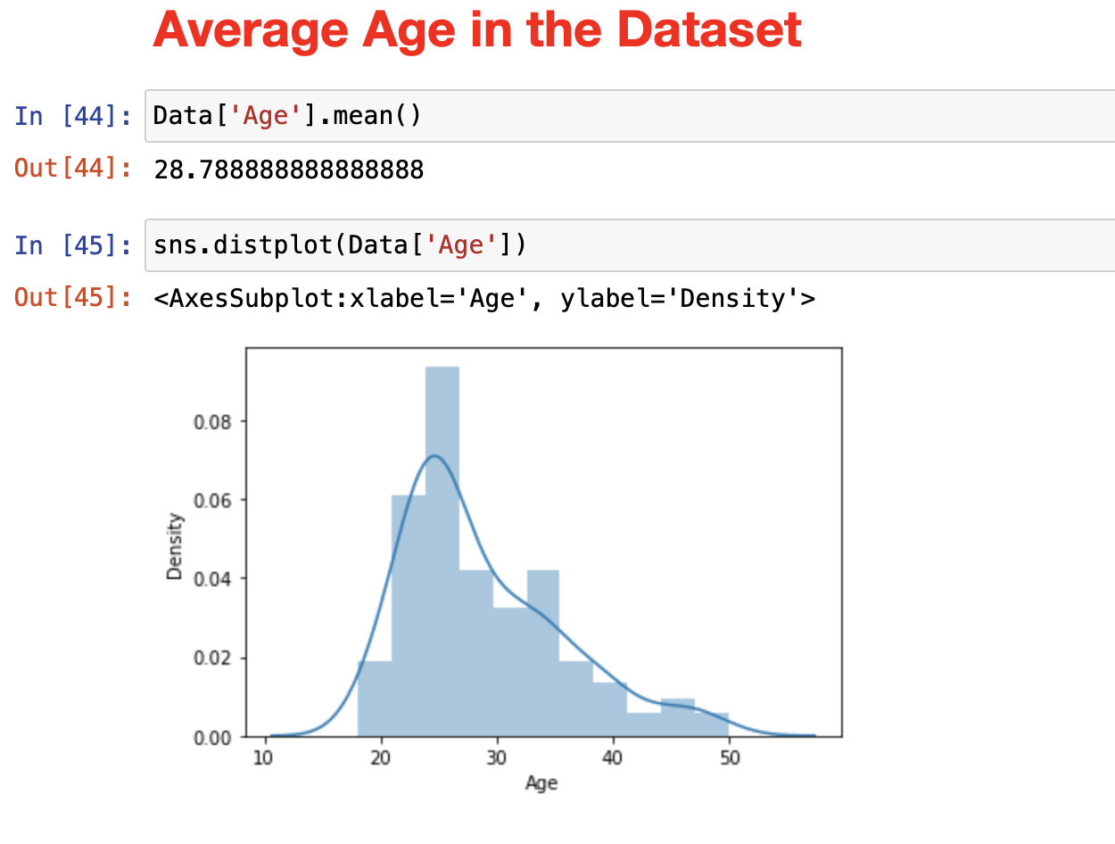
Average Age in the Dataset
This is showing the mean of the variable “Age” in the dataset.

Slide 18
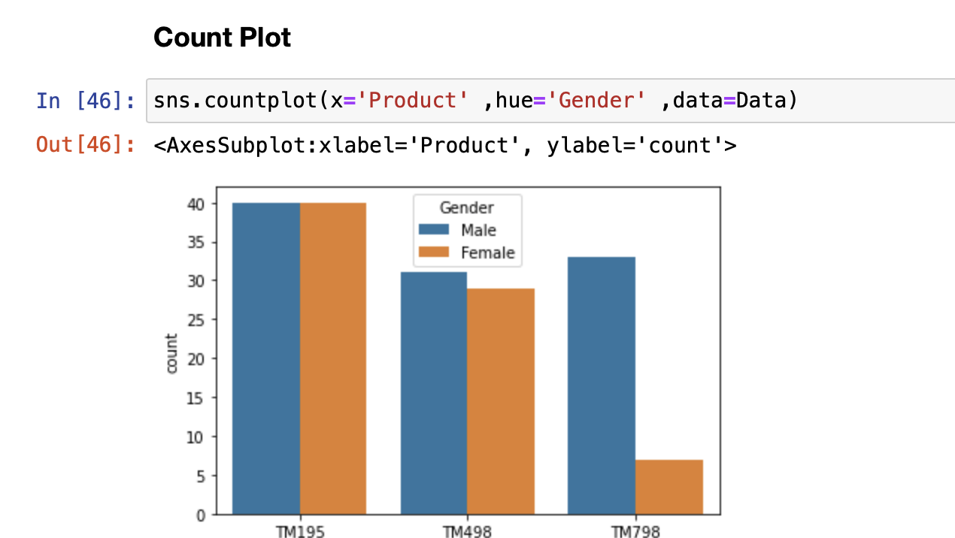
Count Plot
Show the counts of observations in each categorical bin using bars.
This shows the specific gender which used the products.
It shows that the more men used the product “TM798”
Both genders use “TM195” the most

Slide 19
Bivariate
Anisah Inua Mohammed

Slide 20
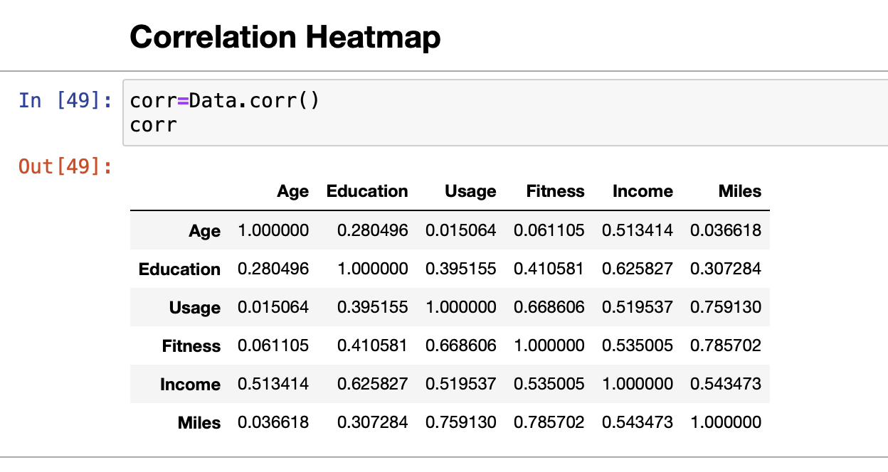
Correlation Heatmap
A correlation heatmap uses colored cells, typically in a monochromatic scale, to show a 2D correlation matrix (table) between two discrete dimensions.

Slide 21
Description
Bivariate Analysis from Dataset
Bivariate analysis refers to the analysis of two variables to determine relationships between them.
Female customers income is lower than male customers
TM798 is populare with high income group
TM798 is popular among age group 25-30
As the education increases, the income is also increasing.

Slide 22
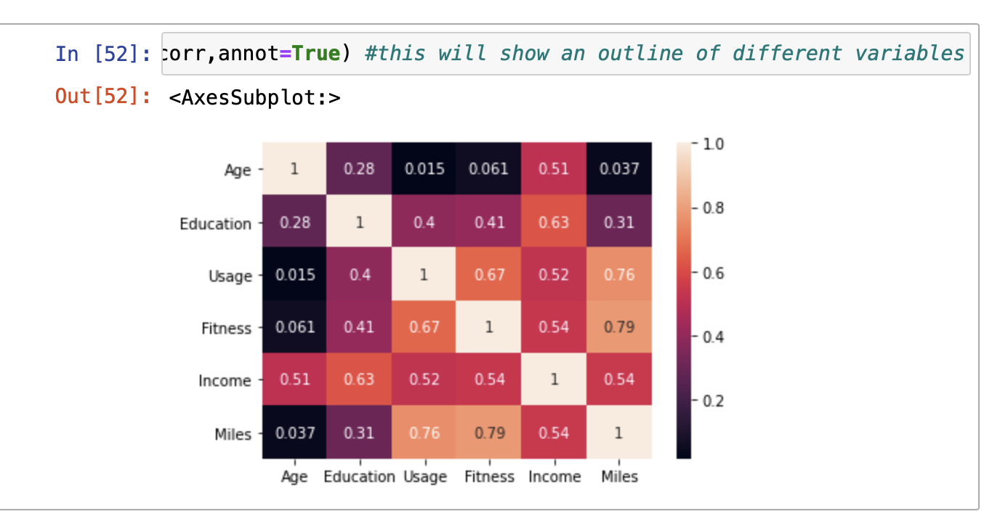
Overview of the heatmap
Instead of doing a simple df.corr(),the use of heatmap when there are large number of variables
The colours used in this map shows the variables which were more correlated
The darker the colour the more the correlation
Most of the age variables had more correlation to the other variables
From the visualisation it shows in the miles field, usage and fitness are highly correlated than any other variables.

Slide 23

Analysis From Correlation
Fitness and Age look unlikely correlated.
Fitness and Usage are highly correlated
Fitness and Miles are highly correlated.
Income and Age are also moderately correlated

Slide 24
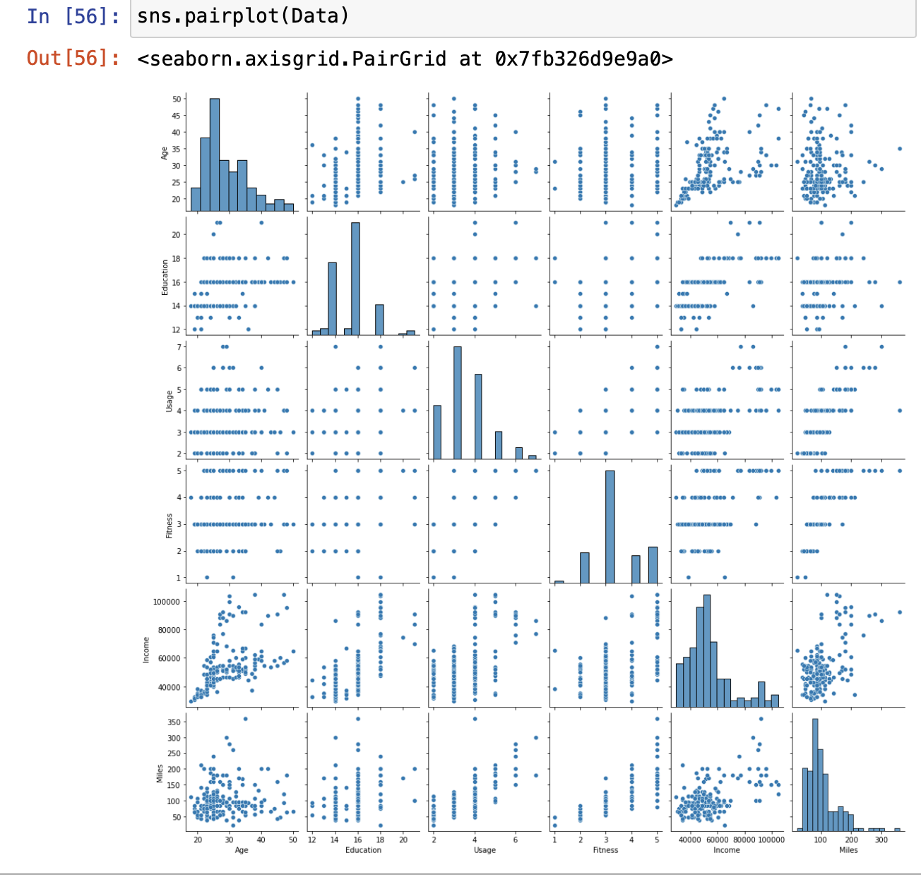
Pairplot
A pairplot plot a pairwise relationships in a dataset. The pairplot function creates a grid of Axes such that each variable in data will by shared in the y-axis across a single row and in the x-axis across a single column

Slide 25
Thank You!
Anisah Inua Mohammed

